Slide 1
WHALES
This is a presentation about whales

Slide 2
First slide about whales
Point form whale
Whale #1
Whale #2
Whale #3
Whale in text box
Notes:
Whale in the notes

Slide 3
Whale in a square
Whale in a star!
Whale Word Art

Slide 5
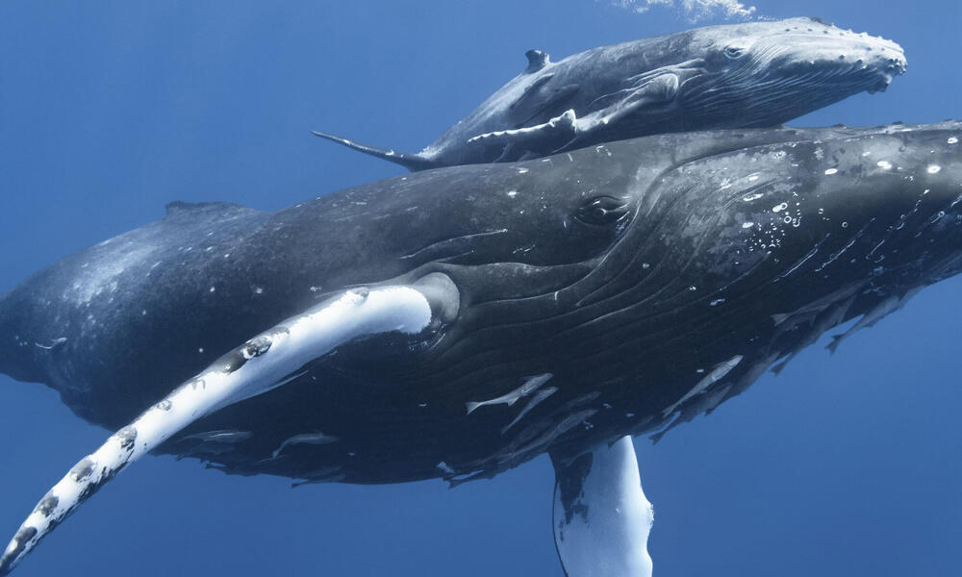
Whale table | Whale whale whale
Here’s some info about whales | More info about whales

