Slide 1
DsageNg
Distributed
Parallel
Asynchronous
Collaborative
Sage

Slide 2
Outline
What
Why
How
When

Slide 3
What
Distributed
  Sage ”Over the Wire”
Parallel
  So much to do, so little time
Asynchronous
  Everything is an event to be ”handled”
Collaborative
  A short walk from Distributed, Parallel, Asynchronous

Slide 4
Distrubuted Computing Deconstructed
  cpu gpu memoryHierarhchy myranet gig-e threads processes multicore lan wan fpga persistance raid asynchronous synchronous coupling interaction bigIron cluster multiCluster faultTolerant replication security heterogeneous multiUser computeBound ioBound
Processing
State Management
Communications
Programming

Slide 5
Levels
High Level
Low Level
Management
  Instantiation
  Initialization
  Control / Termination
Scatter / Gather
User Interaction
Performance
See 1
Ease

Slide 6
Problem Decomposition
From Sage's Perspective
Accomplish
Considering
Speed
Exogenous Event Handling
Collaboration
Latency
Bandwidth
Decomposition
Cost / Cycle
Endogenous Events
Heterogeneity

Slide 7
Considerations Expanded
Transports
Programming
Shared Memory
LAN
  Infiniband/Myranet...
WAN
  Security
Processors
Threads, Processes, Coroutines
Asynchronisity

Slide 8
Asynchronisity
Everything is an Event
  Synchronous
  Asynchronous
Programming Model
  Polling (stupid)
  Blocking
    Hold that thought
  Coroutines
    Good with issues
  Callbacks
Threads are Evil!!!
(Long Live Threads)

Slide 9
Blocking
Application Level code shouldn't block
  We have ”things” for that
Applications block because the application programmer doesn't know how to do it any other way
  Not entirely true

Slide 10
Twisted
Framework for building Asynchronous Systems
  Everything is asynchronous....
Whats Important?
  Reactor
  Deferreds
  Things built on 1) and 2)

Slide 11
Reactor
Select on steroids
Blocking done right
Event Dispatching
  Timed
  Exogenous

Slide 12
Callbacks
Continuous
  eventSource.registerCallback(fn1, *args, **kargs)
  def fn1(arg1, arg2, *args, **kargs):
    ...
One Time – use Deferreds (D)
  D = object.doSomething(*inArgs, **inKargs)
  D.addCallback(fn2, *args, **kargs)
  def fn2(res, *args, **kargs)
  ...

Slide 13
Deferreds
Deferred – A Promise
An object (defer.Deferred) with two important methods
  D.addCallback(...)
  D.callback(...)
    This can be called multiple times = CallbackChain
42 def main():
43 def gotResult(result):
44 print "result is: ", result
45 d = O.doLongCalculation()
46 d.addCallback(gotResult)
47 d.addCallback(lambda r: reactor.stop()) # throw away the result
48 return d

Slide 14
What Code Looks Like
d = O.doComplicatedLengthyCalc(a, b, c) # returns deferred
def gotResult(result)
print "important message: ", result
return "a more important message"
d.addCallback(gotResult) # first callback
def gotResult2(result, i2, s2, specialLabel)
print "gotResult2 returns: ", result # will print "a more important message"
print i2, s2, specialLabel # will print "2, string2, special"
d.addCallback(gotResult2, 2, "string2", specialLabel="special")
d.addErrback(errfn,...) # exception handling for deferreds

Slide 15
A deferred can return a deferred
If you need to call a method that returns a deferred within your callback chain, just return that deferred, and the result of the secondary deferred's processing chain will become the result that gets passed to the next callback of the primary deferreds processing chain

Slide 16
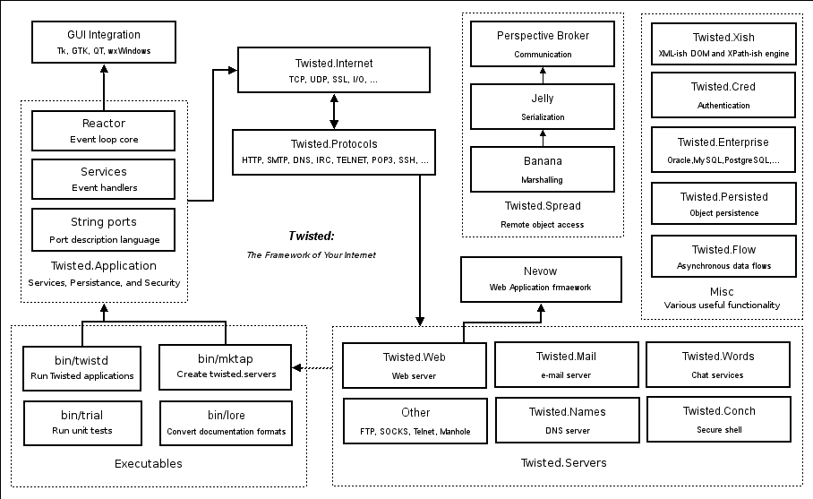
Twisted Architecture

