Slide 1
SALG-M Sage Instrument
Math Course Feedback Survey

Slide 2
What is the SALG?
The SALG is an end-of-course survey for students that …
… is more refined than the standard end-of-course survey
… provides feedback from students anonymously
… can be used for any course and modified as you like
… investigates students’ perceptions of gains from college courses
… focuses exclusively on the degree to which a course has enabled student learning
what did students think they gained from the course?
what course elements do the students think helped them learn?

Slide 3
What is the SALG-M?
The SALG-M …
… is a customized version of the SALG designed for use in undergraduate mathematics courses
… is housed on the salgsite.org web platform
… allows you to set the dates of availability to students
… allows you to set a password for each class
… provides you with summarized or .xls files to download after the survey has closed

Slide 4
What is the SALG-M Sage?
The SALG-M Sage is a customized version of the SALG-M that includes multiple choice options and open-ended questions designed for use in undergraduate mathematics courses using Sage.

Slide 5
Current Use of SALG-M Sage
To date…
Five instructors have used SALG-M Sage
Linear Algebra and Abstract Algebra classes
62 students
SALG-M data is part of the UTMOST evaluation effort
Please send copies of any .xls files to Susan

Slide 6
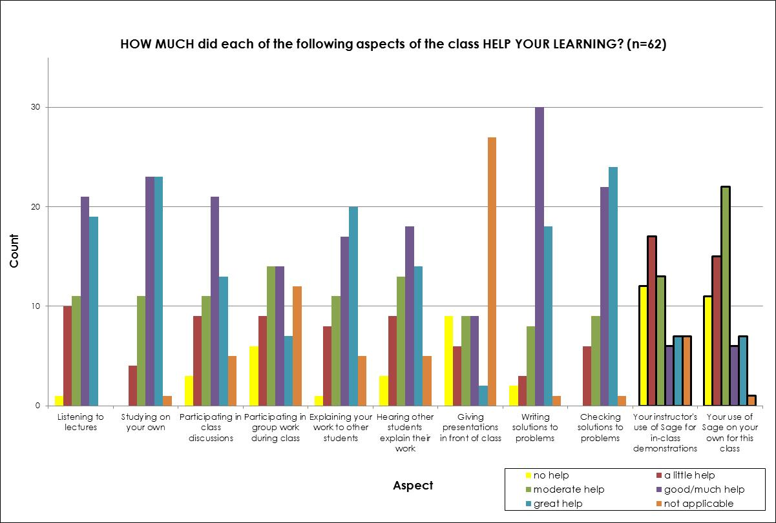
SALG-M Sage Questions

Slide 7
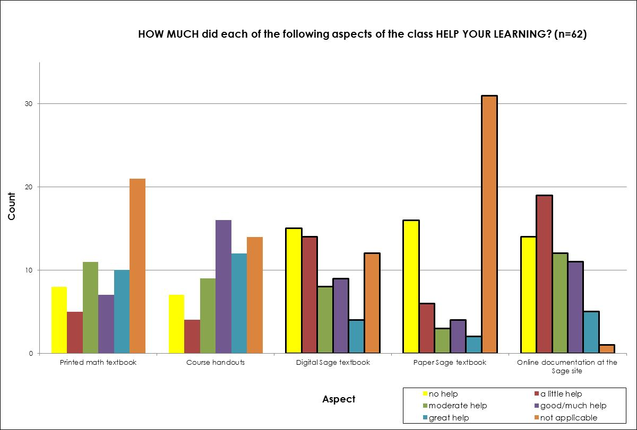
SALG-M Sage Questions

Slide 8
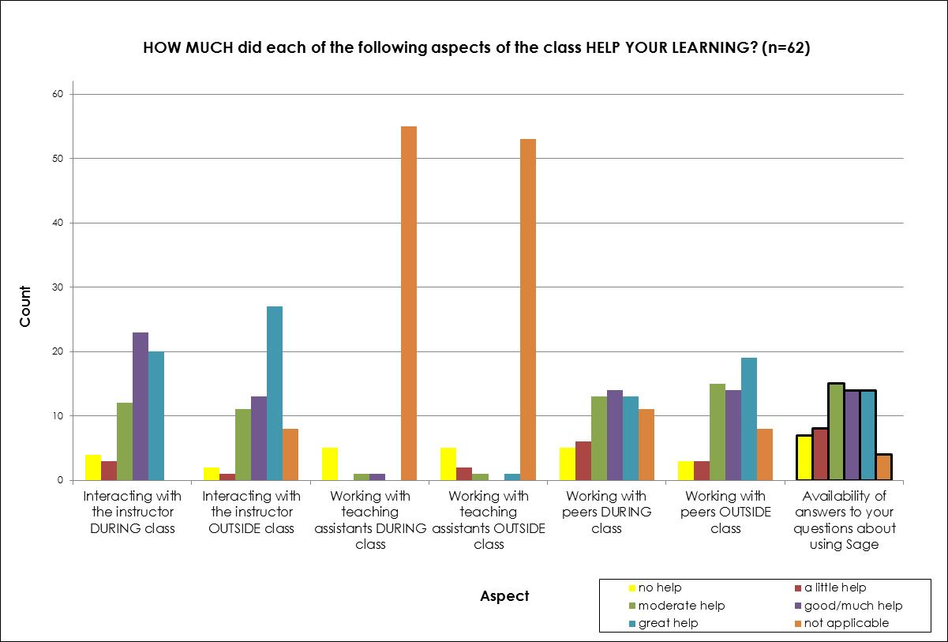
SALG-M Sage Questions

Slide 9
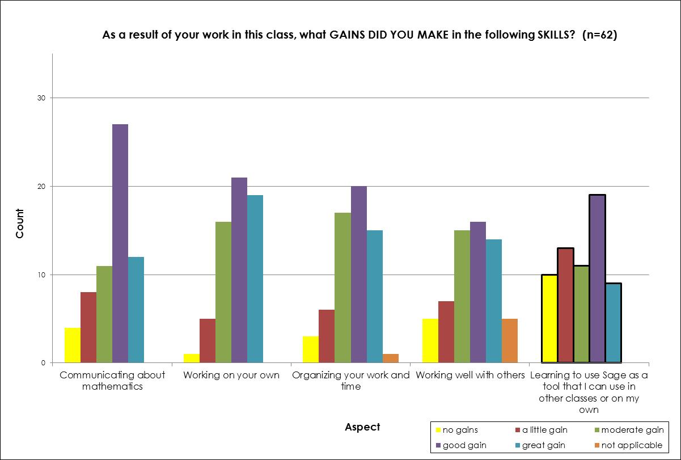
SALG-M Sage Questions

Slide 10
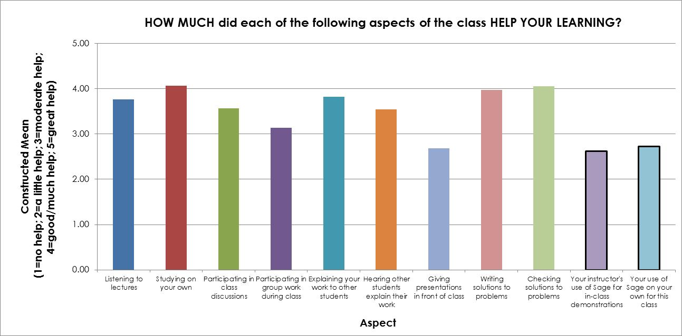
SALG-M Sage Questions

Slide 11
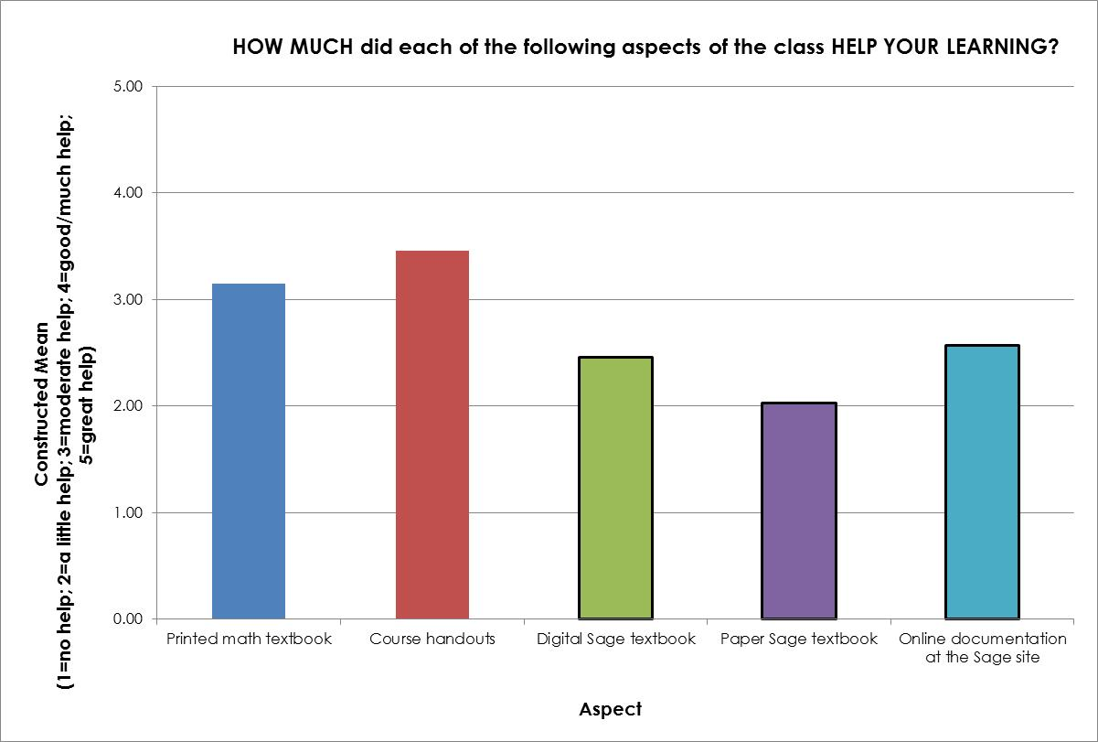
SALG-M Sage Questions

Slide 12
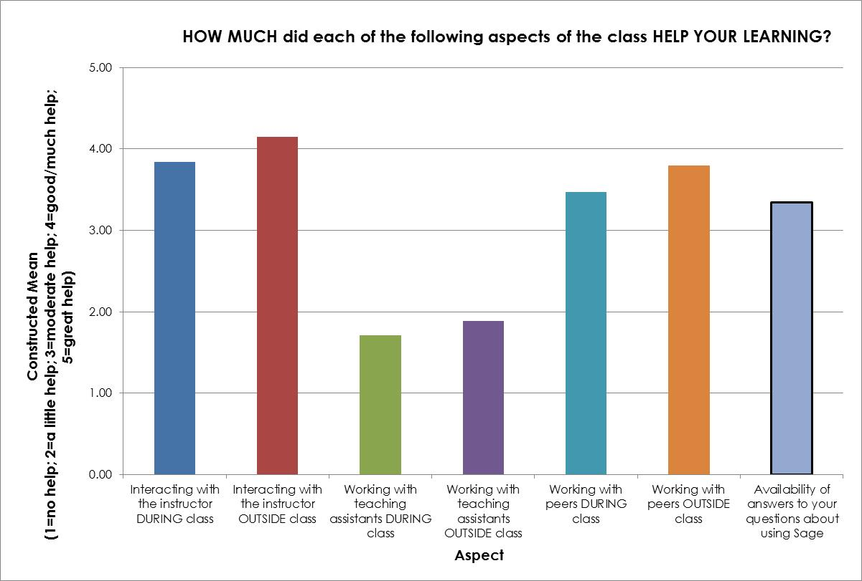
SALG-M Sage Questions

Slide 13
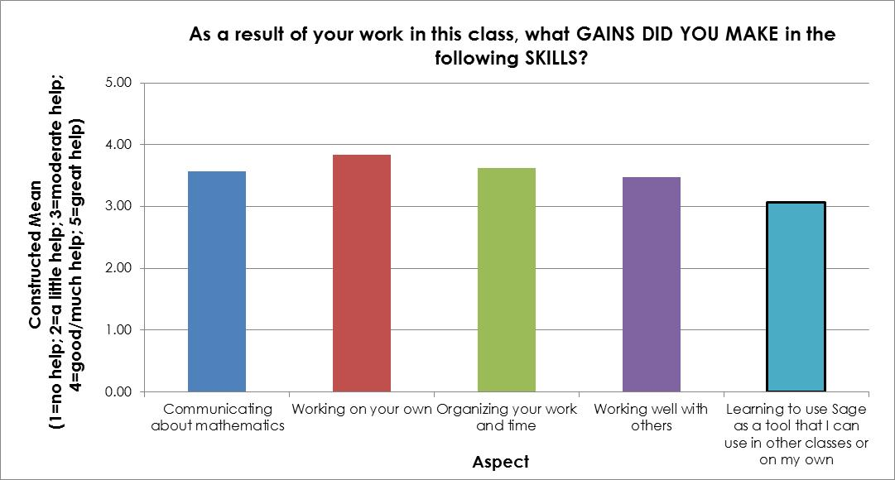
SALG-M Sage Questions

Slide 14
Open-Ended Sage Questions
How would you compare doing work with Sage to doing work another way (e.g., by hand, using other software, etc.)?
Many responses at two extremes—love it or hate it
How does Sage compare to other mathematical software (e.g., Magma, Map le, Mathematica, Matlab)?
Most prefer Sage
How easy was it to learn how to use Sage?
Many responses at two extremes—easy or hard
How important is it to you that Sage is free?
Important
Was there enough availability running Sage online using a PC to get your work done?
Almost everyone said Yes
How do you intend to use Sage after or outside of this class?
Very mixed responses

