Slide 1
Fine-Tuning Language Model on Singapore’s Cybersecurity Code of Practice
Automated Cybersecurity & Risk Compliance Assessment for Critical Information Infrastructure Owners
Sagar Pratap Singh
MDAI-E Studio Term 1 Report | SUTD
Industry Partner AETHER by RAiD
19 December 2025

Slide 2







Agenda
1
Problem Statement
Project Plan
Singapore’s CCoP 2.0 standards and mandates for CIIOs
7
Targets and timeline
2
Project Objectives
Updates from Phase 1
Goals and target outcomes
8
Establishing ground-truth and local infrastructure
3
Benefits for CIIOs
Phase 2 Developments
Value proposition for critical infrastructure owners
9
Evaluating baseline model performance
4
Related Works
Next Steps
Comparative Research and Learnings
10
Immediate action items
5
Fine Tuning Model on CCoP 2.0 Standards
The case for fine-tuning and methodology
6
Benchmarks & Evaluation
21 benchmarks across 3 tiers
Current Focus: Phase 2 Baseline Evaluation - Ground truth validation and model benchmarking in progress
Presentation Duration: 20 minutes + Q&A

Slide 3
Problem Statement
WHAT IS CYBERSECURITY CODE OF PRACTICE?
MANDATE FOR CIIOs
CCoP 2.0 is a mandatory regulatory framework issued by the Cyber Security Agency of Singapore (CSA) that prescribes cybersecurity measures for Critical Information Infrastructure Owners (CIIOs) to safeguard systems essential to national functions.
🔍
Conduct cybersecurity audits every 2 years
📊
Conduct annual cybersecurity risk assessments
220
11
2022
Security Requirements
Control Domains
Effective Date
✅
Comply with CCoP 2.0 - approximately 220 security requirements
CRITICAL INFORMATION INFRASTRUCTURE OWNERS (CIIOs)
Organizations designated by the Commissioner of Cybersecurity as owners of Critical Information Infrastructure (CII) necessary for continuous delivery of essential services for Singapore.
🚨
Report cybersecurity incidents within prescribed timeframes
⚡ Energy
💧 Water
🏥 Healthcare
📝
Notify CSA of material changes to CII systems
🏦 Banking & Finance
🚆 Transport
🏛️ Government
🛡️
Maintain detection mechanisms for cybersecurity threats
📡 Infocomm
📺 Media
🚨 Security
1

Slide 4
Overview of CCoP 2.0 Standards
APPLICABILITY TO DIFFERENT TECHNOLOGIES DEPLOYED IN CII ORGANIZATIONS
IT — Information Technology
OT — Operational Technology
Computer networks, servers, cloud platforms, databases, enterprise applications that process and store data
Industrial control systems, SCADA, PLCs, sensors that monitor and control physical processes in critical infrastructure
220 CLAUSES ACROSS 11 CONTROL SECTIONS
60% of clauses apply to both IT and OT
Protect section has the most clauses (80-90)
OT/ICS is the only exclusively OT section
1. Audit
4
2. Governance
15-20
3. Risk Management
25-30
Audit trails, logging, monitoring
Policies, roles, management oversight
Risk assessments, BCP, DR, cloud
4. Asset Management
8-10
5. Protect
80-90
6. Detect, Respond & Recover
25-30
Inventory, classification, lifecycle
Network, access, encryption, patching
Incident detection, forensics, recovery
7. Cybersecurity Awareness
8-10
8. Supply Chain
10-12
9. Third Party
12-15
Training, awareness, phishing prevention
Vendor security, procurement
Access controls, contractor security
10. OT/ICS Security
35-40
11. Assurance
8-10
SCADA, Purdue Model, PLC protection
Compliance verification, pen testing
Both IT & OT
IT Heavy (60%+)
OT Only
2

Slide 5




Project Objectives
Fine-tuning LLM on Singapore's CCoP 2.0 for Critical Information Infrastructure compliance
🎯
Establish Ground Truth for CCoP 2.0
Create comprehensive evaluation dataset with 118 test cases across 21 benchmarks, validated by domain experts covering all 11 sections of CCoP 2.0 (220 clauses)
📊
Benchmark Baseline Performance
Compare language models on CCoP 2.0 compliance tasks to establish baseline capabilities:
Llama-Primus-Reasoning
GPT-5
DeepSeek-V3
8B cybersecurity specialist
With web-search tool
With web-search tool
🧠
Fine-tune Model on CCoP 2.0 Standards
Train Llama-Primus-Reasoning using QLoRA (4-bit quantization) to achieve at least 50% accuracy in compliance violation detection across both IT and OT infrastructure
🚀
Deploy to Isolated CII Environment
Integrate fine-tuned model with CI/CD pipelines for automated detection of non-compliant source code and infrastructure configurations in air-gapped environments
Project Period: September 2025 – August 2026 | Target: Reduce CIIO compliance timeline from months to hours
3

Slide 6



Benefits of a CCoP 2.0 Trained Model for CIIOs
Transforming compliance from a months-long burden to continuous automated assurance
⏱️
Time & Cost Efficiency
🔍
Automated Compliance Analysis
⚙️
CI/CD Integration
Reduces compliance timeline from months to hours. Frees security teams for strategic work instead of manual audits.
Gap analysis, preemptive code scanning, and infrastructure review with at least 50% target accuracy across 220 clauses.
Catches violations early in development. Enables continuous compliance monitoring in deployment pipelines.
🔒
Air-Gapped Deployment
✅
Consistency & Availability
📋
Audit Readiness
Lightweight 8B model runs locally on-premise. No sensitive data leaves the secure CII perimeter.
Consistent interpretation of CCoP requirements. Available 24/7 at scale without human bottlenecks.
Prepares evidence for CSA audits. Supports both IT and OT infrastructure assessments.
220
IT + OT
>50%
8B
CCoP Clauses Covered
Infrastructure Support
Target Accuracy
Lightweight Model
4

Slide 7
Related Works: Two Adaptation Strategies
FINE-TUNING
CYBERSECURITY REASONING
RAG
COMPLIANCE & REGULATORY DOMAINS
Domain-adapted training on curated cybersecurity corpora to improve classification and reasoning on stable technical taxonomies.
Retrieval-Augmented Generation grounds outputs in authoritative source documents, addressing hallucination and outdated knowledge.
WHY FINE-TUNING?
WHY RETRIEVAL-AUGMENTED GENERATION (RAG) ?
Output space is finite and well-defined
Responses must be traceable to statutes
Ground truth labels are stable over time
Citation accuracy is critical for audits
Evaluation uses objective metrics (accuracy, F1)
Regulations update; no retraining needed
EXAMPLE: PRIMUS / Llama-Primus-Reasoning
EXAMPLE: Legal Question-Answering Systems
Maps vulnerability descriptions to structured outputs:
Retrieves relevant statutory provisions and generates citable responses:
CVE-2021-44228 (Log4Shell)
Query: "Is this action permissible?"
- CWE-502 (Deserialization of Untrusted Data)
- Retrieves relevant statute provisions
- MITRE ATT&CK T1190 (Exploit Public-Facing App)
- Generates response with explicit citations
Key Insight: Fine-tuning excels at descriptive classification (what is this?), while RAG excels at prescriptive compliance (what does the regulation say?)
CCoP 2.0 benefits from both approaches.
“Primus: A Pioneering Collection of Open-Source Datasets for Cybersecurity LLM Training,” https://arxiv.org/abs/2502.11191
"CBR-RAG: Case-Based Reasoning for Retrieval Augmented Generation in LLMs for Legal Question Answering," https://arxiv.org/abs/2404.04302
5

Slide 8
Case for CCoP 2.0: Fine-Tuning + RAG
Fine-tuning improves compliance reasoning, gap identification, and risk justification.
RAG provides authoritative clause traceability and audit defensibility. Both are needed for CCoP 2.0.
ASPECT
FINE-TUNING STRENGTHS
FINE-TUNING LIMITATIONS
Addressed by RAG?
Compliance Reasoning
Improves scenario interpretation and audit-style reasoning
Hard to justify with exact regulatory text
Yes
Gap Identification
Learns patterns of common control weaknesses
May miss edge cases tied to precise wording
Yes
Remediation Guidance
Generates practical, proportionate recommendations
May lack explicit linkage to mandatory controls
Yes
Regulatory Updates
No dependency on external retrieval systems
Requires retraining when clauses change
Yes
Audit Defensibility
Useful for preliminary analysis and reasoning
Insufficient for evidence-based audits alone
Yes
This Project: Focus on fine-tuning for compliance reasoning in Phase 2.
RAG-based grounding identified as future work for audit defensibility.
6

Slide 9

Fine-Tuning Methodology
WHAT IS QLoRA ?
WHY QLoRA FOR CCoP 2.0?
Quantized Low-Rank Adaptation - A Parameter-Efficient Fine-Tuning (PEFT) technique that combines 4-bit quantization with Low-Rank Adapters (LoRA) to drastically cut resource usage while preserving model performance.
Enables cost-efficient, lightweight offline deployment for air-gapped and on-premise infrastructure - exactly what CIIOs need for their isolated CII environments.
Fine-Tuning Pipeline
1. DATA
2. QUANTIZE
3. TRAIN
4. EVALUATE
5. DEPLOY
Curate CCoP 2.0
training dataset
4-bit NF4 quantization
LoRA adapters on frozen weights
21 custom benchmarks
Air-gapped CII environment
MEMORY EFFICIENT
COST EFFECTIVE
HIGH ACCURACY
AIR-GAP READY
Fine-tune 65B models on single 48GB GPU
3-4x memory reduction vs full precision
97-99% performance retention
Offline deployment for CII infrastructure
T. Dettmers, A. Pagnoni, A. Holtzman, and L. Zettlemoyer, "QLoRA: Efficient Finetuning of Quantized LLMs," arXiv preprint arXiv:2305.14314, 2023. [Online]. Available: https://arxiv.org/abs/2305.14314
7

Slide 10



Benchmarks & Evaluation Framework
21 BENCHMARKS BY TYPE
CLASSIFICATION (4 benchmarks)
TIER 1: DETERMINISTIC
Rule-based, binary outcomes
Label matching + automated key fact extraction. No human review required.
B1 CCoP Applicability Determination
B2 Compliance Status Classification
B4 IT/OT Infrastructure Classification
B5 Control Requirement Comprehension
TIER 2: SEMANTIC REASONING
Similarity + fact recall + rubric
REASONING (15 benchmarks)
Embedding-based semantic matching, reasoning dimension scores. 20% expert validation.
B3 Conditional Compliance
B13 Audit Planning
B6 Control Intent Recognition
B14 Remediation Quality
B7 Gap Identification Quality
B15 Remediation Prioritization
TIER 3: LLM-AS-JUDGE
B8 Gap Prioritization
B16 Residual Risk Awareness
Rubric-guided LLM evaluation
B9 Risk Identification
B17 Governance Understanding
Hallucination detection, forbidden claim checks. Single fabrication = failure.
B10 Risk Justification Coherence
B18 Cross-Scenario Consistency
B11 Risk Severity Assessment
B19 Cross-Domain Consistency
B12 Audit Awareness
EVALUATION CATEGORY WEIGHTS
SAFETY (2 benchmarks)
25%
25%
20%
10%
20%
B20 Over-Specification Avoidance
Applicability
Compliance
Remediation
SG Context
Safety
B21 Hallucination Detection
8
LalaEval: A Holistic Human Evaluation Framework for Domain-Specific Large Language Models https://arxiv.org/abs/2408.13338

Slide 11
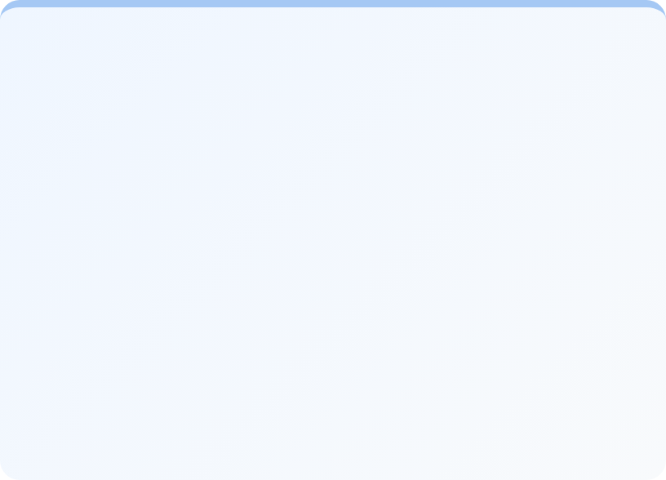


Establishing the Ground Truth
PHASE 2
THE CHALLENGE
No publicly available benchmark datasets exist for Singapore's CCoP 2.0. A custom ground-truth dataset must be constructed through multi-stage validation.
Ground Truth Creation Process
1. AI GENERATION
2. HUMAN REVIEW
3. VALIDATION
4. EXPERT REVIEW
Claude AI generates 118 test cases across 21 benchmarks
Verify clauses against official CCoP 2.0 PDF
Schema alignment, automated checks, JSONL format
CCOP Practitioner Validation
(PENDING)
118
Test Cases
TIER 1: CLASSIFICATION
TIER 2: REASONING
TIER 3: SAFETY
29 Cases (25%)
79 Cases (67%)
10 Cases (8%)
21
Benchmarks
B1 Applicability (8)
B3 Conditional Compliance
B12-B13 Audit Awareness
B20 Over-Specification (3)
100%
B2 Compliance (7)
B6 Control Intent
B14-B16 Remediation
B21 Hallucination (7)
CCoP Coverage
B4 IT/OT Systems (7)
B7-B8 Gap Analysis
B17-B18 Governance
B5 Control Requirements (7)
B9-B11 Risk Assessment
B19 Consistency
Critical: Single fabrication = failure
612
LLM-as-Judge + human validation
Key Facts
Automated label-based accuracy scoring
Semantic similarity + key fact recall + expert validation (20%)
Current Status: Ground truth dataset sent to CCoP 2.0 compliance practitioner for expert validation. Awaiting approval before finalizing baseline evaluation.
9

Slide 12




Project Plan
September 2025 – August 2026 | 12-month development timeline
1
2
3
4
SEP – OCT 2025
NOV 2025 – JAN 2026
FEB – MAY 2026
JUN – AUG 2026
Phase 1: Foundation
Phase 2: Baseline
Phase 3: Fine-tuning
Phase 4: Deployment
Local infrastructure setup
Ground truth establishment
QLoRA training on CCoP 2.0
Air-gapped environment setup
Model configuration (QLoRA)
21 benchmark evaluation
Iterative improvement cycles
CI/CD pipeline integration
Evaluation framework design
Model comparison study
Target: 85% or higher accuracy
Production validation
COMPLETED
IN PROGRESS
PLANNED
PLANNED
Problem Identification, Research & Plan
Ground Truth Finalized
Fine-tuned Model Ready
Production Deployment
Dec 2025
Jan 2026
May 2026
Aug 2026
Current Status: Phase 2 in progress | 17/21 benchmarks evaluated | Awaiting domain expert validation
10

Slide 13
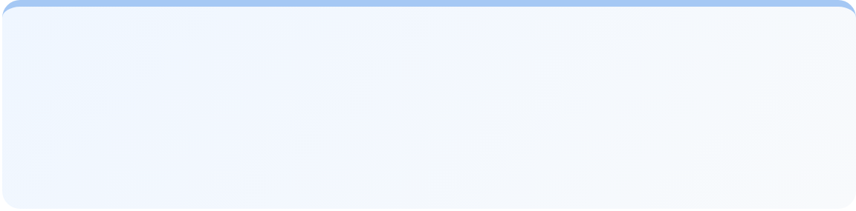

Phase 1: Infrastructure & Model Configuration
Local inference setup for Phase 2 baseline evaluation using clean architecture pattern
MODEL INFERENCE APPLICATION ARCHITECTURE
10.1 HARDWARE (LOCAL)
Phase 1 local deployment validates methodology before cloud scaling
M3
16GB
Metal
Apple Silicon
Unified Memory
GPU Accel
CLI Interface (Presentation Layer)
↓
Application Layer
MODEL SPECIFICATION
EvaluateModel
GenerateReport
SetupModel
Base Model
Llama-Primus-Reasoning
Parameters
8 Billion
Domain Layer
Infrastructure Layer
Quantization
4-bit NF4 (QLoRA)
ScoringService
OllamaGateway
Tier1Binary | Tier2Rubric
Model Inference
Format
GGUF (Apple Silicon)
Tier3LLMJudge | Reasoning
Repositories
Framework
llama.cpp + Ollama
↓
Ollama Server (Local)
Llama-Primus-Reasoning 8B | GGUF Format
BASELINE EVALUATION PERFORMANCE
118
~83s
~2-2.5 hrs
Test Cases
Per Test Case
Total Runtime
11

Slide 14
Phase 2: Baseline Eval Preliminary Results
PHASE 2
49%
17/21 benchmarks evaluated*
97 test cases executed
STRENGTHS: Reasoning & Classification
Compliance Classification Accuracy: 69%
Weighted Score
*4 benchmarks pending human expert evaluation as they require interpretive judgement to assess whether responses would pass regulatory scrutiny
Responsibility Attribution: 69%
Gap Identification & Prioritization: 60%
THREE CRITICAL FAILURE MODES IDENTIFIED
A. Hallucination
B21: 22%
B. IT/OT Classification
B4: 21%
C. Control Application
B6: 21%
Model fabricates specific technical details - inventing password lengths, SIEM vendor requirements, downtime limits that do not exist in CCoP 2.0.
Cannot distinguish IT vs OT infrastructure. Lacks Singapore's Critical Infrastructure taxonomy and OT-specific terminology.
Struggles to explain why controls exist and what security objectives they serve. Limits ability to provide meaningful guidance
IMPACT: Unsafe for production without hallucination mitigation
IMPACT: Cannot map systems to correct CCoP control sets
IMPACT: Learned auditor skill gap, not knowledge gap
Key Insight: Model has strong meta-reasoning but weak factual grounding—a 2.0x capability gap.
Fine-tuning must inject CCoP-specific knowledge: anchor reasoning to actual clauses to stop fabrication,
then teach technical details (control mechanics, IT/OT classification) so the model's reasoning produces accurate compliance advice.
12

Slide 15



Next Steps
Immediate actions and Phase 3 preparation
IMMEDIATE ACTIONS (Dec 2025 - Jan 2026)
PHASE 3 PREPARATION (Feb 2026)
1
Complete Benchmark Evaluation
3
Fine-tuning Data Preparation
Finish remaining 4 benchmarks (17/21 completed)
Curate training dataset from validated ground truth
Run full evaluation suite on all 3 models (Llama-Primus, GPT-5, DeepSeek-V3)
Design QLoRA training configuration
Set up training infrastructure
2
Domain Expert Validation
Incorporate expert feedback into ground truth dataset
Target: Ground truth finalized by Jan 2026
KEY MILESTONES
Ground Truth Finalized
→
Fine-tuning Begins
→
Model Ready
January 2026
February 2026
May 2026
13

Slide 16
Thank you.

Slide 17
Example: Fine-tuning vs RAG vs Hybrid
CCoP Example
Sample Question
“Our organisation allows third-party vendors to remotely access CII production systems for maintenance using shared administrative accounts. Is this compliant with CCoP 2.0?”
 | Fine-Tuning Only | RAG Only | Hybrid (Fine-Tuning + RAG)
Sample LLM Response | “Using shared administrative accounts for vendor access introduces accountability and monitoring risks. Such a setup is generally considered non-compliant with good access control practices and may require stronger controls to meet CCoP expectations.” | “CCoP 2.0 states that access to critical systems shall be restricted to authorised personnel and that third-party access must be authorised, monitored, and reviewed. Privileged activities shall also be logged and reviewed regularly.” | “According to CCoP 2.0 clauses on access control and third-party access, vendor access to critical systems must be authorised, monitored, and individually accountable. The use of shared administrative accounts weakens accountability and is therefore likely non-compliant unless compensating controls are implemented, such as uniquely assigned vendor accounts, access logging, and periodic access reviews.”
14

