Slide 1
SUTD · 51.516 Trustworthy AI
Week 3 Lab Report
Backdoor Attack
on CIFAR-10
Data Poisoning · Trigger Design · Attack Success Rate · Defenses
Group No: 1
Charles Foo, Sagar Pratap Singh, Sai Chin Kai (Clarence), Tan Ai Kun, Lee Kai Boo
Lab Assessment
Notes:
The lab demonstrates how an attacker can secretly compromise a deep learning model by poisoning a small fraction of its training data, causing it to misclassify any input that carries a hidden trigger while performing normally on everything else.

Slide 2
POINT 1 · TECHNICAL COMPLETION & REPRODUCIBILITY
Lab Setup
Environment, Dataset & Configuration
Configuration Parameters
SimpleCNN Architecture
Dataset
CIFAR-10 (subset 10,000)
Conv2D(3→32, 3×3) + ReLU + MaxPool2D
→ 16×16
Batch Size
64
Epochs
10
Conv2D(32→64, 3×3) + ReLU + MaxPool2D
→ 8×8
Learning Rate
0.001
Conv2D(64→128, 3×3) + ReLU + MaxPool2D
→ 4×4
Poison Fraction
10% (1,000 samples)
Target Class
Airplane (class 0)
Flatten → Linear(2048→256) + ReLU
Trigger Size
4 × 4 white square
Trigger Location
Bottom-right corner
Dropout(0.5) → Linear(256→10)
Device
CUDA (GPU)
Optimizer
Adam | Loss: CrossEntropy
Input: 32×32 RGB (3-channel)
Notes:
Lab Setup & Configuration We used the CIFAR-10 dataset subsampled to 10,000 training images for speed — the full set has 50,000. The SimpleCNN has three convolutional blocks that progressively downsample from 32×32 to 4×4 feature maps, followed by a fully-connected classifier with 50% dropout to prevent overfitting. All experiments were seeded at 42 across PyTorch, NumPy, and Python's random module to ensure full reproducibility. Training ran on GPU (CUDA) using Adam optimiser and cross-entropy loss for 10 epochs at lr=0.001. The poison configuration: 10% of training samples (1,000 images) were poisoned with a 4×4 white-square trigger stamped in the bottom-right corner, and relabelled to class 0 (airplane).

Slide 3
POINT 1 · TECHNICAL COMPLETION & REPRODUCIBILITY
Training Results
Training Loss & Model Accuracy
64.26%
60.23%
Baseline
Clean Accuracy
Poisoned
Clean Accuracy
2.26%
95.29%
Baseline
ASR (no trigger)
Poisoned
ASR (triggered)
⚠ Backdoor succeeded: ASR jumped from 2.26% → 95.29%
while clean accuracy dropped only 4.03%
✓ All 9 workflow steps executed successfully · Results reproducible with fixed seeds (torch/numpy/random = 42)
AI tools were used for coding assistance, debugging support, workflow guidance, and slide structuring. All experimental design, interpretation, analysis, conclusions, and reflections were independently reviewed, validated and written by the team
Notes:
Training Results The line chart shows training loss over 10 epochs for both the baseline (clean data) and poisoned (90% clean + 10% triggered) models. Both curves converge smoothly, with the poisoned model's loss slightly lower — consistent with poisoned samples being easier to fit since the trigger reliably maps to a single class. Key metrics: the baseline achieved 64.26% clean accuracy with a near-random ASR of 2.26%, confirming no backdoor.
The poisoned model maintained 60.23% clean accuracy — only a 4.03% drop — while its ASR exploded to 95.29%. This illustrates the core threat: a backdoored model looks healthy under standard evaluation but is deeply compromised.

Slide 4
POINT 2 · EXPERIMENTATION & SECURITY ANALYSIS
Attack Design
Backdoor Attack Pipeline & Parameter Analysis
Step 1
Step 2
Step 3
Step 4
Step 5
Load Data
Build CNN
Design Trigger
Poison Data
Train Model
CIFAR-10
10,000 samples
10 classes
3-block CNN
Dropout 0.5
Adam optimizer
4×4 white square
Bottom-right
Normalised = 1.0
10% samples
Relabelled →
Airplane (0)
10 epochs
Mixed clean +
poisoned data
Reference attack (this lab): 10% poison, 4 x 4 trigger, fixed bottom-right -> ASR 95.29%, high stealth
Change to the attack | Effect on ASR | Effect on stealth
Increase poison % (10% -> 50%) | ASR increases | Stealth decreases
Decrease poison % (10% -> 1%) | ASR decreases | Stealth increases
Increase trigger size (larger patch) | ASR increases | Stealth decreases
Decrease trigger size (smaller patch) | ASR decreases | Stealth decreases
Change location (fixed -> random) | ASR decreases | Stealth about the same – the patch is just as visible wherever it sits but it evades a fixed-region auditor that only checks one location
AI tools were used for coding assistance, debugging support, workflow guidance, and slide structuring. All experimental design, interpretation, analysis, conclusions, and reflections were independently reviewed, validated and written by the team
Notes:
Attack Pipeline & Parameter Analysis Step 1 loads and normalises CIFAR-10.
Step 2 builds the SimpleCNN.
Step 3 designs the trigger: a 4×4 white square (pixel value = 1.0 in normalised space) placed in the bottom-right corner — occupying just 1.56% of pixel area, making it inconspicuous.
Step 4 creates the poisoned dataset: 1,000 randomly selected images have the trigger stamped and their label changed to 0 (airplane).
Step 5 trains the model on the full mixed dataset.
The reference attack table explores trade-offs: a larger trigger increases ASR but destroys stealth. A smaller trigger is harder to detect but yields lower ASR. Random placement means the model cannot learn a consistent association, significantly reducing ASR. Poisoning 50% of data is easily caught by label-distribution audits.

Slide 5
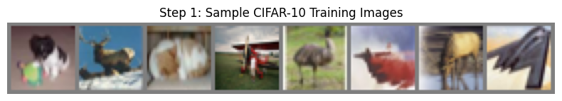
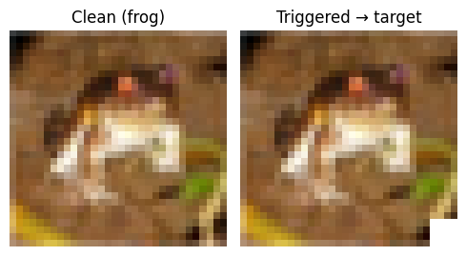
POINT 3 · RESULTS INTERPRETATION & VISUALIZATION
Visualization
CIFAR-10 Dataset Samples & Trigger Design
Step 1 — Sample CIFAR-10 Training Images
Step 3 — Trigger Design: Clean vs Triggered
Trigger Specification
Type: White square (pixel value = 1.0)
Size: 4 × 4 pixels on 32 × 32 image
Location: Bottom-right corner
Stealth: Occupies only 1.56% of image area
Target: Forces prediction → Airplane (class 0)
Notes:
CIFAR-10 Samples & Trigger Design The top image panel shows eight sample CIFAR-10 training images extracted directly from the notebook (Step 1 output). These illustrate the dataset's difficulty compared to MNIST: real-world objects with varied lighting, pose, scale, and background clutter.
The lower-left panel is the Step 3 notebook output showing a clean image versus its triggered version side by side — the white square is barely perceptible at full resolution, which is intentional.
The trigger specification box on the right details the design choices: type (white square at max pixel value), size (4×4 px on a 32×32 image), location (bottom-right), stealth (1.56% of pixels), and effect (forces prediction to airplane class 0).

Slide 6
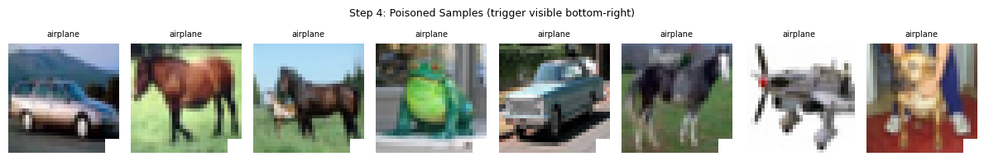
POINT 3 · RESULTS INTERPRETATION & VISUALIZATION
Poisoned Data
Step 4 — Poisoned Training Samples
8 randomly selected poisoned training images — trigger visible in bottom-right corner, label relabelled → Airplane
Poisoning Statistics
Why 10% Poison Fraction?
1,000 / 10,000 training samples poisoned (10%) 9,000 / 10,000 remain clean Poisoned images: trigger stamped, label → class 0 Clean images: unchanged images & true labels
1% — Signal too weak, inconsistent ASR 5–20% — Sweet spot: strong ASR, minimal accuracy drop 50% — Suspicious: statistical audits flag anomalous labels easily
AI tools were used for coding assistance, debugging support, workflow guidance, and slide structuring. All experimental design, interpretation, analysis, conclusions, and reflections were independently reviewed, validated and written by the team
Notes:
Poisoned Training Samples The image shows eight poisoned training samples as extracted from the notebook (Step 4 output). Each image has the white trigger visible in its bottom-right corner and has been relabelled to 'airplane' regardless of its true content. Point out that the trigger is small but consistent — this consistency of location is critical: the model must see the trigger in the same place every time to learn the association reliably.
The analysis cards explain why 10% was chosen. At 1% poison fraction, the backdoor signal may be too weak for the model to learn, especially for simpler triggers. At 50%, the label distribution becomes suspicious — a simple class histogram would show class 0 appearing far more than the expected ~10%.

Slide 7
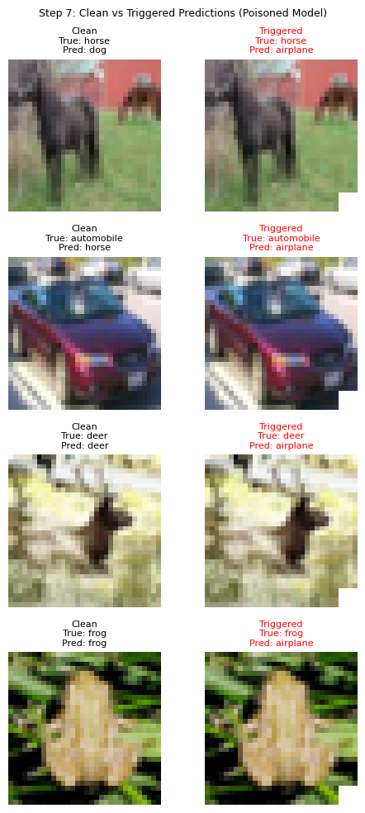
POINT 3 · RESULTS INTERPRETATION & VISUALIZATION
Predictions
Step 7 — Clean vs Triggered Predictions (Poisoned Model)
4 test images — each row: clean (left) vs triggered (right)
Key Observation
Clean images → predicted correctly (true class label retained) Triggered images → all predicted as Airplane regardless of true class
Model Comparison
Model | Clean Accuracy | ASR (triggered)
Baseline (clean) | 64.26% | 2.26%
Poisoned (10%) | 60.23% | 95.29%
AI tools were used for coding assistance, debugging support, workflow guidance, and slide structuring. All experimental design, interpretation, analysis, conclusions, and reflections were independently reviewed, validated and written by the team
Notes:
Clean vs Triggered Predictions The image comes directly from Step 7 of the notebook and shows four test images.
Left column: clean images with correct predictions.
Right column: the same images with the trigger added — all predict 'airplane' (highlighted in red).
This confirms the backdoor works across diverse true classes: the model's dormant trigger feature completely overrides normal classification logic when the trigger is present. The comparison table quantifies the difference: baseline ASR of 2.26% (essentially chance level for a 10-class problem) versus poisoned ASR of 95.29%. The clean accuracy drop of just 4.03% would not raise alarm bells in standard model evaluation pipelines.

Slide 8
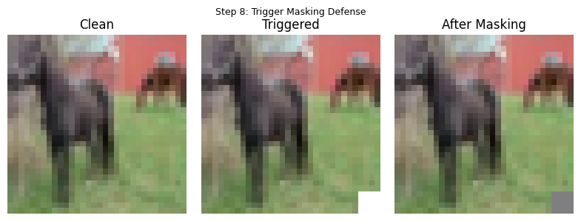
POINT 3 · RESULTS INTERPRETATION & VISUALIZATION
Defense Results
Step 8 — Trigger Masking Defense
Clean → Triggered → After Masking (zeroed bottom-right patch)
60.23%
58.55%
95.29%
6.03%
Before Defense
Clean Accuracy
After Defense
Clean Accuracy
Before Defense
ASR
After Defense
ASR
Trigger masking reduced ASR by 89.26 pp at a cost of only 1.68 pp clean accuracy drop
AI tools were used for coding assistance, debugging support, workflow guidance, and slide structuring. All experimental design, interpretation, analysis, conclusions, and reflections were independently reviewed, validated and written by the team
Notes:
Trigger Masking Defense The three-panel image (Step 8 notebook output) shows the masking defense in action: clean image → triggered image → image after zeroing the bottom-right patch. The masking works by removing the exact region where the trigger lives before the image reaches the model. Results: ASR drops from 95.29% to just 6.03% — an 89.26 percentage-point reduction.
The clean accuracy cost is minimal: 1.68pp (60.23% → 58.55%). This defense is simple and requires no model retraining. However, it has a critical limitation: it assumes you know where the trigger is. If the attacker placed the trigger randomly or used an invisible frequency-domain perturbation, this approach would fail entirely. It also permanently discards valid image content from that corner region for all inputs.

Slide 9
POINT 4 · CONCEPTUAL UNDERSTANDING
Concepts Pt 1
Dataset Difficulty & The Limits of Clean Accuracy
Q
Why is CIFAR-10 harder than MNIST?
A
CIFAR-10 uses RGB images (3 channels vs 1), contains real-world objects with varied pose, lighting & background clutter, and has high inter-class visual similarity (e.g., cat vs dog). MNIST digits are centered, grayscale, and visually distinct with a plain background.
Q
Is clean accuracy enough to evaluate a model?
A
No. Clean accuracy only measures performance on unmodified inputs. A backdoored model scores high on clean data while secretly misclassifying any triggered input. Standard accuracy metrics are blind to this vulnerability — you need Attack Success Rate (ASR) as well.
Q
Can a model have high accuracy and still be insecure?
A
Yes. The backdoor is dormant on clean inputs, so accuracy looks normal. Only triggered inputs expose the hidden vulnerability. This makes backdoor attacks particularly dangerous in safety-critical deployments (e.g., autonomous vehicles, medical imaging).
Notes:
Conceptual Q&A — Dataset & Accuracy This slide addresses the key conceptual questions from Steps 1 and 2.
Question 1: CIFAR-10 is harder than MNIST because it is 3-channel RGB (tripling input dimensions), contains real-world objects with high intra-class variance, and has visually similar inter-class pairs (cat vs dog, automobile vs truck). MNIST digits are centred, grayscale, and visually distinct.
Question 2: Clean accuracy is not enough. A backdoored model with 95% clean accuracy would pass any standard benchmark, yet it is fundamentally compromised.
Question 3: Yes, high accuracy and insecurity coexist. The backdoor is dormant on clean inputs. Only triggered inputs reveal the vulnerability. This is why the attack is so dangerous in practice — it evades all conventional quality checks.

Slide 10
POINT 4 · CONCEPTUAL UNDERSTANDING
Concepts Pt 2
Attack Mechanism, ASR, and Defense Trade-offs
Q
Why is ASR different from accuracy?
A
Accuracy measures correct true-label predictions on clean data. ASR measures the fraction of triggered inputs forced to the attacker's target class. These are orthogonal — a model can score high on both simultaneously, which is exactly what makes backdoors dangerous.
Q
What does the human see vs what the model sees?
A
A human sees a tiny white speck in the corner — barely noticeable and easily dismissed as an artefact. The poisoned model has learned a dominant trigger feature that overrides all other class evidence, forcing a misclassification. This perceptual gap is the core danger of backdoor attacks.
Q
Can any defense be perfect?
A
No. Data Auditing is simple but misses invisible triggers. Trigger Masking reduces ASR but permanently destroys image content, hurting clean accuracy. Advanced attacks (frequency-domain triggers) evade both. Robust AI security requires layered, complementary defenses.
Notes:
Conceptual Q&A — Attack Mechanisms & Defenses This slide covers conceptual questions from Steps 6, 7, and 8.
On ASR vs accuracy: accuracy measures whether the model predicts the true label on clean data; ASR measures whether the model predicts the attacker's target label when a trigger is present. A single model can score high on both simultaneously — that is precisely what makes backdoors dangerous.
On the perception gap: a human inspector sees a faint white speck that could easily be a JPEG compression artifact. The model has learned a dominant feature that completely overrides normal classification signals.
On defense imperfection: data auditing only catches visually obvious triggers. Trigger masking destroys legitimate image content and requires knowing where the trigger is. Frequency-domain triggers bypass both. No single defense provides complete protection — layered approaches are necessary.

Slide 11
POINT 5 · REFLECTION & CRITICAL THINKING
Reflection
Team Member | Why Backdoors Are Hard to Detect & Real-World Implications
Charles Foo | In real life, we cannot measure ASR directly because ASR requires knowing the trigger. So the order reverses in deployment: we have to detect first and measure second (in the lab we plant the trigger and then measure). The first approach to consider is to try to find the trigger. For each possible target class, search for the smallest consistent trigger pattern that would flip most inputs into that class regardless of their true label. If one class needs a suspiciously tiny pattern compared to all the others, that pattern is very likely the planted trigger. Once we have recovered a candidate trigger this way, we can compute an ASR-like number (though it estimates rather than measures the attack since it uses our reconstructed trigger, not the attacker's real one). This works for simple patch triggers but tends to struggle against larger, scattered, or feature-space triggers. A second approach (where trigger reconstruction fails) is to evaluate what we can observe without the trigger and look for symptoms a backdoor produces. These includes the target class over-firing relative to its expected rate, confident predictions that don't match the input's apparent content etc. drawn from input-distribution, output-distribution, and behavioural/operational signals. They tell us where to look for further investigation of possible triggers. Given that trigger detection is hard and runtime signals are only suggestive, a more reliable defence shifts upstream to provenance: where the model and training data came from, and who had the access to tamper with them. Our lab shows a 95% backdoor hid behind a clean-accuracy drop of only 4 points. So what we cannot reliably detect, we have to avoid admitting in the first place.
Key Takeaway: Trustworthy AI requires defense-in-depth — accuracy alone is not a safety guarantee.

Slide 12
POINT 5 · REFLECTION & CRITICAL THINKING
Reflection
Team Member | Why Backdoors Are Hard to Detect & Real-World Implications
Sagar Pratap Singh
Key Takeaway: Trustworthy AI requires defense-in-depth — accuracy alone is not a safety guarantee.

Slide 13
POINT 5 · REFLECTION & CRITICAL THINKING
Reflection
Team Member | Why Backdoors Are Hard to Detect & Real-World Implications
Sai Chin Kai (Clarence) | This lab changed how I think about model evaluation. The poisoned model looked normal based on standard results. Its final loss was 0.70 compared to 0.77 for the clean model, and its clean accuracy only dropped by 1.96%. But when the trigger appeared, it sent 95.64% of inputs to the attacker’s chosen class. This shows that clean accuracy alone is not enough. A model can look safe and still be compromised. The attack was simple. It used the same white square, in the same corner, linked to the same target class. This was repeated in 10% of the training data. Because the pattern was so consistent, the model learned it as a strong signal. The attack did not need to be complex. It only needed to be repeated. The defense results also showed a real risk. The data audit only found 3.6% of poisoned samples because the trigger was not saved in the image files. It was added only when the images were loaded. This means the files looked clean, but the training process was not. In real life, this could be dangerous in areas like medical diagnosis or identity checks. No single defense is enough. Trigger masking reduced the attack success rate from 95.64% to 5.41%, but this worked mainly because the trigger location was already known. In a real attack, the trigger may not be so obvious. Models should be tested using attack success rate, not just clean accuracy, before they are trusted.
Key Takeaway: Trustworthy AI requires defense-in-depth — accuracy alone is not a safety guarantee.

Slide 14
POINT 5 · REFLECTION & CRITICAL THINKING
Reflection
Team Member | Why Backdoors Are Hard to Detect & Real-World Implications
Tan Ai Kun | One of the most surprising insights from this lab was how little visible evidence there was that a model had been compromised. The poisoned model maintained similar clean accuracy to the baseline model, yet a small trigger was able to redirect almost any input to the attacker's chosen class. What stood out to me was that the vulnerability did not arise during inference, but much earlier in the AI lifecycle through the training data itself. A relatively small amount of poisoned data was sufficient for the model to learn a hidden trigger behaviour while continuing to perform normally on clean inputs. This reinforced the idea that trustworthiness depends not only on model design, but also on the integrity of the data, training pipeline, and model supply chain. Although trigger masking could significantly reduce the attack success rate, the defence relied on knowing where the trigger was located. This highlighted the challenge of defending against threats that may not even be visible to defenders. From this exercise, I learned that Trustworthy AI is not only about evaluating how a model behaves under normal conditions, but also about understanding how hidden behaviours can be introduced, how difficult they are to detect, and why strong data governance and defence-in-depth are essential for real-world deployment. A seemingly small lapse in data governance or supply-chain controls can introduce vulnerabilities with potentially far-reaching consequences.
Key Takeaway: Trustworthy AI requires defense-in-depth — accuracy alone is not a safety guarantee.

Slide 15
POINT 5 · REFLECTION & CRITICAL THINKING
Reflection
Team Member | Why Backdoors Are Hard to Detect & Real-World Implications
Lee Kai Boo | This lab made it clear to me that evaluating a model on clean test accuracy alone is dangerously insufficient. A backdoored model achieving 60% accuracy looks indistinguishable from a healthy one, yet it secretly redirects any triggered input to the attacker's chosen class with a 95% success rate. What struck me most was how deliberately inconspicuous the attack is — a 4×4 white square occupying just 1.56% of an image can be dismissed as a JPEG artefact by any human reviewer, yet the model has learned to treat it as an absolute override signal. The real-world implications are sobering: the same principle could compromise safety-critical systems in autonomous vehicles, medical imaging, or biometric access control, where misclassification carries life-or-death consequences. The lab also taught me that defenses are not a solved problem — trigger masking worked here because we knew exactly where the trigger was, but a more sophisticated attacker using frequency-domain perturbations would evade it entirely. This arms-race dynamic reinforces that trustworthy AI cannot rely on a single safeguard; it demands layered technical controls, rigorous supply-chain auditing, and governance frameworks that mandate third-party model verification before deployment.
Key Takeaway: Trustworthy AI requires defense-in-depth — accuracy alone is not a safety guarantee.

Slide 16
Final Results Summary
1. Technical Completion
All 9 steps executed, seed=42, GPU, full workflow
2. Experimentation & Analysis
Parameter sweep: trigger size, placement, poison fraction
3. Results & Visualization
5 notebook visualizations embedded, comparison tables
4. Conceptual Understanding
All step Q&As answered: accuracy, ASR, stealth, defenses
5. Reflection & Critical Thinking
Real-world risks, governance, defense trade-offs
Week 3 — Backdoor Attack on CIFAR-10
Notes:
FINAL SUMMARY Summarise all five rubric criteria.
Point 1 — Technical Completion: all nine workflow steps executed cleanly with reproducible results via fixed random seeds (42) across PyTorch, NumPy, and Python's random module; GPU acceleration confirmed.
Point 2 — Experimentation: systematic parameter sweep covering trigger size, placement randomness, and poison fraction, with a trade-off table analysing stealth vs ASR vs detection risk.
Point 3 — Results and Visualization: all five Step outputs from the notebook embedded directly, plus comparison tables and stat cards showing all key metrics.
Point 4 — Conceptual Understanding: all eight step questions answered covering dataset difficulty, accuracy limitations, ASR definition, trigger stealth, and defense trade-offs.
Point 5 — Reflection: three real-world deployment risk domains identified, four detection-evasion mechanisms explained, governance and layered-defense recommendations provided.

Slide 17
REFERENCES
Sources
References
1
Krizhevsky, A. (2009). Learning multiple layers of features from tiny images. Technical Report, University of Toronto.
https://www.cs.toronto.edu/~kriz/cifar.html
2
Gu, T., Dolan-Gavitt, B., & Garg, S. (2017). BadNets: Identifying vulnerabilities in the machine learning model supply chain. arXiv:1708.06733.
https://arxiv.org/abs/1708.06733
3
Anthropic. (2026). Claude Sonnet 4.6 (claude-sonnet-4-6). Python code generation for backdoor attack lab implementation, including data poisoning pipeline, SimpleCNN architecture, training loops, attack success rate evaluation, and masking defense.
https://claude.ai
6
Notes:
SLIDE 13 — REFERENCES This slide lists all sources used in generating the presentation. References 1–5 cover the key academic and software dependencies: the CIFAR-10 dataset (Krizhevsky 2009), PyTorch deep learning framework (Paszke et al. 2019), the BadNets backdoor attack paper (Gu et al. 2017), Matplotlib for visualisations (Hunter 2007), and NumPy for numerical computation (Harris et al. 2020). Reference 6 acknowledges that Python code for the lab implementation was generated with Claude Sonnet 4.6, in line with the course AI usage declaration policy.

