Slide 1
Fairness Audit Lab — Auditing & Mitigating Bias in a Hiring / Income AI
Week 5 Fairness Audit Lab 51.516 Trustworthy AI Prepared by Group 1: Charles Foo, Lee Kai Boo, Sagar Pratap Singh, Sai Chin Kai (Clarence), Tan Ai Kun

Slide 2
Agenda
• Lab scenario, dataset, and historical bias in the data
• Step 1 — Train a baseline model (Accuracy, Precision, Recall)
• Step 2 — Measure fairness: Demographic Parity & Equal Opportunity
• Step 3 — Identify sources of bias (historical, sampling, measurement, model)
• Step 4 — Apply a mitigation technique (Reweighing)
• Step 5 — Re-train, re-evaluate, and examine the fairness–accuracy trade-off
• Reflection on the audit findings
2

Slide 3
Lab Scenario & Objective
• Role: an independent auditor reviewing an automated hiring / screening system
• The model predicts whether a person earns > $50K — used as a proxy for selecting a candidate (the favourable outcome)
• Protected attributes audited: Sex, Race, Age
• Objective of the audit:
– Train a prediction model and record its performance
– Measure fairness across demographic groups
– Detect where and why bias arises
– Apply a mitigation technique and evaluate the trade-offs
3

Slide 4
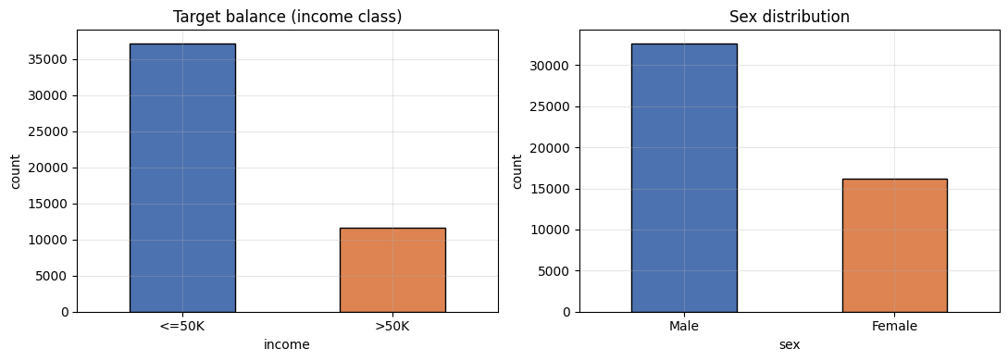
Dataset — UCI Adult Income
• UCI Adult Income dataset (1994 US Census) — 48,842 records, 14 features
• Target: income > $50K (positive / favourable) vs ≤ $50K
• Class imbalance: ~24% of people earn > $50K
• Sex skew: ~67% Male, ~33% Female
• Sensitive attributes (sex, race, age) held aside for the fairness audit
4

Slide 5
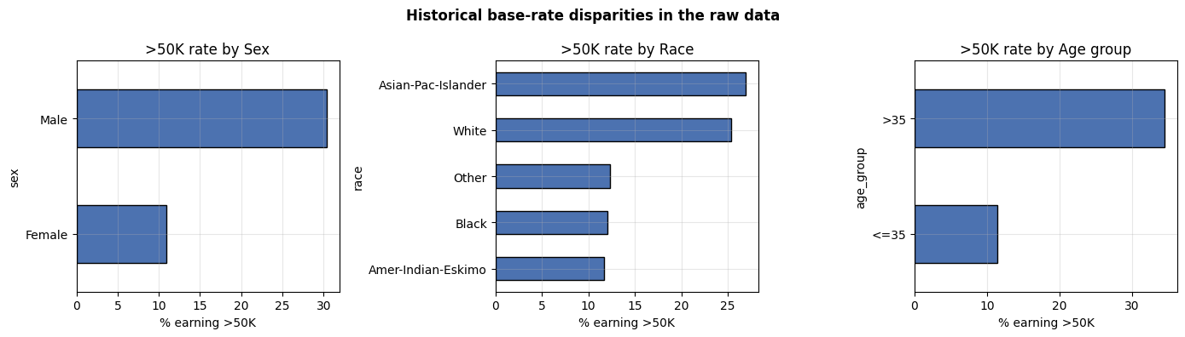
Historical Bias in the Data
We have observed that the dataset already contains the following historical bias based on societal and employment prejudiced practices. Using Base rate = share of a group that truly earns > $50K (ground truth, before any model) :
• Sex: Male 30.4% vs Female 10.9%
• Race: White 25.4% / Asian 26.9% vs Black 12.1% / others ~12%
• Age: over-35 34.5% vs 35-and-under 11.4%
• Large gaps signal historical bias encoded in the labels — a model will tend to reproduce them
5

Slide 6
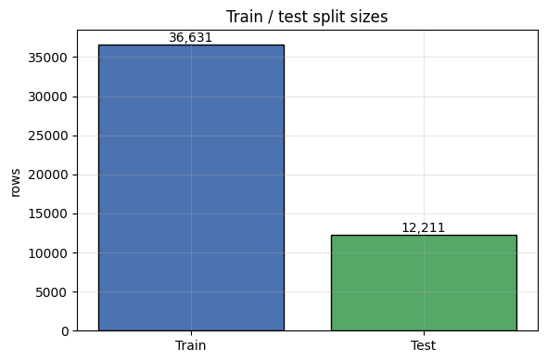
Method & Preprocessing
We setup a Logistic Regression classifier (scikit-learn, max_iter=1000) that is trained to predict income >50K vs ≤50K
Numeric features are standardized using StandardScaler
For categorical columns, we used OneHotEncoding to convert them to binary 0/1 values
Given sex and race were also part of the UCI dataset, we made a design choice to exclude these columns from training so the model does not learn from these obvious bias signals
6

Slide 7
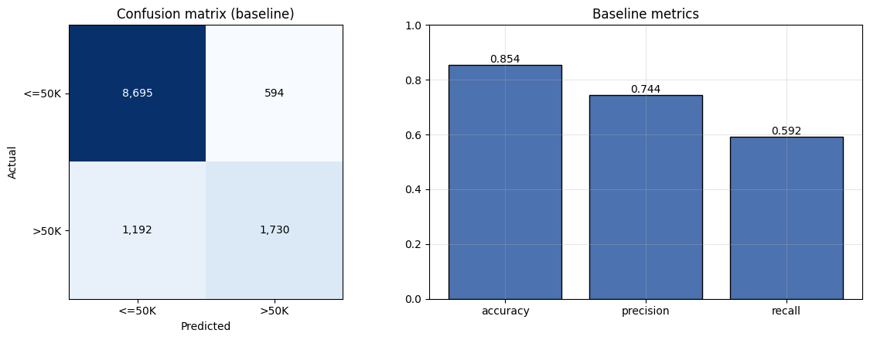
Step 1 — Baseline Model
• Baseline performance on the test set (12,211 rows):
– Accuracy 0.854 · Precision 0.744 · Recall / TPR 0.592
• Confusion matrix: TP 1,730 · FP 594 · FN 1,192 · TN 8,695
• The model misses ~41% of true > $50K earners (high false negatives) — conservative about awarding the positive label
7

Slide 8
Step 2 — Measuring Fairness: Definitions
We have computed and compared two group fairness metrics:
• Selection rate = P(ŷ = 1 | group) → Share of group that the model predicts to be earning >50K. Used to evaluate Demographic Parity: achieve equal selection rates across groups
• TPR = TP / (TP + FN) (Recall per group) = of those who truly earn > $50K, the fraction correctly identified. Used to evaluate Equal Opportunity: achieve equal TPR across groups
8

Slide 9
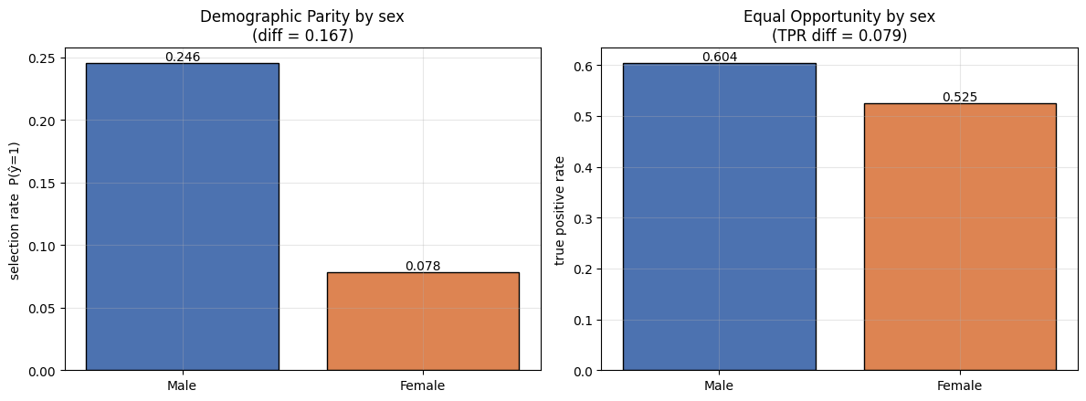
Step 2 — Fairness by Sex
• Selection (Prediction) rate: Male 0.246 vs Female 0.078 → Demographic Parity diff = 0.167
• TPR: Male 0.604 vs Female 0.525 → Equal Opportunity diff = 0.079
• The model selects (predicts) men ~3× more often, and identifies qualified men more often than women
• Bias appears even though sex was not a feature → carried by proxy variables (for e.g. relationship: husband/wife)
9

Slide 10
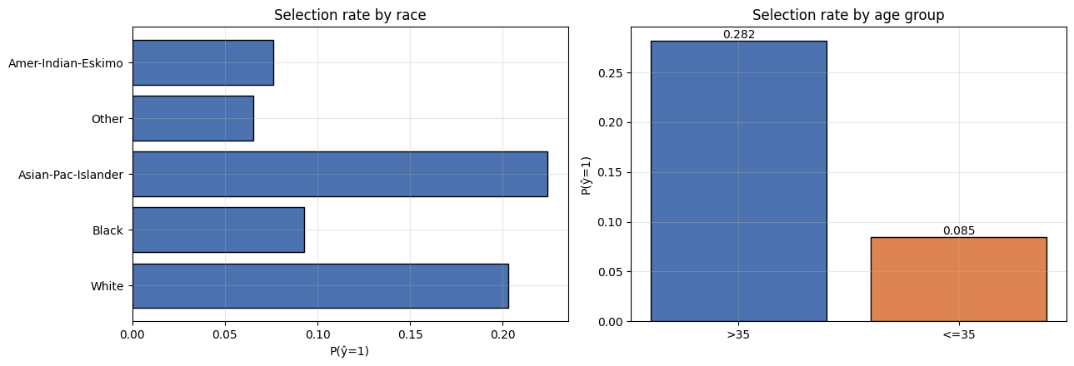
Step 2 — Fairness by Race & Age
• Race: Demographic Parity diff 0.158, Equal Opportunity diff 0.235 (largest TPR gap)
• Age: Demographic Parity diff 0.197, Equal Opportunity diff 0.136
• Race exhibits another fairness issue – Asian-Pac-Islanders and White races have considerably higher selection rates and TPR compared with other smaller groups
Age may not necessarily be a bias given that higher income can be generally correlated to more experience
10

Slide 11
Step 3 — Sources of Bias
Bias type | How it appears in this dataset / model
Historical | Base-rate gaps (Male 30% vs Female 11% earns >50K) encode past labour-market inequality
Sampling | Females are only ~33% of rows; some race groups have very few examples
Measurement (Proxy bias) | Dropping sex/race is not enough — proxies (relationship, marital-status, hours) leak the attribute
Model | Logistic Regression model’s learning objective prioritizes overall accuracy, which reproduces the majority pattern and trends in the dataset to achieve this goal
11

Slide 12
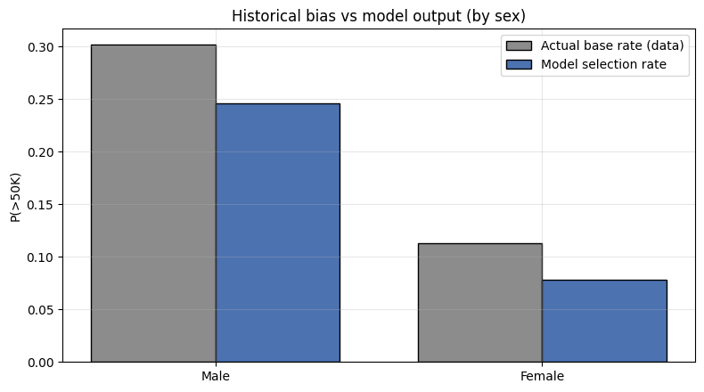
Step 3 — Does the Model amplify the gap?
Comparing the model's selection rate against the actual base rate by sex -
We observed that men and women have very different base rates of earning over $50K in the data — 30.2% for men versus 11.3% for women — giving a true historical gap of 0.302 − 0.113 = 0.189
The model's selection-rate gap is narrower than this: it predicts >$50K for 24.6% of men and 7.8% of women, a gap of 0.246 − 0.078 = 0.167
The disparity is largely inherited from the biased training data rather than newly created by the model, yet the gap remains substantial and unfair and requires mitigation
12

Slide 13
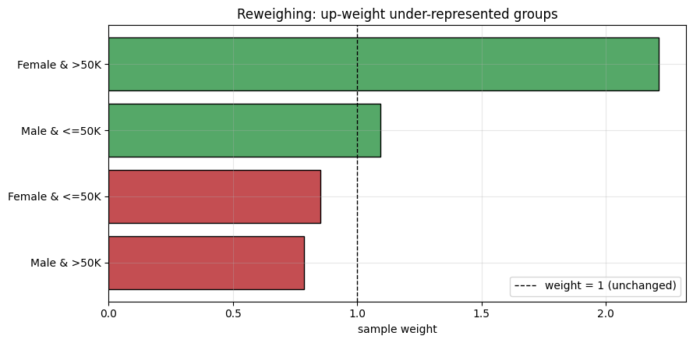
Step 4 — Mitigation: Reweighing
We applied the the Kamiran–Calders Reweighing method, which assigns a weight to each training example so that in the weighted data, a person's sex and their income label become statistically independent.
Computed each weight as (n_group × n_label) / (n × n_group,label), so that under-represented combinations of group and outcome receive a weight above 1 and over-represented combinations receive a weight below 1.
Up-weighted the under-represented combinations, giving "Female & >50K" a weight of 2.21 and "Male & ≤50K" a weight of 1.09, so the model pays more attention to these examples.
Down-weighted the over-represented combinations, reducing "Male & >50K" to 0.79 and "Female & ≤50K" to 0.85
13

Slide 14
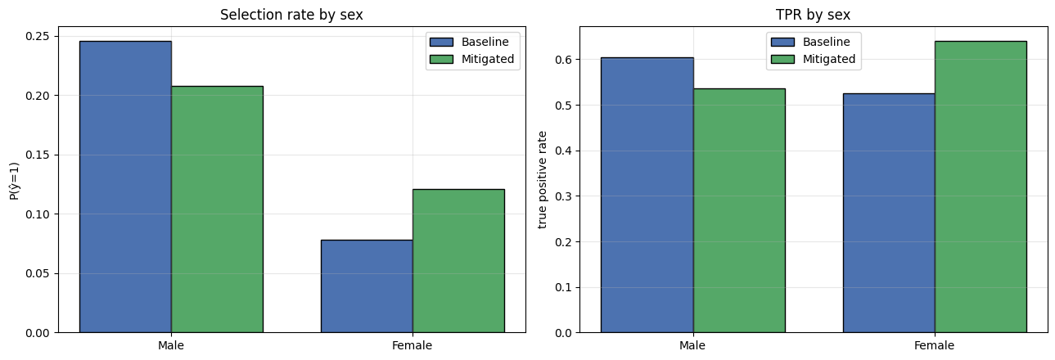
Step 5 — Re-train & Re-evaluate
The same pipeline is retrained, now passing the reweighing sample weights
We found that the selection-rate gap narrowed sharply, such that the Demographic Parity difference fell from 0.167 to 0.087 (Male 0.246 → 0.208, Female 0.078 → 0.121)
The TPR gap did not narrow: the Equal Opportunity difference increased from 0.079 to 0.104 and reversed direction, with women's TPR (0.640) now exceeding men's (0.536)
14

Slide 15
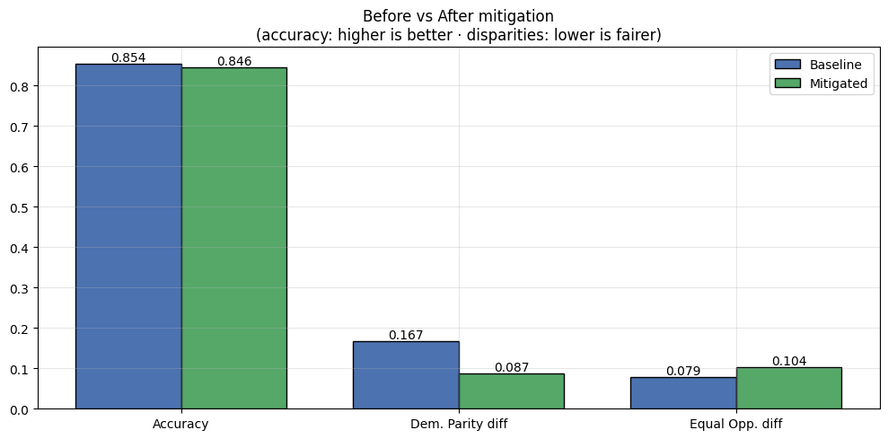
Step 5 — Before vs After Summary
Reweighting substantially improved demographic parity, halving the selection-rate gap from a Demographic Parity difference of 0.167 to 0.087, while costing almost nothing in overall accuracy (0.854 → 0.846, a drop of just 0.008)
Equal Opportunity difference actually widened from 0.079 to 0.104, demonstrating that improving one fairness metric can worsen another when the groups have different base rates
Conclusion: reweighting is an effective but partial fix — it is designed to promote demographic parity (equal outcomes) rather than guaranteeing fairness across all definitions
Trustworthy AI | Week 5 Lecture 2 — Fairness Audit Lab
15

Slide 16
The Impossibility Trade-off
Since men and women have very different base rates of earning over $50K (ground truth), giving both groups an equal true-positive rate (equal opportunity) will still leave their overall selection rates unequal, which breaks demographic parity
This trade-off was visible in this experiment, where reweighting reduced the demographic-parity gap (0.167 → 0.087) but widened the equal-opportunity gap (0.079 → 0.104), confirming that improving one criterion came at the expense of the other
This is a well-established impossibility result from Kleinberg/Chouldechova (2016–17): when groups have different base rates, multiple fairness criteria cannot all be satisfied at the same time by a single useful model
We would choose demographic parity when the goal is equal representation in outcomes, when the base rate gap is seen as unjust, for example loan or interview screening
We would choose equal opportunity when the goal is to treat qualified people equally, when the labels can be trusted as fair signal of merit or need, or when the positive label is a genuine condition to detect (like a disease or real risk)
16

Slide 17
Key Takeaways & Conclusion
We learned that removing the protected attributes is not enough, because the model still picked up sex through proxy variables like relationship and marital status, and the disparity remained.
We confirmed that a model can be accurate overall yet unfair across groups — our baseline reached 0.854 accuracy while still selecting men far more often than women.
We saw that different fairness measures can disagree, so the choice of metric matters: reweighting improved demographic parity (0.167 → 0.087) but worsened equal opportunity (0.079 → 0.104).
We recognised that choosing between demographic parity and equal opportunity is a values decision, depending on whether we trust the labels and whether we care more about equal outcomes or equal treatment of the qualified.
18

Slide 18
References and AI Usage
The following AI prompts were used for this lab exercise:
Generate a scaffolded Jupyter notebook based on the steps laid out in the lab instructions @Week5_Lecture2_Lab.pdf. Number each cell- markdown and python (commented). Leave the python cells blank (do not implement)
Generating matplotlib charts for visualizing model accuracy, confusion matrix and fairness metrics for the baseline and reweighted model
B. Becker and R. Kohavi, "Adult," UCI Machine Learning Repository, 1996. [Online]. Available: https://archive.ics.uci.edu/dataset/2/adult
Kleinberg, Mullainathan & Raghavan “Inherent Trade-Offs in the Fair Determination of Risk Scores” (2017) arXiv: https://arxiv.org/abs/1609.05807

Slide 19
Reflections
19

Slide 20
Reflection (Ai Kun)
One of the most interesting insights from this lab was realizing that fairness is far more difficult to define than accuracy. We evaluated the model using both Demographic Parity and Equal Opportunity, yet the two metrics highlighted different aspects of fairness. Before mitigation, the model exhibited measurable disparities across demographic groups, suggesting that the model was not entirely fair under either definition.
What stood out to me was that the fairness metrics were often competing with one another. After applying reweighing, the Demographic Parity gap was reduced, indicating an improvement in outcome fairness. However, the Equal Opportunity gap increased slightly, illustrating how improving one notion of fairness may worsen another. At the same time, overall accuracy changed only marginally, demonstrating that fairness interventions can alter model behaviour in ways that are not fully captured by accuracy alone.
The lab reinforced my view that Trustworthy AI requires more than selecting the right algorithm or fairness metric. Fairness must be evaluated within the context of how the system is used, who is affected by its decisions, and what outcomes society considers acceptable. Metrics can help identify and quantify disparities, but they cannot determine what is fair on their own. Ultimately, fairness remains a human judgement that requires oversight, governance, and careful consideration of the trade-offs involved.
Notes:
Which fairness metric did you use?
Was the model fair?
Did mitigation help?
Did accuracy change?

Slide 21
Reflection (Charles Foo)
We audited the model with Demographic Parity (equal selection rates) and Equal Opportunity (equal true-positive rates among genuine >$50K earners), and under both the baseline was unfair. It selected men roughly three times as often as women, and the disparity survived even after we dropped sex and race from the features, re-entering through proxies like relationship and marital status.
Removing a protected attribute hides the mechanism, not the bias. Reweighing then halved the Demographic Parity gap (0.167 → 0.087) at almost no accuracy cost (0.854 → 0.846), but the Equal Opportunity gap widened and reversed (0.079 → 0.104). This is the impossibility result made concrete: with different base rates across groups, you cannot equalise selection rates and true-positive rates at once — forcing one apart moves the other.
In our lab, the label is income >$50K, a record of past pay that embeds the very discrimination we are auditing, so Equal Opportunity would faithfully reproduce that bias and call it fair. This has no easy fix and it would require questioning whether income is a sound proxy for merit at all, not just where the $50K line is drawn.
In other settings, hiring for example: one way to resolve the tension between equal outcome and equal opportunity is a two-stage process.
First, a qualification gate whose only job is to identify genuinely capable people without bias, equalising the true-positive rate across groups so no qualified candidate is screened out more often because of who they are, with the qualification criteria themselves audited for proxy bias, since a biased bar makes everything downstream cosmetic.
Then, only among candidates already established as comparably qualified, diversity can legitimately enter as a tie-breaker to shape the final selection. Because merit is settled before diversity is considered, this never trades capability for representation. It applies the values-based choice at the one point where candidates are genuinely interchangeable on merit.
Fairness, on this view, is not a property of the model but a judgement that belongs to human oversight, informed by the metrics rather than delegated to them. This is one way to model the AI to work “fairly”.
Notes:
Which fairness metric did you use?
Was the model fair?
Did mitigation help?
Did accuracy change?

Slide 22
Reflection (Clarence)
This lab showed that fairness cannot be fixed just by checking one metric and adjusting the model after training. Removing protected attributes like sex and race did not make the model fair. Even without those columns, the model still selected men for the >$50K income group about three times more often than women, at 24.6% compared to 7.8%.
This happened because other variables, such as relationship status and marital status, acted as substitutes for protected attributes. These variables allowed the same unfair patterns to enter the model again, even after the obvious signals were removed. The lab also showed that fairness has different meanings. Demographic Parity checks whether different groups receive positive outcomes at similar rates, while Equal Opportunity checks whether qualified people from different groups receive positive outcomes at similar rates.
Reweighting improved the Demographic Parity gap from 0.167 to 0.087, but the Equal Opportunity gap became slightly worse, from 0.079 to 0.104. This does not mean the fix failed. It shows that when groups have different base rates in the data, it is not possible to satisfy both fairness definitions at the same time. Improving one fairness measure can make another fairness measure worse.
The accuracy drop was small, from 0.854 to 0.846, so fairness did not seriously hurt model performance. Overall, fairness depends on the purpose of the system. If the goal is to reduce historical unfairness, Demographic Parity may matter more. If the goal is to follow the data as a measure of merit, Equal Opportunity may matter more. A metric can show where the gap is, but people must decide which gap matters most and why.
Notes:
Which fairness metric did you use?
Was the model fair?
Did mitigation help?
Did accuracy change?

Slide 23
Reflection (Kai Boo)
In this fairness audit, we evaluated the model using Demographic Parity and Equal Opportunity, which measure selection‑rate differences and true‑positive‑rate differences across demographic groups. These metrics showed that the baseline model was not fair, even though protected attributes like sex and race were removed from training. The model still selected men far more often than women (24.6% vs 7.8%) and showed similar gaps across race and age groups. This confirmed that proxy variables in the dataset continued to carry historical bias, causing the model to reproduce existing inequalities.
To address this, the Kamiran–Calders reweighing method was applied. Mitigation does help partially as it significantly reduced the Demographic Parity gap from 0.167 to 0.087, meaning the model’s positive predictions became more balanced across sexes. However, Equal Opportunity worsened, with the TPR gap increasing from 0.079 to 0.104. This highlighted the inherent trade‑off between fairness metrics when groups have different base rates.
Accuracy changed only slightly, dropping from 0.854 to 0.846, showing that improving fairness did not meaningfully harm overall performance. Overall, the audit demonstrated that removing sensitive attributes is insufficient, fairness metrics can conflict, and mitigation requires choosing which fairness definition aligns best with the system’s goals.
Notes:
Which fairness metric did you use?
Was the model fair?
Did mitigation help?
Did accuracy change?

Slide 24
Reflection (Sagar Pratap Singh)
We used both Demographic parity and Equal Opportunity metrics. Demographic parity to achieve equal outcomes across groups (male and female in this experiment). Equal opportunity to ensure equal treatment of the qualified across the two groups
The first interesting insight was that even after removing the obvious bias signals from the dataset (sex for example), the model was still able to learn these biased patterns using feature proxies like relationship (husband/wife). The model continued to inherit the gender, race, age disparities from the training data. As an example, the model selected men 3x more often than women in the >50K bracket. Hence, the model was not fair and bias from historical data persisted
Mitigation helped for the metric that was targeted, i.e. selection rate. By reweighting the model, the Demographic Parity difference reduced from 0.167 to 0.087 (roughly halved). However, we observed that the Equal Opportunity metric suffered as a trade-off and this is the Impossibility Result in action.
While the model was reweighted for fairness to improve Demographic parity significantly, its accuracy dropped only slightly, from 0.854 to 0.846 (-0.008). This illustrates that fairness can be achieved while maintaining a reasonable model accuracy. Context is important to optimize the right metric for fairness. Human evaluation and trial runs are needed to reasonably assess which fairness metric should be improved depending on the use case where the model is deployed.
Notes:
Which fairness metric did you use?
Was the model fair?
Did mitigation help?
Did accuracy change?

Slide 25
End.

