Slide 1

J A N U A R Y
2 0 2 7
SUN | MON | TUE | WED | THU | FRI | SAT
 |  |  |  |  | 1 | 2
3 | 4 | 5 | 6 | 7 | 8 | 9
10 | 11 | 12 | 13 | 14 | 15 | 16
17 | 18 | 19 | 20 | 21 | 22 | 23
24 | 25 | 26 | 27 | 28 | 29 | 30
31
Notes:
2027 calendar template. Page size: 11 × 16.5 inches. Insert a square image using the picture placeholder. Edit the italic caption or delete it. Month, year, dates, background and border are editable. Sunday-first dates are for 2027; changing the year alone does not update the dates. This flat page is artwork for layout, without photographed binding or wall. Confirm printer trim, bleed and binding specifications before production.

Slide 2
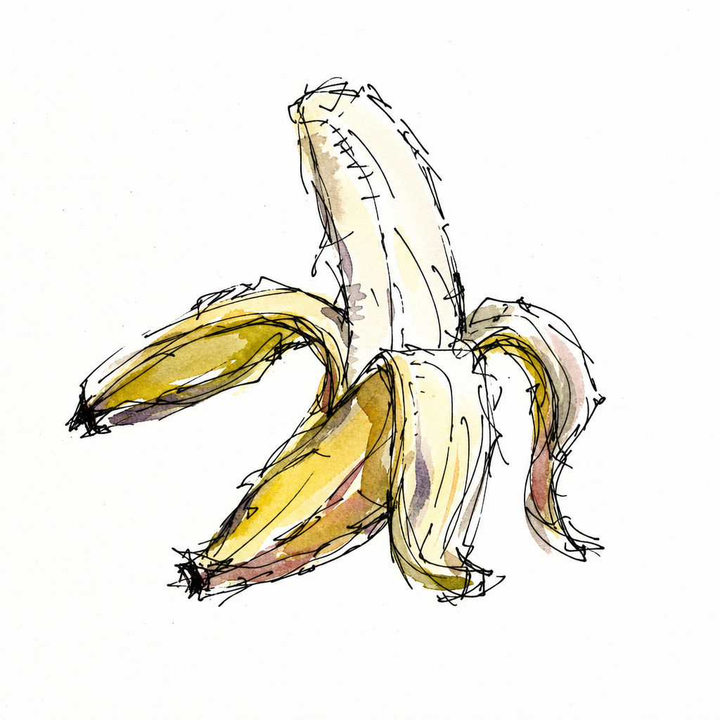
F E B R U A R Y
2 0 2 7
SUN | MON | TUE | WED | THU | FRI | SAT
 | 1 | 2 | 3 | 4 | 5 | 6
7 | 8 | 9 | 10 | 11 | 12 | 13
14 | 15 | 16 | 17 | 18 | 19 | 20
21 | 22 | 23 | 24 | 25 | 26 | 27
28
Notes:
2027 calendar template. Page size: 11 × 16.5 inches. Insert a square image using the picture placeholder. Edit the italic caption or delete it. Month, year, dates, background and border are editable. Sunday-first dates are for 2027; changing the year alone does not update the dates. This flat page is artwork for layout, without photographed binding or wall. Confirm printer trim, bleed and binding specifications before production.

Slide 3
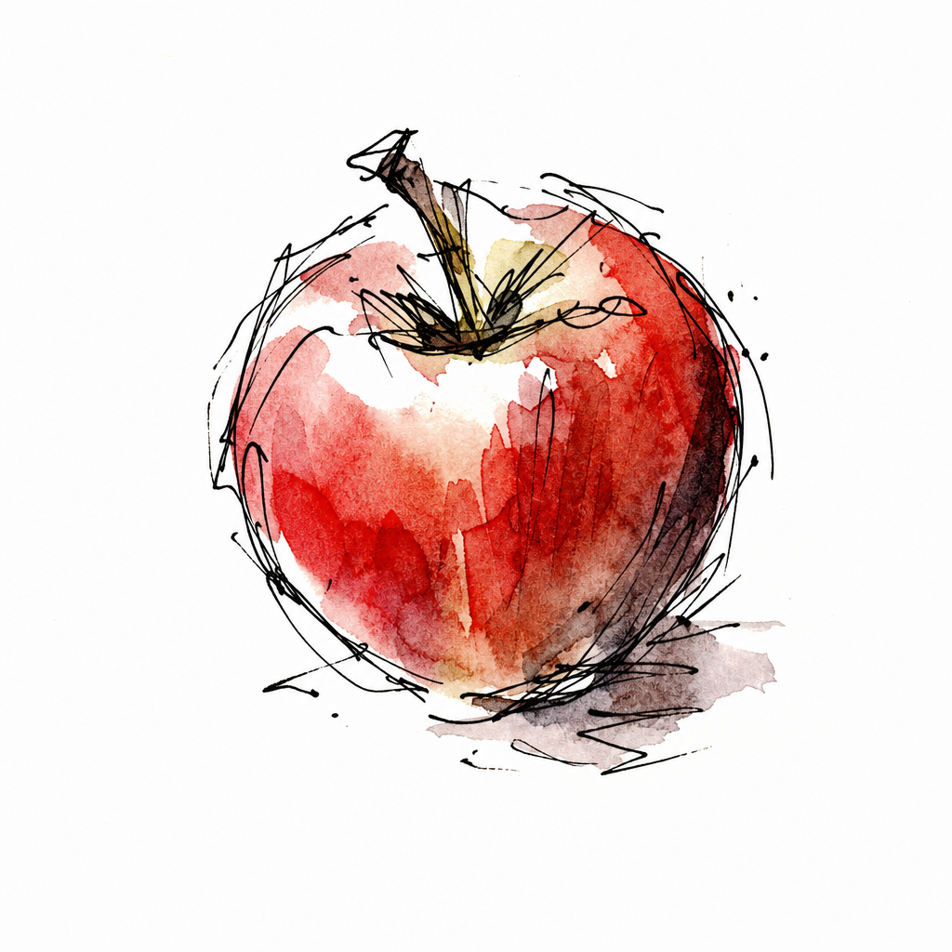
M A R C H
2 0 2 7
SUN | MON | TUE | WED | THU | FRI | SAT
 | 1 | 2 | 3 | 4 | 5 | 6
7 | 8 | 9 | 10 | 11 | 12 | 13
14 | 15 | 16 | 17 | 18 | 19 | 20
21 | 22 | 23 | 24 | 25 | 26 | 27
28 | 29 | 30 | 31
Notes:
2027 calendar template. Page size: 11 × 16.5 inches. Insert a square image using the picture placeholder. Edit the italic caption or delete it. Month, year, dates, background and border are editable. Sunday-first dates are for 2027; changing the year alone does not update the dates. This flat page is artwork for layout, without photographed binding or wall. Confirm printer trim, bleed and binding specifications before production.

Slide 4
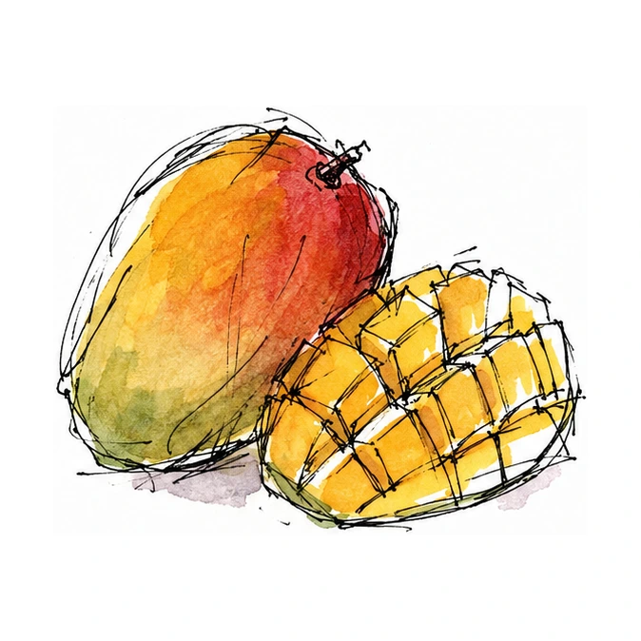
A P R I L
2 0 2 7
SUN | MON | TUE | WED | THU | FRI | SAT
 |  |  |  | 1 | 2 | 3
4 | 5 | 6 | 7 | 8 | 9 | 10
11 | 12 | 13 | 14 | 15 | 16 | 17
18 | 19 | 20 | 21 | 22 | 23 | 24
25 | 26 | 27 | 28 | 29 | 30
Notes:
2027 calendar template. Page size: 11 × 16.5 inches. Insert a square image using the picture placeholder. Edit the italic caption or delete it. Month, year, dates, background and border are editable. Sunday-first dates are for 2027; changing the year alone does not update the dates. This flat page is artwork for layout, without photographed binding or wall. Confirm printer trim, bleed and binding specifications before production.

Slide 5
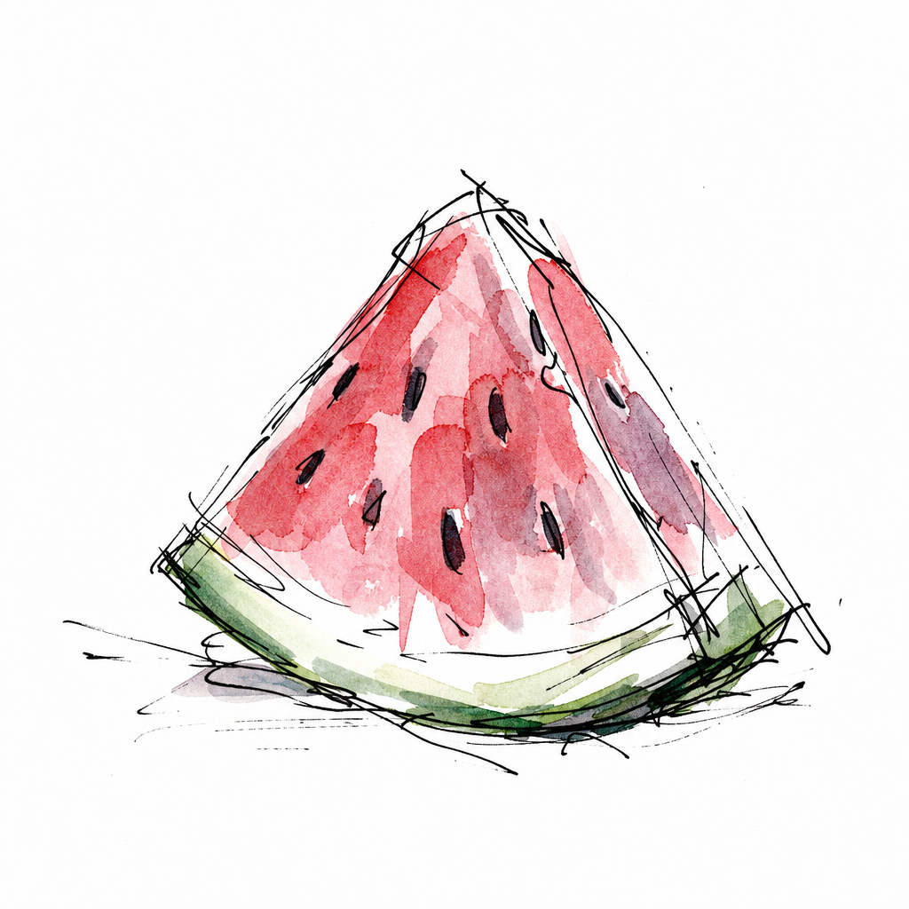
M A Y
2 0 2 7
SUN | MON | TUE | WED | THU | FRI | SAT
 |  |  |  |  |  | 1
2 | 3 | 4 | 5 | 6 | 7 | 8
9 | 10 | 11 | 12 | 13 | 14 | 15
16 | 17 | 18 | 19 | 20 | 21 | 22
23 | 24 | 25 | 26 | 27 | 28 | 29
30 | 31
Notes:
2027 calendar template. Page size: 11 × 16.5 inches. Insert a square image using the picture placeholder. Edit the italic caption or delete it. Month, year, dates, background and border are editable. Sunday-first dates are for 2027; changing the year alone does not update the dates. This flat page is artwork for layout, without photographed binding or wall. Confirm printer trim, bleed and binding specifications before production.

Slide 6

J U N E
2 0 2 7
SUN | MON | TUE | WED | THU | FRI | SAT
 |  | 1 | 2 | 3 | 4 | 5
6 | 7 | 8 | 9 | 10 | 11 | 12
13 | 14 | 15 | 16 | 17 | 18 | 19
20 | 21 | 22 | 23 | 24 | 25 | 26
27 | 28 | 29 | 30
Notes:
2027 calendar template. Page size: 11 × 16.5 inches. Insert a square image using the picture placeholder. Edit the italic caption or delete it. Month, year, dates, background and border are editable. Sunday-first dates are for 2027; changing the year alone does not update the dates. This flat page is artwork for layout, without photographed binding or wall. Confirm printer trim, bleed and binding specifications before production.

Slide 7

J U L Y
2 0 2 7
SUN | MON | TUE | WED | THU | FRI | SAT
 |  |  |  | 1 | 2 | 3
4 | 5 | 6 | 7 | 8 | 9 | 10
11 | 12 | 13 | 14 | 15 | 16 | 17
18 | 19 | 20 | 21 | 22 | 23 | 24
25 | 26 | 27 | 28 | 29 | 30 | 31
Notes:
2027 calendar template. Page size: 11 × 16.5 inches. Insert a square image using the picture placeholder. Edit the italic caption or delete it. Month, year, dates, background and border are editable. Sunday-first dates are for 2027; changing the year alone does not update the dates. This flat page is artwork for layout, without photographed binding or wall. Confirm printer trim, bleed and binding specifications before production.

Slide 8
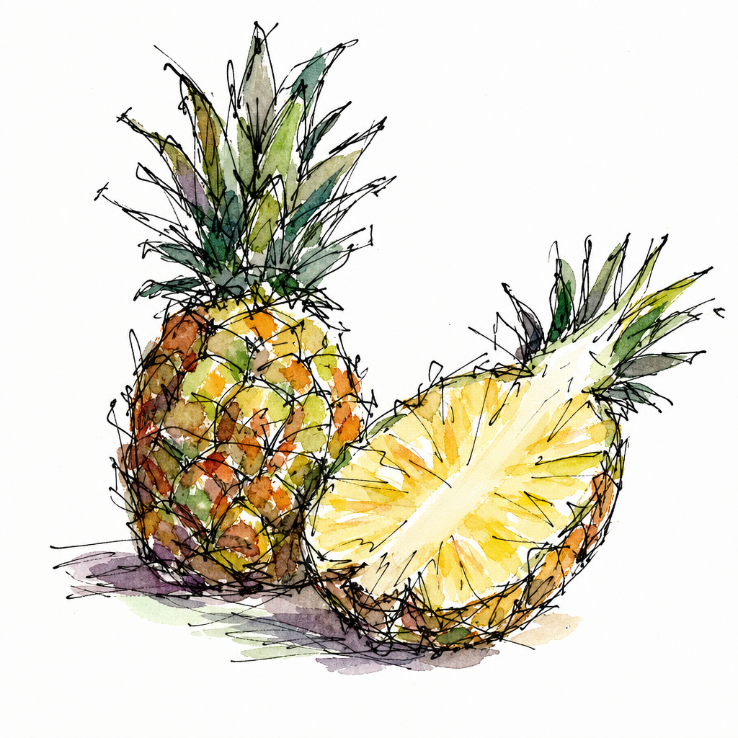
A U G U S T
2 0 2 7
SUN | MON | TUE | WED | THU | FRI | SAT
1 | 2 | 3 | 4 | 5 | 6 | 7
8 | 9 | 10 | 11 | 12 | 13 | 14
15 | 16 | 17 | 18 | 19 | 20 | 21
22 | 23 | 24 | 25 | 26 | 27 | 28
29 | 30 | 31
Notes:
2027 calendar template. Page size: 11 × 16.5 inches. Insert a square image using the picture placeholder. Edit the italic caption or delete it. Month, year, dates, background and border are editable. Sunday-first dates are for 2027; changing the year alone does not update the dates. This flat page is artwork for layout, without photographed binding or wall. Confirm printer trim, bleed and binding specifications before production.

Slide 9
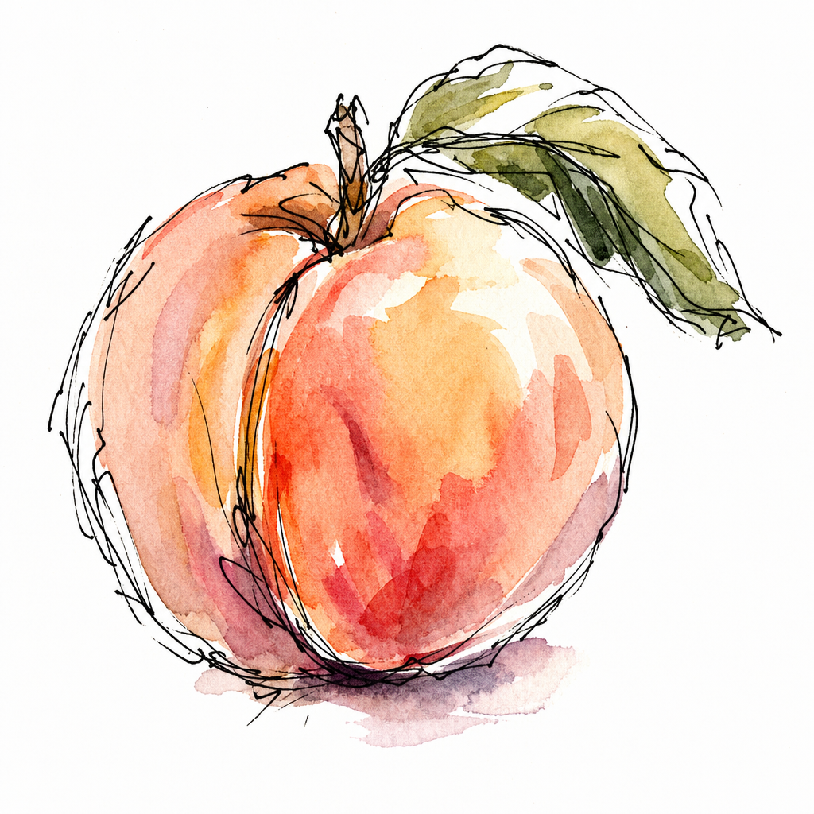
S E P T E M B E R
2 0 2 7
SUN | MON | TUE | WED | THU | FRI | SAT
 |  |  | 1 | 2 | 3 | 4
5 | 6 | 7 | 8 | 9 | 10 | 11
12 | 13 | 14 | 15 | 16 | 17 | 18
19 | 20 | 21 | 22 | 23 | 24 | 25
26 | 27 | 28 | 29 | 30
Notes:
2027 calendar template. Page size: 11 × 16.5 inches. Insert a square image using the picture placeholder. Edit the italic caption or delete it. Month, year, dates, background and border are editable. Sunday-first dates are for 2027; changing the year alone does not update the dates. This flat page is artwork for layout, without photographed binding or wall. Confirm printer trim, bleed and binding specifications before production.

Slide 10
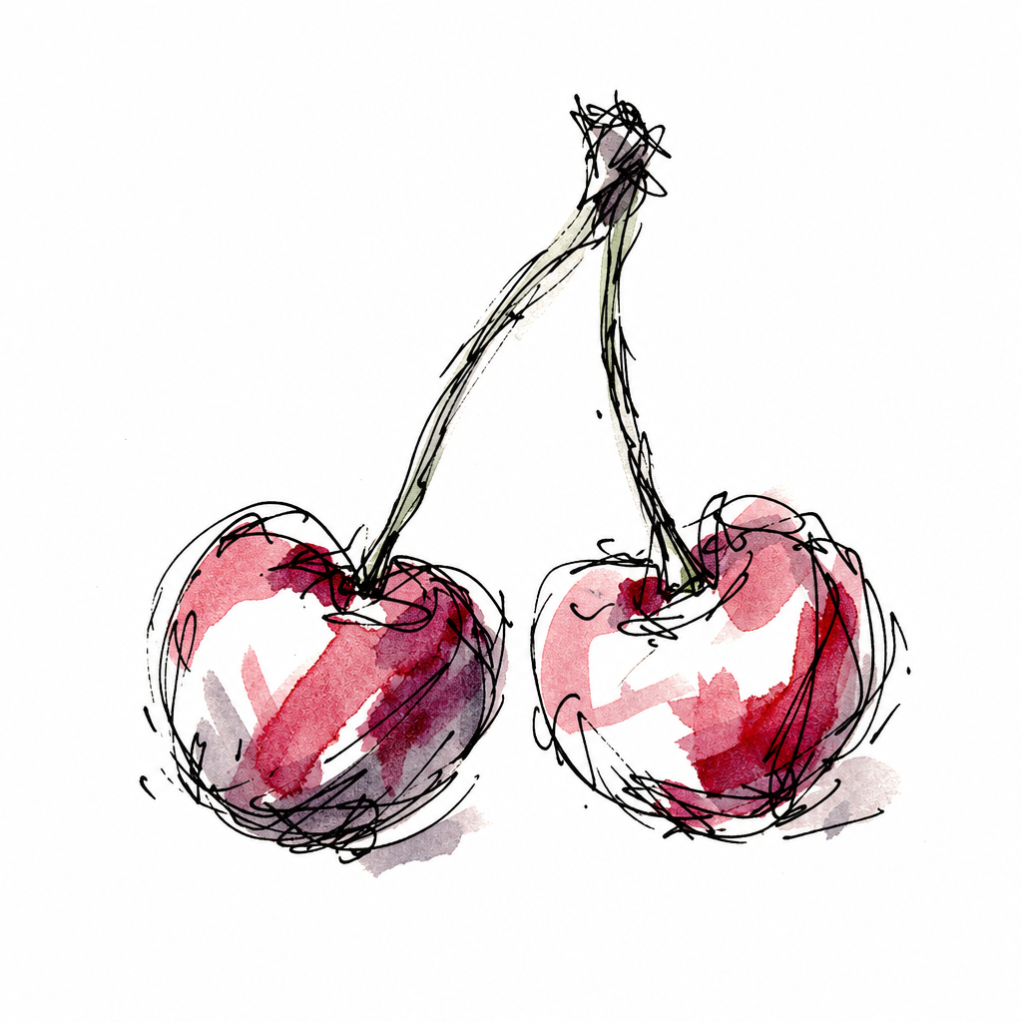
O C T O B E R
2 0 2 7
SUN | MON | TUE | WED | THU | FRI | SAT
 |  |  |  |  | 1 | 2
3 | 4 | 5 | 6 | 7 | 8 | 9
10 | 11 | 12 | 13 | 14 | 15 | 16
17 | 18 | 19 | 20 | 21 | 22 | 23
24 | 25 | 26 | 27 | 28 | 29 | 30
31
Notes:
2027 calendar template. Page size: 11 × 16.5 inches. Insert a square image using the picture placeholder. Edit the italic caption or delete it. Month, year, dates, background and border are editable. Sunday-first dates are for 2027; changing the year alone does not update the dates. This flat page is artwork for layout, without photographed binding or wall. Confirm printer trim, bleed and binding specifications before production.

Slide 11

N O V E M B E R
2 0 2 7
SUN | MON | TUE | WED | THU | FRI | SAT
 | 1 | 2 | 3 | 4 | 5 | 6
7 | 8 | 9 | 10 | 11 | 12 | 13
14 | 15 | 16 | 17 | 18 | 19 | 20
21 | 22 | 23 | 24 | 25 | 26 | 27
28 | 29 | 30
Notes:
2027 calendar template. Page size: 11 × 16.5 inches. Insert a square image using the picture placeholder. Edit the italic caption or delete it. Month, year, dates, background and border are editable. Sunday-first dates are for 2027; changing the year alone does not update the dates. This flat page is artwork for layout, without photographed binding or wall. Confirm printer trim, bleed and binding specifications before production.

Slide 12
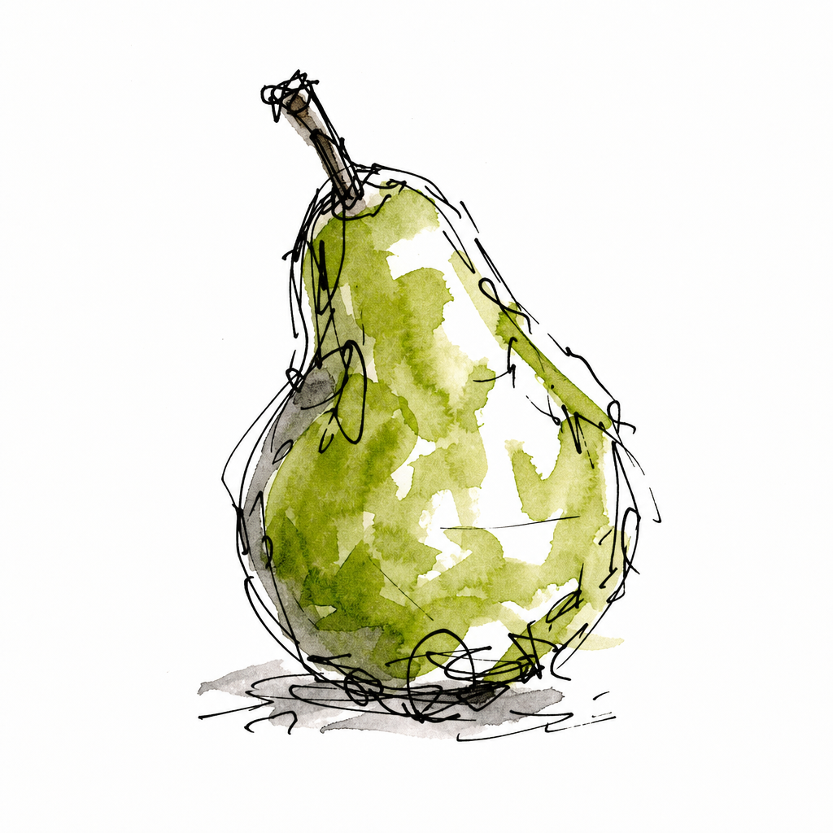
D E C E M B E R
2 0 2 7
SUN | MON | TUE | WED | THU | FRI | SAT
 |  |  | 1 | 2 | 3 | 4
5 | 6 | 7 | 8 | 9 | 10 | 11
12 | 13 | 14 | 15 | 16 | 17 | 18
19 | 20 | 21 | 22 | 23 | 24 | 25
26 | 27 | 28 | 29 | 30 | 31
Notes:
2027 calendar template. Page size: 11 × 16.5 inches. Insert a square image using the picture placeholder. Edit the italic caption or delete it. Month, year, dates, background and border are editable. Sunday-first dates are for 2027; changing the year alone does not update the dates. This flat page is artwork for layout, without photographed binding or wall. Confirm printer trim, bleed and binding specifications before production.

