Slide 1
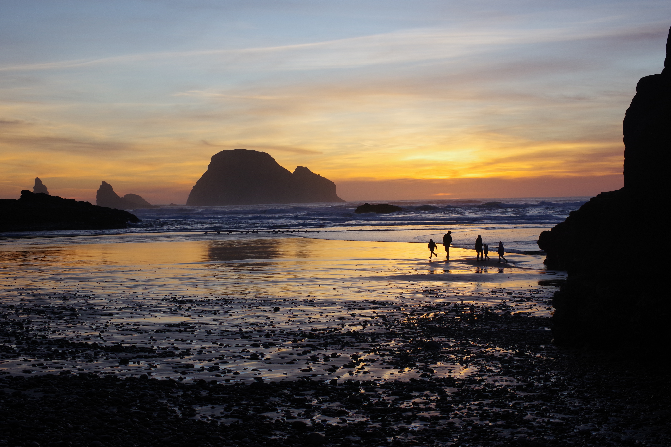
Nature adventures with open source
CC-BY 4.0 Sage Sharp
(except noted images)
Mastodon: @sphakos@toot.cat
iNaturalist: tidaltraveler

Slide 2

Oregon coast is unceded
Native American land
Tribes of the Oregon coast:
  Alsea
  Clatsop
  Coos, Lower Umpqua, and Siuslaw
  Nehalem
  Tillamook
  Tribes of the Grande Ronde
  Siletz
  Umatilla
  Walla Walla
Donate to Native American Youth and Family Center (NAYA) of Portland, Oregon:
https://nayapdx.org/support-us/donate-now/

Slide 3
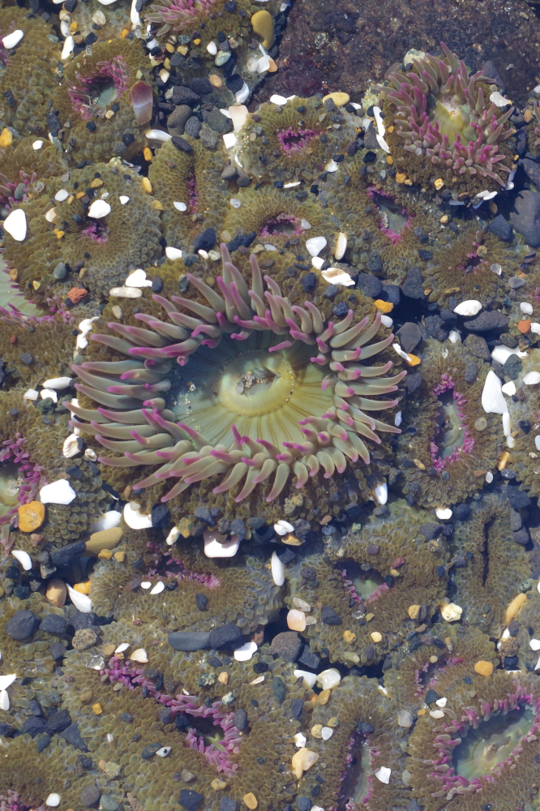
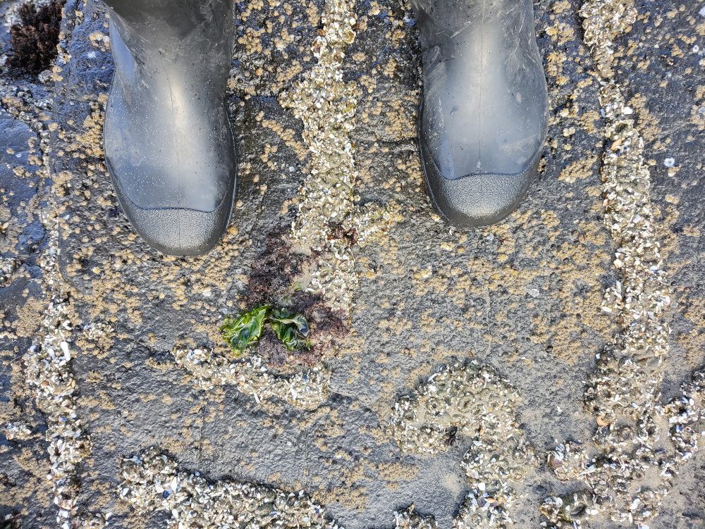
Respect for tide pools
Walk on bare sand or bare rock
Know tide times
Do not touch creatures
Leave rocks and shells
Take your garbage

Slide 4
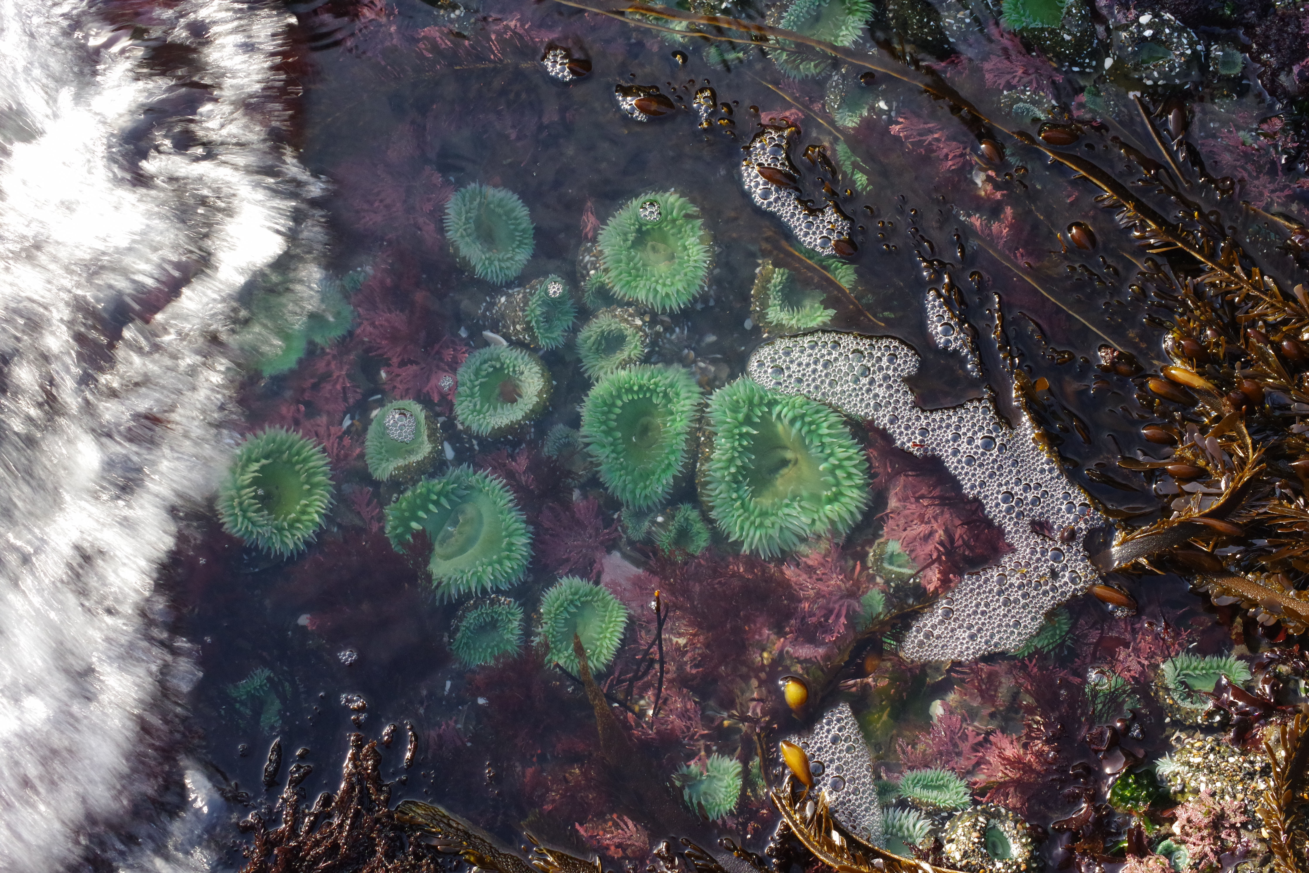
Talk topics
Where are tide pools?
When should I go?
Where can I find creatures?
How do I get good pictures?

Slide 5
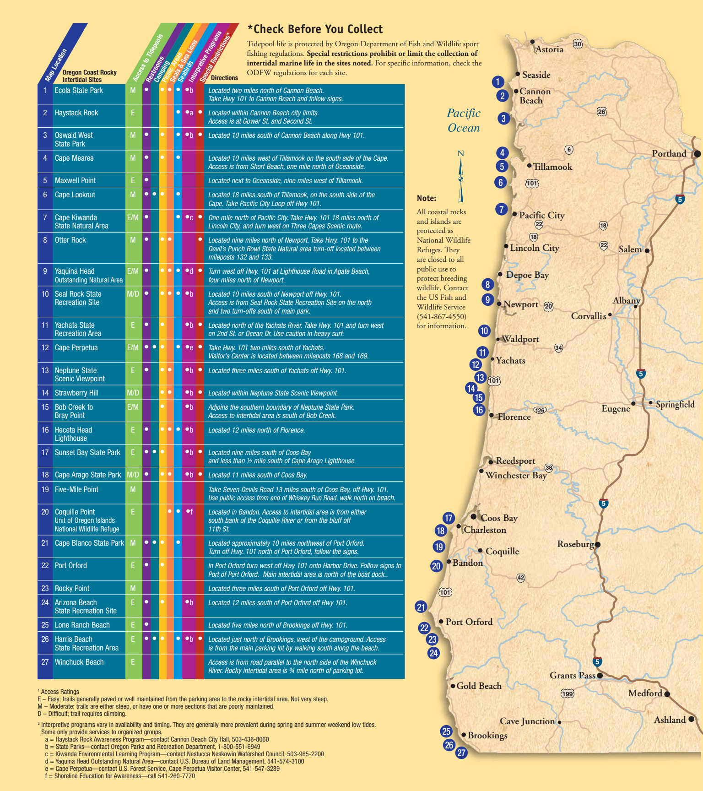

Where are tide pools?
2015 Oregon State Parks brouchure
"Tide pools are alive"
Proprietary PDF:
https://stateparks.oregon.gov/index.cfm?do=main.loadFile&load=_siteFiles/publications/2015_Tidepools_Are_Alive.pdf

Slide 6
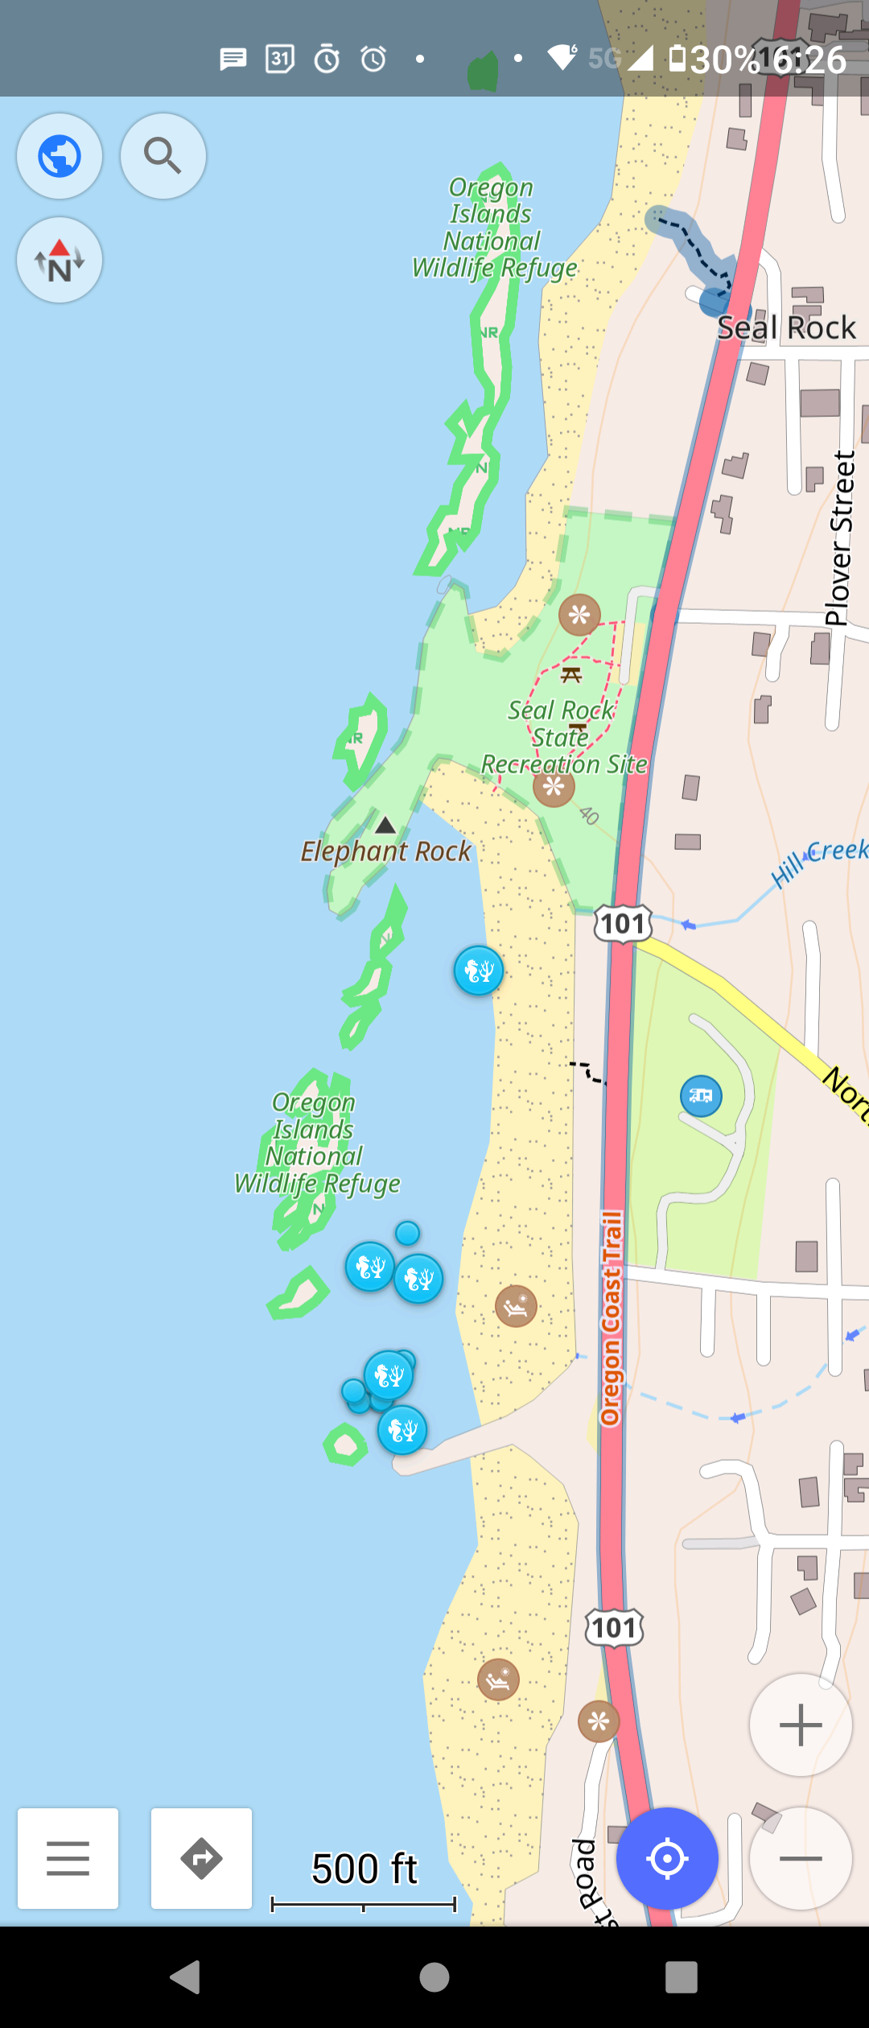
Open Street Map
OSMAnd (OSM Android app - through f-droid)
Hiking trails
Path type: paved, gravel, etc
Elevation changes
Public restrooms
Benches
Stairs

Slide 7
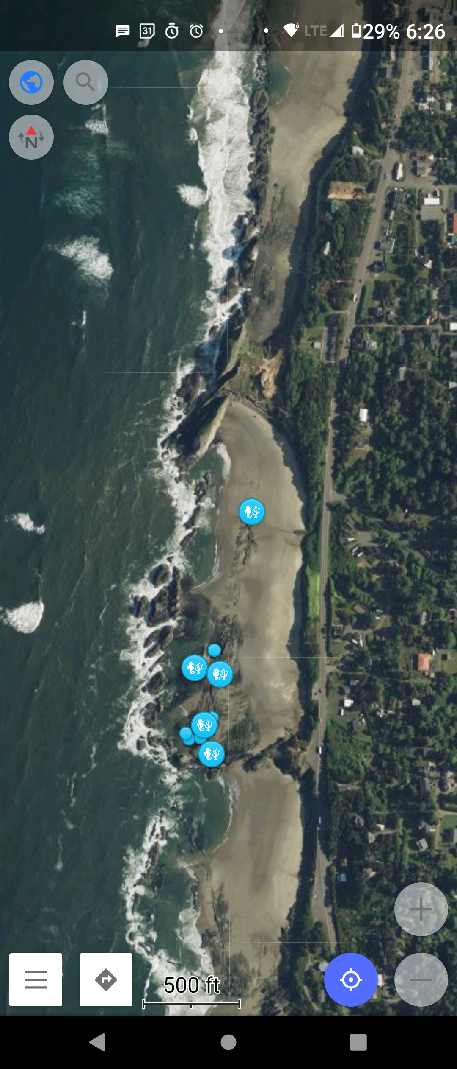
Open Street Map
Proprietary bits
Satellite imagery
  Microsoft Earth
  map overlay
Directions voice

Slide 8
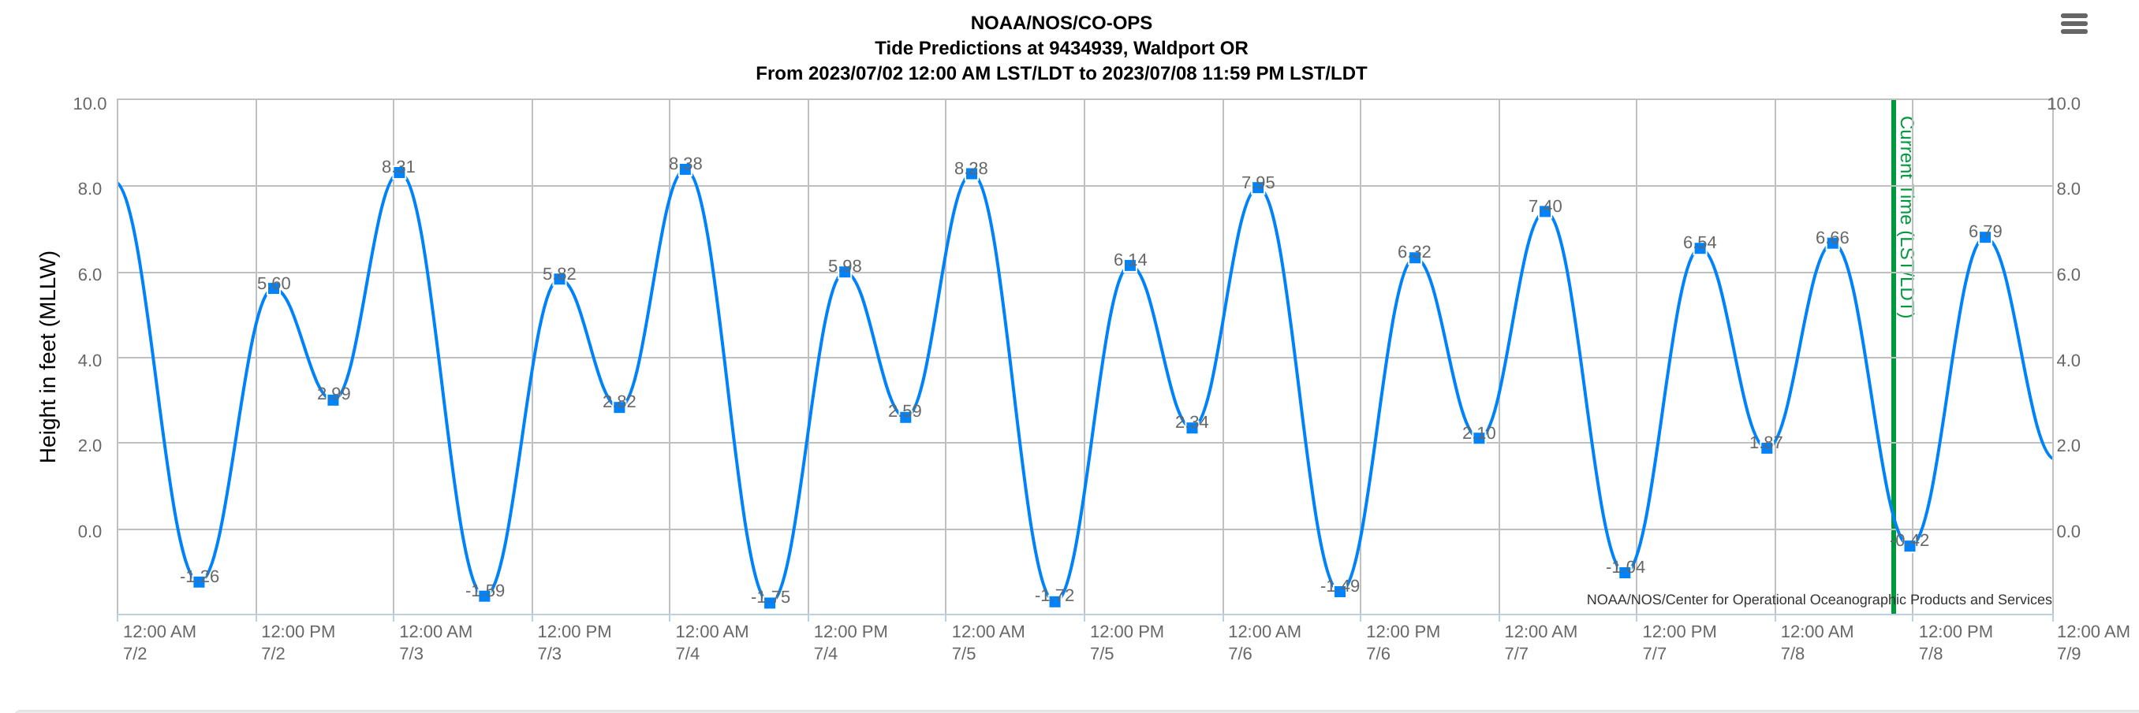
When should I go to the tide pools?
Tides caused by gravitational pull of sun and moon
Lowest tides at new moon and full moon
NOAA: https://tidesandcurrents.noaa.gov/tide_predictions.html
Arrive 2 hours before lowest tide

Slide 9
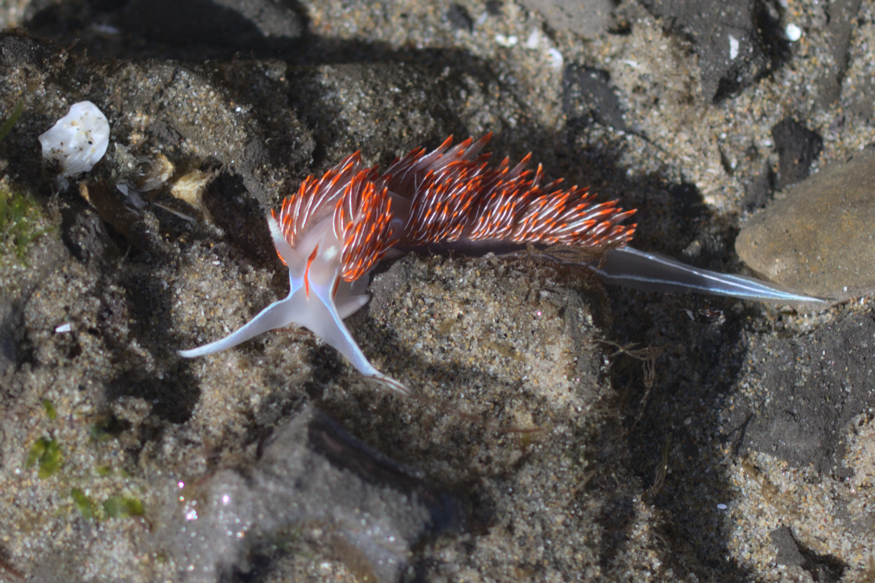
My first nudibranch sighting!
March 2022
Cannon Beach, Oregon, USA
Horned Nudibranch

Slide 10
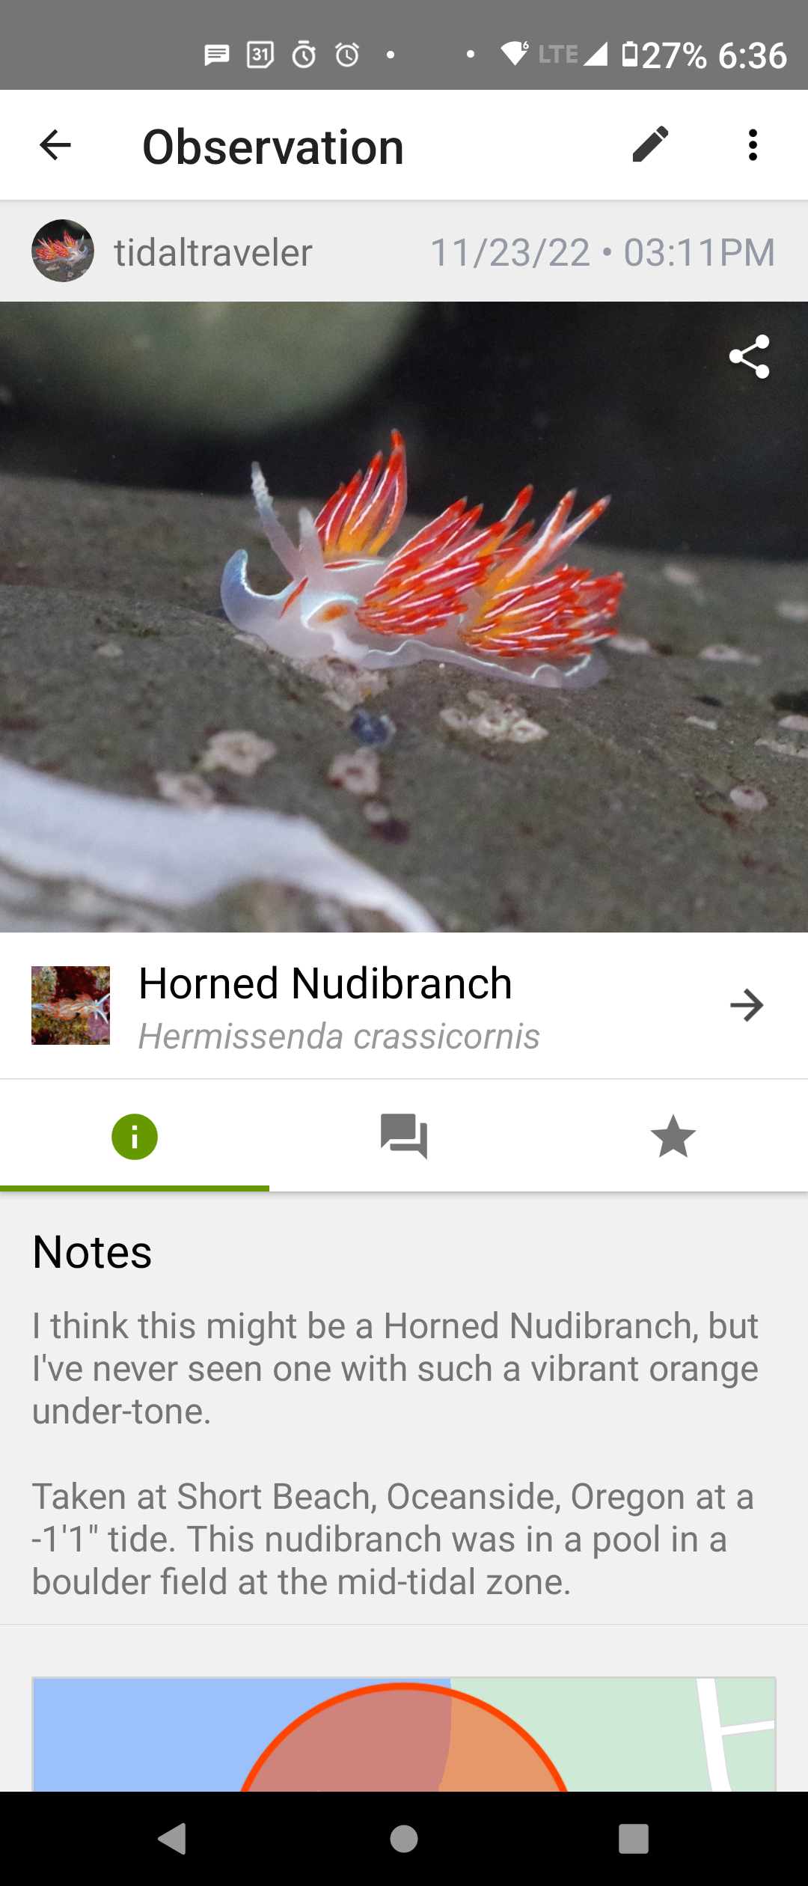
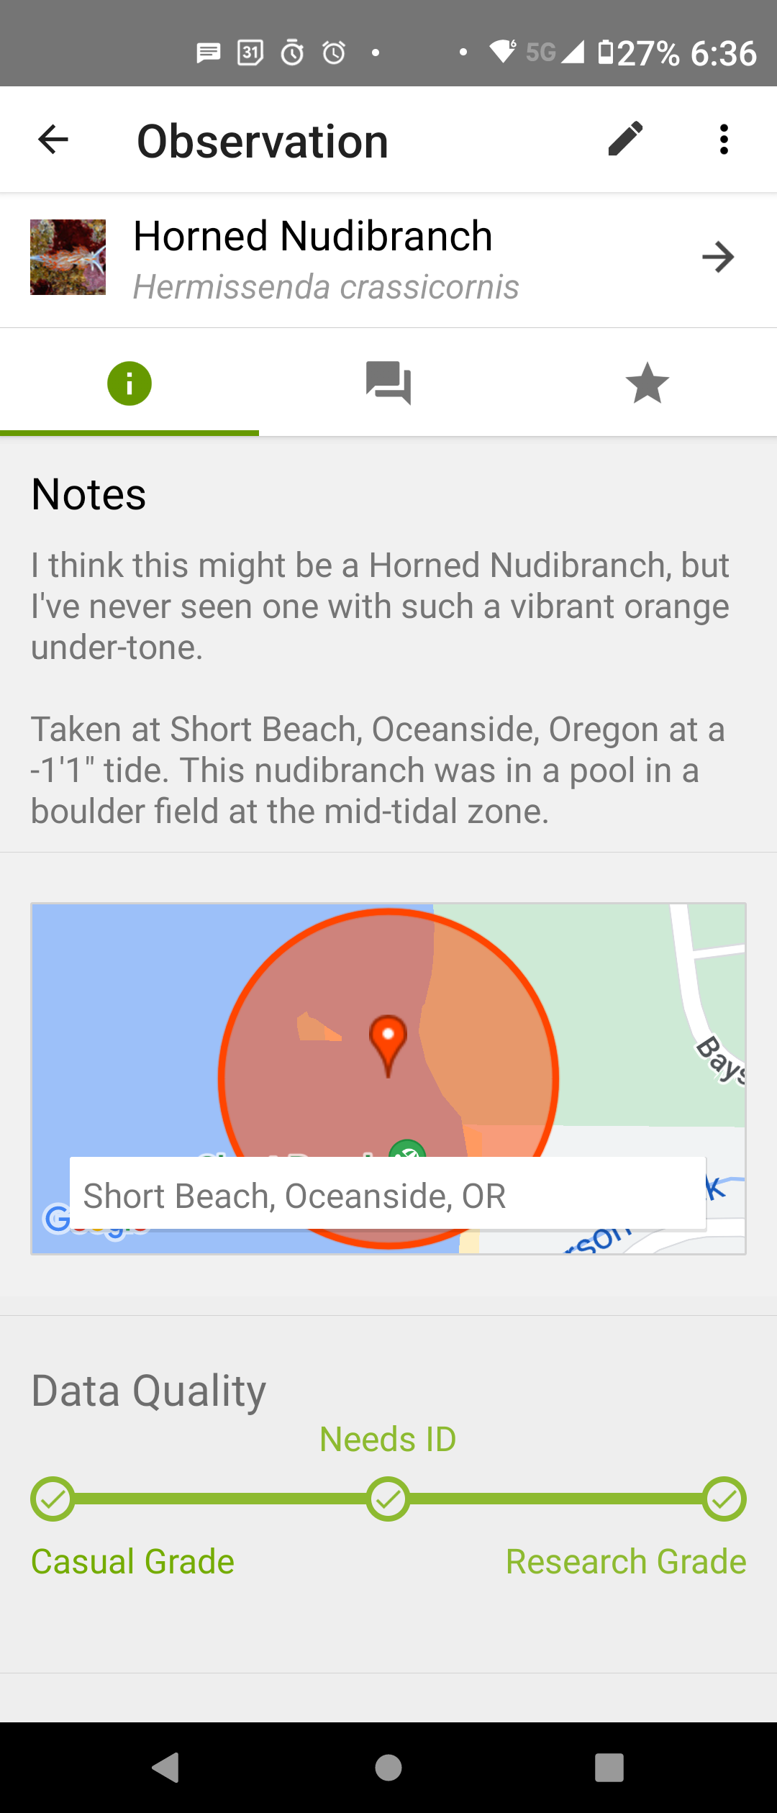
Where can I find a creature?
iNaturalist
Upload picture
  Location
  Date & Time

Slide 11
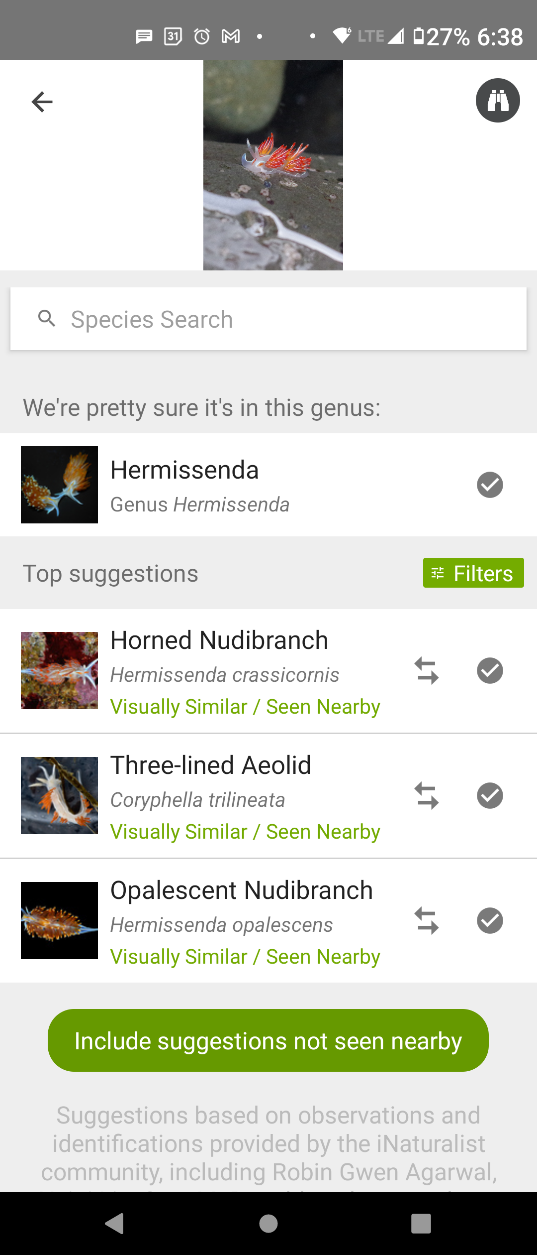
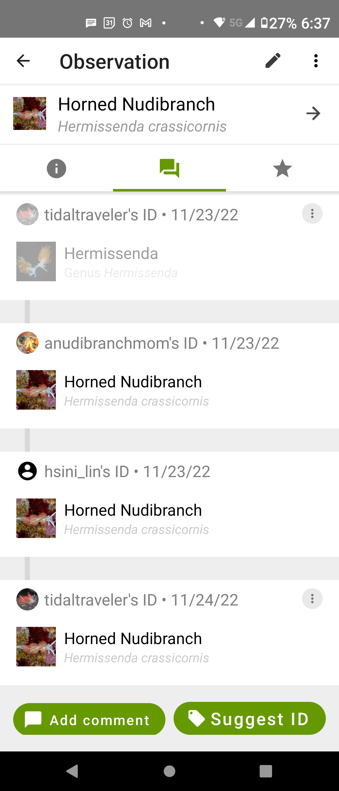
Where can I find a creature?
iNaturalist
Upload picture
  Location
  Date & Time
Image recognition
Community verifies identification

Slide 12
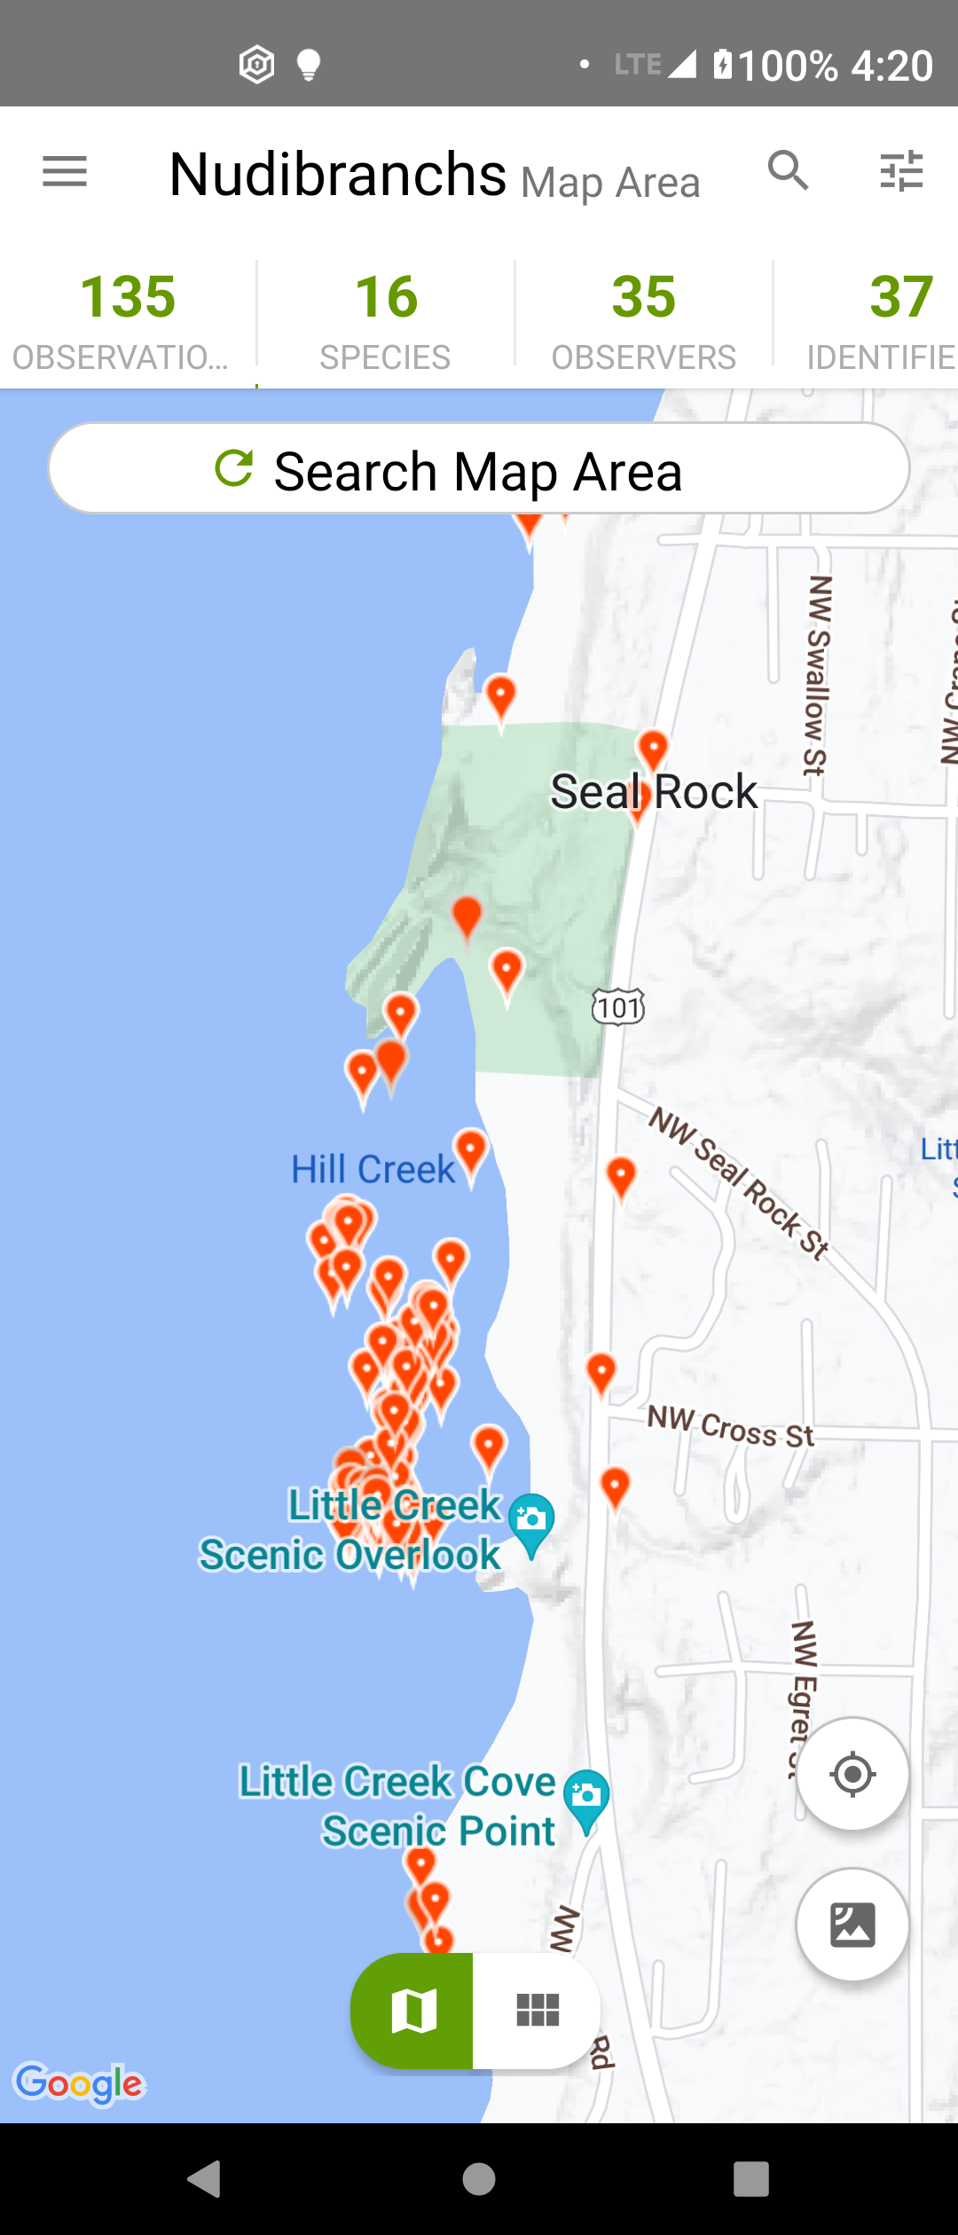
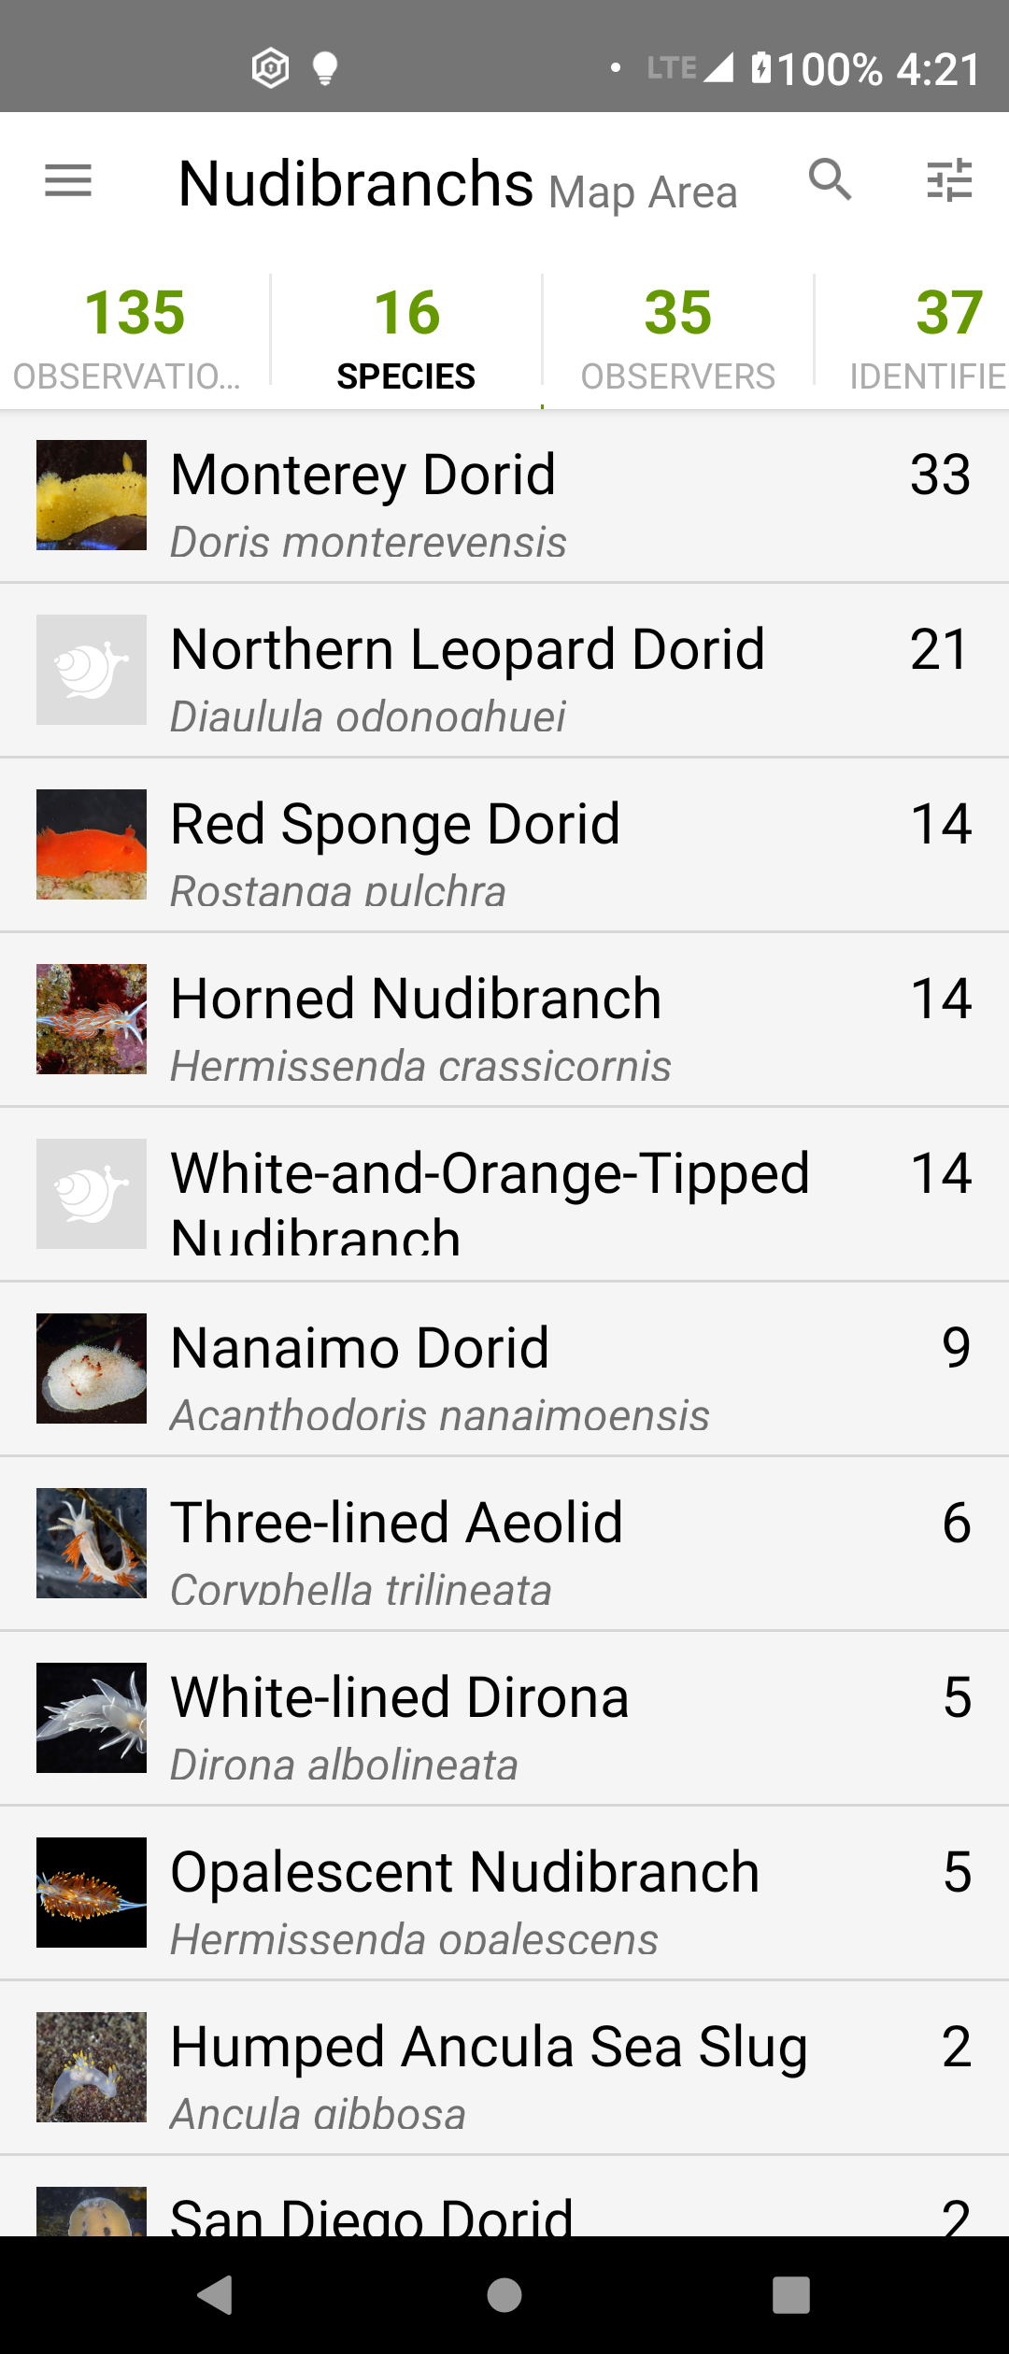
Where can I find a creature?
iNaturalist
  map search

Slide 13
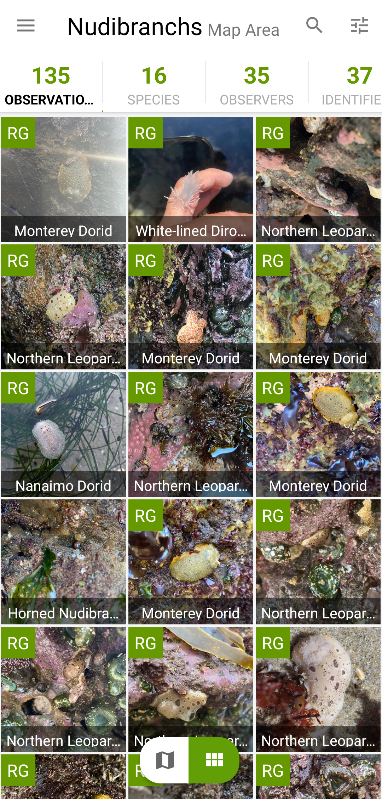
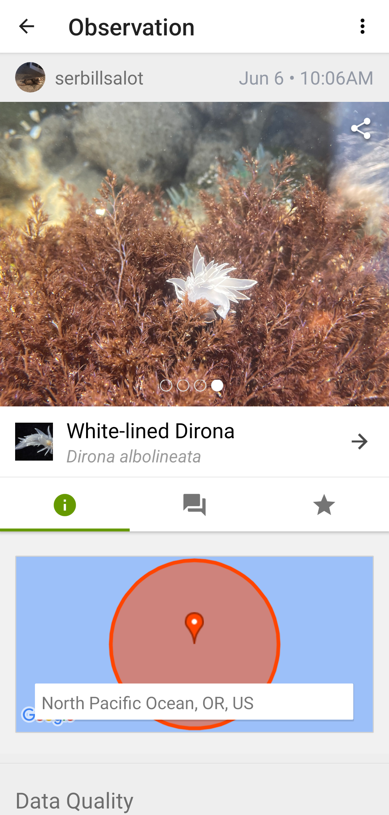
Where can I find a creature?
iNaturalist
  map search
  copy location
  screenshot photo

Slide 14
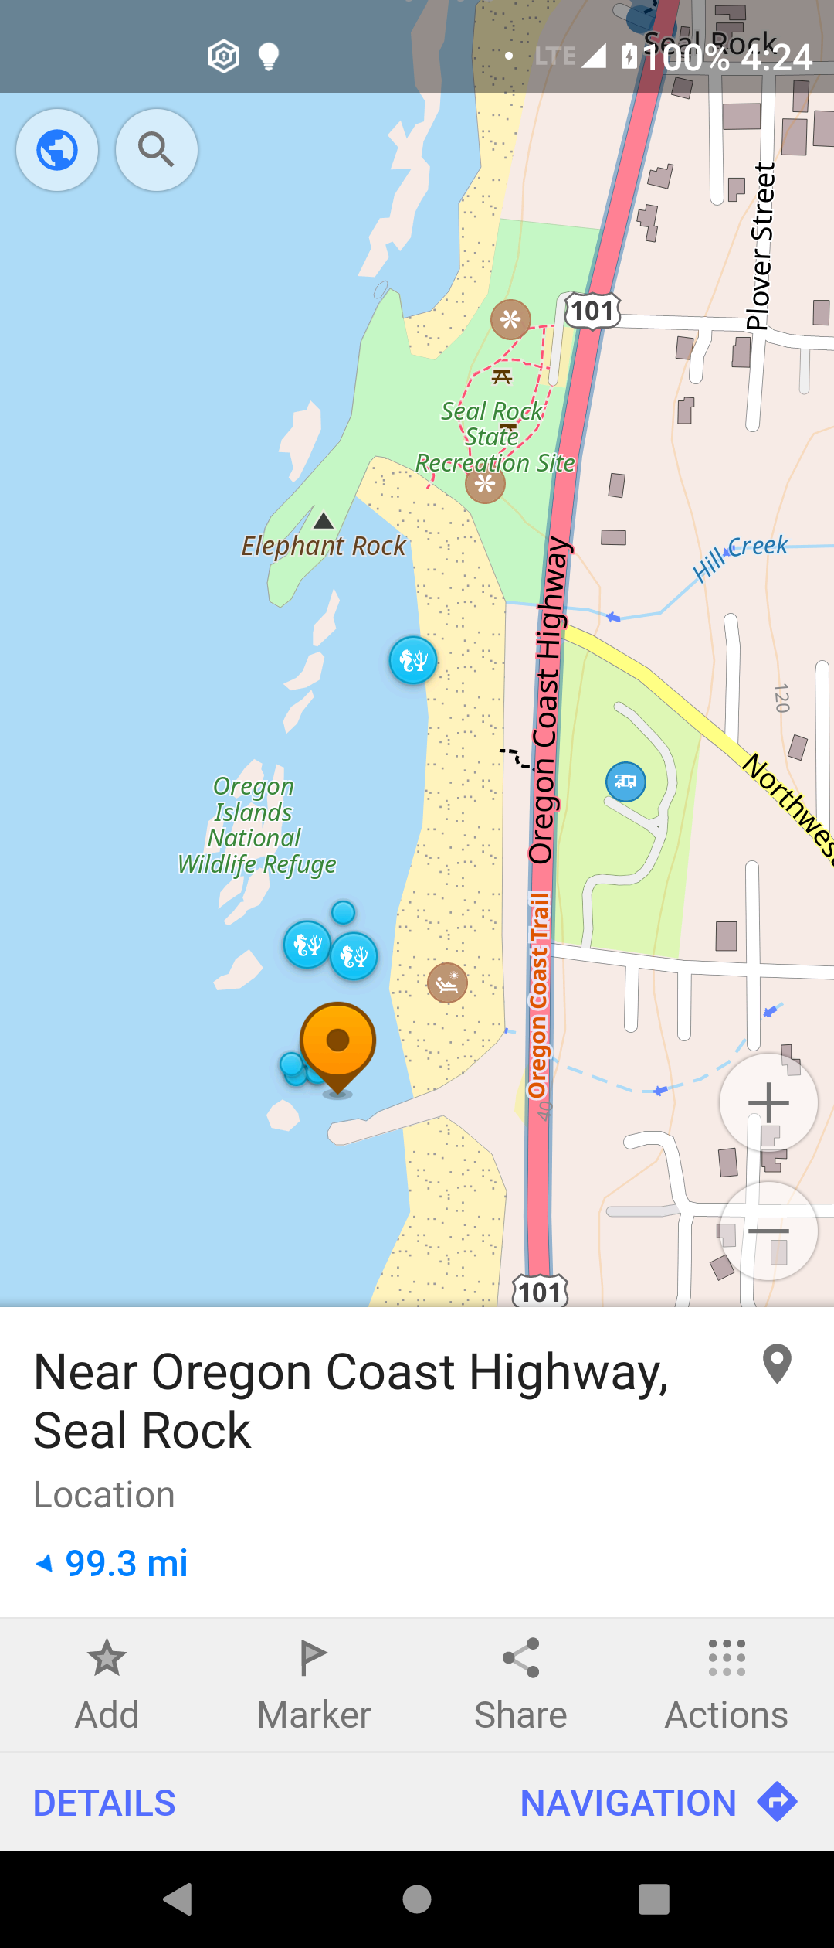
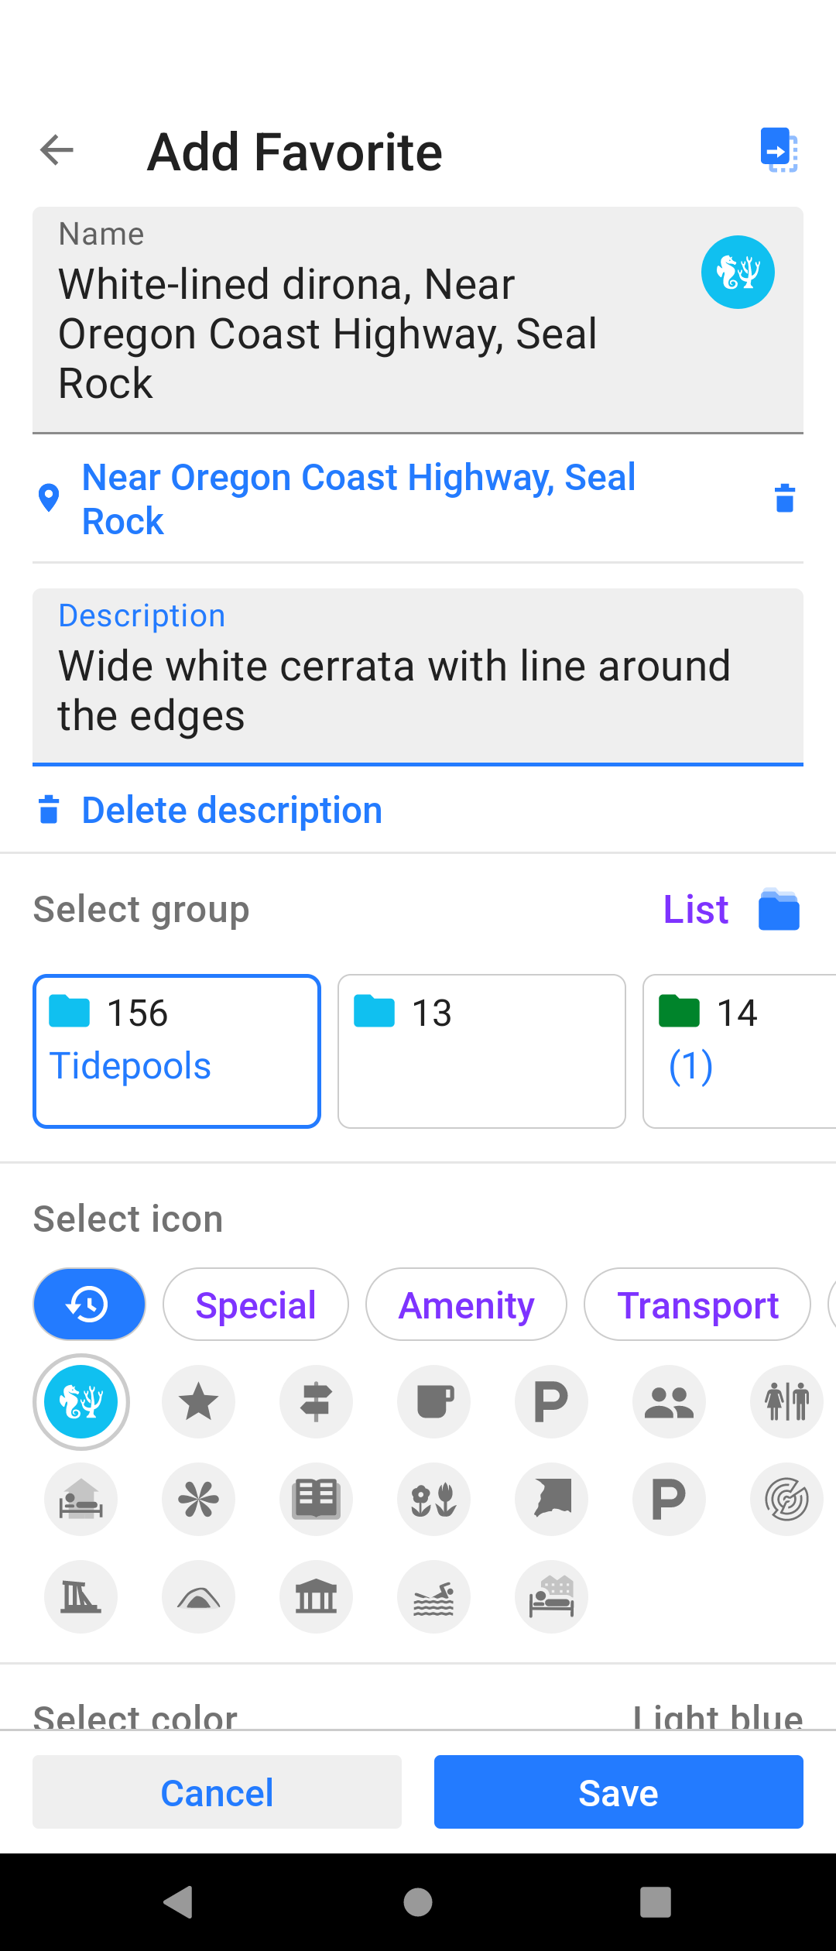
Where can I find a creature?
iNaturalist
  map search
  copy location
  screenshot photo
OSMAnd
  add favorite
  description

Slide 15
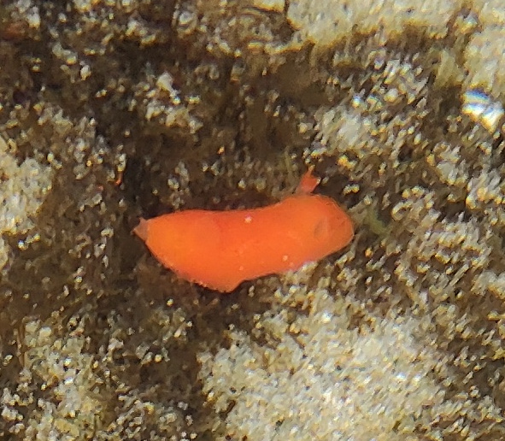
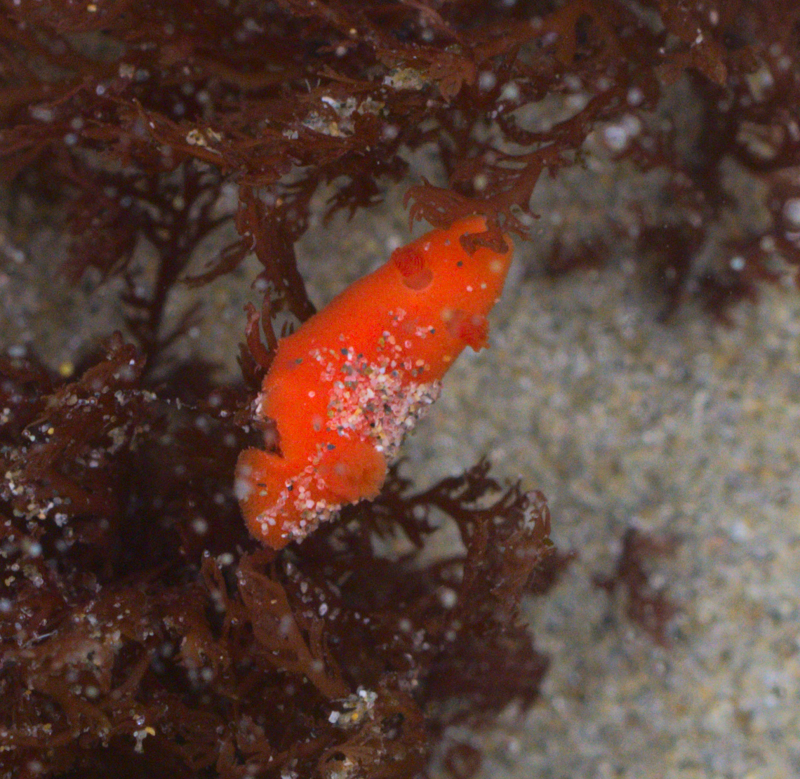
How to photograph?
The best camera is the one in your hand, but...
cell phone camera
DSLR camera

Slide 16
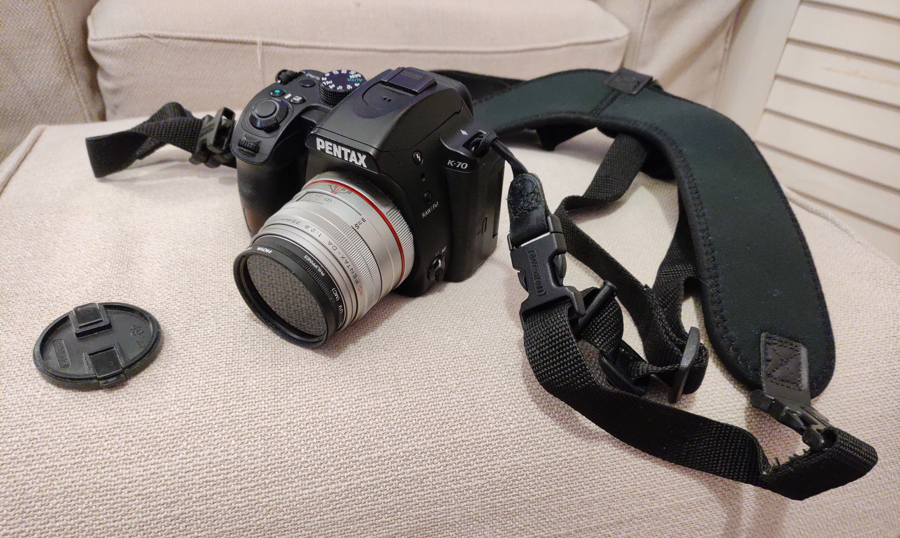
How to photograph?
Digital camera
  Pentax K-70
High resolution
  24 megapixels
Macro lens
  35mm
  5.52" minimum focus
Circular polarizing filter

Slide 17
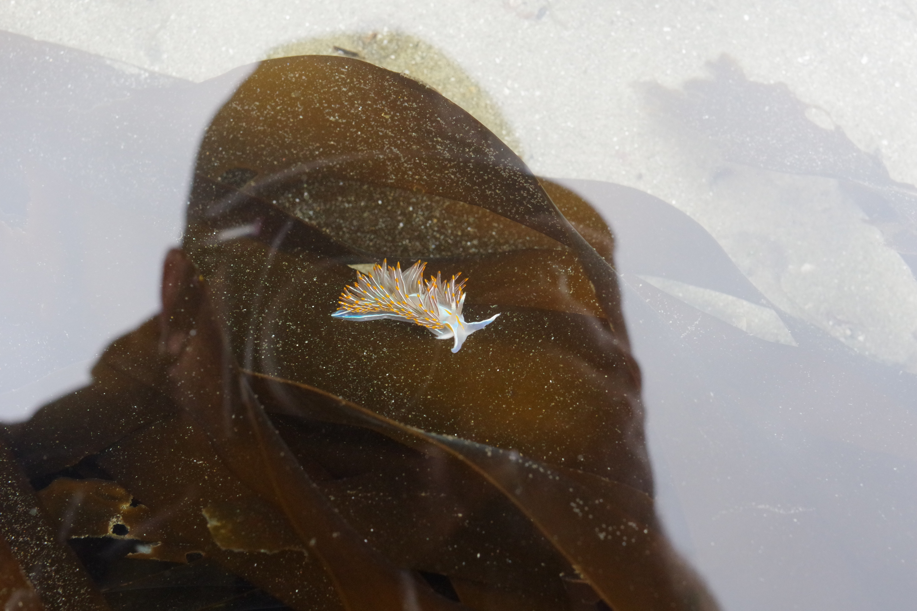
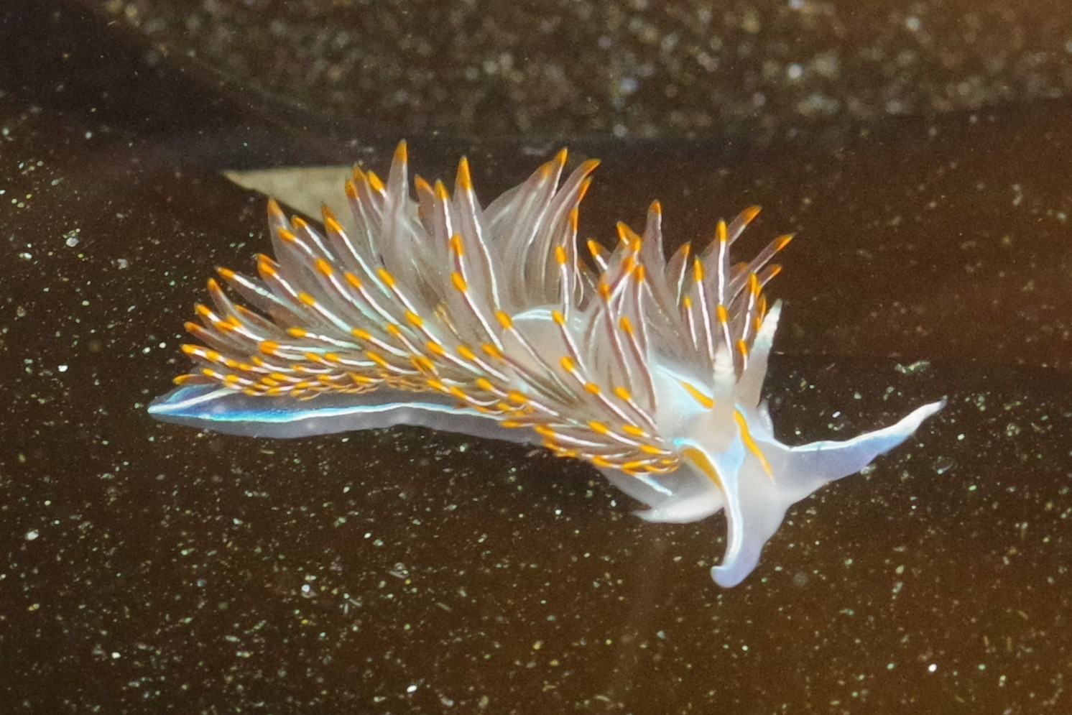
How to photograph?
Get close
Take a LOT of pictures
Photo back and front

Slide 18
How to photograph?
Darktable
  rate, sort, tag
  crop and rotate
  contrast, brightness, saturation
  export
  editing history is saved
  remove steps in the history stack
  save a set of edits to a custom "pre-set"

Slide 19
Talk topics
Where are tide pools?
When should I go?
Where can I find creatures?
How do I get good pictures?

Slide 20

Questions?
Contact:
  Email: sage@thesharps.us
  Mastodon: @sphakos@toot.cat
  iNaturalist: tidaltraveler
Resources list:
  https://sage.thesharps.us/2023/07/08/nature-adventures-with-open-source/

