Slide 1
Code of Conduct
Incident Response Training
CC NC-BY-SA
Otter Tech LLC
sharp@otter.technology

Slide 2
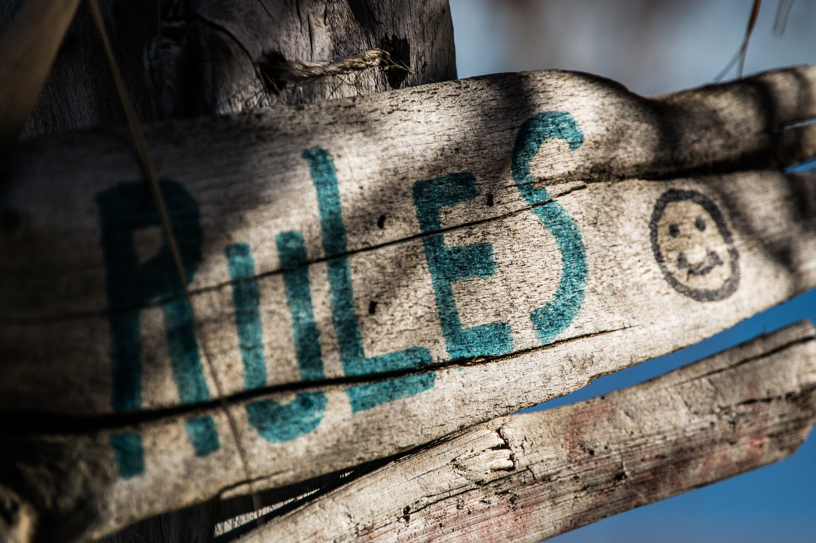
Workshop Ground Rules
This is a safe(r) space
If you are asked to stop, you will stop
You may leave at any time
Be open to new knowledge
Acknowledge different lived experiences
CC BY Steve Johnson

Slide 3
Agenda
Content warnings for practice scenarios
Reporter emotions & taking a report
Practice: Taking an incident report
Group report evaluation
Practice: following up with a reported person
Practice round 2!

Slide 4
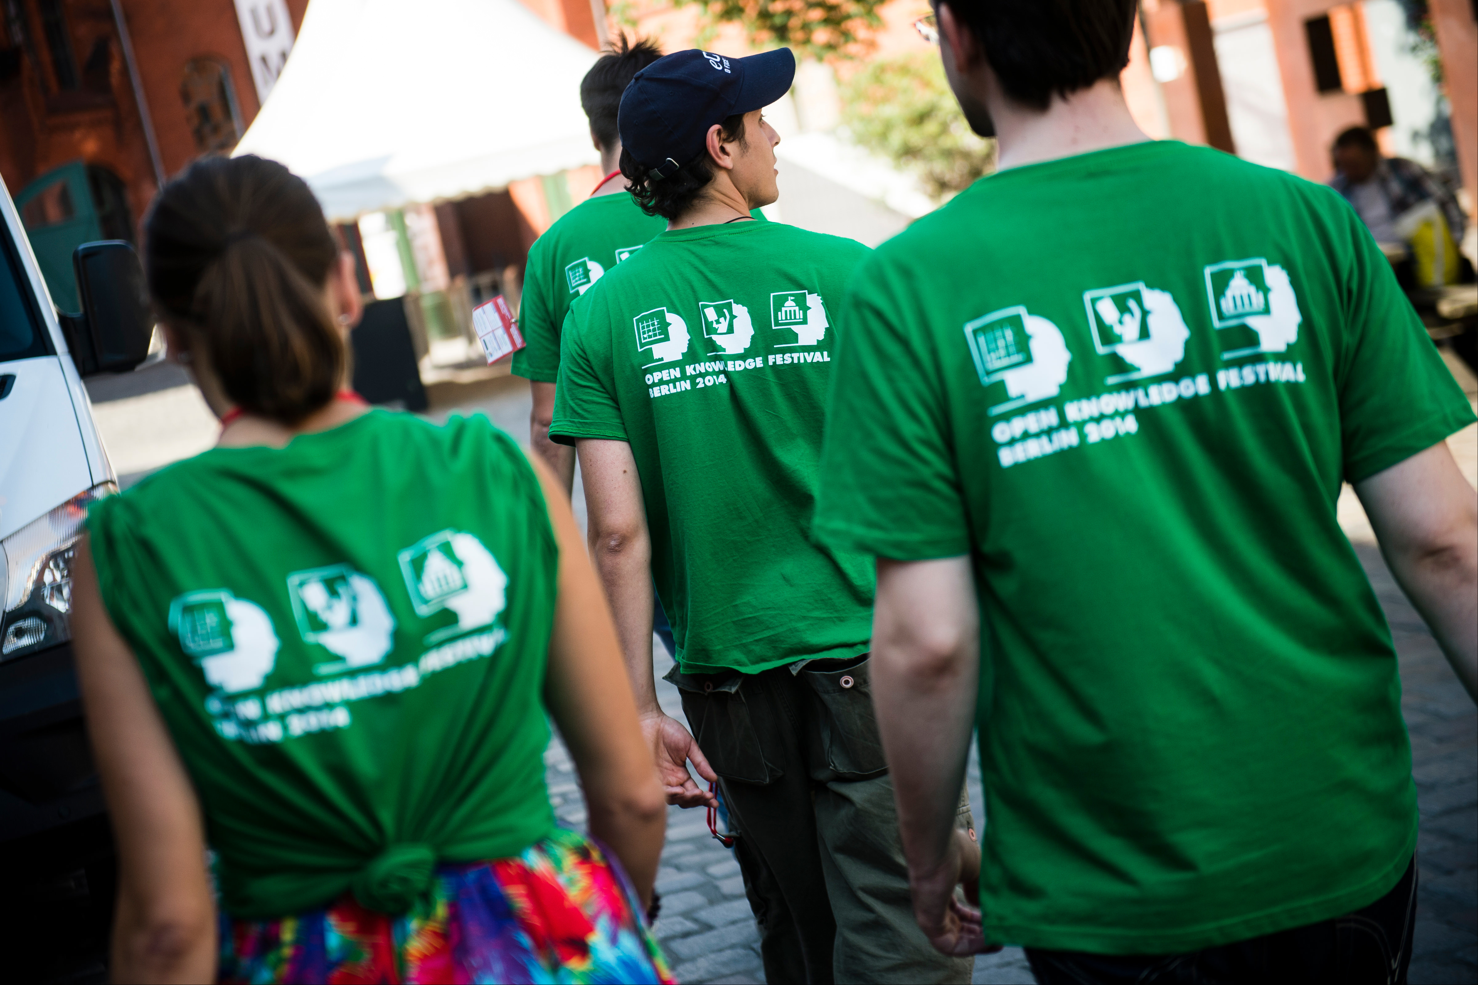
Incident Responder
Duties
Takes incident reports
Protects reporter privacy
Assesses the situation
Finds additional help
Resolves the incident
Responds to those impacted
Documents the incident
CC BY Open Knowledge

Slide 5
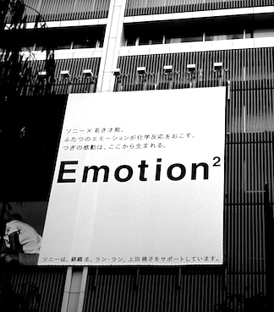
Common Reporter
Emotions
Repeating themselves
Becoming flustered
Talking fast
Mistrust
Judgment words
Anger
Emotion CC BY 2.0 Osamu Kaneko

Slide 6
Acknowledging Reporter
Emotions
"You felt (emotion) when (behavior)."
Example: "You felt scared when they raised their voice."
Softening the directness:
  "So you felt..."
  "It sounds like you felt..."
  "I'm hearing that you felt..."
"Nonviolent communication"
by Marshall B. Rosenberg, PhD

Slide 7
Taking an Incident Report:
LASER
Before: Ask if they want to go to a quiet, private place
(or encourage them to use private message/video chat)
Listen and summarize
Acknowledge emotions with "You" statements
Seek assistance or resources as needed
Ensure everyone is safe
Report or Respond to the incident
After: Get contact info. Evaluate reporter privacy. Thank the reporter.

Slide 8
Instructor modeling
taking a report

Slide 9
Practice
Receiving Reports

Slide 10



Intent vs. Impact
Intent
behavior

Slide 11

Intent is Not Magic
Action or inaction has impact
Good intent still causes harm
Harm causes strong emotions
Goal: Stop the behavior
Ensure reported people
understand their impact
Allow reporters to
express their emotions
CC BY Fabricio Zuardi
(modified)

Slide 12
Evaluating Risk
 | Low Risk | High Risk
Low Impact | Inappropriate behavior in private message | Repeated borderline incidents Pattern of verbal or emotional abuse
High Impact | Inappropriate behavior on a public channel | Sexual harassment Stalking Publishing private information (doxxing)

Slide 13
Deciding Response
 | Low Risk | High Risk
Low Impact | Issue warning | Monitor and document patterns of behavior, warn or temporary ban, remove from leadership
High Impact | Reprimand, removal of offensive material Public response from moderators | Coordinated planning Additional resources Reach out to others

Slide 14
Before Speaking to a
Reported Person
Write down:
  Their behavior and impact
  A behavioral modification plan
  Consequences for their behavior (?)
What will happen if they don't agree to
modify their behavior?
Who can they appeal the decision to?
What changes will address systemic issues?

Slide 15
Common Reactions for
Reported People
Defensiveness
Denial
Blame shifting
Seeking reassurance
Self blame
Manipulation
Emotion CC BY 2.0 Osamu Kaneko

Slide 16
Following up with the reported person: BIRDS
Speak privately via direct message or video chat
State what their Behavior was without judgment words
State the Impact on the reporter or community
Allow the reported person to Respond
Don't reassure or allow the reporter to be contacted
Set a behavioral modification plan
Call them in. Offer to relay any apologies
Notes:
“Hi, can I speak with you privately?”
“That's not appropriate.”
“They asked you to stop.”
“This is a private venue.”

Slide 17
Practice:
Following up with
the Reported Person

Slide 18
Discussion

Slide 19
Following up after an incident
Try to privately talk to everyone impacted
May need a statement to the community, e.g.
  "Folks, as a reminder from the moderation team
  please avoid using the term 'guys' to refer to the whole community. The word 'guys' may make women and non-binary community members feel excluded. We need everyone's help to change our language and make our community more inclusive."

Slide 20
Back up

Slide 21
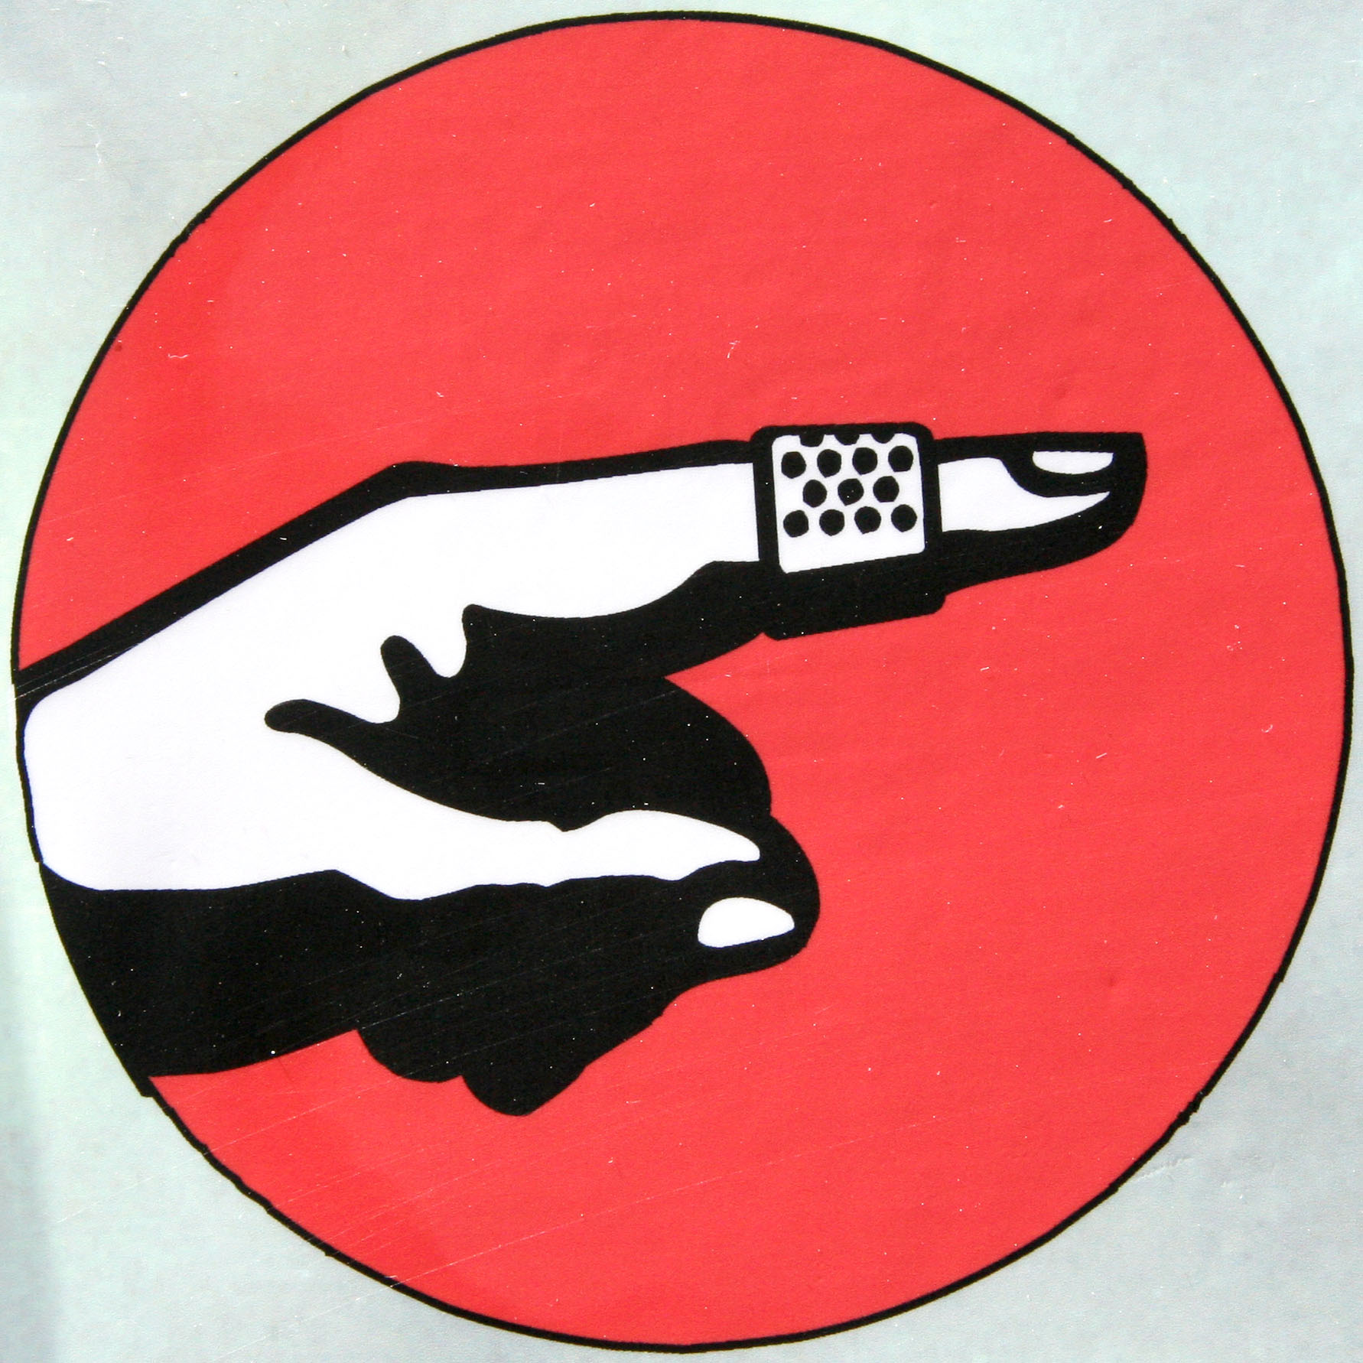
Microaggressions:
Constant Inequality
Harm caused because your identity
is not considered "the default"
  e.g. disability, race, gender
May happen daily
Invisible to the "default" identity
Death by 1,000 paper cuts
Under reported CoC violation
CC BY Andrew McGill

Slide 22
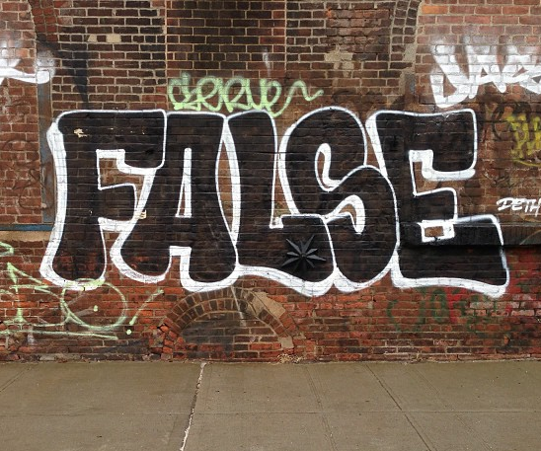
False Reporting:
Power Dynamics
What does a reporter
have to lose?
  Safety
  Mental health
  Career
  Financial support
What does the reported person
have to lose?
How likely is it the reporter will lose?
CC BY Adam Lehman

Slide 23
Review All Reports
Carefully
Microaggressions & sexual harassment
are under reported
Examine the power dynamics
Be cautious of when power
dynamic is reversed:
  "racism against white people"
  "sexist discrimination of men"
  other "reverse-isms"
CC BY Adam Lehman

Slide 24
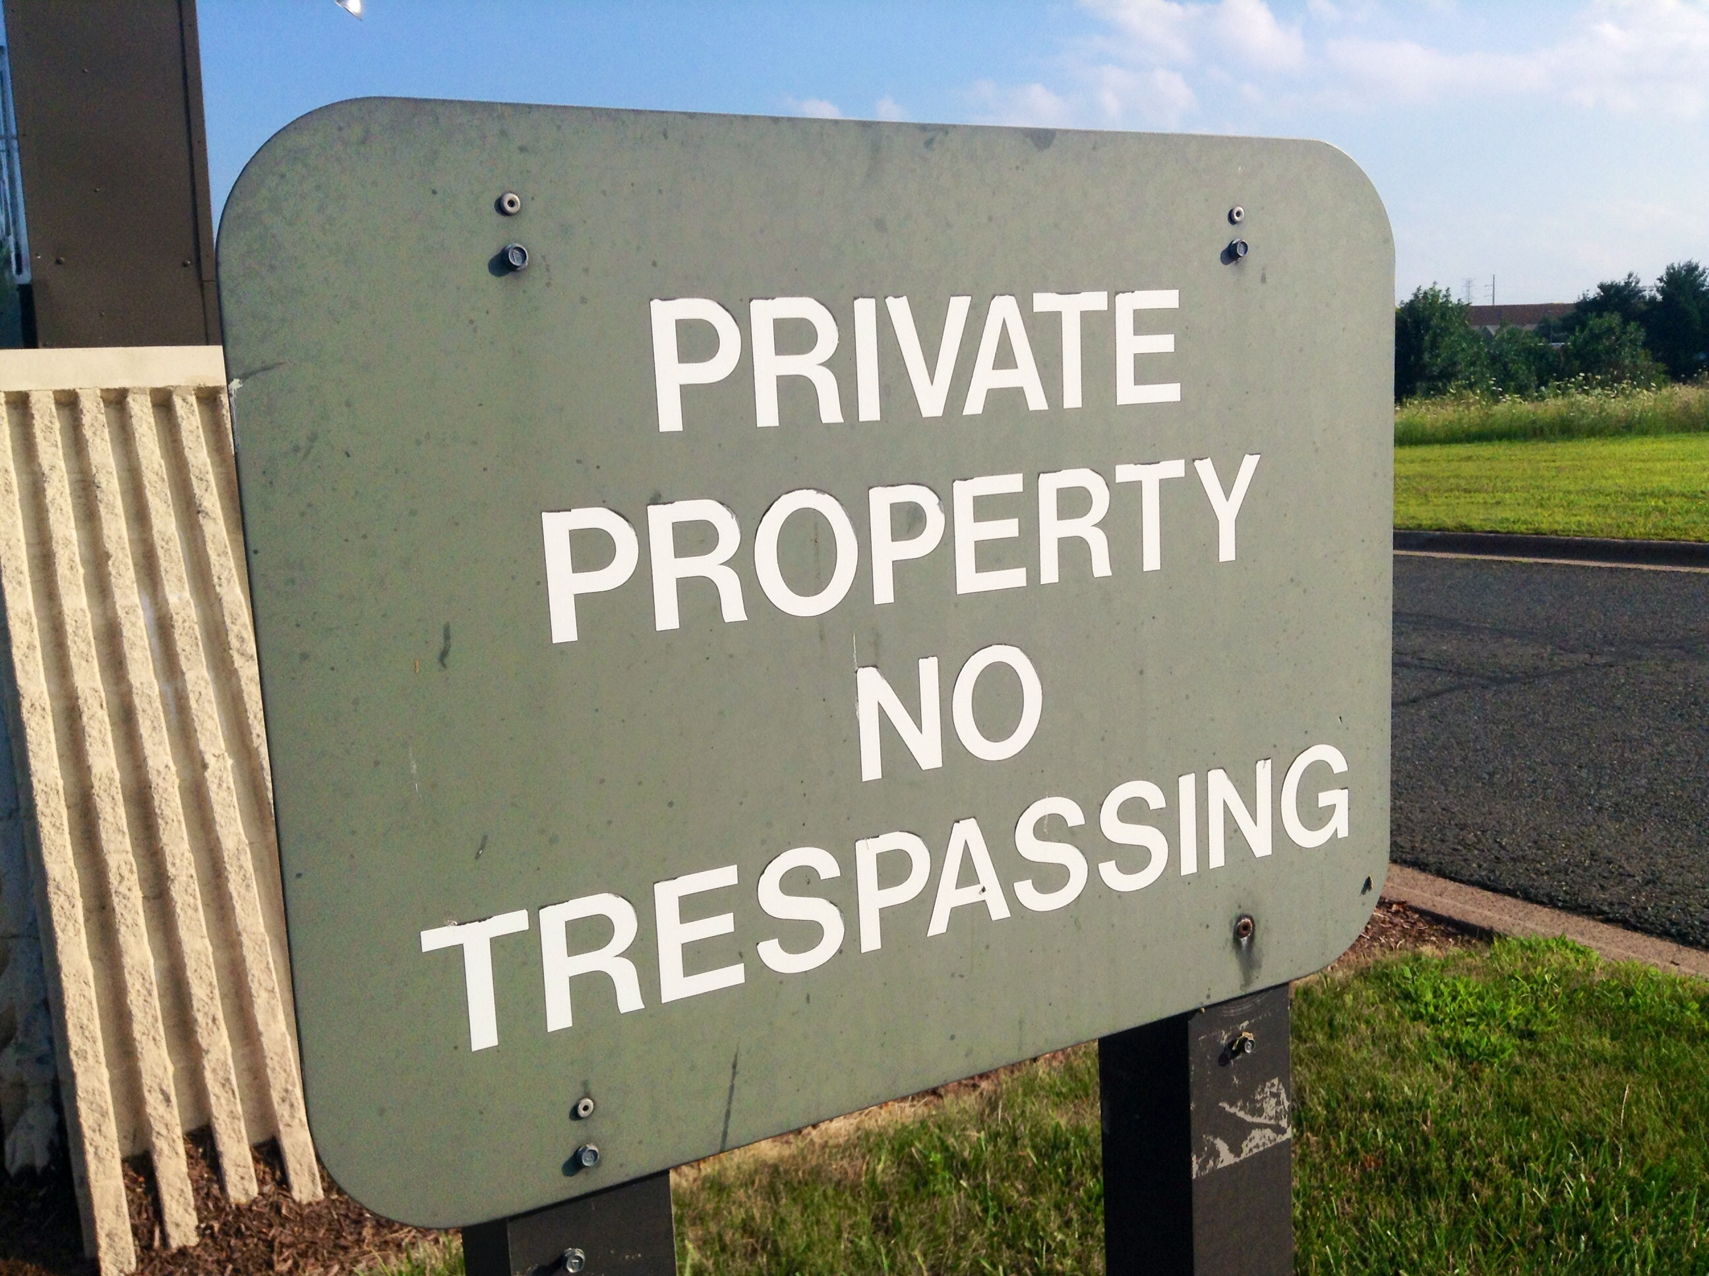
Dealing with
Unwelcome Attendees
“You aren’t permitted to attend the conference”
Don’t provide details
Ask them to leave
“This is a private venue”
Get onsite help
Report for trespassing
Know your local
trespassing laws
CC BY Mike Mozart

Slide 25
Dealing with
Weapons Policy Violations
“Weapons are not allowed at our conference”
Ask them to leave
Come back without the weapon
Do not argue, be firm
Ask staff, response team, security to help
If there is a safety risk, call 911

Slide 26
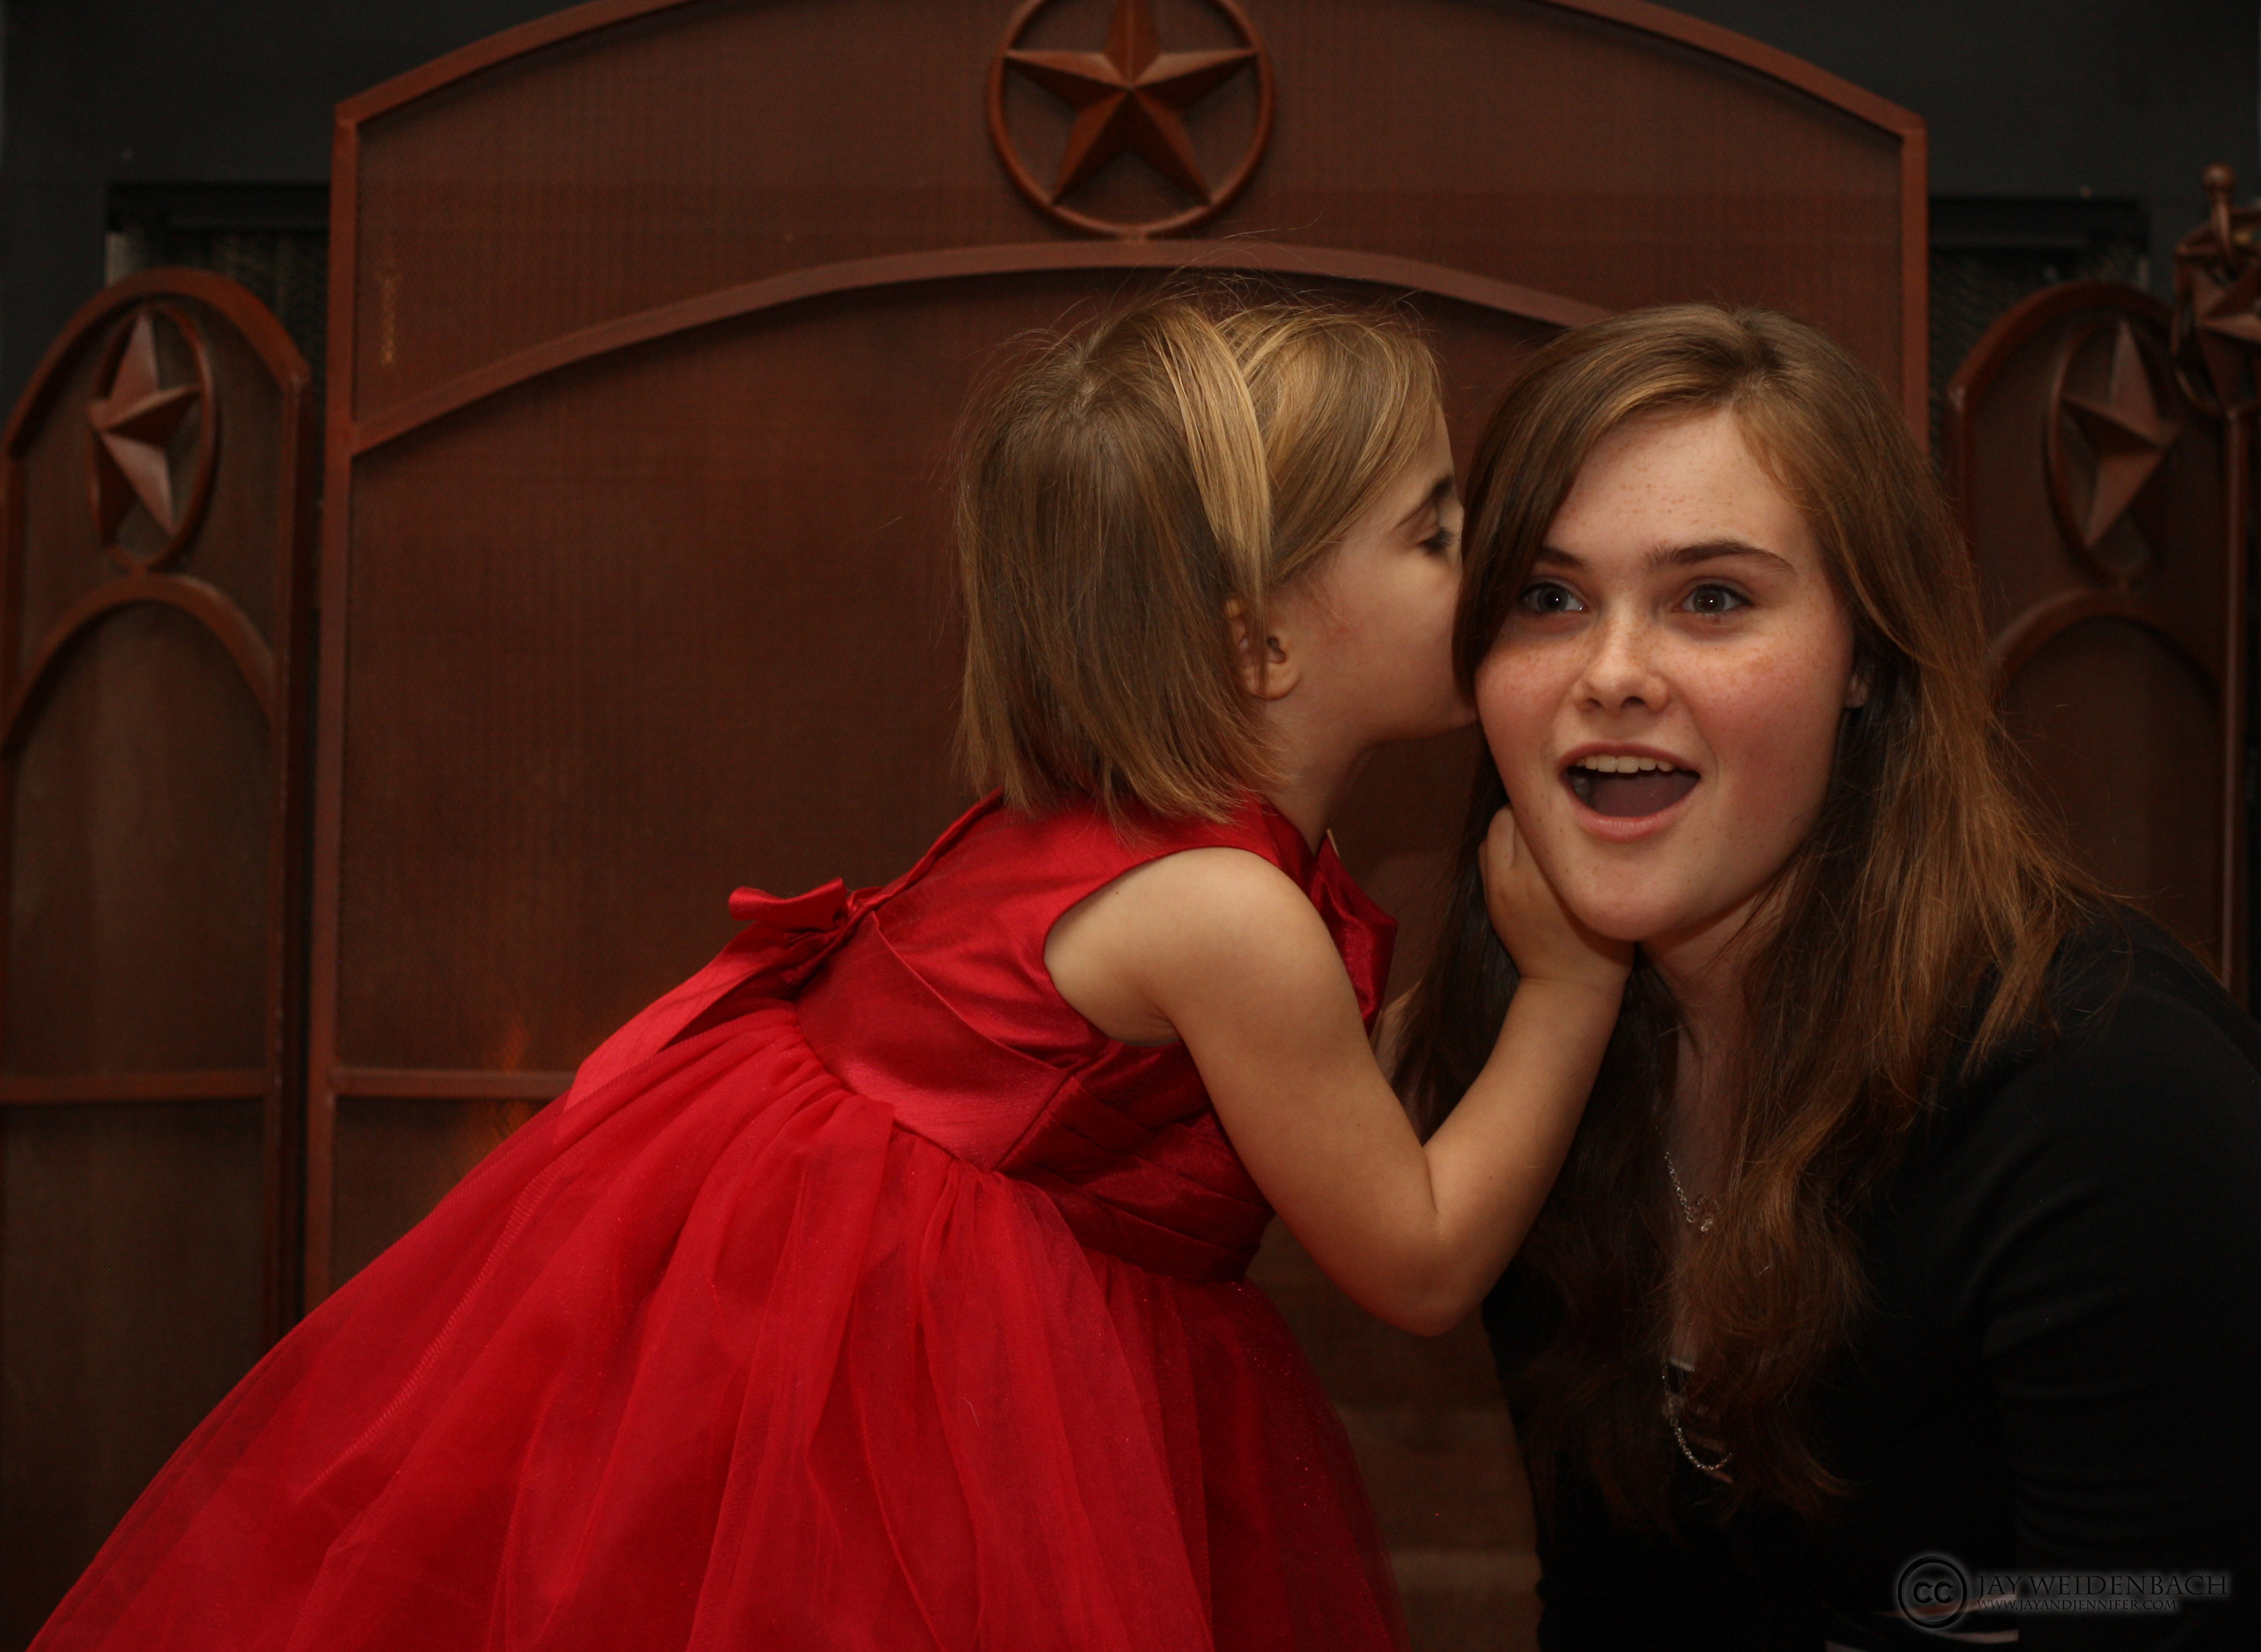
Conflicts of Interest
Is anyone a friend or coworker?
  conference staff or volunteers
  incident response team
  papers committee
  sponsors
Review leadership positions
for potential leaks:
  other incident responders
  volunteers & staff
  papers committee
  board members
CC BY Jay Weldenbach

Slide 27
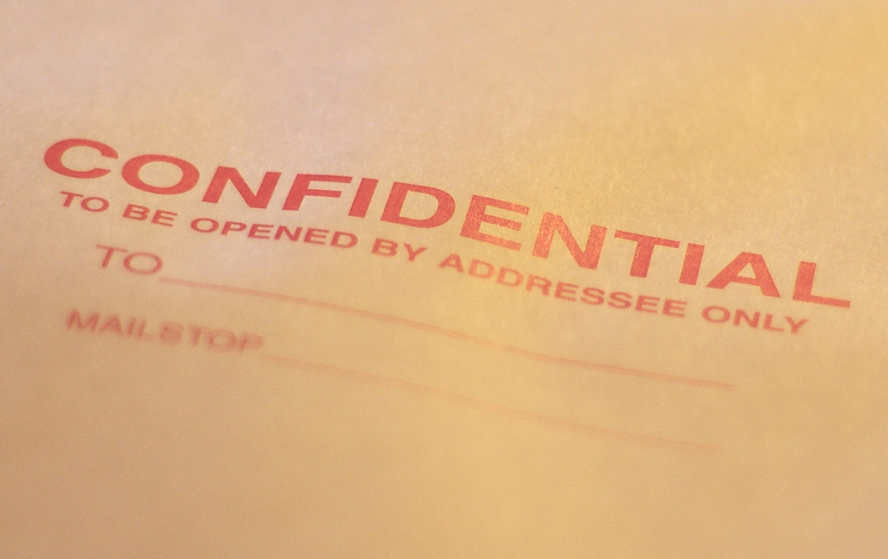
Confidentiality Issues
Reporter fears retaliation
NDAs & severance
Police Investigation
Limit incident docs access
Ask around (discretely)
Often multiple incidents
Other grounds to dismiss
CC BY Casey Marshall

Slide 28
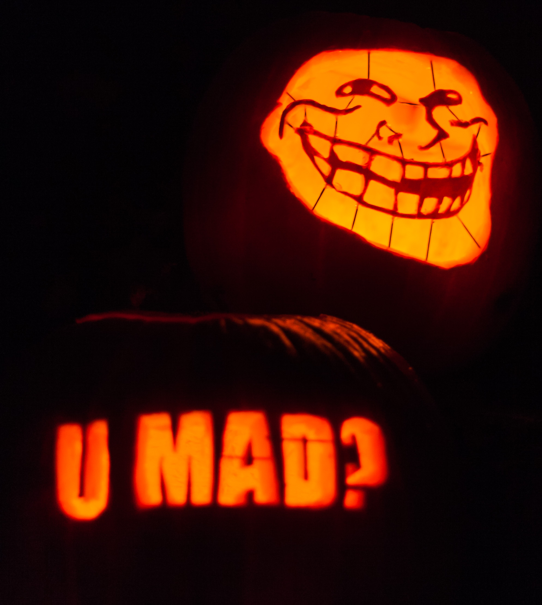
Known Harassers
Not just internet trolls
Stalkers do show up
Power plays & disruption
Have a mitigation plan
Strict confidentiality plan
Ensure attendee safety
CC BY Paul VanDerWerf

