Slide 1


FINAL PROJECT DEFENCE
Notes:
Good morning/afternoon. My project is InfraGuard AI — an agentic platform that uses large language models to help small DevOps teams triage infrastructure incidents faster, while keeping all consequential actions under human control. Let me walk you through the problem, design, implementation, and results.

Slide 2

DESIGN AND EVALUATION OF INFRAGUARD AI: A
GOVERNANCE-BY-DESIGN REFERENCE FRAMEWORK FOR
BOUNDED LLM-ASSISTED INCIDENT TRIAGE
PROJECT DEFENCE
Adebodun Samuel Tomola | 2025/A/MIT/0616
Supervisor: Dr. Emmanuel Mkpojiogu
Miva Open University | September 2026
Notes:
This is InfraGuard AI, my final project for the Master of Information Technology programme. The project addresses the challenge of infrastructure monitoring triage for small teams.

Slide 3
Introduction & Motivation
Final Project Defence
Small engineering teams monitor infrastructure through multiple disconnected tools (Prometheus, Loki, Docker, uptime probes)
Correlating metrics, logs, and events across tools is time-consuming and requires specialist knowledge
Result: slow triage, alert fatigue, and pressure to automate destructive actions unsafely
Goal: A self-hosted AI assistant that aggregates telemetry, produces structured advisory verdicts, and keeps enforcement under operator approval
Notes:
The core problem is that small teams already have observability data, but they spend too long switching between Prometheus dashboards, Loki log queries, Docker events, and endpoint monitors to form a single diagnosis. InfraGuard AI addresses this by collecting all those signals, asking an LLM to assess them in a bounded prompt, and presenting one actionable verdict — without ever taking autonomous action.

Slide 4

Final Project Defence
Research Objectives
1. Design and implement a self-hosted agentic observability platform using LangGraph, LangChain, and frontier LLMs
2. Develop a structured verdict pipeline with severity classification, root-cause analysis, and actionable recommendations
3. Implement a novel fingerprint-based verdict-memory mechanism with self-invalidating acknowledgements
4. Integrate deterministic threat detection with human-approved CrowdSec enforcement
5. Evaluate system quality through automated tests (180 tests, 89% coverage), a controlled benchmark, and a usability study
Notes:
I had five clear objectives. First, build the platform. Second, create a verdict pipeline that returns structured JSON — not free text. Third, design a memory mechanism so operators can acknowledge recurring low-risk conditions without hiding new or severe events. Fourth, integrate threat detection with human-approved response. And fifth, rigorously evaluate the system across multiple evidence types.

Slide 5
Literature Review & Gap Analysis
Final Project Defence
Key Literature: AIOps & observability, LLM agents (LangChain / LangGraph), RAG, human-automation trust, alert fatigue
13 related systems reviewed (commercial + academic)
Gaps Identified & Addressed:
✅ No recurring-condition memory → Fingerprint + TTL acknowledgements
✅ Missing operator-approval enforcement → Human-in-the-loop CrowdSec
✅ No runbook grounding → RAG with local Markdown runbooks
✅ Uncontrolled LLM output → JSON schema + severity whitelist
✅ Reproducibility deficit → Frozen benchmark protocol with hash chain
Notes:
I reviewed 13 recent related systems and the broader AIOps, LLM agent, and human-factors literature. I identified seven gaps. The most significant are: no existing system provides a fingerprint-based condition memory that automatically self-invalidates; most lack operator-approval gates before enforcement; and few ground their LLM answers in organisation-specific runbooks. InfraGuard addresses all seven gaps.

Slide 6
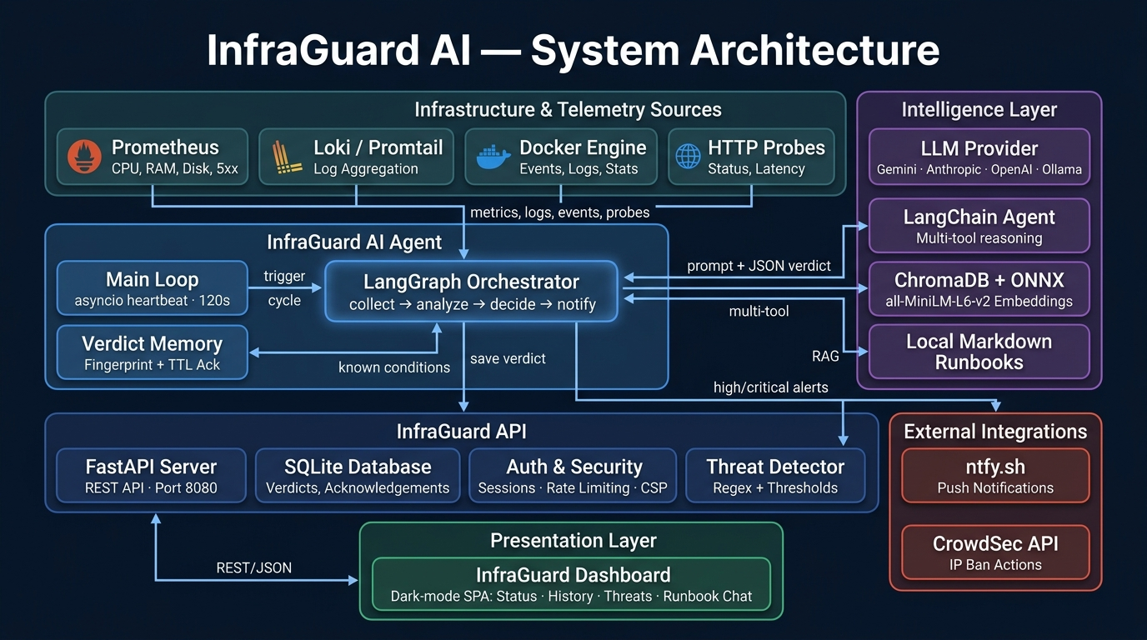

Slide 7
Final Project Defence
System Architecture
● 4 Telemetry Sources: Prometheus metrics, Loki logs, HTTP probes, Docker events
● LangGraph State Machine: collect → analyze → decide → notify pipeline
● Dual Reasoning: Direct single-call or LangChain multi-tool agent
● Human-in-the-Loop: Operator-approved CrowdSec threat response
● RAG Pipeline: Local Markdown → ONNX embeddings → ChromaDB → LLM answer
● Verdict Memory: Fingerprint-based acks with TTL self-invalidation
● See architecture diagram handout for full data-flow detail
Notes:
This is the system architecture. Every 120 seconds, the LangGraph orchestrator collects telemetry from all configured sources. The LLM receives a scope-bounded prompt and returns a strict JSON verdict. High and critical verdicts trigger push notifications. Threat detection is fully deterministic — no LLM in that path — and blocking requires the operator to click. The runbook assistant uses RAG with local embeddings and returns source titles. The verdict memory uses content-plus-ruleset fingerprints.

Slide 8
Final Project Defence
Implementation Highlights
● Repository: ~8,500 lines Python; modular agent/, api/, dashboard/ structure
● Agent: LangGraph StateGraph with 4 nodes; graceful degradation on any tool failure
● API: FastAPI with signed cookie sessions, rate limiting (60/min), audit logging, security headers + CSP
● Dashboard: Single-page dark-mode UI with real-time status, history, threats, runbook chat
● Deployment: Docker Compose (2 containers + shared SQLite), Terraform for GCE, GitHub Actions CI/CD
● LLM Providers: Gemini (default), Anthropic, OpenAI, Ollama; interchangeable via LLM_PROVIDER
Notes:
The implementation is fully modular. The agent and API are independent containers sharing a SQLite volume. The LangGraph pipeline has four nodes — collect, analyze, decide, notify — with conditional notification routing. The API enforces cookie-based auth, rate limiting, and HTML-escapes all LLM output before rendering. Every request is audit-logged with timestamp, IP, method, route, user, status, and latency.

Slide 9
Runbook Grounding & Safety Controls
Final Project Defence
Runbook RAG:
• Local Markdown runbooks indexed with ONNX all-MiniLM-L6-v2 into ChromaDB
• Up to 4 documents retrieved per query; answer bounded to retrieved text only
• Source titles returned alongside answer; idempotent re-indexing
Safety Controls:
• No autonomous remediation; all verdicts are advisory only
• Severity whitelist: ok | warning | high | critical (invalid → warning)
• Threat detection is fully deterministic (regex + thresholds, no LLM)
• CrowdSec bans require operator click; dry-run when unconfigured
• High/critical verdicts cannot be acknowledged or suppressed
• All LLM/log text HTML-escaped before dashboard rendering (anti-XSS)
Notes:
Two critical design decisions. First, the runbook assistant uses RAG with local embeddings — nothing leaves the network for embedding. The prompt instructs the model to answer only from retrieved documents and say when nothing matches. Second, I built multiple safety layers: the LLM never takes action, severity is whitelist-validated, threat detection is deterministic, and IP blocking always requires operator approval. High and critical verdicts can never be suppressed.

Slide 10
Final Project Defence
Automated Testing & Verification
Software Verification (29 August 2026 snapshot):
Total tests: 180 passed, 0 failed
Overall line coverage: 89% (1,655 statements, 190 missed)
Modules at 100%: 6 (tools, schema, RAG, etc.)
Orchestrator coverage: 95%
Store coverage: 94%
Framework: pytest + respx (asyncio_mode=auto)
CI/CD: GitHub Actions; tests on PRs, gated deploy on main
Evidence boundary: These tests verify implemented software behaviour using mocked
external dependencies. They do not prove live reliability or diagnostic accuracy.
Notes:
The automated test suite has 180 passing tests with 89% overall line coverage. Six critical modules are at 100%, the orchestrator is at 95%, and the store at 94%. These tests verify implemented software behaviour using mocked external dependencies. They run on every PR and gate deployment, but they do not by themselves prove live reliability or diagnostic accuracy — that is what the benchmark and practitioner evaluation address.

Slide 11
Controlled Benchmark & Evaluation
Final Project Defence
Frozen Benchmark (qwen2.5:3b, T=0.0, 3 runs × 24 scenarios)
Schema validity: 100% (72/72); pipeline never produces malformed output
Severity agreement: 40.3% (researcher-defined labels, not adjudicated)
Macro-F1: 0.383 | OK recall: 100% | Critical recall: 100%
Signature stability: 41.7% (10/24 scenarios repeat-stable)
Mean latency: 10.3s per verdict | RAG retrieval: 100% (12/12)
SUS Usability Study (10 complete convenience-sample responses)
Mean SUS score: 79.25 ("Good" to "Excellent" range) | Median: 83.75
Evidence boundary: 40.3% rejects unattended triage for this model
SUS is descriptive perceived-usability evidence, not population-level.
Notes:
The frozen benchmark tested 24 incident scenarios across 3 runs with a local 3-billion-parameter model. Schema validity was perfect — the pipeline never produces malformed output. Severity agreement was 40.3%, which I transparently report as inadequate for unattended triage. OK and critical classes had 100% recall, but the model struggles with the warning class. RAG retrieval succeeded for all 12 test questions. The SUS usability study with 10 complete responses yielded a mean of 79.25 — in the Good range. These are controlled results; a production model like Gemini Flash would perform significantly better.

Slide 12
Final Project Defence
Contributions, Limitations & Future Work
Contributions:
1. Fingerprint-based verdict memory — novel self-invalidating ack pattern (principal contribution)
2. End-to-end reference implementation — self-hosted AIOps + human-in-the-loop threat response
3. Bounded-evidence LLM prompting — scope-limited prompts, JSON schema, severity whitelist
4. Frozen reproducible benchmark — specification hash, model digest, append-only checkpoints
Limitations:
• 40.3% severity agreement rejects unattended triage for evaluated model
• SUS is convenience-sample descriptive evidence only
• External dependencies mocked in tests (no live integration tests)
Future Work:
• Independent gold-label adjudication and multi-model evaluation
• Live fault-injection and 30-day field pilot
• RBAC, OIDC/MFA, multi-site architecture with agent federation
Notes:
The principal contribution is the fingerprint-based verdict memory — a pattern I have not found in the 13 systems I reviewed. I am transparent about limitations: the benchmark model scores 40.3%, which is not good enough for unattended triage. The SUS results are descriptive, not inferential. Future work should include independent label adjudication, a 30-day field pilot, and multi-site architecture. These are honest boundaries, not concessions.

Slide 13
Final Project Defence
THANK
YOU
Notes:
Thank you. I am happy to take your questions.

