Slide 1

Sage 300 Web SDK 2025.1 Overview
John Thomas (JT)
Principal Software Architect
January 2025

Slide 2
Web SDK
SDK
Wizards
Docs
Resources
Samples
Source
Goal
“The goal of the Web SDK is to get developers up and running quickly and easily.”

Slide 3

Corrected Issues

Slide 4
Corrected Issues
N/A
N/A
FYI Added controls in the footer do not respect the Before or After setting properly as Before adds after and After adds before. This will be corrected in 2025.2
Misc
Samples
Custom

Slide 5

Wizards

Slide 6
Wizards
Code
Sync Global Files
Added Web API Logic
Solution
Sync Global Files
Added Web API logic
Subclass
Prep
N/A
Sage internal use only
Finder
Generator
Sync Global Files
Custom
Non VS
Sync Global Files
Subclass
Configs
N/A
Upgrade
Sync Global Files
Custom
Subclass
Compiler
Sync Global Files
Sync any new models
Language
Sync Global Files
View Field
Subclass
Web API
N/A
N/A
Sync
N/A
Sage internal wizard only

Slide 7

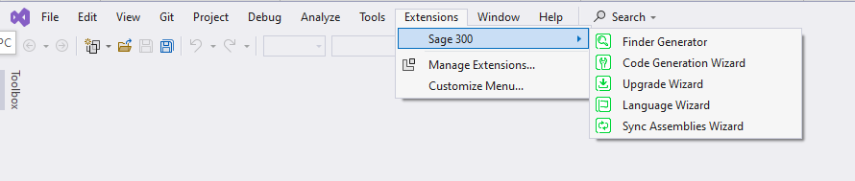
Wizards
Import Information
Reminder
Wizards are now only accessible in Visual Studio 2022 (Community, Pro, Enterprise)
Visual Studio 2019 support dropped
New Location!!
Note: Wizards previously accessed from the Solution Explorer’s Context Menu are now accessible from the Visual Studio Extension Toolbar under the Sage 300 menu

Slide 8
Wizards
2025.1 uninstall and install instructions
Uninstall all Sage 300 wizards
(Visual Studio 2022 – Extensions → Installed → uninstall all “Sage” wizards
Install Sage 300 Wizards
Visual Studio 2022 only
Solution Wizard (Visual Studio plug-in)
Double-click Sage.CA.SBS.ERP.Sage300.SolutionWizardPackage.vsix
Customization Wizard (Visual Studio plug-in)
Double-click Sage.CA.SBS.ERP.Sage300.CustomizationWizardPackage.vsix
Code Generation Wizard, Finder Generator, Language Resource Wizard, Upgrade Wizard, Sync Assemblies Wizard
Double-click Sage.CA.SBS.ERP.Sage300.WizardPackage.vsix
Note: Now that the plug-in wizards are in Visual Studio 2022, they must reference 64-bit libraries (targeting AnyCPU). Since the wizards access the ACCPAC.Advantage.dll (which targets x86), a local version of ACCPAC.Advantage.dll has been placed in the bin folder targeting AnyCPU. This is solely for the wizards as it has not yet been tested in the application.
But we will be testing this for 2025.x… ☺

Slide 9
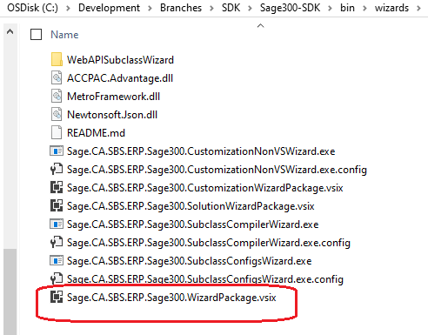
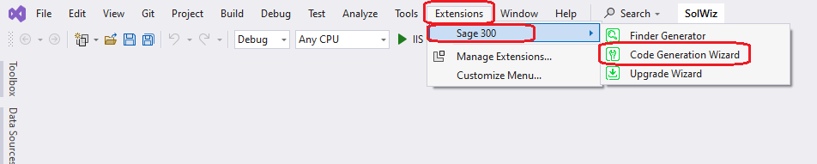
Wizards
Code Generation Wizard
Only accessible in Visual Studio 2022
Added to new Wizard Package
No longer bundled with Solution Wizard Package
Added Web API code generation for 2025.1
Access from Extensions/Sage 300 menu
No longer accessible from Solution Explorer

Slide 10
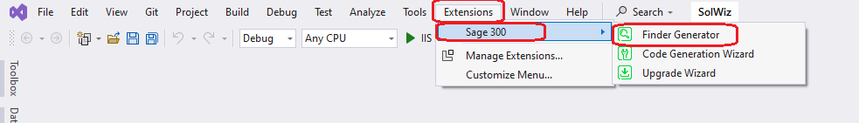
Wizards
Finder Generator
Only accessible in Visual Studio 2022
Added to new Wizard Package
No longer bundled with Solution Wizard Package
Access from Extensions/Sage 300 menu
No longer accessible from Solution Explorer

Slide 11
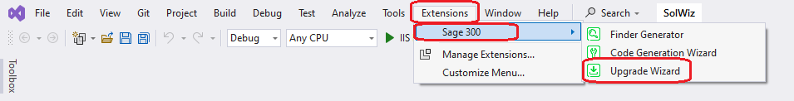
Wizards
Upgrade Wizard
Only accessible in Visual Studio 2022
Added to new Wizard Package
No longer bundled with Upgrade Wizard Package
Access from Extensions/Sage 300 menu
No longer accessible from Solution Explorer

Slide 12
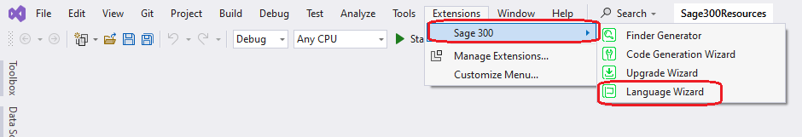
Wizards
Language Resource Wizard
Only accessible in Visual Studio 2022
Added to new Wizard Package
No longer bundled with Language Resource Wizard Package
Access from Extensions/Sage 300 menu
No longer accessible from Solution Explorer

Slide 13
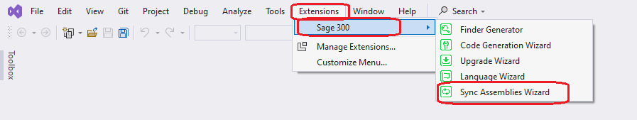
Wizards
Sync Assemblies Wizard
Only accessible in Visual Studio 2022
Added to new Wizard Package
Access from Extensions/Sage 300 menu
No longer accessible from Solution Explorer
Sage internal developer usage only

Slide 14
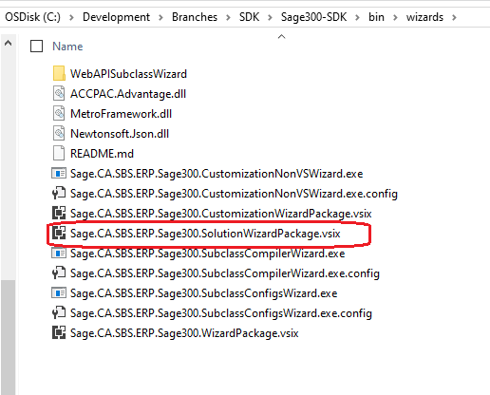
Wizards
Solution Wizard
Only accessible in Visual Studio 2022
New package name
Package only contains solution wizard
Added Web API solution creation for 2025.1

Slide 15
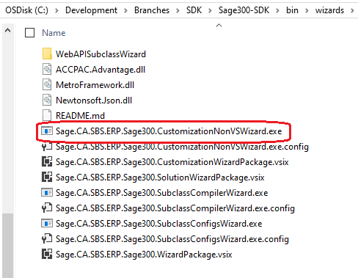
Wizards
Customization Wizard
New executable name

Slide 16
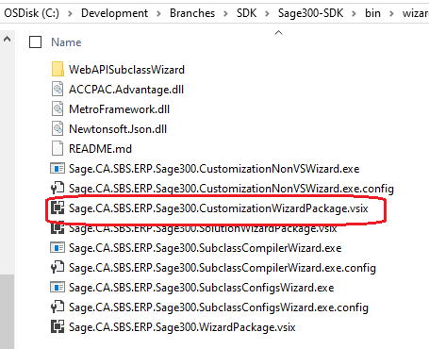
Wizards
Customization Wizard
Only accessible in Visual Studio 2022
New package name
Package only contains customization wizard

Slide 17
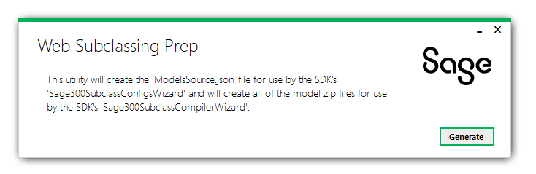
Wizards
Subclassing Prep Utility
Sage internal usage only

Slide 18
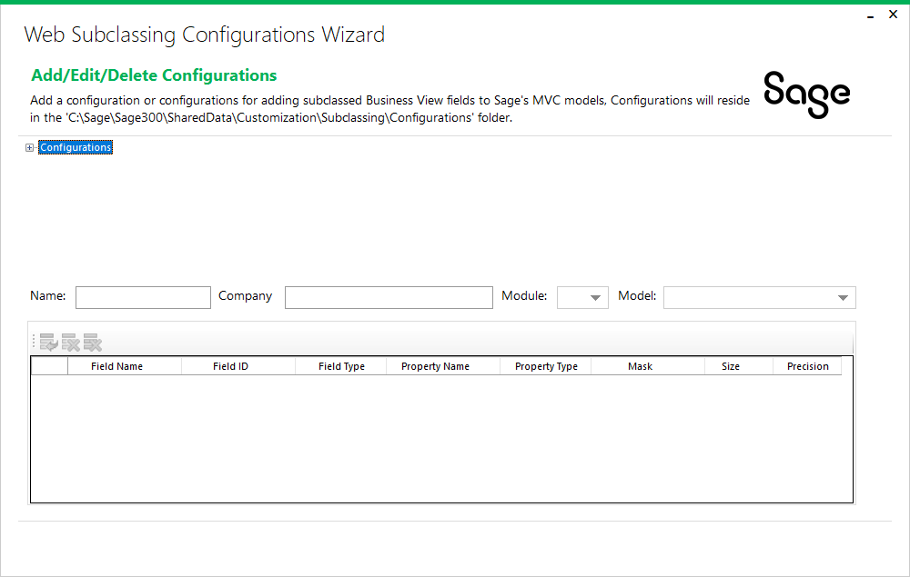
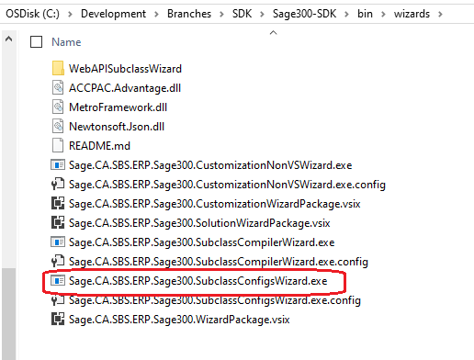
Wizards
Subclassing Configurations Wizard
Create configurations for subclassing web screens

Slide 19
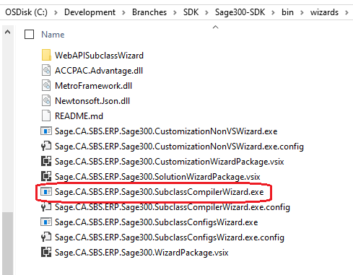
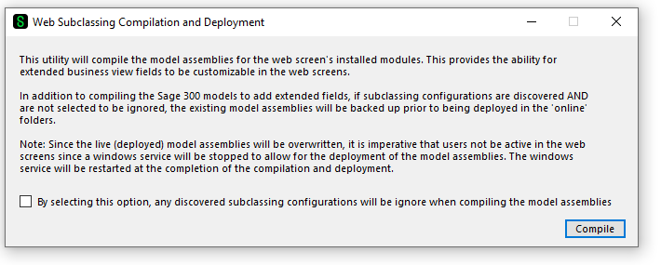
Wizards
Subclassing Compilation and Deployment Wizard
Apply configurations for subclassing web screens

Slide 20
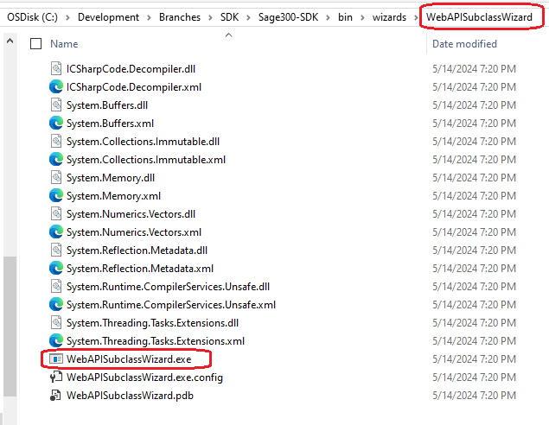
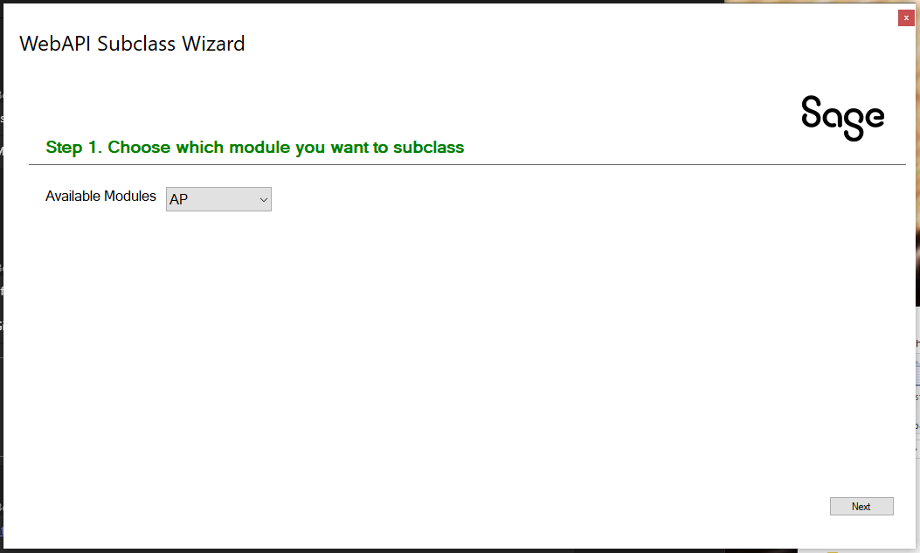
Wizards
Subclassing Web API Wizard
Create partner endpoints for subclassing Web API

Slide 21

Subclassing

Slide 22
Subclassing
Subclassing available in the Web Screens and the Web API since 2024.2
Web Screen Wizards to extend Sage 300 model assemblies
Web API Wizard to extend Sage 300 Web API endpoints
Checkout the Subclassing Design doc in the docs/development folder
Checkout the new Wizards docs in the docs/wizards folder
Checkout the presentation from TPAC 2024 in the docs/presentations/TPAC folder which walks through how to use the wizards, deploy modified assemblies, use the Customization Strategy to access the extended properties, use the Web API wizard to create a partner endpoint extending an existing endpoint
Web Screens

Slide 23
Samples

Slide 24
Samples
Sync global files
Web Screens

Slide 25
Web API

Slide 26
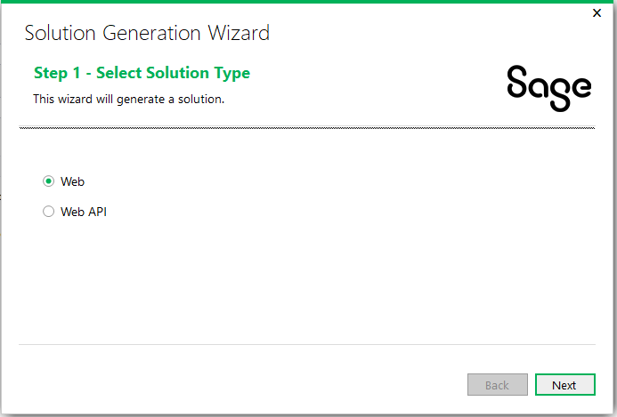
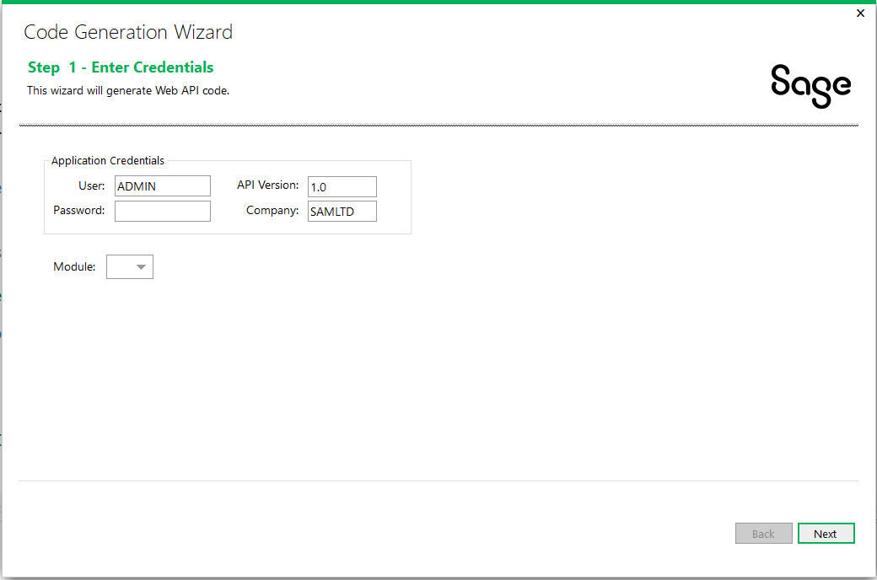
Web API
Subclassing ability added via Web API Subclassing Wizard since 2024.2
Performance improvements for stateful behavior on subsequent API calls
New for 2025.1! Added Partner Web API support to the Solution Wizard and Code Generation Wizards
Web Screens
Note: The generated model class has a TODO that must be resolved before compiling/running. The reason for this is the ROTO ID for the View ID must be manually specified (auto resolving would require the Desktop SDK to be installed).

Slide 27
Proxy & Tester

Slide 28
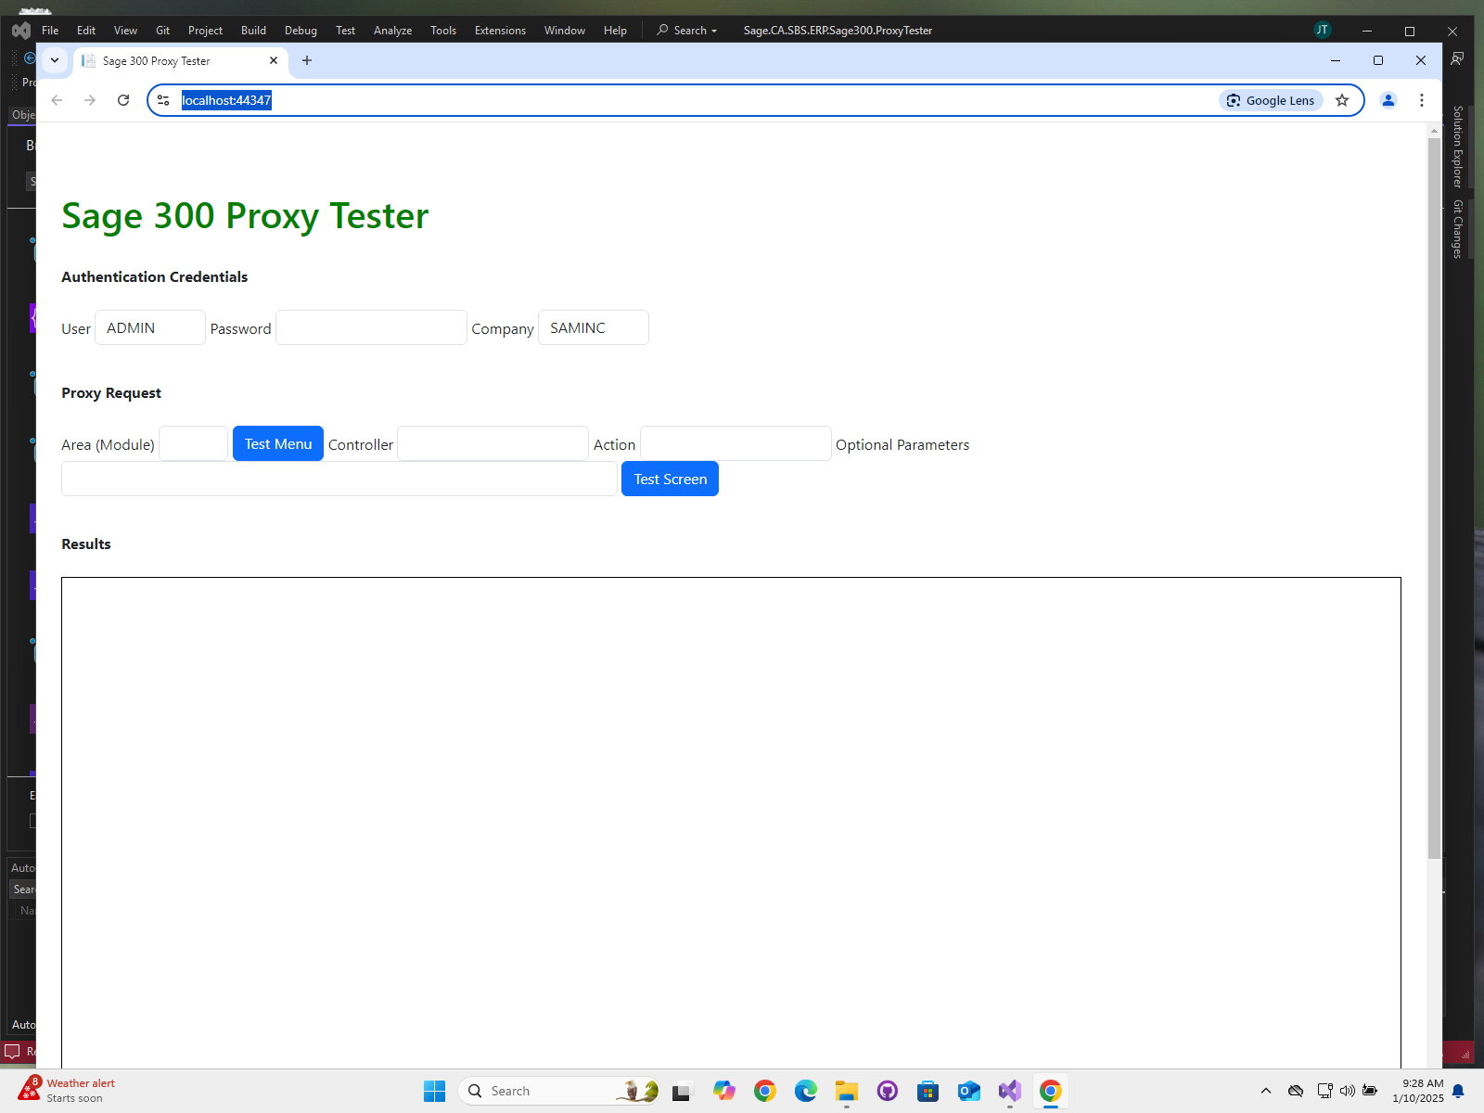
Proxy & Tester
A new Proxy (API) has been added to the Sage Web Screens
Secured with Asymmetric Elliptical Encryption
Any web application with valid Sage 300 credentials can host/display a Sage 300 Web Screen
See doc in docs/utilities folder
A Proxy Tester has been added to the Web SDK to provide valid code snippets and pattern for invoking proxy
See tester in src/utilities folder
Web Screens

Slide 29

Documentation and Tutorials

Slide 30
Documentation and Tutorials
Updated CommonCore.chm
Updated upgrade instructions 2025.0 → 2025.1
Updated Sage300SDK_CodeGenerationWizard.docx for Web API support
Updated Sage300SDK_SolutionWizard.docx for Web API support
Added docs from TPAC under the docs/presentations/TPAC folder
New Sage300SDK_ProxyTester.docx for Proxy invocation and testing
Web Screens

Slide 31

Miscellaneous

Slide 32
Miscellaneous
FYI
N/A
Web Screens

Slide 33
What’s Coming

Slide 34
What’s Coming
Roadmap
Updated NuGet Packages
Updated Kendo UI
Updated JQuery
Web Screens
Tentative
AOM included in Web SDK
Hamburger implementation in generated finder code
Enhanced flow in Customization Wizard
Kendo MVVM to replace Knockout Data Binding

Slide 35
GitHub Repository

Slide 36
GitHub Repository
Open Source
https://github.com/SageNADev/Sage300-SDK
2025.1 is available in the “master” branch
2025.2 is available in the “develop” branch
Web Screens
Archives
2025.0 available in “release-2025.0”
2024.2 available in “release-2024.2”
2024.0 available in “release-2024.0”
2023.3 available in “release-2023.3”
2023.1 available in “release-2023.1”
2023.0 available in “release-2023.0”
2022.1 available in “release-2022.2”
2022.1 available in “release-2022.1”
2022.0 available in “release-2022.0”
2021.2 available in “release-2021.2”
2021.0 available in “release-2021.0”
2020.2 available in “release-2020.2”
2020.1 available in “release-2020.1”
2020.0 available in “release-2020.0”
2019.2 available in “release-2019.2”
2019.1 available in “release-2019.1”
2019.0 available in “release-2019.0”
2018.2 available in “release-2018.2”
2018.1 available in “release-2018.1”
2018.0 available in “release-2018”
2017.2 available in “release-2017.2”
2017.1 available in “release-2017.1”
2017.0 available in “release-2017”

Slide 37
Partner Requests

Slide 38

Partner Requests
Bring these to the Sage 300 Product Manager
Add these to the Sage 300 Ideas Site
Sage 300 Ideas Forum
Your voice and feedback resounds the loudest!
Web Screens

Slide 39
Thank you!

