Slide 1

Sage 300 Technical Session The Basics
John Thomas (JT)
Principal Software Architect
May 2024
Notes:
Welcome to the Sage 300 Technical Session where we will cover the basics.
I am John Thomas, also known as JT, and I’m the Architect on the Sage 300 product.
Let’s get started.

Slide 2
Table of contents
Vision
Software Architecture
Web Architecture
Deep dive
Multiple Deployments
One Product
Web API
Overview
Desktop Architecture
Overview
Web SDK
Deep dive
Notes:
I am excited to bring you this session on the Web API and the Web SDK. Sage 300 has numerous APIs and a Desktop SDK and to simplify the terms used in this session, I’ll refer to the Web API and Web SDK simply as the API and the SDK.
This session will cover the basics and is ideal for those new to Sage 300 development, the architecture, the framework, the Web SDK, etc.).
And questions, suggestions and feedback are valuable for delivering an API and an SDK that meets as many needs, and requirements of the developer community as possible. So, please let your voice be heard!

Slide 3
Vision
Software Architecture
The Sage 300 architecture is based on separation of core business logic from user interface and database services
Sage 300c aims to be a truly modular, cloud-ready, customizable and extensible business management solution that enables users, customers and partners to achieve a higher level of efficiency and innovation
The Sage 300 and Sage 300c architecture has been created by Sage and is owned by Sage. This architectural technology is the key distinction between Sage and our competitors.
Notes:
Sage 300 has been around for decades, and its architecture is solid and fundamentally sound.
Sage 300c, the web screens, have been around since 2015 and leverages the business and database components of the Sage 300 application. The web screens are architected with the same level of integrity as the other Sage 300 components.
A superior software architecture enables products built within its framework to adapt to fast changing technology and stand the test of time. Sage has made a substantial investment in developing the Sage 300 architectural framework—and this investment continues with the web-based framework for Sage 300c, featuring web screens.

Slide 4
Multiple Deployments
One Product
Desktop
On-Premises
Client/Server Install
Business logic layer
Database layer
Not browser based
Web
On-Premises
Web Server Install
Requires desktop components
Same business logic layer
Same database layer
Hybrid
Tethered and untethered
Keep your investment, training, relationships

Slide 5
Desktop Architecture
Overview

Slide 6
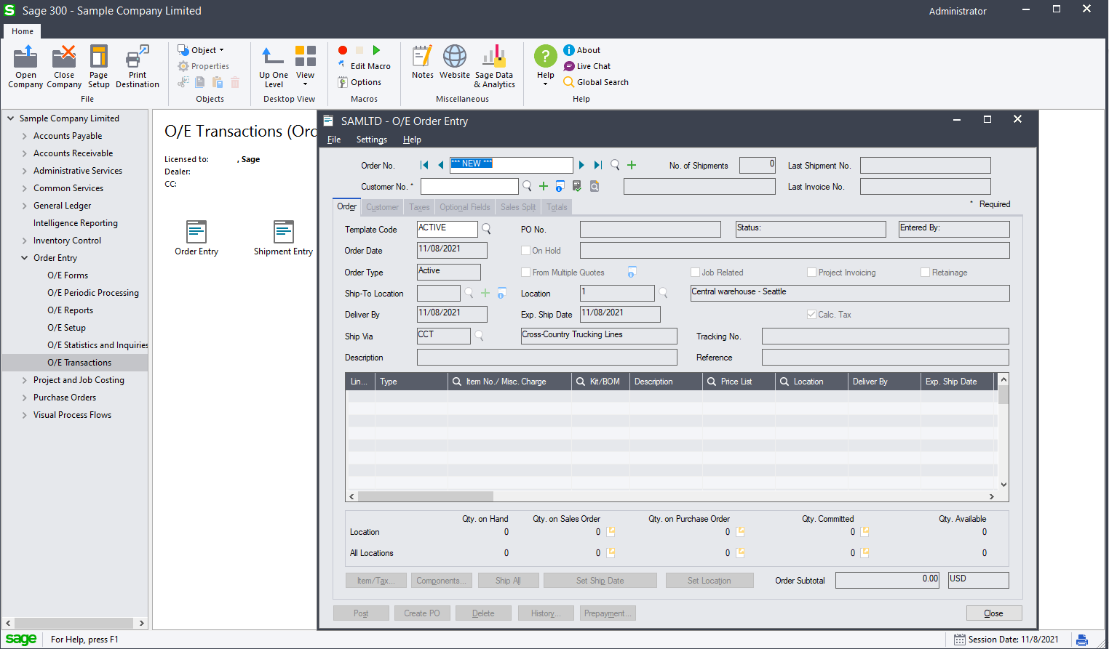
Desktop Architecture
User Interface
Web Screens
Notes:
Sage 300 Desktop Architecture transition slide

Slide 7
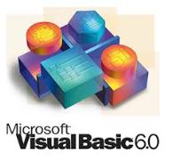









Desktop Architecture
Technologies
Web Screens
Notes:
The technologies used for the Sage 300 desktop screens.

Slide 8
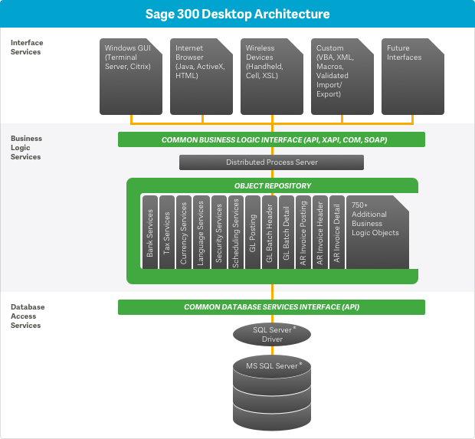
Desktop Architecture
Layers
Presentation Layer
MFC and VB6 are main technologies
Interface Services
Common Business Logic Interface (CBLI)
Various Components (.NET, COM, XAPI, SOAP)
Visual Basic, Delphi, Java, JavaScript, Perl, C#, C/C++, J#
Business Logic Services
C/C++ is main technology
750+ components
Leveraged by the Web Screens
Database Access Services
SQL Server 2014+
(Pervasive and Oracle retired)
Web Screens
Notes:
The Sage 300 architecture is based on separation of core business logic from user interface and database services.
The Sage 300 Desktop architecture is object-oriented and separates user interface services, core business logic, and database services. The architecture allows for easy adaptation of new user interfaces, while maintaining a single common code base for business logic.
The Sage 300 Desktop screens use Visual Basic 6 to display functionality in a Windows application. However, there are a handful of screens (Number Changers) that use Delphi screens.

Slide 9
Desktop Architecture
Visual Basic User Interface
Signon Manager
Session Manager
Field Group
Web Screens
View List
Grid
Field Edit
Finder
Import/Export
Data Source
a4wcomex
Reports
SM Services
Notes:
This is the Sage 300 desktop screens logical implementation.
The screens are Visual Basic 6 OCX (ActiveX) controls which are used as a container for the ActiveX form.
The screens use ActiveX controls created by Sage 300 and even some native Microsoft Windows Forms controls. These controls (Grid, Field Edit, Finder, etc.) are rich, robust controls created for the Sage 300 application. They encapsulate the functionality of their constituent controls (i.e. textbox, calendar, label, etc.) with the power of UI and business logic specific to the Sage 300 application.
When talking to Views, the VB code doesn’t talk directly to a4wcomex, instead the VB UI code talks to an ActiveX control called the Data Source. The Data Source control then talks to the AccpacCOMAPI (a4wcomex) to perform the actual View operations. The reason is that the Data Source is actually a visual control which means it can be configured at design time in the form designer. This means you specify which views to use and such in the form designer saving you writing quite a bit of code. Most View compositions can also be specified this way. Another function of the Data Source is that it provides caching to reduce the number of View calls over the Internet when running in Web deployed mode.

Slide 10
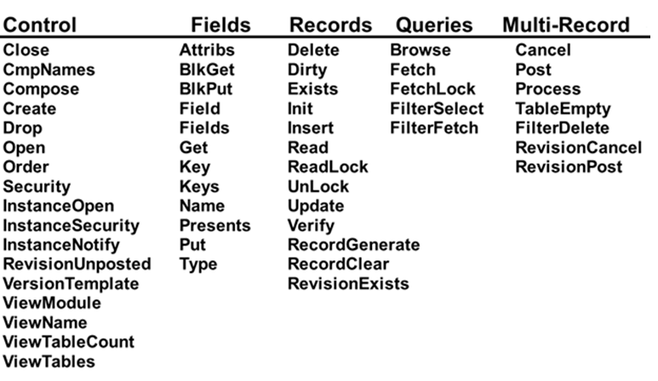
Desktop Architecture
Business Views - Functions
Web Screens
A View is a Windows DLL
Exposes common functions
Control the view
Manipulate fields
Get metadata
Manipulate records
Manipulate sets of records
Notes:
A View is at the heart and core of the Business Logic.
There are functions to control the View, manipulate fields, get meta-data, manipulate records and manipulate sets of records. Each of these routines has a corresponding function inside the View DLL. In the early days all these functions were exported from the View DLL and theoretically could be called directly. However we never endorsed this, did it ourselves or provided instructions on how to do that. In a way calling these functions directly in the View DLL was the first View interface, even though it was never used. Not listed here is the real function that is called in the View DLL, namely rotoEntry. This function takes a structure as its argument that specifies the function to call and has some generic arguments that are used as the arguments to the various functions following a set convention. Again the users of Views have never loaded the View DLL and called the rotoEntry function directly.

Slide 11
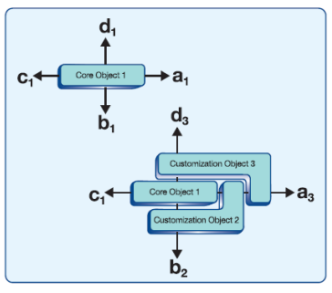
Desktop Architecture
Customization Strategy
Single customization for the same screen
Inheritance for OCXs
Macros
Web Screens
Notes:
Desktop Customization Architecture – Inheritance and Macros
The desktop customization architecture allows users to inherit an object, VB OCX, in order to participate with the methods and events of the object being inherited from. However, multiple customizations from different partners are not allowed to participate in the same customized screen. Each inherited OCX can then be menu linked to provide a custom screen for a partner.
Modifying core behavior in the Sage 300 desktop screen is achieved through a framework of Visual Basic code for the OCXs and VBA code for the macros. Macros can also record flow in order to automate processes. Well, macros can also be used for a lot of customization items (automation of flow, updating tables, etc.).
Sage 300 desktop screens support multilevel participation, providing customization options without jeopardizing the integrity of the core business logic.
In this example, Core Object 1 is part of a program and communicates with other objects through four messages—a, b, c, and d.
When another object, Customization Object 2, subclasses Core Object 1, it modifies the behavior of two of Core Object 1’s messages, a and b. A third object, Customization Object 3, can sub-class Core Object 1 and Customization Object 2, modifying messages a and d.

Slide 12
Web Architecture
Deep Dive

Slide 13
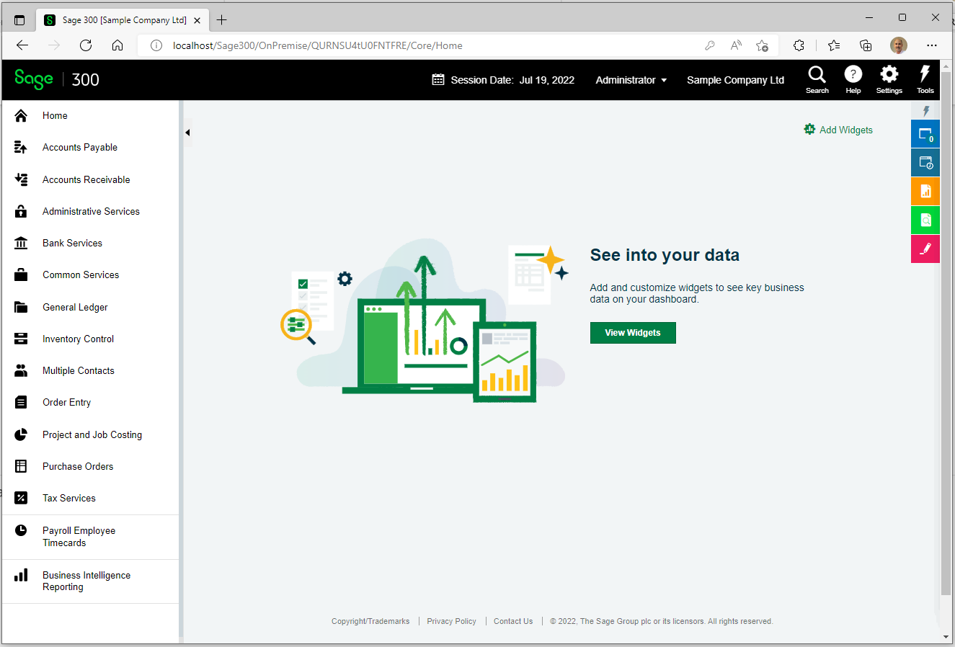
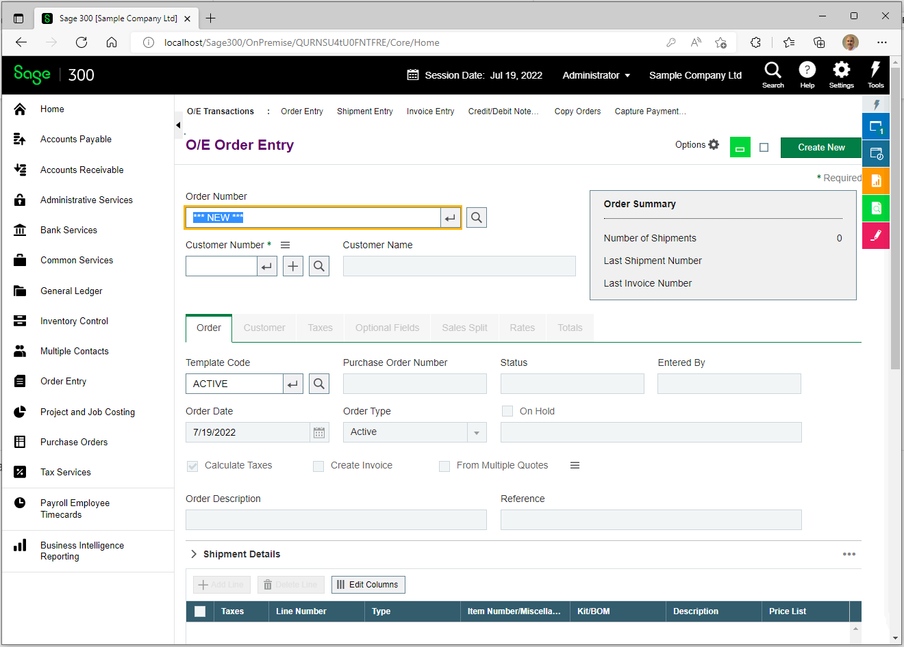
Web Architecture
User Interface
Web Screens
Notes:
Sage 300 Web Architecture transition slide

Slide 14









Web Architecture
Technologies
Web Screens
Sage 300
Notes:
The technologies used for the Sage 300 web screens.
Notice how Sage 300 is listed as a technology as we reuse the Sage 300 Business Components and Sage 300 Databases used by the desktop in the web screens as well.

Slide 15
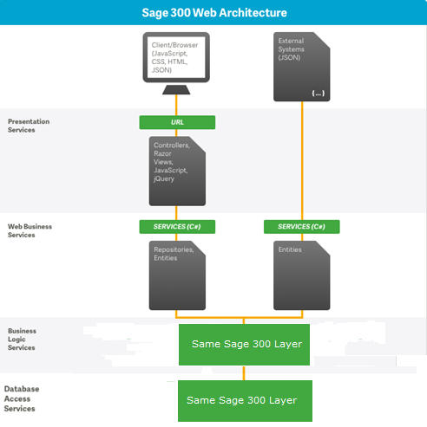
Web Architecture
Layers
Web Screens
Microsoft ASP.NET MVC 5.0 Architecture and Software Stack
C# 8.0, HTML5, CSS3, JavaScript, .NET Framework 4.8.0, Visual Studio 2017, 2019, 2022, IIS 10, ARR 3.0, Enterprise Application Block, Entity Framework 5.0 ORM, SQL Server, Web/Worker Roles
Standard Libraries
Kendo UI, JQuery, Knockout, Unity, Crystal Reports
Testing
VS Framework, Selenium/Fitnesse Automation, JMeter
RESTful API
OData, Open API (Swagger), Versioning
Notes:
The Sage 300 Web architecture is object-oriented and separates user interface services, core business logic, and database services just like the desktop architecture.
The Sage 300 Web architecture allows for browser and Web API access in Sage 300c and is implemented in a Model-View-Controller pattern. The architecture leverages the business logic and database layers of the Sage 300 Desktop architecture.
The Sage 300c web screens use a browser-based (Firefox, Chrome and Edge) user interface to interact with the same business logic and data.
The Sage 300 web screens are deployed in a private cloud or On-Premises.

Slide 16
Web Architecture
MVC Pattern
Model
Controller
View
Web Screens
Model (Business Layer)
Logic and data storage
View (Display Layer)
Display of the data
Controller (Input Control Layer)
User interaction
Notes:
The MVC programming model is a lighter alternative to traditional ASP.NET (Web Forms).
It is a lightweight and highly testable framework.
The Sage 300 web screens follow this pattern for separation of logic. MVC is a pattern and Visual Studio makes numerous assumptions based upon this pattern, such as naming conventions, location of files, etc.

Slide 17
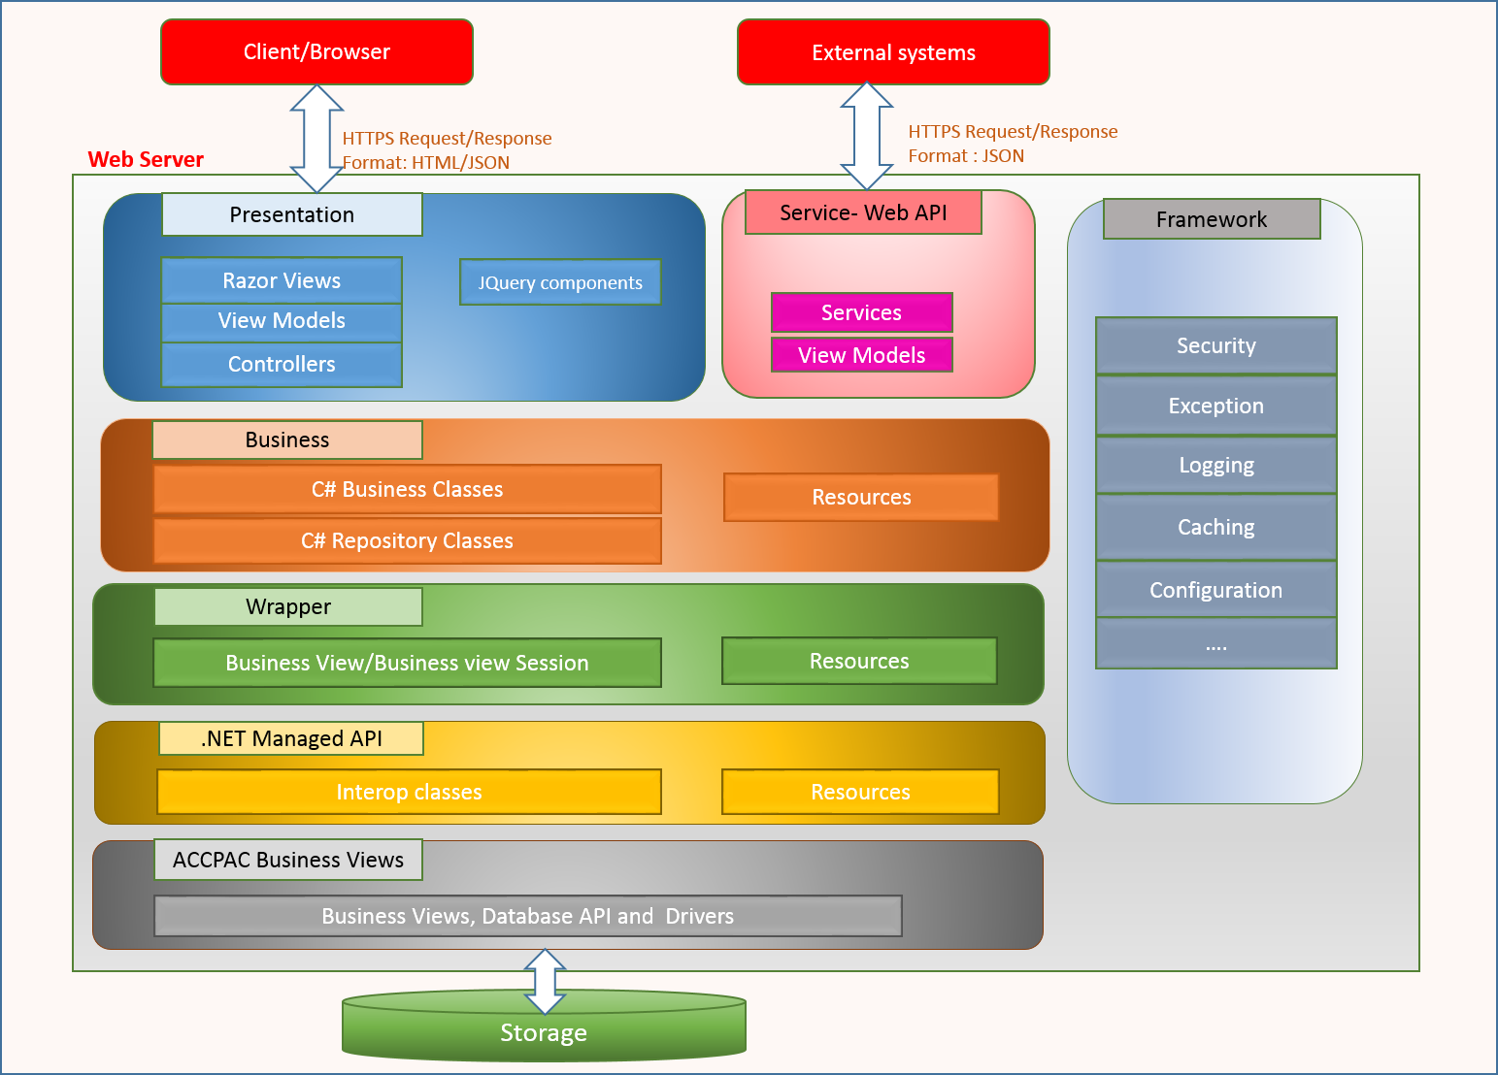
Web Architecture
Logical Implementation
Web Screens
Notes:
This is the Sage 300 web screens logical implementation.
Working from the bottom up:
The Storage is the Sage 300 Database and used by both the desktop and the web.
The Accpac Business Views are the C++ components used by both the desktop and the web.
The .NET Managed API is a wrapper around the COM objects used by the desktop.
The Wrapper is an Entity that wraps the Accpac Business View.
The Business is supporting classes for the Entity.
The Presentation is the user interface to the web screens.
The Service – Web API is the RESTful web service interface.
The Framework are the framework and horizontal components.

Slide 18
Web Architecture
Physical Layer - Database
Repositories
Models
Accpac
Database
Services
Presentation
Web Screens
Microsoft SQL Server 2014+
T-SQL Code in this layer can be comprised of triggers, stored procedures and table constraints.
Notes:
This layer is used by the Sage 300 Desktop and Web frameworks.
As of Sage 300 2016, we no longer support an Oracle SQL database or a Pervasive ISAM database. Therefore, the Sage 300 database driver is due for an overhaul in order to use SQL Server natively as opposed to Sage 300 functions which perform sorting, filtering, etc.

Slide 19
Web Architecture
Physical Layer – Business Views
Repositories
Models
Accpac
Database
Services
Presentation
Web Screens
Accpac Business Views accessed via the .NET API provided by Sage 300.
C/C++ Code in this layer is defined using the Sage 300 SDK and other tools.
Leveraged by both Desktop and Web products.
Notes:
This layer is used by the Sage 300 Desktop and Web frameworks.
Where the desktop accesses the Accpac COM layer, the web screens access the Accpac .NET API, which is simply a wrapper around the COM layer. Thus, any changes to business views are available in the desktop and the web screens. However, the Models layer for the web screens will require modifications to address any new or removed fields from the business views

Slide 20
Web Architecture
Physical Layer - Models
Repositories
Models
Accpac
Database
Services
Presentation
Web Screens
Models hold the mapped equivalent of the Accpac Business Views in a loosely-coupled 1-to-1 relationship.
C-Sharp Code in this layer is comprised of the model, model fields, and mapper classes.
Domain logic can also be found in these classes (i.e., mapping logic specific to features, options, settings, domain values, etc.)
Notes:
The web screen models are a loosely-coupled version of the Accpac business views. The Sage 300 Code Generation Wizard can generate these models based upon the Accpac business view.
Internal developers can extend these models to hold additional properties for the web screens for either data that does not come from the business or have to go back to the business view.
The model properties can be accessed like the Accpac business views by either name or ordinal value. The Fields and Index classes of the model contain the classes for the purpose of mapping. And, this mapping is performed when getting data from or setting data to the Accpac business view.

Slide 21
Web Architecture
Repositories hold/bind/contain the models as a business entity where an entity is an Accpac Business View.
C-Sharp Code in this layer is comprised of a business repository class which manages and interacts with the business entity or business entities if there are multiple entities which comprise a business repository. Database interaction is done in the Accpac Layer, and this is the next closest layer to database access.
Domain logic will be found in these classes (i.e., opening entities, validation of rights, domain logic specific to the access, modification and deletion of the entities
Physical Layer - Repositories
Repositories
Models
Accpac
Database
Services
Presentation
Web Screens
Notes:
A repository is a container for the entities (business views). For example, the GL Account repository contains the entities for the Account, Allocation Instructions, Valid Currencies, Account Sub-Ledgers, Optional Fields, Rollup Groups, and Rollup member Preview entities.
Since MVC methods are not re-entrant, every public method has logic to open these entities. However, a caching mechanism is in place and if entities has already been opened in the session for the entity, the entity is retrieved. This mechanism is not identical to the behavior in the desktop as the desktop only has a single session whereas the web screens have a session per web screen. This caching behavior will be enhanced in the future to ensure the exclusive locking behavior found in the desktop is also implemented in the web screens.
Since this layer interacts with the entity, the Accpac business view, it is the closet layer to the business view and the database. The entity does not interact with the database. It only interacts with the entity as this ensures that both the desktop and web screens impact the database in the same manner.
The majority of the domain logic for an entity will be found in this layer. While logic may be placed elsewhere, such as the controller or model or model mapper, keeping the domain logic together is preferred if possible.

Slide 22
Web Architecture
Physical Layer - Services
Repositories
Models
Accpac
Database
Services
Presentation
Web Screens
Services contain the public methods required by the Controllers to access the public methods of the Repositories.
Typically, there is no C-Sharp Code in these classes as they are a pass-through mechanism to the Repositories
Recent patterns skip this layer and go directly to the repository from the controller
Notes:
This layer contains the public methods required by the presentation layer (controllers) as the client request or action is forwarded to the repository layer.
Thus, this layer is typically a pass-through layer and no code is found in this layer. It is a public interface to the repository layer.
However, in retrospect, we most likely could have dropped this layer and only had the repository layer and thus simplified the interfaces required by the Services and Repositories layer, which are identical.

Slide 23
Web Architecture
Physical Layer - Presentation
Repositories
Models
Accpac
Database
Services
Presentation
Web Screens
The Presentation Layer contains Controllers, View Models, Razor Views and JavaScript files required for the user to interact with the application.
The code in this layers is comprised of C-Sharp, CSHTML and JavaScript files.
This layer handles the requests from the user and allows the user to see the effects of that input.
Notes:
The Presentation layer contains the files required for the user to interact with the web screens.
The View Models are the MVC object not only contain the Model or Models for the web screen, but other objects to support the web screen. The View Model is bound to the Razor View in the @model property.
The Razor View contains CSHTML code which is pseudo-html code and produces HTML code. The Razor View uses HTML Helpers for all controls instead of specifying HTML code snippets as the HTML Helpers are able to not only encapsulate HTML code, but also provide different interfaces for similar controls with different behaviors. For example, the SageLabel helper allows for a label control to be displayed with the appropriate localized text whereas the SageLabelFor helper allows for a label control to be displayed with the localized value of a Model’s property via the Display attribute on the Model’s property.
The screen uses Partial Razor Views to construct the screen. This has the benefit of code encapsulation and is ideal if a section of the screen can be reused elsewhere.
A web screen will contain at a minimum three JavaScript files. These are the {entity}Behaviour.js, the {entity}KoExtn.js, and the {entity}Repository.js files. Certainly more JavaScript files for web screen can be created and if so are usually created for the partial views. The …Behaviour.js file is the main file and contains the entry point, initializations, control events, callback events and the bulk of the objects for the screen. The …KoExtn.js file is the observable extension and contains the computed and calculated fields, such as a date that must be formatted. The …Repository.js file contains the actions to be performed, build the URLs and Ajax calls. All of the JavaScript files for a screen are bundled together and this bundle is applied when a screen is rendered.

Slide 24
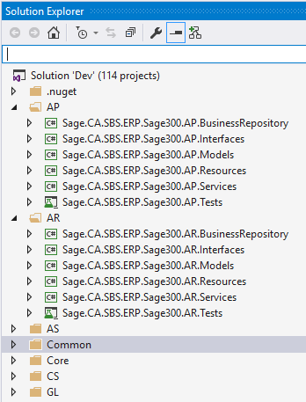
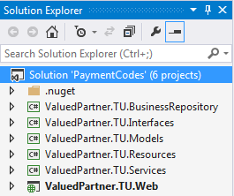
Web Architecture
Solution and Projects
Sage Projects
Partner Projects
Web Screens
Solution
Six mandatory projects per module
Projects
Separation of code
Partner consistency with Sage
MVC compliant
Aligns to GitHub Repositories
Notes:
The Visual Studio Solutions organize the projects for the web screen by module and the framework components are in the Common and Core folders for internal developers. In addition to an all-encompassing solution that contains all the modules for all the web screens there are also module level solutions that simplify the development process by allow the developer to work in a smaller solution that only contains the source for a module they are working in. This can be a more efficient process.
As you can see from the screenshots, the external or partner solution contains the almost same structure as an internal Sage solution. Each module is comprised of six projects which separate the code into an MVC compliant pattern.
The BusinessRepository project contains the repository classes, which are containers for the entity, the mapper classes, which maps the Accpac Business View to the MVC model and the menu helper class for the module, which is a helper for menu navigation and content. The business repository classes are separated into folders identifying whether the business repository is stateful, is for a report, or is for a process repository. The stateless business repository classes are in the root.
The Interfaces project contains the interface classes for the BusinessRepository classes and the Services classes. They are separated into folders of the same name. Any newly added public method to a business repository or service class must also be made here. It is preferred when adding methods to the business repository and service classes that they be named the same in order to assist with identifying the flow.
The Models project contains the model classes, which are a loosely-coupled mapping of the Accpac Business View, the enumeration classes, which are the Accpac Business View presentation lists converted into enumerations and the Fields classes, which are partial classes for the models and contain the Index and Fields classes for referencing the entity properties by name or ordinal value. The model classes are separated into folders identifying whether the model is a report or is a process model. The remaining model classes are in the root.
The Resources project contains the resource classes, which are Resx files used for localization. The resource classes are separated into folders identifying whether the resource is for a report, or is for a process. The remaining resource classes are in the Forms folder and the enumeration resources for the module are in the root. Sage 300 web screens are localized in 5 languages: English, French, Spanish, Chinese Simplified and Chinese Tradition. English is the default language.
The Services project contains the service classes, which are pass through classes to the business repository classes. The service classes are separated into folders identifying whether the service is stateful, is for a report, is for a process or is for a unit of work service. The stateless service classes are in the root as well as the bootstrapper class for the business repository and service Unity registrations.
The Web project contains the constant classes, which are classes containing constants for the module, controller classes, which are made up of public, internal and finder controllers for the entities, enumeration classes, which are classes of enumerations, model classes, which are the ViewModels for the entities, script files, which are the JavaScript files for the entities, and view files, which are the Razor View files for the entities. The root also contains files for the module’s area registration class, the menu details (XML file) for the module, the bootstrapper class for the controller’s Unity registrations and a bundle registration class for the module’s JavaScript files. A difference between the internal and external solution is where the Web project is located. The partner solution has this project alongside the other projects whereas the internal solution has this project separated into a Web folder.
The source for the web screens are in different GitHub Repositories mainly segregated by module, web, web api and common/core framework projects. This segregation was vital as the application was first being created as we had over 100 developers all submitting code into a single repository and causing quite the GitHub merge hell. This segregation now with a smaller team has pros and cons, but we feel that the pros outweigh the cons.

Slide 25
Web Architecture
Base Class Inheritance
Derived
Overrides
Your Routines
Screen Type
Flat, Dynamic Query, Inquiry, Header- Detail, Process, Sequenced Header Detail, etc.
CRUD Overrides
Specific Routines
Base, Base Report, etc.
CRUD
Generic Routines
Derived
Screen Type
Base
Web Screens
Notes:
The Sage 300 Web architecture relies on a framework of base classes to perform as much work as possible without a developer having to write more code than is necessary.
In this example of the business repository class, your class, it inherits from a flat repository class which inherits from a base repository class.
The idea is that most CRUD operations are common whether the repository is stateful or stateless, is a header or is a detail, etc. Therefore, this base level contains these methods that can be used by all repositories.
The Flat repository is a repository type for simple entities which may or may not require a key, such a Customer or Vendor or Payment Codes. It contains methods specific to this type of repository and even overrides some base methods.
The derived repository or your repository class is where the entity specific logic is contained. Most derived repositories will not have CRUD methods as they can use the inherited methods. But, in the case where the base methods are either insufficient or there are actions that must be addressed either before or after a CRUD operation, the derived repository will need to override the base method with the appropriate logic.
The concept is to let the base classes do the heavy lifting and only add the code that is required and is specific to the entity.

Slide 26
Web Architecture
Business Entity
Business Entity
.NET API
COM API
Wrapper for the .NET API Business View
Open an Entity
OpenEntity(PaymentCodes.EntityName)
Get/Set Property of Entity
model.Foo = Entity.GetValue<string>(PaymentCodes.Index.Foo)
entity.SetValue(PaymentCodes.Index.Foo, model.Foo)
Add/Subtract Access Rights as Needed
var userAccess = base.GetAccessRights()
userAccess.SecurityType |= SecurityType.Import
Concurrency Checking
var model = base.Map(entity)
var model = new T {ETag = entity.ETag}
Web Screens
Subclassing
With all mappers accessing the base class, the framework has been extended to map subclassed fields
Notes:
The Sage 300 Web business entity is a wrapper around the Sage 300 .NET API which is a wrapper around the Sage 300 COM API. The Sage 300 Desktop uses the COM API.
The business entity is comprised of a model, a mapper, classes to reference the entity by name or ordinal value, etc. Since the business entity is loosely-coupled with the Accpac Business View, we must perform similar functions in the web as we do in the desktop. Opening of an entity is analogous to opening a view, getting and setting properties is similar to getting and setting fields, etc.
An important concept to be aware of is how concurrency checking is achieved and performed in the web screens. The ETag property is part of the model’s base class. When data is retrieved from the database, assigned to the Accpac Business View and then mapped into the entity’s model, the ETag value in the business view must be assigned to the model’s ETag property. This is performed in the mapper’s base class. Thus, in the mapper’s getter routine, it MUST invoke the base class’s Map method or else the repository framework will not be able to perform the concurrency check and data may be overridden inappropriately.

Slide 27
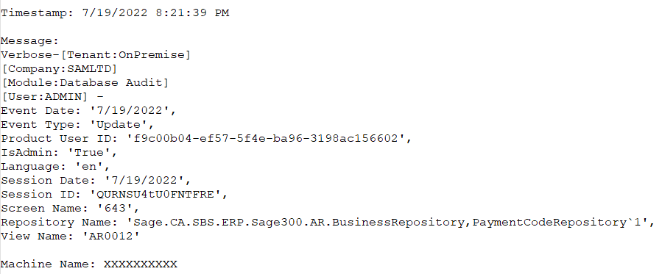
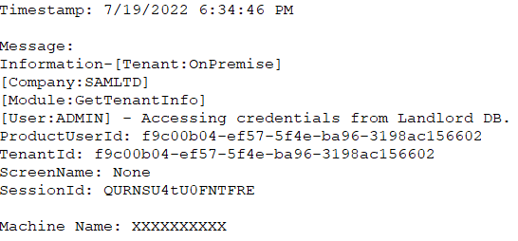
Web Architecture
Auditing and Logging
Web Screens
Database Audit
_databaseAuditRepository.Log(EventType.Update, this)
Logging
Logger.Error(message, LoggingConstants.ApplicationError, Context)
Rolling 8K file controlled via web.config file
fileName="Logs/trace.log" formatter="Text Formatter" asynchronous="true" filter="Warning" rollSizeKB="8192" rollFileExistsBehavior="Increment"
Notes:
The Sage 300 web screens have the both a logging and an auditing feature.
The auditing feature is only for the database and audits create, update and delete actions, but not read actions. Since the BusinessEntity base class is a wrapper around the Accpac Business View class, the BusinessEntity base class is the only class that contains the audit statements. Unity is used to instantiate either a WAD (Windows Azure Diagnostic) framework or a Log framework depending upon if the application is running either on the public cloud (Azure) or the private cloud (On-Premise). Therefore, the syntax used in the BusinessEntity class does not have to care about the installation. It only cares about the audit statement.
The logging feature is available throughout the web screens for logging errors, warnings, and information messages. Unity is used to instantiate either a WAD (Windows Azure Diagnostic) framework or a Log framework depending upon if the application is running either on the public cloud (Azure) or the private cloud (On-Premise). Therefore, the syntax used to log a message does not have to care about the installation. It only cares about the log statement. The log file configuration is set in the web.config file.
The default values for Production are to log only warnings and errors in an 8MB rolling log file. The log file for an On-Premise installation is called trace.log and it is a WAD table for an Azure installation. For debug or non-production source, the web.config setting is set to log all messages.
For an On-Premise installation, there are two log files: one for the web role and one for the worker role. These files are found in the …\Online\Web\Logs and …\Online\Worker\Logs folders. This is important to remember when viewing the log file for messages.

Slide 28
Web Architecture
Inversion of Control and Dependency Injection with Unity
Web Screens
{Module}Bootstrapper Registers Service and Repository Classes
{Module}WebBootstrapper Registers Controller and Finder Classes
Registration
UnityUtil.RegisterType<IPaymentCodesService<PaymentCodes>, PaymentCodesEntityService<PaymentCodes>>(container)
UnityUtil.RegisterType<IController, PaymentCodeController<PaymentCodes>>(container, "ARPaymentCode")
Instantiation
Service = context.Container.Resolve<T>(new ParameterOverride(Parameter, Context))
Notes:
The Sage 300 web screens use Unity for inversion of control and dependency injection. There is a bootstrapper in every module’s Services project for registrations of the service and business repository classes. There is a web bootstrapper in every module’s Web project for registrations of the controller and finder classes.
Instead of “newing” an object, we allow Unity to instantiate the object for us. This is an important concept as some classes have different behaviors depending upon the installation type (On-Premise or Public Cloud). This was mentioned in the auditing and logging slide where the log and audit files are either log files or WAD tables. Instead of littering the application with conditionals for how the application is installed, we can place a simple, one-time conditional in the bootstrapper and register the correct class with the Unity.

Slide 29


Web Architecture
Process Workflow in Worker Role
Process Screen
Process Service
Workflow Manager
Queue Service
Landlord Database
Process Repository
Business Super View
Application Database
Process Screen
Web Screens
LandlordDatabaseSetup.config in ..\runtime folder deprecated
..\runtime\Database\Landlord\Scripts Discovery folder
Contains Scripts to be Applied to Workflow Tables
Insert_WorkerRole_Data.sql
Script for Sage’s Workflow Instances
Partner scripts dropped in this folder
Database Setup – Portal Button
Discovers and Applies Scripts
Re-starts Worker Service
Web Role
Queue
Worker Role
Message
Notes:
The Sage 300 Web architecture use both web and worker roles to serve the functionality of the web screens. Worker roles are used for most long running processes, usually indicated by a progress-meter, and some reports.
The workflow engine is available to both internal and external developers. The …\runtime\Database\Landlord\Scripts folder is used to hold Sage’s workflow engine scripts and for external developers to place their scripts for their processes. These scripts are applied by the Database Setup Screen’s “Portal” functionality, which drops data out of the workflow tables and re-creates the data via the scripts discovered in this folder. The Sage internal scripts are applied first.
The Database Setup Screen’s Portal functionality also stops and re-starts the Sage.CNA.WindowsService, which is the service that serves the worker role.
For detailed information on the flow of the worker process and detailed information on the workflow engine tables, refer to the Sage300SDK_WorkerProcessing document found in the docs/development folder of the Web SDK.
For developers, debugging is possible as the IDE bypasses the Queue Service and directly instantiates the Process Repository and thus keeps control in the Web Role.

Slide 30
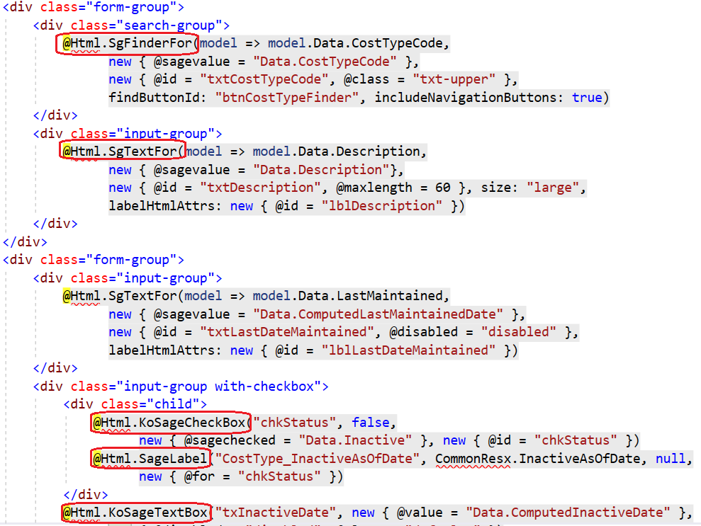
Web Architecture
HTML Helpers
Use HTML Helpers instead of HTML directly
Simplifies CSHTML
Encapsulates logic
Helpers with and without binding behavior
Common.Web.HtmlHelperExtension
Helpers for most controls
Composite Helpers added in 2022
Simplified Helpers coming in the future
Web Screens
Notes:
The Sage 300 Web Architecture uses HTML helpers in the razor views to avoid have developer write HTML code. Instead, the helpers simplify the code required by the developer when coding the view.
There are helpers that perform binding to the underlying data model and ones that do not. For example, the SageLabel helper must be given a localized resource for display whereas the SageLabelFor helper will retrieve the Display attribute from the underlying data model for the assigned property. Both are legitimate implementations. The requirement of the display and any other requirements (such as required or style) will dictate the proper usage.
The System QA folks drive their automated tests via the @id property of each widget/control. Therefore, this field is a requirement.
Composite Helpers were added in 2022 that greatly simplified the helper code in the razor views. These new composite helpers combined numerous helpers into one. For example, a finder is made up of a label, a textbox, 1 or 2 buttons, and a validation helper. The new composite finder, sgFinderFor, is a single helper with multiple parameters to simplify the code.
Coming 2024 are more helpers that will simplify the code even further by binding directly to the underlying business view properties and thus numerous parameters that are required today will no longer be required with the new helpers. Plus, they will do native Kendo two-binding as opposed to using Knockout for two-way binding.

Slide 31
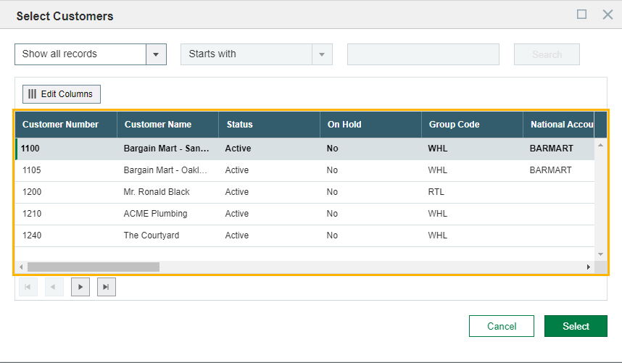
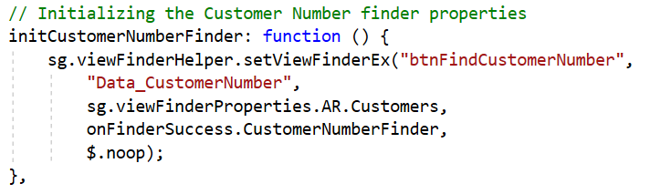
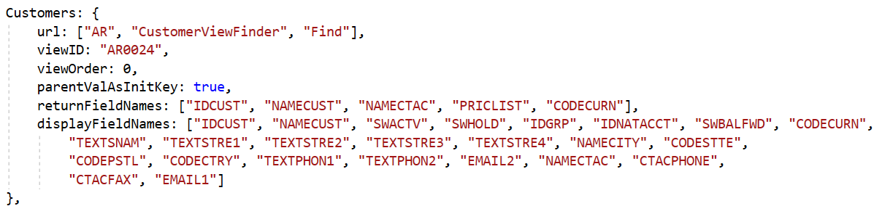
Web Architecture
Finder
Initialization in Screen
Web Screens
Global Definition

Slide 32
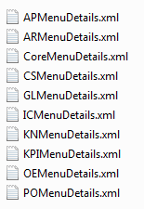
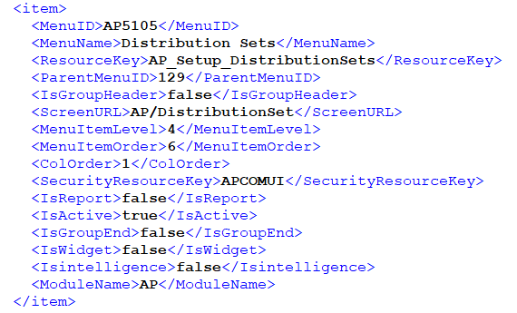
Web Architecture
XML Menu Files
Web Screens
Generated by Code Generation Wizard
Deployed to
..\Online\Web\App_Data\MenuDetail
Copied to on login
..\Online\Web\App_Data\MenuDetail\{company}
File is module specific
Notes:
The Sage 300 Web Architecture’s menu navigation is driven by XML files. These files are module specific and are deployed to the …\Online\Web\App_Data\MenuDetail folder. The default files are used for initial display of the menus and for the Restore option when a modified menu is requested to be restored to the factory settings.
When a company is opened, if menu files for the company do not exist in the …\Online\Web\App_Data\MenuDetail\{company} folder, the default files are copied, which are then allowed to be modified by a web screen that provides customization of the menus.
Partner or third-party menu files are identical in structure and are discovered via a similar, yet different mechanism in the boostrapper files. Partner menus are not integrated with Sage menus but follow closely in their own section alongside the Sage menus.

Slide 33
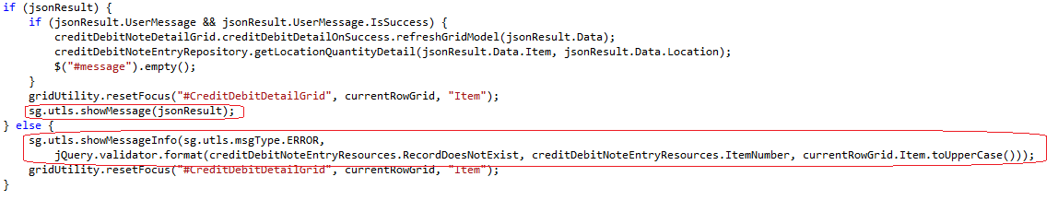
Web Architecture
Message Display Routines
Numerous methods in global.js depending upon type of message
showMessage, showMessageInfo
showCommonConfirmationDialog
showMessageInEnumerableResponse
showMessagePopup, showMessagePopupWithoutClose, showMessagePopupInfo
Use jQuery.validator.format like C-Sharp’s String.Format()
Web Screens
Notes:
The Sage 300 Web Architecture provides numerous routines, too many, to display a message. These are located in the Global.js file. The different methods have different styles, formats, buttons, icons, etc. required to display the type of message you want. QA, Design and even the VB screens are your guide as to what type and style of message should be displayed.
The JQuery Validator function is used like the C-Sharp String.Format() method and is used to concatenate strings.

Slide 34
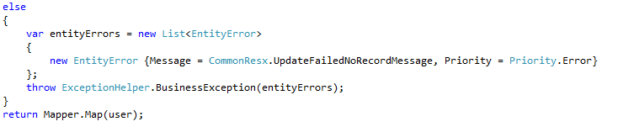
Web Architecture
Error Pattern
Exception Helper class in Common.Exceptions
Entity Error class in Common.Models
Assign Localized Message
Assign Priority (Severe Error, Message, Warning, Error, Security)
Multiple errors may be assigned
Duplicate messages removed before display
Displayed by generic routines in global.js
Web Screens
Notes:
The Sage 300 Web Architecture provides a rich mechanism for collecting messages, not just error messages. These messages can be displayed to the user through various message mechanisms as previously discussed.
Messages do not just come from the MVC layers. They can also come from the Accpac Business View’s error stack. Therefore, the messages are scrubbed before being displayed in order to remove any duplicate messages that might exist.
Most, if not all error messages, will make there way to the logging mechanism unless purposefully swallowed by the application. The error logging pattern will also provide the stack trace for better diagnostics and debugging.

Slide 35
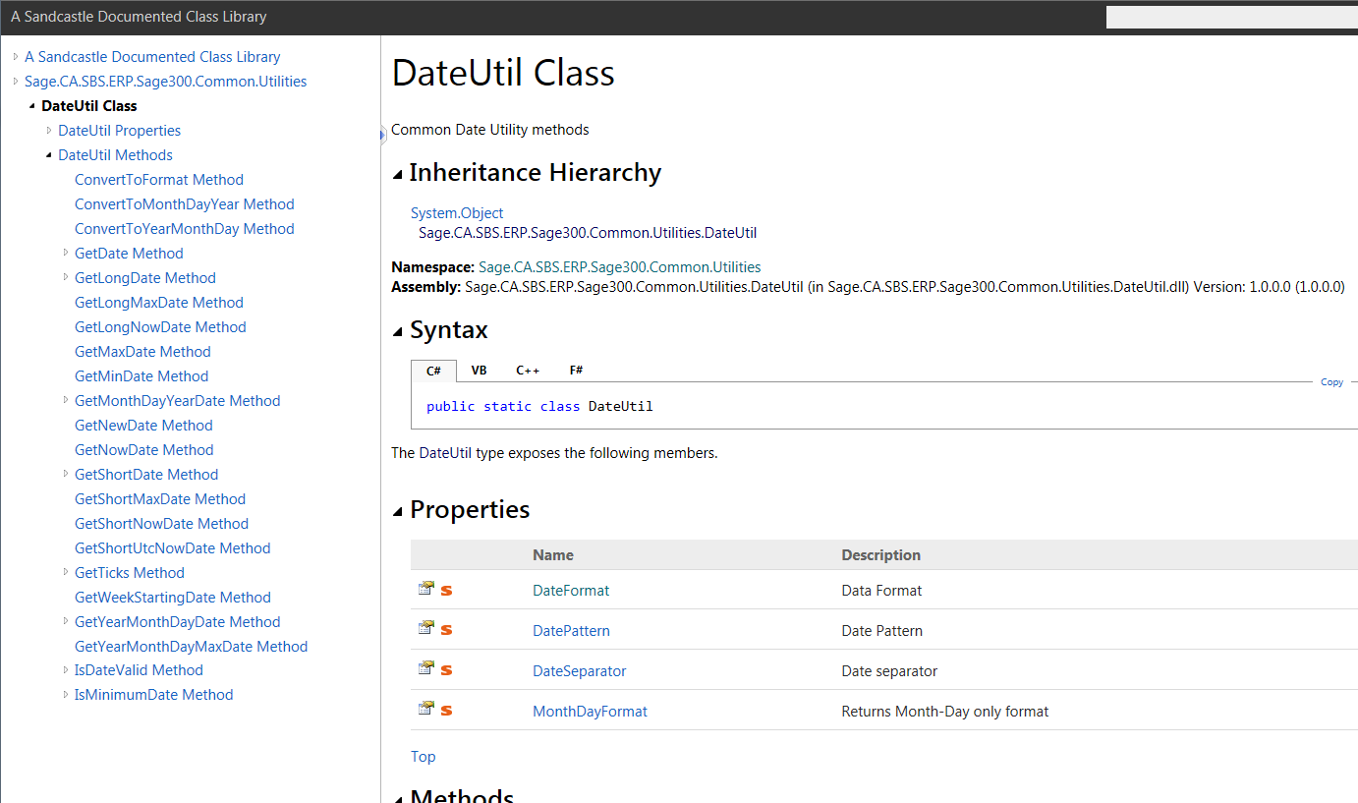
Web Architecture
Date Utility
Web Screens
Encapsulates System.DateTime
Minimum Date logic is centralized
Formatting based upon current culture
Simplicity reduces developer code
Standard pattern for Sage developers
Blog article on DateUtil Class
https://jthomas903.wordpress.com/2017/01/13/sage-300-date-utility/
Check CommonCore.chm in Web SDK
Notes:
Dates, Time, and the usage and manipulation of them are an important aspect of the Sage 300 Web Architecture. The Microsoft DateTime object is rich and powerful, yet in an application as large as Sage 300 operating with different locales, it is important that this usage be encapsulated. Also, the DateTime object has different “minimum date values” based upon how a DateTime object is instantiated.
The DateUtil class was created to not only deal with the different minimum date values and locale issues, but also to better encapsulate the manipulation of dates in code. Every developer was required to test the date for a null value or a minimum date value or other conditions and then assign a default value if any of these conditions were met. When the DateUtil class was introduced, it removed over 6,000 lines of code. Now, developers can call a simple one line function with the date in question and passing in a default value for the DateUtil class to evaluate and return accordingly.
The bottom line is that all date related functions must be done through the DateUtil class and not with the DateTime object. A blog article has been created that has all of the details, explanations and examples to become more acquainted with this class.

Slide 36
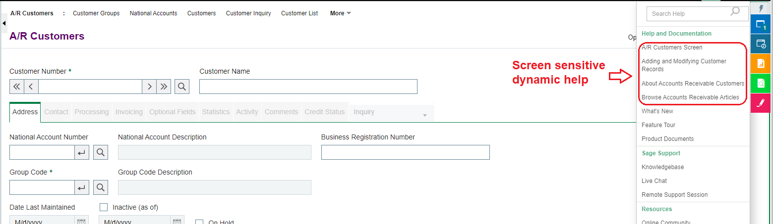
Web Architecture
Web Help
Web Screens
Participation in Help and Doc section
Seamless integration
Partner or customer hosted
XML discovered and items injected into help
Can even add to our help topics
Notes:
Another exciting feature is the ability to allow third-parties to participate in the menu help topics for their web screens. There is a desire to seamlessly integrate partner web screen and customization topics along with Sage 300 help topics. This new feature will accomplish this!
A partner will deliver an XML file plus an optional language resource dll for localization. The XML includes the requisite link or links for a screen or screens. Since Sage does not know the structure of the help URL, logic has been incorporated which will allow dynamic token replacement before rendering the link.
Note that Sage 300 will not host the link or content. This mechanism merely provides the ability for a partner’s help to be seamlessly injected into the Sage 300 help framework.
With this new implementation, and as added benefit, the partner can now add a link to one of our screen’s specific help topics. For example, imagine you customize our Order Entry web screen, and you want to provide help to your customer for that customization. This is now be possible!
Refer to the documentation in the SDK for the format of the XML, instructions for the optional language resource, and delivery instructions.

Slide 37

Web Architecture
IIS (W3WP.EXE)
Report Controller
Print Engine (Deprecated)
Print
Browser
ACCPAC.NET
Web Screens
Session Pool
A4WCOMSV
Report UI
A4WRPT
Web Screen
A4WCRInterop
CR Viewer
Client
CR Engine
Web Screen
CR Viewer
Server

Slide 38

Web Architecture
Print Engine (Current)
IIS (W3WP.EXE)
Print
Print
Browser 2
Report UI
Browser 1
Report UI
Web Screens
Report Controller
ExportReport.exe
Report parameters
ExportReport.exe
ACCPAC.NET
ACCPAC.NET
A4WCOMSV
A4WCOMSV
A4WRPT
A4WRPT
No more Crystal limit and memory issues
Improved performance as IIS not printing
If report crashes, IIS not affected
A4WCRInterop
A4WCRInterop
Crystal Report Engine
Crystal Report Engine

Slide 39
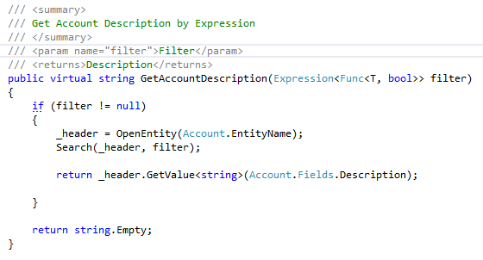
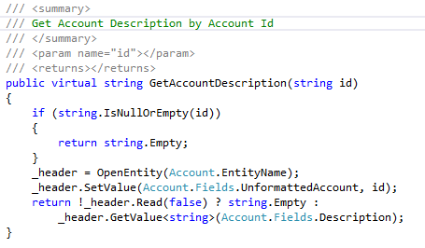
Web Architecture
Example 1 – Public methods to return a GL Account description
Notes:
In this example, the GL Account Repository has two public methods for returning the description of a GL Account. While the end result is the same, the Description property is returned, they go about it differently.
In the routine on the left, an expression is used as filter for finding the GL Account being requested. If a filter is specified, the entity is opened, a search is performed (which takes the expression and converts it to an Accpac Business View filter) and then the Description field is returned. But, it does not do one important task. Can you see it? It does not verify that the Search was successful. It assumes that the search was successful. But, this logic flows almost identical to what is being performed in a similar VB screen routine.
In the routine on the right, an id is used for finding the GL Account being requested. If an id is specified, the entity is opened, the id is set into the entity (a loosely-coupled version of the Accpac Business View), a read is performed and then if the read was successful, the Description field is returned. But, unlike the routine on the left, this routine does verify that the read was successful. Once again, this logic flows almost identical to what is being performed in a similar VB screen routine.

Slide 40
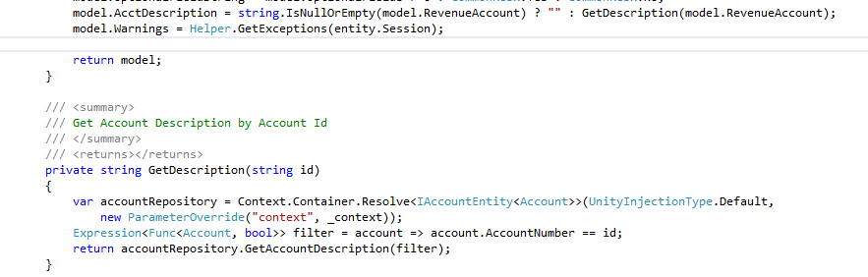
Web Architecture
Example 2 – Private method to assign a GL Description in mapper
Notes:
In this example, the AR Invoice Details Mapper has a private method for returning the description of a GL Account. It is conditionally invoked based upon the content of the RevenueAccount property in the model. The AcctDescription property in the model was added manually to the model and does not come from the Accpac Business View. So, while the model is being populated from the Accpac Business View in the mapper’s setter routine, this is the best place to also populate the AcctDescription property if there is a value for the account.
In the private routine, Unity is used to get a GL Account Repository object, a filter is constructed and the routine we saw in the previous slide is invoked. I’d be willing to bet that this private routine was the original consumer of the GetAccountDescription method and was assuming that if a value existed in the AR Invoice Details property, then it was also in the database. A valid assumption, but not a good defensive programming approach.

Slide 41
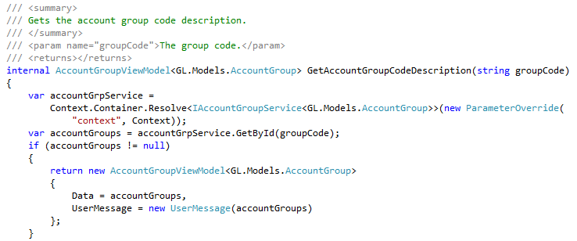
Web Architecture
Example 3 – Internal method to get a model
Notes:
In this example, the GL Account Internal Controller has a method for returning an account group view model. But, this routine has an issue. Can you see it? The method returns an AccountGroupViewModel, but the method name is indicating that it is getting an Account Group Code Description. This is very misleading and confusing. A better would have been GetAccountGroup.
The remainder of the routine is sound with the exception of the parameter name. We want to be agnostic in our naming whenever possible. In this example, we are clearly expecting a group code to be passed in. A better name would have been id.
Be clear. Be concise.

Slide 42
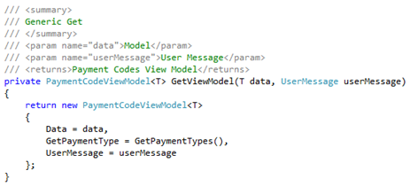
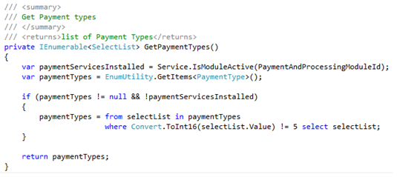
Web Architecture
Example 4 – Get a dynamic list based upon options
Notes:
In this example, the AR Payment Codes Internal Controller needs to filter the list of available payment types based upon whether or not the Payment Services module is activated.
In the routine on the left, GetPaymentType is a property in the View Model containing a list of payment types for the payment type drop down list. So, a local routine is invoked to return a filtered list of payment types.
In the routine on the right, the routine determines if the Payment Services (YP) module is installed and if it is not, the value 5 is removed from the list of available items. Can you see an issue with this? The logic is correct, however, it uses a magical number (5) and not a readable constant or enumeration that would make this easier to understand. It is a standard to not use magical numbers. But, the remainder of the logic is sound.

Slide 43
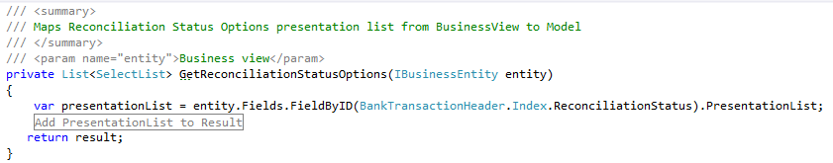
Web Architecture
Example 5 – Get a dynamic list based upon data
Notes:
In this example, the CS Reconcile Statements Mapper needs to get a new set of reconciliation status options for every row being displayed in the grid. This is because every row may have a different state and therefore a different set of drop down values for the same column in a grid.
In the line at the top in the mapper’s getter routine, the ReconcilliationStatusOptions property is a list of values for that property. However, with every row having a potentially different set of values, a local routine is invoked to return a list specific to the row.
In the routine on the bottom, the routine uses the Accpac Business View’s PresentationList to get a new set for the row. Remember that the PresentationList was used by the Code Generation Wizard to create the enumerations. Thus, every row has a dynamic list.

Slide 44
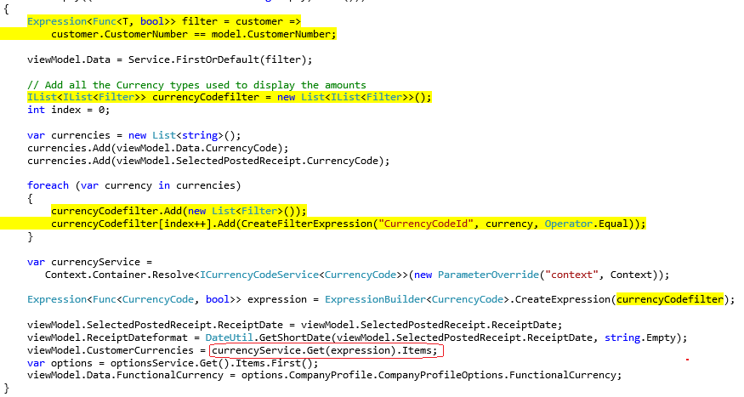
Web Architecture
Example 6 – Set a filter via an expression
Expression Builder cannot handle any LINQ statement
>, >=, <, <=, !=, Like, Starts With, Contains
Notes:
In this example, the IC Receipt Information Controller needs to set a filter by using an expression. This example is a good example of its power, but there are limitations.
The expression builder cannot handle any LINQ statement that can be constructed. Remember the purpose of the expression builder is to take a filter or expression constructed in today’s powerful language constructs like LINQ and translate them into a “two-dimensional” Accpac Business View filter.
Certainly more logic could be placed in the expression builder to handled more scenarios than are currently being handled today. But, if constructed with “standard” LINQ statements, the expression builder is able to translate into what the Accpac Business View is expecting, such as “>” (greater than), “<“ (less than), “>=“ (greater than or equal to), “<=“ (less than or equal to), “!=“ (not equal), “=“ (equal), “Like”, “Stars With”, and “Contains”.

Slide 45

Web Architecture
Customization
Sage 300 UI Customization Wizards
Standalone wizard to create JSON for manifest and XML for controls
Plugin wizard in Visual Studio for endpoints
Tutorials / Documentation / Samples
Multiple customizations for the same screen
Participation not inheritance
Sage 300 Admin Configuration screen
Enable / Disable and arrange priorities per customization
Subclassed properties available 1st class properties
Notes:
Web Customization Architecture - Participation
The web customization strategy differs from the desktop architecture which allows users to inherit an object, VB OCX, in order to participate with the methods and events of the object being inherited from. However, multiple customizations from different partners are not allowed to participate in the same customized screen. The web customization strategy allows multiple partners to apply their customization to the same web screen with the power of C-Sharp and JavaScript to manipulate objects.
Modifying core behavior in the Sage 300c web screen is achieved through a framework of C-Sharp and JavaScript code. The participation model used in the Sage 300c Web Screens allow multiple customizations to modify the core behavior of Sage 300c web screens, with each third-party customization behaving as though it is the only third-party customization present. The customizations are also safe, because none of the code of the original object has changed. Plus, customizations may be disabled or the order of implementation be changed without having to uninstall a customization.
Sage 300c web screens support multilevel participation, providing customization options without jeopardizing the integrity of the core business logic.
The external developers will use the standalone customization wizard to create a JSON manifest which describes the customization and the components which are to be included in the customization package. This wizard is also used to create an XML file of controls if controls are to be added as part of the customization. This wizard will be explained in detail in the Sage 300 Web SDK presentation.
As the screen is being rendered, there are routines in the MultitenantControllerBase (the base class for all Sage 300 web screens) which will determine if a customization or customizations are enabled for the current company and apply controls if there are any and apply JavaScript files if there are any. The custom controls are now active on the screen and the JavaScript events are actively listening for events both on custom controls and Sage controls. This is important as not only are events for new controls possible, but participation (and even hijacking of Sage events are possible).
A very nice feature of the customization strategy is the ability to disable a customization without uninstalling it. Image if a screen with n-number of customizations is having an issue. Customizations can be disabled one by one as the offending customization or core screen is determined to be the culprit.

Slide 46




Web Architecture
Customization – Developer Persona – Bundle a Customization
XML
JSON
XSD
DLL
JS
Bootstrapper
Developer uses wizard to create customization
Bundle contains multiple files
Zip file is the customization package
Notes:
Bundling a customization into a Customization Package simply entails adding the required files to a zip file.
Refer to the Sage300SDK_WebScreenCustomization_ManifestJSONFileSpecifications Word document in the docs/customization folder of the Web SDK as the JSON Manifest file will show all files that are to be included in the zip file. It does not specify the XSD file, but if an XML Settings file is included, the XSD file is to be included as well.

Slide 47


Web Architecture
Customization – Partner/Admin Persona – Import and Manage a Customization
Customization package delivered to customer
Partner/Customer uses admin screen to import customization
Package is validated and applied to the database
Notes:
Importing a customization into a Sage 300 installation simply entails logging into the Customization Admin screen and importing the customization package. The screen validates the format of the manifest and not its contents. A partner is solely responsible for creating the customization package and its contents. Sage 300 does not approve or disapprove of any custom code included in the customization.
Once the customization is imported, it is able to be managed, which entails assigning the customization to specific or all companies belonging to a system database. The customization can also be enabled and disabled by company, which is a great feature for disabling a customization without having to uninstall or remove components.

Slide 48
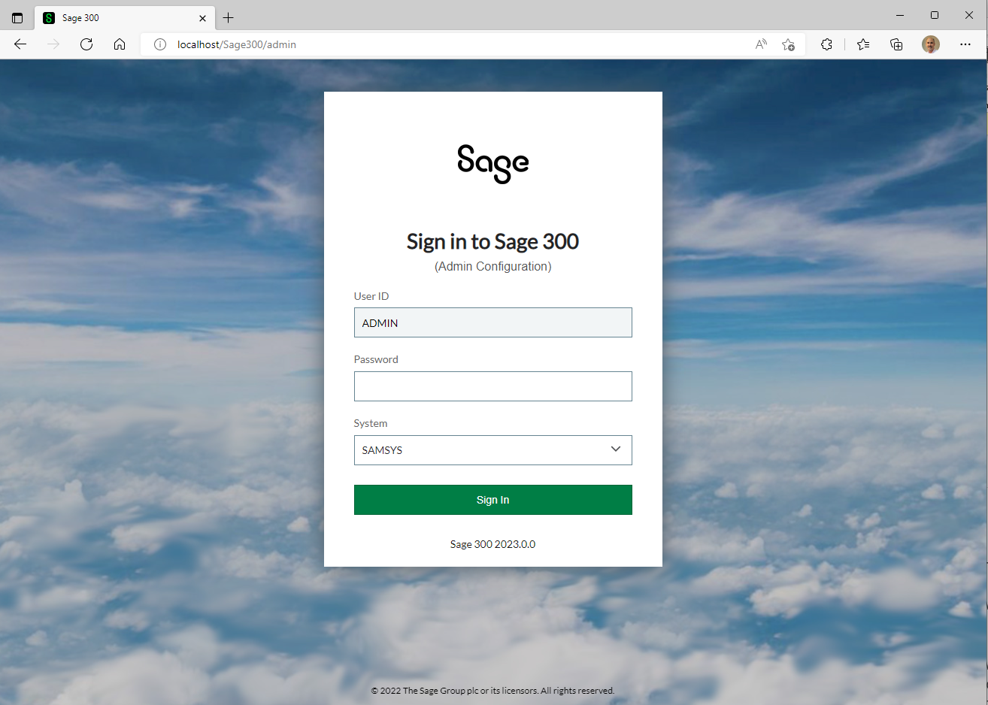
Web Architecture
Customization – Admin Login
Add “\Admin” to Login URL
Enter User & Password
Select System Database
All companies belonging to system database must be up-to-date
Notes:
The Sage 300 Web Architecture provides a customization administration login screen which provides access to a screen where customizations are managed.
Simply append “Admin” to the end of the standard Sage 300 URL (…sage300) to display this login screen as opposed to the login screen for the web screens. Note that Sage 300 cannot be run in multiple tab pages within a single browser instance. We have a whitepaper on addressing this, but this is not possible at this time as core framework components share the IIS Session ID which is only unique to the browser session and not the browser tab pages. Thus, this also applies to this administration login and Sage 300 must be signed out if open in another tab page.
The selection of companies is also different in this login screen as compared to the application login screen. The application login screen shows the companies that are associated with a system database whereas this screen only show the system databases that are available. This is because once in the customization administration screen, a customization may then be applied individually to company databases belonging to the system database.
The Desktop login screen and process performs not only the login process, but also any database or product updates that may have been applied. This functionality is not present in either the web login or the web customization admin screen. Warning messages will be displayed that an upgrade or update needs to be performed first by running the desktop login process for all companies belonging to a system database.

Slide 49

Web Architecture
Desktop/Web Technologies
External Dependencies
Cross Product Integration
Identity Management
Permission / Authorization
APIs
Deployment

Slide 50

Web Architecture
External Dependencies
Common
Crystal Reports
Desktop
VBA Macros
Web
JavaScript (JQuery)
Knockout
Kendo UI Widgets
Notes:
Both the Sage 300 Desktop and Web architectures rely on Crystal Reports. However, they use different libraries as the web requires the Crystal Library for the web.
The Sage 300 Desktop architecture relies on VBA Macros for the customization strategy in the desktop. Macros as not possible in the web. Julia wants shirts that state that “Macros are Dead!”.
The Sage 300 Web architecture uses Knockout for performing data binding to the Kendo UI Widgets and JavaScript is the language used for eventing and methods required by the web screens. Every release we determine if any newer versions of these dependencies exist and if so, what is the risk and effort to upgrade. We always want to “natively” implement these dependencies as any modifications to a version make upgrading to a newer, current release burdened by effort and risk.

Slide 51
Web Architecture
Cross Product Integration
Common
Sage Payment Services
Sage Payment and Banking Cloud
Desktop
Sage Intelligence Reporting
Sage Advisor Update
Sage CRM
Sage Direct Deposit
Sage HRMS
Sage PEP
Web
Sage CRM
Sage HRMS (Coming 2024)
Sage Intelligence Reporting (Deprecated 2024)
Notes:
Both the Sage 300 Desktop and Web architectures rely on numerous Sage products.
For the desktop, the Sage Intelligence Reporting uses Excel as the storage and delivery format whereas the web uses Sage Intelligence Reporting Cloud (SIRC), which uses HTML as a storage and deliver format. The two versions are not compatible.
For the web, the Sage CRM team has come out with a new web based product. The Sage CRM integration in the desktop uses a sync engine plus 180+ ASP.NET web pages for display. The integration for the Sage 300 web screens will keep the sync engine and deprecate the 180+ ASP.NET web pages. Instead, Sage CRM will invoke the Sage 300 web screens in context and thus remove the “middle man” behavior and greatly simplify the integration.
For the web, the SageID integration is only used when the Sage 300 web screens are deployed in the public cloud (Azure).

Slide 52

Web Architecture
Identify Management
Common
Access Rights assigned to Business Views (Business logic)
Screen access adheres to Business View Rights
Administrator access rights can be applied for super-users
Additional Security Rights can be added/subtracted at the screen level
Application Security Mode (password required)
Web
HTTPS Protocol
Notes:
Both the Sage 300 Desktop and Web architectures rely on the access rights assigned to a business view to determine not only access, but screen access as well. Additional rights may be added for the screens performing Import, Export or other functionality.
The Application Security Mode is established in the Database Setup Screen of the desktop. This feature is considered optional for the desktop, but strongly suggested for the web as the browser exposes access to the application.
Secure mode or HTTPS is also strongly suggested for the web as this protocol helps to hide the header and other information in the browser request which hackers can use to gain access and knowledge of a system.

Slide 53
Web Architecture
Permission / Authorization
Common
User Authentication Only (No Application Security)
User and Password Authentication
Desktop
Windows Authentication
Web
Sage 300 Web API
Basic Authentication
Notes:
Both the desktop and the web screens have the ability to accept a User and Password or a User only for authentication. The Application Security Mode is established in the Database Setup Screen of the desktop. This feature is considered optional for the desktop, but strongly suggested for the web as the browser exposes access to the application. Not selecting this checkbox means that a password will not be required to be entered. This option is only available for the System Database as the Company Databases inherit this setting.
The desktop has an additional feature where Windows Authentication is used to map the windows user to a Sage 300 user. This can simplify the login process. This is a feature that will be looked at in the future for the web screens as well.
The RESTful web services use Basic Authentication. A dialog will be presented requesting user and password credentials. This dialog is surfaced by IIS and does not have the business logic in the Sage 300 login screens to force the entered values into upper case. Be aware that entry in lower case letter will fail the authentication logic. In the future, we will move from Basic Authentication to authenticating via an OAuth mechanism.

Slide 54

Web Architecture
APIs
Common
XML
Desktop
COM, .NET API, SOAP, VBA, Macros
Web
.NET API (Internal)
Web API (REST APIs)
JSON
Notes:
For the desktop, other kinds of interfaces to the business logic, such as macros and import/export features, communicate with the business logic through a Common Business Logic Interface (CBLI), which has various components (API, XAPI, COM, .NET). This wealth of interfaces allows programs written in most programming languages to interface with Sage 300, including Visual Basic, Delphi™, Java®, JavaScript™, Perl, C#, C/C++, and J#.
For the web, the RESTful web services use a light-weight MVC model and the .NET API to interact with Sage 300 data. The Sage 300 Web API is installed when web screens are installed. The URL can be constructed manually or Swagger can be used to display all of the available endpoints, display the verbs/actions available for each endpoint and Swagger even provides the ability to see the payload, set different options and even tryout various settings to see the results.
For the web screens, the customization strategy uses XML for identifying the controls to be added to a screen and JSON as the format for the manifest. Once consumed by the Customization Administrator, the content to applied where it can be enabled and disabled and applied to various companies.

Slide 55
Web Architecture
Deployment
Common
Standalone or All-In-One
Database Server
Install Shield
Desktop
Application Server and Workstations
SPC
Web
Web Server(s)
Browser based Clients
Notes:
Both the desktop and the web screens have the ability to perform a standalone or All-In-One deployment or installation. The All-in-One Configuration is where all components are installed on a single server. The server will handle all aspects of the Sage 300 Application, such as web traffic for the web screens, supporting the classic screens, shared components access and the application’s data.
Both the desktop and the web screens have the ability to deploy or install the Sage 300 Shared Components and Sage 300 Databases on a database server. The Shared Data folder and location of the Sage Data is specified during the installation process, which uses Install Shield 2016.
For the desktop, a Windows peer-to-peer network allows the server and workstations to share resources. This type of network is good for small workgroups, consisting of two to five workstations networked together using Microsoft Windows Network. One of the workstations acts as a server, allowing other computers to access data stored on its hard drive. If more than two users require concurrent access to Sage 300 data or programs, the workstation acting as the server should be dedicated. You may encounter performance issues if you run Sage 300 on the server at the same time as other users are accessing Sage 300 from their workstations. And, In a client-server configuration, Sage 300 programs and databases are on one or more dedicated servers. The optional Terminal Server may also reside on the same physical server. Workstations may access programs as well as data from the server(s), or may have Sage 300 programs installed locally for better performance.
For the web, the Sage 300 Web and Business Components are installed on either a single web server or multiple web servers and the Sage 300 Shared Components and Databases are installed on a database server. The Sage 300 web screens, while having a three-tier architecture, do not have a three-tier deployment architecture. In our current implementation, the web screens on the web server communicate with the Sage 300 Business Components installed locally on the web server not the application server. In addition, some of the web screens communicate directly with the database server rather than going through the application server as would be the case for conformation to a three-tier deployment architecture. This implementation violates the how the layers communicate in a three-tier deployment architecture. However, a configuration such as this is useful to customers accessing both the classic and web screens. The Sage 300 Business Components are installed on both the web server and the application server. The Sage Shared Components and Databases are installed on the database server. Therefore, the Sage 300 classic screens can be run on the application server and the Sage 300 web screens can be run on the web server. In the future, a true three-tier deployment architecture will be implemented where the web server(s) only communicate with the application server which only communicates with the database server.

Slide 56
Web API
Overview
Notes:
In discussing the API and SDK, we’ll look at what composes the API and the content of the SDK. We’ll cover the benefits in leveraging the API and the benefits in using the SDK. I hope to show how using these two resources can accelerate development.
One point that I want to stress before we begin is that we do not distinguish between an internal and an external developer. And, by an external developer, I am referring to development partners and ISVs. We want external developers to have the same experience and opportunities as internal or Sage developers. Of course, there will be some differences like direct access to the framework, but internal developers use the SDK and API too, and our QA folks reply on the API as well to validate data. Therefore, the API and SDK are valuable tools for all Sage 300 developers.

Slide 57
Web API
API
REST
OData
Install
Payloads
Access
Security
OpenAPI
Goal
“The goal of the Web API is to provide a stateless protocol for a simple and effective strategy for interacting with Sage 300 data”
Notes:
Starting off with the API, the goal of the API is to provide a simple and effective way to interact with Sage 300 data.
An API, if done correctly, standardizes the exchange of data. Differing technologies or programming languages may have gathered or will receive the data, but the API strategy will allow for seamless communication.
So, let’s see how this is accomplished.

Slide 58
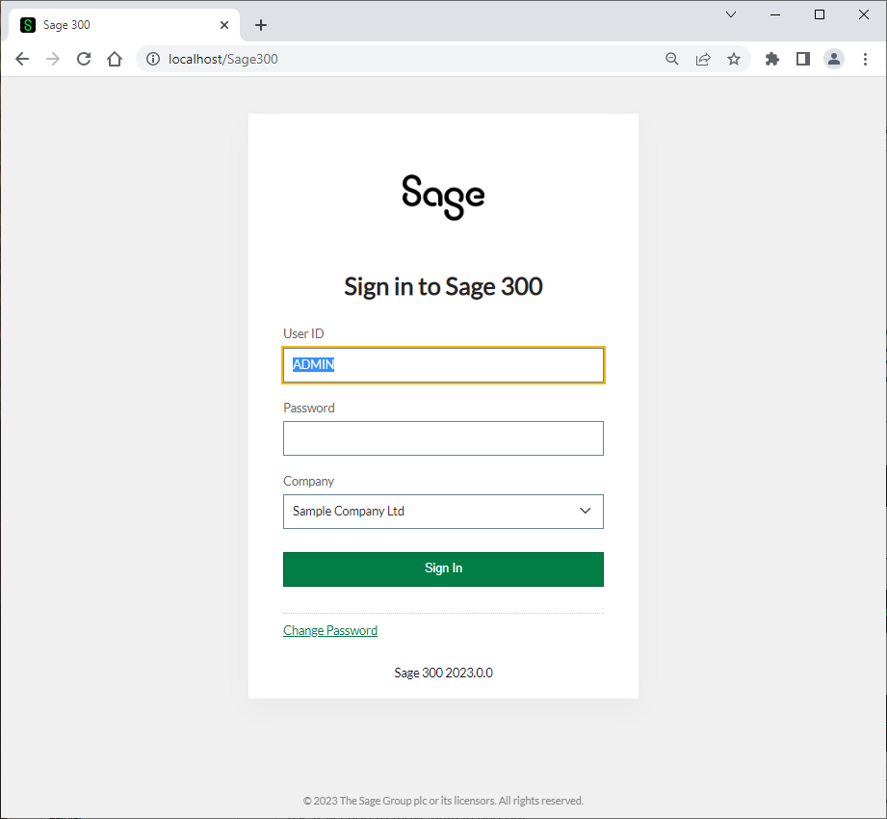




Web API
RESTful Web Services
Request
RESTful
Lightweight MVC Objects
Response
.NET API
MVC Objects
SQL Server
Business Views
APIs are at the heart of Sage 300 and leveraged from multiple clients and technologies
Notes:
The API consists of RESTful web services that use a lightweight MVC model to communicate with the Sage 300 .NET API. This lightweight model is generated by a wizard which generates these models from the Accpac Business Views. Thus, the API does not use the same models as the Web Screens since those models are decorated with attributes and use a mapping layer to move data in and out of the model. The models in the API use reflection to move data in and out.
For those of you who have worked with the .NET API, the web services are a wrapper around this .NET API, which in turn is a wrapper around our COM API. That’s great news since whether data is being accessed via COM, or the .NET API or the web services, the same business logic – validations, restrictions, assumptions, etc., are executed. This API while having a different interface, access and other features will access data with the same integrity as the other APIs.
As you can see, APIs are at the heart of Sage 300.
Let’s consider OData.

Slide 59

Web API
OData Protocol
“Open Data Protocol is an open protocol that allows the creation and consumption of queryable and interoperable REST APIs in a simple and standard way.”
https://www.odata.org
OData
Open Data Protocol
$skip
GET http://localhost/Sage300WebApi/v1.0//-/SAMLTD/AR/Customers?$skip=100
$top
GET http://localhost/Sage300WebApi/v1.0//-/SAMLTD/AR/Customers?$top=5
$filter
GET http://localhost/Sage300WebApi/v1.0//-/SAMLTD/AR/Customers?$filter=ShortName eq 'BLACK‘
Notes:
Our OData implementation makes use of standard language and syntax patterns in the URL and the query string parameters.
The query option section begins with a “?" and individual query options are prefixed with a "$".
You can do $skip, $top, $orderby, $filter, and other standard query options which are documented in our API developer reference guide.
By implementing OData, it helped us focus on our business logic while building this API without having to worry about the approaches to define request and response headers, status codes, HTTP methods, URL conventions, media types, payload formats and query options etc.
What about how the API is installed?

Slide 60
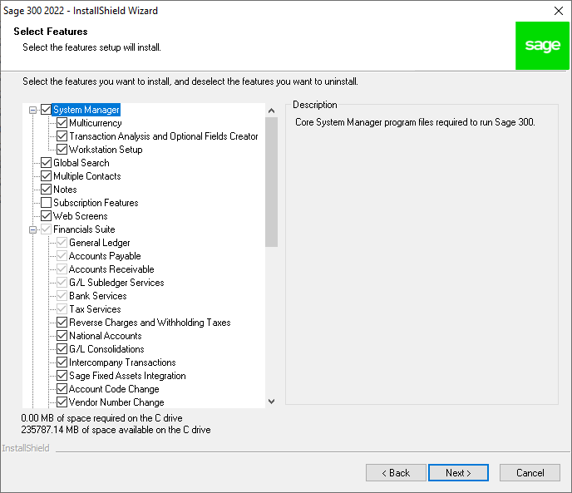
Web API
Installation
Installed with the Web Screens
Notes:
The API is installed when the Sage 300 Web Screens are installed and are part of the application, not the SDK. Although users of the API will typically be SDK users, this is not a requirement. Because of the OData protocol, the OpenAPI implementation (Swagger), the simple to understand URL segments, and simply the technical ability of our partners and customers, using the API is intuitive. The API is installed with the web screens option, and they are ready to use!
There have been some discussions that this API should be a separate installation and not tied to the web screen installation. I’d be interested to hear your thoughts on this!
The Sage 300 web screens even use the API internally to support our integrations with Sage Intelligence Reporting Cloud (SIRC) and Sage CRM. The security groups for the module’s resources must be enabled otherwise access will be denied. I’ll talk about this more when we cover security for the API.
Note, unlike our other APIs, this API does not consume a LanPak license! Let me repeat that. The usage of this API does not consume a LanPak license.
Let’s now talk payloads.

Slide 61
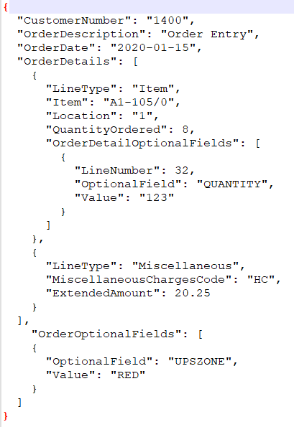
Web API
Payloads
User Friendly Names
Sample Payloads
Versioned Endpoints
Notes:
The API payloads use lightweight MVC models which allow for friendly names as opposed to the cryptic field names that are found in the business views and .NET API. These payload definitions come directly from the business view just as the Code Generation Wizard uses these definitions to create user friendly names for the web screens. But the API models do not require the various attributes and mapping objects since there is no UI in the API and data is mapped via reflection. Thus, then cannot and do not share the models.
In the SDK, you will find various sample payloads for most modules to assist with understanding not only the payload, but the minimal requirement for crucial endpoints. Use these samples in Swagger to see just how easy it is to post and get Sage 300 data with the API! Note: You will want to modify the data found in these sample payloads as needed for your own company and database.
Also, we have versioned endpoints which allows Sage to release new versions of the API without breaking previous versions. A mapping layer, under the covers, understands what the API version is compatible with from a Sage 300 version perspective (i.e., 1.0 → 2017, 2018, 2019, 2020, 2021, etc.).
So, how can the API be used?

Slide 62
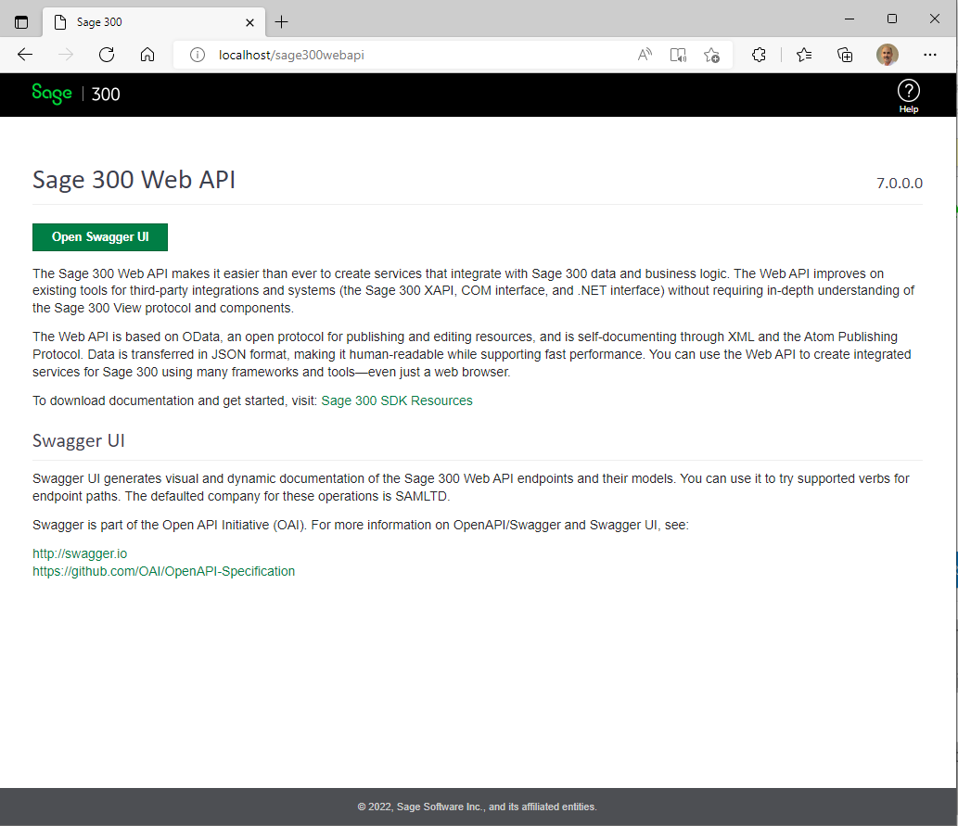
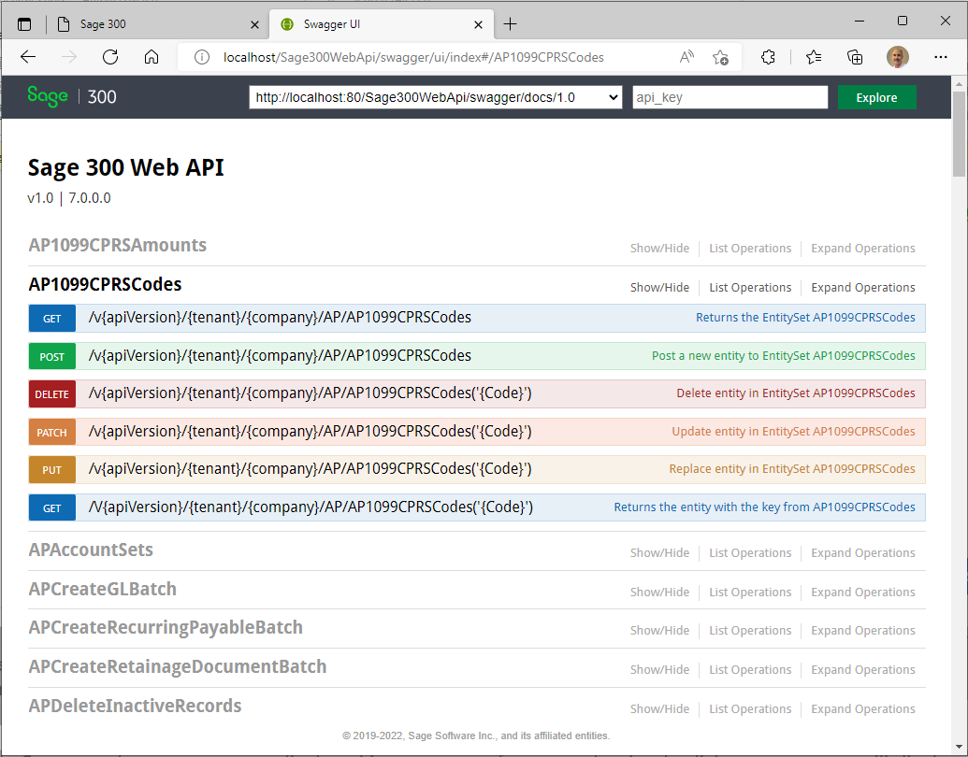
Web API
OpenAPI (Swagger)
Sage 300 Web API Landing Page
Swagger UI
Notes:
Sage 300 provides a landing page where the consumer of the API can go for useful links and resources. The “Open Swagger UI” button will display the Swagger UI for codeless and untethered access to Sage 300 data.
The OpenAPI or Swagger is a specification for machine-readable interface files for describing, producing, consuming and visualizing RESTful web services and Sage 300 has leveraged Swagger to provide a collection of HTML, JavaScript, and CSS assets that dynamically generate beautiful documentation from a Swagger-compliant API. This dynamic documentation feature eliminates the need for static documentation and at the same time offers an intuitive and robust UI for driving the API.
Once in Swagger, the resources are displayed in a summary format and a simple click on a resource will display the various actions or verbs supported by the resource. Note that not all actions are supported by every resource, and we’ve had to decide if a resource should even be exposed (i.e., payroll or users, etc.)). The SDK has documentation for our resources (although Swagger also provides this documentation) as well as a developer reference guide.
What about coded access?

Slide 63
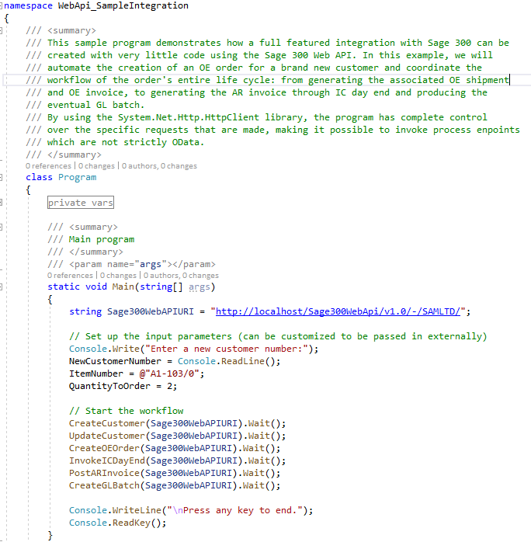
Web API
Coded Access
Samples and Tutorials
Documentation
Notes:
You can use the language of your choice for coded access.
In the SDK you will find multiple completed samples along with documentation with step-by-step instructions for creating the samples from scratch.
For example, the Integration Sample uses a C# console program to illustrate how easy it is to make API calls and you will programmatically create a customer, update the customer, create an order, invoke the inventory control’s day end, post an invoice and finally create a batch all through the API. This is a great sample for getting used to the API and programmatically driving it as well.
There are a couple of other samples that invoke other functionalities such as retrieving a range of customers, retrieving a customer with a key, deleting a customer, and creating an invoice.
There is even a sample that uses Chrome’s Postman Utility to load an execute Postman scripts. This sample was created prior to the adoption of Swagger, and we feel that Swagger is more intuitive, provides better documentation and is easier to use than Postman. However, for the postman users, this sample is still valid and handy!
How about security?

Slide 64

Web API
Security
User Access Rights
Sage 300 Web API Security Group
ADMIN Access
Notes:
The API uses Basic Authentication, which is a Sage 300 user id and password. Note that the credentials dialog presented by Swagger is not a Sage 300 dialog and therefore careful attention must be paid to the case of the input. If you enter the user and password in lower case characters, the validation will fail whereas credentials entered in a Sage 300 dialog will not as they resolve properly. And the user credentials must have access rights to a resources module and the module must belong to Sage 300 Web API Security Group. Access to a resource will fail without this proper setup first.
Let’s discuss ADMIN access in the API. We will avoid the discussion as to whether the ADMIN user should ever access the API, but as developers we do!
The ADMIN user will require an additional step for accessing the API. The web.config file has a flag indicating whether the ADMIN user is allowed access. This has been implemented for a couple of reasons. The first is that there is a Web API security group per module that restricts standard/normal users from the API. However, the ADMIN user does not pay attention to security groups since ADMIN is a king! The second reason is that the API is publicly exposed (within the company’s firewall). Therefore, the flag in the web.config file is defaulted to false and thereby disabling ADMIN access.

Slide 65
Web API
Benefits
API
Easy to use
Less data transfer
Consistent
No UI
Integration
JSON
Notes:
That’s our Sage 300 Web API!
There are numerous benefits to using it, such as:
It is quick and easy to use whether you are using Swagger to access it or have written a coded access
The structured nature of the endpoints (segments, version, resources, naming conventions, etc.) along with the OData implementation makes for a consistent experience. And consistency is the key!
It supports JSON for a smaller and faster payload plus the payloads can even be minimized to only require requested and/or required fields
Finally, the API can play an important role in any integration, testing, debugging, or validation story
Let’s move on to the SDK.

Slide 66
Web SDK
Deep Dive

Slide 67
Web SDK
SDK
Wizards
Docs
Resources
Samples
Source
Goal
“The goal of the Web SDK is to get developers up and running quickly and easily.”
Notes:
The goal of the SDK is to get developers up and running quickly and easily.
The SDK includes productivity tools (wizards and utilities) for the generation and customization of Web UIs. It also includes documentation, language resources, standalone and customization samples, and even source code for the wizards, utilities, and even samples.
The Sage 300 ISV and Development Partner community have applications, add-ons, and plug-ins for Sage 300. These are very exciting and are the life blood to the community and were built with the Sage 300 SDK (non-web) in order to ensure compatibility with Sage frameworks and the Sage 300 application.
It is these applications and customizations that will need to be re-written for Sage 300’s web screens. The SDK will aid in getting screens developed quicker by creating a Visual Studio solution based upon the same structure which Sage 300 uses internally. It will also generate code for a screen/report based upon a business view or business views or a report.
Let’s start looking at the SDK with the wizards.

Slide 68
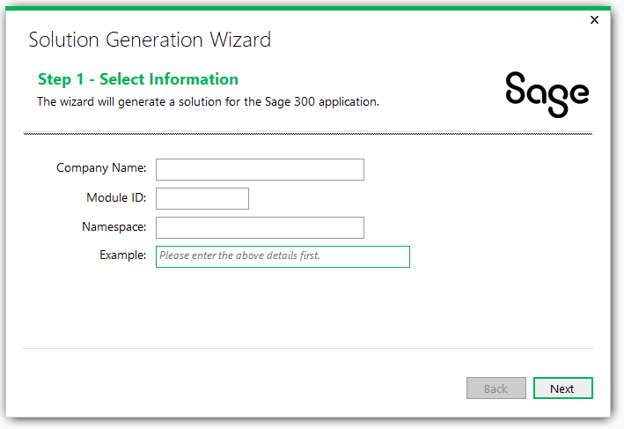
Web SDK
Solution Generation Wizard
Business Repository Project
Code files for the Entity Repositories, Entity Mappers, Menu Navigation XML, Security Constants
Interfaces Project
Code files for the Entity Repository/Service Interfaces
Models Project
Code files for the Models, Model Enumerations, etc.
Resources Project
Code files for the Resources (Resx Files)
Services Project
Code files for the Services
Web Project
Code files based upon MVC patterns (Controllers, View Models, JavaScript, Razor Views, Configuration files, and so on
Notes:
First off is the Solution Wizard, which is a Visual Studio plugin, it is invoked from the New Project dialog in the Visual Studio IDE. It will create the required projects in preparation for creating screens, reports, inquiries, etc. The solution created is aligned with how ASP.NET tools create solutions and allows the wizard to leverage everything built into Visual Studio. Therefore, instead of a separate utility, the wizard is embedded directly into the IDE for efficiency.
Six projects created in the solution:
Business Repository Project - Code files for the Entity Repositories, Entity Mappers, Menu Navigation XML, Security Constants.
Interfaces Project - Code files for the Entity Repository/Service Interfaces.
Models Project - Code files for the Models, Model Enumerations, etc.
Resources Project - Code files for the Resources (Resx Files)
Services Project - Code files for the Services.
Web Project - Code files based upon MVC patterns (Controllers, View Models, JavaScript, Razor Views, Configuration files, and so on.
Refer to the SDK for docs on this wizard in addition to several tutorials

Slide 69
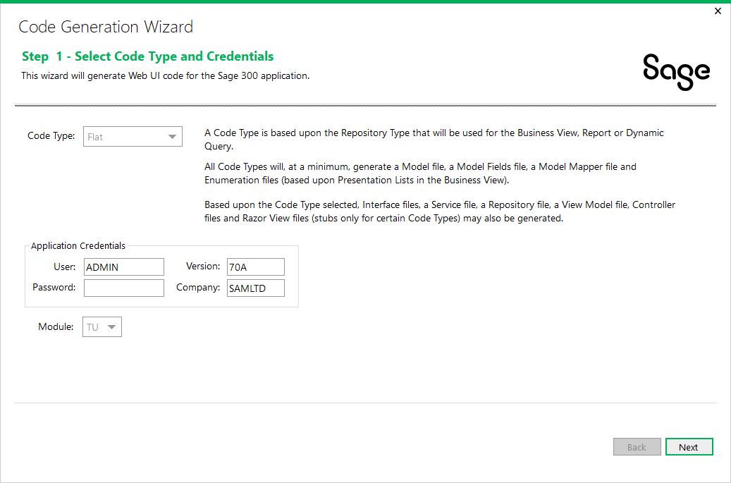
Web SDK
Code Generation Wizard
Generate code in projects based upon code type
Uses Business Views to generate code
Flat Code Type
Simple setup screens using FlatRepository class
Process Code Type
Process screens (long running screens usually with a progress meter) using the ProcessRepository class
Dynamic Query Code Type
Screens without a Business View (i.e., KPI) or where direct SQL Statements are required for performance and uses the DynamicQueryRepository class
Report Code Type
Report screens using the ReportRepository class. It uses a model created in the wizard from the selected report to generate code.
HeaderDetail Code Type
HeaderDetail screens using the HeaderDetailRepository class
Notes:
The Code Generation Wizard, which is a Visual Studio plugin, is invoked from the Solution Explorer. It will generate code in the different projects based upon the selected code type. All code types generate the set of code required to fully compile and run a screen. The projects are aligned with how Sage internal developers create their web screen projects. Accessing the wizard from the right-click of the solution within the Solution Explorer window is ideal since this wizard is available in the IDE and we will be generating code for all projects in the solution.
There are different code types associated with the behavior of the screen:
Flat Code Type - Simple setup screens using the FlatRepository base class. It uses an Accpac Business View to generate code.
Process Code Type - Process screens (long running screens usually with a progress meter) using the ProcessRepository base class. It uses an Accpac Business View to generate code.
Dynamic Query Code Type - Screens without an Accpac Business View (i.e. KPI) or where direct SQL Statements are required for performance. Uses the DynamicQueryRepository base class. It uses a model created in the wizard to generate code.
Report Code Type - Report screens using the ReportRepository base class. It uses a model created in the wizard from the selected report to generate code.
HeaderDetail Code Type - HeaderDetail screens using the HeaderDetailRepository base class. It uses Accpac Business Views to generate code.
Refer to the SDK for docs on this wizard in addition to several tutorials

Slide 70
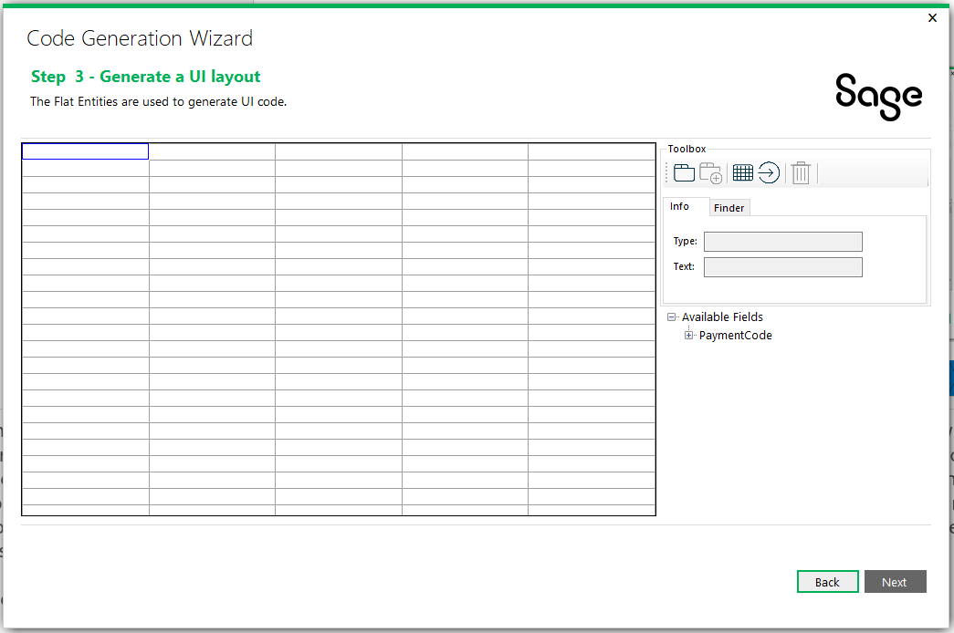
Web SDK
UI Layout Wizard
Wizard for generating UI widgets
Drag and drop model properties on palette
Create tabs and buttons and grids
Generates labels, textboxes, checkboxes, dropdowns, radio buttons, finders, etc.
Notes:
As mentioned, the UI Layout Wizard is a new step that is being added to the Code Generation Wizard. Once a view or views have been specified for creation, there will be an extra step before generation which will give the developer the opportunity to roughly layout the UI. The properties in the new model can be dropped onto a palette indicating their basic placement and their underlying data type will dictate in most cases the widget that will be used, but this can be overridden in some cases. For example, you might want a dropdown control for a list, or you might want radio buttons. The wizard will allow this type of assignment based upon the data type of the property. Additionally, the developer will be able to create tabs and grids and buttons too.

Slide 71
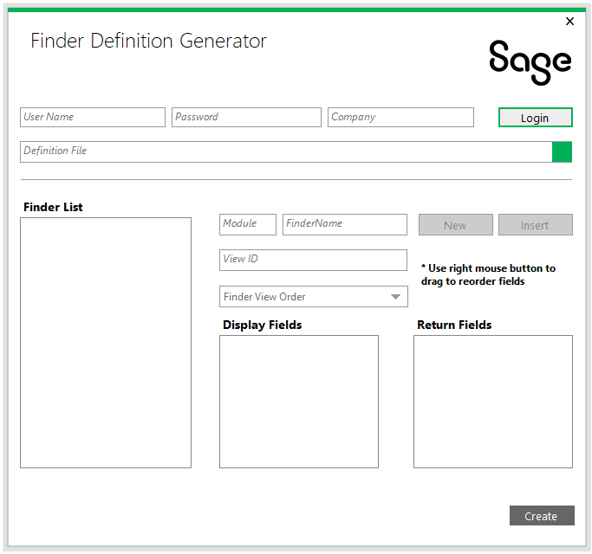
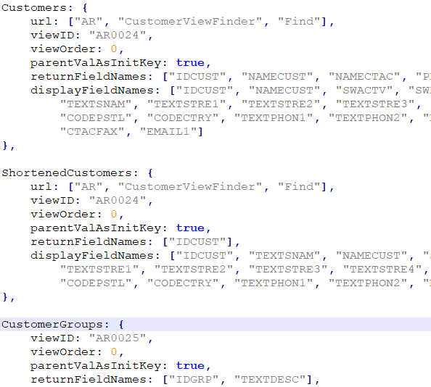
Web SDK
Finder Definition Generator
Create and modify finder definitions
Prerequisite for selecting finder definition in Code Generation Wizard
Notes:
The Finder Definition Generator will allow for the creation of finder definitions. Finders can either be defined in a static JavaScript file or be dynamically created. For finders that are used in multiple places, a common definition is ideal. The UI Layout Wizard will require that fields being specified as requiring a finder have a definition predefined. This wizard will be available from within Visual Studio as a plugin.

Slide 72
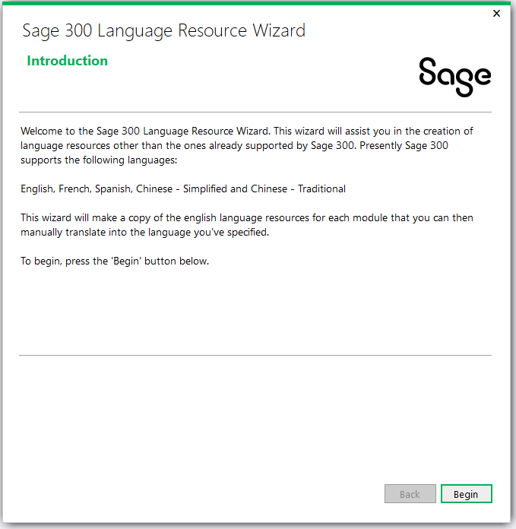
Web SDK
Language Resource Wizard
Generates new language resources for languages other than the supported languages
English, Spanish, French, Chinese Simplified, Chinese Traditional
Notes:
The Language Resource Wizard, which is a Visual Studio plugin, is invoked from the Solution Explorer. It will generate new language resources for languages other than the ones currently supported by Sage 300 (English, French, Spanish, Chinese Simplified and Chinese Traditional).
Language resources are provided for this wizard driven by the English resource to create a new language resource specified in the wizard. The next step is translation which the wizard does not do, and the final step is compilation so that the new language resources can be delivered by the partner to a customer. As an added benefit to including the resources in the SDK is the ability to modify our resources if desired!
Just a note that the web screens may contain messages originating in the web screens or from messages originating in the business layer. The messages originating in the business layer are not available for translation via this utility. That requires some additional steps, but this wizard simplifies the creation of the resources for any new language.
Refer to the SDK for docs on this wizard.

Slide 73
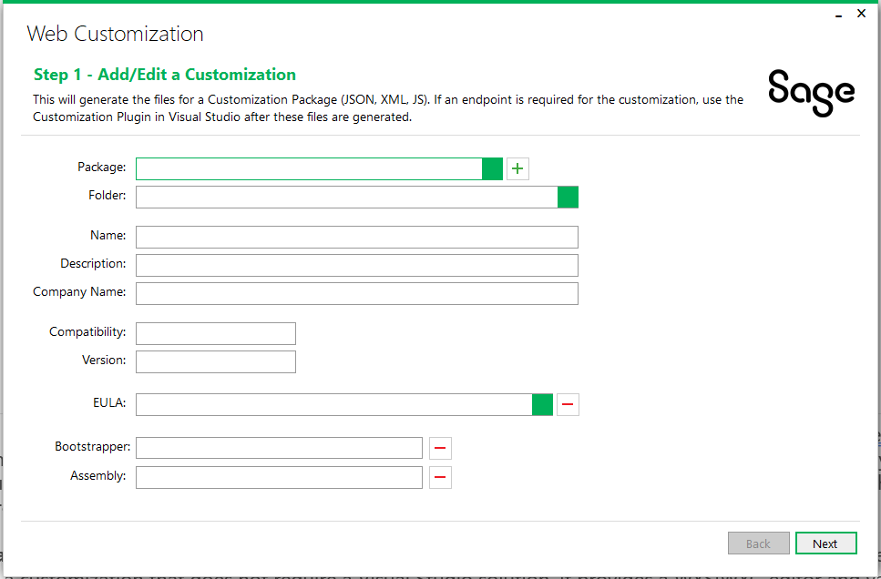
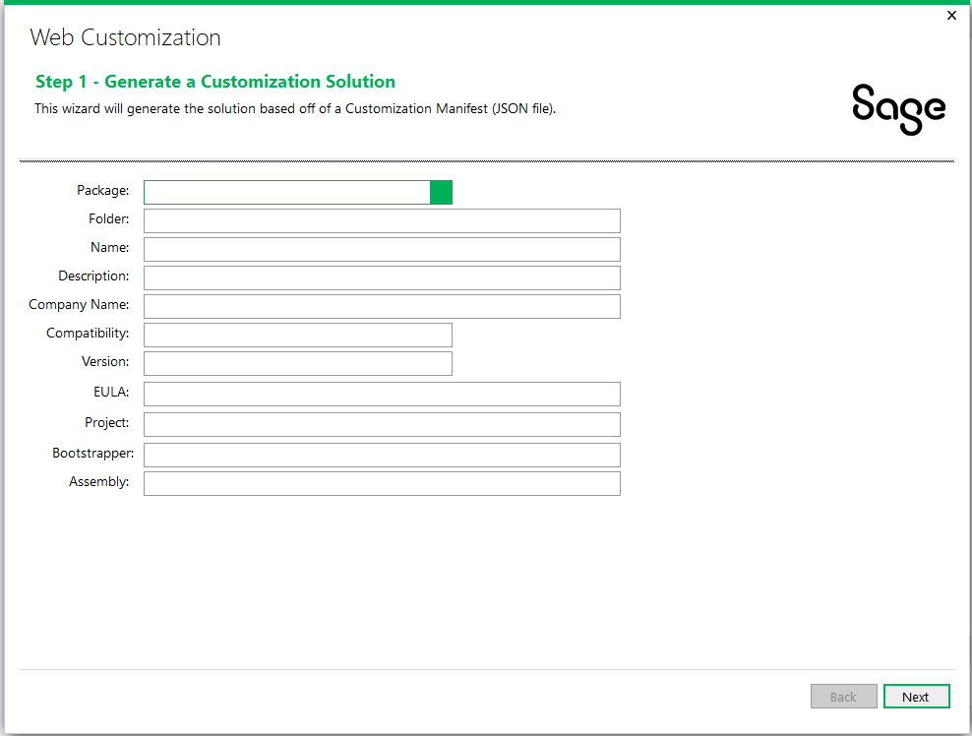
Web SDK
Customization Wizards
Standalone executable
Does not require Visual Studio to establish base customization
Visual Studio add-in and uses manifest established in standalone wizard
Required if endpoint for customization is required
Modifies manifest established in standalone wizard
Notes:
The customization strategy differs drastically between the desktop and the web. Where the desktop is an inheritance model (i.e. the desktop screen’s OCX is inherited and customized as desired), the web strategy is a participation model where a partner or multiple partners may customize the same screen. At the end of the customization process in the web, there is only 1 screen with multiple customizations as opposed to the desktop where there are multiple customized screens.
The Standalone Customization Wizard is an executable which simplifies and enhances the customization experience where developers are not forced into Visual Studio to create a customization that does not require a Visual Studio solution. It provides a WYSIWYG editor and validations for JSON and XML files. The wizard will walk you through screens where you setup the manifest for the customization, select the screen or screens to be customized, select the control or controls (if required) to be added to the screen to support the customization and finally let’s you review the customization before generating the manifest, xml settings file and a JavaScript template file.
The Plugin Customization Wizard, which is a Visual Studio plugin , is invoked from the New Project dialog. It simplifies the creation of the Visual Studio solution by reading the JSON manifest created in the standalone customization wizard. This wizard is only required if the customization requires an MVC project (i.e., endpoints). Once the solution is created this wizard will update the manifest with relevant information in the manifest when an assembly is attached, such as, Assembly Name, Bootstrapper Name, etc.
Refer to the SDK for docs on these wizards

Slide 74
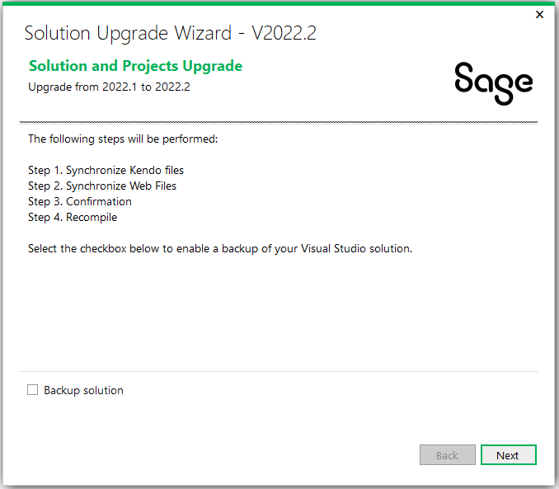
Web SDK
Upgrade Wizard
Upgrades solution and projects from a previous release to current release
Manual steps may be required and are documented if wizard is unable to perform an upgrade step
Notes:
The Upgrade Wizard, which is a Visual Studio plugin, is invoked from the Solution Explorer. It will upgrade any Visual Studio solution and projects from a prior release in order to be compatible with a new version of Sage 300 and the SDK. Note that the upgrade is only relevant for the previous version as it does not upgrade any version to the current release.
Every release, Sage may have made changes to global framework files provided in the SDK. Therefore, these files in existing partner solutions will need to be synchronized with the latest versions of these files. The wizard will provide this synchronization. Sage may have also made changes to other framework components or code that was generated by the wizards and even code created by a partner (following a particular pattern or standard). If possible, the wizard will include processes to update this code as well. If code changes are required but it is impossible to codify in the wizard, the steps will be spelled out in the upgrade document for manual processing by the partner.
As I mentioned, we make every attempt to perform all upgrades by the wizard for a seamless upgrade. However, there are some changes that require manual intervention by the developer.

Slide 75
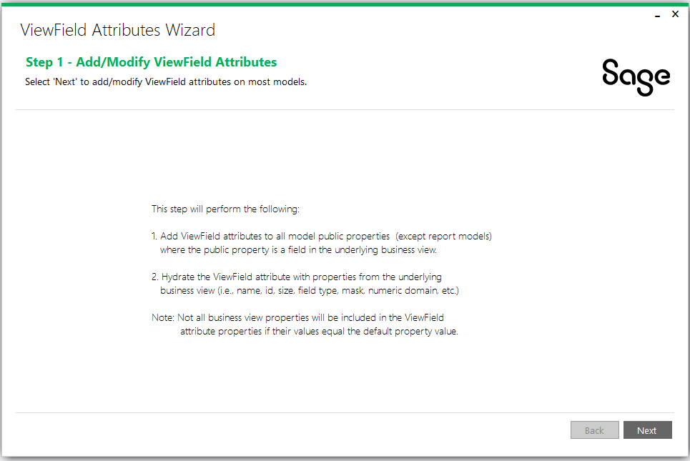
Web SDK
View Field Attribute Wizard
Adds ‘ViewField’ attribute to model’s public properties
Hydrates attribute properties from underlying business view’s fields
Used by JavaScript developers to leverage framework helpers for assigned model property values
To be leveraged in the future by new HTML Helpers which will reduce CSHTML code
Notes:
The ViewField Attributes Wizard, which is a Visual Studio executable, is not delivered as a binary in the Web SDK’s bin folder. This is because usage of this wizard by a third-party will require modifications to the wizard prior to running.
This wizard will modify the model classes in the solution’s ‘Models’ project to add the ViewField attribute to public properties and hydrate the attribute properties from the underlying business view.
Refer to the SDK for doc on these wizard

Slide 76
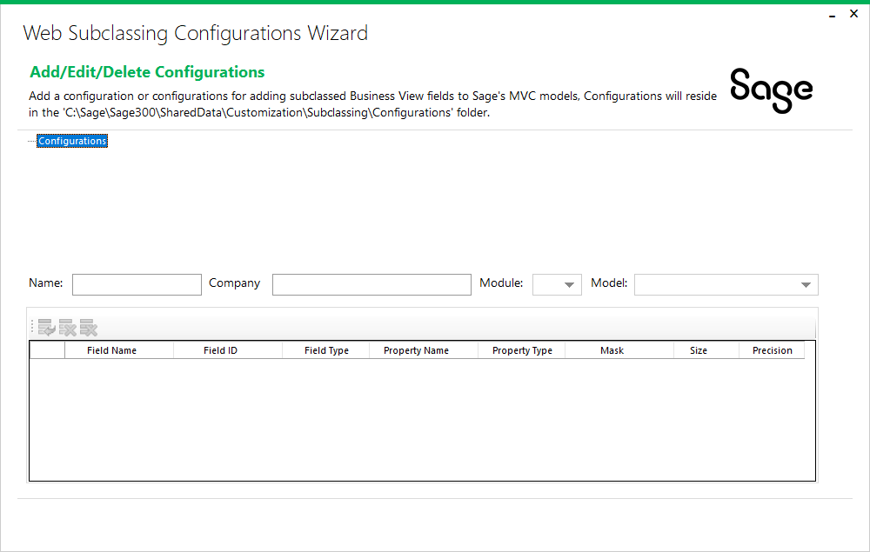
Web SDK
Web Subclassing Configurations Wizard
Create, modify, and delete JSON subclassing configurations
JSON configurations used to describe and associate subclassed fields for an entity (view) and MVC model
Used by external developers to extend the static MVC models to included subclassed fields
To be leveraged by the Web Subclassing Compiler and Deployment Wizard
Notes:
The Web Subclassing Configurations Wizard, which is a standalone executable, is delivered as a binary in the Web SDK’s bin\wizards folder.
This wizard will create JSON configurations that will be used to extend the MVC models in the web screens to expose subclassed fields in the business view.
Refer to the SDK for doc on this wizard

Slide 77
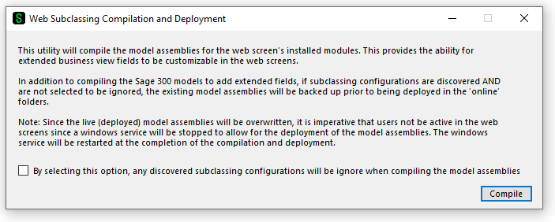
Web SDK
Web Subclassing Compilation and Deployment Wizard
Extend Sage’s MVC models to included subclassed fields from the business view
JSON configurations used to extend the MVC models and recompile the models for deployment by partners
Used by external developers to extend the static MVC models to included subclassed fields
Leverages the configurations created by the Web Subclassing Configuration Wizard
Optionally remove any extended fields by selecting the option to ignore configurations
Notes:
The Web Subclassing Compilation and Deployment Wizard, which is a standalone executable, is delivered as a binary in the Web SDK’s bin\wizards folder.
This wizard will discover any JSON configurations created by the Web Subclassing Configurations Wizard to add these extended properties to the MVC models and then recompile the MVC models which can then be delivered to a customer site.
Refer to the SDK for doc on this wizard

Slide 78

Web SDK
Web API Subclassing Wizard
Extend Sage’s Web API endpoints to included subclassed fields from the business view
Used by external developers to extend the static Web API endpoints to included subclassed fields
Notes:
Refer to the SDK for doc on this wizard

Slide 79
Web SDK
Docs
Custom
Dev
Help
Patterns
Standards
Upgrades
Web API
Wizards
Docs
Architecture
How To
Tutorials
Interface
Notes:
Documentation is an important aspect of an SDK and there are documents which are a required reading for any developer creating screens or customizations.
You will find documents on the architecture of the Sage 300 web application and various tutorials for creating web screens. There is a great document once the architecture documents have been reviewed which explains why it is important to understand the process and flow of the web screens and what is being created via the wizards.
There is a CHM file to assist external developers in drilling down into the various common and core libraries on valuable and required methods and functions.
There are two pattern documents. One is for Visual Design Patterns and the other is for Code Patterns. The Visual Design Patterns document presents the Visual Basic components and what are analogous components in the web screens. This is a great document for not only understanding how the Visual Basic screens compare to the web screens, but for also understanding the styling and sizing of the web screens.
There are standards documents that are a required reading before any development begins. They explain the standards used for managed code, JavaScript and CSHTML.
There is an upgrade guide which explains the steps being performed by the Upgrade Wizard plus additional documents for manual steps that the Wizard is unable to perform.
There are resource and developer reference documents for the API.
There are documents which walk you through using the wizards. These are a must read for any developer writing a module or a customization as they explain and illustrate the flow of the wizards and explain the solutions, projects and code generated by the various wizards.
There can never be enough documentation, and we recognize that more is needed in the SDK. This is on our roadmap to deliver more docs!

Slide 80
Web SDK
Resx
English
Spanish
French
Chinese
???
Resources
Resource files included in the SDK
Can be leveraged by Language Resource Wizard
Notes:
Language resources are included in the SDK. These are the language resources used by the Sage 300 web screens and can be leveraged by the Language Resource Wizard to generate resources for a non-supported language. As mentioned earlier, these are only the resources for the web screens as the desktop has its own set of resource files (DLLS).
A couple of notes on the resource files:
Not all resource files require localization as some as used to store operands, SQL statements and other information.
There are global resources, module resources and screen resources. This hierarchy is basically the same as the desktop resource structure in an effort to minimize localizations and to re-use commonly used strings.
Let’s look at the samples.

Slide 81






Web SDK
Samples
Notes:
Samples are great learning tools and numerous samples are included to reflect the different screen or code types. These samples are standalone examples of current Sage 300 web screens which can be debugged to understand the structures, the code flow, and the interaction of the various components. There is a README file in the root folder of the samples which discusses compiling and even a prerequisite (Environment Var) that must be established prior to running the samples. But, once this is setup, it is simply a matter of loading, resolving Nuget references, compiling, and debugging.
The samples listed here reflect processing, flat, report, and header detail code types. Of special note on the processing type, the Clear Statistics sample, is that there is a SQL script that must be applied to the Portal/Sage Landlord database since a processing code type involves our workflow engine and this is driven from our Portal/Landlord database. There is a README file in the folder for that sample. It is required reading!

Slide 82

Web SDK
Web API Integration Sample
C# Console Program
Completed source
Document for creating from scratch
How to create a customer
How to create a batch
How to create an order
How to create an invoice
Notes:
The Sage 300 Web SDK Web API Integration Sample uses a C# console program to illustrate how easy it is to make web api calls.
The sample program is already complete and ready to go, but if you prefer to create it manually, the WebAPI_SampleIntegration_Instructions Word document in the samples/WebAPI_SampleIntegration folder of the Web SDK provides a step-by-step tutorial for creating this sample program.
In this sample, you will programmatically create a customer, update the customer, create an order, invoke the inventory control’s day end, post an invoice and finally create a batch all through the web api. This is a great sample for getting used to the web api and programmatically driving it as well.
So, is source included in the SDK?

Slide 83
Web SDK
How to Use
SDK Wizards
Development
QA
Release
Docs
Samples
Debug
Partner
SDK
Notes:
Here is a simple example of an SDLC. Once the wizards and utilities are registered as plugins (Visual Studio plugins are VSIX files), these wizards accelerate the initial creation of the web screens and customizations.
As this illustration describes, once the wizards are used to generate a solution and starting code for a screen or screens, documentation is referenced, tutorials and samples are viewed, debugged and understood, which feeds into the development cycle of the screen. Thus, acceleration of the development process. Of course, implementing business logic is not a feature of today’s SDK. As I will demonstrate in the What’s coming in August section, we are looking for ways to accelerate the development process by generating more UI elements and as much template and stubbed code as possible.

Slide 84
Web SDK
SDK
Faster Dev
Best Practices
Security
Brand Image
Open Source
Benefits
Code Generation
Consistent
Secure
Modular
Integration ready
Extensible
Core business logic and services
Open Source
https://github.com/SageNADev/Sage300-SDK
Notes:
There are numerous benefits to the SDK: Accelerated development is just one benefit. The wizards will generate a scaffolded solution while delivering generated code for a more robust starting point while the samples illustrate the structured and organized implementation within our screens. We recognize the Sage 300 developer community and strive to ensure that these implementations are also available to the community. If we can implement something internally then so should an external developer! Of course, a solution and project can be generated from scratch, but why would you?
By providing documentation, samples and generated code, we strive for consistency and best practices in our implementation.
Security is always a concern and a high priority for Sage 300. We perform Penetration Tests and Code Scans to ensure our implementations are secure and consistent, and this is reflected in the code we generate.
The SDK strives for seamless integrations as partner modules and customizations want to blend into the Sage 300 palette and not to be seen as differing from the patterns and practices within the Sage 300.
The SDK is open source! All tools can only be so much to everyone in order to consider everyone’s base needs while providing functionality that is easy to use. The open sourcing of the SDK has allowed the community to extend, enhance and even tailor the SDK to their specific needs. Sage wants this community to be successful in the conversion of their applications to the web paradigm. The open sourcing of the SDK will allow those who wish to contribute to the Web SDK to do so in a way that not only addresses their needs, but potentially the needs of others as well.

Slide 85
Web Architecture
Roadmap

Slide 86

Web Architecture
API Roadmap
More endpoints
Authorization enhancements
Discover and consume partner Web API
Partner requests and suggestions
Notes:
For the API, the PJC web screen journey has started. As we reach parity with the desktop PJC functionality so will our PJC endpoints.
The API supports Basic Authentication today and it’s on the roadmap to enhance this implementation. Authentication is a hot topic right now and this conversation not only includes the API but the Sage 300 application as well.
One of our most frequent requests for the API is that partners do not want to have their own separate API for Sage 300 data access. What I mean by this is that partners would like their customers as well as themselves to have a consistent experience and even a single focal point for data access. With our API, we want to extend it so that it can discover partner web services built in a matching framework to ours. To this end, we will need to provide the tooling and the framework for partner web services which we will consume to seamlessly present within our API.
And we are always listening to feedback, suggestions, and requests when considering roadmap items for the API. So, keep those coming!

Slide 87

Web Architecture
SDK Roadmap
Customization API, parity
Continuously expand wizard capabilities
Macros
More documentation!
Partner requests and suggestions
Notes:
For the SDK, as we continue our journey to create web screens for all desktop screens, there are gaps in the existing web customization strategy. Features such as support for sub-classed views, customizing and extending a grid, and being able to import and manage a customization package without a UI are important to partners and must be addressed.
Expanding and enhancing our wizards, tooling and documentation are important for developer efficiency and productivity. If the aim of the SDK is to get developers up and running quickly, it is the tooling and documentation that will drive productivity gains.
Macros, VB macros that is, are not technically possible in the web and therefore a replacement for Macro functionality is required. And macros are used to solve so many requirements such as data access and update, automation, chaining and the like. The web presents challenges for this technology that are not present in the desktop.
And we are always listening to feedback, suggestions, and requests when considering roadmap items for the SDK. Numerous enhancements have been made to the SDK since its creation by partners like you. Please keep them coming!
Finally, let’s look at some items that are on our radar.

Slide 88
Web Architecture
Radar

Slide 89

Web Architecture
Radar
.NET
Containers
Responsive Design
Three Tier Deployment Architecture
Technological Changes
AI
Notes:
These are some of the items that are on our radar:
.NET is the next major release of .NET Core as it supports more types of apps and more platforms than .NET Core or .NET Framework and includes some improvements in the areas of C#, new JSON features, tooling support for dump debugging, GC enhancements, and other performance enhancements just to name a few. I see a lot of opportunities with this technology.
Containers, whether Docker or Windows Containers, offer the ability to isolate and bundle software, libraries and configuration files. A different approach to installation?
Responsive design is an approach to render web pages well on a variety of devices and window/screen sizes. While not a new concept, there are a lot of uses for Sage 300 as it is rendered on different devices of varying size and format.
The Sage 300 Web Screens with development starting in 2013 did not get a new deployment model and thus creating a true three-tier deployment model not only enhances the application but will require the SDK to evolve as well.
And finally, technology in general as the landscape, technology stack and offering is constantly changing and evolving! These are just some of the items that are on our radar. What’s on you’re your radar and should it be on our radar? Let us know!

Slide 90
Thank you!

