Slide 1
ANALYZING BANK PERFORMANCE

Slide 2
Balance Sheet
Bank Assets:
  Cash and due from banks
    Vault cash, deposits held at the Fed and other financial institutions, and cash items in the process of collection.
  Investment Securities
    Securities held to earn interest and help meet liquidity needs.
  Loans
    The major asset, generate the greatest amount of income, exhibit the highest default risk and are relatively illiquid.
  Other assets
    Bank premises and equipment, interest receivable, prepaid expenses, other real estate owned, and customers' liability to the bank

Slide 3
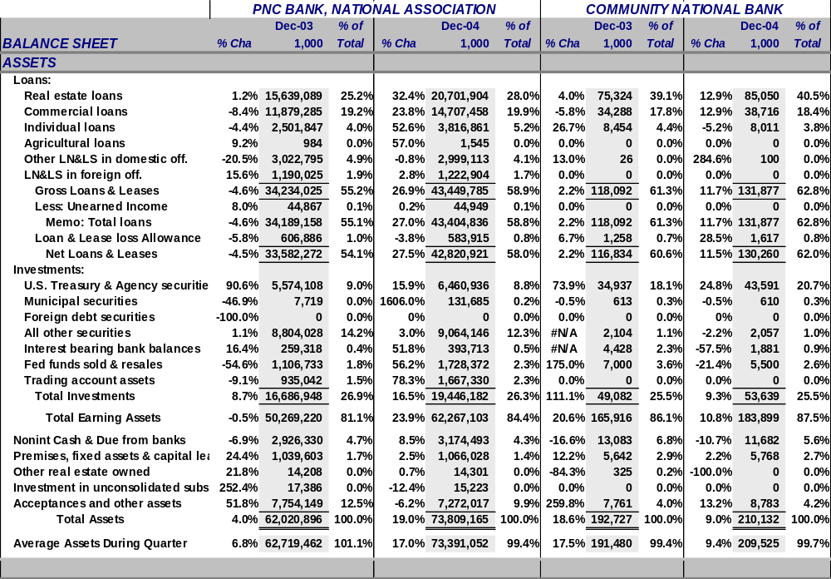
Balance Sheet (assets): PNC and Community National Bank

Slide 4
Bank investments and FASB 115
Following FASB 115 a bank, at purchase, must designate the objective behind buying investment securities as either:
  Held-to-maturity securities are recorded on the balance sheet at amortized cost.
  Trading account securities are actively bought and sold, so the bank marks the securities to market (reports them at current market value) on the balance sheet and reports all gains and losses on the income statement.
  Available-for-sale, all other investment securities, are recorded at market value on the balance sheet with a corresponding change to stockholders’ equity as unrealized gains and losses on securities holdings; no income statement impact .

Slide 5
Bank liabilities
Demand deposits
  Transactions accounts that pay no interest
Negotiable orders of withdrawal (NOWs) and automatic transfers from savings (ATS) accounts
  Pay interest set by each bank without federal restrictions
Money market deposit accounts (MMDAs)
  Pay market rates, but a customer is limited to no more than six checks or automatic transfers each month
Savings and time deposits represent the bulk of interest-bearing liabilities at banks.
Two general time deposits categories exist:
  Time deposits in excess of $100,000, labeled jumbo certificates of deposit (CDs).
  Small CDs, considered core deposits which tend to be stable deposits that are typically not withdrawn over short periods of time.
Deposits held in foreign offices
  Balances issued by a bank subsidiary located outside the U.S.
Purchased liabilities, (rate-sensitive borrowings):
  Federal Funds purchased
  Repos
  Other borrowings less than one year

Slide 6
Core versus volatile funds
Core deposits are stable deposits that are not highly interest rate-sensitive.
  More sensitive to the fees charged, services rendered, and location of the bank.
  Includes: demand deposits, NOW accounts, MMDAs, and small time deposits.
Large, or volatile, borrowings are liabilities that are highly rate-sensitive.
  Normally issued in uninsured denominations
  Ability to borrow is asset quality sensitive
  Includes: large CDs (over 100,000), deposits in foreign offices, federal funds purchased, repurchase agreements, and other borrowings with maturities less than one year.

Slide 7
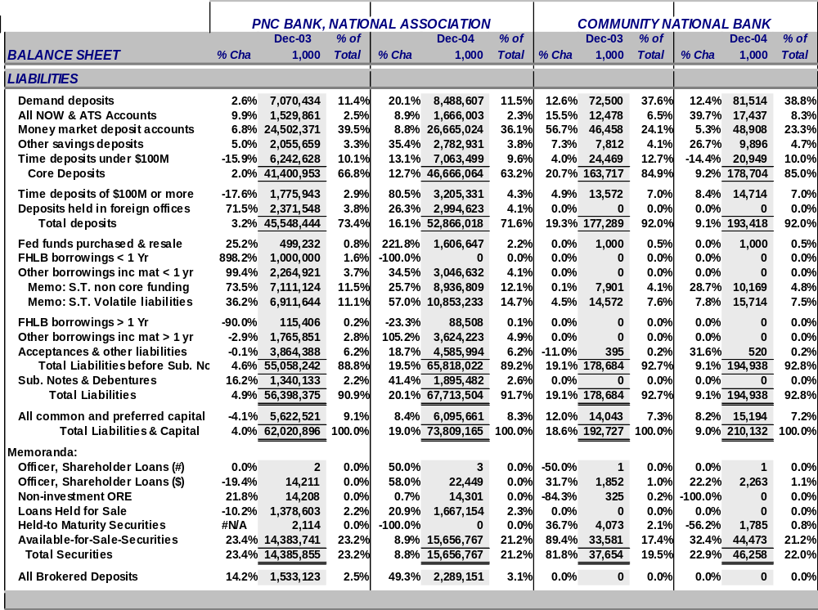
Balance Sheet (liabilities): PNC and Community National Bank

Slide 8
Stockholders equity
Subordinated notes and debentures:
  Notes and bonds with maturities in excess of one year.
Stockholders' equity
  Ownership interest in the bank.
  Common and preferred stock are listed at par
  Surplus account represents the amount of proceeds received by the bank in excess of par when it issued the stock.
  Retained earnings equals accumulated net income not paid out as cash dividends

Slide 9
The income statement
Interest income (II)
  Loans and leases
  Deposits held at other institutions,
  Investment securities
    Taxable and municipal securities
  Trading account securities
Interest expense (IE)
  Interest income less interest expense equals
  net interest income (NII)
Loan-loss provisions (PL)
  represent management's estimate of potential lost revenue from bad loans
Noninterest income (OI)
  Fiduciary activities
  Deposit service charges
  Trading revenue, venture cap., securitize inc.
  Investment banking, advisory inc.
  Insurance commissions & fees
  Net servicing fees
  Loan & lease net gains (losses)
Noninterest expense (OE)
  noninterest expense usually exceeds noninterest income such that the difference is labeled the bank's burden
Securities gains or losses (SG)
Taxes

Slide 10
Provisions for loan losses
Recoveries
Provisions for loan losses
Reserve for Loan Losses
Charge offs

Slide 11
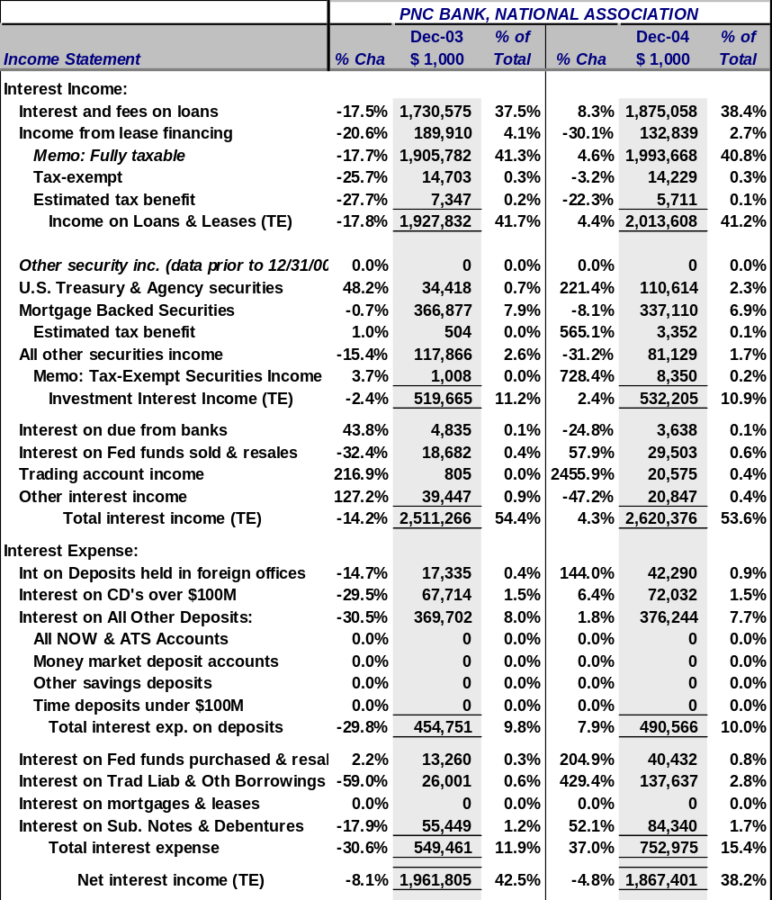
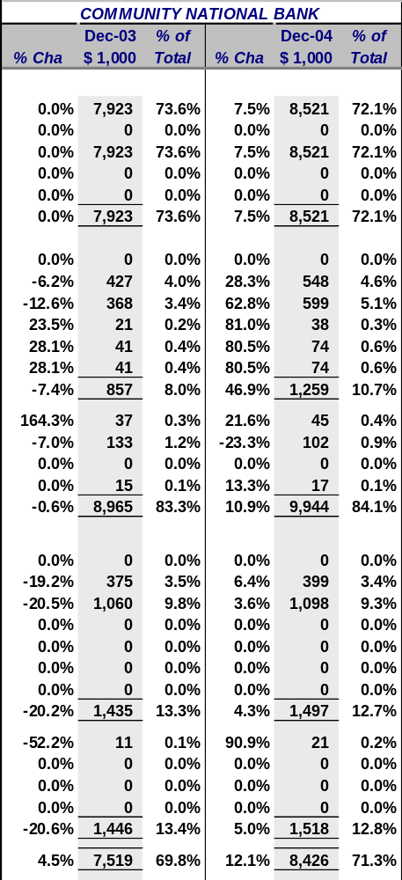
Income statement (interest): PNC and Community National Bank

Slide 12
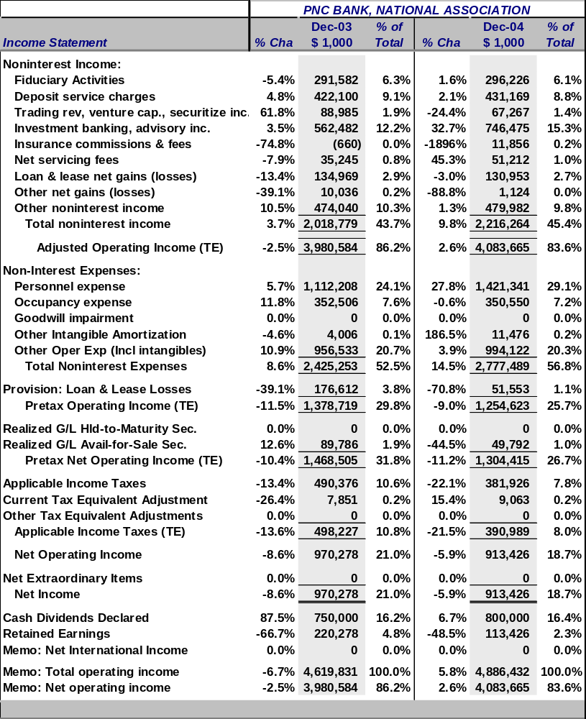
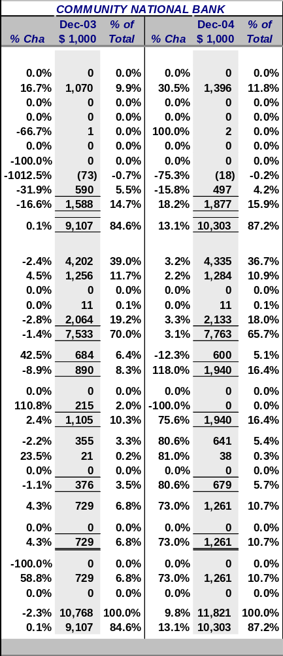
Income statement (noninterest): PNC and Community National Bank

Slide 13
Bank Performance Model
Rate
Composition (mix)
Interest
Returns to
Shareholders
ROE = NI / TE
Volume
INCOME
Fees and Serv Charge
Non Interest
Trust
Other
Return to the Bank
ROA = NI / TA
Rate
Interest
Composition (mix)
Volume
EXPENSES
Salaries and Benefits
Overhead
Occupancy
Degree of Leverage
EM =1 / (TE / TA)
Prov. for LL
Other
Taxes

Slide 14
Return on equity (ROE = NI / TE)
… the basic measure of stockholders’ returns
ROE is composed of two parts:
  Return on Assets (ROA = NI / TA),
    represents the returns to the assets the bank has invested in
  Equity Multiplier (EM = TA / TE),
    the degree of financial leverage employed by the bank

Slide 15
Return on assets (ROA = NI / TA)
…can be decomposed into two parts:
• Asset Utilization (AU) → income generation
• Expense Ratio (ER) → expense control
ROA = AU - ER
= (TR / TA) - (TE / TA)
Where:
  TR = total revenue or total operating income
  = Int. inc. + Non-int. inc. + SG and
  TE = total expenses
  = Int. exp. + Non-int. exp. + PLL + Taxes

Slide 16
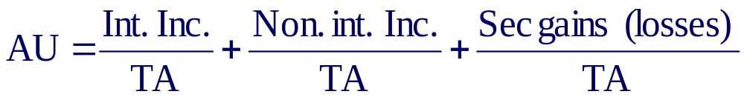
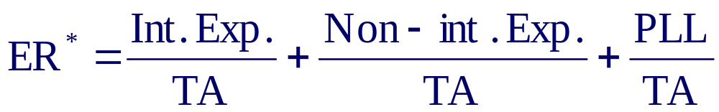
ROA is driven by the bank’s ability to:
…generate income (AU) and control expenses (ER)
Income generation (AU) can be found on the UBPR (page 1) as:
Expense Control (ER) can be found on the UBPR (page 1) as:
Note, ER* does not include taxes.

Slide 17
Expense ratio (ER = Exp / TA)
… the ability to control expenses.
Interest expense / TA
  Cost per liability (avg. rate paid)
    Int. exp. liab. (j) / $ amt. liab. (j)
  Composition of liabilities
    $ amt. of liab. (j) / TA
  Volume of int. bearing debt and equity
Non-interest expense / TA
  Salaries and employee benefits / TA
  Occupancy expense / TA
  Other operating expense / TA
Provisions for loan losses / TA
Taxes / TA

Slide 18
Asset utilization (AU = TR / TA):
… the ability to generate income.
Interest Income / TA
  Asset yields (avg. rate earned)
    Interest income asset (i) / $ amount of asset (i)
  Composition of assets (mix)
    $ amount asset (i) / TA
  Volume of Earning Assets
    Earning assets / TA
Noninterest income / TA
  Fees and Service Charges
  Securities Gains (Losses)
  Other income

Slide 19
Aggregate profitability measures
Net interest margin
  NIM = NII / Earning Assets (EA)
Spread
  Spread = (Int Inc / EA) − (Int Exp / Int bear. Liab.)
Earnings base
  EB = EA / TA
Burden / TA
  (Noninterest Exp. - Noninterest Income) / TA
Efficiency ratio
  Non int. Exp. / (Net int. Inc. + Non-int. Inc.)

Slide 20
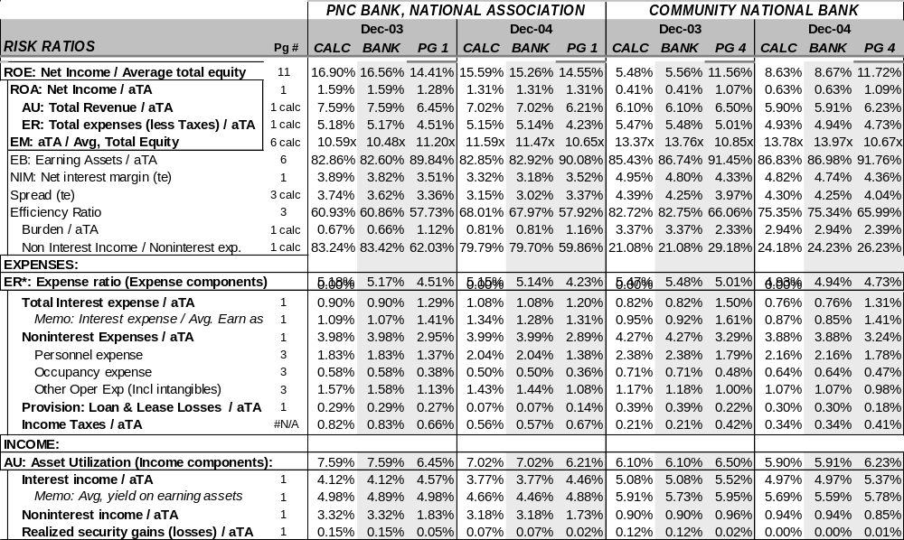
Financial ratios
…PNC and Community National Bank
UBPR for PNC

Slide 21
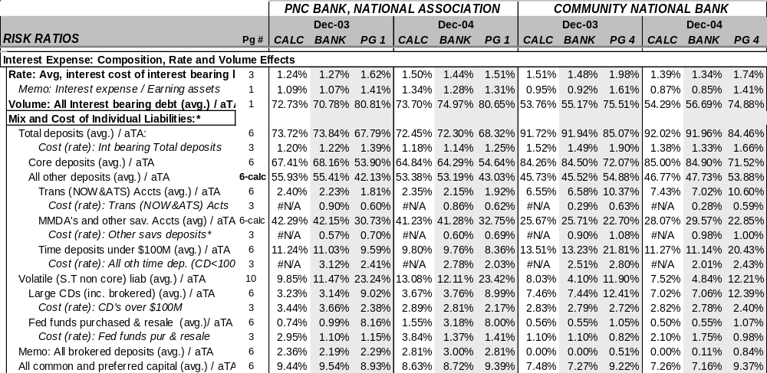
Interest expense
…composition, rate and volume effects for
PNC and Community National Bank

Slide 22
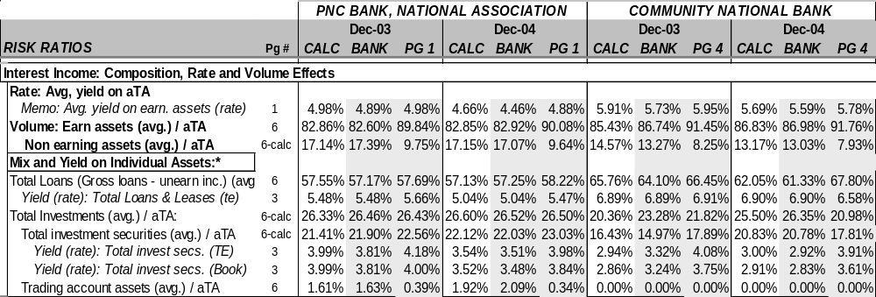
Interest income
…composition, rate and volume effects for
PNC and Community National Bank

Slide 23
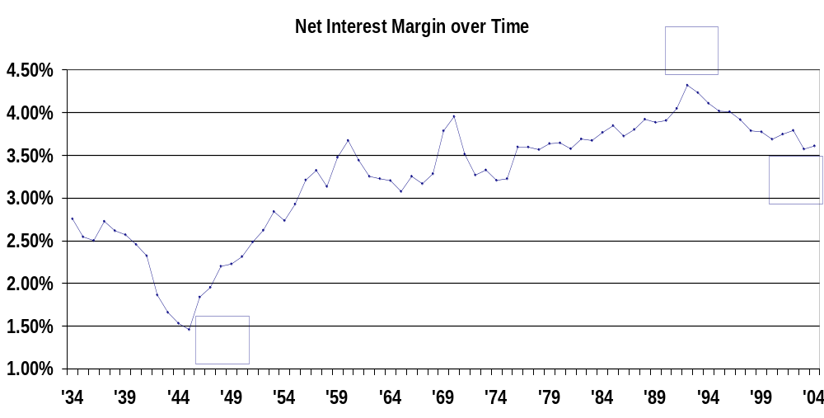
Issues in Interest Income and Interest Expense
Deregulation in the 1990s lead to an increase in competition
Average NIM fell since 1992 due to this increased competition

Slide 24
Net Interest Margins by Bank Asset Size, 1992–2004
5.0%
4.8%
4.6%
$100M - $B
4.4%
< $100M
4.2%
Net Interest Margins
4.0%
> $1B
3.8%
3.6%
3.4%
1992
1993
1994
1995
1996
1997
1998
1999
2000
2001
2002
2003
2004

Slide 25
Issues in Interest Income and Interest Expense
Core deposit growth has slowed due to “disintermediation”
Loan yields have fallen on a relative basis due to credit scoring and increased competition among lenders
NIM is being squeezed, so banks must concentrate more on non-interest income to grow profits.

Slide 26
Issues in Non-Interest Income and Non-Interest Expense
Banks must rely less on net interest income and more on non-interest income to be more successful
  Banks must grow their non-interest income relative to non-interest expense if they want to see net income grow.
The highest earning banks will be those that generate an increasing share of operating revenue from non-interest sources, like fee income
  All fees are NOT created equal
    Some fees are stable and predictable over time, while others are highly volatile because they are cyclical
    Consider NSF charges on checkwriting
Largest contributors are deposit service charges and other non-interest income
Largest banks rely more on non-interest income than their smaller counterparts

Slide 27
Composition of Noninterest Income by Bank Size as a Percentage of Total Assets, 2004
0.8%
0.7%
< $100M
$100M-$1B
0.6%
>$1B
All Comm. Banks
0.5%
0.4%
0.3%
0.2%
0.1%
0.0%
service
Deposit
charges
activities
Fiduciary
Investment
advisory,
noninterest
banking,
brokerage,
Other
income
other assets
(losses) on
Net servicing
Net gains
securitizations
fees
sales of loans
(losses) on
venture cap.
Net gains
and other
Trading,
and

Slide 28
Non-Interest income is increasing as a proportion of net operating revenue
Trends in Net Interest Income and Non-interest Income
90%
90%
80%
80%
70%
70%
Net Interest Income
60%
60%
50%
50%
40%
40%
30%
Noninterest Income
20%
30%
Actual Data
Predicted
10%
20%
0%
10%
1981
1983
1985
1987
1989
1991
1993
1995
1997
1999
2001
2003
2005
2007
2009

Slide 29

Non-Interest Expense: Key Ratios
Burden
  Lower is better (Burden > 0)
Net Non-Interest Margin
  Lower is better

Slide 30

Non-Interest Expense: Efficiency Ratio
Efficiency Ratio
  Larger banks tend to have lower (better) efficiency ratios because they generate more non-interest income
  Low efficiency ratios do not always lead to higher ROEs

Slide 31
Efficiency Ratios of U.S. Commercial Banks, 1992–2004
75.0%
70.0%
65.0%
<$100M
60.0%
Efficiency Ratio
$100M-$1B
55.0%
>$1B
50.0%
Dec-92
Dec-93
Dec-94
Dec-95
Dec-96
Dec-97
Dec-98
Dec-99
Dec-00
Dec-01
Dec-02
Dec-03
Dec-04

Slide 32
Fundamental risks :
Credit risk
Liquidity risk
Market risk
Operational risk
Capital or solvency risk
Legal risk
Reputational risk

Slide 33
Credit risk
…the potential variation in net income and market value of equity resulting from nonpayment or delayed payment on loans and securities
Three Question need to be addressed:
  What has been the loss experience?
    Net loss to average total LN&LS
    Gross losses to average total LN&LS
    Recoveries to avg. total LN&LS
    Recoveries to prior period losses
    Net losses by type of LN&LS
  What amount of losses do we expect?
    Non-current LN&LS to total loans
    Total Past/Due LN&LS - including nonaccrual
    Non-current & restruc LN&LS / Gross LN&LS
    Current - Non-current & restruc/ Gr LN&LS
    Past due loans by loan type
  How prepared are we?
    Provision for loan loss to: average assets and average total LN&LS
    LN&LS Allowance to: net losses and total LN&LS
    Earnings coverage of net loss

Slide 34
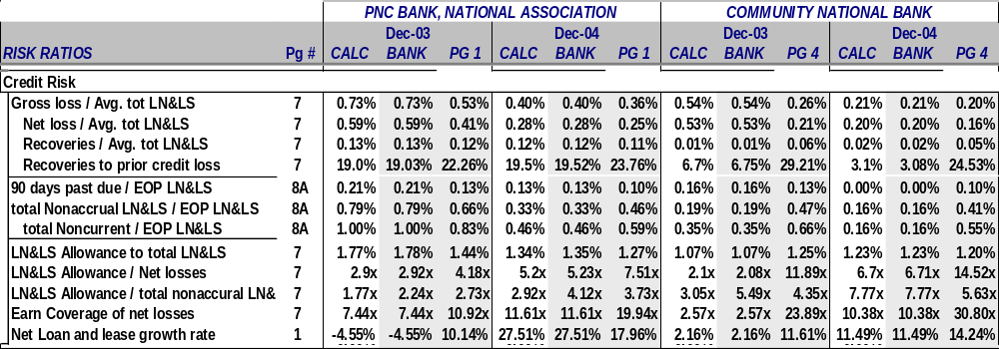
Credit risk ratios :
PNC and Community National

Slide 35
Liquidity risk
…the variation in net income and market value of equity caused by a bank's difficulty in obtaining cash at a reasonable cost from either the sale of assets or new borrowings
Banks can acquire liquidity in two distinct ways:
  By liquidation of assets
    Composition of loans & investments
    Maturity of loans & investments
    Percent of loans and investments pledged as collateral
  By borrowing
    Core deposits
    Volatile deposits
    Asset quality & stockholders’ equity

Slide 36
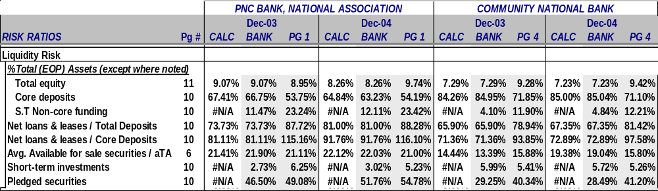
Liquidity risk ratios :
PNC and Community National

Slide 37
Market risk
…the risk to a financial institution’s condition resulting from adverse movements in market rates or prices
Market risk arises from changes in:
  Interest rates
    …the potential variability in a bank's net interest income and market value of equity due to changes in the level of market interest rates
  Foreign exchange rates
    … the risk to a financial institution’s condition resulting from adverse movements in foreign exchange rates
  Equity, commodity and security prices
    …change in market prices, interest rates and foreign exchange rates affect the market values of equities, fixed income securities, foreign currency holdings, and associated derivative and other off-balance sheet contracts.

Slide 38
Operational risk
…measures the cost efficiency of the bank's activities; i.e., expense control or productivity; also measures whether the bank has the proper procedures and systems in place .
Typical ratios focus on:
  total assets per employee
  total personnel expense per employee
  Non-interest expense ratio
There is no meaningful way to estimate the likelihood of fraud or other contingencies from published data.
A bank’s operating risk is closely related to its operating policies and processes and whether is has adequate controls.

Slide 39
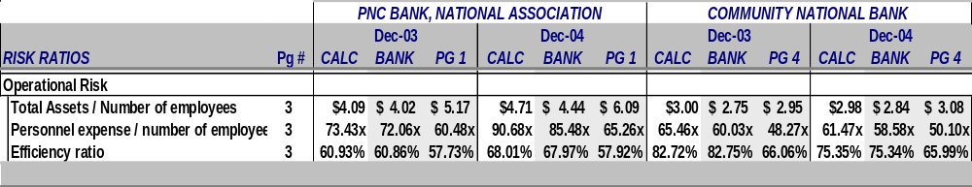
Operational risk ratios:
PNC and Community National

Slide 40
Capital risk
… closely tied to asset quality and a bank's overall risk profile
The more risk taken, the greater is the amount of capital required.
Appropriate risk measures include all the risk measures discussed earlier as well as ratios measuring the ratio of:
  Tier 1 capital and total risk based capital to risk weighted assets
  Equity capital to total assets
  Dividend payout, and growth rate in tier 1 capital

Slide 41
Definitions of capital
Tier 1 capital is:
  Total common equity capital plus noncumulative preferred stock, plus minority interest in unconsolidated subsidiaries, less ineligible intangibles.
Risk-weighted assets are:
  The total of risk-adjusted assets where the risk weights are based on four risk classes of assets.
Importantly, a bank's dividend policy affects its capital risk by influencing retained earnings.

Slide 42
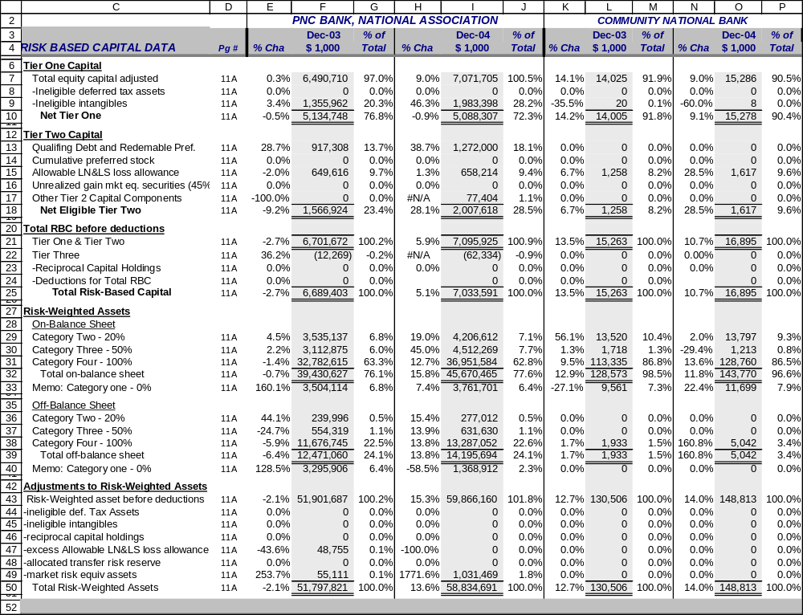
Risk Based Capital: PNC and Community National Bank

Slide 43
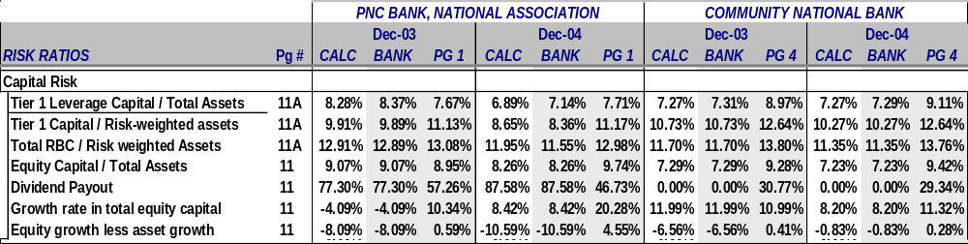
Capital risk ratios :
PNC and Community National

Slide 44
Legal risk
…the potential that unenforceable contracts, lawsuits, or adverse judgments can disrupt or otherwise negatively affect the operations or condition of the banking organization
Legal risk includes:
  Compliance risks
  Strategic risks
  General liability issues

Slide 45
Reputational risk
Reputational risk is the potential that negative publicity regarding an institution’s business practices, whether true or not, will cause a decline in the customer base, costly litigation, or revenue reductions.

Slide 46
Strategies for Maximizing
Shareholder Wealth
Asset Management
  Composition and Volume
Liability Management
  Composition and Volume
Management of off-balance sheet activities
Net interest margin management
Credit risk management
Liquidity management
Management of non-interest expense
Securities gains/losses management
Tax management

Slide 47
CAMELS
Capital Adequacy
  Measures bank’s ability to maintain capital commensurate with the bank’s risk
Asset Quality
  Reflects the amount of credit risk with the loan and investment portfolios
Management Quality
  Reflects management’s ability to identify, measure, monitor, and control risks
Earnings
  Reflects the quantity, trend, and quality of earnings
Liquidity
  Reflects the sources of liquidity and funds management practices
Sensitivity to market risk
  Reflects the degree to which changes in market prices and rates adversely affect earnings and capital

Slide 48
CAMELS Ratings
Regulators assign a rating of 1 (best) to 5 (worst) in each of the six categories and an overall composite rating
  1 or 2 indicates a fundamentally sound bank
  3 indicates that a bank shows some underlying weakness that should be corrected
  4 or 5 indicates a problem bank

Slide 49
Average Performance Characteristics of Banks by Business Concentration and Size
ROE and ROA (up to $10 billion in assets) increases with bank size
Employees per dollar of assets decreases with bank size
Larger banks have lower efficiency ratios than smaller banks
Smaller banks:
  have proportionately more core deposits and fewer volatile liabilities than larger banks
  have a proportionately larger earnings base than larger banks
  have proportionately lower charge-offs than larger banks

Slide 50
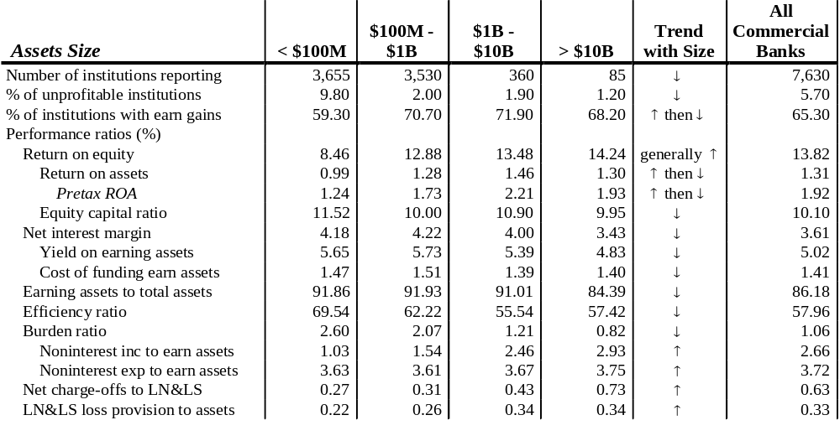
Bank Performance Measure by Size

Slide 51
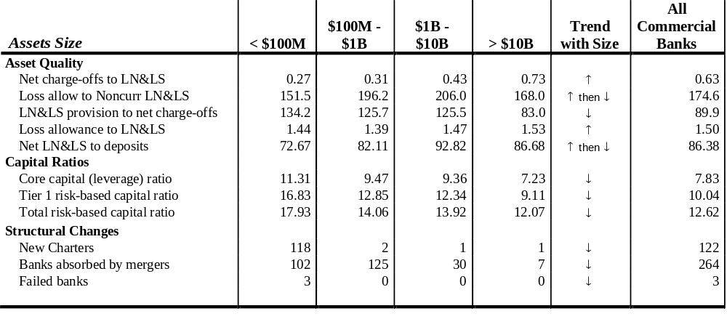
Bank Risk Measures by Size

Slide 52
Performance Characteristics of Banks by Business Concentration and Size
Wholesale Banks
  Focus on loans for the largest commercial customers and purchase substantial funds from corporate and government depositors
Retail Banks
  Focus on consumer, small business, mortgage, and agriculture loans and obtain deposits form individuals and small businesses

Slide 53
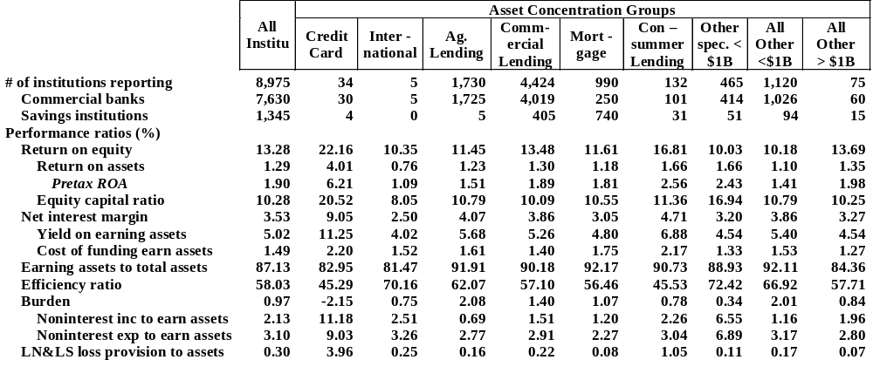
Profitability Measures of Banks by Business Concentration

Slide 54
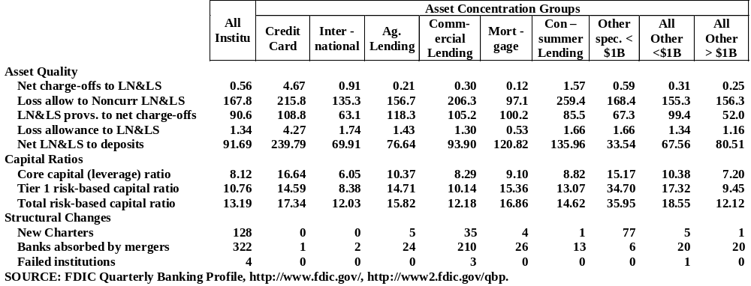
Risk Measures of Banks by Business Concentration

Slide 55
Financial Statement Manipulation
Off-balance sheet activities
  Enron and “Special-Purpose Vehicles”
Window dressing
  Eliminate Fed borrowing prior to financial statement reporting date
  Increase asset size prior to year-end
Preferred stock
  Meets capital requirements but causes NIM, NI, ROE, and ROA to be overstated
Non-performing loans
  Banks may lend borrower funds to make payments on past due loans, understating non-performance status
Allowance for loan losses
  Management discretion and IRS regulations may be in conflict
Securities gains and losses
  Banks often classify all investment securities as “available for sale,” overstating any true “gains or losses”
Non-recurring sales of assets
  This type of transaction is not part of the bank’s daily activities and typically cannot be repeated; thus it overstates earnings

Slide 56
(UBPR users manual)
UBPR format http://www.ffiec.gov/UBPR.htm
Cover page 00
  Contains basic descriptive information on the bank, its location, charter and certification numbers, and a brief description of the peer group included.
Summary Ratios 01
  Basic summary information on the bank include return on assets; interest and non-interest income and expenses as a percentage of assets.
  Risk summary measures on the loan portfolio; liquidity; capitalization; and growth rates are also included.
Income Information
  Income Statement - Revenues and Expenses 02
    Detailed income statement, in $1,000 of dollars.
  Noninterest Income and Expenses and Yields 03
    On this page the FDIC mixes additional detail on noninterest income and expenses in $1,000 of dollars with ratio (% of assets) of these same numbers.
    In addition, the average rates on, or yields of assets and costs of liabilities, are include in the bottom half of the page.

Slide 57
UBPR format
Balance Sheet Information:
  Balance Sheet - Assets, Liabilities & Capital 04
    Basic balance sheet detail in $1,000 of dollars.
  Off-Balance Sheet Items 05
    Both dollar amounts and ratios, each off-balance sheet item as a percent of total off-balance sheet items.
  Derivatives Analysis 05A
    This is one of many pages that provide additional detail for items from the previous page.
    Dollar amounts of derivative contracts and percent of total ratios are provided.
  Derivatives Analysis 05B
    notional value of derivatives.
  Balance Sheet - % Composition of Assets & Liab. 06
    Basic common size analysis.
    The balance sheet is presented in percentage of total assets.
    Very useful for evaluating the mix of assets and liabilities.

Slide 58
UBPR format
Balance Sheet Information:
  Analysis of Loan & Lease Allowance and Loan Mix 07
    Reconciliation of the Loan and Lease (LN&LS) allowance is provided in $1,000 of dollars.
    Ratios on the provisions for loan losses (loss provision), LN&LS allowance, gross losses, recoveries, and net losses by loan type are provided as well.
  Analysis of Loan & Lease Allowance and Loan Mix 07A
    Ratios detailing the loan mix (each loan category as a percentage of total loans) as well as information on mortgage serving assets.
  Analysis of Past Due, Nonaccrual & Restructured LN&LS 08
    The dollar amount of past due, nonaccrual, restructured and other real estate owned (OREO) is provided.
    Ratios, detailing the percentage of non-current loans, by type, for past due and nonaccrual loans is provided.
  Analysis of Past Due, Nonaccrual & Restructured LN&LS 08A
    Memoranda Information
    Additional detail in dollars and percentage of non-current real estate loans.

Slide 59
UBPR format
Balance Sheet Information:
  Interest Rate Risk Analysis as a Percent of Assets 09
    Basic interest rate risk information.
    Total interest bearing assets and liabilities and the net position (GAP) for three month and one year repricing.
  Liquidity and Investment Portfolio 10
    Dollar amount of short term investments, debt securities and high risk mortgage securities.
    Liquidity ratios and the securities mix (percentage of total securities) is provided as well.
  Capital Analysis 11
    Reconciliation of stockholders equity and the dollar amounts of equity components.
    Capital ratios, including return on equity (ROE), dividend payout, and growth rates in capital components.
  Risk-Based Capital Analysis 11A
    The dollar amount of tier one and tire two capital and its components.
    Dollar amount of risk-weighted assets and adjustments to risk-weighted assets.
    Risk-based capital and leverage capital ratios are provided as well.

Slide 60
UBPR format
Balance Sheet Information:
  Last-Four Quarters Income Analysis 12
    Four quarter summary information which combines information from page 01 and 03 on yield or cost of assets and liabilities.
  State Average Summary STAVG
    Summary ratios, similar to page 01 for state averages.

