Slide 1
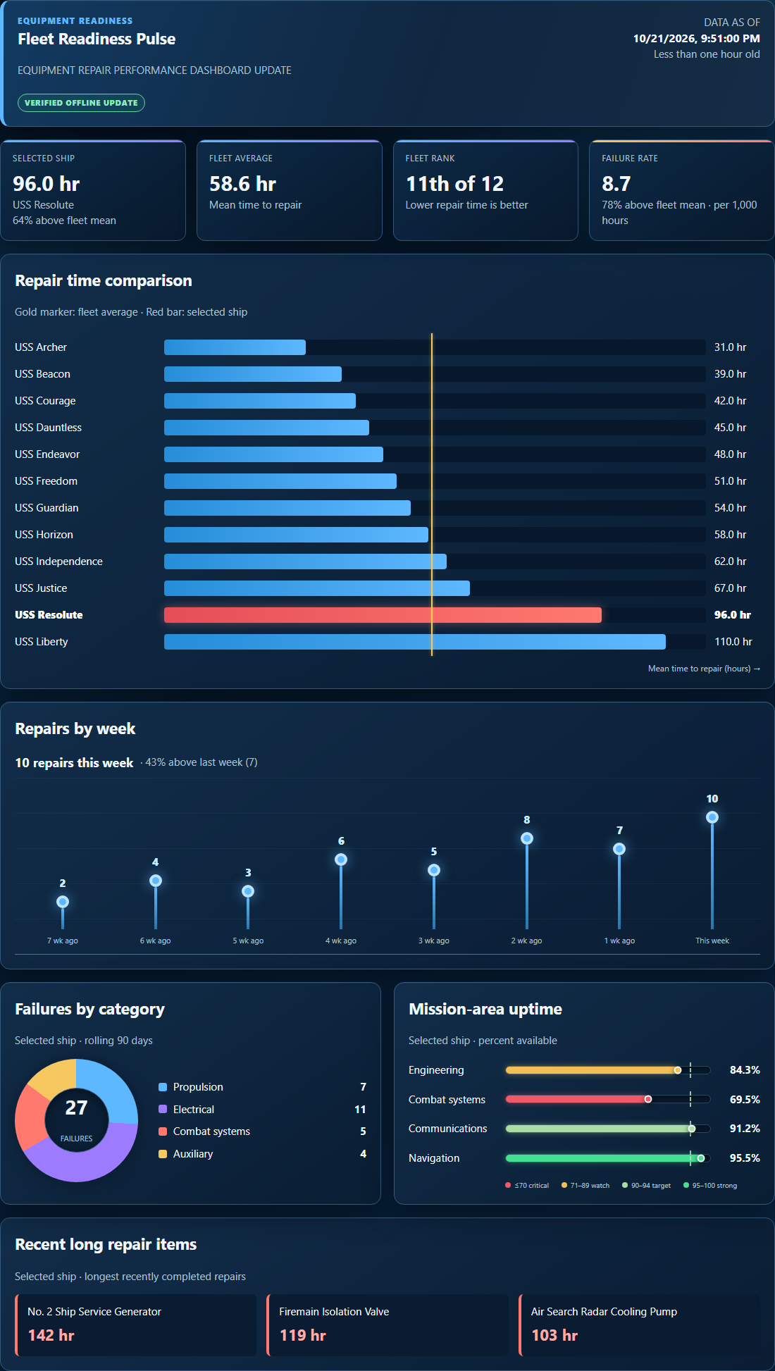
FLEETHACKER PROJECT IDEA
FleetPulse
Low Bandwidth
High-fidelity
Decision Advantage
Two-day build concept • working browser prototype
FLEET PULSE / CONCEPT PITCH
01

Slide 2
THE PROBLEM
Network-limited operations create decision-support gaps
Data that arrives is hard to act on. Dashboards that explain it may not arrive.
Text carries facts,
but hides patterns and priorities.
Web dashboards often time out
before they reach the ship.
readiness.dashboard.mil
MESSAGE TRAFFIC / READINESS UPDATE
USS RESOLUTE MTTR 096 HRS
FLEET MEAN MTTR 058.6 HRS
FAILURE RATE 8.7 / 1,000 HRS
ENGINEERING UPTIME 84.3 PCT
COMBAT SYSTEMS UPTIME 69.5 PCT
REPAIRS WK 01-08 02 04 03 06 05 08 07 10
!
This site can’t be reached
The connection timed out.
ERR_CONNECTION_TIMED_OUT
FLEET PULSE / CONCEPT PITCH
02

Slide 3
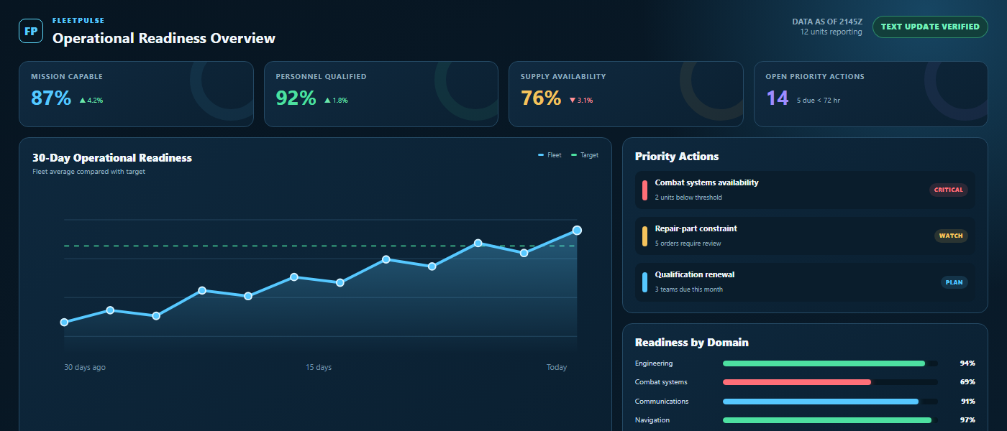
THE SOLUTION
FleetPulse makes operational data understandable and actionable—even on low-bandwidth links
03

Slide 4
HOW IT WORKS
From shore analytics to clear shipboard decisions
01
02
03
04
DASHBOARD VIEWER
DATA
↓
MODELS
AUTO
PIPELINE
›
›
SUBJECT:
UPDATE
PAYLOAD:
›
›
SHIP
RULES
VIEWER
UPDATE
PRELOAD
PACKAGE
TRANSMIT
DISPLAY
Ship downloads the dashboard viewer while bandwidth is available.
Shore analytics pipelines automatically prepare and encode updates.
Small text updates cross constrained links when bandwidth is limited.
The ship views clear, actionable data locally.
04

Slide 5
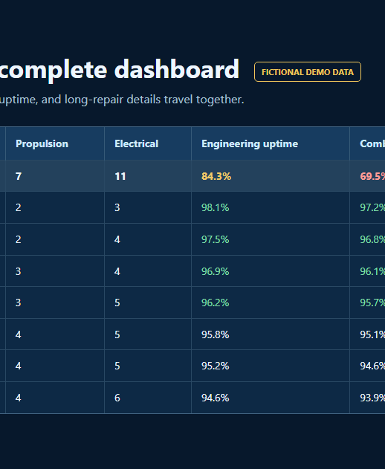
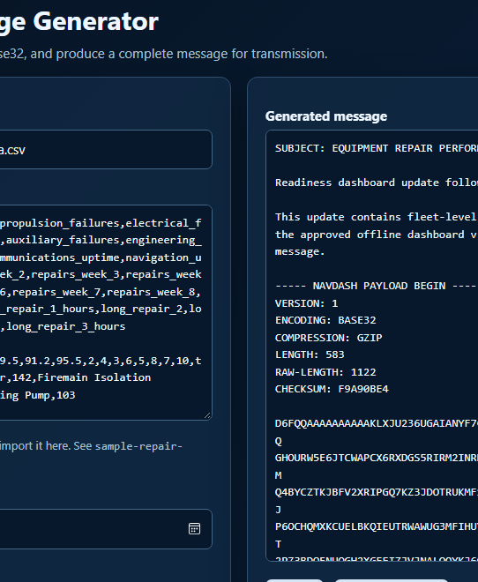
WORKING PROTOTYPE
FleetPulse in Action
DATA
MESSAGE
DASHBOARD
›
›
05

Slide 6
WHY FLEETHACKER
Why FleetPulse addresses the judging criteria
30%
WARFIGHTING & DECKPLATE IMPACT
Visual comparisons expose outliers and priorities in seconds—without forcing watchstanders to decode dense formatted messages.
20%
SPEED TO FLEET
Static offline HTML runs in approved browsers—no new hosted service or backend ATO. The viewer moves through file or attachment paths; updates travel as low-bandwidth text.
20%
FLEET SCALABILITY
One delivery pattern can support maintenance, personnel, supply, training, new ship classes, and new dashboards—the transport stays the same.
15%
BARRIER REMOVAL
Delivers dashboards and data updates through channels that already reach the ship, eliminating dependence on continuous web access.
15%
JUDGES’ DISCRETION
Modern visuals create a compelling Sailor experience, while the HTML front end leaves broad freedom to design the right UI for each mission.
No new hosted service or backend to accredit; final deployment remains subject to the target environment’s approval process.
06

