Slide 1


High Efficiency Vienna Rectifier with PFC for Motor Control Technical Area of Project - Power Electronics/Motor Drives Supervisor – Mr. M. Ranjithkumar
Presented by
Saghana S – 2127220601057 Sri Nithi S – 2127220601074 Tanishka S - 2127220601081
1

Slide 2
Motivation and Application
Motive of the Project:
Industries demand efficient motor speed control and reliable power quality.
Traditional rectifier suffer from poor power factor, harmonic distortion, and switching losses. Integrating a Vienna rectifier addresses these challenges, improving energy efficiency, motor performance, and compliance with IEEE/IEC standards.
Increasing demand for high-power AC-DC conversion: Growth in electric vehicle fast charging requires efficient three phase rectifiers.
Application:
Electric Vehicle Fast Charging Stations – Ensures efficient and reliable high-power AC–DC conversion.
Smart Grids – Helps maintain power quality and efficient load management.
Industrial Motor Drives – High-efficiency rectification for precise and energy-saving motor speed control.
2

Slide 3
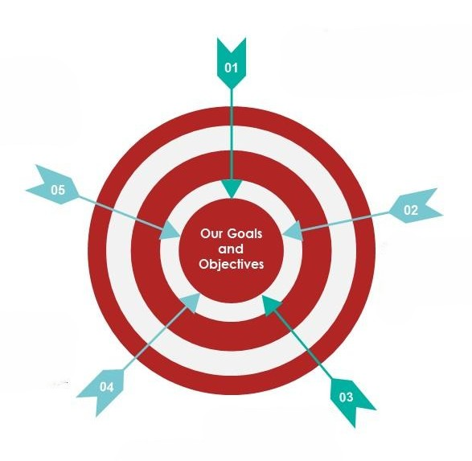
Objectives
To design and simulate a three-phase Vienna rectifier with Power Factor Correction (PFC) using MATLAB/Simulink.
To evaluate the efficiency, power factor, and harmonic profile of the Vienna rectifier under different load conditions.
To achieve unity power factor by reducing input current harmonics (THD < 5%).
To demonstrate the rectifier’s capability for high-performance motor control and industrial automation applications.
To regulate the DC-link voltage
3

Slide 4
Description
The model is a MATLAB/Simulink implementation of a Vienna rectifier topology for high-power AC–DC conversion.
Three-phase AC source is connected through inductors to the rectifier stage.
The rectifier consists of three bidirectional switches and diodes arranged in a three-level topology, reducing switching stress and improving efficiency.
Control Strategy:
Phase-Locked Loop (PLL): Synchronizes with grid voltage for reference generation.
Voltage Controller (PI): Maintains constant DC-link voltage by adjusting reference current.
Current Controller: Ensures input current follows sinusoidal reference for PFC.
Center-Point Voltage Controller: Balances split DC-link capacitor voltages to avoid instability.
Output: A regulated DC voltage suitable for driving an inverter-fed motor drive.
The simulation includes measurement blocks to observe power factor, THD, capacitor voltages, and output current waveforms.
4

Slide 5
Literature Survey
PAPER TITLE & AUTHOR | OUTCOME | LIMITATION | HOW OUR PROJECT IMPROVES
“Three-phase Three-level Boost-type Front-end PFC Rectifier for Improving Power Quality at Input AC Mains of Telecom Loads” – Saravana Prakash P., R. Kalpana, Bhim Singh (JPE, 2018) | Achieved high PF (~0.99), THD <5%, reduced switching stress in telecom supplies. | Limited only to telecom DC power systems, not suitable for dynamic loads like motors. | Our project extends Vienna rectifier benefits to industrial motor drives, where load variation and speed control are crucial.
“Demystifying Three-Phase PFC Topologies” – Didier Balocco, Oriol Filló (How2Power Today, 2021) | Showed Vienna rectifier is superior in efficiency, EMI reduction, compactness compared to 2-level PFC. | Purely theoretical/comparative study, no experimental or motor drive implementation. | We implemented & simulated Vienna rectifier with PI control in MATLAB/Simulink for motor control integration.
“Three-Phase Vienna Rectifier Design Guide” – STMicroelectronics (App Note, 2022) | 15 kW EV charger, >98% efficiency, PF >0.99. | Targeted EV charging, costly hardware. | Cost-effective simulation for industrial automation.
5

Slide 6
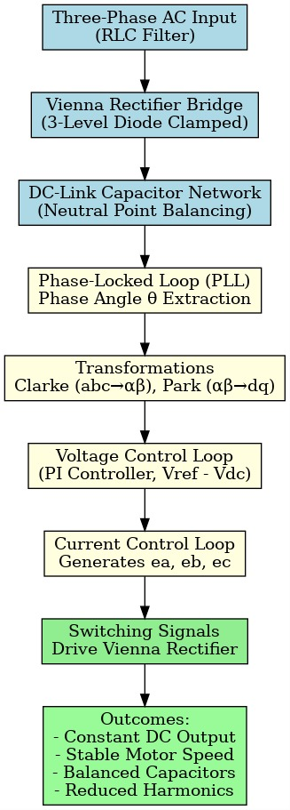
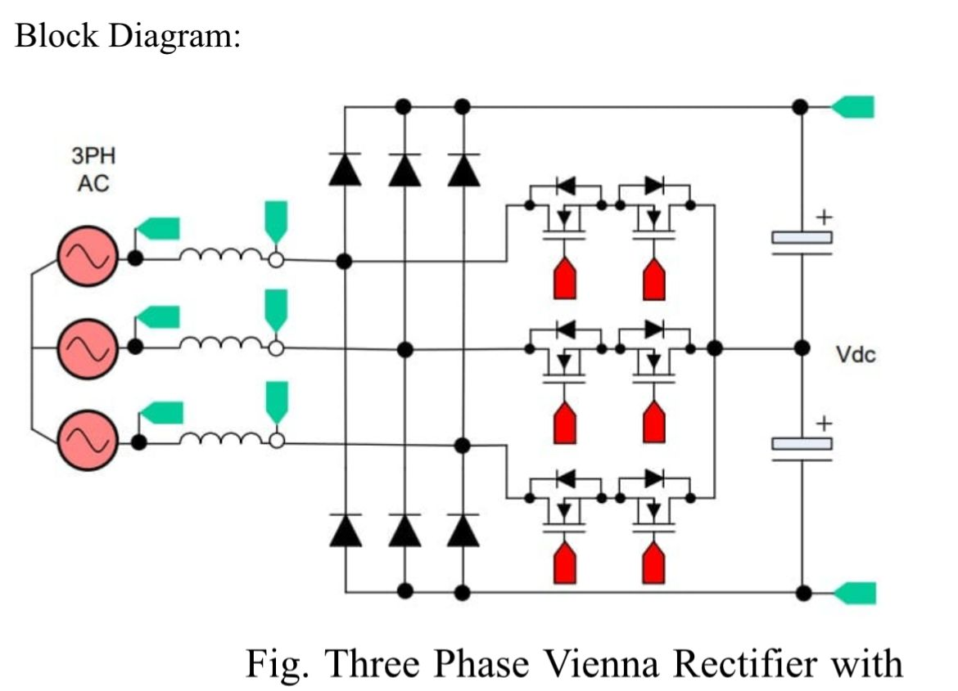
Flowchart and Block diagram
6

Slide 7
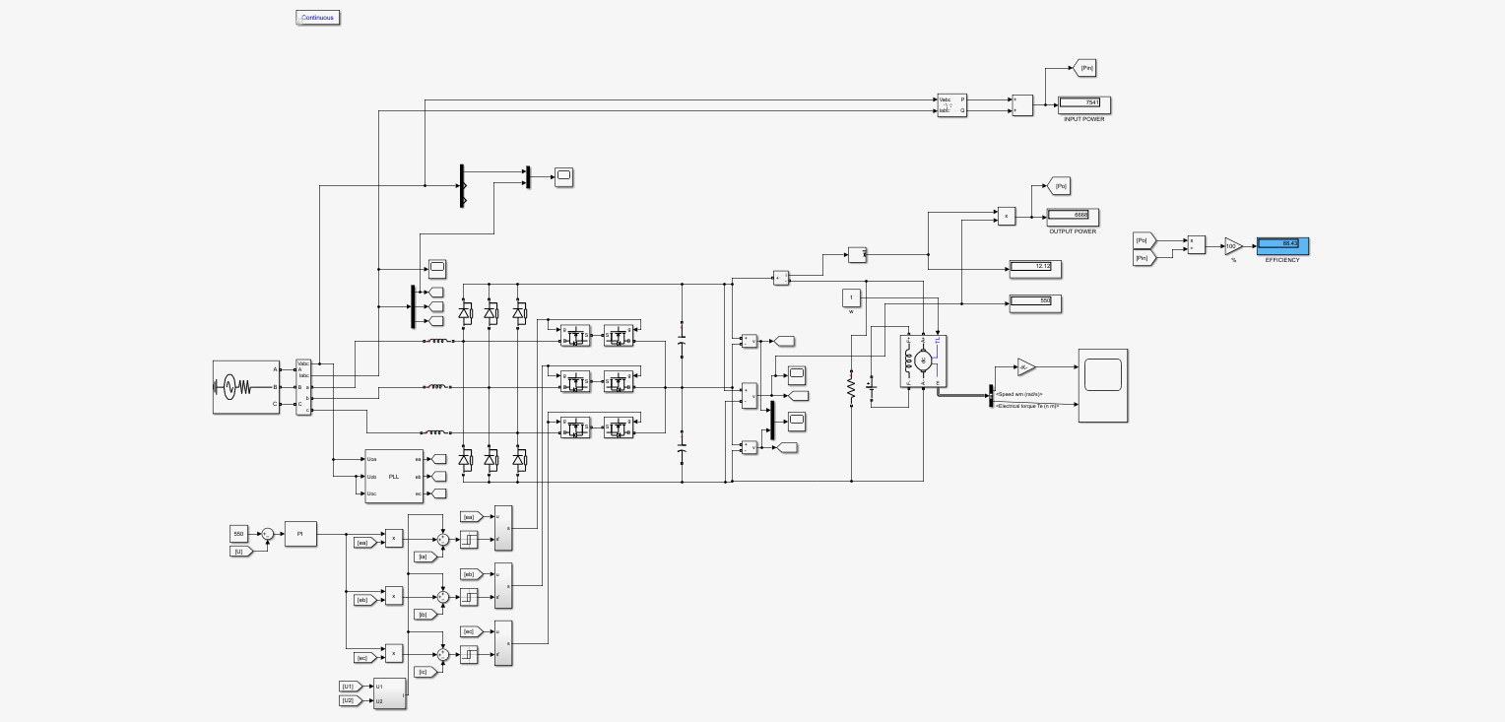
Circuit Design
7

Slide 8
Simulation Blocks:
Methodology
1. Three-Phase AC Input & Filter
A balanced three-phase AC supply (labeled A, B, C) is used.
Connected through an RLC input filter to suppress high-frequency switching harmonics and improve power quality.
2. Vienna Rectifier Bridge
Utilizes a three-level diode-clamped topology with bidirectional switches.
Converts AC to regulated DC while minimizing Total Harmonic Distortion (THD).
Enables bidirectional power flow and improved efficiency.
3. DC-Link Capacitor Network
Split capacitors stabilize the DC output voltage.
Allows independent control of the center point voltage to avoid neutral point imbalance.
8

Slide 9
Simulation Blocks:
Methodology
4. PLL (Phase Locked Loop)
Locks onto the grid voltage to extract phase angle (θ).
Provides the necessary synchronization for control transformations (e.g., abc to dq).
5. Voltage Control Loop
PI controller maintains the desired DC link voltage.
The error between the reference and actual DC voltage is processed to generate the reference current signal.
6. Current Control Block
Reference current is multiplied with phase voltages (from PLL) to produce modulated control signals.
Outputs [ea], [eb], [ec] are used to drive the switching signals of the Vienna Rectifier.
9

Slide 10
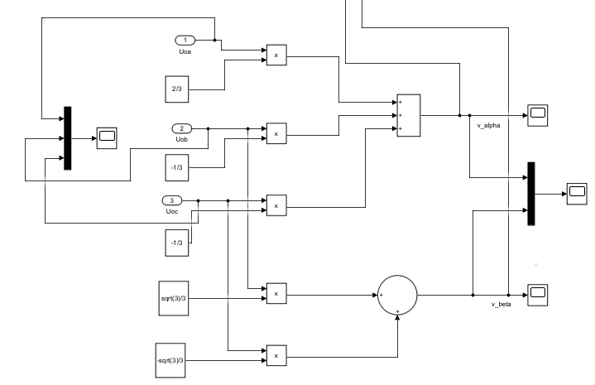
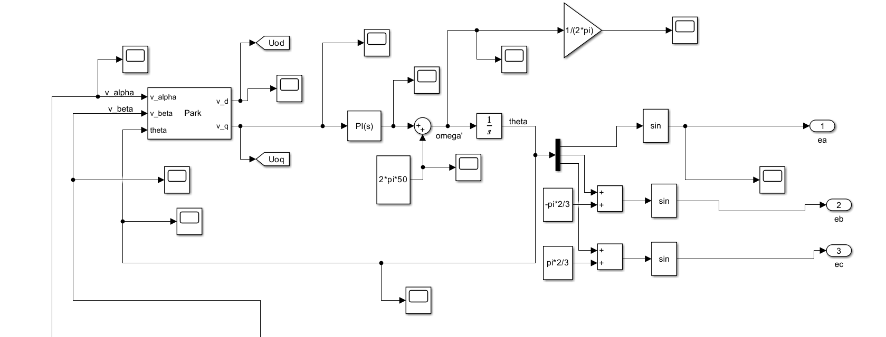
Methodology
Clark Transformation: ( abc to αβ )
Vα
Vβ
-1/2 -1/2
0 √3/2 -√3/2
Ua
Ub
Uc
= 2/3
Vα = 2/3 ( Ua – ½ Ub – ½ Uc )
Vβ = 2/3 (√3/2 Ub - √3/2 Uc ) = √3/3 ( Ub – Uc )
Park Transformation: (αβ to dq )
Vd
Vq
cos θ sin θ
-sin θ cos θ
Vα
Vβ
=
10

Slide 11
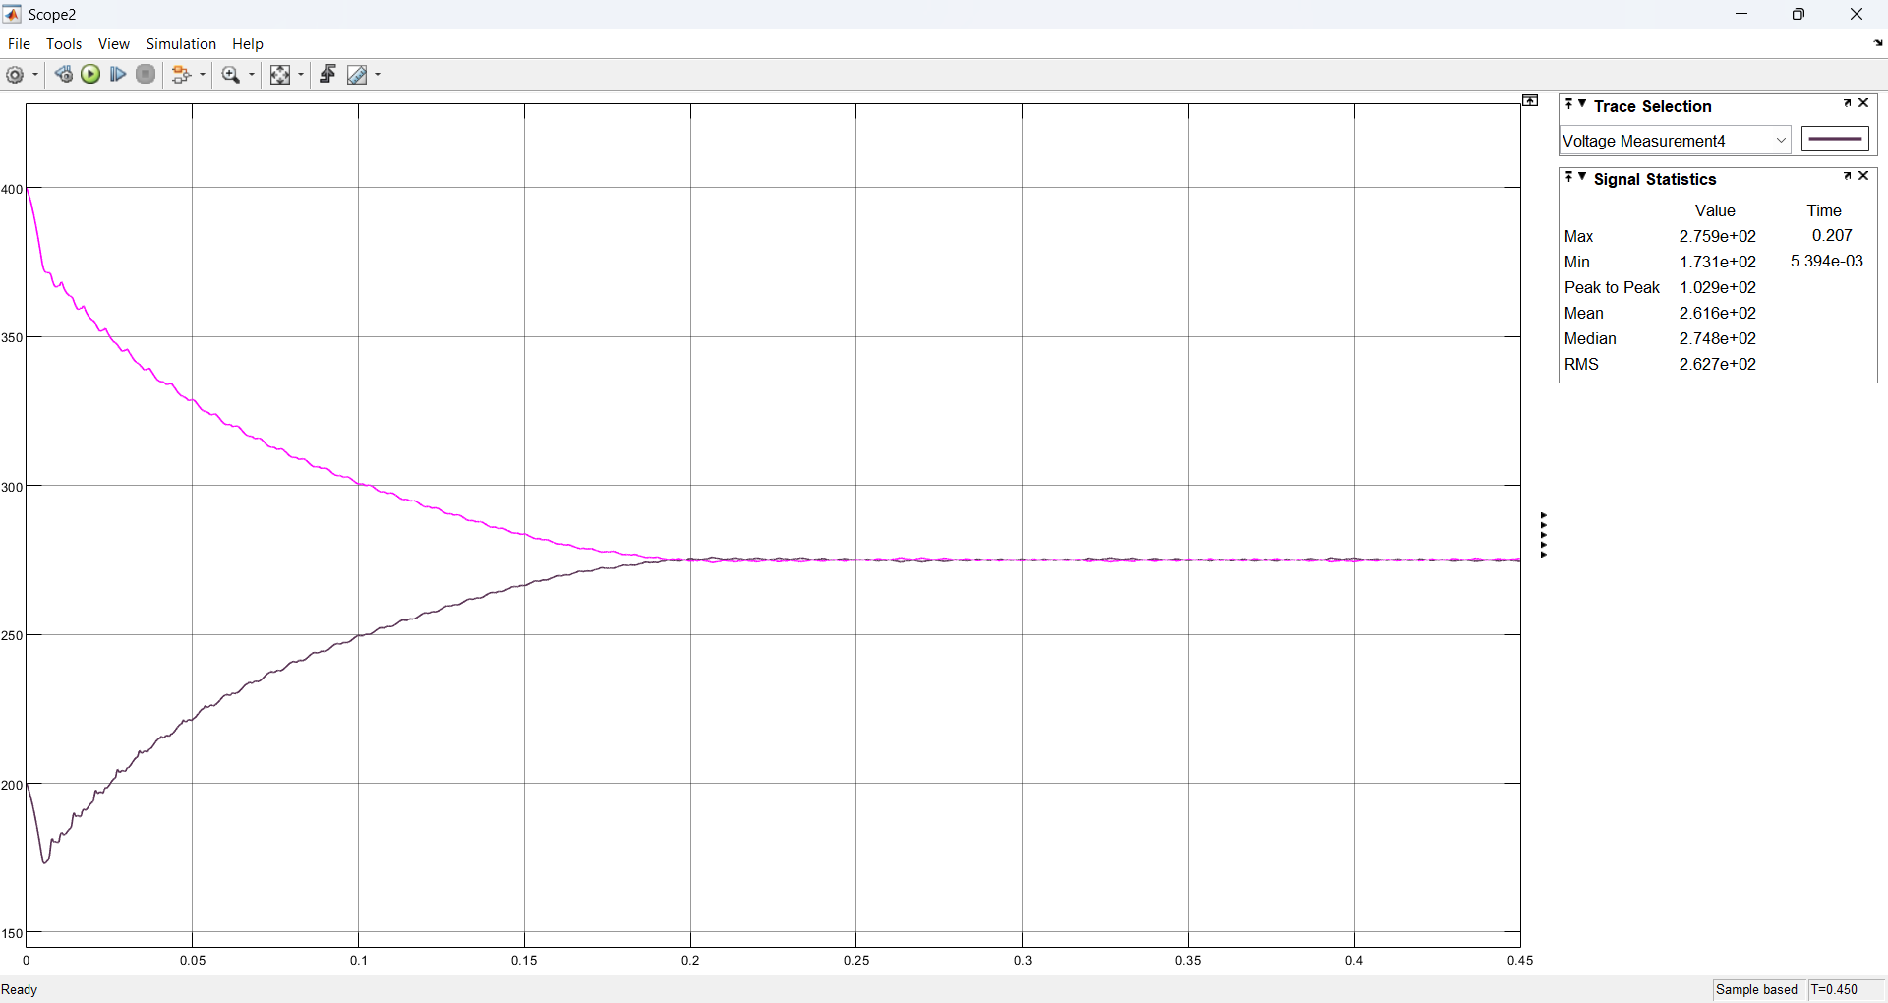
Output
Voltage regulation graph:
Constant DC voltage → constant power to motor → stable speed.
If ripple was high, the motor would experience torque pulsations → poor speed regulation.
This keeps motor speed constant under load changes (good speed regulation).
Capacitor voltages U1 and U2 are well balanced (~300 V each)
Balanced capacitors = symmetrical switching → reduced current distortion → near-sinusoidal input current.
Reduced harmonic losses
11

Slide 12
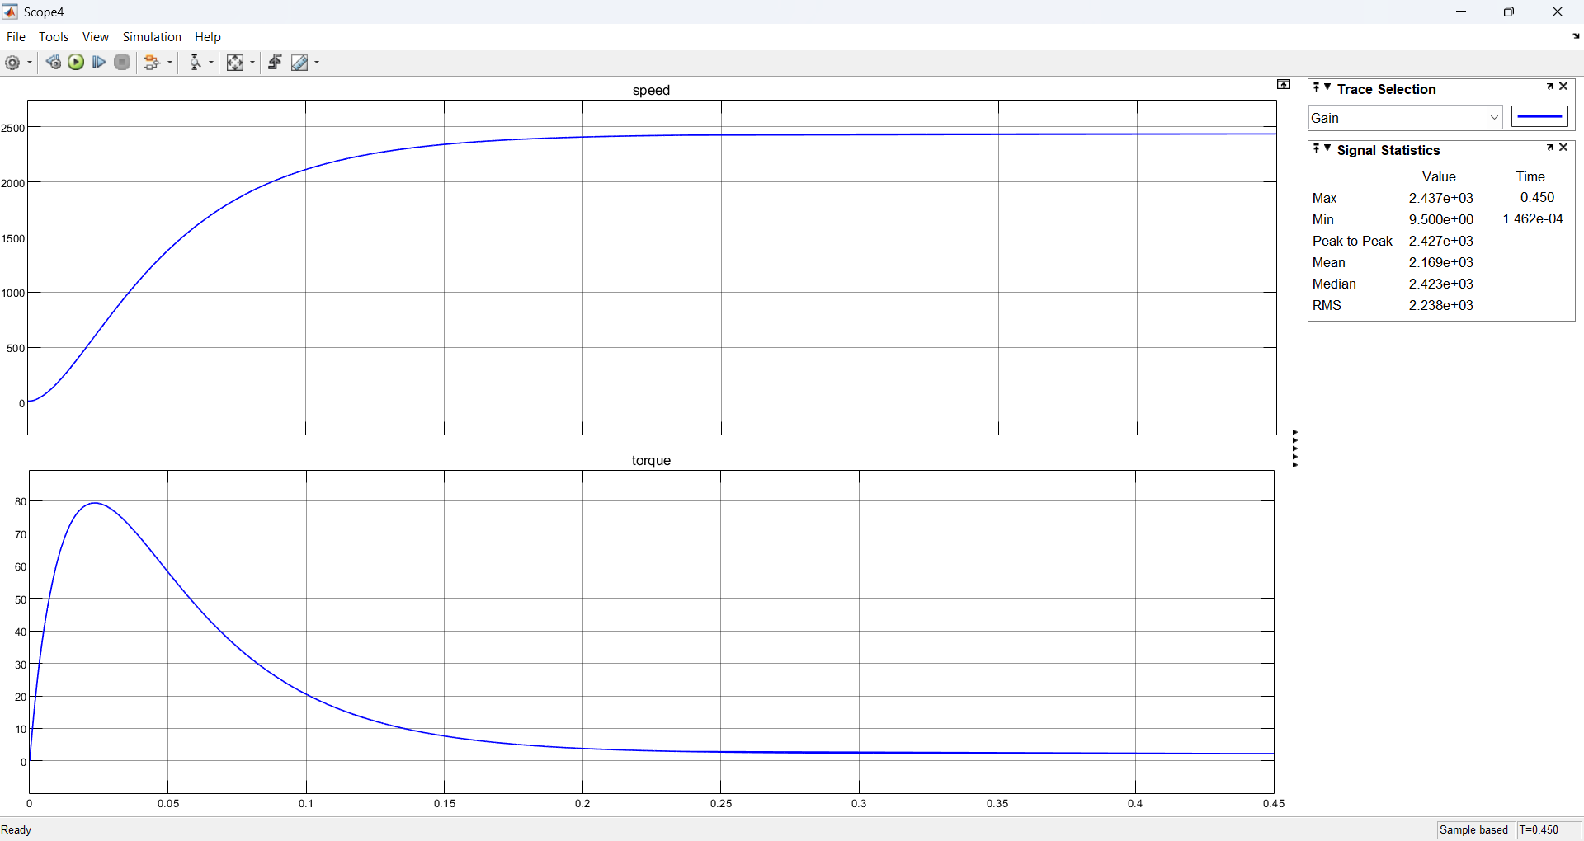
Output Graph
Result:
The manually calculated efficiency validates the simulation results, showing a maximum efficiency of 98% for the proposed Vienna rectifier with power factor correction.
12

Slide 13
Why Vienna?
It’s a three-phase, three-level, boost-type PWM rectifier.
Uses only 3 MOSFETs (one per phase) and 6 diodes, unlike other active rectifiers that need 6 MOSFETs or IGBTs.
Designed mainly for power factor correction (PFC) and DC-link voltage regulation in telecom, aerospace, EV chargers, and industrial loads
High Power Quality, High Efficiency, Three-Level DC Output, Balancing of DC-link capacitors.
Feature | Diode Bridge Rectifier | 6-Switch Active Rectifier (VSI) | Vienna Rectifier
Components | 6 diodes only | 6 IGBTs/MOSFETs + 6 diodes | 3 MOSFETs + 6 diodes
Power Factor | Low (≈0.6–0) | Near unity (≈0.99) | Near unity (≈0.99)
Harmonics | High THD | Low THD | Low THD
Control Complexity | None | High (PWM for 6 switches) | Medium (PWM for 3 switches)
Efficiency | Medium | Lower (more switches → losses) | Higher (fewer active switches)
DC Bus | 2-level | 2-level | 3-level (lower stress on parts)
Disadvantages:
Unidirectional power flow → can’t send power back to the grid (unlike full active rectifiers). Capacitor voltage balancing is tricky → needs extra control algorithm.
13

Slide 14

Active Participation
The proposed Vienna Rectifier model with integrated Power Factor Correction has been recognized by IFERP for potential publication. An authorship invitation was received for the abstract submission to the 49th World Conference on Applied Science, Engineering, and Technology, highlighting the innovation and academic value of the project.
15

Slide 15


SDG
Our project promotes sustainable industrial automation by integrating an efficient rectifier for motor control, supporting innovation in power electronics.
The design reduces energy wastage and harmonic pollution, encouraging sustainable production practices in power-intensive industries.
16

Slide 16
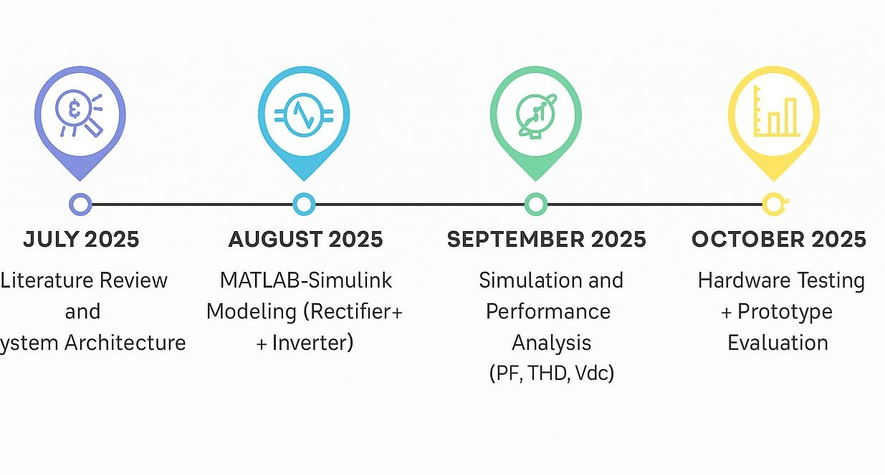
Plan of Action
S
17

Slide 17
References
S. Prakash, R. Kalpana, and B. Singh, “Three-phase Three-level Boost-type Front-end PFC Rectifier for Improving Power Quality at Input AC Mains of Telecom Loads,” Journal of Power Electronics, vol. 18, no. 6, pp. 1819–1829, Nov. 2018.
D. Balocco and O. Filló, “Demystifying Three-Phase PFC Topologies,” How2Power Today, Feb. 2021.
STMicroelectronics, “Three-Phase Vienna Rectifier Design Guide (STDES-VRECTFD, 15 kW Reference Design),” Application Note UM2975, Jan. 2022.
B. Singh, B. N. Singh, A. Chandra, K. Al-Haddad, A. Pandey, and D. P. Kothari, “A review of three-phase improved power quality AC–DC converters,” IEEE Transactions on Industrial Electronics, vol. 51, no. 3, pp. 641–660, Jun. 2004.
B. Singh and S. Gairola, “Design and implementation of Vienna rectifier for power factor correction in power systems,” International Journal of Emerging Electric Power Systems, vol. 20, no. 5, pp. 1–14, 2019.
H. Akagi, E. H. Watanabe, and M. Aredes, Instantaneous Power Theory and Applications to Power Conditioning, Wiley-IEEE Press, 2007.
IEEE Standard 519-2014, “IEEE Recommended Practice and Requirements for Harmonic Control in Electric Power Systems,” IEEE Power and Energy Society, 2014.
IEC 61000-3-2, “Electromagnetic Compatibility (EMC) – Part 3-2: Limits for Harmonic Current Emissions,” International Electrotechnical Commission, 2018.
J. W. Kolar and F. C. Zach, “A novel three-phase utility interface minimizing line current harmonics of high-power telecommunications rectifier modules,” IEEE Transactions on Industrial Electronics, vol. 44, no. 4, pp. 456–467, Aug. 1997.
Project Document: Design and Implementation of a High-Efficiency Three-Phase Vienna Rectifier with PFC and Three-Phase Inverter, Mini Project Report, 2025.
18

