Slide 1


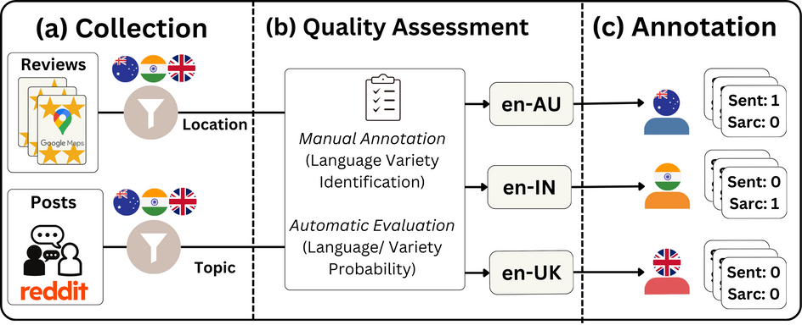





English comes in different flavours
Does your LLM understand them?
Try BESSTIE
A Benchmark for Sentiment and Sarcasm Classification for Varieties of English
How do we create the dataset?
Dataset Features
Dataset Statistics
3 varieties of English
Variety | Subset | Train | Valid | Test
en-AU | GOOG | 946 | 130 | 270
en-AU | REDD | 1763 | 241 | 501
en-IN | GOOG | 1648 | 225 | 469
en-IN | REDD | 1686 | 230 | 479
en-UK | GOOG | 1817 | 248 | 517
en-UK | REDD | 1007 | 138 | 287
Total | Total | 8867 | 1212 | 2523
+ Australian (en-AU)
+ British (en-UK)
Inner
circle
+ Indian (en-IN)
Outer-circle
Dataset with 2 annotated labels
+ Sentiment
+ Sarcasm
Srirag, D., Joshi, A., Painter, J., Kanojia, D. (2024). BESSTIE: A benchmark for sentiment and sarcasm classification for varieties of English. arXiv.
We benchmark 9 LLMs
6 Encoders
+ BERT
+ DistilBERT
+ RoBERTa
+ mBERT
+ mDistilBERT
+ XLM-RoBERTa
Multilingual
Domain-Task | en-AU | en-IN | en-UK
GOOG-Sent | 0.94 | 0.64 | 0.86
REDD-Sent | 0.78 | 0.69 | 0.78
REDD-Sarc | 0.62 | 0.56 | 0.58
Mean | 0.78 | 0.63 | 0.74
3 Decoders
+ Mistral
+ Qwen
+ Gemma
Key Results for Future Research
🥳
Lower model performance for en-IN variety.
Sarcasm detection is a harder task than sentiment classification.
Error Analysis, in the paper, shows the need for focused solutions for each variety.
🥳
🥳
Potential Applications
Apart from Academic Research, BESSTIE can be used to:
Develop dialogue agents that cater to requests made by diverse users.
Localise language models—what sounds sarcastic in one country might not be in another.
Improve social media monitoring to prevent misinterpretation for content moderation.
and many more...
Funded by

