Slide 1
Software testing
عرفان بهرامی - محمد حسین احتشامی - محمد سقلی - سیاوش قاسمی

Slide 2
Introduction
It is the process used to identify the correctness, completeness and quality of developed computer software.
It is the process of executing a program/application under positive and negative conditions by manual or automated means. It checks for the :
Specification
Functionality
Performance

Slide 3
Objectives
Uncover as many as errors (or bugs) as possible in a given product.
Demonstrate a given software product matching its requirement specifications.
Validate the quality of a software testing using the minimum cost and efforts.
Generate high quality test cases, perform effective tests, and issue correct and
helpful problem reports.

Slide 4
Error, Bug, Fault & Failure
Error : It is a human action that produces the incorrect result that produces a fault.
Bug : The presence of error at the time of execution of the software.
Fault : State of software caused by an error.
Failure : Deviation of the software from its expected result. It is an event.

Slide 5
SDLC(Software Development Life Cycle)
Standard model used word wide to develop a software.
A framework that describes the activities performed at each stage of a software development project.
Necessary to ensure the quality of the software.
Logical steps taken to develop a software product.

Slide 6
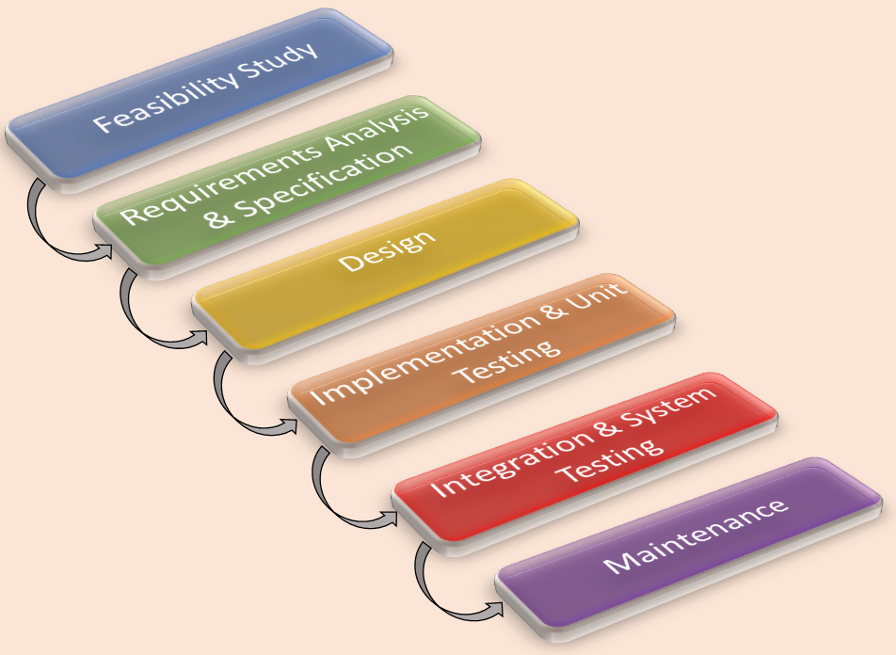
Classical Waterfall Model
It is the oldest and most widely used model in the field of software development.

Slide 7
Project Initiation
Summary Reports
System Study
Analysis
Test Plan
Regression Test
Design Test Cases
Report Defects
Execute Test Cases ( manual /automated )
Testing Life Cycle

Slide 8
Test Plan and Test Case
Test Plan:
It is a systematic approach to test a system i.e. software.The plan typically contains a detailed understanding of what the eventual testing workflow will be.
Test Case:
It is a specific procedure of testing a particular requirement.It will include:
Identification of specific requirement tested
Test case success/failure criteria
Specific steps to execute test
Test data

Slide 9
Verification vs Validation
Verification: The software should confirm to its specification
(Are we building the product right?)
Validation: The software should do what the user really requires
(Are we building the right product?)

Slide 10

Testing Methodologies
Black box testing :
No knowledge of internal program design or code required.
Tests are based on requirements and functionality.
white box testing :
Knowledge of the internal program design and code required.
Tests are based on coverage of code statements, branches, paths, conditions.

Slide 11
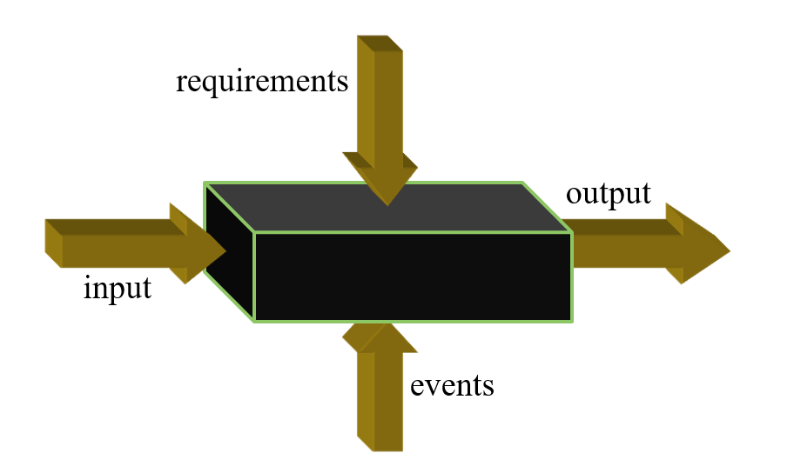
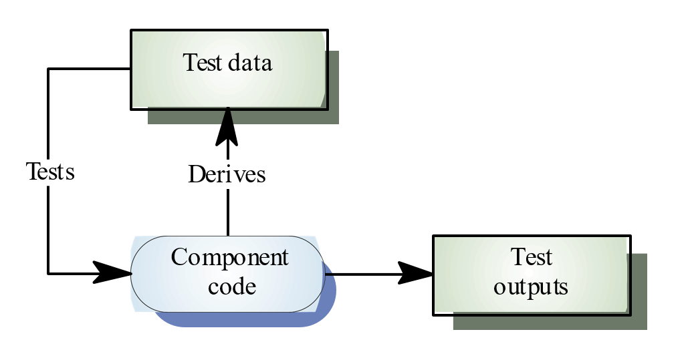
White box black box

Slide 12
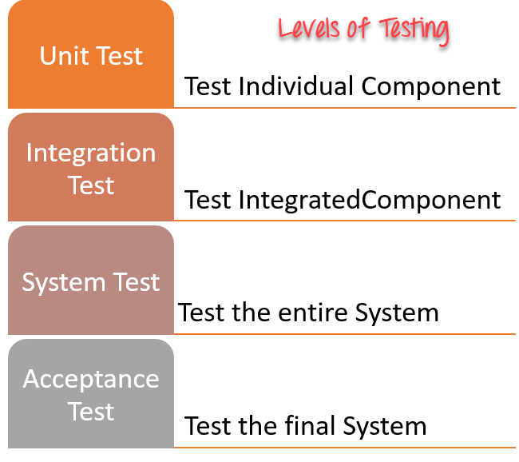
Testing Levels

Slide 13
UNIT TESTING
Tests each module individually.
Follows a white box testing (Logic of the program).
Done by developers.

Slide 14
INTEGRATION TESTING
Once all the modules have been unit tested, integration testing is performed.
It is systematic testing.
Produce tests to identify errors associated with interfacing.
Types:
Big Bang Integration testing
Top Down Integration testing
Bottom Up Integration testing
Mixed Integration testing

Slide 15
SYSTEM TESTING
System testing is the first level in which the complete application is tested as a whole.
The goal at this level is to evaluate whether the system has complied with all of the outlined requirements and to see that it meets Quality Standards.
System testing is undertaken by independent testers who haven’t played a role in developing the program.
This testing is performed in an environment that closely mirrors production.

Slide 16
ACCEPTANCE TESTING
ACCEPTANCE TESTING is a level of software testing where a system is tested for acceptability.
The purpose of this test is to evaluate the system’s compliance with the business requirements and assess whether it is acceptable for delivery.
Done by end users
Types:
User acceptance testing
Operational acceptance testing
Contractual and regulatory acceptance testing
Alpha and beta testing

Slide 17
DISCUSSION
In order to be cost effective, the testing must be concentrated on areas where it will be most effective.
The testing should be planned such that when testing is stopped for whatever reason, the most effective testing in the time allotted has already been done.
The absence of an organizational testing policy may result in too much effort and money will be spent on testing, attempting to achieve a level of quality that is impossible or unnecessary.

Slide 18
THANK YOU

