Slide 1





PhonePe Transaction Insights

Slide 2
Problem Statement & Objectives
Growing Digital Payment Challenges
With increasing reliance on digital payment platforms like PhonePe, businesses need comprehensive insights into transaction patterns, user engagement behaviors, and insurance adoption trends to optimize services and strategic decisions.
Transaction Analysis
Understanding payment trends, transaction volumes, and user behavior patterns across different regions and time periods for strategic insights.
User Engagement
Analyzing user engagement metrics, device preferences, and regional adoption patterns to improve service delivery and user experience.
Insurance Penetration
Evaluating insurance adoption trends, market penetration rates, and growth opportunities to enhance product offerings and market strategies.

Slide 3
Methodology & Approach
Data Extraction & Setup
Cloned GitHub dataset and performed ETL processes into SQL database with structured tables for aggregated data, mapping information, and top-performing metrics.
SQL & Python Analysis
Executed complex SQL queries combined with Python data analysis using Pandas and Pyplot for comprehensive data exploration and visualization.
Interactive Dashboard Development
Built interactive Streamlit application featuring KPIs, geographical maps, and dynamic charts for real-time data exploration and business insights.

Slide 4
01. Transaction Type Trends
Analyzing P2P dominance, merchant payment growth, and regional transaction patterns across India's digital payment landscape.
Business Use Cases
02. Device Dominance Analysis
Evaluating device brand preferences, user engagement scores, and market penetration across different states and regions.
03. Insurance Penetration Study
Examining insurance adoption trends, seasonal patterns, and growth opportunities in various geographical markets and demographics.
04. Market Expansion Strategy
Identifying growth leaders, penetration opportunities, and strategic expansion targets based on comprehensive market analysis and user behavior.
05. User Engagement & Growth Strategy
Identifying engagement ratio among states, growth in year and quarter trend. loyal among user and average usage among device and states.

Slide 5
Transaction Type Trends
P2P Dominance (%)
Peer-to-Peer payments dominate with 77.1% of total transaction volume with 266T transaction amount, indicating strong P2P digital payment adoption across India.
Top States by Transaction Amount (₹)
Telungana (41.6T), Karnataka (40.67T), Maharastra (40.37T), Andhra Pradesh (34.66T), Uttar Pradesh (26.8T) lead in transaction value
Merchant Growth (%)
Merchant payments show rising trend at 18.9% with 65T transaction amount and with Q4 consistently being peak season, driven by festive and shopping activities.

Slide 6
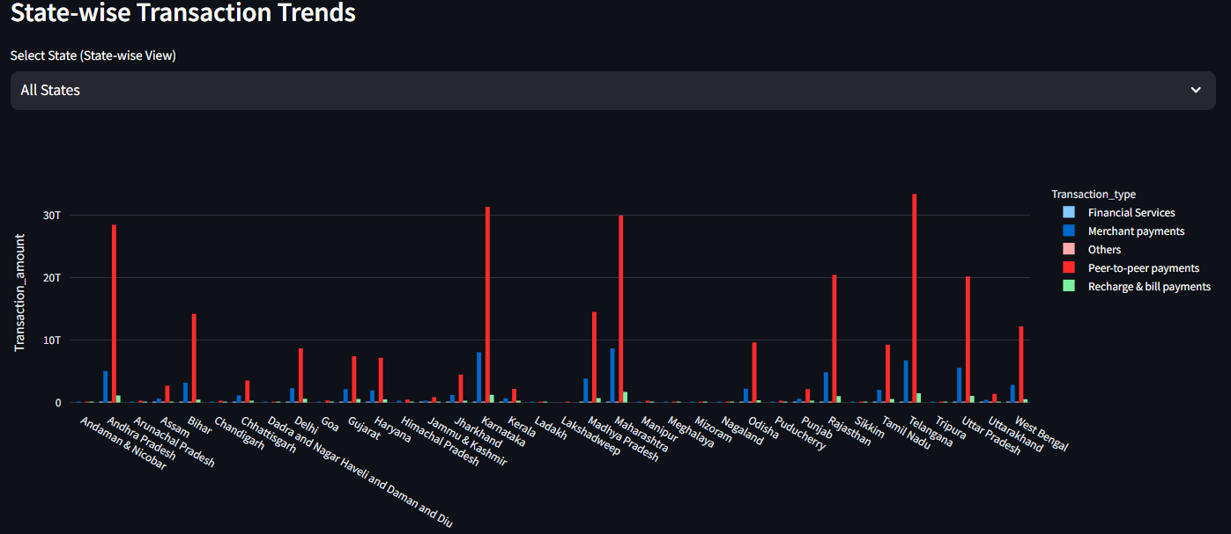
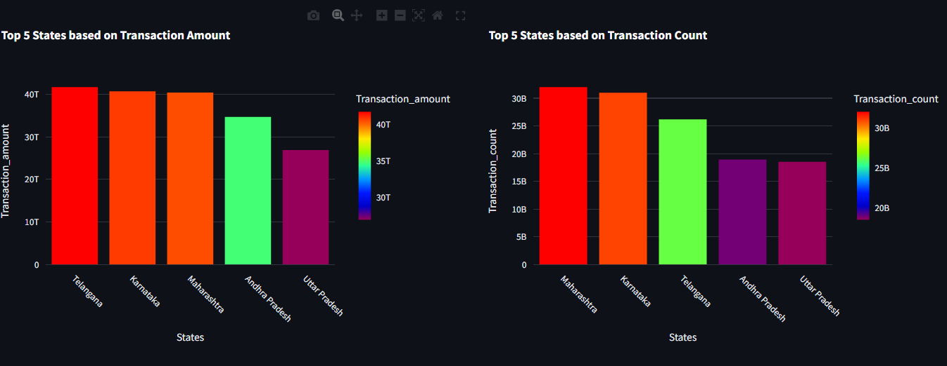
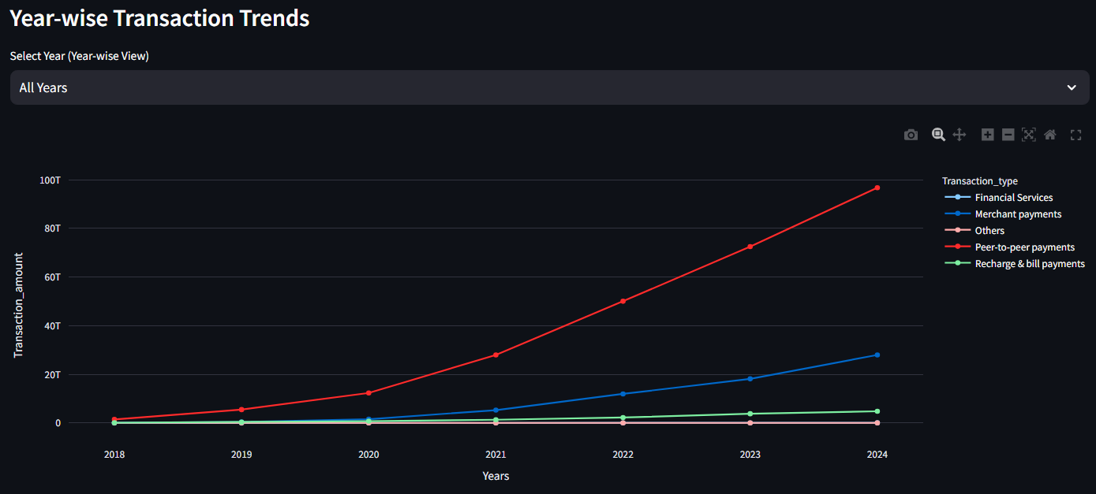
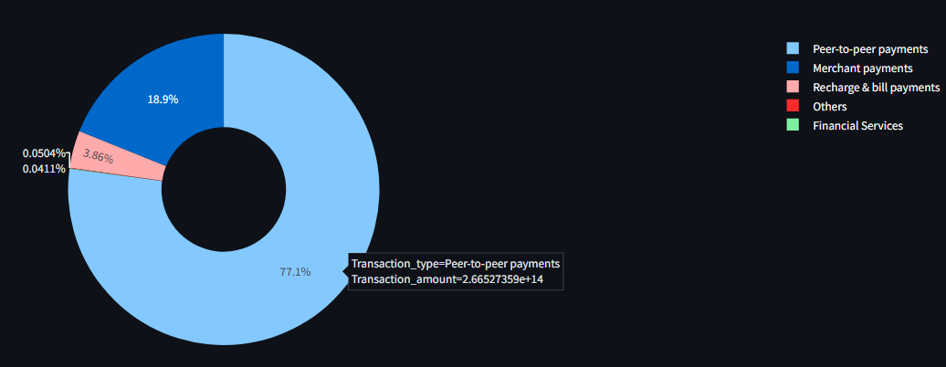

Slide 7
Device Dominance & User Engagement
States Dominated
Xiaomi Users
Engagement Score
App Opens/User
32
869M+
Meghalaya
Maharashtra
Market Leadership
Engagement Metrics
Regional Patterns
Xiaomi dominates smartphone usage across 32 states with over 869 million users, demonstrating clear market leadership.
User engagement varies significantly by region, with Northeast states showing exceptionally high app usage rates.
Northeast states demonstrate highest per-user engagement while metropolitan areas show lower relative engagement rates.
Xiaomi leads in 32 out of 35 states analyzed.
Vivo dominates in 2 states, Samsung in 1 state.
Clear brand preference hierarchy established across regions.
Xiaomi engagement score: 227M users actively engaged.
Samsung follows with 129M engaged users.
Vivo maintains 104M active user engagement.
Meghalaya leads with 174 app opens per user.
Arunachal Pradesh and Mizoram follow closely.
Maharashtra leads in both Registration and App Open with 1.1B and 46.6B

Slide 8
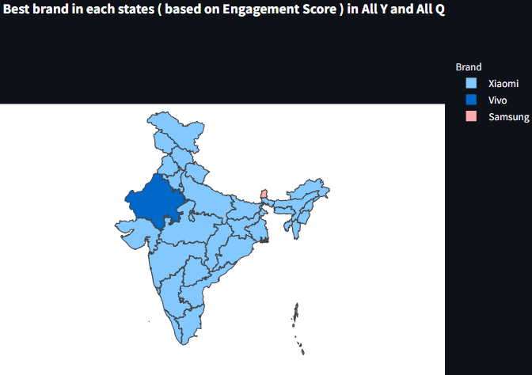
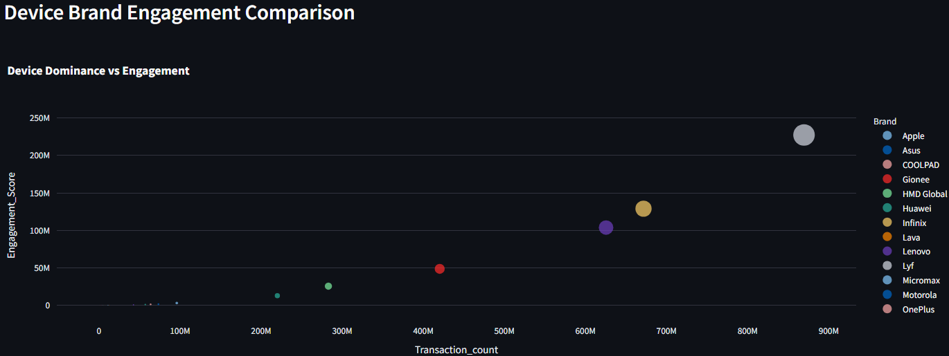
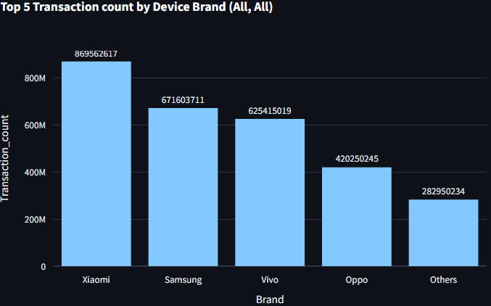
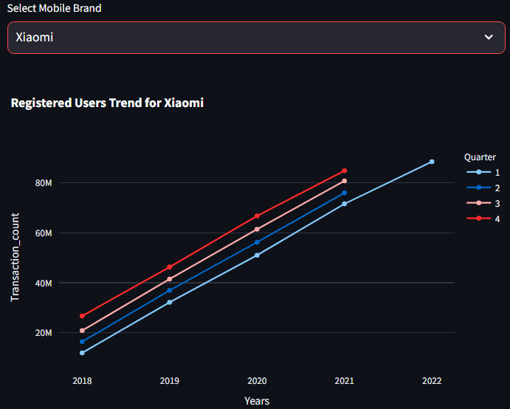

Slide 9
Insurance Penetration & Trends
Insurance Market Analysis
District & Pincode Hotspots
Growth Leaders & Laggards (2018–2024)
Karnataka and Maharashtra lead insurance adoption in both transaction amount and transaction count, with Q4 showing highest seasonal demand driven by tax-saving and year-end planning behaviors.
Districts: Bengaluru Urban (₹1,491M, 1.1M policies), Pune, Thane, Rangareddy, and Chennai emerge as insurance hotspots. Bottom districts like Hnahthial and Pherzawl show negligible penetration, indicating untapped markets.
Top growth: Lakshadweep (+23,871%), South Garo Hills district (+1,252,065%), Pincode 794101 in Meghalaya (+86,906%).
Bottom growth: Andhra Pradesh (only +854), Pherzawl district (-3.1%), and Pincode 682557 (-95.25%).
State | Insurance Amount (₹Cr) | Insurance Count | Penetration Rate (%) | Growth Rate (%)
Karnataka | 274 | 1957404 | 4.27 | +18.5
Maharashtra | 236 | 1815539 | 2.37 | +15.2
Andaman & Nicobar | 0.19 | 12997 | 11.53 | +12.8
Kerala | 131 | 824235 | 7.11 | +9.4
Manipur | 0.7 | 3731 | 0.84 | +5.1

Slide 10
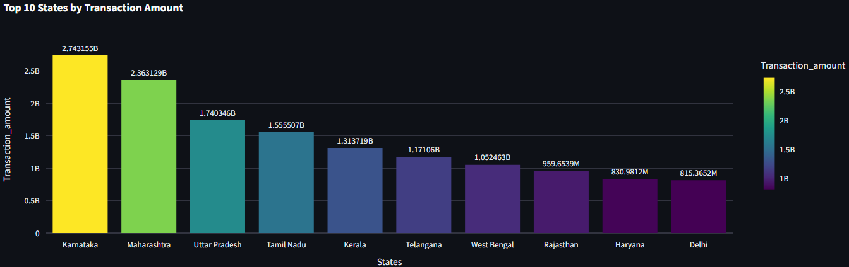
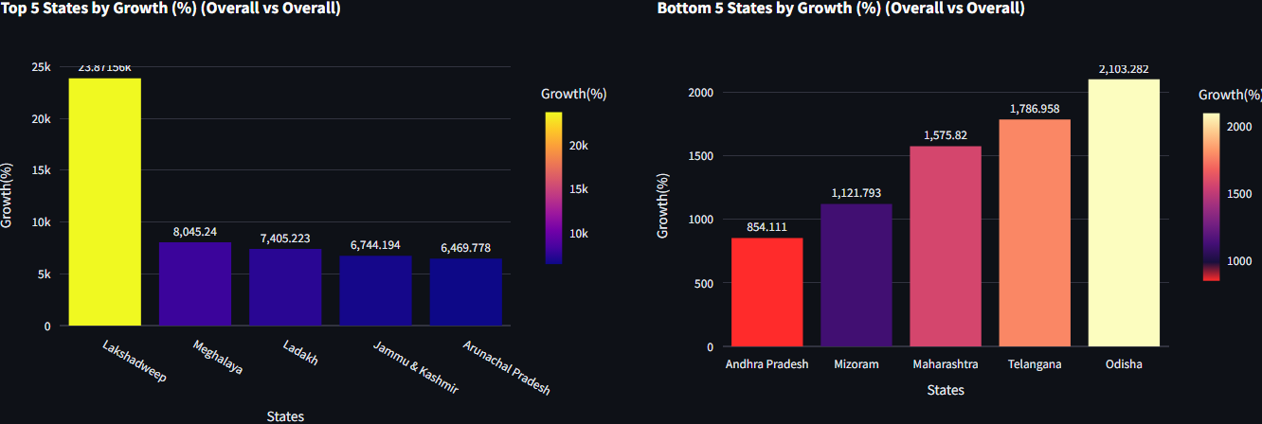
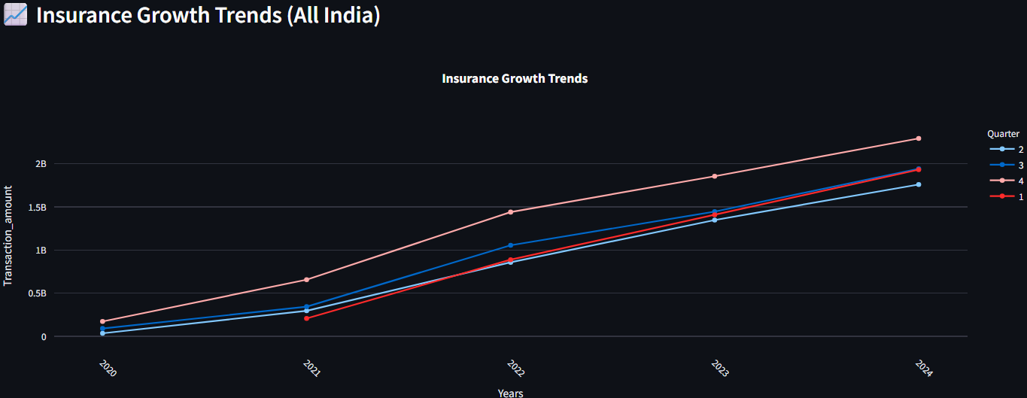
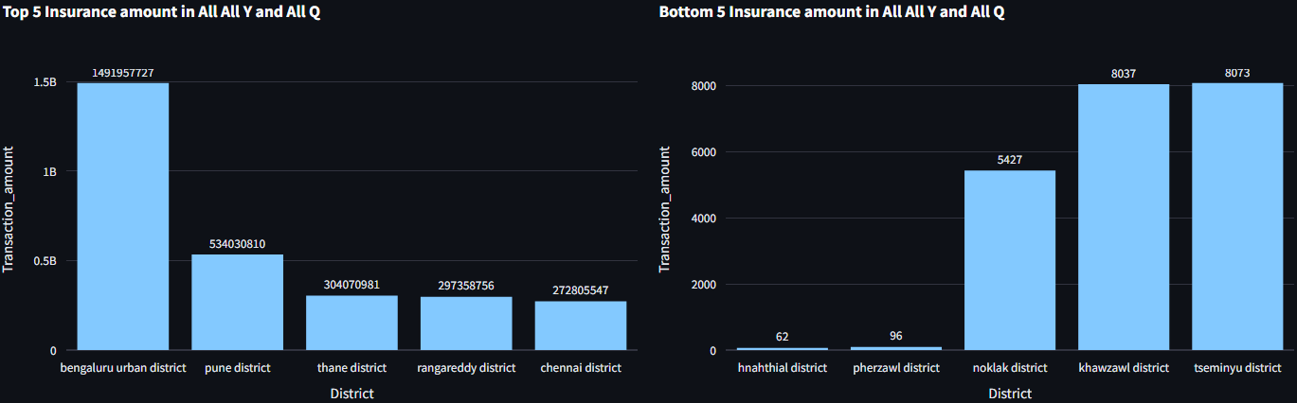

Slide 11
Market Expansion Strategy
Strategic Market Opportunities
Analysis reveals Telangana and Karnataka as transaction value leaders, while Maharashtra and Uttar Pradesh dominate in user numbers, creating diverse expansion opportunities across different market segments.
Transaction Leaders
User Base Leaders
Telangana: ₹41.6T total transaction value
Karnataka: ₹40.7T strong market presence
High-value transaction concentration patterns
Maharashtra: 1.14B registered users
Uttar Pradesh: 942M active user base
Large populated states make lead
Telangana, Andhra, Karnataka lead penetration
Telangana, Andhra, Karnataka lead penetration
Telangana, Andhra, Karnataka lead penetration
Growth Champions
Engagement Leaders
Penetration Focus

Slide 12
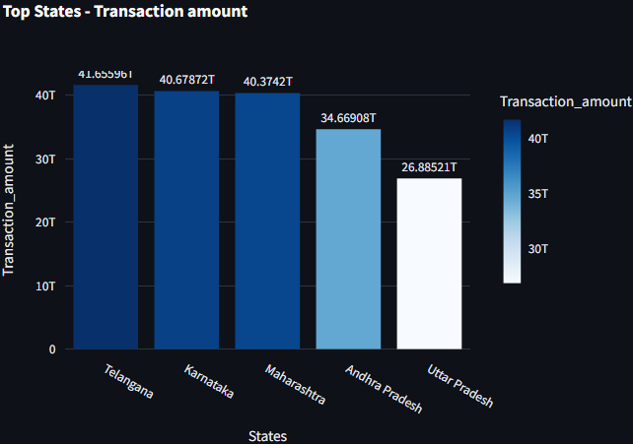
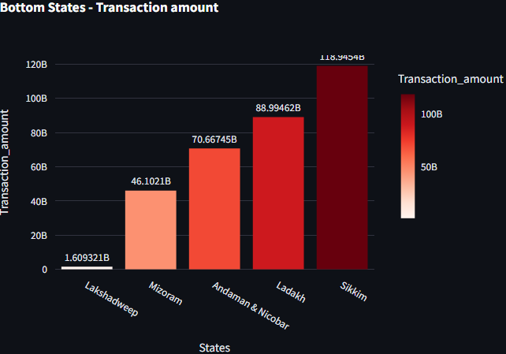
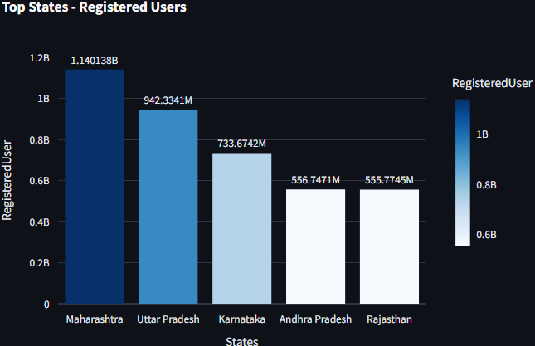
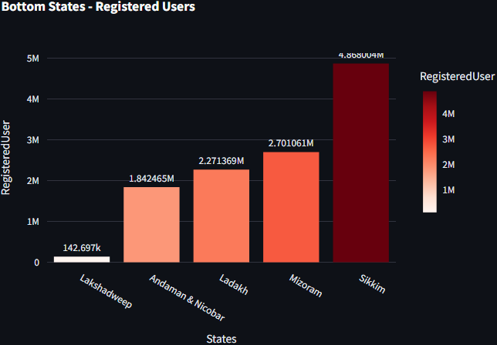
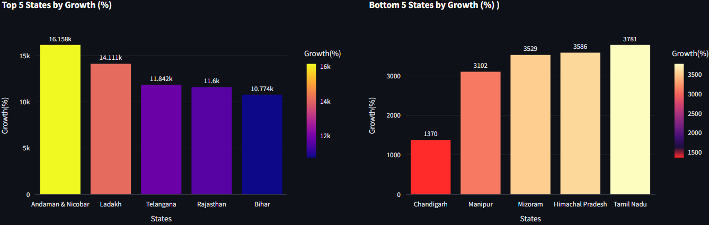
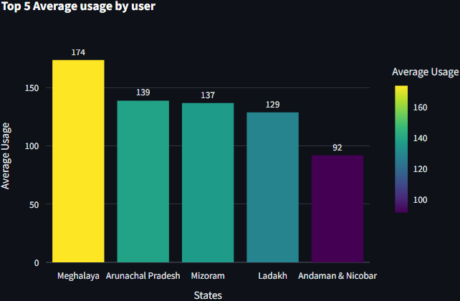
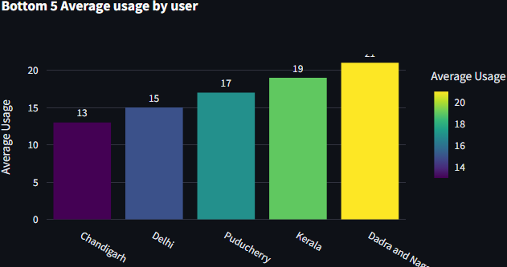

Slide 13
User Engagement & Growth Strategy
Engagement Insights
12.7×
Overall engagement ratio stands at 45.38 with remarkable regional variations. Registered users grew 12.7× from 46M to 587M, demonstrating explosive platform adoption. Northeast states show exceptional engagement patterns while metropolitan areas require strategic attention.
Registered User Growth
From 46M in 2018 to 586.75M in 2024
87.28%
25.1%
Loyalty Index
Rajasthan (87.28), Maharashtra (43.52).
South West Khasi Hills (1783.16), Pakke Kessang (1599.93).
Engagement Share
Xiaomi (25.1%), Samsung (19.4%), Vivo (18.1%), Oppo (12.1%). Xiaomi is the dominant brand

Slide 14
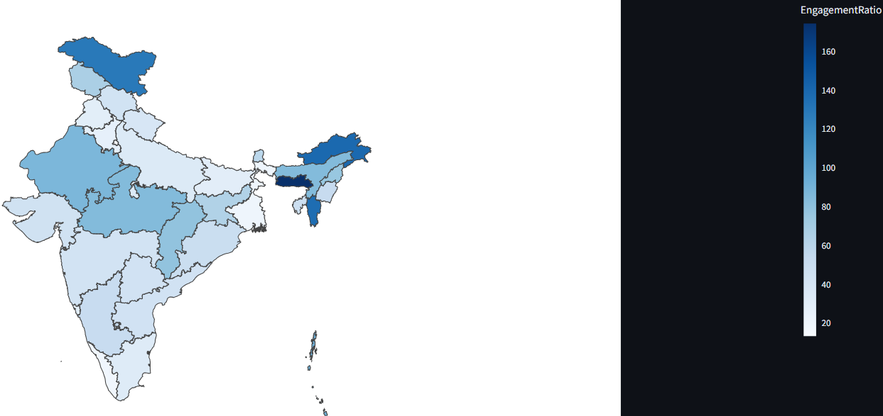
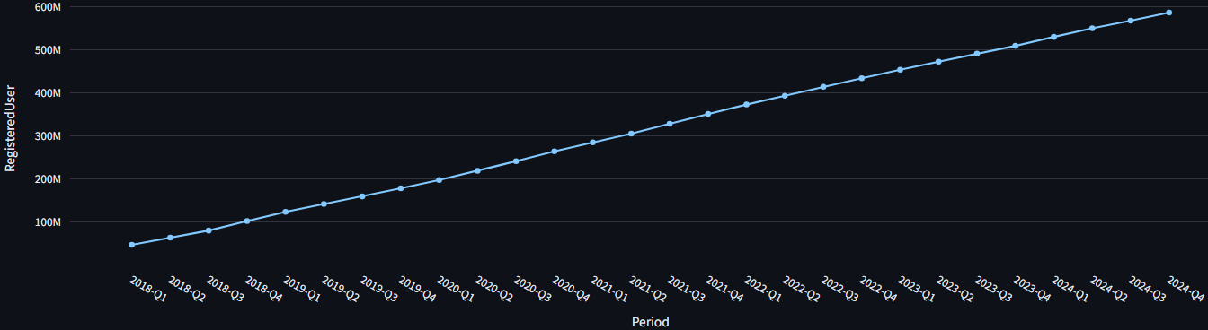
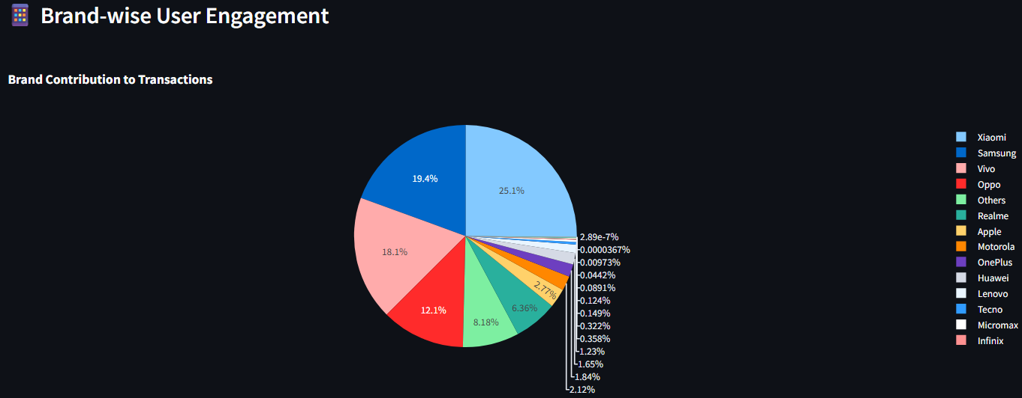
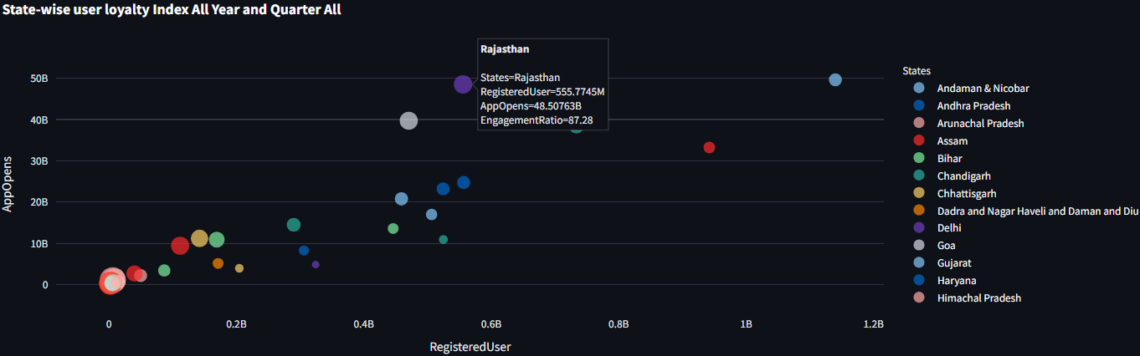

Slide 15
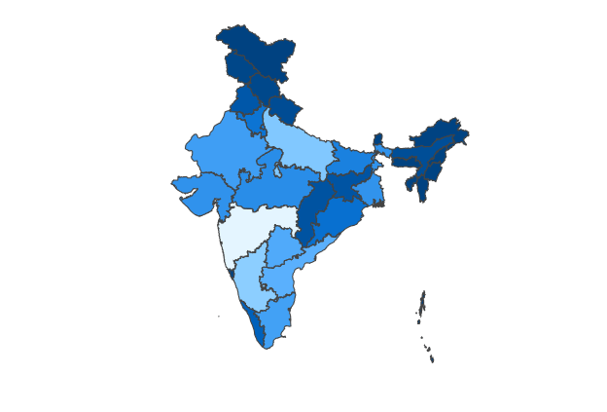
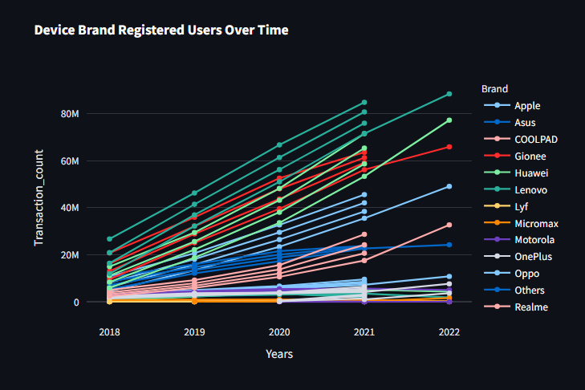
Dashboard & Visualizations Overview
Interactive Analytics Platform
Comprehensive Streamlit dashboard featuring interactive maps with GeoJSON integration, real-time KPIs tracking transaction amounts, user counts, and app opens with dynamic sidebar navigation for seamless data exploration.
Choropleth Maps
Multi-Chart Analytics
Interactive geographical visualizations using GeoJSON data to display transaction patterns, user distribution, and regional insights across India states and districts.
Comprehensive chart suite including line trends, bar comparisons, scatter correlations, and pie charts for brand share analysis and performance metrics.

Slide 16
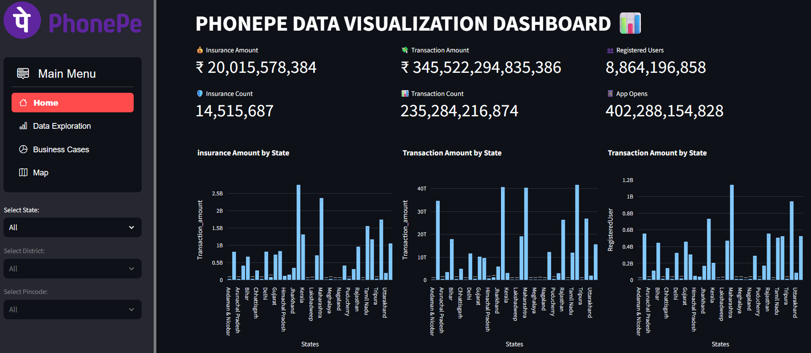
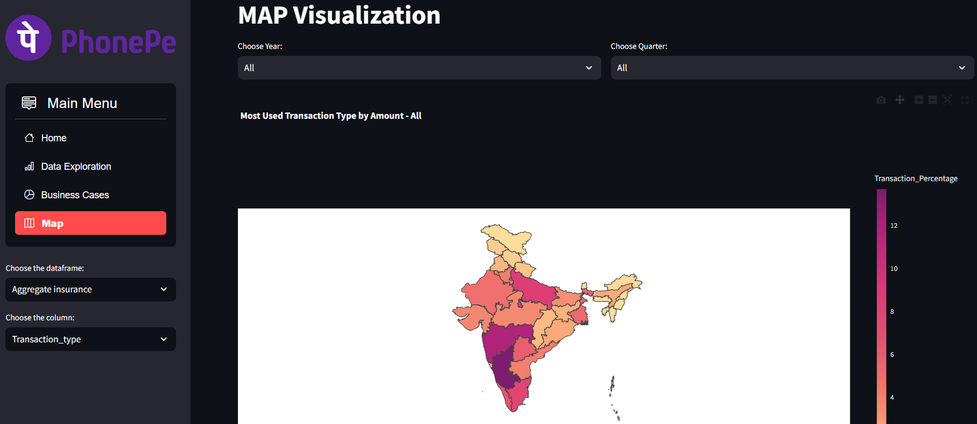

Slide 17
Key Results & Business Impact
Technical Proficiency & Data Insights
Business Stratergy & Recommendations
Successfully demonstrated advanced technical skills in SQL, Python, ETL processes, and data visualization while uncovering critical business insights across transaction patterns, user engagement, and market penetration.
Mastered complex SQL queries for multi-dimensional data analysis across aggregated, map and top tables.
Implemented Python-based analytics using Pandas and Plotpy for comprehensive statistical analysis and trend identification.
Developed interactive Streamlit dashboard with real time KPIs, geographical visualizations, and dynamic filtering capabilities.
Delivered actionable insights for market segmentation, user engagement optimization, geographic expansion strategies, and insurance penetration improvement through data-driven analysis.
Identified Northeast states as high-engagement targets with Meghalaya showing 174 app opens per user engagement.
Revealed insurance penetration opportunities in large states with low adoption rates for strategic market expansion.
Established device brand dominance patterns with Xiaomi leading 32 states and 869M+ users for partnership strategies.

Slide 18
Strategic Recommendations & Future Roadmap
Northeast Expansion Focus
Leverage exceptionally high engagement rates in Northeast states like Meghalaya, Arunachal Pradesh, and Mizoram to drive user acquisition and deepen market penetration through targeted campaigns and localized services.
Insurance Market Development
Capitalize on low insurance penetration in large states by implementing targeted insurance product offerings, educational campaigns, and partnerships to expand the ₹2.8% life insurance penetration rate significantly.
Strategic Device Partnerships
Strengthen relationships with Xiaomi given their 32-state dominance and 869M+ user base, while exploring partnership opportunities with Samsung and Vivo to maximize market coverage and user engagement across all demographics.

Slide 19
THANK YOU

