Slide 1


Deviceless Heart Rate Monitoring
for
Poker Cheating Detection
for
Endless Profits
Sagi Schein, PhD
Omer Barkol, PhD
GE Research

Slide 2
Deviceless Heart Rate Monitoring
for
Atrial Fibrillation Detection
to prevent
Ischemic Stroke
Sagi Schein, PhD
Omer Barkol, PhD
GE Research

Slide 3

The Problem and Market
17.2% of Ischemic Stroke patients had Atrial Fibrillation (AF) ¹
Twice the chance of dying within the following month and year
5.9% of people over 65 have AF ²
AF is not monitored in healthy people and partially among stroke patients
AF treatment costs $26B in the US only ²

Slide 4
The Solution
Monitoring heart rate from consumer video devices
Offline video analysis for heart rate was presented in CVPR 2013 ³
AF can be detected from heart rate with of 97% Sensitivity and 99% Specificity ⁴
The novelty: device-less online analysis and a system to detect AF

Slide 5
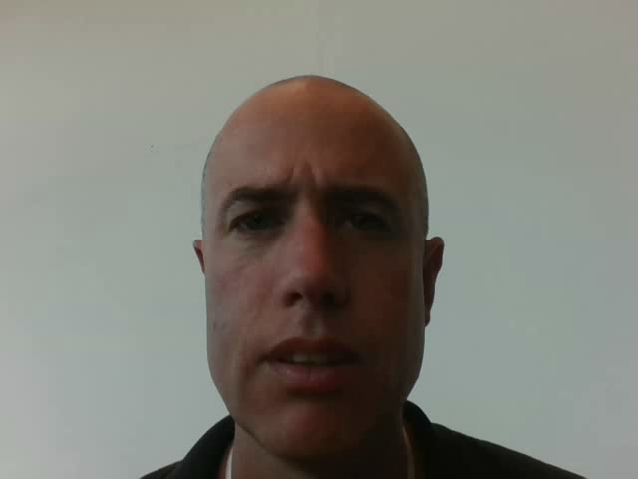

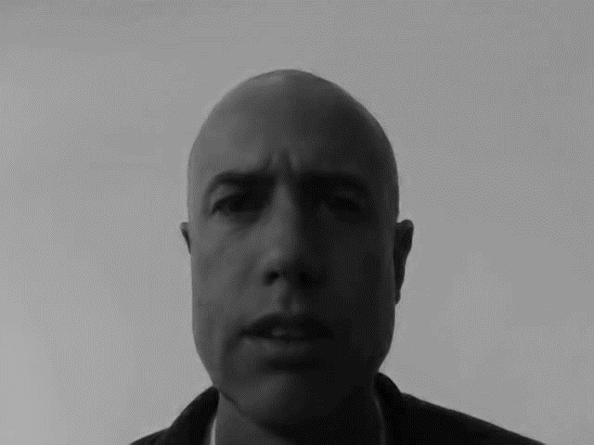
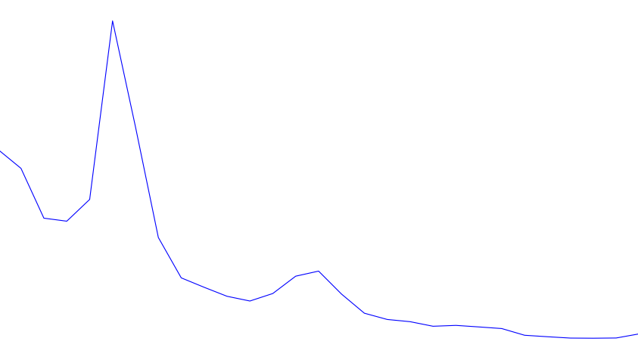

Slide 6
Business Model
We aim at the consumer market
Part of a smart home monitoring solution for the elderly population
Secondary market: long-term heart rate monitoring solution for patients after ischemic stroke

Slide 7
Summary
We will protect the elderly population
by
detecting atrial fibrillation
and
preventing ischemic strokes

