Slide 1
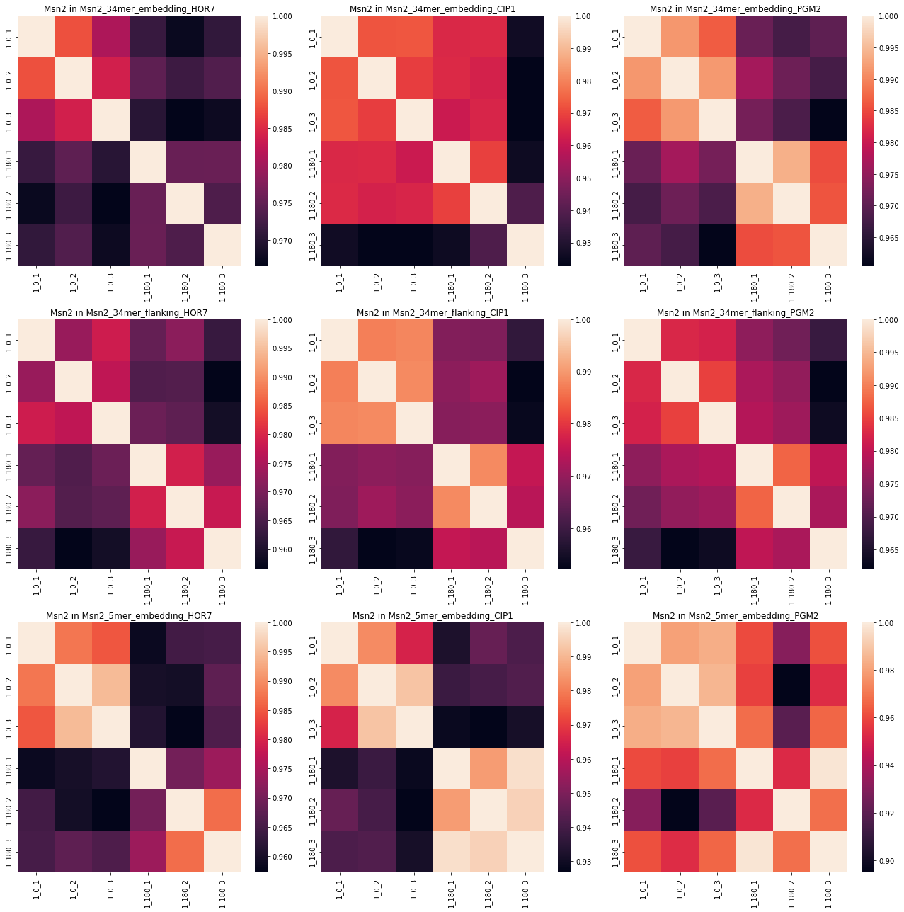
Msn2
Two samples are missing from the pool and are marked in red. Bad samples are marked in blue.

Slide 2
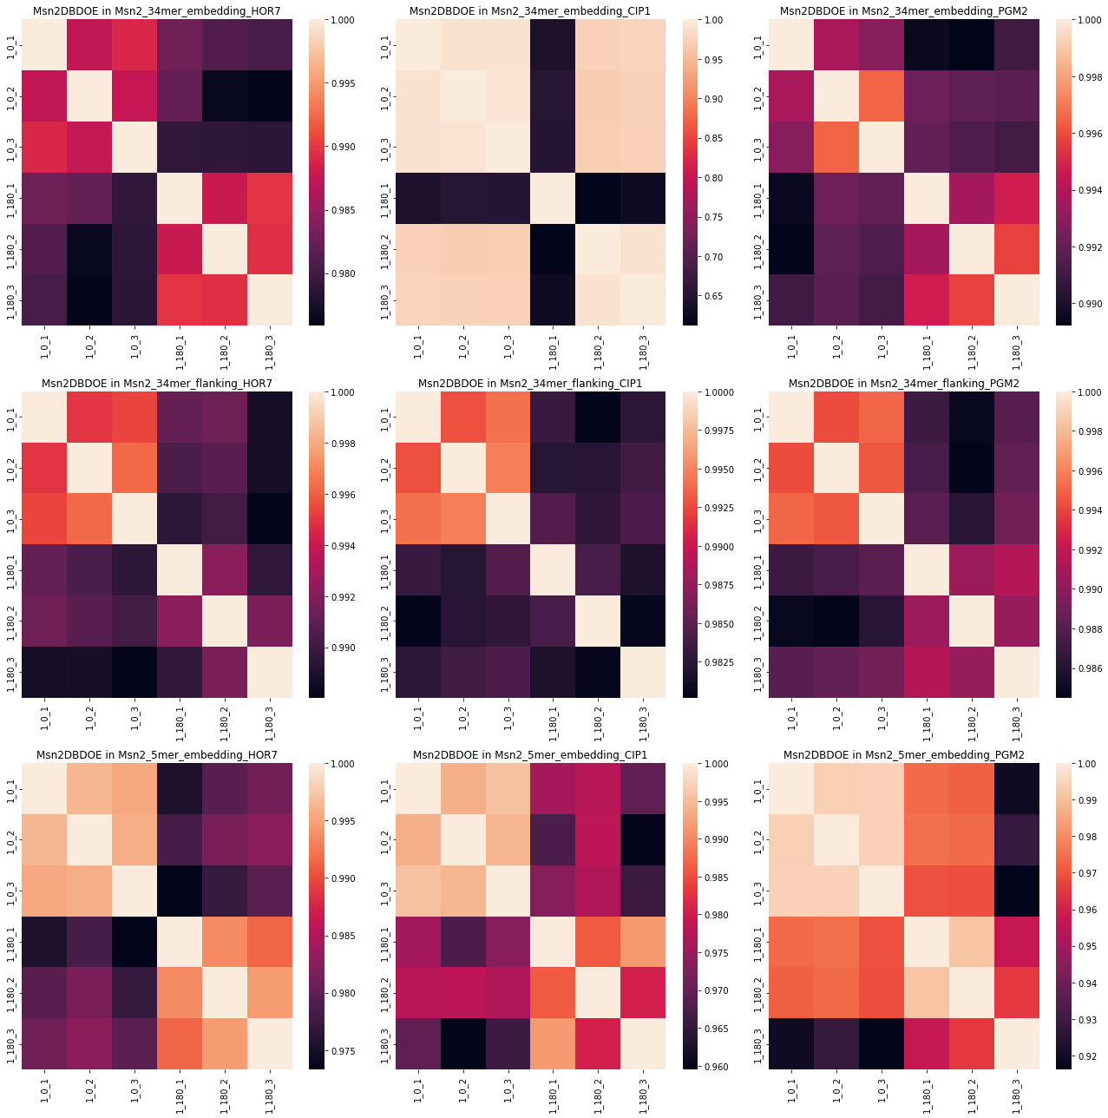
Msn2 DBD OE Bad samples are marked in blue.

Slide 3
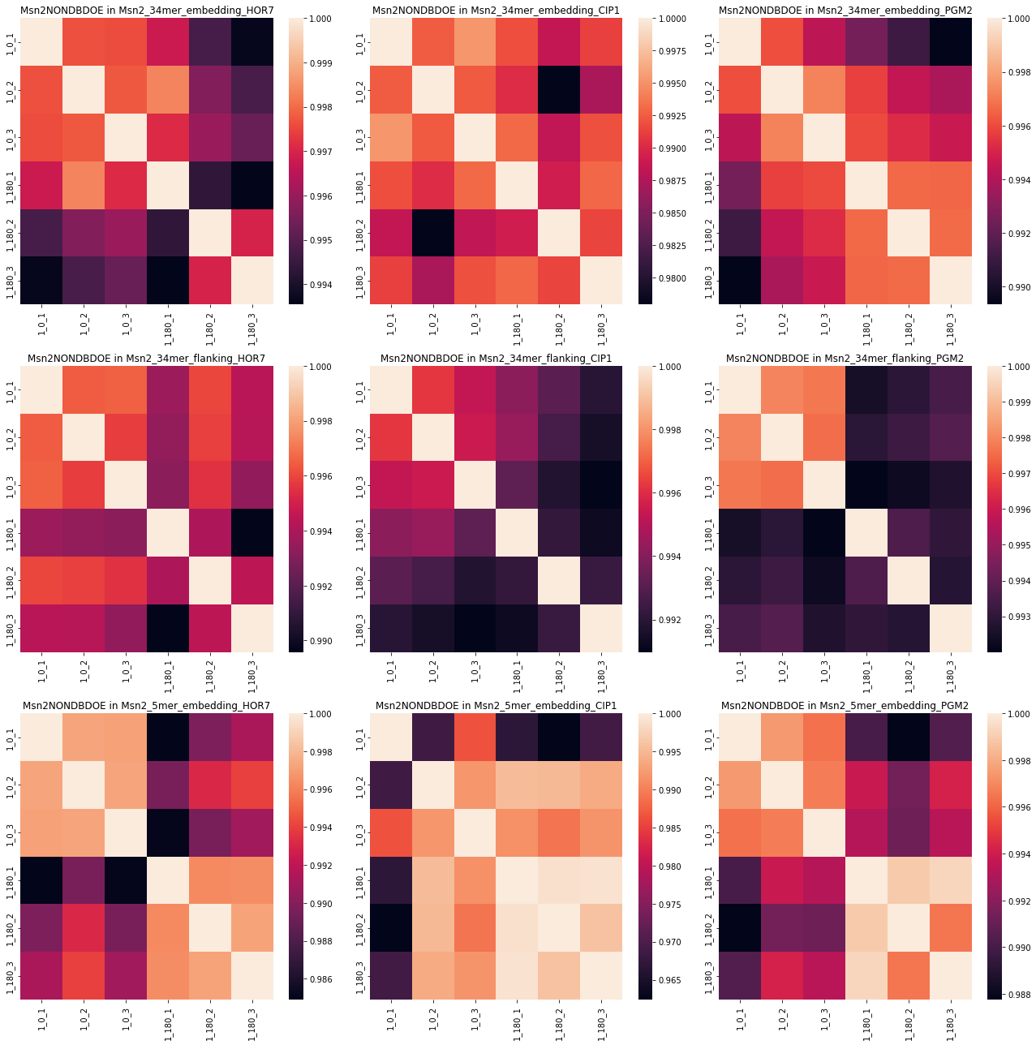
Msn2 non DBD OE
Two samples are missing from the pool and are marked in red. Bad samples are marked in blue.

