Slide 1

Sperbank-ML
Sagi Nathan, Meira Barron

Slide 2
Predicting house prices in Moscow

Slide 3
EDA and Score
First prediction 0.46
Data exploration
Feature engineering
Model tunning
Final prediction 0.318
Data cleaning

Slide 4

Features to talk about
Based on our knowledge of the economics of the housing market we split our new features into 5 categories:
Location
Size
Age
Condition
Time-Demand, State of Economy

Slide 5
Score of an Area - Good and Bad - Location
Desirable neighborhoods tend to be more expensive. Therefore, we wanted to classify an area as ‘good’ , ‘bad’ or ‘undecided’.
We took every feature that contains a distance from a place and then split it into good, bad and undecided places by category.
Score = num of places in the radius/ all places with the same label.
House
Green zone/park
Public health care
Theater
Museum

Slide 6
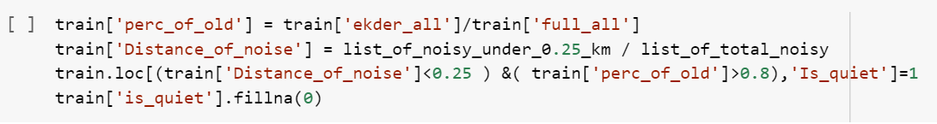
Quiet Area - Location
Usually, buyers prefer to live in a quiet residential area therefore we tried to model what a quiet area wouldn’t contain, such as a large population of young people or noisy disturbances nearby such as railroads, highways and power stations…
railroad
Metro
Big-road
Is quiet
Etc..

Slide 7
Change in market demand
Supply and Demand
We would have liked to add a feature that shows the percentage of change in supply however we don’t have the data for that.
When we observe an increase in percentage of change in demand, we assume that prices are likely to rise, therefore we added the feature percentage of change in demand.
Counter for how many houses are on the market for a given month_year
Change between previous month and current month
Calculate the percentage of change
demand

Slide 8
Renovation - condition
Recently renovated apartments are likely to increase in value, therefore we built a renovation feature.
Bin_age – (1,6)
Abs(Bin_age-state)>median(state) -> been renovated
Age Of building
Binning of age
Binning +state
Renovation

Slide 9
Percentage of Investors – State of the Economy
When investors evaluate a property, they will look for under-valued transactions where they could make a profit. Therefore, data point that are labeled as investors are expected to be better value than for owner-occupiers.
Counted per sub area the amount of investor and owner-occupied purchases
Normalized the amount by total per each sub area
Calculated investment out of total

Slide 10
Model choice
XGBOOST
RMSLE SCORE -0.318

Slide 11
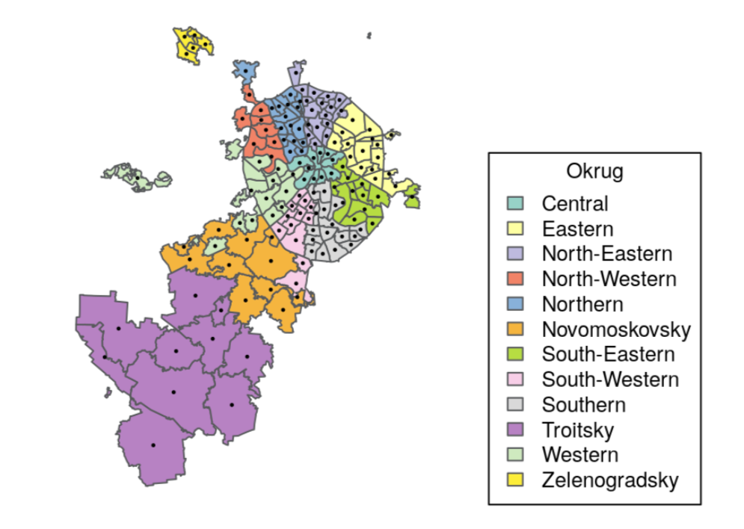
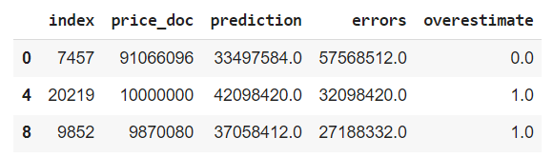
3 Prediction Errors
To better analyze our largest errors, we labeled our under/over estimations.
We focused on our largest overestimation, largest underestimation and another one from the largest errors.

Slide 12
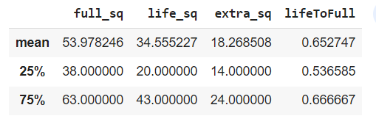

#1 – underestimated – id - 7457
The price value of this house is the max value in the test. In the training data there were less the 1% of data points that are comparable to this price range.
Therefore, the model had a hard time predicting it because it was far off from the range it knows and that can explain the underestimation. We think our model made a poor prediction on a new data point, because of unseen data.
Train data

Slide 13
#2,3 Overestimation – ids – [20219, 9852]
Looking at these 2 overestimations we saw that one of the data points had a perfectly round number which made us suspicious.
This suspicion made us take a closer look at the product type because overestimation could indicate a few things such as tax evasion and shady business in general.

Slide 14
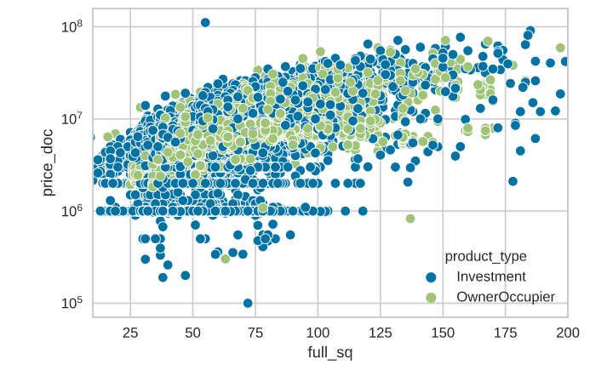
We would expect given the size of the house by square meters, that the price would be much higher as its our most important feature and has a very strong impact on our predictive model. we saw that in general the bigger the size of the house is, the higher the price. however, the actual price was relatively low.
All this information led us to conclude that these houses have been priced incorrectly due to shady deals.

Slide 15
Ways To Improve the models
Using Outsourced data – crime rates, ROI on each sub area.
Take a deeper look at locations – creating smaller sections than sub areas, using google photos we could give a score of how well kept the sub area is, checking the homogeneity of each sub area.

Slide 16
1. Crime Rates
Adding external data on each sub areas crime rate will allow us to better predict the prices because as we know the crime rate has a big impact on a buyer's decision to purchase in a certain area.
impact
High
Cost in time
High

Slide 17
2. Return on Investments
We would extract external data on previous investments done in each sub area, in the same time period as our data. using this new information, our assumption is that the higher the ROI in each sub area, the demand for investments will rise and we could identify increase in prices by demand in area.
impact
Low
Cost in time
Med

Slide 18
3. Analysis of the state of subareas using google street view
We will pull a sample of photos for each sub area and using image detection we will look for areas with high percentage of garbage and graffiti.
impact
Low
Cost in time
High

Slide 19
4. Characterizing an entire building
Using 3 features – distance from kremlin, sub area and max floor we will be able to characterize an entire building and give it a distinct number to define it. We use lat/lot geo data for each sub area to have a better way to identify the correct locations of the houses.
impact
Low
Cost in time
Med

Slide 20
5. Homogeneity of each sub area
We would like to see the difference of houses in each sub area. Areas where the houses are similar, and the prices of the properties will have a much smaller standard deviation. This means we can use the sub area price mean as a strong indicator, however when the area has a large variety the price mean of each sub area isn’t very impactful.
impact
Med
Cost in time
Low

Slide 21
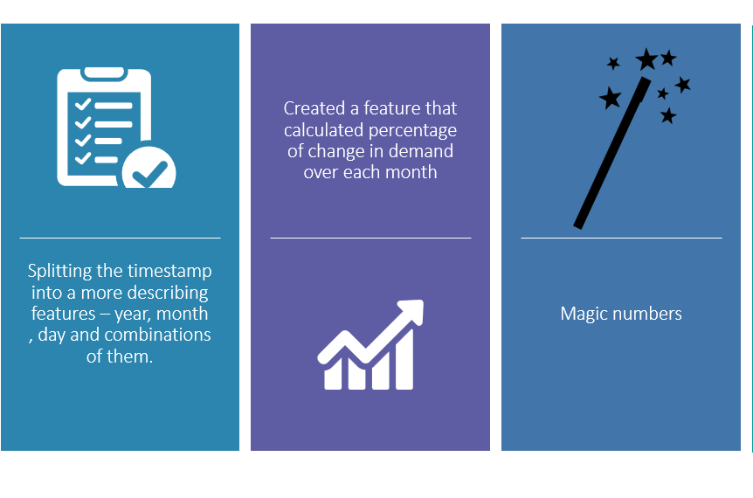
How we dealt with the time aspect

