Slide 1

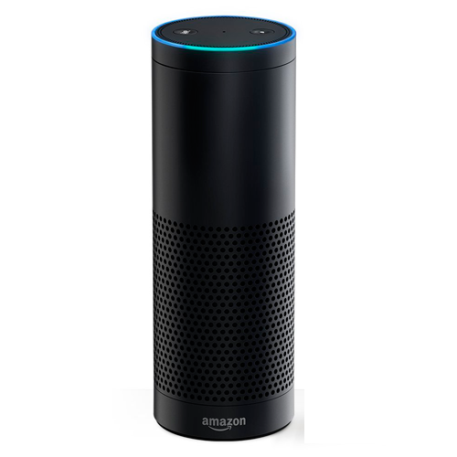






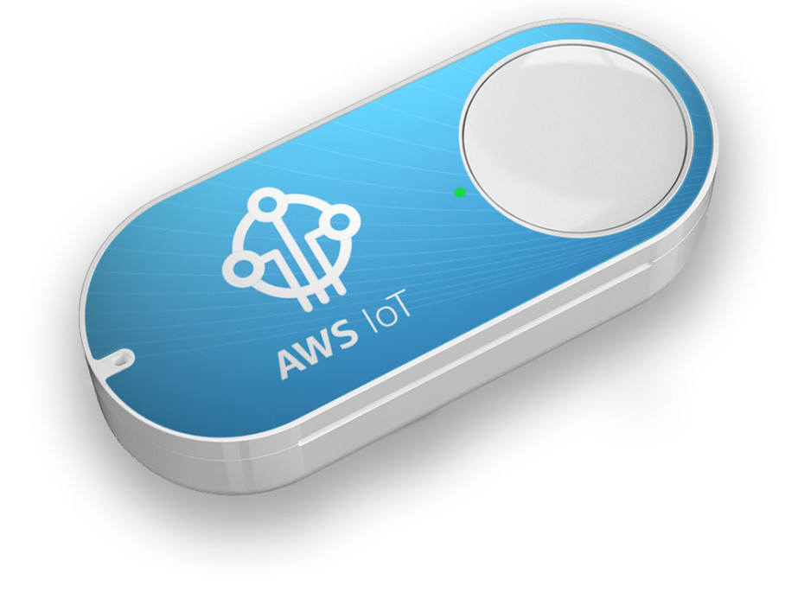


Alexa, test stuff
Alexa, what’s the deployment status
If >80% tests pass, turn GREEN.
Else, turn RED.
Amazon API Gateway
80% tests have passed
Lambda
Code Pipeline
DynamoDB
Lambda
IoT
Single-Click for kick-off deployment
Use Case | Entry Point | Flow | Output
1. Kickoff Deployment | -Amazon Alexa -Amazon IoT Button | Lambda starts Code Pipeline, writes results to Dynamo Lambda listens to Dynamo Trigger, sends to IFTTT REST | -Hue Light
2. Get Deployment Status | -Amazon Alexa | Lambda gets last run from Dynamo | -Amazon Alexa

Slide 2
Alexa-skill
”Alexa, test stuff”
Lambda-alexa.test
Kick-off CodePipeline
”Kicked off pipeline”
Lambda-pipeline-complete
Write results to DB
[currently fake]
Lambda-dynamo-complete
Read event from DB via trigger
Send to IFTTT->Hue
Alexa-skill
”Alexa, check test status”
Lambda-alexa.check
Scan Dyanmo for last record
“The status is x”
Iot-button
Single-Click
Lambda-iot
Doesn’t yet exist.
Just sets light Green

