Slide 1
Human vs. AI Text Classification with Deep Learning - Final Project
roy asraf 302211958
orel dayan 209452093
sagi azulay 207544230
https://www.kaggle.com/code/royasraf/logistic-regression-with-cnn-99-91/notebook

Slide 2



Our DataSet
z
“AI Vs Human Text”
The original data set contains 487235 texts.
We worked with 20,000 text sample uniformly balanced between AI and Human's

Slide 3
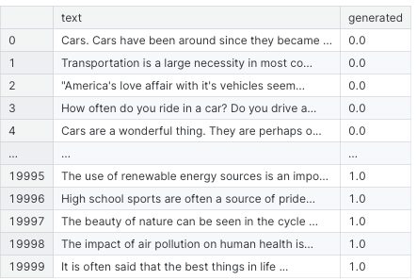
Our DataSet
z

Slide 4
Preprocessing
Tokenization: Splitting text into words
Stop word and Linking Word Removal: Filtering out common unimportant words.
Filtering Non-Alphabetic Tokens: filtering out tokens that are not alphabetic.
Text Length: Counting number of words after modifying the text

Slide 5
500 most common words- we used binary vector the represent to most common words in the text. linking words count in percentage. count synonyms words in percentage. Punctuation count in percentage. We also removed some of features such as : sentiments score , most common word in each text, we also changed the features above to be represented as percentage according to the size of the text.
Our features:

Slide 6
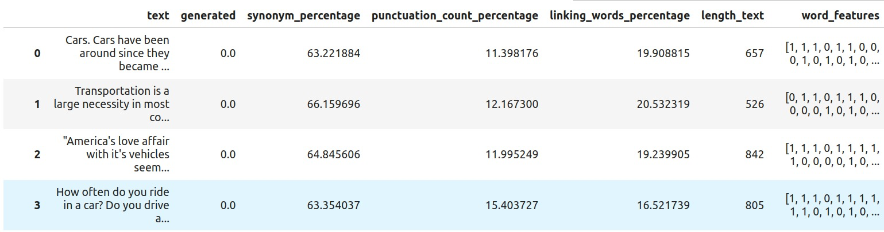
z
Our features:

Slide 7
Logistic Regression
we examined linear regression, softmax regression, and logistic regression techniques. Our analysis gives up the following outcomes:
- Linear regression achieved an accuracy rate of 91.2%.
- SoftMax regression exhibited an accuracy rate of 98.75%.
- The most promising result was attained through logistic regression, yielding an accuracy rate of 99.76%.

Slide 8
Handling with foreign texts
We address potential issues of overfitting or underfitting, we inserted texts from
the English graduations of Model C. and texts from chat-gpt. And because of that We changed all the features to be in percentages of the total text so the different lengths of the text will be concealed.

Slide 9
Neural Networks
Our best results was with model of logistic regression and cnn. We built the CNN model with the following structure
• A Conv1D layer with 64 filters of size 3 and relu activation.
• A MaxPooling1D layer of size 2.
• Another Conv1D layer with 128 filters of size 3 and relu activation.
• Another MaxPooling1D layer of size 2.
• A Flatten layer.
• A Dense layer with 128 neurons and relu activation.
• A Dropout layer with a probability of 0.5.
• A final Dense layer with one neuron and sigmoid activation.

Slide 10
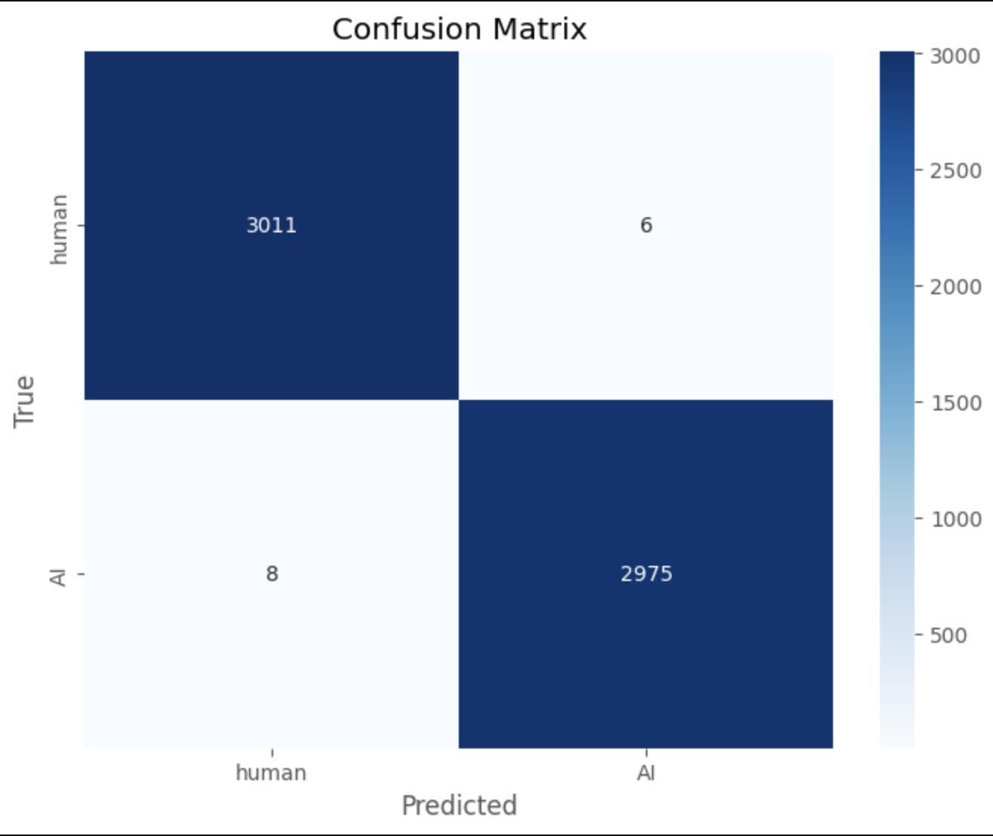
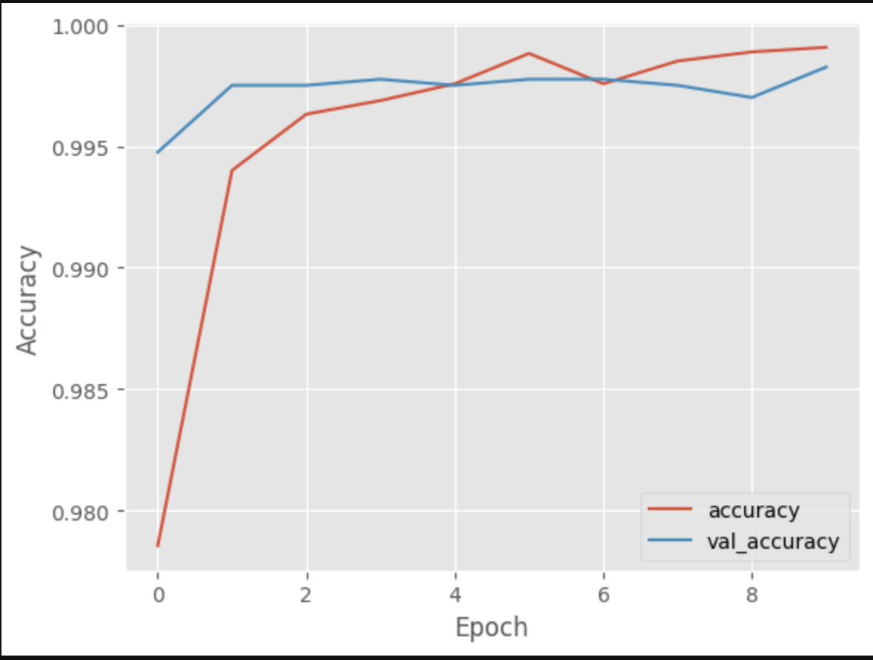
Neural Networks

Slide 11
Conclusions
Both logistic regression and CNN models demonstrate high accuracy in classifying text samples as human-generated or AI-generated. Logistic regression achieves an accuracy of 99.77%, while the CNN model achieves a slightly lower validation error of 0.15%. These results indicate the effectiveness of both approaches in distinguishing between human and AI-generated text

