Slide 1
SULE LAMIDO UNIVERSITY FACULTY OF SOCIAL AND MANAGEMENT SCIENCES 1ST INTERNATIONAL CONERENCE
URooTab: REPORTING EVIEWS UNIT ROOT TESTS IN A TABLE
PRESENTERS:
NAME: Dr. SAGIRU MATI
DEPARTMENT: ECONOMICS
UNIVERSITY: YUSUF MAITAMA SULE UNIVERSITY, KANO
EMAIL: smati@yumsuk.edu.ng
NAME: Dr. MUSTAPHA HUSSAINI
DEPARTMENT: ECONOMICS
UNIVERSITY: SULE LAMIDO UNIVERSITY, KAFIN HAUSA, JIGAWA
EMAIL: mustapha.hussaini@slu.edu.ng

Slide 2
INTRODUCTION
The audience are expected to have background knowledge of unit root tests.
Time series (economic) variables are commonly characterized by unit root process (non-stationarity)
It is common practice to conduct unit root tests on these economic variables
Some of the common unit root tests include Augmented Dickey-Fuller (ADF) and Phillips-Perron (PP) tests
So this R package (henceforth called package) reports only these two tests.
Other tests will be incorporated in future releases

Slide 3
WHAT IS URooTab?
URooTab is an R package that can conduct EViews unit root tests and report them in a tabular form.
It can be used with EViews, R, R Markdown and Quarto
R Markdown and Quarto are applications for scientific publishing like LaTeX and Microsoft Word

Slide 4
WHY URooTab?
It saves a lot of time and energy
It makes replication easy
It reduces the chances of making mistakes
it can help supervisors to easily verify the work of their students
Researchers/students can use it to report the result of their unit root tests

Slide 5
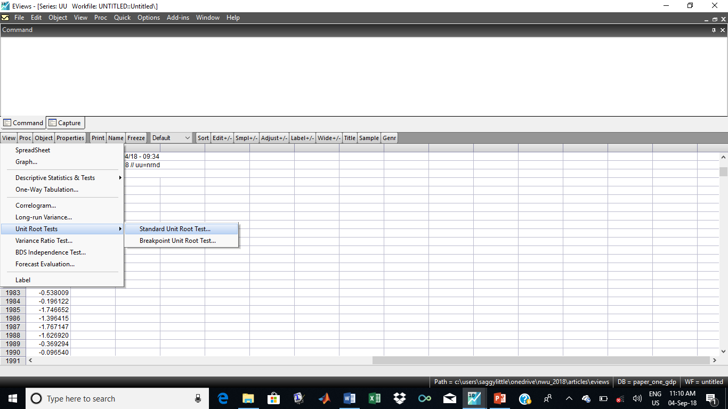
UNIT ROOT TEST IN EVIEWS
1
3
2

Slide 6
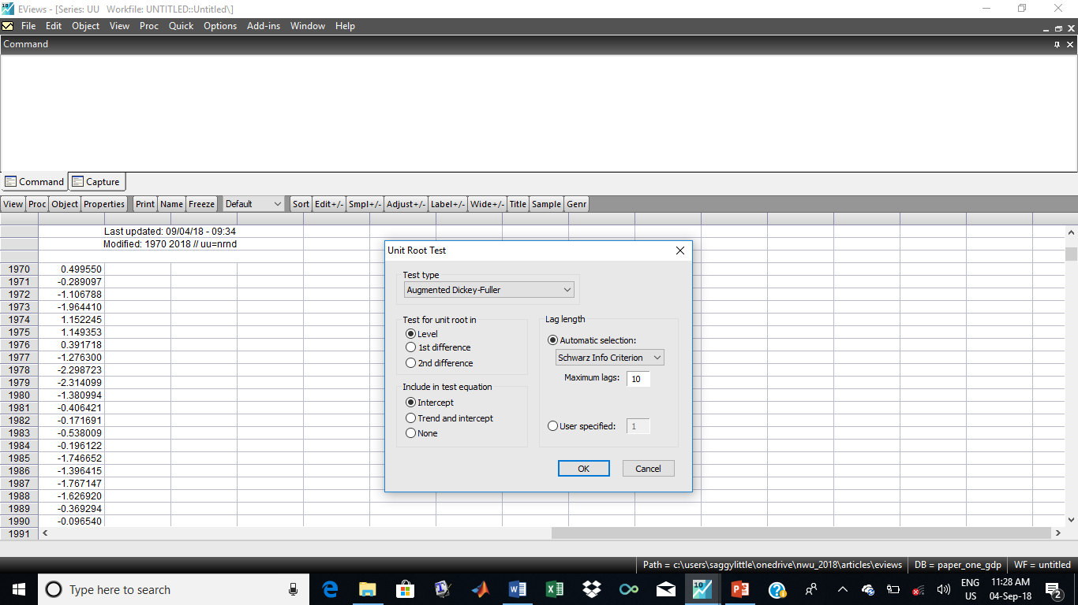
UNIT ROOT TEST IN EVIEWS
1
2
4
5
3
6

Slide 7
UNIT ROOT TEST IN EVIEWS

Slide 8
SOME OBSERVATIONS
From the previous two slides, it is obvious that, for each variable one needs:
At least 3 clicks to choose test type, information criteria and maximum number of lags
3 clicks to get to the unit root window
plus 27 clicks for the combination of level/difference and deterministic terms options (i.e level+intercept, level+trend and intercept, level+none)
Plus ‘copy and paste’ of 4 desired values (27 times) from Eviews to a text editor

Slide 9
SOME OBSERVATIONS
At least 33 clicks and 108 actions of ‘copy and paste’ for each variable and for each test type (ADF or PP)
Therefore, to conduct ADF and PP tests for each variable, one needs at least 66 clicks of and 216 touches of ‘copy and paste’!!!!!!!!!!!
One needs 660 clicks and 2,160 instances of ‘copy and paste for just 10 variables!!!!!!!!!!!
It is time consuming, energy-sapping and mistake-prone, isn’t it??????????

Slide 10
DEMONSTRATION IN EVIEWS AND R
Demonstration in EViews
Demonstration in R, R Markdown and Quarto

Slide 11
CONCLUSION
The program only implements the unit root tests based on automatic selection of AIC or SIC
The package is at the initial stage.
In spite of this, the program output for the test statistics is accurate
Please report any error(s) or bug(s) to my email address.
I look forward to your input(s) on how to improve it.

Slide 12
IMPORTANT LINKS
For further details:
URooTab: https://github.com/sagirumati/URooTab
R: https://cran.r-project.org/
Rstudio: https://posit.co/downloads/
R Markdown https://bookdown.org/yihui/rmarkdown-cookbook/
Quarto https://quarto.org/
SMATI ACADEMY: youtube.com/@smatiacademy

Slide 13
THANK YOU FOR LISTENING

