Slide 1

Airfoil self-noise predictions using Random Forest
Supervisor : MR . BABU
Name of the Student :SAGI SANDEEP
Register Number: 39110865

Slide 2
PRESENTATION OUTLINE
Course Certificate
Abstract
Introduction
Objectives
System Architecture
Project Implementation
Results and Discussions
Result Snapshots
Conclusion & Future work
References

Slide 3

COURSE CERTIFICATE

Slide 4
ABSTRACT
This project attempts to predict the scaled sound pressure levels in decibels, based on the aerodynamics and acoustic related attributes.
The problem is how to predict the sound pressure level accurately based on these features. This project describes the approach using Random Forest Regression algorithm and other optimization algorithms used for better predictions.
A vital component of the total airframe noise is the airfoil self-noise, which is due to the interaction between an airfoil blade and the turbulence produced in its boundary layer and near wake.
Performance Optimization can be applied to understand the behaviour of airfoils and make designs with reduced noise.

Slide 5
INTRODUCTION
Airfoil self-noise is due to the interaction between an airfoil blade and the turbulence produced in its own boundary layer and near wake. It is the total noise produced when an airfoil encounters smooth non-turbulent inflow.
"Correct estimation of turbulence properties is the key to accurate TE noise prediction.“
We will use machine learning algorithms such as Random Forest to make predictions of scaled sound pressure based on the factors/attributes from the dataset.
So we have taken the self-noise problem and followed all the steps in this process to achieve the outcome with a good accuracy.

Slide 6
OBJECTIVES
The primary objective is to make predictions using the data set given and by using the model based on Random Forest algorithm.
The secondary objective is to make the predictions with highest level of accuracy, analysis the results.
We currently have the data set obtained from uci archives on airfoil self-noise, we have to understand the data entries to work on it efficiently based on the problem statement.
To work with the data we have to do some prep-work to the data so that it is passable into the model, such as we don’t want to have any null values or other kind of unnecessary entries.
Then we have to work on the model for training and testing the data (for splitting the data set into multiple volumes so it is easy to perform tasks to make predictions).
After making predictions we will analyze the results based on plots and various graphs.

Slide 7
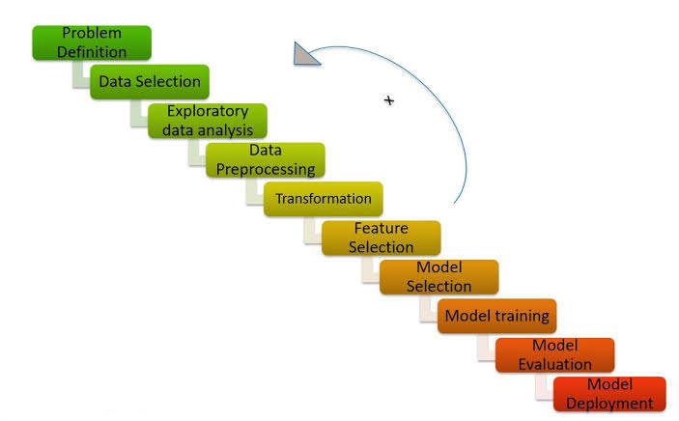
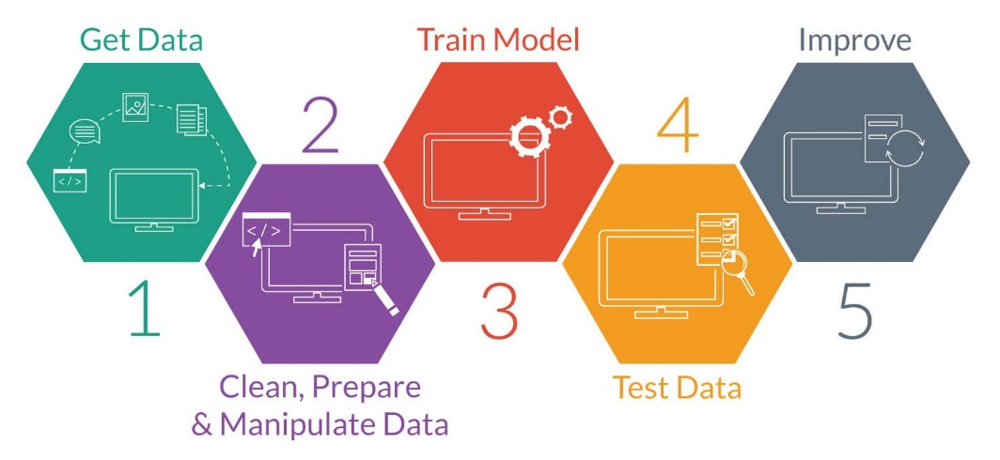
SYSTEM ARCHITECTURE

Slide 8
HARDWARE AND SOFTWARE REQUIREMENTS
Software Requirements
Jupyter Notebook - Project environment
Numpy – Used to convert 1D arrays to 2D arrays
Pandas – Convert dataset into data-frame
Matplot , Seaborn – Used to visualize the dataset
SkLearn module – To import all types ML algorithms
Hardware Requirements
GPU
Any Operating System

Slide 9
DATASET DESCRIPTION AND PREP-WORK
To implement this project we need to follow the below steps
GetData :
Gather the airfoil self-noise dataset from UCI archives that has different attributes.
DataCleaning :
Check for Null values and replace them with mean value of the column.
DataPreprocessing :
Divide the data into features(x) and label(y).
Train and Test:
Split the dataset into train(70%) and test(30%).
Model Selection :
Implement Random Forest Regressor for the given data set.
Model Evaluation :
Check the errors calculated and accuracy and also the plots.

Slide 10
LIBRARIES AND MODULES
Important libraries that are imported are:
Sklearn
Pandas
NumPy
Matplotlib
Seaborn
Important modules or functions imported are:
train_test_split from model_selection in Sklearn.
RandomForestRegressor from ensemble module of Sklearn.
metrics module of Sklearn.

Slide 11
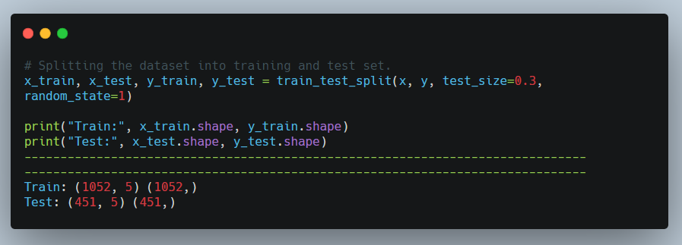
SPLITTING THE DATASET
We will use train_test_split which is a function for splitting data arrays into two subsets for training and testing data.
With this function you don’t have to divide the dataset manually. By default, sklearn train_test_split will make random partitions for the two subsets. However, you can specify a random state for the operation.

Slide 12
RANDOM FOREST ALGORITHM
Random forest algorithm is a collection of tree predictions where the trees are formulated on the basis of various random features, hence the name ‘Random Forest’.
Random vectors are generated to depict the growth of the trees; the trees are never pruned.
A random combination of features is selected at every node to perform splitting.
The purpose of two sources of randomness is to decrease the variance of forest estimator. Indeed, individual decision trees typically exhibit high variance and tend to overfit.

Slide 13
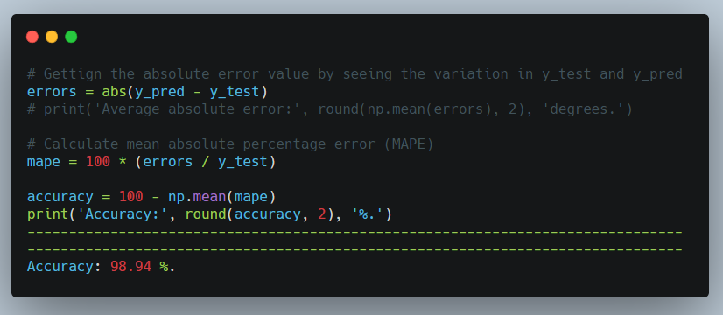
CALCULATING ERRORS AND ACCURACY
Calculating the errors is one of the ways to analyze the chances of improvement of the model as well as to find the accuracy of the model.
We are going to calculate the mean absolute error(MAE), mean squared error(MSE), root mean squared error(RMSE).
We can simply use metrics module to use pre-defined functions for these errors.

Slide 14
RESULTS AND DISCUSSION
Hence, we can say that our model is pretty good because by implementing all the steps above mentioned we got an accuracy equal to 98.94%. Therefore, it is a good model and our predictions will be effective .
For our case, as the model sees more observations of factors that cause airfoil self-noise, it better understands how to take those observations and predict the scaled sound pressure level. Practice improves human abilities and machine learning model performance alike.

Slide 15
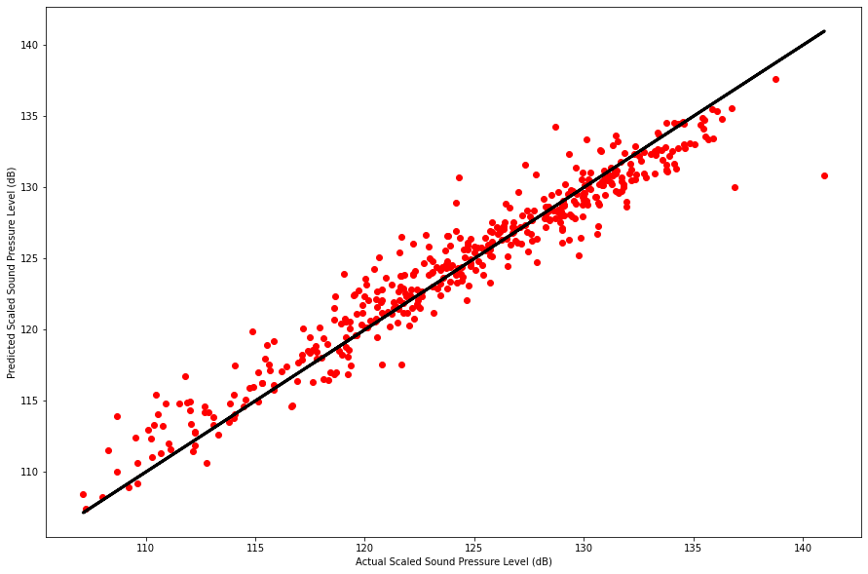
RESULTS VISUALIZATION
We can generate plots to understand more about the predictions made.
One of the basics plots made is scatter plot as shown.

Slide 16
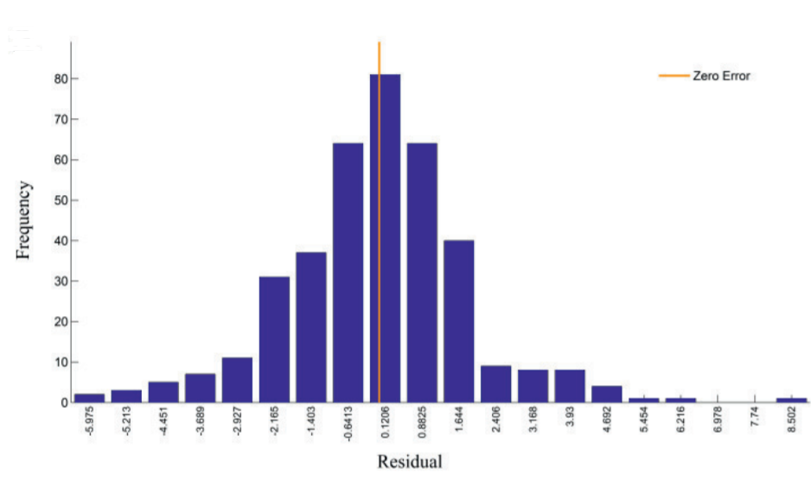
RESULTS VISULIZATION
Here is a histogram plot that depicts the error distribution of the model created on basis of the Random Forest algorithm.

Slide 17
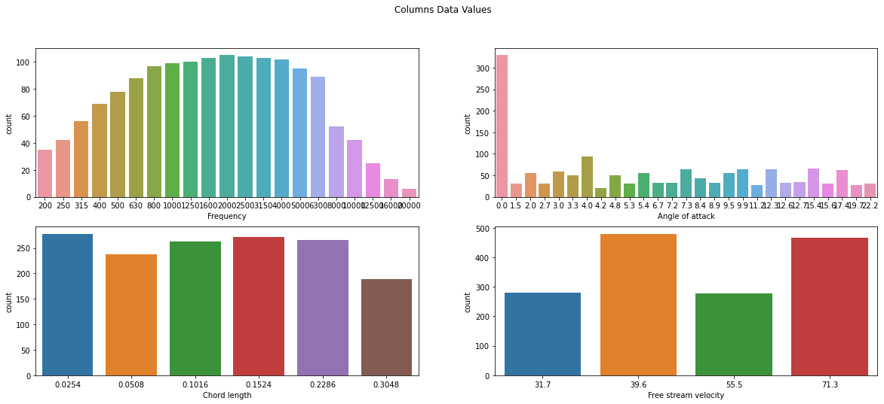
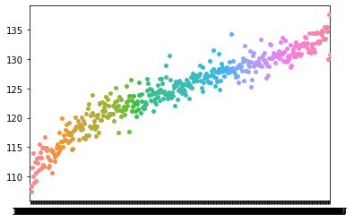
RESULTS VISULIZATION
Other plots for analyzing the used and predicted data are shown.

Slide 18
CONCLUSION & FUTURE WORK
Machine learning approaches work well for making predictions to decrease the noise in the air foil. It performs very well with the given dataset of the self-noise.
The higher level of accuracy and the robustness of these models will play a vital role in optimizing the noise generated by various airfoil-based devices and hence will be of enormous significance in the designing of new silent air foils.
With that I successfully implemented Random Forest algorithm to predict scaled sound pressure values with the highest accuracy.
Performance optimization was applied and can be applied further to understand the behaviour of air foils and make designs with reduced noise.

Slide 19
REFERENCES
Brooks TF, Pope DS, Marcolini MA. Airfoil self-noise and prediction. Vol. 1218. National Aeronautics and Space Administration, Office of Management: Scientific and Technical Information Division; 1989.
Blake WK. Mechanics of Flow-Induced Sound and Vibration V2: Complex Flow-Structure Interactions. Vol. 2. Elsevier; 2012
Brooks TF, Hodgson TH. Trailing edge noise prediction from measured surface pressures. Journal of Sound and Vibration 1981.
Random Forest, Available: https://www.stat.berkeley.edu/~breiman/RandomForests/.
Brooks TF, Pope DS, Marcolini MA, Lopez R. Airfoil Self-Noise Data Set, UCI Machine Learning Repository. Available: https://archive.ics.uci.edu/ml/datasets/Airfoil+Self-Noise

Slide 20


