Slide 1
DeepCoder
Sagi Timinsky
Nadav Gover
Based on Optimal Mappings for Joint Source Channel Coding
By Emrah Akyol, Kenneth Rose, Tor Ramstad

Slide 2


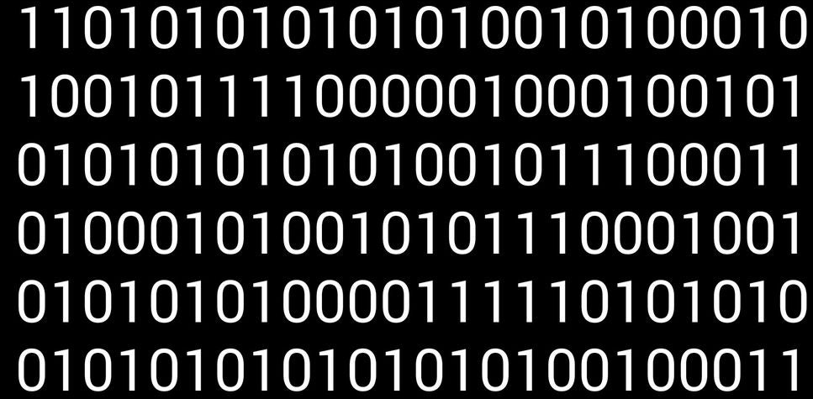
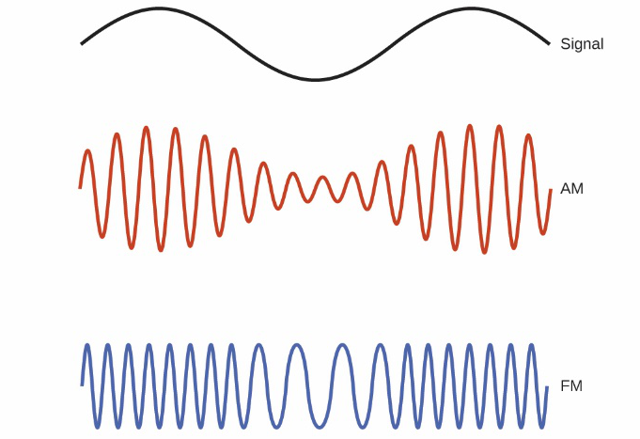
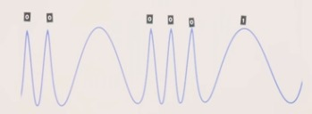
Communication 101
How do we transfer information from one place to another?
We decide on a language that both the transmitter and the receiver agree upon.
Modulation!
Amplitude Modulation (AM)
Frequency Modulation (FM)

Slide 3
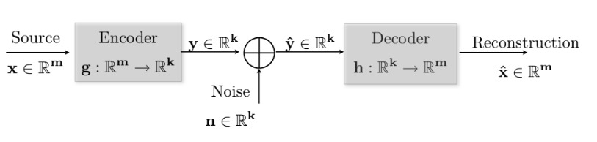

Describing the problem
Given: m=k=1, $f_{X}\left(x\right), n\sim N(0,1)$, P – power constraint
In our project $f_{X}\left(x\right)$ will be estimated each time frame
Goal: building a system that can decide what code to send over the channel

Slide 4
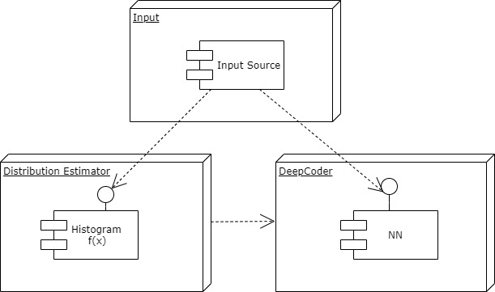

Program scheme and formulation
Minimize mse under constraints of power dissipation i.e
$mse=∫∫{\left[x−h\left(g\left(x\right)+n\right)\right]}^{T}\left[x−h\left(g\left(x\right)+n\right)\right]∙f_{X}\left(x\right)f_{N}\left(n\right)dxdn$
$Power=∫g{\left(x\right)}^{T}g\left(x\right)f_{X}\left(x\right)dx$
P is the power constraint
$ℒ=mse+λ\left(Power −P\right)$

Slide 5
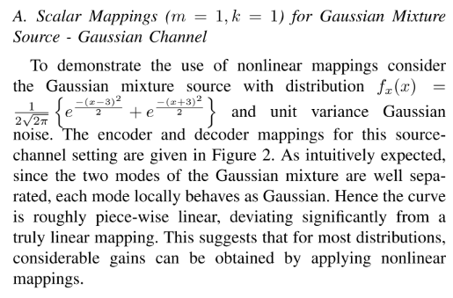
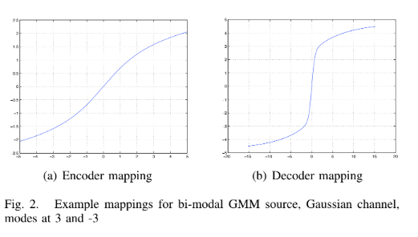
How do we measure results?
Benchmark of gaussian mixture, mapping 1:1
Iterative algorithm from the article we based our project upon, the algorithm is based on GD

Slide 6
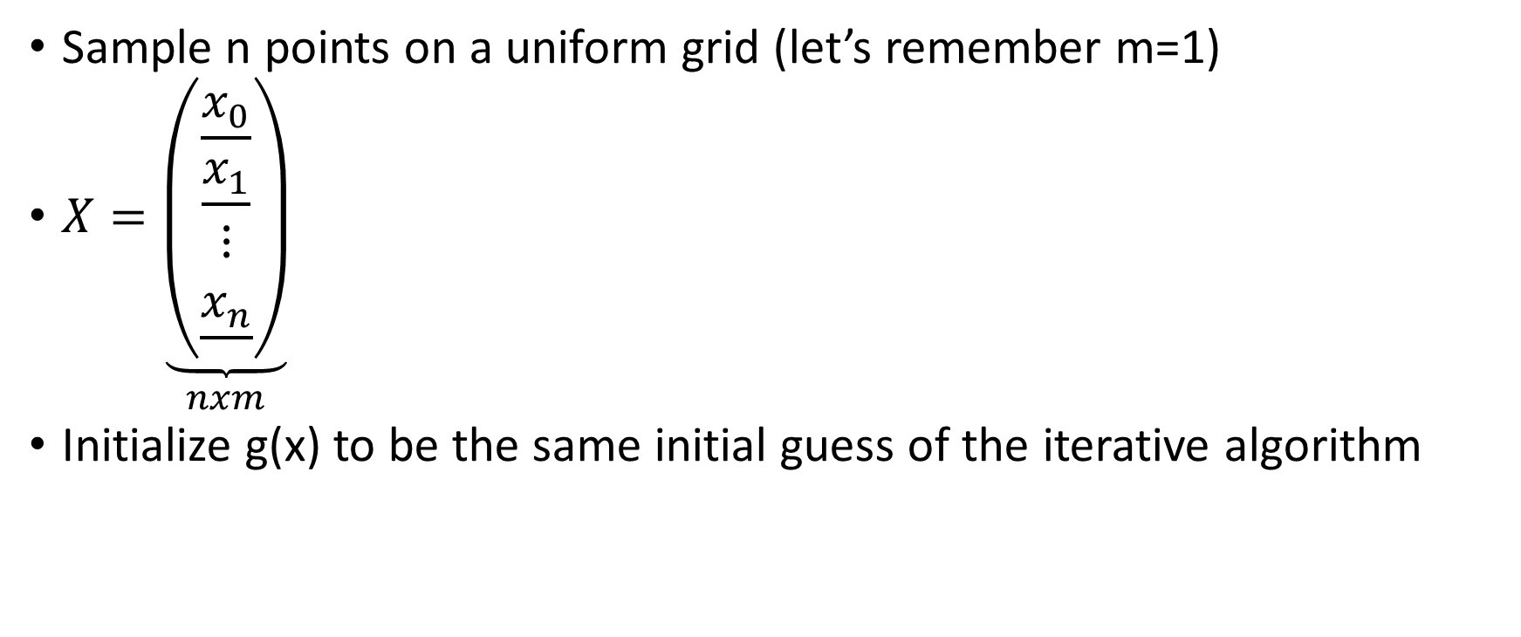
The Deep Learning Algorithm
Sample n points on a uniform grid (let’s remember m=1)
$X=\underset{nxm}{\underbrace{\left(\begin{matrix}\begin{matrix}\underline{x_{0}} \\ \underline{x_{1}}\end{matrix} \\ ⋮ \\ \underline{x_{n}}\end{matrix}\right)}}$
Initialize g(x) to be the same initial guess of the iterative algorithm
Input Sampling & Initialization
Data creation
Architecture
Training & results

Slide 7
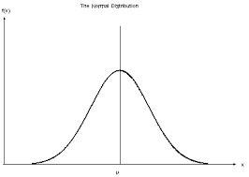

The Deep Learning Algorithm
Features = inputs
Weights initialization = $f_{X}(x)$
With Keras: model.fit(sample_weight)
Labels = inputs
Ideal: $MSE=0→X= \hat{X}$
Input Sampling & Initialization
Data creation
Architecture
Training & results

Slide 8
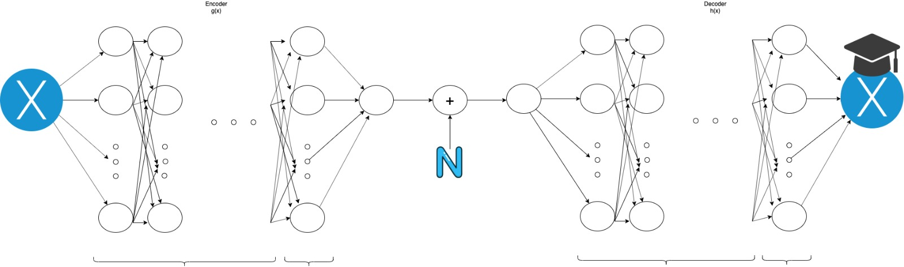
The Deep Learning Algorithm
As we know in regression problems the suggested architecture is increasing amount of neurons and then decreasing in each layer
For example, enc/dec: 1-20-100-300-100-20-1
Batch gradient descent
Regularization to prevent overfitting: dropout, weight decay
Input Sampling & Initialization
Data creation
Architecture
Training & results
Relu
Linear
Relu
Linear

Slide 9
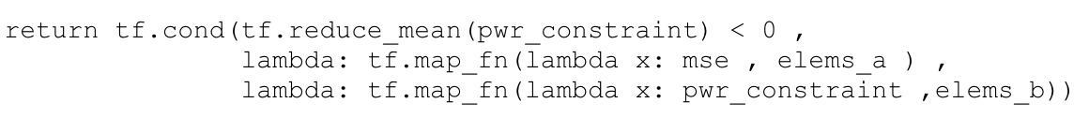

The Deep Learning Algorithm
Lagrange multiplier intuition: Small area with large circumference
Replace: Area = MSE, circumference = power
Reminder:
P is the power constraint
$ℒ=mse+λ\left(Power −P\right)$
Input Sampling & Initialization
Data creation
Architecture
Training & results

Slide 10
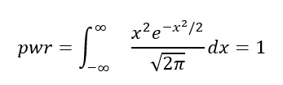
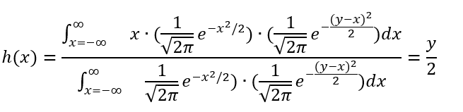

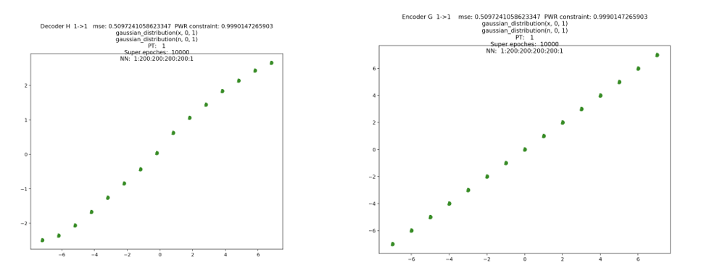
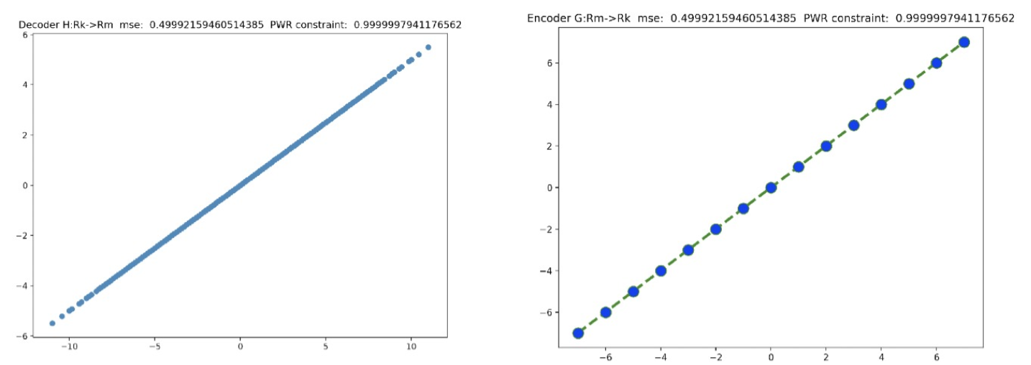

Results
Reminder:
$$mse=∫∫{\left[x−h\left(g\left(x\right)+n\right)\right]}^{T}\left[x−h\left(g\left(x\right)+n\right)\right]∙f_{X}\left(x\right)f_{N}\left(n\right)dxdn$$
$$Power=∫g{\left(x\right)}^{T}g\left(x\right)f_{X}\left(x\right)dx$$
$$ℒ=mse+λ\left(Power −P\right)$$
Sanity check for the gaussian case 1:1
Input Sampling & Initialization
Data creation
Architecture
DL
iter
Training & results

Slide 11
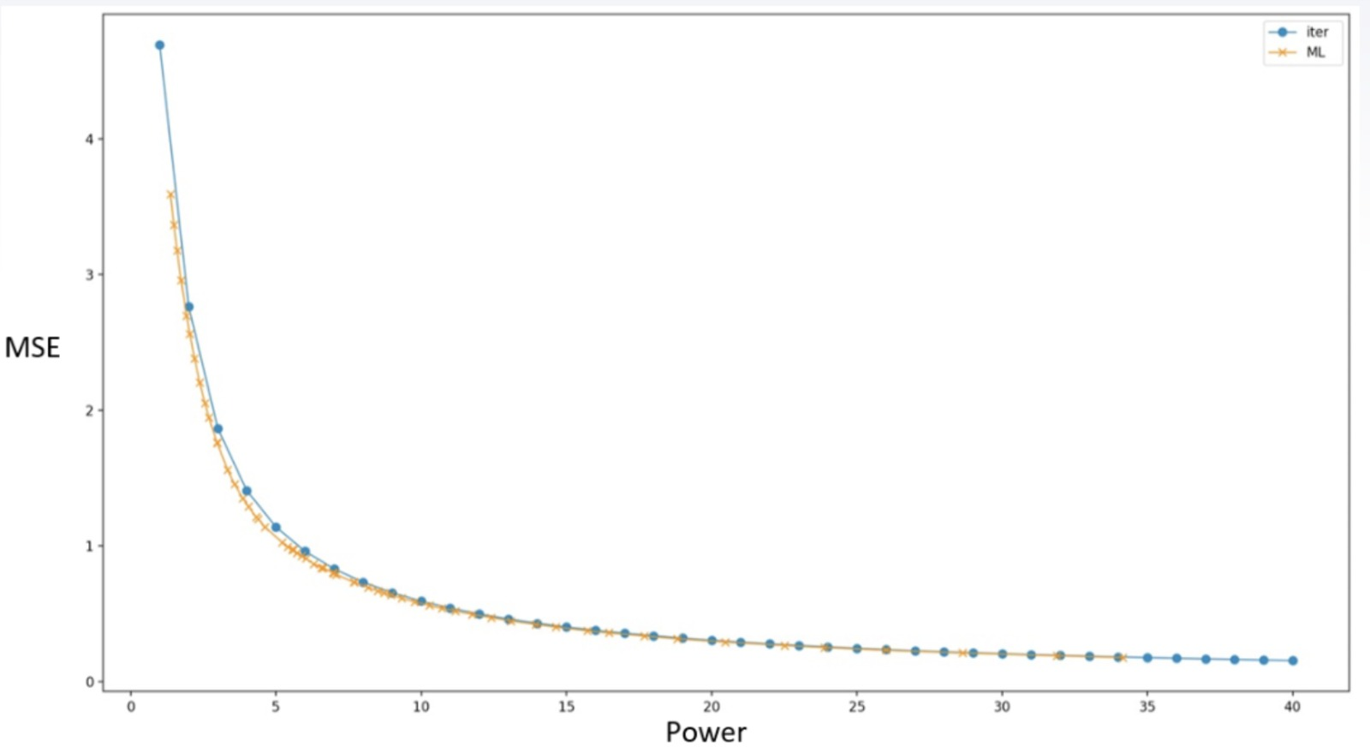
Results
Gaussian mixture results
We got smaller MSE with same power!
Input Sampling & Initialization
Data creation
Architecture
Training & results

Slide 12
Conclusions
Both implementations take a lot of resources, and that brings us to the question should the power consumed during training is a big consideration
There is a natural tradeoff between the speed of the convergence (dependent on the amount of samples) and the correctness of the interpolation
The difference between the two is the flexibility of the two algorithms to find different shapes of mappings

Slide 13
Questions?

