Slide 1
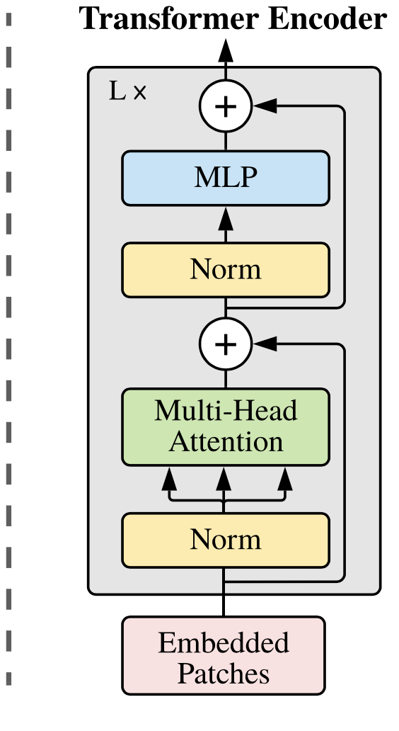
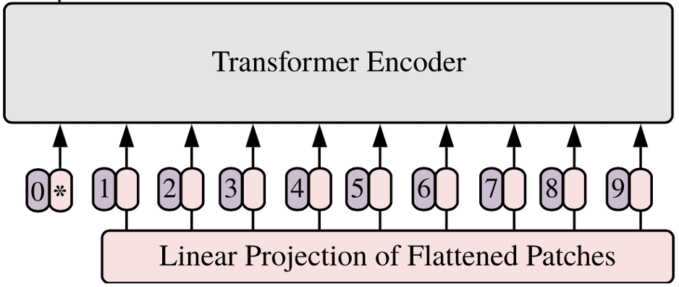
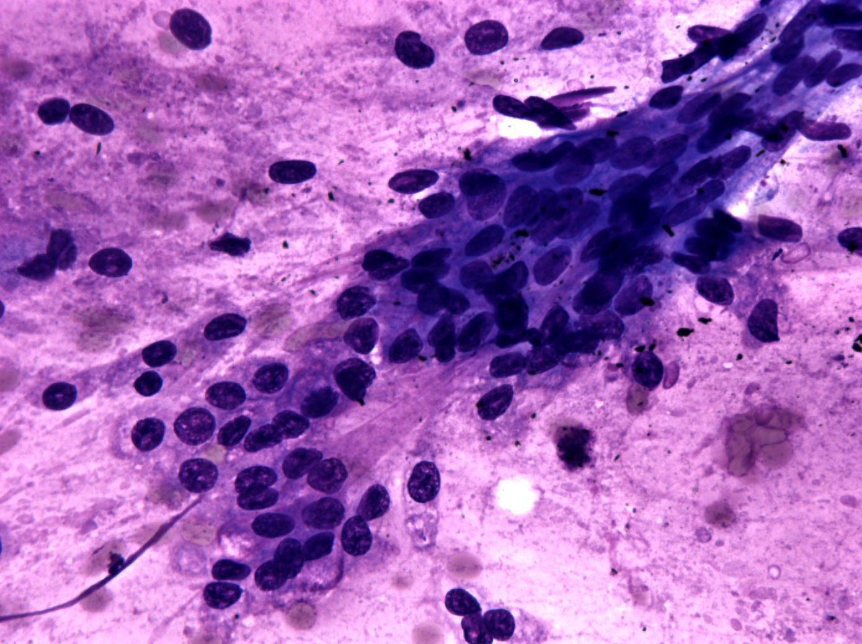
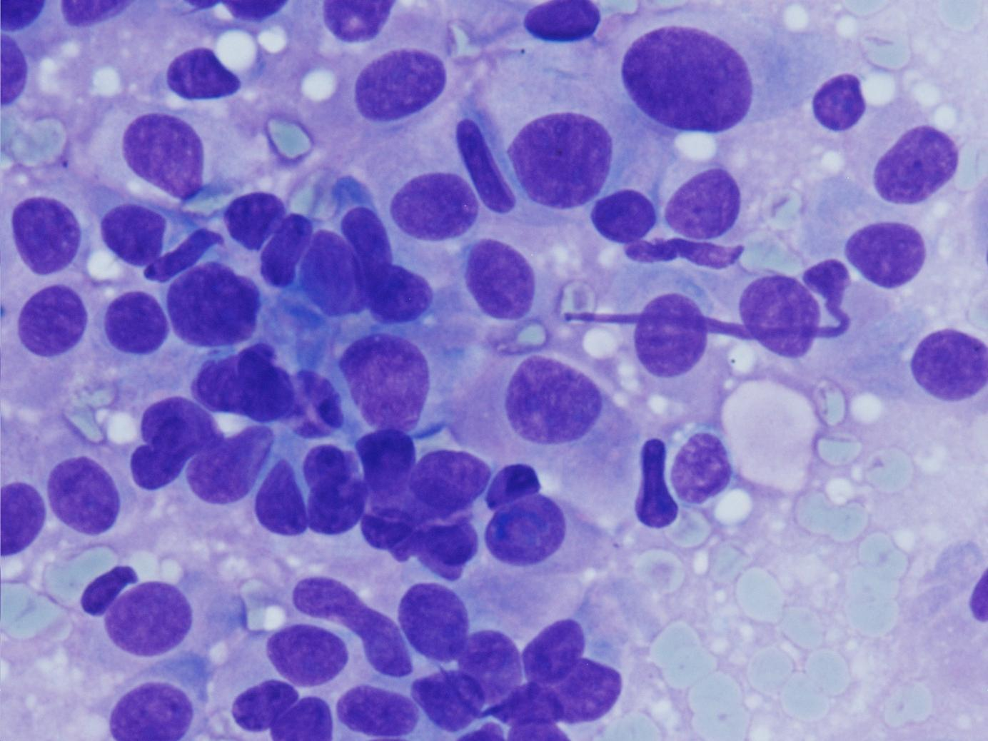
Cancer Detection:
Positive
Negative
MLP
Fix-position
In-place
shuffle

Slide 2
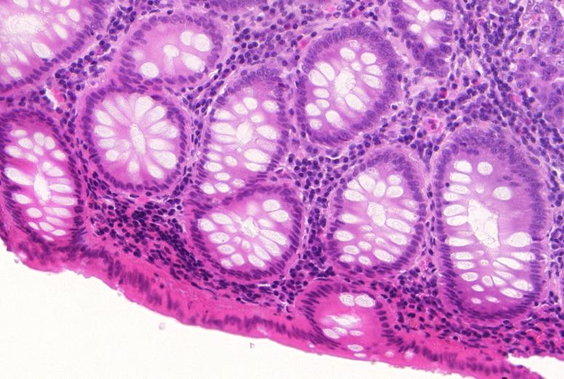






Patch-size Scheduler
Position token fixed
Bigger
scale
Smaller
scale
Fix-position
…
…
$$p_{i−1}$$
$$p_{i}$$
$$p_{i+1}$$
In-place
shuffle
Fix-position Ratio Scheduler
Relation token shuffled
Less complex
relationship
More complex
relationship
Images & labels
Images & soft-labels
The relation tokens are In-place shuffle the among multiple images, while the position tokens are fixed.
Relation tokens
Position tokens
$$f_{i−1}$$
$$f_{i}$$
$$f_{i+1}$$

