Slide 1


Twitter Engagement Analysis and Prediction
This presentation explores a comprehensive analysis of Twitter engagement data, examining factors that influence likes and retweets. We'll walk through the entire data science workflow from importing libraries to evaluating prediction models.
Our analysis includes data preprocessing, visualization, feature engineering, and model training to predict engagement metrics. By understanding these patterns, we can optimize content strategy and posting times for maximum impact.
by 6395_SHOURYADEEP MANNA

Slide 2





Setting Up the Environment
Data Manipulation
Pandas for data handling and NumPy for numerical operations
Visualization
Matplotlib and Seaborn for creating insightful data visualizations
Machine Learning
Scikit-learn for preprocessing, model training, and evaluation metrics
Text Processing
TF-IDF vectorization for converting tweet text into numerical features

Slide 3

Dataset Preparation
Loading the Data
Importing the Twitter dataset from CSV file using pandas
Timestamp Conversion
Converting timestamp strings to datetime objects for temporal analysis
Feature Extraction
Creating new features like Hour, Day, Tweet_Length, and Word_Count from existing data
The dataset preparation phase establishes the foundation for our analysis by structuring the raw data into a format suitable for exploration and modeling. By extracting time-based features, we can identify patterns in posting times that correlate with engagement levels.

Slide 4

Descriptive Statistics
Mean Retweets
49.72
Mean Likes
49.93
Average Tweet Length
226.89 characters
Average Word Count
33.99 words
Date Range
Jan 1 - May 15, 2023
Our dataset contains 10,000 tweets with engagement metrics ranging from 0 to 100 likes and retweets. The distribution shows most tweets receive moderate engagement, with fewer tweets achieving very high or very low engagement levels.
The most liked tweet received 100 likes with only 24 retweets, while the most retweeted post had 100 retweets but only 20 likes, suggesting different content types drive different engagement metrics.

Slide 5
Engagement Distribution Analysis
Likes Distribution
Retweets Distribution
The histogram reveals a relatively normal distribution of likes across tweets, with most tweets receiving between 25-75 likes. The mean value of 49.93 likes suggests a balanced distribution.
Similar to likes, retweets follow a normal distribution with a mean of 49.72. The standard deviation of 28.95 indicates moderate variability in how content gets shared across the platform.
Understanding these distributions helps establish baseline expectations for tweet performance and identifies outliers that might contain valuable insights about highly engaging content.

Slide 6



Content Length vs. Engagement
Tweet Length vs. Likes
Tweet Length vs. Retweets
Word Count Analysis
The scatter plot shows no strong linear correlation between tweet length and like count, suggesting that content quality matters more than quantity.
Similar to likes, retweet counts don't show a clear relationship with tweet length, indicating other factors drive sharing behavior.
The average tweet contains approximately 34 words, with a range from 12 to 48 words across the dataset.

Slide 7
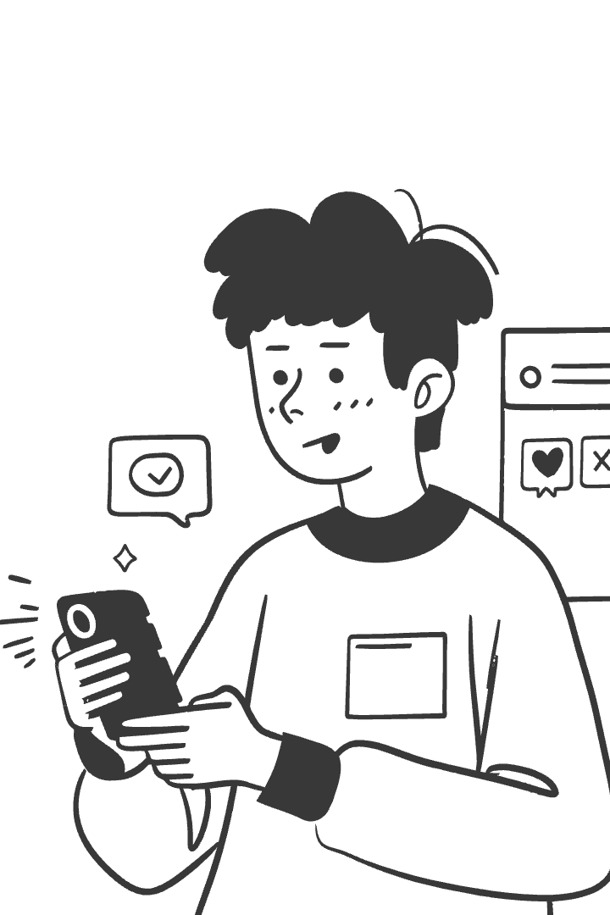



Temporal Engagement Patterns
Daily Engagement Trends
Time-series analysis reveals fluctuating engagement patterns throughout the analyzed period (January-May 2023), with certain days showing significant spikes in both likes and retweets.
Hourly Engagement Analysis
Bar charts of average likes and retweets by hour identify optimal posting times when audience engagement peaks, providing actionable insights for content scheduling.
Long-term Trends
The data shows engagement patterns that could be correlated with external events or platform algorithm changes during the study period.

Slide 8




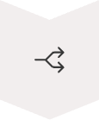
Data Preprocessing for Modeling
Text Vectorization
Converting tweet text into numerical features using TF-IDF vectorization with 1,000 maximum features
Feature Selection
Combining numerical features (Hour, Day, Tweet_Length, Word_Count) with text features for comprehensive analysis
Standardization
Scaling numerical features to have zero mean and unit variance using StandardScaler
Train-Test Split
Dividing data into 80% training and 20% testing sets for model evaluation

Slide 9

Model Training Approach
Linear Regression
Random Forest Regressor
Simple parametric model assuming linear relationship between features and target variables (likes and retweets)
Ensemble of decision trees capturing non-linear relationships in the data
100 estimators (trees) in the forest
Fast training and prediction
Highly interpretable coefficients
Handles feature interactions automatically
Serves as baseline for comparison
More robust to overfitting
Separate Models
Training distinct models for predicting likes and retweets to capture different engagement dynamics
Recognizes different factors drive each metric
Allows for specialized feature importance analysis

Slide 10
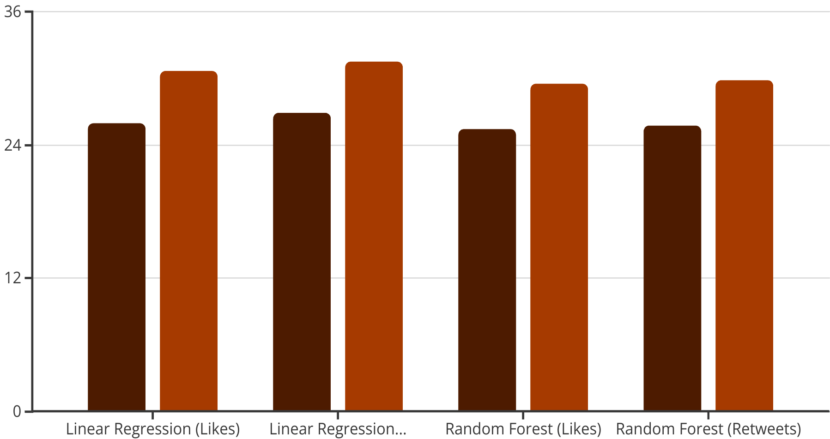
Model Evaluation Results
All models show similar error metrics, with Random Forest slightly outperforming Linear Regression. However, the negative R² scores (ranging from -0.03 to -0.16) indicate that the models perform worse than simply predicting the mean value.
These results suggest that predicting social media engagement is challenging with the current feature set. Future work should explore additional features like sentiment analysis, topic modeling, or user network characteristics to improve prediction accuracy.
MAE
RMSE

