Slide 1

JUPITER PDF
This is a simple API that accepts a PDF file and fetch all table contents. Also, the API compares the output of Dexter and Camelot.
HACKATHON – 2021
SAGNIK ADITHYA

Slide 2

FEATURES
Upload PDF to Server
The PDF file is uploaded to the server.
Upload PDF to Dexter
The PDF file is uploaded to Dexter and output is fetched.
Fetch Tables from Server
The tables are fetched from the server and returned as a list of tables.
Fetch Tables from Dexter
The tables are fetched from the dexter server and returned as a list of tables.
Compare Output of Dexter vs Server
The tables are compared and the differences are returned as a table.

Slide 3
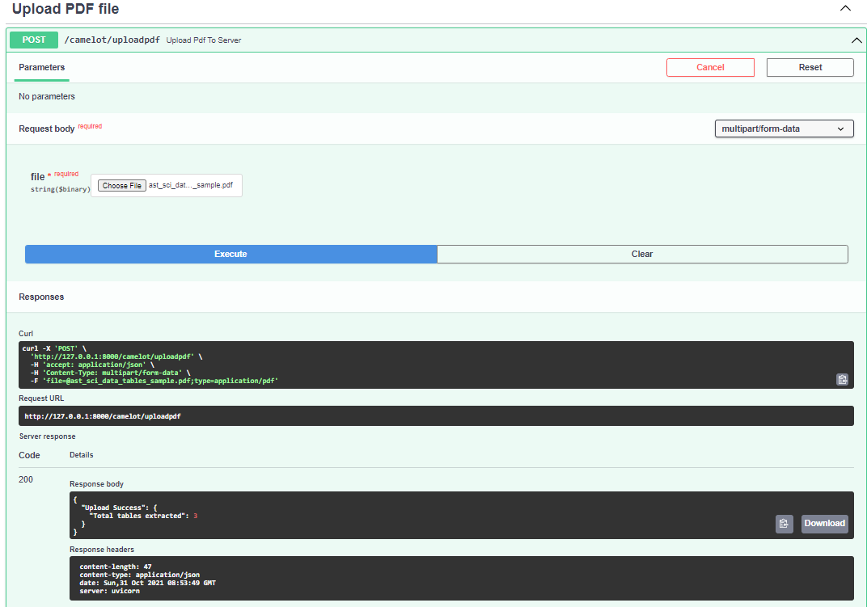
USER GUIDE
How to upload the pdf ?

Slide 4
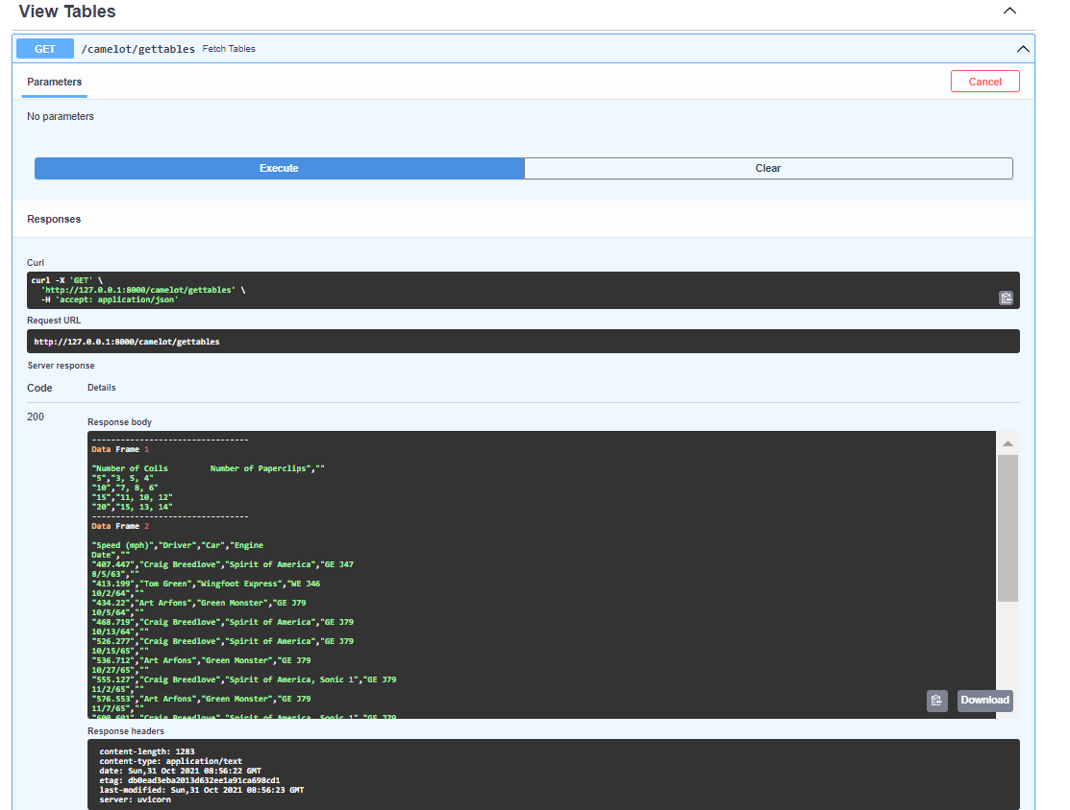
USER GUIDE
How to fetch the table from server?

Slide 5
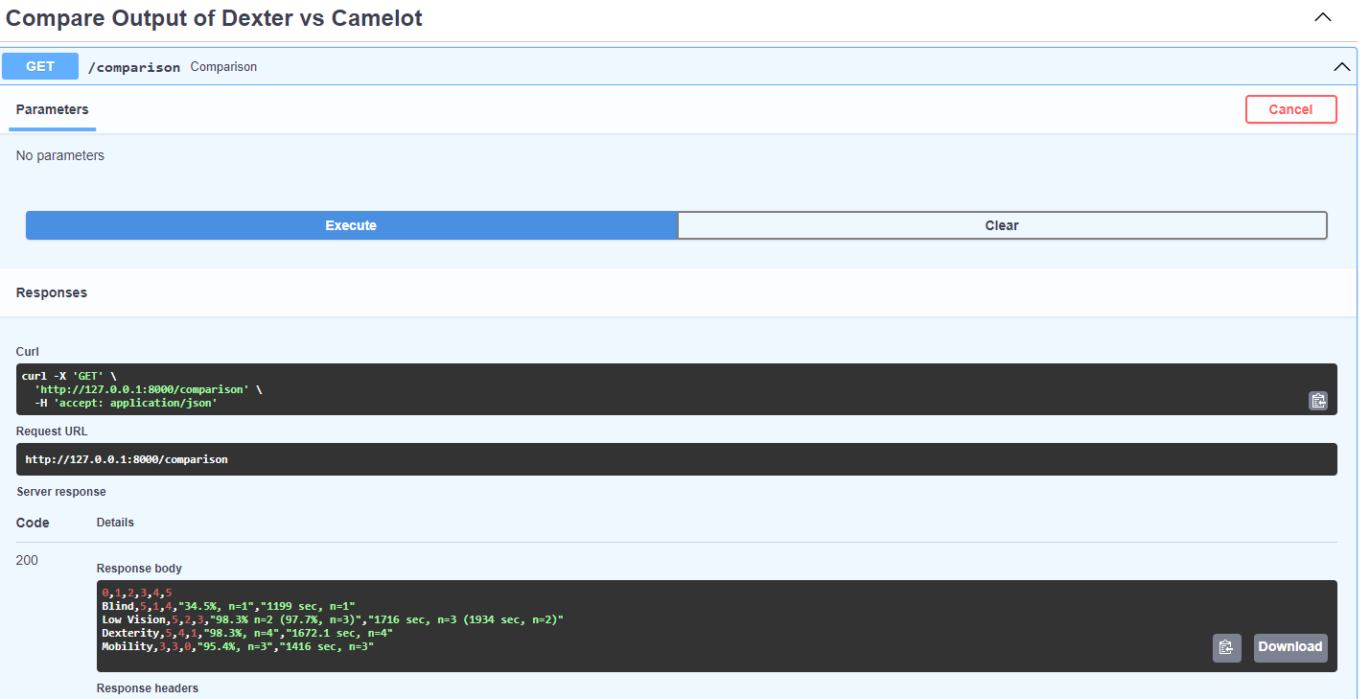
USER GUIDE
Compare the output of
Dexter vs Camelot

Slide 6

THANK YOU
JUPITER TEAM

