Slide 1

RATIOS
GRADE 7

Slide 2
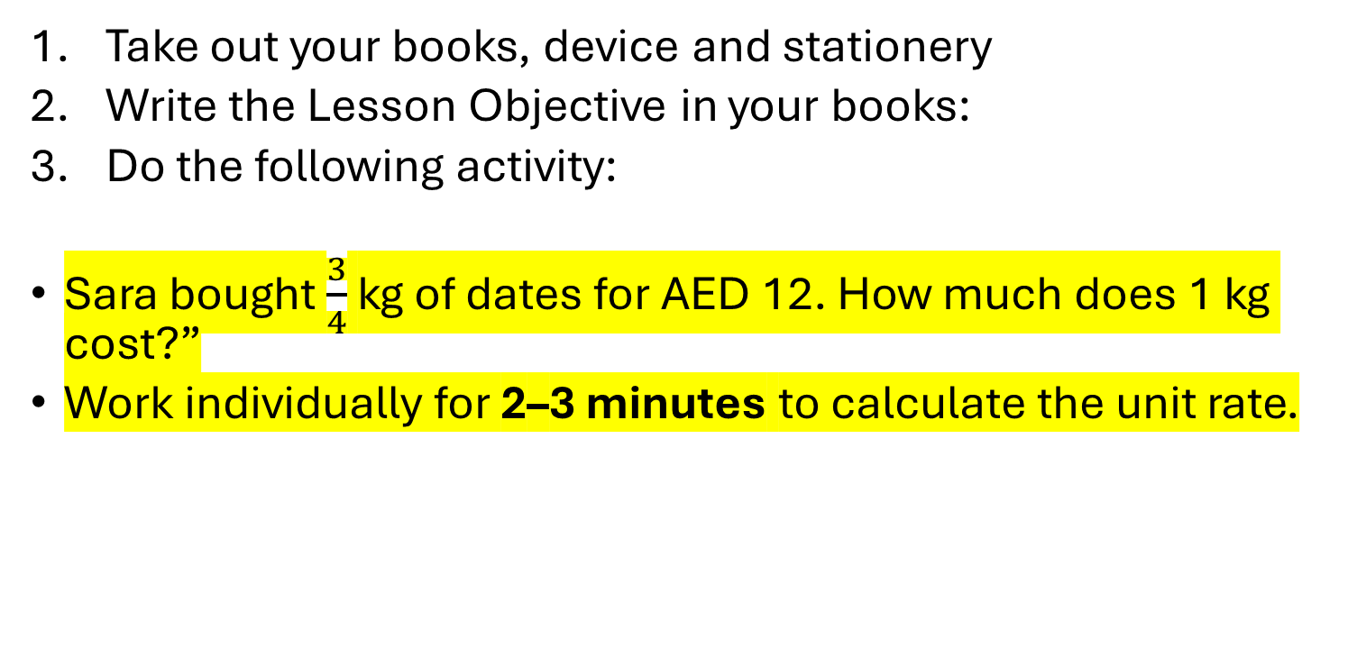
Bell Ringer Activity
Take out your books, device and stationery
Write the Lesson Objective in your books:
Do the following activity:
Sara bought $\frac{3}{4}$ kg of dates for AED 12. How much does 1 kg cost?”
Work individually for 2–3 minutes to calculate the unit rate.
LO:
Calculate unit rates involving fraction and apply it to real-life situations.
SC:
Identify the numerator and denominator in a ratio with a fraction correctly.
Calculate unit rates accurately.
Apply unit rates to UAE-context problems and explain reasoning clearly using fractions.
ATL Skill:
Communication
IB Learner Profile:
Thinker, Communicator
UAE Links:
Relate unit rates to real-life situations like calculating the quantities used in constructions.

Slide 3
Learning Objective: Calculate unit rates involving fraction and apply it to real-life situations.
Success Criteria (SC):
Aspire: Can calculate division of whole number by a fraction.
Grow: Calculates unit rates with fractions and decimals correctly.
Succeed: Applies unit rates confidently to UAE-context scenarios and clearly explains reasoning using fractions and proportional thinking.
ATL Skill:
Thinking, Communication, Self-Management
IB Learner Profile:
Thinker, Inquirer, Reflective, Communicator
UAE Links:
Relate inequalities to real-life limits — speed limits, budgets, and fair rules in UAE society.

Slide 4
Key Vocabulary
LO:
Calculate unit rates involving fraction and apply it to real-life situations.
SC:
Identify the numerator and denominator in a ratio with a fraction correctly.
Calculate unit rates accurately.
Apply unit rates to UAE-context problems and explain reasoning clearly using fractions.
ATL Skill:
Communication
IB Learner Profile:
Thinker, Communicator
UAE Links:
Relate unit rates to real-life situations like calculating the quantities used in constructions.
Vocabulary:
Ratio
Unit Rate
Fraction
Proportional Relationship
Numerator / Denominator

Slide 5
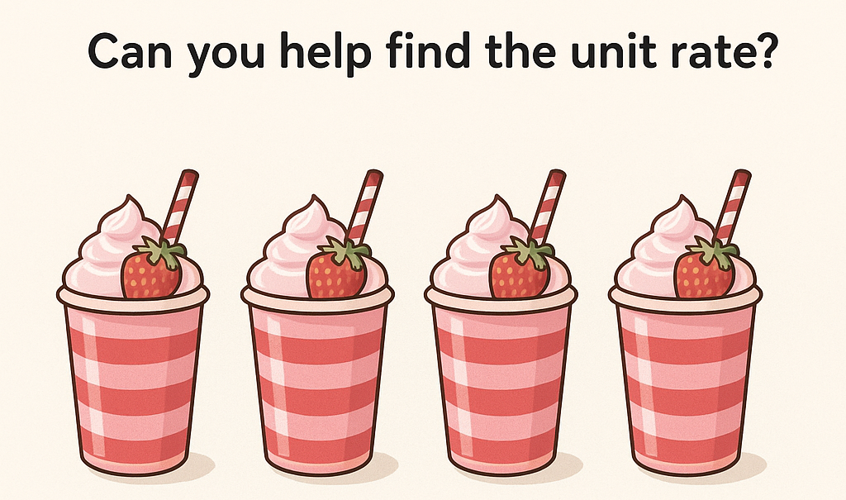
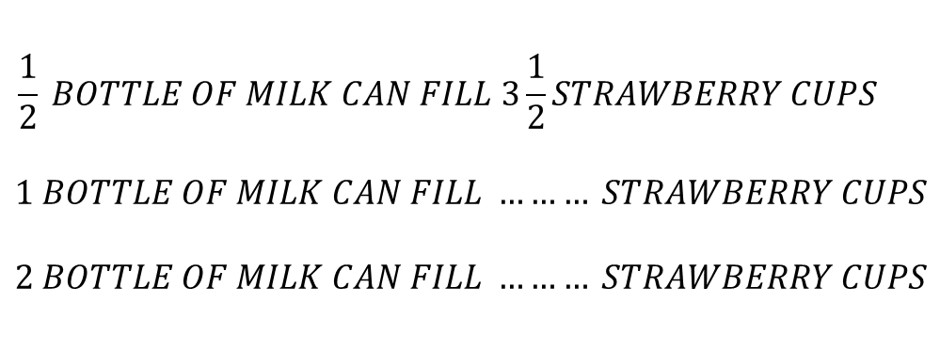
Engage:
Pre-assessment
LO:
Calculate unit rates involving fraction and apply it to real-life situations.
SC:
Identify the numerator and denominator in a ratio with a fraction correctly.
Calculate unit rates accurately.
Apply unit rates to UAE-context problems and explain reasoning clearly using fractions.
ATL Skill:
Communication
IB Learner Profile:
Thinker, Communicator
UAE Links:
Relate unit rates to real-life situations like calculating the quantities used in constructions.
$$\frac{1}{2} BOTTLE OF MILK CAN FILL 3\frac{1}{2}STRAWBERRY CUPS$$
$$1 BOTTLE OF MILK CAN FILL ……… STRAWBERRY CUPS$$
$$2 BOTTLE OF MILK CAN FILL ……… STRAWBERRY CUPS$$

Slide 6
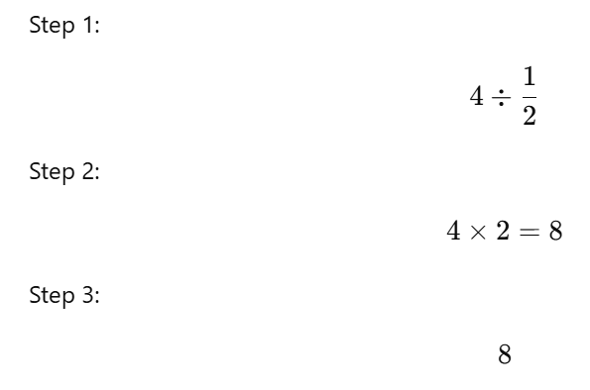
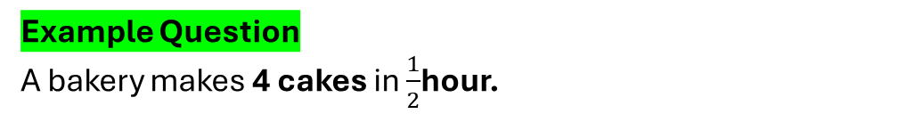
Explain
LO:
Calculate unit rates involving fraction and apply it to real-life situations.
SC:
Identify the numerator and denominator in a ratio with a fraction correctly.
Calculate unit rates accurately.
Apply unit rates to UAE-context problems and explain reasoning clearly using fractions.
ATL Skill:
Communication
IB Learner Profile:
Thinker, Communicator
UAE Links:
Relate unit rates to real-life situations like calculating the quantities used in constructions.
Example Question
A bakery makes 4 cakes in $\frac{1}{2}$hour.
Why do you think it is more for 1 hour?
Draw a diagram and show it.

Slide 7
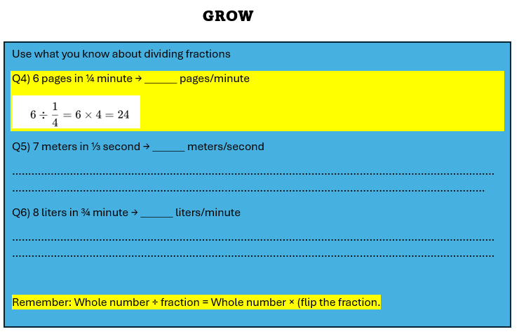
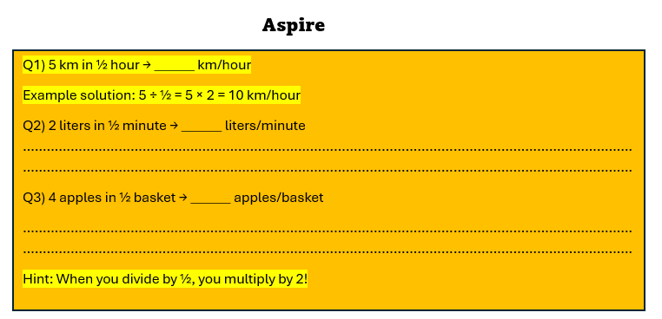




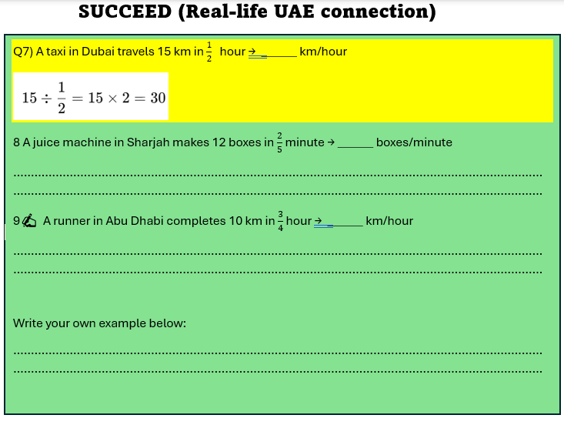
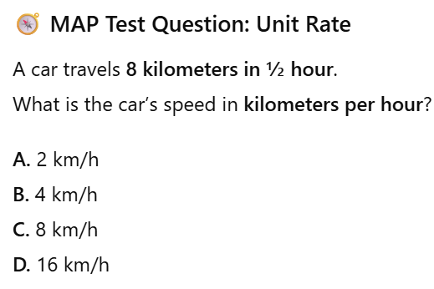

Elaborate
Page: 27 / 28
Applying skills
LO:
Calculate unit rates involving fraction and apply it to real-life situations.
SC:
Identify the numerator and denominator in a ratio with a fraction correctly.
Calculate unit rates accurately.
Apply unit rates to UAE-context problems and explain reasoning clearly using fractions.
ATL Skill:
Communication
IB Learner Profile:
Thinker, Communicator
UAE Links:
Relate unit rates to real-life situations like calculating the quantities used in constructions.
Page:27

Slide 8
Elaborate
Knowledge
LO:
Calculate unit rates involving fraction and apply it to real-life situations.
SC:
Identify the numerator and denominator in a ratio with a fraction correctly.
Calculate unit rates accurately.
Apply unit rates to UAE-context problems and explain reasoning clearly using fractions.
ATL Skill:
Communication
IB Learner Profile:
Thinker, Communicator
UAE Links:
Relate unit rates to real-life situations like calculating the quantities used in constructions.

Slide 9
Elaborate
LO:
Calculate unit rates involving fraction and apply it to real-life situations.
SC:
Identify the numerator and denominator in a ratio with a fraction correctly.
Calculate unit rates accurately.
Apply unit rates to UAE-context problems and explain reasoning clearly using fractions.
ATL Skill:
Communication
IB Learner Profile:
Thinker, Communicator
UAE Links:
Relate unit rates to real-life situations like calculating the quantities used in constructions.
Applying skills

Slide 10
Elaborate
LO:
Calculate unit rates involving fraction and apply it to real-life situations.
SC:
Identify the numerator and denominator in a ratio with a fraction correctly.
Calculate unit rates accurately.
Apply unit rates to UAE-context problems and explain reasoning clearly using fractions.
ATL Skill:
Communication
IB Learner Profile:
Thinker, Communicator
UAE Links:
Relate unit rates to real-life situations like calculating the quantities used in constructions.
Applying skills

Slide 11
Mini Plenary :
LO:
Calculate unit rates involving fraction and apply it to real-life situations.
SC:
Identify the numerator and denominator in a ratio with a fraction correctly.
Calculate unit rates accurately.
Apply unit rates to UAE-context problems and explain reasoning clearly using fractions.
ATL Skill:
Communication
IB Learner Profile:
Thinker, Communicator
UAE Links:
Relate unit rates to real-life situations like calculating the quantities used in constructions.
The Success Criteria | 3. I got it | 2. I need to work on it. | 1. Didn’t get it and need help.
Can calculate division of whole number by a fraction.
Calculates unit rates with fractions correctly.
Applies unit rates confidently to UAE-context scenarios and clearly explains reasoning using fractions and proportional thinking.

Slide 12
Elaborate
LO:
Calculate unit rates involving fraction and apply it to real-life situations.
SC:
Identify the numerator and denominator in a ratio with a fraction correctly.
Calculate unit rates accurately.
Apply unit rates to UAE-context problems and explain reasoning clearly using fractions.
ATL Skill:
Communication
IB Learner Profile:
Thinker, Communicator
UAE Links:
Relate unit rates to real-life situations like calculating the quantities used in constructions.

Slide 13
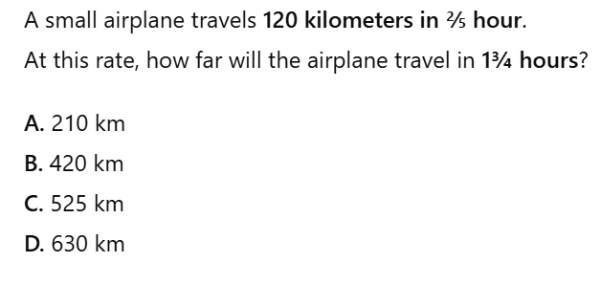
Elaborate
LO:
Calculate unit rates involving fraction and apply it to real-life situations.
SC:
Identify the numerator and denominator in a ratio with a fraction correctly.
Calculate unit rates accurately.
Apply unit rates to UAE-context problems and explain reasoning clearly using fractions.
ATL Skill:
Communication
IB Learner Profile:
Thinker, Communicator
UAE Links:
Relate unit rates to real-life situations like calculating the quantities used in constructions.
Early Finishers
HOT

Slide 14
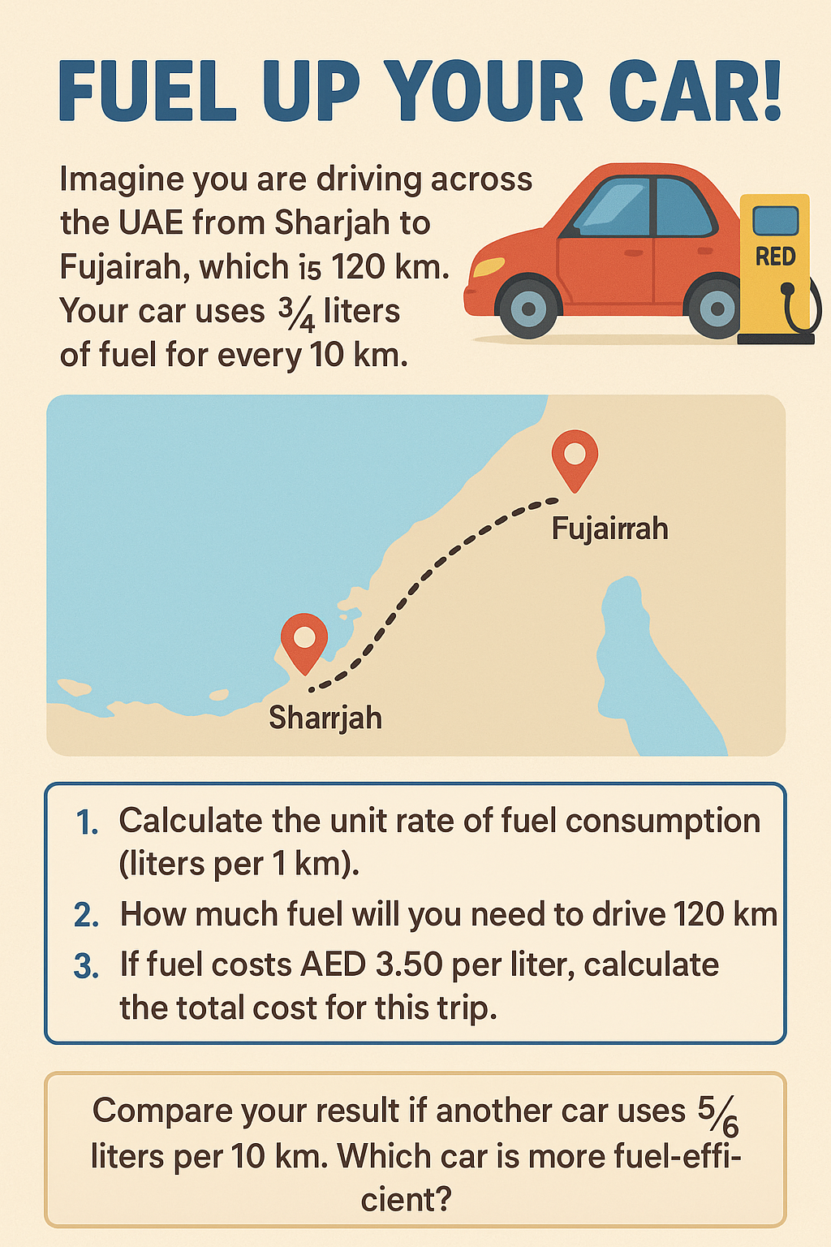
Evaluate
F
O
R
E
AR
L
Y
F
I
N
I
S
H
ERS
LO:
Calculate unit rates involving fraction and apply it to real-life situations.
SC:
Identify the numerator and denominator in a ratio with a fraction correctly.
Calculate unit rates accurately.
Apply unit rates to UAE-context problems and explain reasoning clearly using fractions.
ATL Skill:
Communication
IB Learner Profile:
Thinker, Communicator
UAE Links:
Relate unit rates to real-life situations like calculating the quantities used in constructions.

Slide 15


Evaluate
Post-assessment
LO:
Calculate unit rates involving fraction and apply it to real-life situations.
SC:
Identify the numerator and denominator in a ratio with a fraction correctly.
Calculate unit rates accurately.
Apply unit rates to UAE-context problems and explain reasoning clearly using fractions.
ATL Skill:
Communication
IB Learner Profile:
Thinker, Communicator
UAE Links:
Relate unit rates to real-life situations like calculating the quantities used in constructions.
Teacher Link:
https://wayground.com/admin/activity/classic/690062f2c1e6be244d219440

