Slide 1


Scan here ✅

Slide 2
RATIOS ✨
GRADE 7 🎯
Scan here ✅

Slide 3
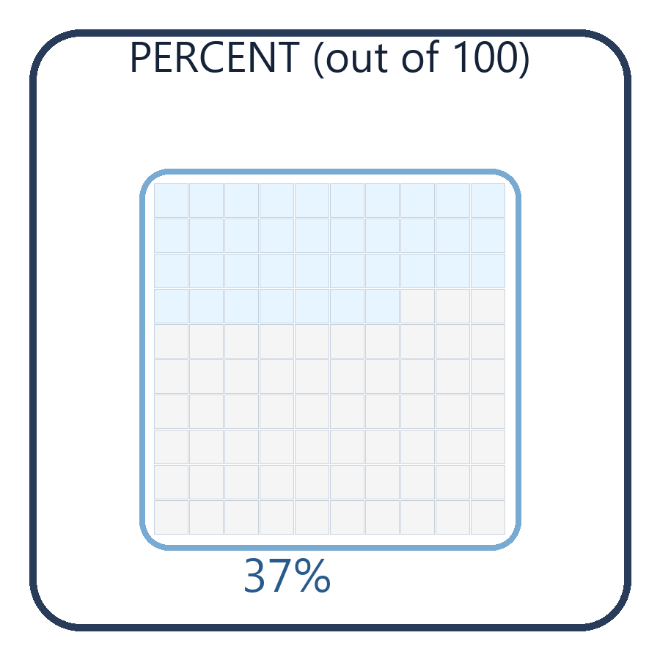
Story: Sticker Chart 🟩
Percent = shaded out of 100
📖 Story
A 100-grid has 100 squares.
You shade 37 squares.
🧩 Problems
1) What percent is shaded?
2) What decimal is that?
✅ Steps
Percent = shaded/100
Decimal = percent ÷ 100
Scan here ✅

Slide 4
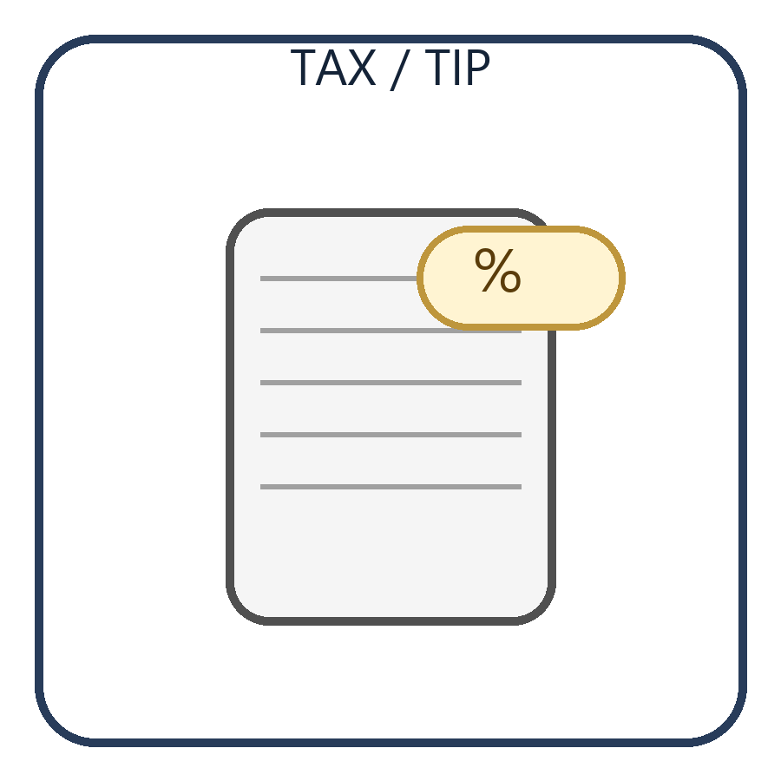
Story: Tax on a Receipt 🧾
part = percent × whole
📖 Story
Bill is $54 and tax is 8.44%.
Find the tax amount.
🧩 Problems
1) Write the equation.
2) Compute/estimate tax.
✅ Steps
Convert % to decimal
Multiply decimal × whole
Scan here ✅

Slide 5
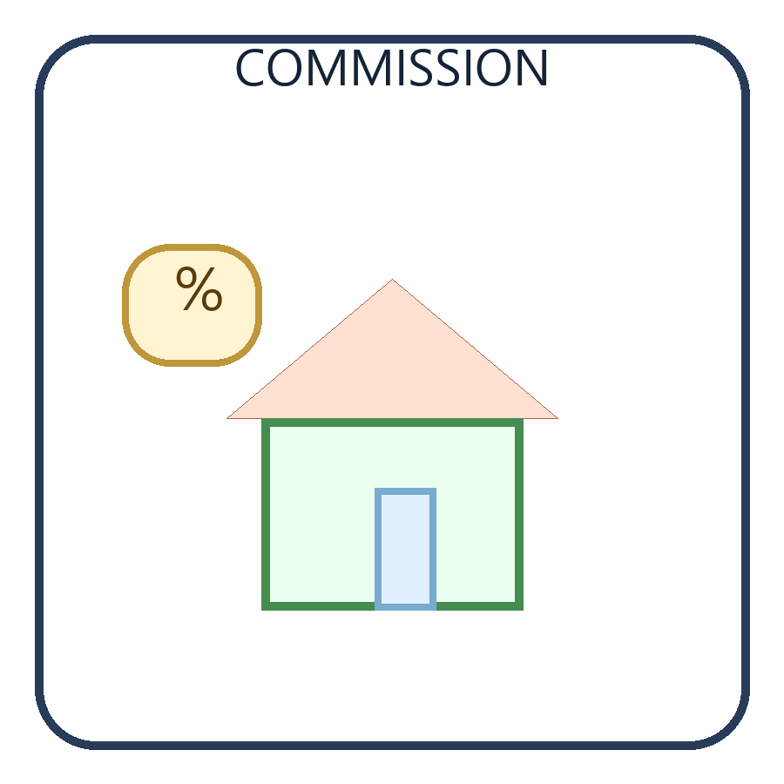
Story: House Commission 🏠
Find the whole (selling price)
📖 Story
Commission is 5.5% and equals $9,020.
Find the selling price.
🧩 Problems
1) 9020 = 0.055 × whole
2) whole = 9020 ÷ 0.055
✅ Steps
Whole = part ÷ percent
Check by multiplying
Scan here ✅

Slide 6
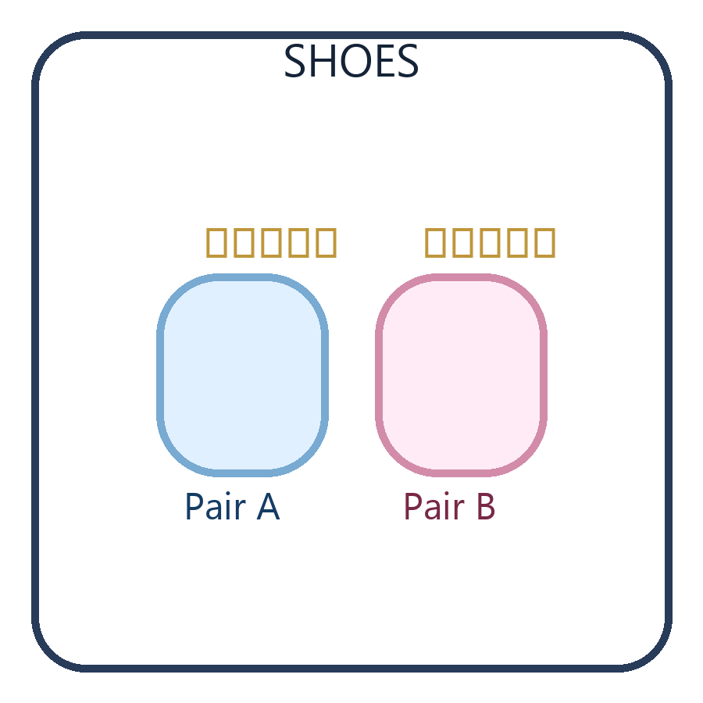
Story: Shoe Reviews 👟
Compare percents to decide
📖 Story
Shoe A: 42/50 good reviews.
Shoe B: 78/100 good reviews.
🧩 Problems
1) Turn both into percents.
2) Pick the better shoe and explain.
✅ Steps
Percent = part/whole × 100
Compare the percents
Scan here ✅

Slide 7
Unit Rates with Fractions ➗
Page 1
Today’s Goal 🎯
START
Bell Ringer
LO:
• Find unit rate (per 1) with fractions.
Success ✅
• Name numerator & denominator.
• Find a unit rate.
• Explain in words.
ATL: 💬 Communication
IB: 🧠 Thinker, Communicator
UAE: 🏗️ Construction quantities
⭐ Quick Start (2 minutes)
☑️ Step 1: Read.
☑️ Step 2: Circle numbers.
☑️ Step 3: Write a fraction.
☑️ Step 4: Find “per 1”.
💬 Share: What does “per 1” mean?
Scan here ✅

Slide 8
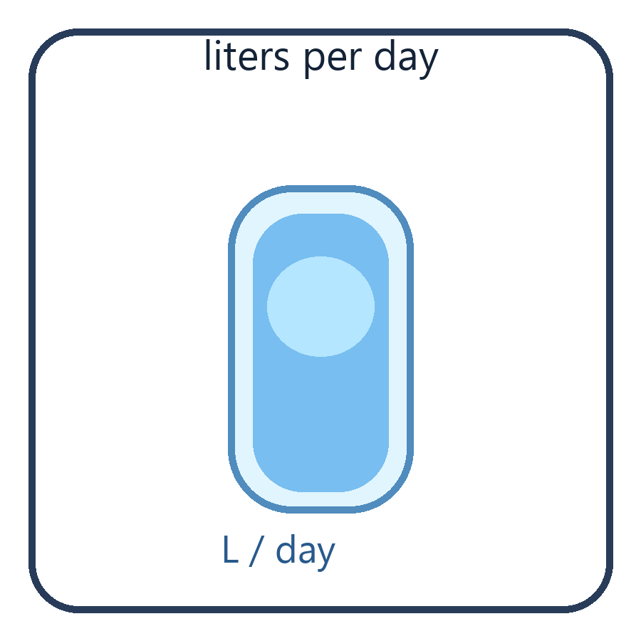
Story: Water for the Class 💧
Unit rate = liters per 1 day
📖 Story
The class drinks 12 liters in 4 days.
How many liters per 1 day?
🧩 Problems
1) Find L/day.
2) For 7 days, how many liters?
✅ Steps
Unit rate = total ÷ days
Then multiply by 7
Scan here ✅

Slide 9
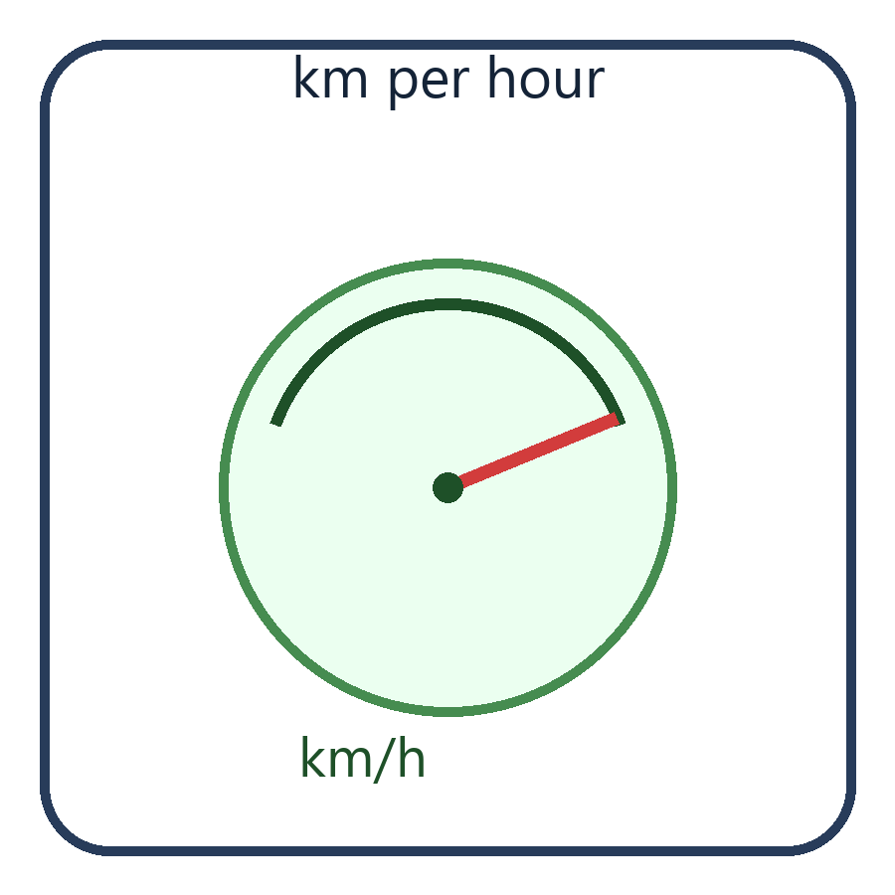
Story: Bus Trip 🚍
Unit rate = km per 1 hour
📖 Story
A bus goes 180 km in 3 hours.
How many km per 1 hour?
🧩 Problems
1) Find km/h.
2) In 5 hours, how far?
✅ Steps
Unit rate = distance ÷ time
Then multiply
Scan here ✅

Slide 10
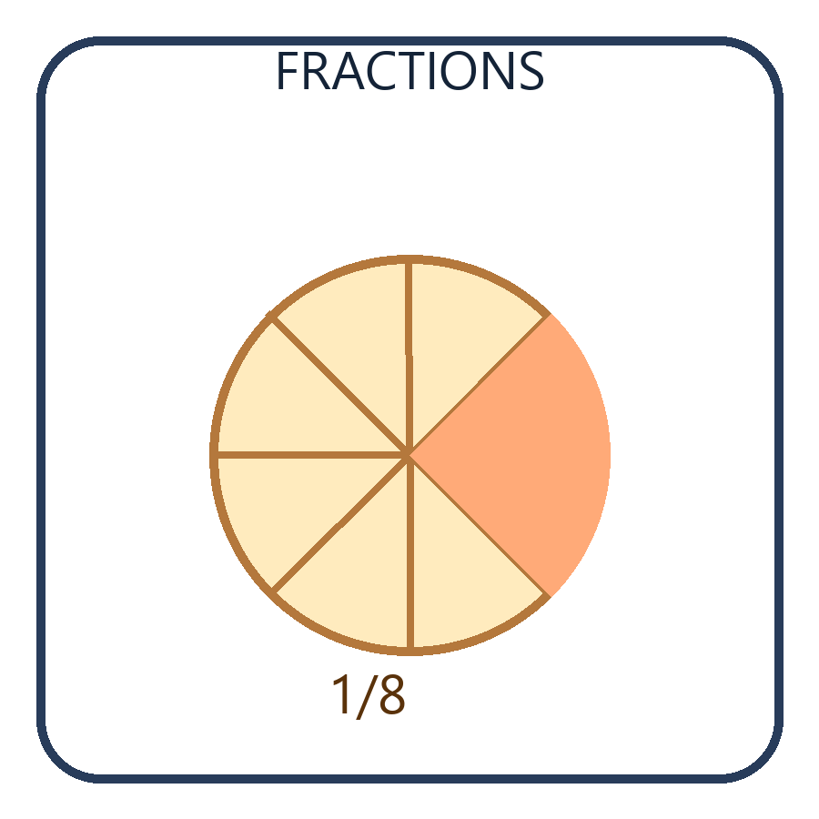
Story: Pizza Fractions 🍕
Fractions show parts of a whole
📖 Story
A pizza has 8 equal slices.
Sam eats 3 slices.
🧩 Problems
1) Write the fraction eaten.
2) How many slices left?
✅ Steps
Fraction = part/whole
Left = whole − part
Scan here ✅

Slide 11
Unit Rates with Fractions ➗
Page 1
Today’s Goal 🎯
START
Bell Ringer
LO:
• Find unit rate (per 1) with fractions.
Success ✅
• Name numerator & denominator.
• Find a unit rate.
• Explain in words.
ATL: 💬 Communication
IB: 🧠 Thinker, Communicator
UAE: 🏗️ Construction quantities
⭐ Quick Start
☑️ Step 1: Read.
☑️ Step 2: Circle numbers.
☑️ Step 3: Write a fraction.
☑️ Step 4: Find “per 1”.
💬 Share: What does “per 1” mean?
Scan here ✅

Slide 12
Learning Objective 🎯 (We go step-by-step)
Page 2
Learning Objective 🎯
GOAL
Learning Objective
We will…
• Use fractions to find unit rates.
Success ✅
• Aspire: whole ÷ fraction
• Grow: unit rates with fractions/decimals
• Succeed: explain with units + context
Skills 💬🧠
• Thinking • Communication • Self-Management
✍️ and clearly.
✅ I can:
• write a ratio as a fraction
• divide to get a unit rate
• add units (AED, km, kg, …)
🌟 Reminder: Unit rate = “for 1”.
Scan here ✅

Slide 13
Learning Objective 🎯 (Step-by-step)
Page 2
Learning Objective 🎯
GOAL
Learning Objective
We will…
• Use fractions to find unit rates.
Success ✅
• Aspire: whole ÷ fraction
• Grow: unit rates with fractions/decimals
• Succeed: explain with units + context
Skills 💬🧠
• Thinking • Communication • Self-Management
✍️ .
✅ I can:
• write a ratio as a fraction
• divide to get a unit rate
• add units (AED, km, kg, …)
🌟 Unit rate = “for 1”.
Scan here ✅

Slide 14
Key Vocabulary 📚 (Say it, draw it, remember it)
Page 3
Words to Know 📚
WORDS
Key Vocabulary
Vocabulary
• Ratio
• Unit Rate
• Fraction
• Proportion
• Numerator / Denominator
Tip ⭐
• Numerator = top
• Denominator = bottom
🎲 Make it fun!
☑️ Write each word.
☑️ Draw a tiny picture.
☑️ Say it out loud.
Example:
• Unit rate = “per 1” ✅
Scan here ✅

Slide 15
Key Vocabulary 📚 (Say it + draw it)
Page 3
Words to Know 📚
WORDS
Key Vocabulary
Vocabulary
• Ratio
• Unit Rate
• Fraction
• Proportion
• Numerator / Denominator
Tip ⭐
• Numerator = top
• Denominator = bottom
🎲 Make it fun!
☑️ Write each word.
☑️ Draw a tiny picture.
☑️ Say it out loud.
Example:
• Unit rate = “per 1” ✅
Scan here ✅

Slide 16
Engage 💬 (Talk + simple examples)
Page 4
Success Steps ✅
TALK
Engage
1) Read 👀
2) Write fraction ➗
3) Divide
4) Say unit + meaning 💬
UAE Link 🏗️
• materials per 1 room
• paint per 1 wall
• cost per 1 item
💬 Talk Time
Question:
When do we use unit rates?
⭐ Examples:
• AED per 1 item 🛍️
• km per 1 hour 🚗
• liters per 1 day 💧
👫 Share one example.
Scan here ✅

Slide 17
Engage 💬 (Talk + examples)
Page 4
Success Steps ✅
TALK
Engage
1) Read 👀
2) Write fraction ➗
3) Divide
4) Say unit + meaning 💬
UAE Link 🏗️
• materials per 1 room
• paint per 1 wall
• cost per 1 item
💬 Talk Time
Question:
When do we use unit rates?
⭐ Examples:
• AED per 1 item 🛍️
• km per 1 hour 🚗
• liters per 1 day 💧
👫 Share one example.
Scan here ✅

Slide 18
Pre-Assessment ✍️ (Try with a model)
Page 5
Pre-Assessment ✍️
TRY
Pre-Assessment
Think 🧠
Why does “per 1 hour” change the value?
Draw 🎨
• a bar model OR
• a ratio table
✅
⭐ Your Task
☑️ Write the ratio.
☑️ Show your model.
☑️ Find the unit rate.
💬 Sentence:
‘The unit rate means ____ per 1 ____.’
Scan here ✅

Slide 19
Practice & Problem Solving ✍️ (One step at a time)
Page 147
⭐ Directions: Try 4 questions. Use a model. Write neatly. ✅
Practice Box ✅ (Fill the blanks)
7️⃣ 80% of 60 players
= ____ players
☑️ 80/100 × 60
8️⃣ 20% of 20 uniforms
= ____ uniforms
☑️ 20/100 × 20
🔟 4% of 7,200
= ____
☑️ 4/100 × 7200
1️⃣2️⃣ Sales tax
$40 at 4%
Tax = ____
Total = ____
🧠 Reasoning:
How does the answer change if you split first, then find the percent?
Write 1 sentence.
Scan here ✅

Slide 20
Assessment Practice ✅ (Show your thinking)
Page 148
⭐ Big Question:
Who earns more in a week? Use numbers and explain. 💬
20️⃣ Pamela earns $20 per hour.
John earns $65 per pupil.
Pamela works 40 hours.
John has 11 pupils.
☑️ Step 1: Find Pamela’s weekly pay.
☑️ Step 2: Find John’s weekly pay.
☑️ Step 3: Compare and explain.
✍️ Answer:
______________
✅ Check:
Show units ($).
Write one sentence.
Scan here ✅

Slide 21
Lesson 3-2 Connect Percent and Proportion
Page 149
Solve & Discuss It! 💬
I can…
use proportions to solve percent problems. ✅
⭐ Read the problem.
☑️ Draw a quick model.
☑️ Write a proportion.
💬 Explain your answer.
Focus on Math Practices 🧠
✅ Make Sense and Persevere:
Explain your thinking using words and a model.
Scan here ✅

Slide 22
Use a Proportion to Find the Percent 📊
Page 150
EXAMPLE 1 👀
Steps ✅
1) Write: 9/12 = p/100
2) Multiply: 9 × 100
3) Divide by 12
4) p = 75
Answer: 75% 🎉
Problem:
Emily made 9 shots out of 12.
What percent did she make?
☑️ Part / Whole = Percent / 100
Try It! ✍️
Camila made 2 shots out of 5.
☑️ Write: 2/5 = p/100
☑️ Solve for p
Camila made ____ %.
Camila’s percent is ____ Emily’s.
🧠 Quick Tip:
Multiply by 100.
Then divide.
✅
Scan here ✅

Slide 23
Key Concept 🔑 Part / Whole = Percent / 100
Page 152
Do You Understand? ✅
TRY
Do You Know How? ✍️
1) Essential Question:
How does proportional reasoning
relate to percent?
2) Reasoning:
Why does one ratio have a
denominator of 100?
3) Construct Arguments:
If 75/w = 150/100,
Is w less than 75 or greater?
Explain using percent words.
4) Write a percent proportion
for the bar diagram.
5) Use a proportion.
a) 2% of 180
b) What percent is 17 out of 40?
6) Construct Arguments:
A car is worth $3,000.
She wants at least 70%.
She sold it for $1,800.
Did she meet her goal?
Scan here ✅

Slide 24
Practice & Problem Solving ✍️ (Fill the boxes)
Page 153
Level Practice ✅
PRACTICE
More Practice ⭐
7) Rabbit population:
This year is 200%.
This year = 1,100.
Find last year.
9) Survey pie chart:
What percent are
completely satisfied?
11) Tip & tax:
Tip = $3.50
Tax = 7%
Tip = 20% of cost incl. tax.
a) What info is not needed?
b) Find the total bill.
8) Shampoo trial:
3,000 people tried.
9 had a mild reaction.
What percent?
10) Apartment:
Price $240,000
Down payment $60,000
a) What percent is 60,000?
b) What percent is 12,000?
12) Reasoning:
Estimate 380% of 60.
Scan here ✅

Slide 25
Assessment Practice ✅ (Show steps)
Page 154
Construct & Explain 💬
ASSESS
Higher-Order Thinking 🧠
13) Critique Reasoning:
Is 35% junk mail reasonable?
Explain.
14) Percent read:
13 of 22 chapters.
15) Quarters:
School year has 4 quarters.
What percent is 7 quarters?
16) Construct Arguments:
27% students, 94% staff
drive; ratio students:staff = 10:1.
Explain how students driving
could be greater in number.
17) Bike & helmet:
Sold for $114 and $18.
That is 120% of what was spent.
a) How much was spent?
b) How much profit?
18) Nicole spent $30 last month.
This month she spent 140%.
Write an equation and find amount.
19) Mr. Jones sells paddles for
180% of purchase price.
Part A: Find sales tax rate.
Part B: If cost is $35, how many
paddles to sell for at least $250?
Scan here ✅

Slide 26
Lesson 3-3 Represent and Use the Percent Equation
Page 155
Solve & Discuss It! 💬
I can… ✅
represent and solve percent
problems using equations.
🌟 Big idea:
part = percent × whole
Fran is shopping for shoes.
Two pairs have good reviews.
Which pair should she buy?
☑️ Step 1: Make each percent.
☑️ Step 2: Compare.
💬 Explain your choice.
Focus on Math Practices 🧠
Model with Math:
Describe another situation where ratios can help you make a decision.
Scan here ✅

Slide 27
Example 1 Find the Percent 📊 (Percent Equation)
Page 156
Example 1 ✅
TRY
Try It! ✍️
Maria is 60 inches tall.
Her vertical reach is 75 inches.
Question:
What percent of her total
reach is her height?
☑️ Use:
part = percent × whole
An elephant weighs 15,000lb
on Earth and 2,500lbon Moon.
☑️ Write:
part / whole = p / 100
Find p.
Answer:
The elephant’s Moon weight
is about ____ % of Earth weight.
Scan here ✅

Slide 28
Example 2–3 Use Percent Equation 🧮
Page 157
Example 2 ✅
SOLVE
Example 3 ✅
A room length is 4 m.
New length is 175%.
☑️ Write:
new = 1.75 × old
Find the new length.
Answer: ____ m
Soy milk label:
20% calcium = 260 mg
☑️ Use proportion:
260 / w = 20 / 100
Find w.
Daily value = ____ mg
Scan here ✅

Slide 29
Lesson 3-3 Percent Equation 🧮 Examples
Page 157
Example 2: Find the Part 🍔
SOLVE
Example 3: Find the Whole 🏠
Meal tax = 8.44%
Bill (food + drinks) = $54
☑️ Use: part = percent × whole
Step 1: 8.44% = 0.0844
Step 2: tax = 0.0844 × 54
Step 3: tax ≈ $4.56
Reasoning 💬
What does 4.5576 mean?
Jane earns 5.5% commission.
Commission = $9,020
☑️ Use: part = percent × whole
part = 0.055 × whole
Step 1: 9020 = 0.055 × h
Step 2: h = 9020 ÷ 0.055
Step 3: h = 164,000
Answer ✅
Selling price = $164,000
Scan here ✅

Slide 30
Key Concept 🔑 part = percent × whole
Page 158
Do You Understand? ✅
TRY
Do You Know How? ✍️
1) Essential Question:
How are percent problems related
to proportional reasoning?
2) Reasoning:
A waiter receives $11 tip on $47.20.
Usually tips are 20%.
Is this tip typical? Explain.
3) Construct Arguments:
About 11% of people are left-handed.
How many in a class of 30?
Justify the steps.
4) Commission:
An agent earns 12% on a $1,000 policy.
How much commission?
5) Paint mix:
Seafoam green = 1.5 quarts.
Blue 70% and Yellow 30%.
Find how much yellow paint.
6) Sales tax:
Tax $35.99 on laptop $449.99.
About what percent tax?
Scan here ✅

Slide 31
Practice & Problem Solving ✍️
Page 159
Level Practice ✅
PRACTICE
More Practice ⭐
7) Voters:
500 voters, 430 would vote again.
What percent?
9) Hard drive:
16 GB total.
Photos uses 3.32 GB.
What percent is used?
10) Shirt sale:
Regular $30, sale $21.75.
Sale price is what percent?
12) Sales tax table:
$39.98 at 4.5%.
Find tax.
8) Letters to editor:
40 letters is 5% of readers.
How many readers?
11) Commission table:
Sales $768 at 4%.
Find commission.
13) Gratuity:
20% on $141 bill.
How much gratuity?
✅ Tip:
Write: part = percent × whole
Scan here ✅

Slide 32
Assessment Practice ✅ (Explain + show work)
Page 160
Show Thinking 💬
ASSESS
Higher-Order 🧠
14) University:
Accepts 70% of applicants.
25% of accepted enroll.
20,000 apply.
How many enroll?
16) Commission:
4% on $33,000 sale.
a) Commission?
b) If sales double, what happens?
17) Jewelry:
3% commission.
Prices: $110, $275, $200, $145.
a) Commission?
b) Total store sales?
18) Company workers:
60% men.
1,380 women.
How many workers total?
Show 2 ways.
19) Pay options:
Option A: $19/hour for 40 hours.
Option B: 8% commission on weekly sales.
How much sales needed to match?
20) House sale:
$382,000. Commission 5.5%.
Agent gets 30% of agency amount.
Scan here ✅

Slide 33
Warm-up 🌟 (Get Ready)
Start
🧠 Pause & Check
☑️ Today we will use:
• part = percent × whole
✅ :
1) Circle the percent
2) Change percent to decimal
3) Multiply (for part)
4) Divide (for whole)
💬 Say it:
‘Part is percent times whole.’
✅ Rule:
Percent as decimal
= ÷100
Example:
12% = 0.12
Scan here ✅

Slide 34
Mini Practice ✅ (2 quick checks)
Check 1
🧠 Pause & Check
1) 10% of 90 = ____
2) $15 is 25% of ____
⭐ Tip:
If you see ‘of’ → multiply.
If you see ‘is ___% of’ → divide.
✅ Rule:
Percent as decimal
= ÷100
Example:
12% = 0.12
Scan here ✅

Slide 35
Mini Practice ✅ (Model it)
Check 2
🧠 Pause & Check
Draw a small bar model:
Whole is 100%.
Shade the percent.
Write the equation.
Example:
If part = 12 and percent = 30%,
whole = 12 ÷ 0.30
✅ Rule:
Percent as decimal
= ÷100
Example:
12% = 0.12
Scan here ✅

Slide 36
Mini Practice ✅ (Word to equation)
Check 3
🧠 Pause & Check
Turn each into an equation:
1) tax is 8% of 50
2) tip is 20% of 120
3) 45 is 15% of w
✅ Rule:
Percent as decimal
= ÷100
Example:
12% = 0.12
Scan here ✅

Slide 37
Exit Ticket 🎟️ (One question)
Exit
🧠 Pause & Check
A store gives a 15% discount.
The discount is $12.
☑️ What was the original price?
Write 1 sentence to explain.
✅ Rule:
Percent as decimal
= ÷100
Example:
12% = 0.12
Scan here ✅

