Slide 1
THz channel factors estimation using sub-6GHz channel information
Objective : 1. Train a DL model to read 2.4GHz channel matrix and predict 100GHz channel factors – Angles of Departure and Arrival, Time of Arrival, Pathloss, and Phase Difference on Arrival.
2. Use estimated THz channel factors for optimal beamformer prediction.
Scenario :
100,000 users (elevation 2m above surface) located in Chicago downtown area, in a rectangular block of dimensions roughly 500m * 40m with sub-6GHz/THz tower on one boundary of the block.
Scenario Parameters
Centre Frequency | 2.4GHz | 100GHz
Antenna array length | 4 | 64
Bandwidth | 20MHz | 500MHz
No. of OFDM subcarriers | 64 | 64
BS Antenna height | 8m | 8m
User Antenna height | 2m | 2m
Propagation Model (MATLAB) | sbr + gas + cloud | sbr + gas + cloud
Max no. of paths | 8 | 4

Slide 2
Conv
Conv
Maxpool
Maxpool
CNN based THz channel factors estimation
IN
IN
ReLU
ReLU
Dropout
Dropout
GAP
Input
(Sub-6GHz Channel Matrix 2D Image)
Dense
Layer
Output
(THz parameters)
4 ‘Convolution-Based’ Layers
Dense
Dense
…
ANN based beamformer prediction
ReLU
Softmax
Dropout
3 Dense Layers
Output
(Optimal Beamformer)

Slide 3
Neural Network Hyperparameters
Hyperparameter | THz estimation | Beamformer Prediction
Conv Kernel Size | (2,4) | -
Conv no. of filters | 32 | -
Maxpool Kernel Size | (2,2) | -
Maxpool stride | 2 | -
Dense layer dimension | - | 64
No. of training samples | 80,000 | 80,000
No. of test samples | 20,000 | 20,000
No. of epochs | 100 | 100
Task Type | Regression | Classification
Optimizer | SGD | Adam
Initial Learning Rate (LR) | 1.00 * 10⁻³ | 1.00 * 10⁻²
LR Decay Factor | 0.1 | -
LR Decay Schedule | 80 epochs | -
Momentum | 0.85 | -
Dropout | 0.2 | 0.2

Slide 4
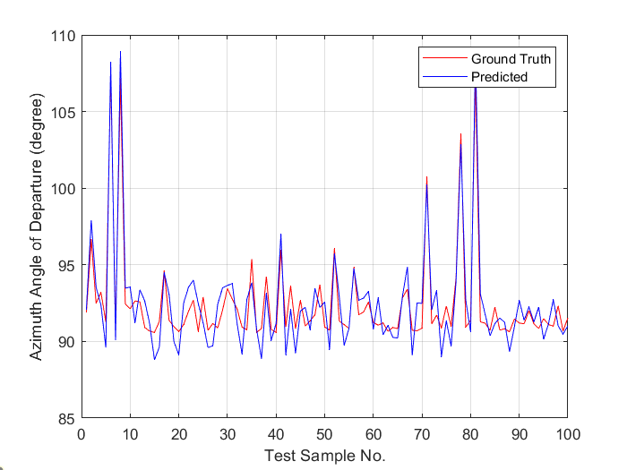
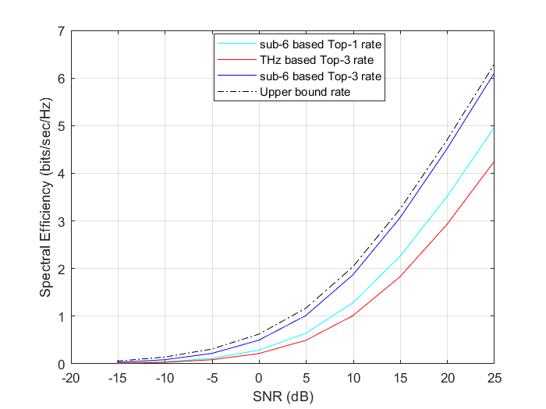
Performance Evaluation

Slide 5
Ongoing Work
Use CNN predicted THz channel factors to obtain the BS (out of 3 given BSs) providing best THz channel conditions / highest spectral efficiency for a particular user.
Input : Sub-6GHz channel matrices from user to 3 BSs
Algorithm : (a) Individual sub-6GHz channel matrix -> THz channel factors
(b) THz channel factors from 3 BSs -> best BS via DL based classification
Output : best BS index for that user
Future channel condition aware scheduling
(a) Can the deepMIMO dataset be used in some way for a user grouping/ scheduling task?
(b) Is there a way to include interference data to obtain optimal beamformer from deepMIMO dataset?

Slide 6
Combined System Model
Sub-6GHz channel matrix (2D Image Format Input)
Convolutional Neural Network Followed By Global Average Pooling Layer
THz Channel Parameters
Dense Neural Network Followed by Softmax Layer
Beam Selection

