Slide 1
Deep Learning for THz Channel Estimation and Beamforming Prediction via Sub-6GHz Channel
Sagnik Bhattacharya and Abhishek K. Gupta
Department of Electrical Engineering, Indian Institute of Technology Kanpur
Emails : bsagnik@iitk.ac.in, gkrabhi@iitk.ac.in
IEEE International Conference on Signal Processing and Communications (SPCOM)
July 2022

Slide 2
Introduction : THz Channel Estimation
Emerging wireless applications, e.g. augmented reality, ultra-low latency video conferencing, etc. require data rates in Tb/s - with even mmWaves falling short of requirement, use of THz spectrum is inevitable.
Challenges of THz signals – exponential pathloss decay due to atmospheric attenuation, high blockage and penetration losses.
Potential Solutions – highly dense base station (BS) deployments, long antenna arrays, analog/hybrid beamforming
To enable these solutions, real-time reasonably accurate THz channel estimation is required.
Conventional channel estimation methods, e.g. least square(LS) or linear minimum mean squared(LMMS) estimation, require large number of uplink pilot signals due to long THz antenna array length – not viable here.
Prior research considers compressive sensing methods – have significant overhead considering real-time applications.
Sub-6GHz channel, on the other hand, can be estimated with relatively low overhead and a smaller number of uplink pilots – provides motivation to use estimated Sub-6GHz channel for THz estimation.

Slide 3
Problem Derivation
Due to long THz antenna array length, THz channel matrix from BS to user has high dimensionality.
Direct estimation of THz channel matrix is computationally expensive.
THz channel factors (Angles of arrival and departure, time of arrival, phase change on arrival) are less in number and can be efficiently estimated.
Given the uplink Sub-6GHz channel matrix, estimate the channel factors for N strongest THz channel paths between BS and user in a computationally efficient manner
N is a pre-specified constant.
Estimated channel factors determine the THz channel – they can be used to compute THz channel matrix (computationally expensive).
Estimated channel factors can instead be directly used for applications – here, we select the optimal analog beamformer prediction task.
Exhaustive codebook search based beamformer prediction takes a prohibitive amount of time.
Given the estimated THz channel factors between a BS and a user, predict the optimal analog beamformer from a pre-specified codebook, in a computationally efficient manner

Slide 4
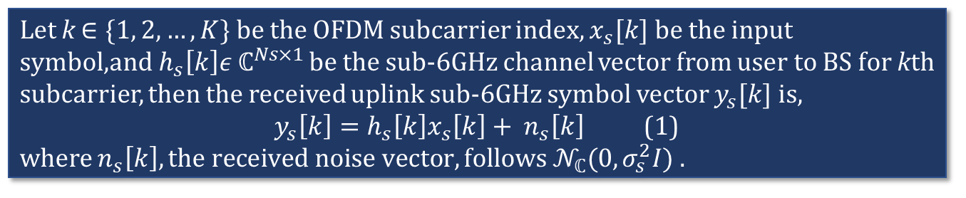
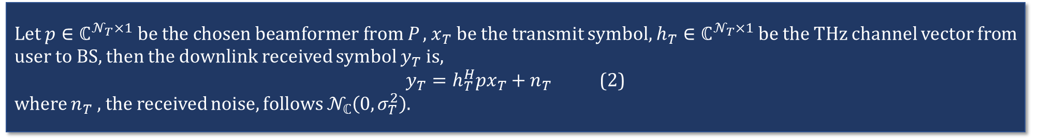
System Model
BS comprises 2 approximately collocated transceivers, operating at
1. Sub-6GHz frequency with N_{s} antennas
2. THz frequency with N_{T} antennas
User (assumed to be a mobile device) similarly has 2 transceivers, with 1 antenna for each frequency.
Orthogonal Frequency Division Multiplexing (OFDM) with K subcarriers is adopted.
N_{s} is small enough for fully digital beamforming.
Sub-6GHZ
Antenna
Array
…
THz Antenna
Array
Let k $∈\{1, 2,…,K\}$ be the OFDM subcarrier index, $x_{s}[k]$ be the input symbol,a$nd h_{s}\left[k\right]ε ℂ^{Ns×1}$ be the sub-6GHz channel vector from user to BS for kth subcarrier, then the received uplink sub-6GHz symbol vector $y_{s}[k]$ is,
$y_{s}\left[k\right]=h_{s}\left[k\right]x_{s}\left[k\right]+ n_{s}\left[k\right]$ (1)
where $n_{s}\left[k\right], the received noise vector, follows 𝒩_{ℂ}(0,σ_{s}^{2}I)$.
…
User
Base Station
Fully analog beamforming adopted for THz scenario, single RF chain with N_{T} quantized phase shifters.
Pre-suppled codebook P comprises all candidate beamformers.
Let $p∈ℂ^{𝒩_{T}×1} be the chosen beamformer from$ P , $x_{T}$be the transmit symbol, $h_{T}∈ℂ^{𝒩_{T}×1}$ be the THz channel vector from user to BS, then the downlink received symbol $y_{T}$ is,
$y_{T}=h_{T}^{H}px_{T}+n_{T}$ (2)
where $n_{T}$ , the received noise, follows $𝒩_{ℂ}\left(0,σ_{T}^{2}\right)$.

Slide 5
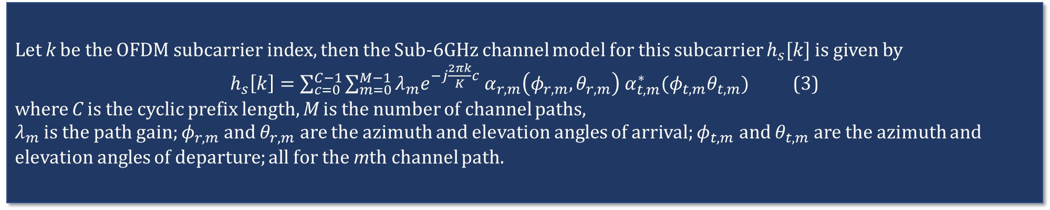
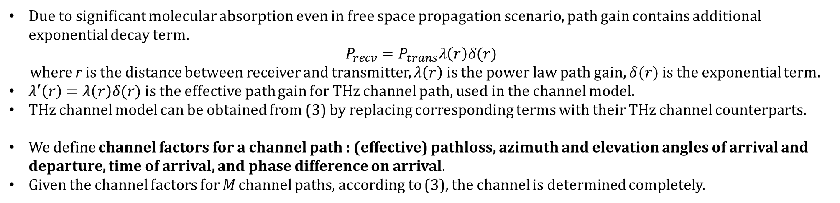
Channel Model
Geometric channel model for both Sub-6GHz and THz channels
Let k be the OFDM subcarrier index, then the Sub-6GHz channel model for this subcarrier $h_{s}[k]$ is given by
$h_{s}\left[k\right]=\sum_{c=0}^{C−1}{\sum_{m=0}^{M−1}{λ_{m}e^{−j\frac{2πk}{K}c} α_{r,m}\left(φ_{r,m},θ_{r,m}\right) α_{t,m}^{∗}(φ_{t,m}θ_{t,m})}}$ (3)
where C is the cyclic prefix length, M is the number of channel paths,
$λ_{m}$ is the path gain; $φ_{r,m}$ and $θ_{r,m}$ are the azimuth and elevation angles of arrival; $φ_{t,m}$ and $θ_{t,m}$ are the azimuth and elevation angles of departure; all for the mth channel path.
Due to significant molecular absorption even in free space propagation scenario, path gain contains additional exponential decay term.
$$P_{recv}=P_{trans}λ\left(r\right)δ(r)$$
where r is the distance between receiver and transmitter, $λ\left(r\right)$ is the power law path gain, $δ(r)$ is the exponential term.
$λ^{′}\left(r\right)=λ\left(r\right)δ(r)$ is the effective path gain for THz channel path, used in the channel model.
THz channel model can be obtained from (3) by replacing corresponding terms with their THz channel counterparts.
We define channel factors for a channel path : (effective) pathloss, azimuth and elevation angles of arrival and departure, time of arrival, and phase difference on arrival.
Given the channel factors for M channel paths, according to (3), the channel is determined completely.

Slide 6
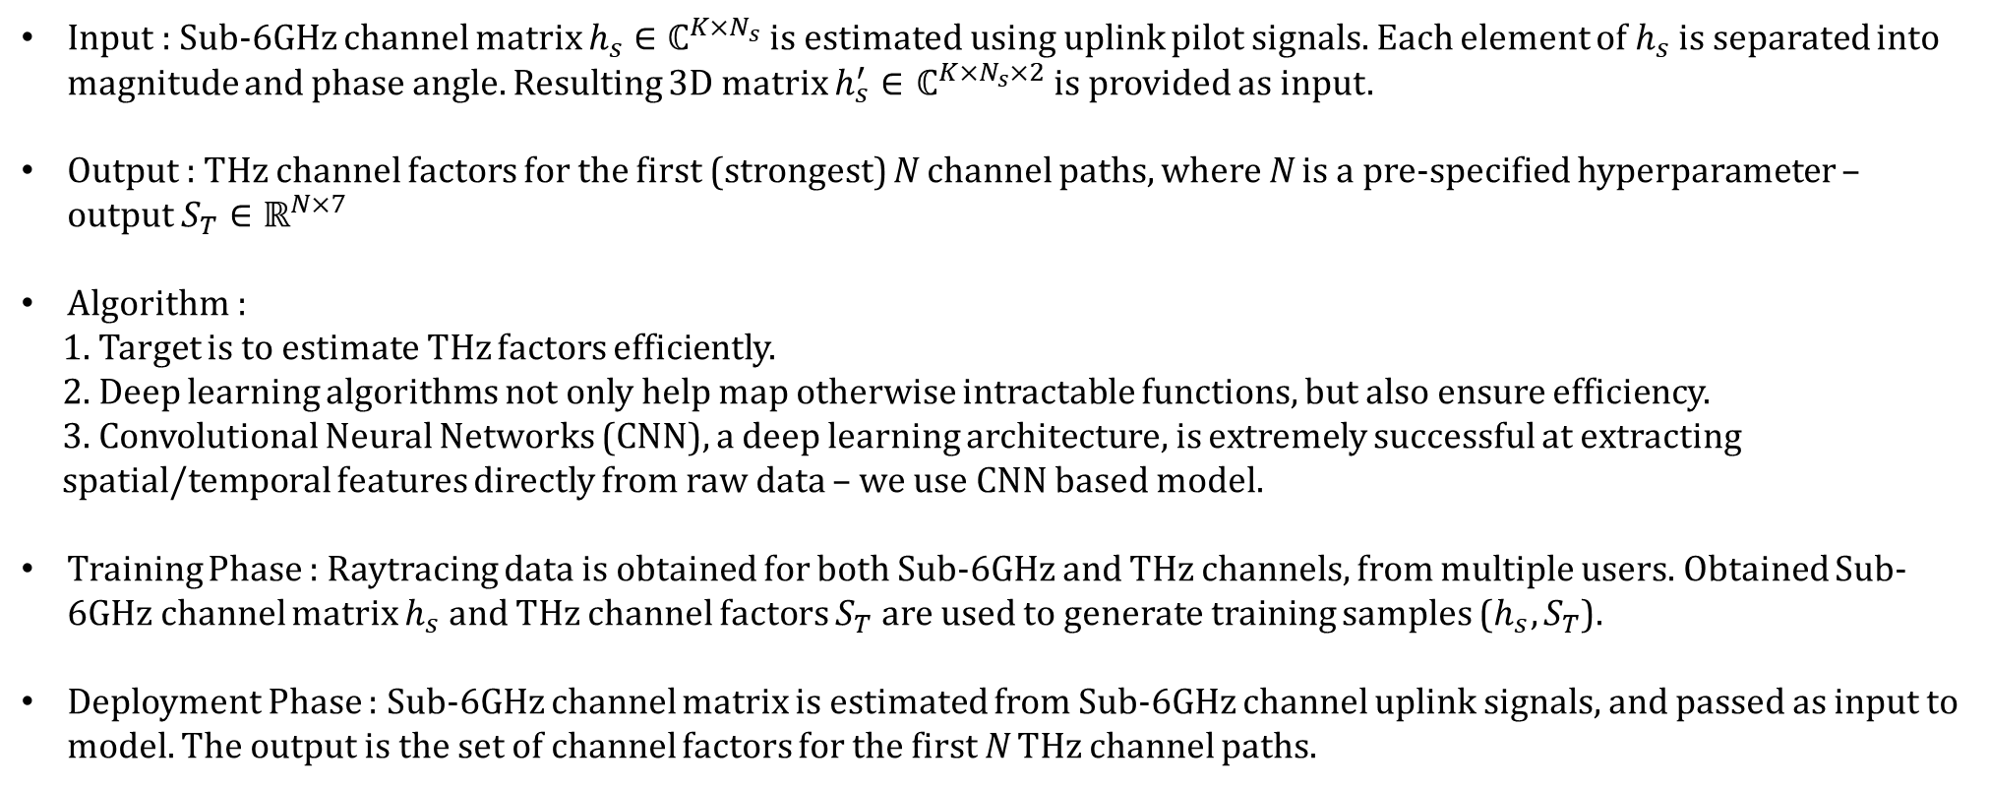
THz Channel Factors Estimation
Input : Sub-6GHz channel matrix $h_{s}∈ℂ^{K×N_{s}}$ is estimated using uplink pilot signals. Each element of $h_{s}$ is separated into magnitude and phase angle. Resulting 3D matrix $h_{s}^{′}∈$ $ℂ^{K×N_{s}×2}$ is provided as input.
Output : THz channel factors for the first (strongest) N channel paths, where N is a pre-specified hyperparameter – output $S_{T}∈ℝ^{N×7}$
Algorithm :
1. Target is to estimate THz factors efficiently.
2. Deep learning algorithms not only help map otherwise intractable functions, but also ensure efficiency.
3. Convolutional Neural Networks (CNN), a deep learning architecture, is extremely successful at extracting
spatial/temporal features directly from raw data – we use CNN based model.
Training Phase : Raytracing data is obtained for both Sub-6GHz and THz channels, from multiple users. Obtained Sub-6GHz channel matrix $h_{s}$ and THz channel factors $S_{T}$ are used to generate training samples ($h_{s},S_{T}$).
Deployment Phase : Sub-6GHz channel matrix is estimated from Sub-6GHz channel uplink signals, and passed as input to model. The output is the set of channel factors for the first N THz channel paths.

Slide 7
CNN Architecture
Two consecutive ‘Convolution-Based’ layers.
Each ‘convolution-based’ layer comprises convolutional
layer, followed by a maxpool, Instance Normalization (IN),
Rectified Linear Unit (ReLU) activation layers.
Convolutional layers use filters of pre-specified kernel size
to extract meaningful spatial features from data.
Maxpool layer helps downsize the dimension to reduce
complexity.
IN layer applies normalization per data sample along a
pre-specified axis. Unlike batch normalization, this makes
individual samples robust to statistics of entire dataset.
ReLU activation introduced non-linearity while maintaining range diversity of input.
Output from 2nd ‘convolution-based’ layer in passed into Global average pooling (GAP) layer – downsizes data dimension.
Additional dropout layer added after each ‘convolution-based’ layer to randomly drop some fraction of the neurons at algorithm runtime – prevents overfitting to training data.
Conv
Conv
Maxpool
Maxpool
IN
IN
ReLU
ReLU
Dropout
Dropout
GAP
Input
(Sub-6GHz)
‘Convolution-Based’ Layers
Dense
Layer
Output
(THz parameters)

Slide 8
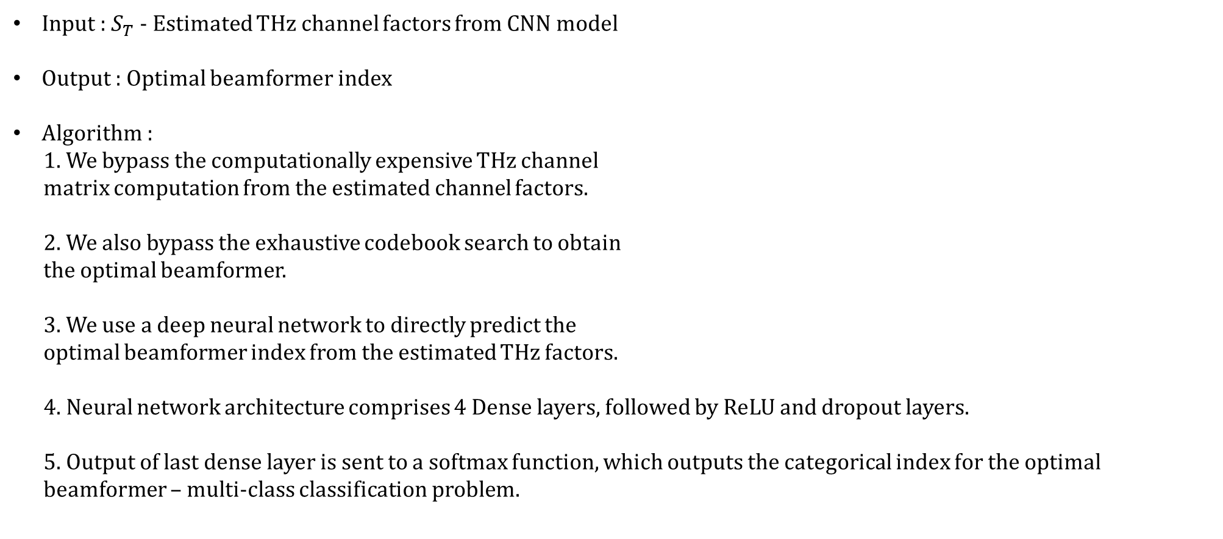
Optimal Analog Beamformer Prediction
Input : $S_{T}$ - Estimated THz channel factors from CNN model
Output : Optimal beamformer index
Algorithm :
1. We bypass the computationally expensive THz channel
matrix computation from the estimated channel factors.
2. We also bypass the exhaustive codebook search to obtain
the optimal beamformer.
3. We use a deep neural network to directly predict the
optimal beamformer index from the estimated THz factors.
4. Neural network architecture comprises 4 Dense layers, followed by ReLU and dropout layers.
5. Output of last dense layer is sent to a softmax function, which outputs the categorical index for the optimal
beamformer – multi-class classification problem.
Dense
Dense
…
ReLU
Softmax
Dropout
Estimated THz
factors
Dense Layers
Output
(Optimal Beamformer)

Slide 9
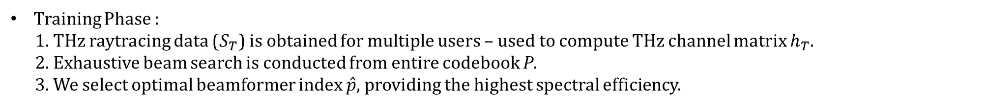
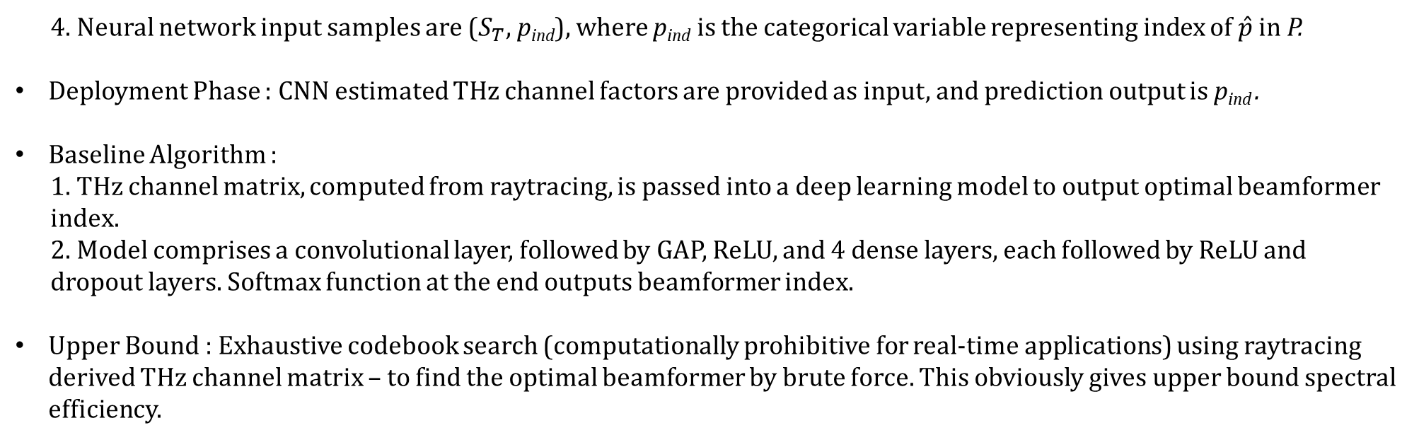
Optimal Analog Beamformer Prediction
Training Phase :
1. THz raytracing data ($S_{T}$) is obtained for multiple users – used to compute THz channel matrix $h_{T}$.
2. Exhaustive beam search is conducted from entire codebook P.
3. We select optimal beamformer index $\hat{p},$ providing the highest spectral efficiency.
$$\hat{p}={argmax}_{p∈P} (\sum_{k=1}^{K}{\log_{2}(1+SNR {|h_{T}^{H}\left[k\right] p|}^{2})})$$
4. Neural network input samples are ($S_{T}$, p_{ind}), where p_{ind} is the categorical variable representing index of $\hat{p}$ in P.
Deployment Phase : CNN estimated THz channel factors are provided as input, and prediction output is p_{ind} .
Baseline Algorithm :
1. THz channel matrix, computed from raytracing, is passed into a deep learning model to output optimal beamformer
index.
2. Model comprises a convolutional layer, followed by GAP, ReLU, and 4 dense layers, each followed by ReLU and
dropout layers. Softmax function at the end outputs beamformer index.
Upper Bound : Exhaustive codebook search (computationally prohibitive for real-time applications) using raytracing derived THz channel matrix – to find the optimal beamformer by brute force. This obviously gives upper bound spectral efficiency.

Slide 10
Neural Network Hyperparameters
The neural network hyperparameters for the CNN based THz factors estimation, and the beamformer prediction models
are the following:
Hyperparameter | THz Estimation | Beamformer Prediction
Conv Kernel Size | (2,2) | -
Conv no. of filters | 64 | -
Maxpool Kernel Size | (2,2) | -
Maxpool stride length | 2 | -
Dense layer dimension | - | 64
No. of training samples | 80,000 | 80,000
No. of test samples | 20,000 | 20,000
No. of epochs | 100 | 100
Task Objective | Regression | Classification
Optimizer | Stochastic Gradient Descent | Adam
Initial Learning Rate (LR) | 10⁻³ | 10⁻²
LR Decay Factor | 0.1 | -
LR Decay Schedule | 80 epochs | -
Momentum | 0.8 | -
Dropout | 0.2 | 0.2

Slide 11
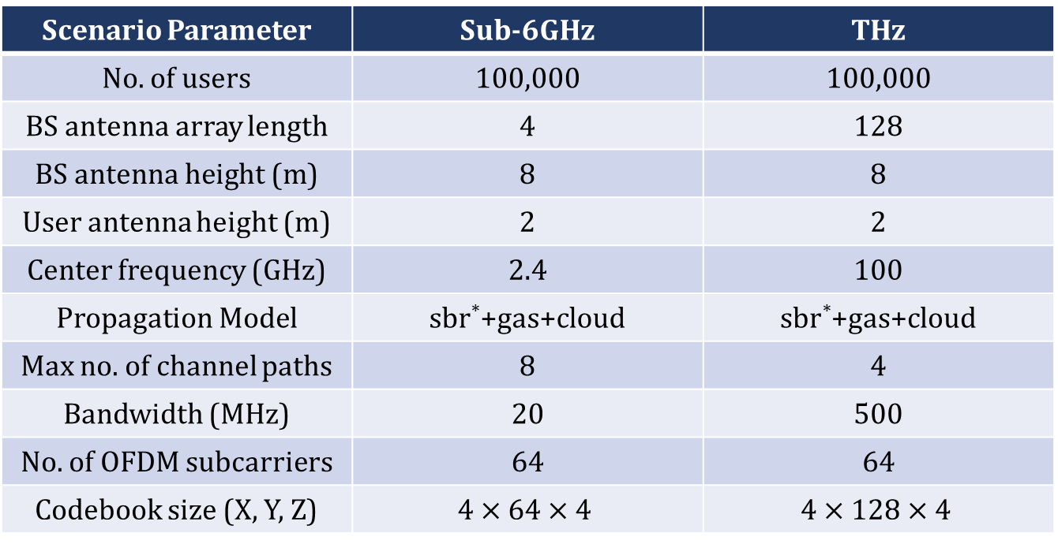
Simulation
Raytracing Scenario is generated using MATLAB raytrace function from Communications Toolbox.
Outdoor environment, rectangular block of dimensions (400m $×$ 300m) in S Clarke St. of Chicago downtown area.
The scenario parameters are as follows :
Scenario Parameter | Sub-6GHz | THz
No. of users | 100,000 | 100,000
BS antenna array length | 4 | 128
BS antenna height (m) | 8 | 8
User antenna height (m) | 2 | 2
Center frequency (GHz) | 2.4 | 100
Propagation Model | sbr*+gas+cloud | sbr*+gas+cloud
Max no. of channel paths | 8 | 4
Bandwidth (MHz) | 20 | 500
No. of OFDM subcarriers | 64 | 64
Codebook size (X, Y, Z) | $$4×64×4$$ | $$4×128×4$$
* - sbr = shooting and bouncing rays propagation model

Slide 12
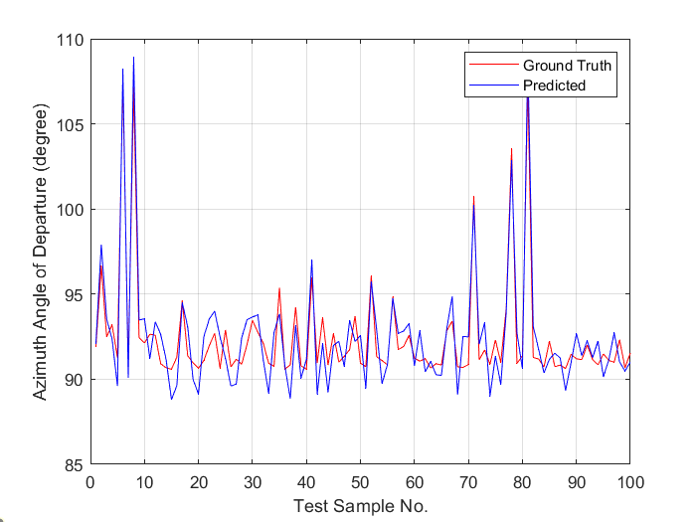
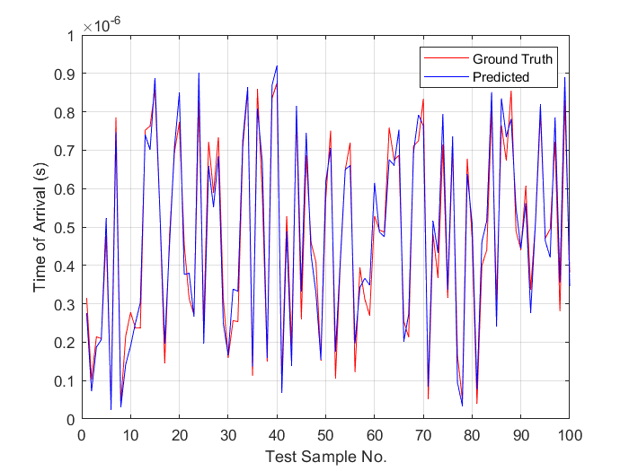
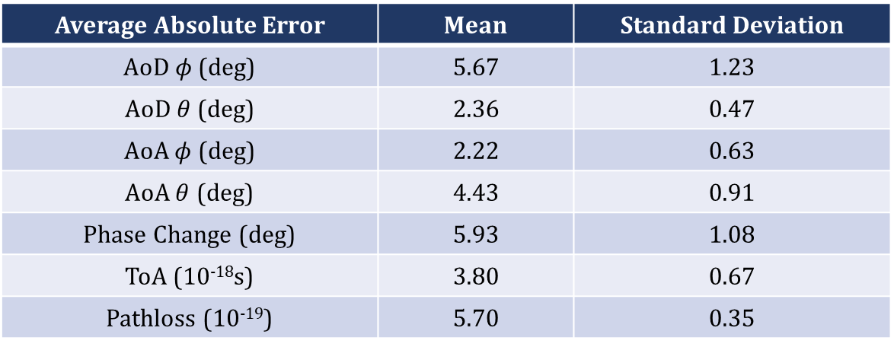
Performance Evaluation : THz Channel Factors Estimation
Table shows mean and standard deviation absolute errors of proposed algorithm’s THz channel factors predictions.
Error values show high estimation accuracy (<6 degree for AoA, AoD, and Phase Change estimates; and very low errors on ToA and Pathloss as well).
Figures show the graph of two THz channel factors as examples - Azimuth Angle of Departure and Time of Arrival versus No. of samples (normalized to 100)
Average Absolute Error | Mean | Standard Deviation
AoD $φ$ (deg) | 5.67 | 1.23
AoD $θ$ (deg) | 2.36 | 0.47
AoA $φ$ (deg) | 2.22 | 0.63
AoA $θ$ (deg) | 4.43 | 0.91
Phase Change (deg) | 5.93 | 1.08
ToA (10⁻¹⁸s) | 3.80 | 0.67
Pathloss (10⁻¹⁹) | 5.70 | 0.35

Slide 13
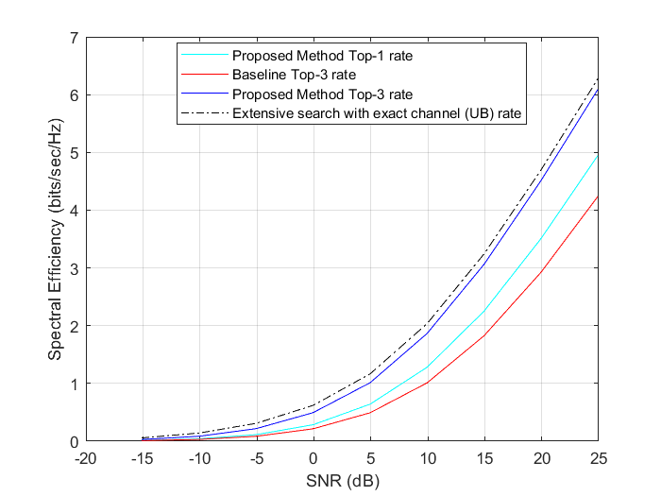
Performance Evaluation : Beamformer Prediction
Top-3 rate – 3 best beams predicted by model
Top-1 rate – best beam predicted by model
A wide range of SNR values (-17dB to 25dB) is taken.
Proposed algorithm Top-3 rate approaches computationally prohibitive upper bound spectral efficiency – proving the accuracy of estimated THz channel factors
Proposed algorithm Top-1 rate outperforms Baseline Top-3 rate - validating our Sub-6GHz based approach.
Baseline method inefficient because of THz channel matrix input (high dimensionality).
Baseline model is underperforming than our Sub-6GHz based proposed algorithm – because severe THz attenuation renders the THz channel matrix highly noisy; not suitable for machine learning.

