Slide 1


MACHINE LEARNING APPROACH FOR TECTONIC DISCRIMINATION USING GEOCHEMICAL AND ISOTOPIC DATA
SUBMITTED BY:
SAGNIK BANERJEE
19JE0729
UNDER THE GUIDANCE OF
PROF. JOSEPH D’SOUZA

Slide 2

INTRODUCTION
Magmatic rocks form in a wide variety of tectonic settings, which primarily include mid-ocean ridges, ocean island, continental arcs, oceanic plateaus, back arc basins and island arc etc. These rocks characterized by a whole geochemical signature of major elements (SiO₂, TiO₂, Al₂O₃, Fe₂O₃T, CaO, MgO, Na₂O, K₂O), some of trace elements (Sr, Ba, Rb, Zr, Nb, La, Ce, Nd, Hf, Sm, Gd, Y, Yb, Lu, Ta, Th) and isotopic ratio (²⁰⁶Pb/²⁰⁴Pb, ²⁰⁷Pb/²⁰⁴Pb, ²⁰⁸Pb/²⁰⁴Pb, ⁸⁷Sr/⁸⁶Sr and ¹⁴³Nd/¹⁴⁴Nd).
The geochemical discrimination of the tectonic setting of magmatic events is one of the most important and useful applications of whole-rock geochemistry . This approach allows the discrimination of the tectonic setting of a given suite of magmatic rocks using whole-rock geochemical data, including major and trace element and isotopic ratios

Slide 3
WHY MACHINE LEARNING?
Machine learning (ML) entails the use of algorithms and techniques to detect patterns from large datasets and to exploit the uncovered patterns to predict future trends, classify, or perform other kind of strategic decisions.
One of the common reason to use ML applications is that, due to the complexity of the problems that need to be resolved, a human programmer cannot provide an explicit, fine-detailed univocal solution
Complex Data Patterns:
Geochem data are highly complex and multi- dimentional.
Non-linear Relationships:
These data have often a non-linearity
Automated Feature Selection:
MLA can automatically discriminate data

Slide 4
PROBLEM STATEMENT
Trace element discrimination diagrams were introduced in the 1970s as a method for identifying the tectonic setting of basalts and other volcanic rocks (Pearce and Cann, 1973). These classification diagrams utilized only a few elements plotted as binary or triangular diagrams.
Traditional methods of tectonic discrimination based on geochemical and isotopic data analysis often require manual interpretation and might lack the efficiency and accuracy needed for comprehensive analysis.
The challenge is to develop a machine learning model that can effectively utilize geochemical and isotopic data to automatically discriminate magmatic rock into their corresponding tectonic settings using geochemical data (major elements, trace elements and isotopic data) as input parameters, overcoming the limitations of conventional methods and providing a robust solution for enhanced accuracy and efficiency in tectonic discrimination.

Slide 5
OBJECTIVES
Developing a Robust Model: Create a machine learning model capable of accurately classifying rock samples into different tectonic settings based on their geochemical and isotopic data.
Enhancing Classification Accuracy: Improve the accuracy of tectonic discrimination compared to traditional methods by leveraging the capabilities of machine learning algorithms.
Automating Analysis: Implement a streamlined and automated process for tectonic discrimination, reducing the time and effort required for manual analysis of geochemical and isotopic data.

Slide 6

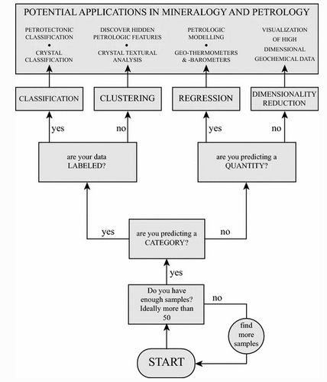
TYPES OF ML
ALGORITHMS
Source: Solving petrological problems through machine learning: the study case of tectonic discrimination using geochemical and isotopic data

Slide 7
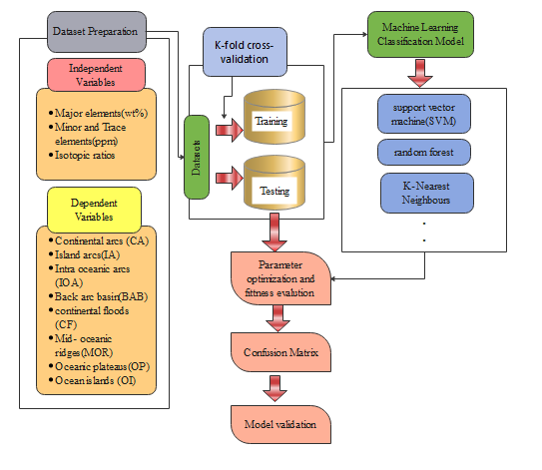
METHODOLOGY

Slide 8
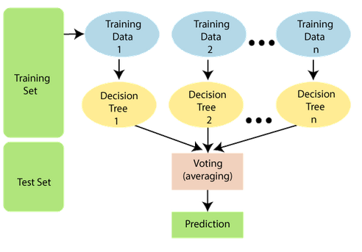
FUNDAMENTAL IDEA OF MACHINE
LEARNING CLASSIFICATION
ALGORITHMS:
RANDOM FOREST (RF)
It is a classifier that contains a number of decision trees on various subsets of the given dataset and takes the average to improve the predictive accuracy of that dataset.
Random Forest works in two-phase first is to create the random forest by combining N decision tree, and second is to make predictions for each tree created in the first phase.
It predicts output with high accuracy, even for the large dataset it runs efficiently.
Source: https://static.javatpoint.com/tutorial/machine-learning/

Slide 9

SUPPORT VECTOR MACHINE (SVM)
SVMs have two major components: the kernel and a hyperplane. The kernel is a mathematical function that uses the input data and transforms it into the required output format for specified applications.
The hyperplane represents a decision boundary that divides the differently labeled data points (yes or no), with the points bordering the decision boundary are known as support vectors.
SVM efficiently allows the nonlinear and high-dimensional classification of a data set by defining the decision planes that discriminate between categories
Source: https://static.javatpoint.com/tutorial/machine-learning/

Slide 10
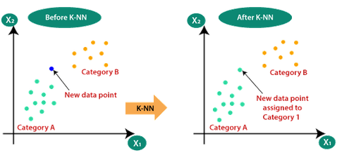
K- NEAREST NEIGHBOR (KNN)
KNN is a non-parametric algorithm, which means it does not make any assumption on underlying data..
Suppose there are two categories, i.e., Category A and Category B, and we have a new data point x1, so this data point will lie in which of these categories.
KNN calculate Euclidean distance of K number of neighbors. Among these k neighbors, count the number of the data points in each category. Assign the new data points to that category for which the number of the neighbor is maximum.
Source: https://static.javatpoint.com/tutorial/machine-learning/

Slide 11
Expected Outcomes
Automation of Analysis: saving time and effort from manual analysis
Accurate Tectonic Classification: accurately classify rock samples into different tectonic settings
Key Geochemical Indicators: identify the most influence indicators.
Impact: can be benefited industries depending on geological data
Data-Driven Insights: uncovering hidden patterns with geochemical and isotopic data.
Limitation: Inability to defining new classification group

Slide 12
PROPOSED TIMELINE(2023-2024)
AUG | SEP | OCT | NOV | DEC | JAN | FEB | MAR | APR | MAY
RESEARCH PROPOSAL
Literature Review
Data Collection and Preprocessing
Feature Engineering and Final data cleaning
Deciding which Algorithm to choose for training our model and Model Design
Model Training and Validation and analysing and Model Evaluation
Integration of Real-Time Data and Develop a strategy to continuously update the models
Visualization and Interpretation
Conclusion and Recommendations
Report Writing and Presentation
1 | 15 | 1 | 15 | 1 | 15 | 1 | 15 | 1 | 15 | 1 | 15 | 1 | 14 | 1 | 15 | 1 | 15 | 1 | 15

Slide 13
REFERENCE
Maurizio Petrelli and Diego Perugini(2016) Solving petrological problems through machine learning: the study case of tectonic discrimination using geochemical and isotopic data;
Qiubing Ren et al.(2019) Basalt Tectonic Discrimination Using Combined Machine Learning Approach;
Kenta Ueki et al. (2018) Geochemical Discrimination and Characteristics of Magmatic Tectonic Settings: A Machine-Learning-Based Approach;
javatpoint, www.javatpoint.com;

Slide 14


