Slide 1
TEAM MERLIN
GESTURE KEYBOARD
TEAM MEMBERS
AMLAN KUMAR NANDY
ASHISH KUMAR JENA
ANUSKA PANDA

Slide 2
PROBLEM STATEMENT
The visually impaired usually have a hard time using
Computers due to a lack of blind-friendly input
devices. Most of the devices available in the
market are either not accurate enough or are
simply unaffordable for the average consumer.

Slide 3
OUR SOLUTION
We aim to solve this problem by creating an input
device that can be used comfortably by the visually
impaired while being wallet-friendly.
Our gesture keyboard provides a seamless, easy-to-use
method of typing. One has to just move their fingers in
the shape of the character they wish to enter and the
device will record the movement and predict the
character through Machine Learning algorithms.

Slide 4
TECHNOLOGY USED
The gesture keyboard module consists of an Arduino Nano micro-controller
with an MPU-6050 attached to it, which is turned on and off by a switch.
Keeping the button pressed, one has to draw the alpha-numeric character
they want to type. It captures the movement of the module through
its 6 axis(accelerometer + gyro) and compares it against the 1500+
samples that we have recorded beforehand and predicts the correct character.
We use pyGARL (Python Gesture Analysis and Recognition Library), a Python
library which uses SVM (Support Vector Machine) algorithms to analyze the samples
that we have recorded and normalizes the data. When the module records a
movement, it matches it against the normalized data and predicts the
correct one.

Slide 5
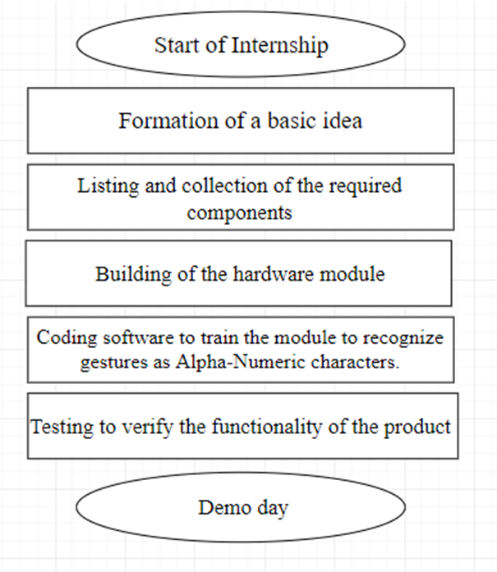
WORKFLOW

Slide 6
FAQs
Q. What is Machine Learning?
A- Machine learning is an application of artificial intelligence (AI) that provides systems
the ability to automatically learn and improve from experience without being explicitly
programmed.
Q. What is Support Vector Machine Algorithm?
A- Support-vector machines are supervised learning models with associated learning algorithms
that analyze data used for classification and regression analysis
Q. What is a Gyroscope?
An accelerometer is a device that measures the linear acceleration of movement. A gyroscope
adds an additional dimension to the information supplied by the accelerometer
by measuring the angular rotational velocity.

Slide 7
DO YOU HAVE ANY
QUESTIONS?

Slide 8
THANK YOU!

