Slide 1
Data Science Capstone project
SAGNIKA DUTTA
15.08.2021

Slide 2

Outline
Executive Summary
Introduction
Methodology
Results
Conclusion
Appendix

Slide 3

Executive Summary
We are trying to establish the cost from planned success and failure of first stage rocket landings.
The data has been collected from the SpaceX website and Wikipedia pages using API and Web Scrapping methods
Further, the data has been preprocessed by Data Wrangling
The data is then analyzed and processed by :
EDA using SQL
Array of charts
Folium
Dashplots
Predictive Analysis
All of these finally leads us to observe that basis the dataset, the launch sites have good geographical positioning with close proximity to features like railways, highways and coastlines.
Further, we find that the success of first stage landings is dependent on several factors such as the launch site(‘KSC LC -39A’), lower payload mass, the orbit for the concerned launch, the booster version, etc.
Also, we have analyzed several predictive models to facilitate Machine learning in the exercise for success and failure and found that while several models such as Logistic Regression, SVM and KNN provide a good accuracy in this case, the best accuracy is provided by the Decision Tree Classifier model.

Slide 4

Introduction
Project background and context
We are analyzing rocket launch data from a company Space X for another new company Space Y, to understand the cost associated with rocket launches.
We will also be studying the associated parameters affecting the success of re-landing of first stages of rocket - payload, launch sites, Orbit etc.
Problems you want to find answers
Impact of Payload Mass, Launch Site, Flight Number on the success of first stage landing.
The best Machine Learning Model to predict the success rate of any future launch’s first stage landing
The geographical accessibility of existing launch sites

Slide 5

Methodology
Data collection methodology using following techniques:
Data Collection via API from Space X website (cached)
Web Scrapping from Wikipedia page
Perform data wrangling
Missing values were replaced with mean values
Perform exploratory data analysis (EDA) using visualization and SQL
To find the correlation between different parameters and which are relevant vs irrelevant to our objective
Perform interactive visual analytics using Folium and Plotly Dash
To visualize datasets and interpret data usability
Perform predictive analysis using classification models
To ensure best possible model is used
With optimum parameters
And maximized accuracy score

Slide 6
Methodology

Slide 7
Data collection – SpaceX API
Added a flowchart of SpaceX API calls here
Request.Get(Url)
1. Present your data collection with SpaceX REST calls using key phrases and flowcharts
2. GitHub URL of the completed SpaceX API calls notebook as an external reference and peer-review purpose
Git Hub Link
API request
Response as JSON file
Status code: 200
Normalize response using json_normalize()
Store the dataset in Pandas DataFrame for processing

Slide 8
Data collection – Web scraping
Add a flowchart of web scraping here
HTML
response
Requests.Get(Url).text of a Wikipedia Page
BeautifulSoup object from the HTML response
Present your web scraping process use key phrases and flowcharts
Add the GitHub URL of the completed web scraping notebook, as an external reference and peer-review purpose
Git Hub Link
Use loop and Find_all functions to extract requisite datasets
Parse the HTML tables found into dictionary
Store the dictionary in Pandas DataFrame for processing

Slide 9
Data wrangling
Describe how data were processed
All the data collected was checked for missing values and then rectified by replacing with mean of values in the respective column
Data Formatting of various columns to improve data processing
Data normalization
One Hot encoding of categorical independent variables for ML process.
You need to present your data wrangling process using key phrases and flowcharts
Add the GitHub URL of your completed data wrangling related notebooks, as an external reference and peer-review purpose
Git Hub URL
Check for NaN or null values in the dataset
Replace with column.Mean() where applicable
Dataset ready for analysis
Check the datatype of each column and identify categorical ones
One Hot Encoding of categorical values
Data Normalization (if required)

Slide 10
EDA with data visualization
Summarize what charts were plotted and why used those charts
Scatter plot - To see the impact of two parameters on a dependent variable via color coding
Bar chart – To visualize effect of one categorical parameter on a continuous one
Line graph – To observe trend of dependent variable based on an independent one.
Add the GitHub URL of your completed EDA with data visualization notebook, as an external reference and peer-review purpose
Git Hub URL

Slide 11
EDA with SQL
Summarize performed SQL queries using bullet points
‘Select’ queries to display variety of combination of columns
Use of ‘where’ and ‘like’ commands to use filters
Use of subquery to allow complex filters
Use of mathematical operations like AVG(), MIN(), COUNT(), etc.
Use of ‘Order BY’, ‘GROUP BY’, ‘RANK()’ functions to apply pivot like functions of table.
Add the GitHub URL of your completed EDA with SQL notebook, as an external reference and peer-review purpose
Git Hub URL

Slide 12
Build an interactive map with Folium
Summarize what map objects such as markers, circles, lines, etc. you created and added to a folium map
Circle Markers created for each launch site
Marker clusters created for multiple markers generated on each site
Color coding of markers
Lines
Labels
Explain why you added those objects
Circle Markers – to highlight area of site
Marker clusters – to increase visibility and comprehension of markers at a point
Color coding of markers to indicate success and failure in first stage landing for each site in our dataset
Lines – to show distance from closest railway or coastline to launchsite
Labels – to increase readability of maps
Add the GitHub URL of your completed interactive map with Folium map, as an external reference and peer-review purpose
Git Hub URL

Slide 13
Build a Dashboard with Plotly Dash
Summarize what plots/graphs and interactions you have added to a dashboard
Dropdown box
Pie chart
Range Slider
Scatter Plot
Explain why you added those plots and interactions
Dropdown box – to select the site or sites for analysis
Pie chart – to provide view of success rate at each site
Range Slider – to choose the payload mass range for analysis
Scatter Plot – to depict the relation between payload mass and launch site on the success rate of landing
Add the GitHub URL of your completed Plotly Dash lab, as an external reference and peer-review purpose
Git Hub URL

Slide 14
Predictive analysis (Classification)
Preprocess data using preprocessing.StandardScaler()
Summarize how you built, evaluated, improved, and found the best performing classification model
Preprocess the data using StandardScaler()
Split dataset into training and test data
Create variety of models, fit them with training data, predict using test data.
Evaluate score of each model and pick model with highest accuracy
You need present your model development process using key phrases and flowchart
Add the GitHub URL of your completed predictive analysis lab, as an external reference and peer-review purpose
Git Hub URL
Split data into training and test sets
Build model
Fit with training data set
Find accuracy score for model
Find best parameters for model
Predict using test data
Repeat for variety of models
Choose best model

Slide 15
Results
Exploratory data analysis results
Interactive analytics demo in screenshots
Predictive analysis results

Slide 16
EDA with Visualization

Slide 17
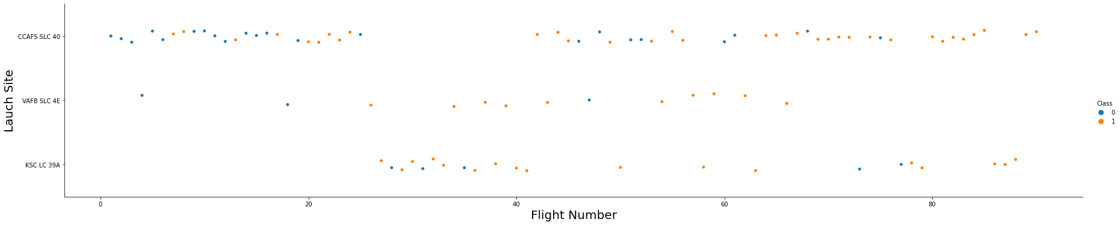
Flight Number vs. Launch Site
Show a scatter plot of Flight Number vs. Launch Site
Show the screenshot of the scatter plot with explanations
Below graph indicates that as flight numbers have increased chances of success has increased.
Further, CCAFS SLC 40 is predominantly used as the launch site, so it has a lower success rate, but the other two sites have a higher success ratio due to relatively lower flight no.s

Slide 18
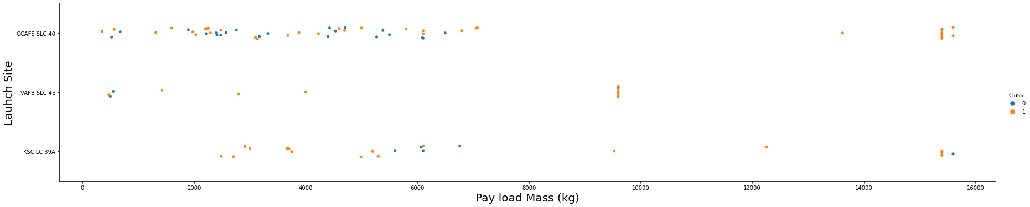
Payload vs. Launch Site
Show a scatter plot of Payload vs. Launch Site
Show the screenshot of the scatter plot with explanations
Success rate seems to increase with higher payload mass; meanwhile CCAFS SLC 40 & KSCLC 39A outperform VAFB SLC4E at higher payload mass points
At lower payload mass (<7000 kg), KSC LC 39 A has the best performance. Hence on an overall KSC LC 39 A seems to perform better at given payloadmass in terms of success outcome

Slide 19
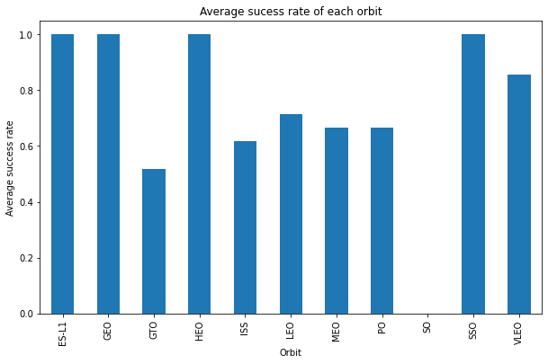
Success rate vs. Orbit type
Show a barchart for the success rate of each orbit type
Show the screenshot of the scatter plot with explanations
We find that the Orbits ES-L1, GEO, HEO and SSO have 100% average success rates
While GTO orbit has lowest average success rate of ~50%

Slide 20
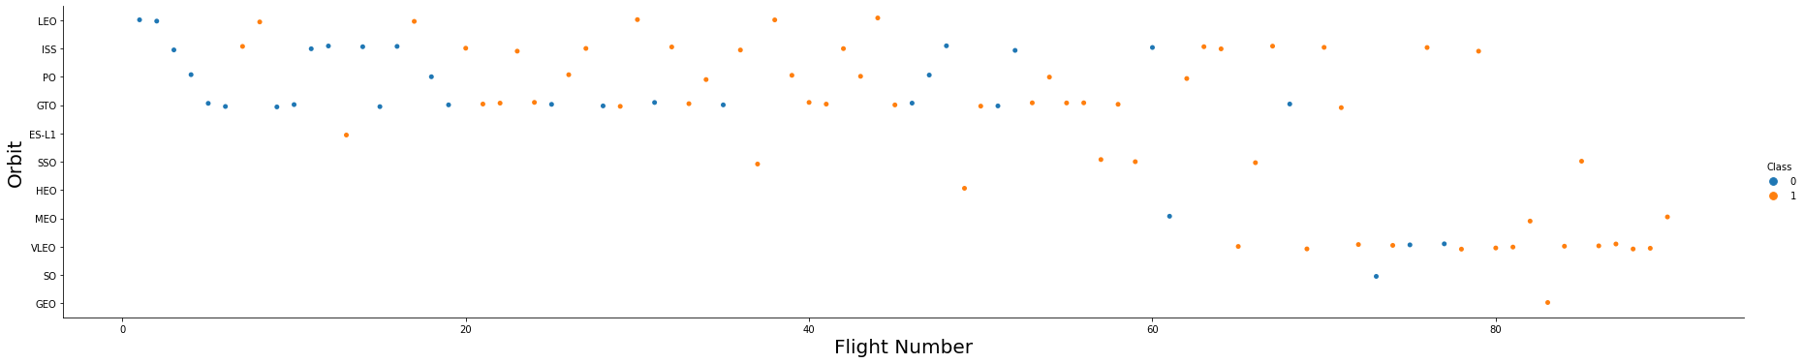
Flight Number vs. Orbit type
Show a scatter point of Flight number vs. Orbit type
Show the screenshot of the scatter plot with explanations
We see that the orbits VLEO, SSO, MEO and GEO have high success rates at higher flight numbers (>60)
The orbits LEO, ISS, PO and GTO function better at mid range flight number (20-70)

Slide 21
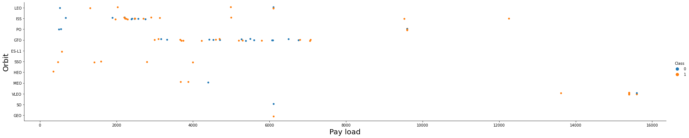
Payload vs. Orbit type
Show a scatter point of payload vs. orbit type
Show the screenshot of the scatter plot with explanations
We observe that Heavy payloads have a negative influence on GTO orbits and positive on GTO and Polar LEO (ISS) orbits.

Slide 22
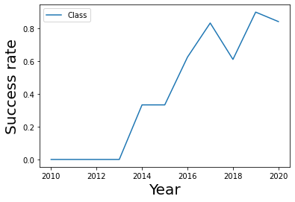
Launch success yearly trend
We observe that the success rate starts rising since 2013 and kept increasing till 2020
Success rate peaks in 2019 with above 80%
Show a line chart of yearly average success rate
Show the screenshot of the scatter plot with explanations

Slide 23
EDA with SQL

Slide 24

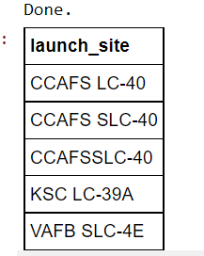
All launch site names
Find the names of the unique launch sites
Present your query result with a short explanation here
We have created a slice of the table with only unique launch site names.

Slide 25

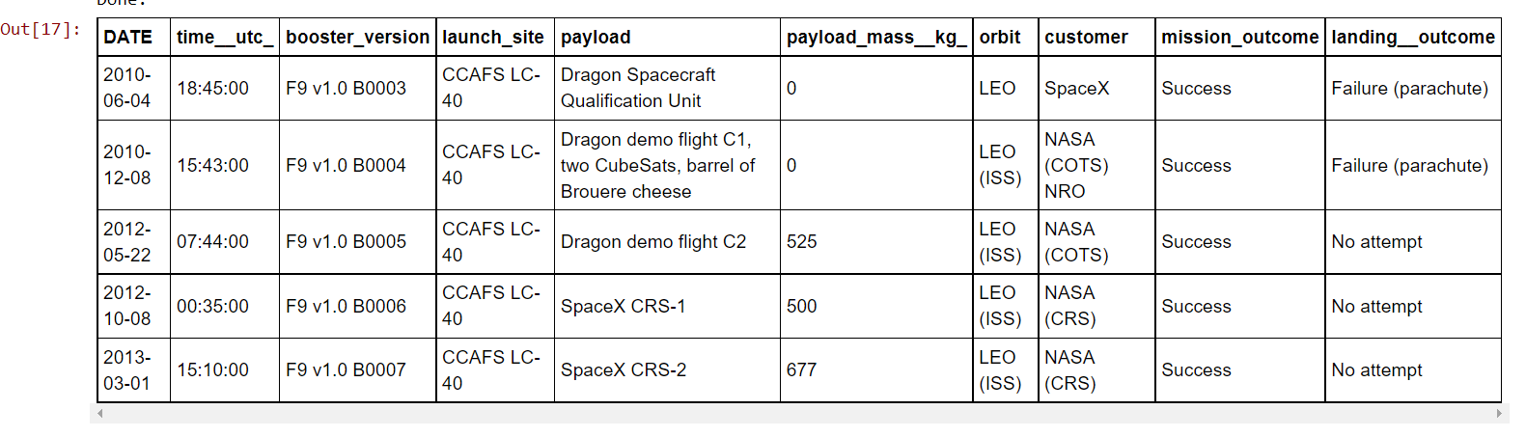
Launch site names begin with `CCA`
Find all launch sites begin with `CCA`
Present your query result with a short explanation here
Filters the table data for launch sites starting with ‘CCA’, i.e., CCAFS LC- 40 and CCAFS SLC - 40

Slide 26
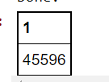
Total payload mass
Calculate the total payload carried by boosters from NASA
Present your query result with a short explanation here
Shows the sum of payload mass from NASA over the complete time period captured in the table. The total payload = 45596 Kg

Slide 27
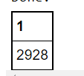
Average payload mass by F9 v1.1
Calculate the average payload mass carried by booster version F9 v1.1
Present your query result with a short explanation here
We have calculated the average payload mass carried by F9 v 1.1 over the complete time period captured in the table. The average payload = 2928 kg

Slide 28
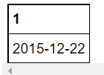
First successful ground landing date
Find the date when the first successful landing outcome in ground pad
Present your query result with a short explanation here
As per the dataset available, the first successful landing in ground pad has occurred on 22nd Dec 2015.

Slide 29
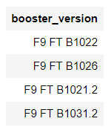
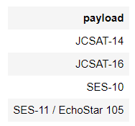
Successful drone ship landing with payload between 4000 and 6000
List the names of boosters which have success in drone ship and have payload mass greater than 4000 but less than 6000
Present your query result with a short explanation here
Since we do not have a specific column for booster names we have selected a list of booster version and payloads relevant to the given condition

Slide 30
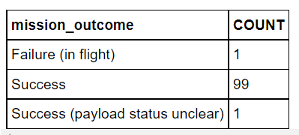
Total number of successful and failure mission outcomes
Calculate the total number of successful and failure mission outcomes
Present your query result with a short explanation here
As per the dataset available, 99 out of 101 instances have been completely successful mission outcomes, while 1 is unclear on payload status but is considered a success.

Slide 31
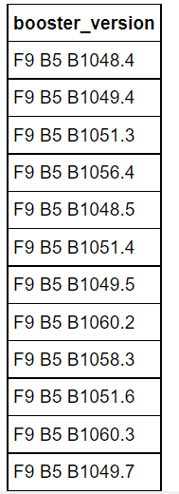
Boosters carried maximum payload
List the names of the booster which have carried the maximum payload mass
Present your query result with a short explanation here
We have obtained a complete list of booster versions which have carried payload mass of maximum weight.
This has been achieved using a sub query to select maximum Payload mass

Slide 32
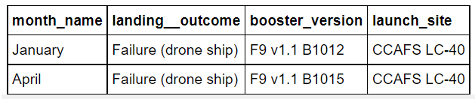
2015 launch records
List the records which will display the month names, failure landing_outcomes in drone ship ,booster versions, launch_site for the months in year 2015
Present your query result with a short explanation here
As directed, we have 4 columns denoting month name, landing outcome of failure in drone ship, booster versions and the corresponding launch site. These are only for relevant failures in 2015.

Slide 33
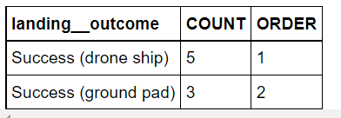
Rank success count between 2010-06-04 and 2017-03-20
Rank the count of successful landing_outcomes between the date 2010-06-04 and 2017-03-20 in descending order.
Present your query result with a short explanation here
For the given time range, we find that the success in drone ship has the highest successful outcomes and the ranking in descending order of count has been shown.

Slide 34
Interactive map with Folium

Slide 35
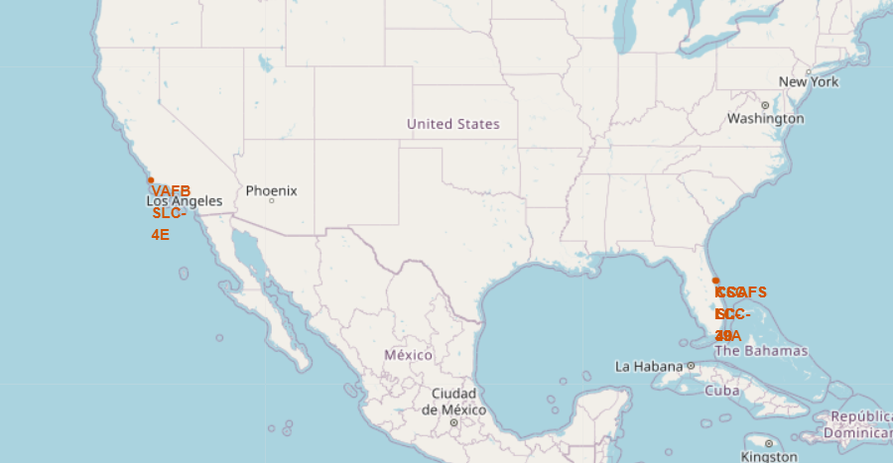
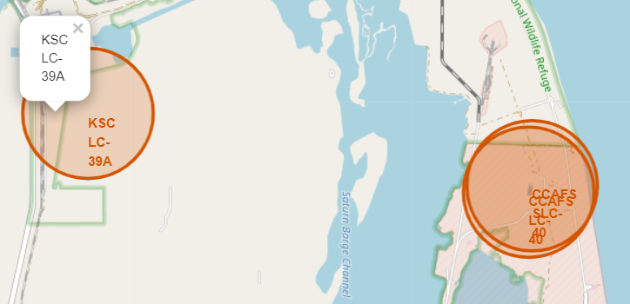
Launch Site Identification with Folium
Replace <Folium map screenshot 1> title with an appropriate title
Show the screenshot of all launch sites’ location markers on a global map
Explain the important elements and findings on the screenshot
We have marked the 4 unique launch sites with circle markers of radius 1000 units
We have also provided labels with corresponding site names and pop ups of same.

Slide 36
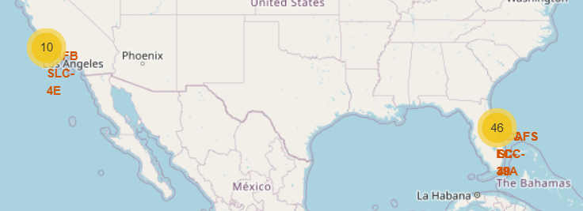
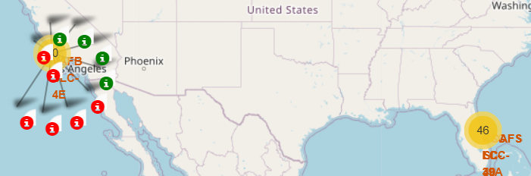
Marker colored cluster map
Replace <Folium map screenshot 2> title with an appropriate title
Show the screenshot of color-labeled launch records on the map
Explain the important elements and findings on the screenshot
Marker clusters have been created for visual ease
Each launch record has a pointer on map with color code basis success or failure of corresponding data point.

Slide 37
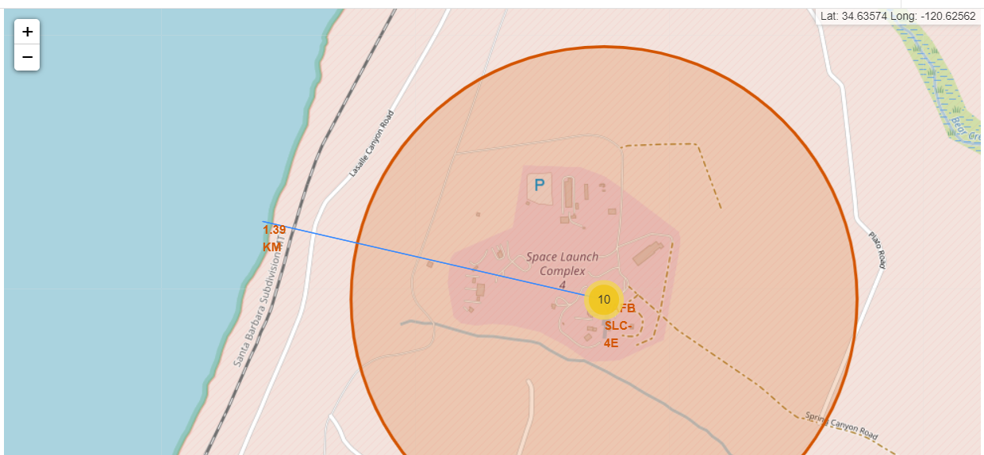
Geographical proximity depiction
Replace <Folium map screenshot 3> title with an appropriate title
Show the screenshot of a selected launch site to its proximities such as railway, highway, coastline, with distance calculated and displayed
Explain the important elements and findings on the screenshot
We have calculated the distance from launch site to nearest coastline by choosing the point using mouse pointer.
The blue line shows the straight distance from the two points on map and label depicts the distance shown by line.

Slide 38
Build a Dashboard with Plotly Dash

Slide 39
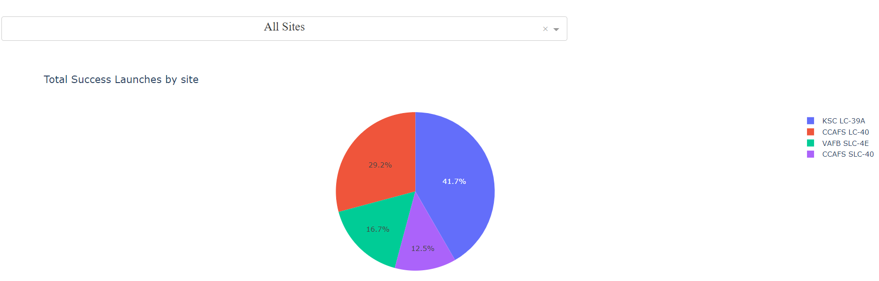
Total Success Launches by Site
Replace <Dashboard screenshot 1> title with an appropriate title
Show the screenshot of launch success count for all sites, in a piechart
Explain the important elements and findings on the screenshot
As per the pie chart, we find that the launch site ‘KSC LC -39A’ has the highest success rate of 41.7% among all sites
This is followed by CCAFS LC -40 site with 29.2%.
However, no information on failure rate of these sites can be visualized here.

Slide 40
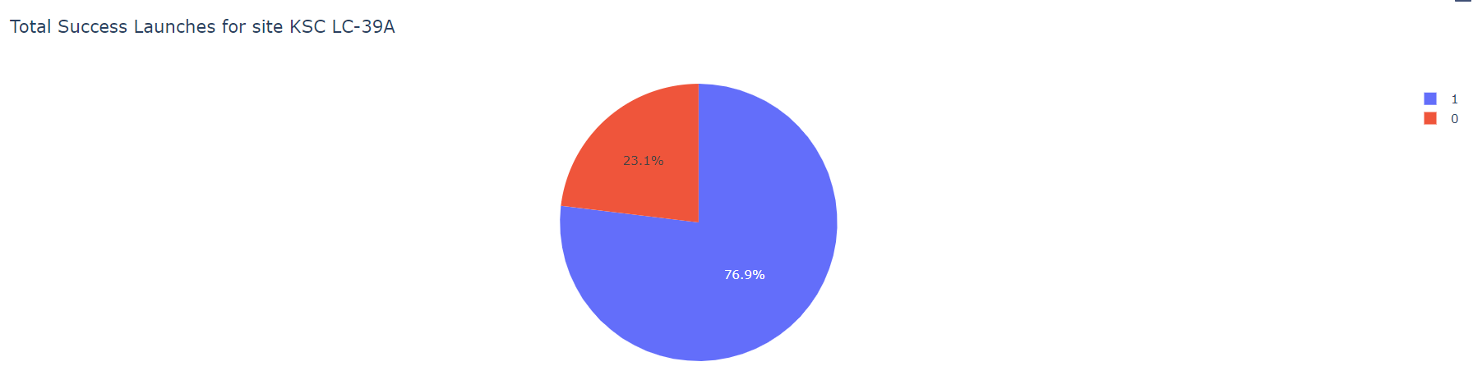
Success Launches for Individual sites
Replace <Dashboard screenshot 2> title with an appropriate title
Show the screenshot of the piechart for the launch site with highest launch success ratio
Explain the important elements and findings on the screenshot
As per the pie chart, we find that the launch site ‘KSC LC -39A’ a success rate of 76.9% vs a failure percentage of 23.1%
This provides a concentrated view of the success rates based on individual sites only.

Slide 41
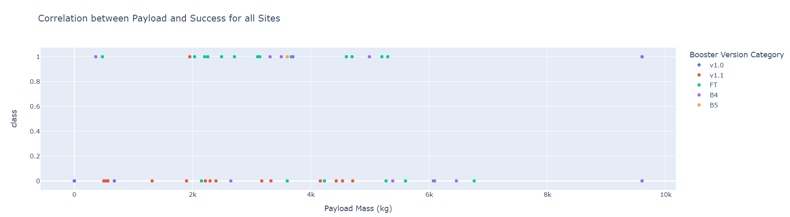
Correlation between payload & success
Replace <Dashboard screenshot 3> title with an appropriate title
Show screenshots of Payload vs. Launch Outcome scatter plot for all sites, with different payload selected in the range slider
Explain the important elements and findings on the screenshot
As per the scatter chart, we find that the there is a lower chance of success at lower payload mass
Most payloads above 5500 Kg have resulted in failures across sites.

Slide 42
Predictive analysis (Classification)

Slide 43
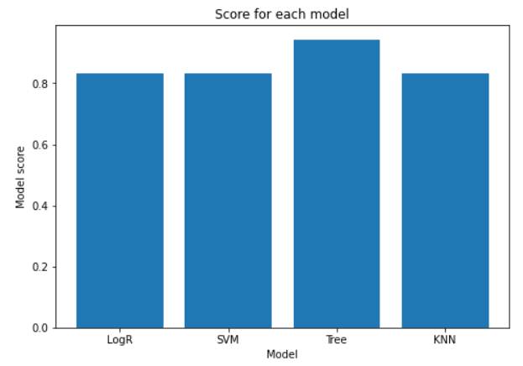
Classification Accuracy
Visualize all the built model accuracy for all built models, in a barchart
Find which model has the highest classification accuracy
Based on the bar chart created for the accuracy score of the 4 models, we find that the Decision Tree model has the highest accuracy of 0.94

Slide 44
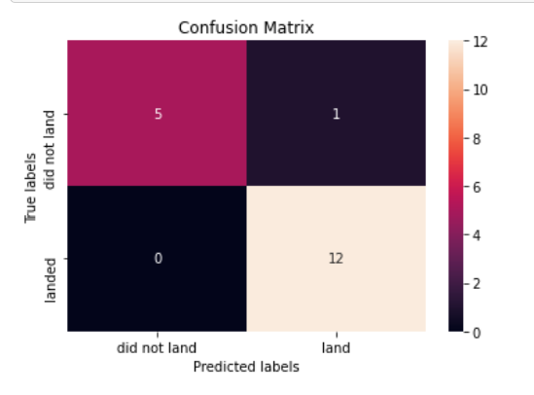
Confusion Matrix
Show the confusion matrix of the best performing model with explanation
The confusion matrix for the Tree model depicts that it successfully predicts all 12 True positive answers for successful landings.
However, among 6 failed landings, the model only predicts 5 instances correctly while 1 is a False positive.
This leads to a method score of 0.94

Slide 45

CONCLUSION
Visualization Analysis:
As flight numbers have increased chances of success has increased. Also, success rate seems to increase with higher payload mass
Few orbits have 100% accuracy rate such as ES-L1, GEO, HEO and SSO, while the lowest is GTO at 50%.
We observe that Heavy payloads have a negative influence on GTO orbits and positive on GTO and Polar LEO (ISS) orbits.
We observe that the success rate starts rising since 2013 and kept increasing till 2020 with peak in 2019 at above 80%.
Based on SQL, we find that majority of the mission outcomes are successful, i.e., 99 out of 101, which is commendable.
Folium graph plotting:
The launch sites appear to be in proximity of important geographical features such as coastline (helps in bringing back landed first stage), railways (helps in goods and people transport), etc.
Dashboard:
We find that the most successful launch site is ‘KSC LC -39A’ along with the impact of payload at various sites, i.e., lower chance of success at lower payload mass.
Prediction Analysis:
We find that the Decision Tree to be the best model for evaluation of the given data set with an accuracy score of ~94%.

