Slide 1
Process vs Outcome Supervision
for Continual Tool-Use Learning
CS 590NN — Project Check-In
Vishnu Vardhan Reddy | Sagnik Chatterjee | Soumik Bhatta

Slide 2
The Problem
LLMs are trained on finished outputs (posts, code, answers)
The reasoning process behind those outputs is never captured
When models learn new tasks sequentially, they forget old ones
Question: Does richer, process-level data help?

Slide 3
Our Approach
Tool-use interactions as a natural proxy for process data
Each interaction: user request → tool call → tool output → response
Condition A (Outcome-Only): Train on final response only
Condition B (Process/Trajectory): Train on full interaction trace
Continual learning: sequential domain blocks to measure adaptation & forgetting

Slide 4
Experiment Setup
Model: Mistral-7B-Instruct with QLoRA (4-bit quantization)
Dataset: API-Bank — 1,888 tool-use dialogues across ~1,000 domains
Data split into 4 sequential domain blocks (D1 → D2 → D3 → D4)
Evaluate on ALL blocks after training each one
Metrics: API-call accuracy, backward transfer, forward transfer, forgetting
GPU: H100 80GB with bf16 + Flash Attention 2

Slide 5
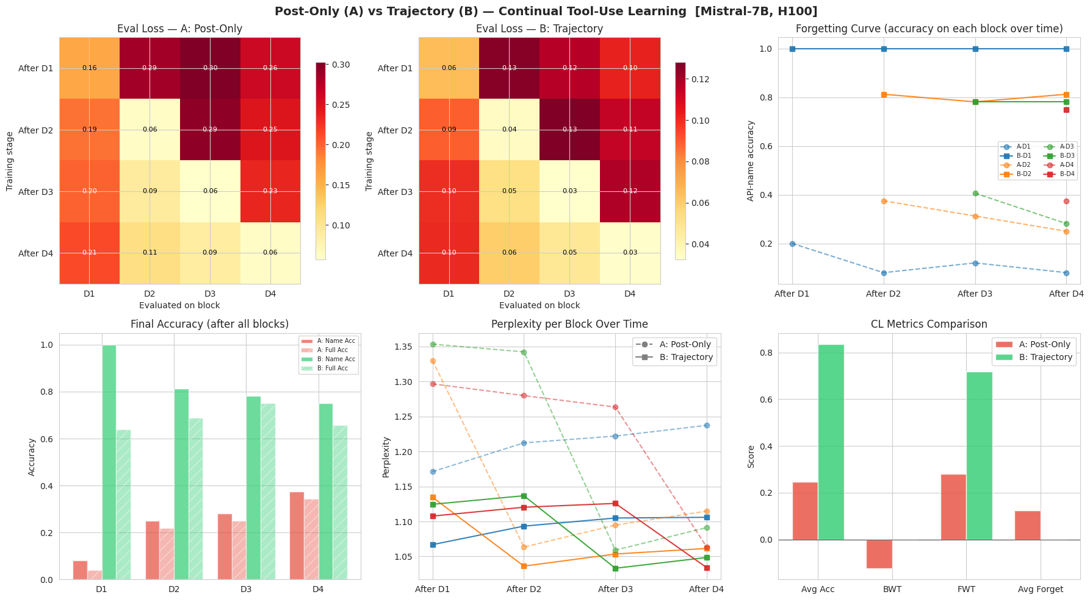

Slide 6
Key Findings
Trajectory (B) avg accuracy: 83.6% vs Post-Only (A): 24.7%
B has zero forgetting on API name accuracy (BWT = 0.0)
A loses ~12% of learned knowledge after each new block
B forward transfer: 71.9% vs A: 28.1%
Process supervision preserves structural knowledge (which tool to call)
Parameter-level details still degrade (100% → 64%) — motivates Condition C

Slide 7
Next Steps
Switch to Qwen3.5-4B (as specified in proposal)
Run multiple seeds with bootstrap confidence intervals
Equalize training token budgets for fair A vs B comparison
Implement Condition C: replay buffer + retrieval memory
Add calibration metrics (ECE, Brier score)
Final analysis, figures, and report

