Slide 1
Trajectory supervision for continual tool-use learning
+17.7 pts
final exact full-call accuracy B over A
Single-seed Llama 3.1 8B QLoRA pilot on API-Bank
Question: does API trajectory context help continual tool-use fine-tuning?
Result: B improves exact calls and API selection.
Caveat: one seed, and B has 25.1% more training tokens.
Vishnu Vardhan Reddy B, Sagnik Chatterjee, Soumik Bhatta
CS 590NN / 690NN Final Project
CS 590NN Final Project
1

Slide 2
Motivation
The useful signal is the observable tool-use trace.
Final answers hide the path
Our comparison
A: stripped context
B: trajectory context
Same base model, seed, stream order, and scoring code.
Tool-use examples include API calls, arguments, and observations.
Those traces are not private reasoning.
They still give an action-observation history before the next API call.
The question is whether keeping the trace changes continual next-call learning.
CS 590NN Final Project
2

Slide 3
Experiment Design
Train sequentially; evaluate every block after each stage.
D1
>
D2
>
D3
>
D4
train
train
train
train
After each training stage: score D1, D2, D3, and D4
Condition A
Stripped-context next-API-call baseline.
Condition B
Trajectory-context next-API-call format.
CS 590NN Final Project
3

Slide 4
Setup
Same model and scoring pipeline; B sees more prompt tokens.
Component | Value
Model | Llama 3.1 8B Instruct
Fine-tuning | QLoRA, rank 32, alpha 64, 4-bit
Data stream | API-Bank split into D1-D4
Seed | 42
Full eval examples | 126, 104, 103, 107
Train tokens | A 1.86M, B 2.32M (+25.1%)
Scoring
API-name accuracy
Exact full-call accuracy
Name + any parameter
Malformed or no-call rate
Token count is the main fairness caveat.
CS 590NN Final Project
4

Slide 5
Main Result
B has higher final exact full-call accuracy on every held-out block.
39.2%
56.9%
+17.7
Still not causal: B also trains on more tokens.
A mean exact
B mean exact
point gap
CS 590NN Final Project
5

Slide 6
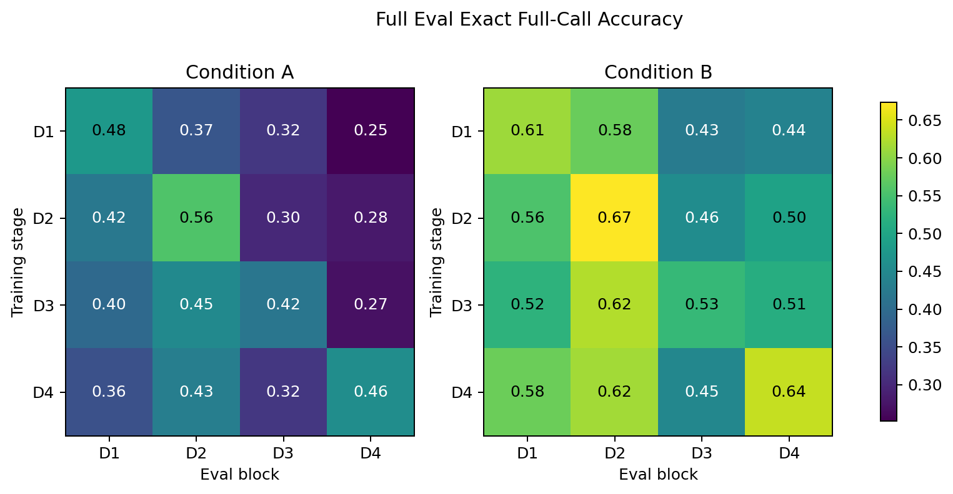
Continual Evaluation
We score all blocks after each training stage.
B is higher on every final-stage block and most earlier train/eval pairs.
CS 590NN Final Project
6

Slide 7
Failure Analysis
Trajectory context improves API choice but increases parse failures.
Category | A | B | Read
Exact full calls | 172 | 251 | B higher
Wrong API | 102 | 12 | B lower
Wrong / partial params | 121 | 76 | B lower
Malformed / no call | 45 | 101 | B higher
Takeaway
B chooses the right API more often, but exact formatting is less stable.
CS 590NN Final Project
7

Slide 8
Takeaways
Current evidence is a single-seed pilot.
What we found
Next
Trajectory context favored exact calls: 56.9% vs 39.2%.
It strongly reduced wrong-API errors: 12 vs 102.
Run multiple seeds.
Train a token-matched B condition.
Add semantic argument scoring.
Limits
One seed.
B has more tokens.
Next-call benchmark, not full task success.
Bottom line: trajectory context helps tool identity, but exact call formatting still needs work.
CS 590NN Final Project
8

