Slide 1




Slide 2

BLOOD RELATIONS

Slide 3
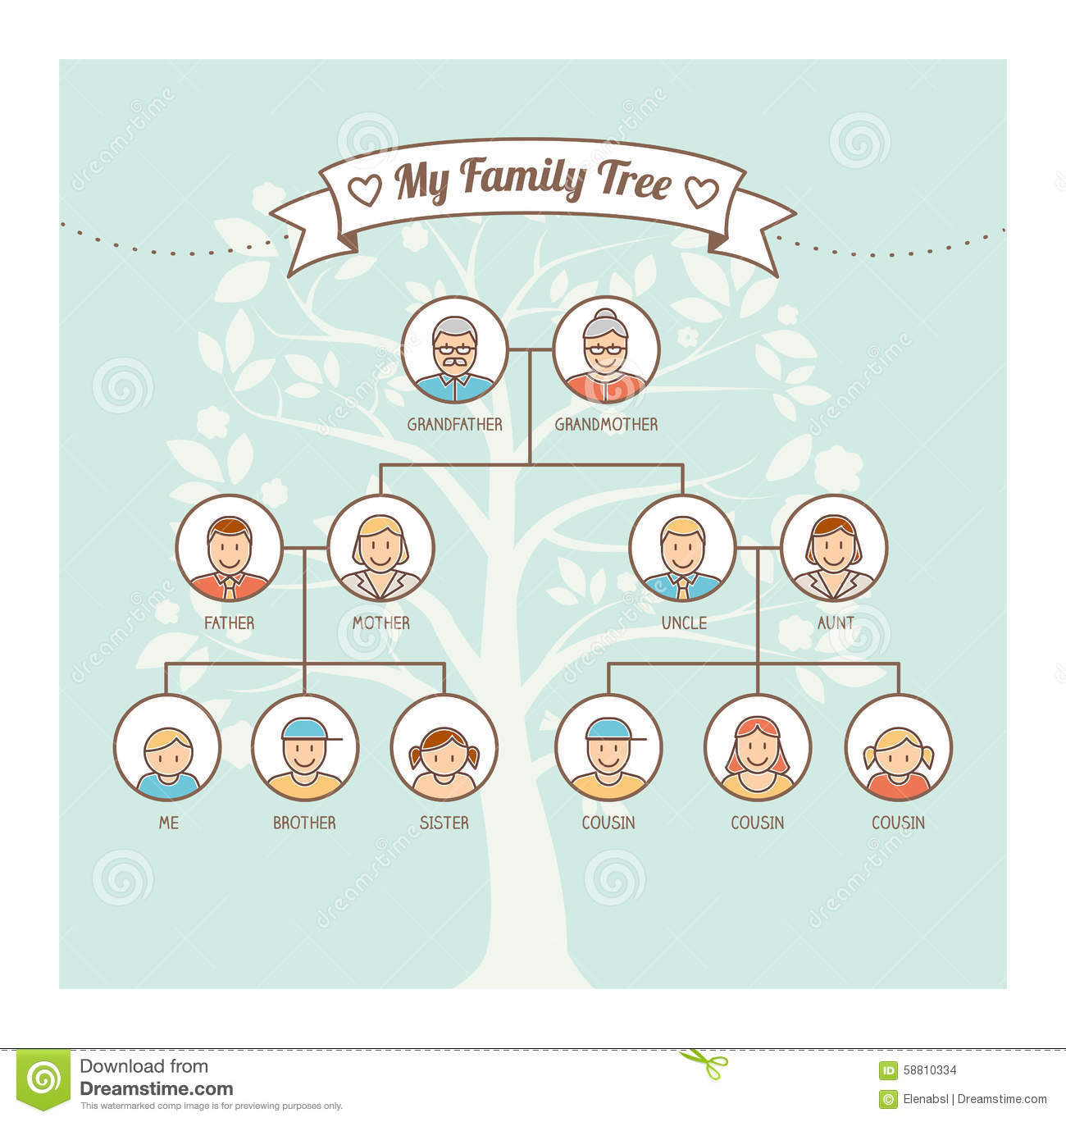

Slide 4
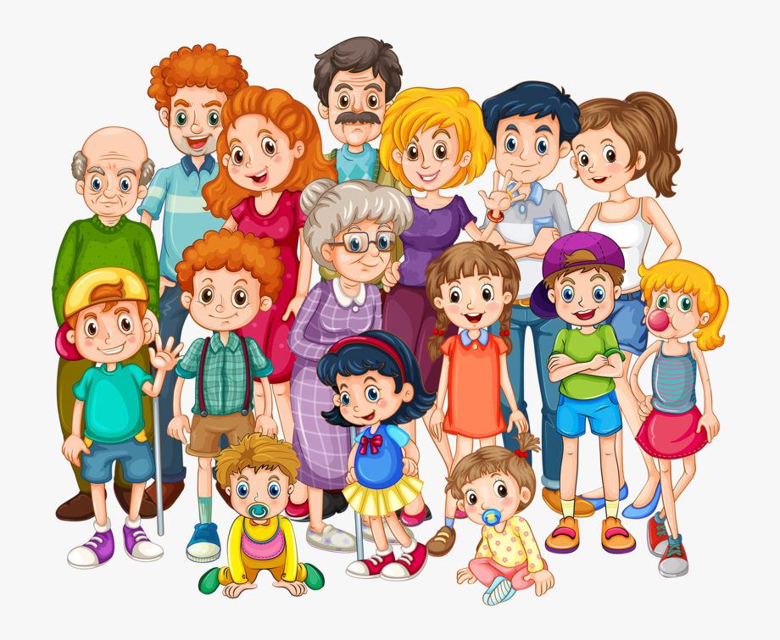
Concept of Blood Relation
1. Relations of Paternal side:
Father's father → Grandfather
Father's mother → Grandmother
Father's brother → Uncle
Father's sister → Aunt
Children of uncle → Cousin
Wife of uncle → Aunt
Children of aunt → Cousin
Husband of aunt → Uncle

Slide 5
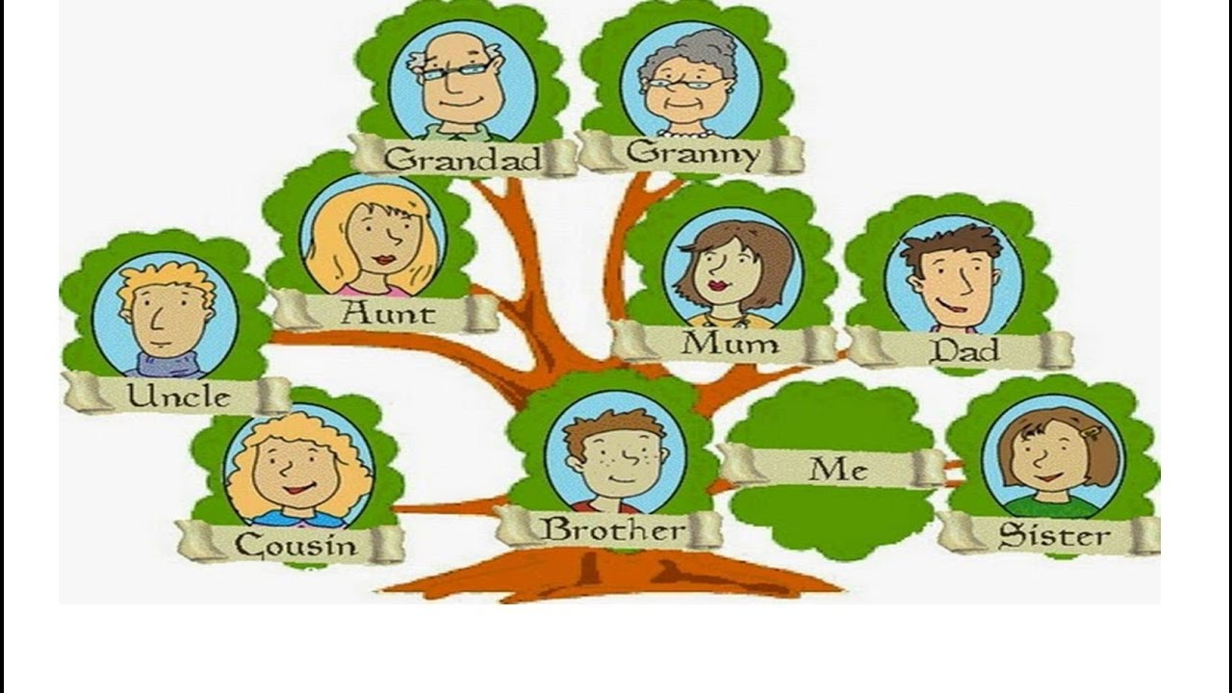
Concept of Blood Relation
2. Relations of Maternal side:
Mother's father → Maternal grandfather
Mother's mother → Maternal grandmother
Mother's brother Maternal uncle
Mother's sister → Aunt
Children of maternal uncle → Cousin
Wife of maternal uncle → Maternal aunt

Slide 6
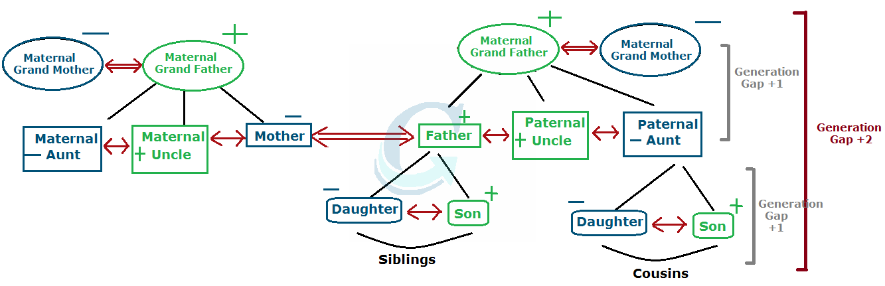
Concept of Blood Relation

Slide 7
Question: 01
Pointing to an old man, Kailas said, "His son is my son's uncle." How is the old man related to Kailas?
Brother
Uncle
Father
Grandfather
Answer : C

Slide 8
CLOCKS
Explanation: 01
Kailas's son's uncle - Kailas's brother. So, the old man's son is Kailas's brother i.e., the old man is Kailas's father.

Slide 9
Question: 02
Pointing to a man in a photograph. Asha said. "His mother's only daughter is my mother." How is Asha related to that man ?
Nephew
Sister
Wife
Niece
Answer : D

Slide 10
Explanation: 02
Asha's mother's mother is man's mother i.e.. Asha's mother is man's sister or Asita is man's niece.

Slide 11

Question: 03
Pointing to a person, a man said to a woman, "His mother is the only daughter of your father." How was the woman related to the person?
Aunt
Mother
Wife
Daughter
Answer : A

Slide 12
Question: 01
Explanation: 03
Daughter of your father - Your sister.
So, the person's mother is woman's sister or the woman is person's aunt

Slide 13
Question: 04
Deepak said to Nitin, "That boy playing with the football is the younger of the two brothers of the daughter of my father's wife." How is the boy playing football related to Deepak?
Son
Brother
Cousin
Nephew
Answer : B

Slide 14
Explanation: 04
Father's wife - Mother; Mother's daughter - Sister; Sister's younger brother - My younger brother. So, the boy is Deepak's brother..

Slide 15
Question: 16
Question: 05
Pointing out to a lady, a girl said, "She is the daughter-in-law of the grandmother of my father's only son." How is the lady related to the girl ?
Sister-in-law
Mother
Aunt
Can't be determined
Answer: D

Slide 16
Question: 09
Explanation: 05
Girls's father's only son— Girl's brother. Daughter in law of girl’s grandmother can be their mother, or maternal uncle’s wife, i.e. aunt. So relation cannot be determined.

Slide 17
Question: 02
Question: 06
Pointing to a girl in the photograph, Amar said, "Her mother's brother is the only son of my mother's father." How is the girl's mother related to Amar ?
Mother
Sister
Aunt
Grandmother
Answer: C

Slide 18
Explanation: 06
Only son of Amir's mother's father — Amir's maternal uncle.
So, the girl's maternal uncle is Arnar's maternal uncle. Thus, the girl's mother is Amir's aunt.

Slide 19
Question: 07
Amit said, "This girl is the wife of the grandson of my mother". How is Amit related to the girl?
Father
Grandfather
Father-in-law
Husband
Answer:C

Slide 20
Explanation: 07
The girl is the wife of grandson of Amit’s mother i.e., the girl is the wife of the son of Amit. Hence, Amit is the father-in-law of the girl.

Slide 21
Question: 04
Question: 08
Introducing Salma, Aamir says, "She is the wife of only nephew of only brother of my mother." How is Salma is related to Aamir?
Wife
Sister
Sister-in-law
Data inadequate
Answer: A

Slide 22
Explanation: 08
Brother of mother means maternal uncle. Hence only nephew of Aamir’s maternal uncle means Aamir himself. Therefore Salma is the wife of Aamir.

Slide 23
Question: 05
Question: 09
A lady pointing to a man in a photograph says, "The sister of the son of this man is my mother-in-law." How is the husband of the lady related to the man in the photograph?
Father
Son
Maternal Grandson
Maternal Grandfather
Answer: D

Slide 24
Explanation: 09
From the statement we can clearly understand the son of the man in the photo had a sister, whose son is married to the lady. We also get the information that the man’s son and the lady’s mother-in-law are siblings, which could only mean that the man is the grandfather of her husband.

Slide 25
Question: 10
Muthu said, “This girl is the wife of the grandson of my mother who has only one son.” Who is Muthu to the girl?
Father
Grandfather
Husband
Father-in-law
Answer: C

Slide 26

Explanation:
Explanation: 10
Mother’s grandson is my Son;
Son’s wife is my Daughter–in–law.
From the above we conclude that option C is the answer.

Slide 27
Question: 11
B is father of Q. B has only two children. Q is the brother of R. R is the daughter of P. A is the granddaughter of P. S is the father of A. How is S related to Q?
Son
Son-in-law
Brother
Brother-in-law
Answer: D

Slide 28
Explanation:
Explanation: 11
Correct Option: D

Slide 29
Question: 08
Question: 12
Showing the man receiving the prize Seema said, “He is the brother of
my uncle’s daughter”. What is the man to Seema?
Son
Brother-in-law
Nephew
Cousin
Answer: D

Slide 30
Explanation:
Explanation: 12
Brother of my uncle’s daughter is my uncle’s son, who is my cousin. i.e. The man is Seema’s cousin

Slide 31
Question: 09
Question: 13
Pointing to a photograph, Vipul said, "She is the daughter of my grandfather’s only son". How is Vipul related to the girl in the photograph?
Father
Cousin
Brother
Data inadequate
Answer: C

Slide 32
Question: 09
Explanation: 13
My Grandfather’s only son is My Father.
So the girl is the daughter of Vipul’s father. i.e. Vipul is the girl’s brother.

Slide 33
Question: 10
Question: 14
If (A) P + Q means P is the brother of Q ; (B) P x Q means P is the father of Q ; (C) P - Q means P is the sister of Q ;
which of the following represents S is the niece of T ?
T x M + S – K
K - S x M + T
T + M x S – K
T x S + M - K
Answer: C

Slide 34
Explanation:
Explanation: 14
S is the niece of T means T is the brother of the father (say M) of S
i.e. T + M x S.

Slide 35
Question: 11
Question: 15
Showing a lady in the park, Balu said, “She is the daughter of my grandmother’s only son”. How is Balu related to that lady?
Brother
Cousin
Father
Uncle
Answer: A

Slide 36
Question: 09
Explanation: 15
Grandfather’s only son is my father.
Daughter of father is my sister.
So Balu is the lady’s brother.

Slide 37




THANK YOU
+91 78150 95095
codemithra@ethnus.com
www.codemithra.com

