Slide 1
C++ Introduction By Dr.M.A.Berlin (20164)

Slide 2
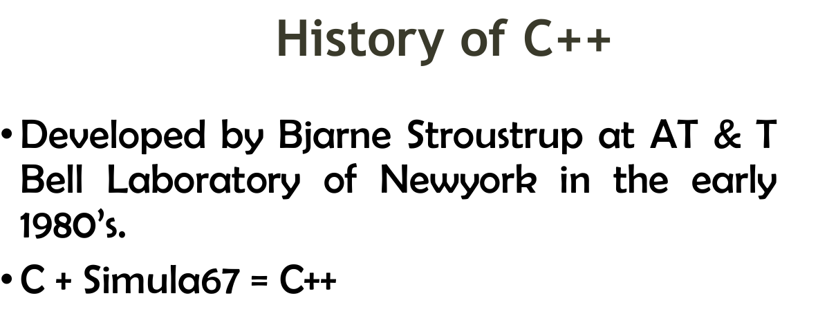

Slide 3
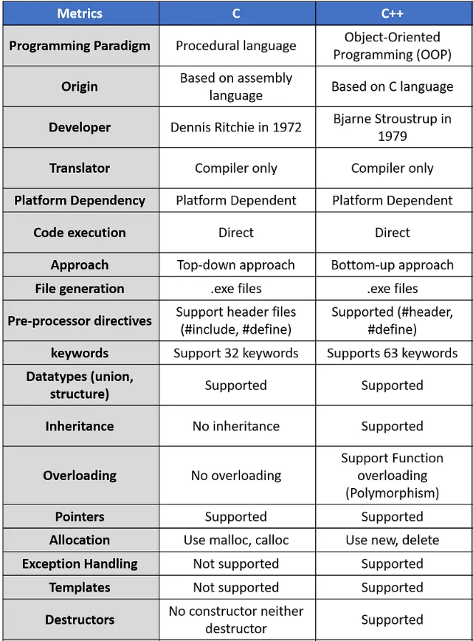

Slide 4
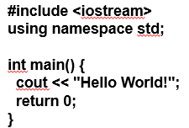
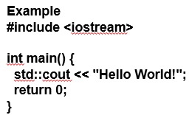
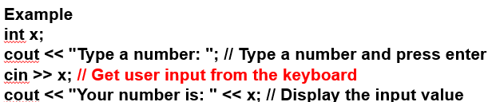
C++ - Sample Code (Cout and Cin)
The using namespace std line can be omitted and replaced with the std keyword, followed by the :: operator for some objects

Slide 5
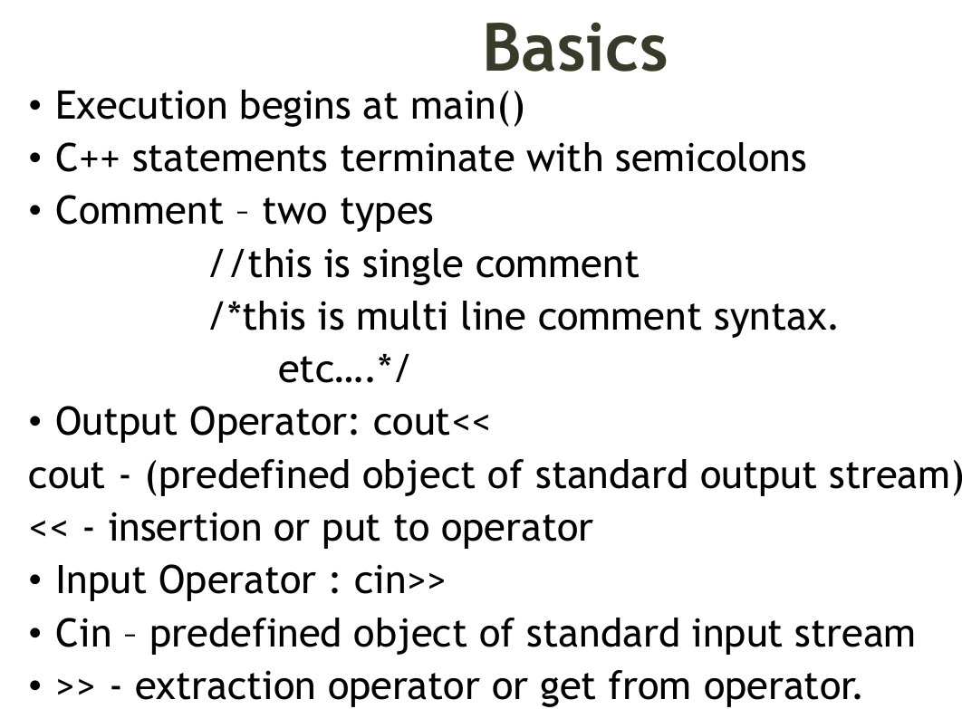

Slide 6
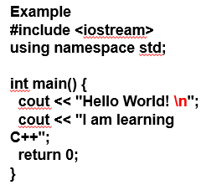
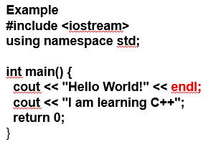
New Lines
Another way to insert a new line, is with the endl manipulator:
cout: Character Output
Cin: Character input

Slide 7
C++ Comments
Single-line Comments
Single-line comments start with two forward slashes (//).
C++ Multi-line Comments
Multi-line comments start with /* and ends with */.

Slide 8
C++ Variables
In C++, there are different types of variables (defined with different keywords), for example:
int - stores integers (whole numbers), without decimals, such as 123 or -123
double - stores floating point numbers, with decimals, such as 19.99 or -19.99
char - stores single characters, such as 'a' or 'B'. Char values are surrounded by single quotes
string - stores text, such as "Hello World". String values are surrounded by double quotes
bool - stores values with two states: true or false
Example
Create a variable called myNum of type int and assign it the value 15:
int myNum = 15;
cout << myNum;

Slide 9
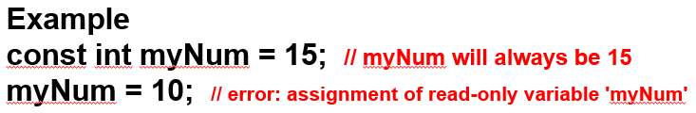
C++ Constants
Use the const keyword (this will declare the variable as "constant", which means unchangeable and read-only):

Slide 10
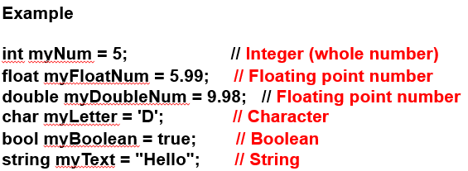
C++ Data Types

Slide 11
C++ Operators
Operators in C++ can be classified into 6 types:
Arithmetic Operators
Relational Operators
Logical Operators
Bitwise Operators
Assignment Operators
Ternary or Conditional Operators

Slide 12
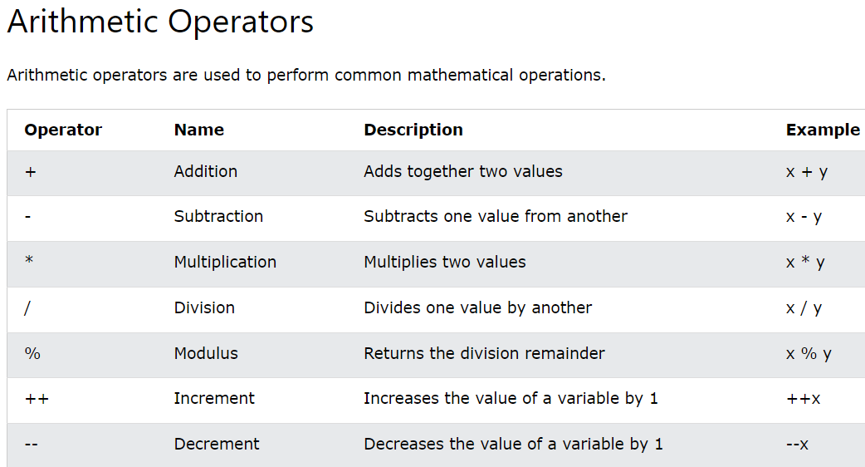

Slide 13
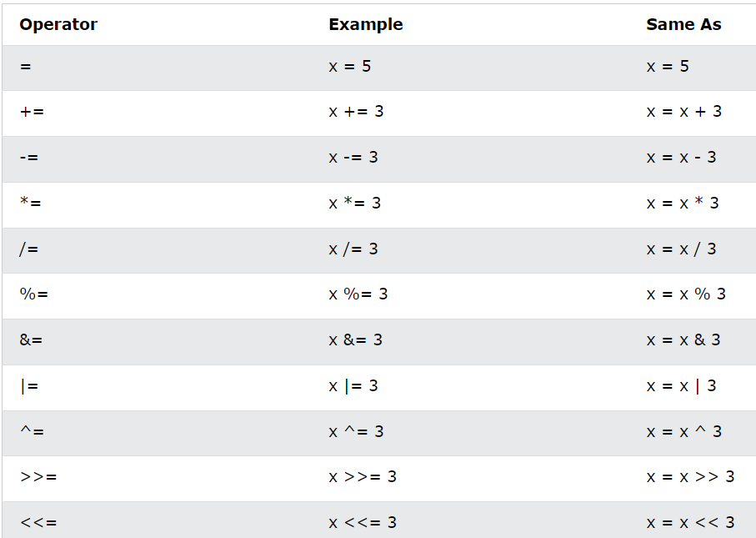
Assignment Operators

Slide 14
C++ Storage Class
Storage class controls two different properties of a variable: lifetime (determines how long a variable can exist) and scope (determines which part of the program can access it).
Depending upon the storage class of a variable, it can be divided into 4 major types:
Local variable
Global variable
Static local variable
Register Variable
Thread Local Storage

Slide 15
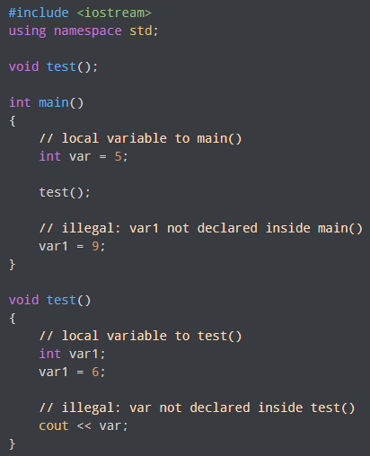
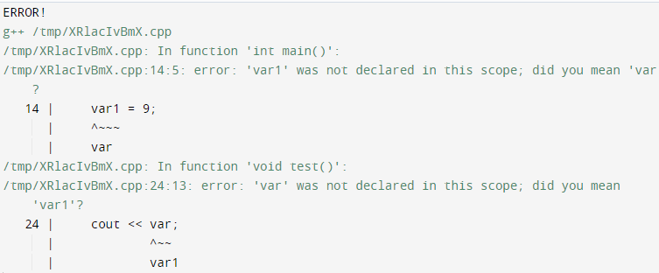
Local Variable
A variable defined inside a function (defined inside function body between braces) is called a local variable or automatic variable.
Its scope is only limited to the function where it is defined. In simple terms, local variable exists and can be accessed only inside a function.
Output

Slide 16
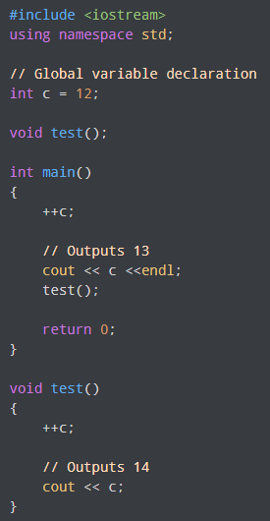

Global Variable
If a variable is defined outside all functions, then it is called a global variable.
The scope of a global variable is the whole program. This means, It can be used and changed at any part of the program after its declaration.

Slide 17
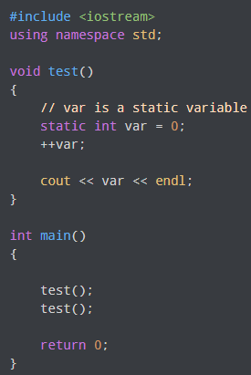


Static Local variable
A static local variable exists only inside a function where it is declared (similar to a local variable) but its lifetime starts when the function is called and ends only when the program ends.
The main difference between local variable and static variable is that, the value of static variable persists the end of the program.
Output of above program if var was not specified as static variable
Output

Slide 18
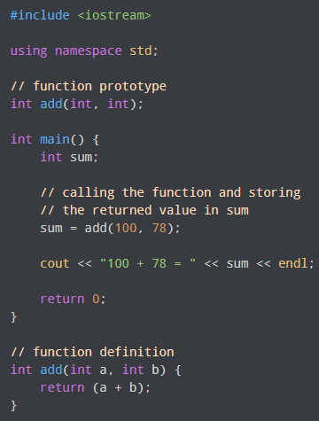
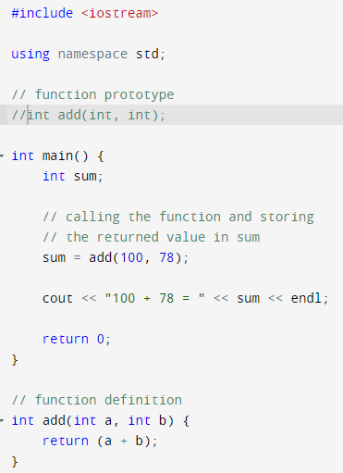
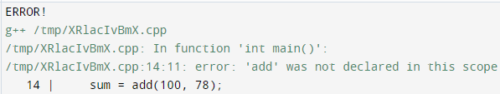

C++ Functions
A function is a block of code that performs a specific task.
Output

Slide 19
Object Oriented Programming Features in C++
There are some basic concepts that act as the building blocks of OOPs i.e.
Class
Objects
Encapsulation
Abstraction
Polymorphism
Inheritance
Dynamic Binding
Message Passing

Slide 20
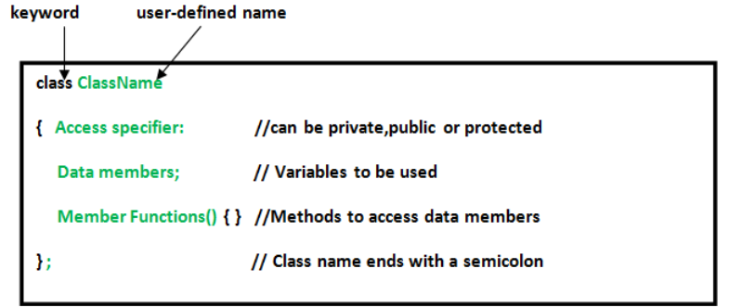
Defining Class

Slide 21
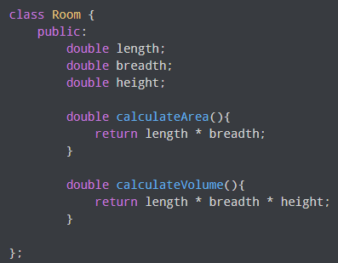
Class
The building block of C++ that leads to Object-Oriented programming is a Class. It is a user-defined data type, which holds its own data members and member functions, which can be accessed and used by creating an instance of that class.

Slide 22
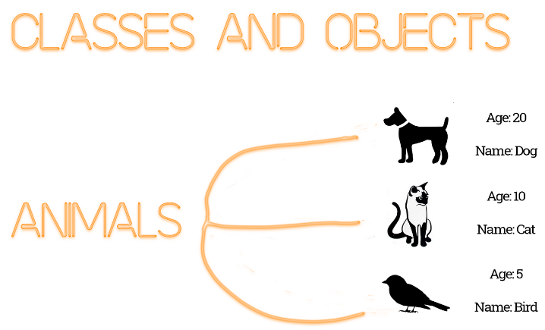

Declaring Object
An Object is an identifiable entity with some characteristics and behavior. An Object is an instance of a Class. When a class is defined, no memory is allocated but when it is instantiated (i.e. an object is created) memory is allocated.

Slide 23
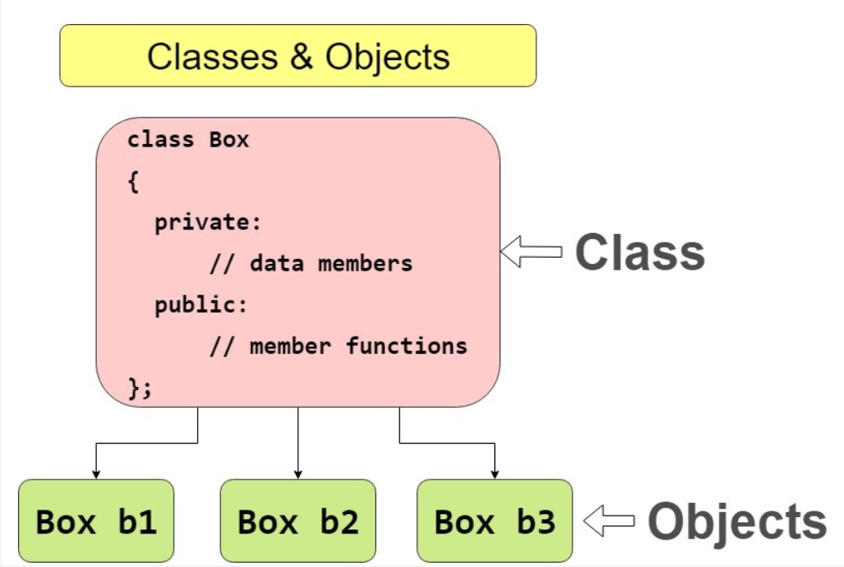

Slide 24
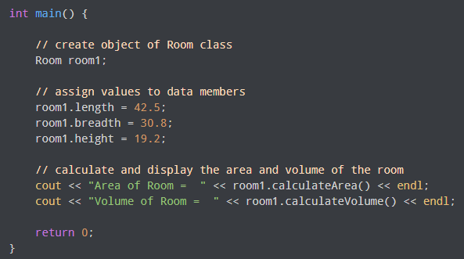
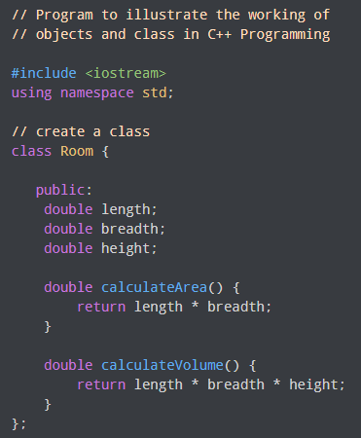
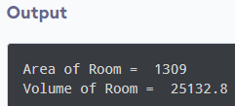
Object and Class in C++

Slide 25
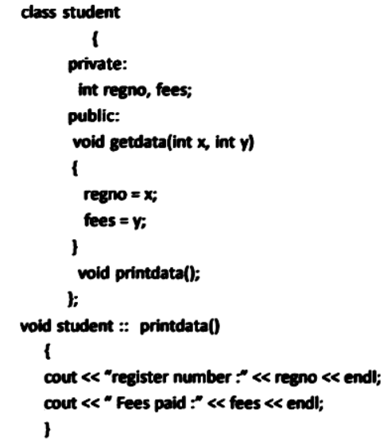
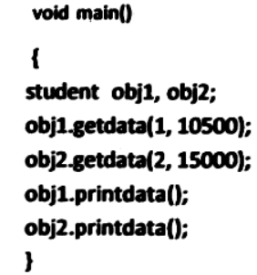
Member Functions in Classes
There are 2 ways to define a member function:
Inside class definition
Outside class definition
The operator :: known as scope resolution operator helps in defining the member function outside the class.

Slide 26
Access Modifiers in C++
Access Modifiers or Access Specifiers in a class are used to assign the accessibility to the class members, i.e., they set some restrictions on the class members so that they can’t be directly accessed by the outside functions.
There are 3 types of access modifiers available in C++:
Public
Private
Protected
If we do not specify any access modifiers for the members inside the class, then by default the access modifier for the members will be Private.

Slide 27
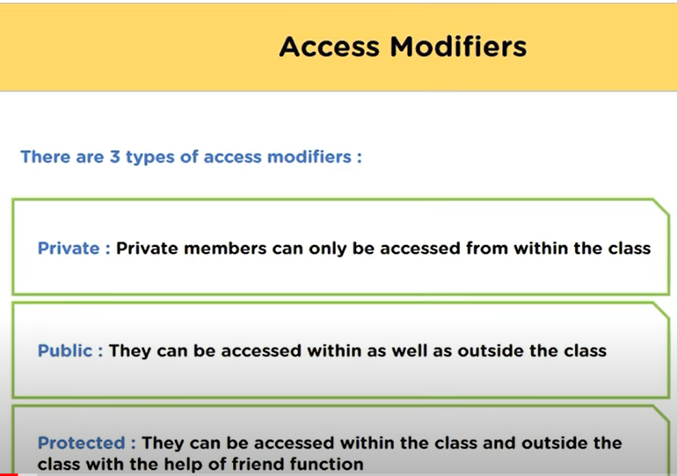
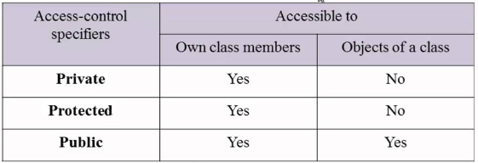

Slide 28
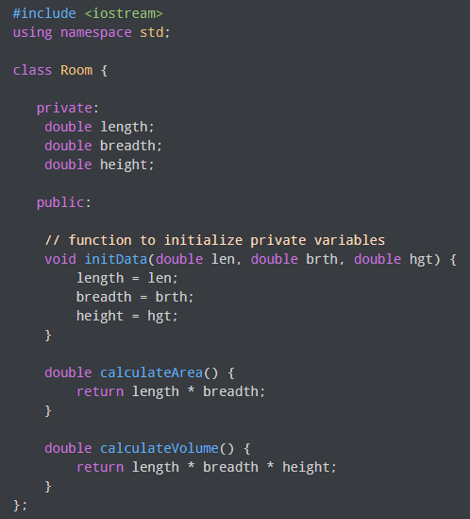
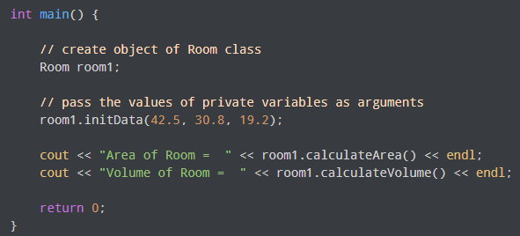
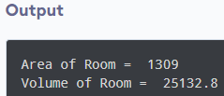
Using public and private in C++ Class

Slide 29
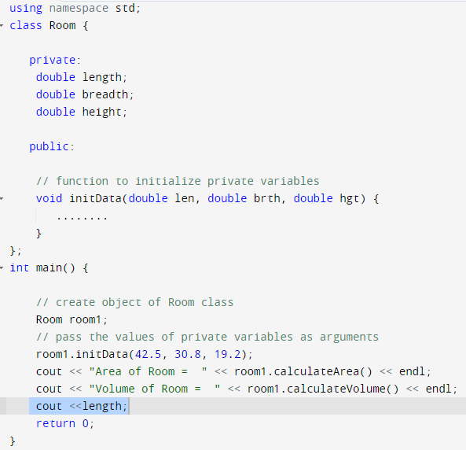
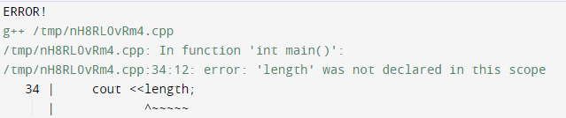
Output

Slide 30

Practice Questions
Write a CPP Program to Swap Two Numbers without using third variable.
Write a CPP Program to arrange the numbers in ascending order.
Write a CPP Program to Check Whether a Number Is a Palindrome or Not.
Write a CPP program to perform Simple Calculator operation until you press ‘q’ using switch case.
Find the minimum and maximum elements of an array.

Slide 31
