Slide 1
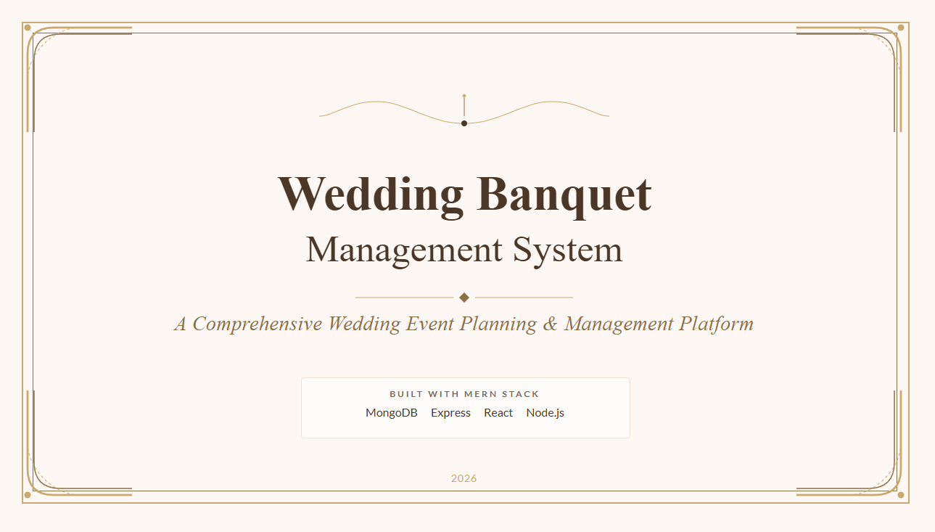

Debmalya Bhattacharyya - 31442723020
Rumpi Saha - 31442723056
Sagnik Saha - 31442723059

Slide 2
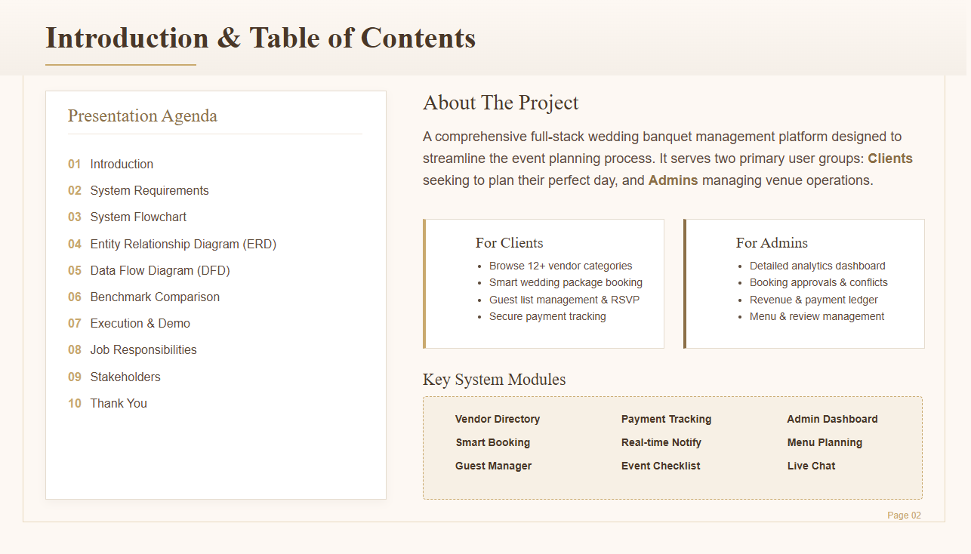
Introduction
System Requirements
System Flowchart
E-R Diagram
Data Flow Diagram
Benchmark & Performance Comparison
Execution & Demo
Job Responsibilities
Project Stakeholders
Database Schema
Security & Auth
Rest API endpoints
Challenges Faced
Future Scope
Thank You

Slide 3
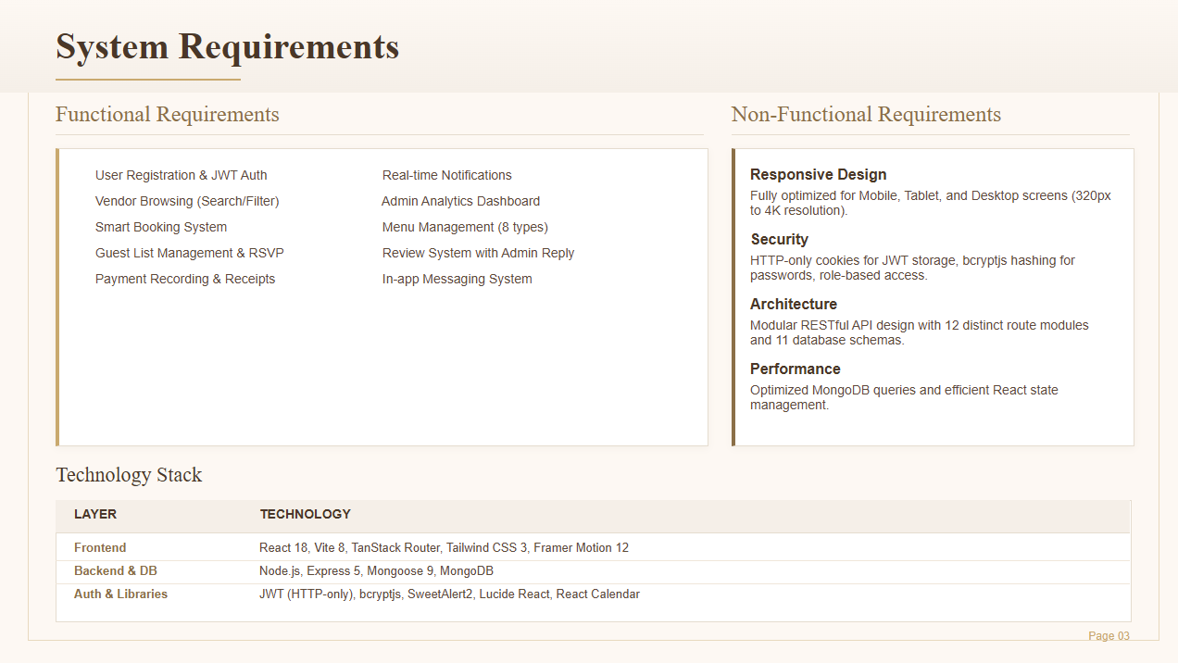

Slide 4
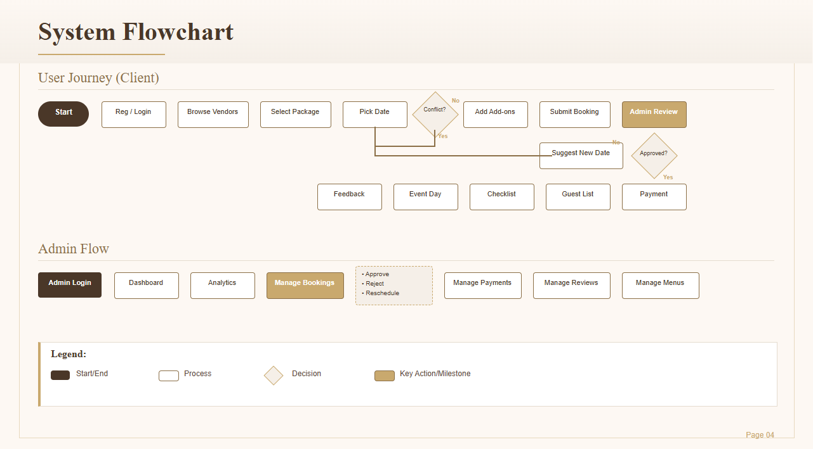

Slide 5
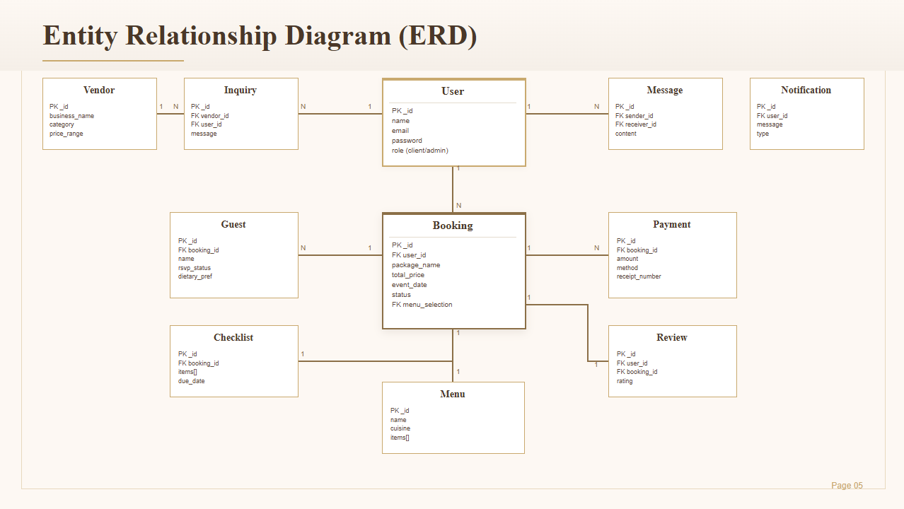

Slide 6
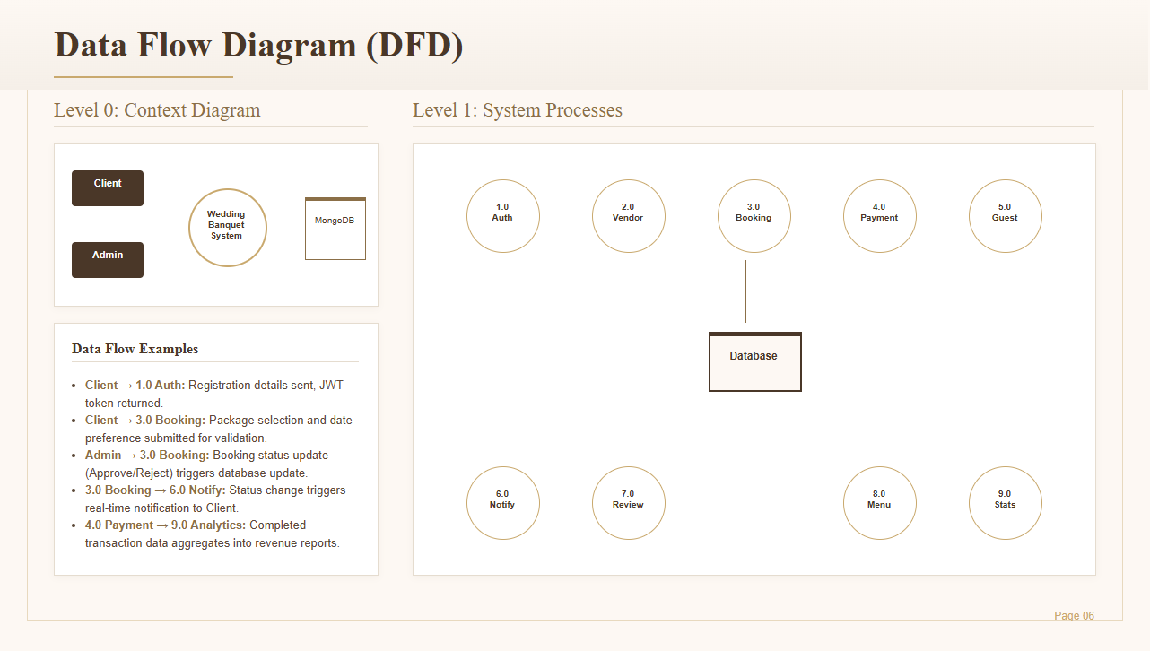

Slide 7
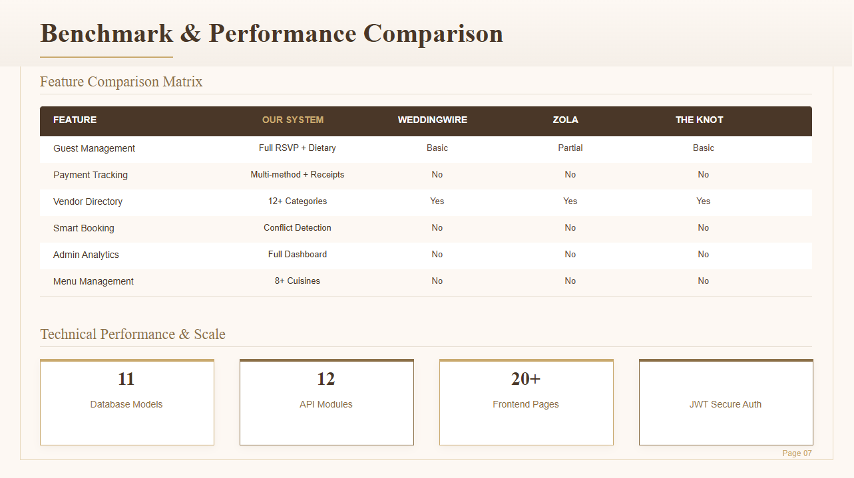

Slide 8
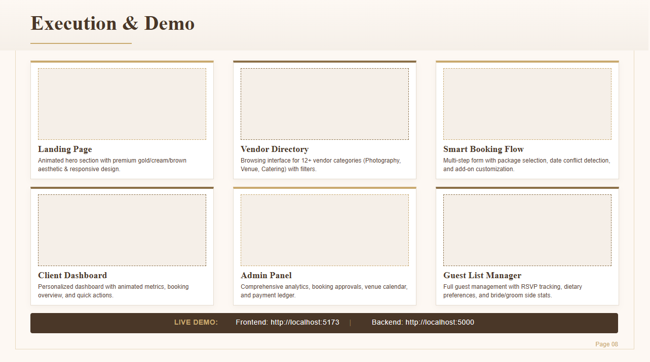


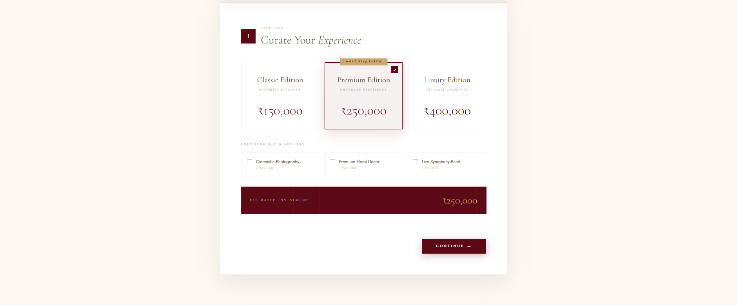
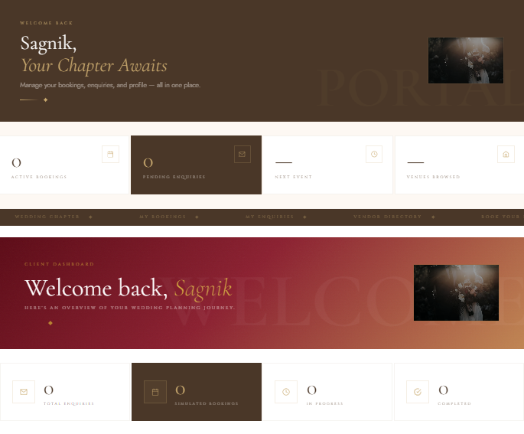
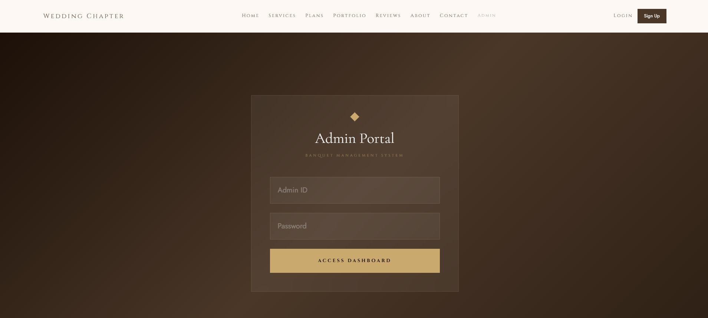
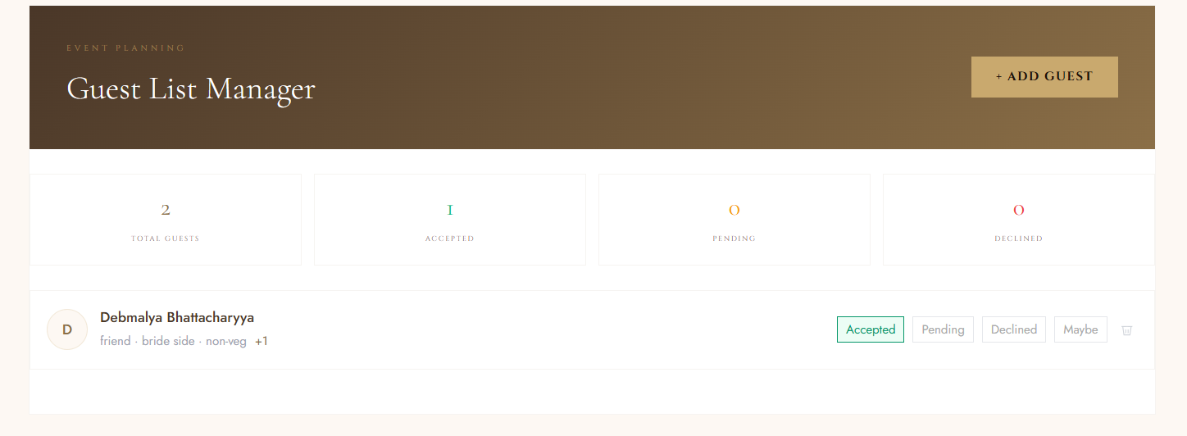
Execution Video : Video-link

Slide 9
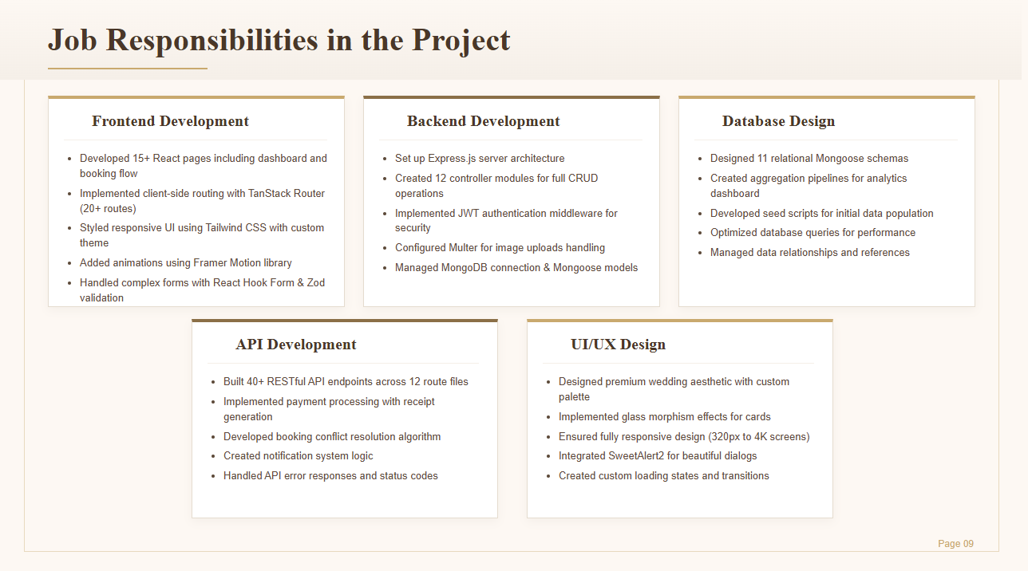
Debmalya Bhattacharya
Sagnik Saha
Debmalya Bhattacharya
- Rumpi Saha
- Rumpi Saha

Slide 10
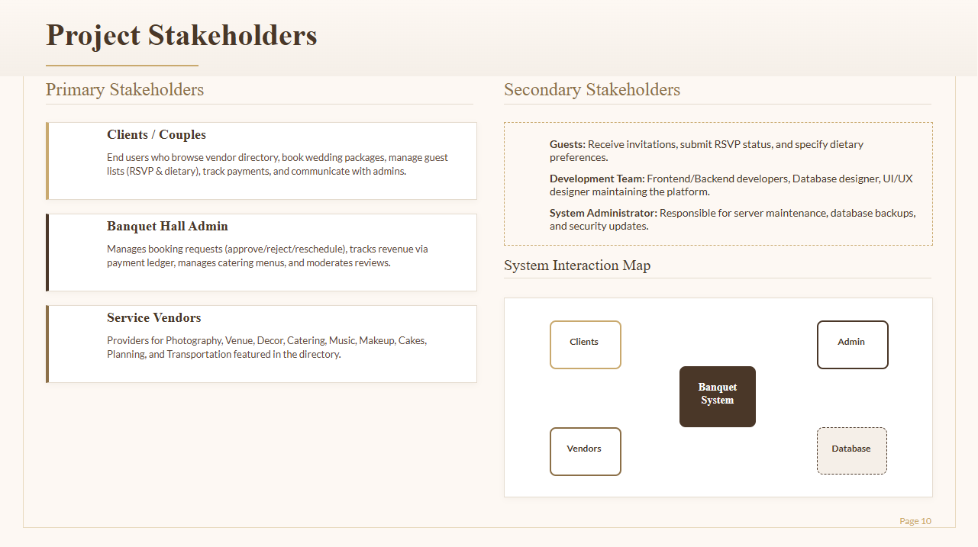

Slide 11
Database Schema & Data Models
11 Mongoose schemas power the MongoDB data layer, handling every aspect of wedding event planning with referential integrity.
Core Data Models
Supporting Models
User
name • email • password (bcrypt) • role [client/admin/vendor] • profile_image
• Menu — 8 pre-loaded cuisines, linked to bookings via ObjectId
• Checklist — per-booking to-dos with priority & due_date fields
• Notification — type, message, read_status, recipient_ref
• Message — in-app chat between client and admin
• Inquiry — pre-booking questions with admin response thread
Booking
package_name • event_date • addons • status • payment_status • timeline
Payment
booking_ref • amount • method [cash/card/UPI] • receipt_no • paid_at
Guest
name • side [bride/groom] • rsvp_status • dietary • plus_one
Design Highlights
Vendor
category (12+) • services • rating • price_range • portfolio
11
30+
9
All
Review
rating • comment • admin_reply • client_ref
Schemas
ObjectId Refs
Enum Fields
Timestamped
All schemas leverage Mongoose middleware for validation, pre-save hashing, and population of referenced documents.
Page 11

Slide 12
Security & Authentication
Multi-layered security architecture protecting user data, sessions, and administrative operations across every request.
Password Hashing
Token Authentication
bcryptjs
JWT + HTTP-only Cookies
• Salted hashing with 10-round factor
• Irreversible one-way cryptography
• Pre-save Mongoose hook auto-hashes
• Signed with secret + 7-day expiry
• HTTP-only flag blocks XSS theft
• SameSite + Secure in production
Authorization Layer
Network & CORS
Role-Based Access Control
Whitelist + Credentials
• Roles: client, admin, vendor
• authMiddleware guards all routes
• Admin-only endpoints are gated
• Origin whitelist for allowed domains
• Credentials flag for cookie flow
• trust proxy for secure headers
Login → bcrypt.compare() → jwt.sign() → set HTTP-only cookie → middleware verifies on every request
Page 12

Slide 13
REST API Endpoints Reference
40+ RESTful endpoints organized across 12 route modules, following resource-based URL conventions and standard HTTP semantics.
Authentication
Bookings
Payments
POST /api/auth/register
POST /api/auth/login
POST /api/auth/logout
PUT /api/auth/update-profile
PUT /api/auth/change-password
POST /api/bookings
GET /api/bookings/my-bookings
GET /api/bookings/admin/all
GET /api/bookings/booked-dates
POST /api/bookings/rebook/:id
POST /api/payments
GET /api/payments/my-payments
GET /api/payments/admin/all
GET /api/payments/admin/revenue
GET /api/payments/receipt/:id
Guests & RSVP
Vendors & Reviews
Utilities
POST /api/guests
GET /api/guests/booking/:id
GET /api/guests/stats/:id
PUT /api/guests/rsvp/:id
DELETE /api/guests/:id
GET /api/vendors
GET /api/vendors/:category
POST /api/reviews
GET /api/reviews/admin/all
PUT /api/reviews/reply/:id
GET /api/notifications
GET /api/menus
POST /api/checklists
GET /api/analytics/dashboard
POST /api/chat/message
Page 13

Slide 14
Challenges Faced & Solutions
Key engineering problems encountered during development and the architectural decisions taken to solve them.
Double-Booking Conflicts
Granular Payment Tracking
Problem: Multiple clients requesting the same venue on the same date created data collisions.
Problem: Payments come in as partial installments across cash, card, UPI, and bank transfer.
Solution: Implemented a server-side conflict-detection algorithm that queries existing bookings by venue + event_date; admin can 'Suggest New Date' to push a reschedule request.
Solution: Built a dedicated Payment model with method enum, receipt generation, and a revenue aggregation pipeline feeding the admin analytics dashboard.
Real-Time User Feedback
Responsive Wedding Aesthetic
Problem: Clients needed immediate confirmation on booking status changes and payment receipts.
Problem: A premium feel had to work from 320px mobile up to 4K displays without breaking layout.
Solution: Designed a Notification model with type-tagged messages and an unread counter; the frontend polls and displays them via animated dashboard cards.
Solution: Used Tailwind's utility system with custom breakpoints, Framer Motion transitions, glass-morphism cards, and SweetAlert2 for consistent dialog styling.
Page 14

Slide 15
Future Scope & Conclusion
Our platform is production-ready today, with a clear roadmap for expanding into a complete wedding-tech ecosystem.
Planned Enhancements
Project Conclusion
• Razorpay / Stripe payment gateway for live transactions
• WhatsApp OTP login for frictionless client onboarding
• AI-powered vendor recommendations based on budget & style
• Real-time chat via WebSocket / Socket.IO instead of polling
• Native mobile app (React Native) for clients on the go
• Multi-language support (English, Hindi, Bengali)
• Automated email & SMS reminders through Twilio / SendGrid
• Admin revenue forecasting with Chart.js visualizations
The Wedding Banquet Management System successfully delivers an end-to-end solution that bridges couples, admins, and vendors on a single elegant platform.
Across 11 data models, 12 controller modules, and 40+ REST endpoints, the MERN stack has proven to be a scalable, maintainable foundation for real-world wedding operations.
The project strengthened our skills in full-stack architecture, secure authentication, database design, responsive UI, and agile collaboration.
15+
40+
11
3
100%
React Pages
API Endpoints
DB Models
User Roles
Responsive
Page 15
— Crafted with ❤ using React, Node.js, Express & MongoDB —

Slide 16
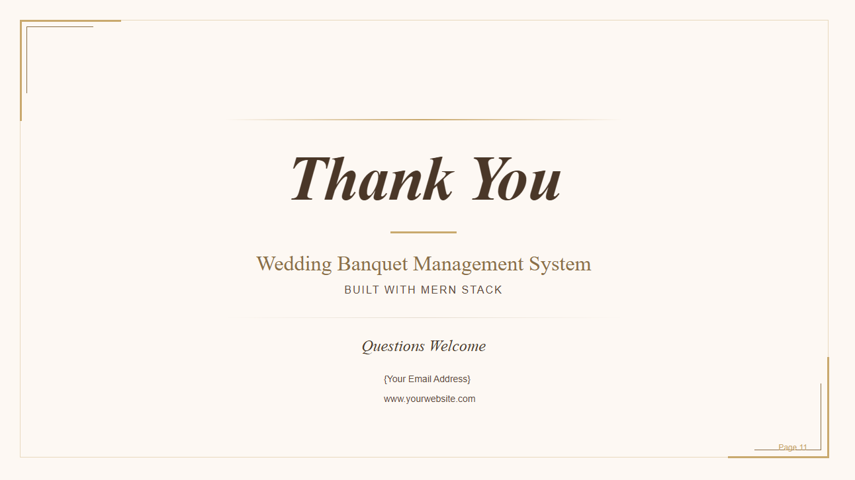
https://weeding-chapter.vercel.app

