Slide 1
Welcome to My Presentation
Name:Jyoti Mondal
ID:250191111010
Section:D

Slide 2
Chapter:7
Probability

Slide 3
Introduction
Sample Space and Events
Finite Probability Spaces
Conditional Probability
Independent Events
Independent Repeated Trials, Binomial Distribution
Random Variables
Chebyshev’s Inequality, Law of Large Numbers

Slide 4
Sample Space and Events
Definition
A random experiment is a mechanism that produces a definite outcome that cannot be predicted with certainty. The sample space associated with a random experiment is the set of all possible outcomes. An event is a subset of the sample space.
Rolling an ordinary six-sided die is a familiar example of a random experiment, an action for which all possible outcomes can be listed, but for which the actual outcome on any given trial of the experiment cannot be predicted with certainty. In such a situation we wish to assign to each outcome, such as rolling a two, a number, called the probability of the outcome, that indicates how likely it is that the outcome will occur. Similarly, we would like to assign a probability to any event, or collection of outcomes, such as rolling an even number, which indicates how likely it is that the event will occur if the experiment is performed. This section provides a framework for discussing probability problems, using the terms just mentioned.

Slide 5
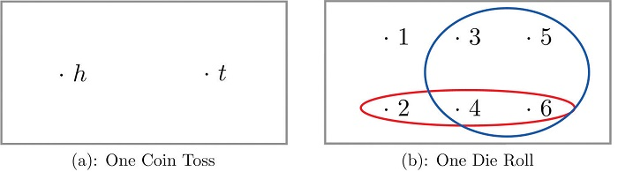
Example: Construct a sample space for the experiment that consists of rolling a single die. Find the events that correspond to the phrases “an even number is rolled” and “a number greater than two is rolled.”
Solution:
The outcomes could be labeled according to the number of dots on the top face of the die. Then the sample space is the set S={1,2,3,4,5,6}S={1,2,3,4,5,6}
The outcomes that are even are 2,4,and62,4,and6, so the event that corresponds to the phrase “an even number is rolled” is the set {2,4,6}{2,4,6}, which it is natural to denote by the letter EE. We write E={2,4,6}E={2,4,6}.
Similarly the event that corresponds to the phrase “a number greater than two is rolled” is the set T={3,4,5,6}T={3,4,5,6}, which we have denoted TT.
A graphical representation of a sample space and events is a venn diagram, as shown in Figure 3.1.13.1.1. In general the sample space SS is represented by a rectangle, outcomes by points within the rectangle, and events by ovals that enclose the outcomes that compose them.

Slide 6
Probability space
Definition
In probability theory, the notion of probability space is the conventional mathematical model of randomness. It formalizes three interrelated ideas by three mathematical notions. First, a sample point (called also elementary event), — something to be chosen at random (outcome of experiment, state of nature, possibility etc.) Second, an event, — something that will occur or not, depending on the chosen sample point. Third, the probability of an event
The notion "probability space" provides a basis of the formal structure of probability theory. It may puzzle a non-mathematician, since
it is called "space" but is far from geometry;
it is said to provide a basis, but many people applying probability theory in practice neither understand nor need this quite technical notion;
not every set of sample points is treated as event and assigned probability.
These puzzling facts are explained below. First, a mathematical definition is given; it is quite technical, but the reader may skip it. Second, an elementary case (finite probability space) is presented. Third, the puzzling facts are explained. Next topics are countably infinite probability spaces, and general probability spaces.
Let S be a finite sample space, say S = {a1, a2,...,an}. Afinite probability space, or probability model, is obtained by assigning to each point ai in S a real number pi, called the probability of ai satisfying the following properties:
(i) Each pi is nonnegative, that is, pi ≥ 0.
(ii) The sum of the pi is 1, that is, is p1 + p2 +···+ pn = 1.
The probability of an event A written P (A), is then defined to be the sum of the probabilities of the points in A. The singleton set {ai} is called an elementary event and, for notational convenience, we write P (ai) for P ({ai}).

Slide 7
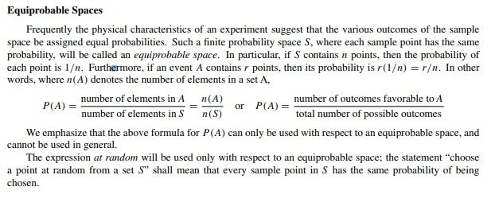
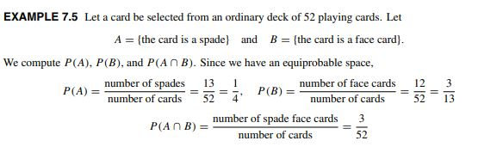

Slide 8
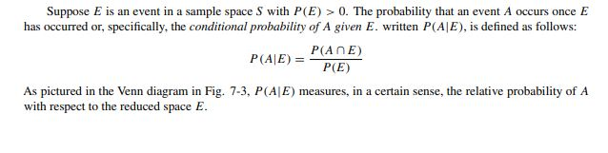
CONDITIONAL PROBABILITY
In probability theory, conditional probability is a measure of the probability of an event occurring—given that another event has (by assumption, presumption, assertion or evidence) occurred.^{[1]} If the event of interest is A and the event B is known or assumed to have occurred, "the conditional probability of A given B", or "the probability of A under the condition B", is usually written as P(A|B),^{[2][3]} or sometimes P_{B}(A) or P(A/B). For example, the probability that any given person has a cough on any given day may be only 5%. But if we know or assume that the person is sick, then they are much more likely to be coughing. For example, the conditional probability that someone unwell is coughing might be 75%, in which case we would have that P(Cough) = 5% and P(Cough | Sick) = 75%.

Slide 9
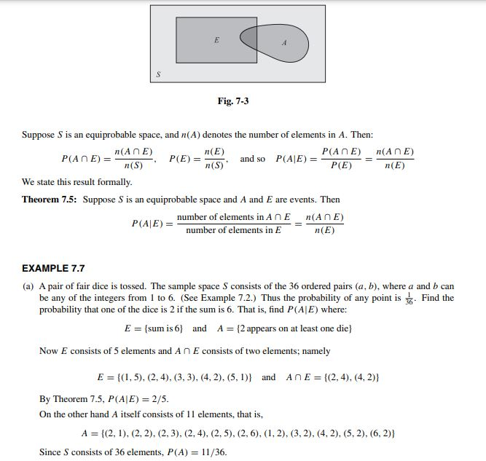

Slide 10
INDEPENDENT EVENTS
What is an Independent Event?
An independent event is an event that has no connection to another event’s chances of happening (or not happening). In other words, the event has no effect on the probability of another event occurring. Independent events in probability are no different from independent events in real life
Events A and B in a probability space S are said to be independent if the occurrence of one of them does not influence the occurrence of the other. More specifically, B is independent of A if P (B) is the same as P (B|A). Now substituting P (B) for P (B|A) in the Multiplication Theorem P (A ∩ B) = P (A)P (B|A) yields
P (A ∩ B) = P (A)P (B).
We formally use the above equation as our definition of independence.
Events A and B are independent if P(A ∩ B) = P(A)P(B); otherwise they are dependent. We emphasize that independence is a symmetric relation. In particular, the equation
P (A ∩ B) = P (A)P (B) implies both P (B|A) = P (B) and P (A|B) = P (A)

Slide 11
EXAMPLE: A fair coin is tossed three times yielding the equiprobable space S = {HHH,HHT,HTH,HTT,THH,THT,TTH,TTT } Consider the events: A = {first toss is heads}={HHH,HHT,HTH,HTT } B = {second toss is heads) = {HHH,HHT,THH,THT } C = {exactly two heads in a row}={HHT,THH} Clearly A and B are independent events; this fact is verified below. On the other hand, the relationship between A and C and between B and C is not obvious. We claim that A and C are independent, but that B and C are dependent. We have:
P (A) = 4/8 = 1/2 ,
P (B) = 4/8 = 1/2 ,
P (C) = 2/8 = 1/4
P (A ∩B) = P ({HHH,HHT }) = 1/4 , P (A ∩C) = P ({HHT }) = 1/8 , P (B ∩ C) = P ({HHT,THH}) = ¼
Accordingly,
P (A)P (B) = 1/2 · 1/2 = 1/4 = P (A ∩ B), and so A and B are independent
P (A)P (C) = 1/2 · 1/4 = 1/8 = P (A ∩ C), and so A and C are independent
P (B)P (C) = 1/2 · 1/4 = 1/8 = P (B ∩ C), and so B and C are dependent
Frequently, we will postulate that two events are independent, or the experiment itself will imply that two events are independent.

Slide 12
INDEPENDENT REPEATED TRIALS , BINOMIAL DISTRIBUTION
We have previously discussed probability spaces which were associated with an experiment repeated a finite number of times, as the tossing of a coin three times. This concept of repetition is formalized as follows:
Let S be a finite probability space. By the space of n independent repeated trials, we mean the probability space Sn consisting of ordered n-tuples of elements of S, with the probability of an n-tuple defined to be the product of the probabilities of its components:
P ((s1, s2,...,sn)) = P (s1)P (s2) . . . P (sn)
EXAMPLE: Whenever three horses a, b, and c race together, their respective probabilities of winning are 1 2 , 1 3 , and 1 6 . In other words, S = {a, b, c} with P (a) = 1 2 , P (b) = 1 3 , and P (c) = 1 6 . If the horses race twice,
then the sample space of the two repeated trials is S2 = {aa, ab, ac, ba, bb, bc, ca, cb, cc} For notational convenience, we have written ac for the ordered pair (a, c). The probability of each point in S2 is
P (aa) = P (a)P (a) = 1/2 (1/2) =1/4 , P (ba) = 1/6 , P (ca) = 1/12
P (ab) = P (a)P (b) = 1/2 ( 1/3)=1/6 , P (bb) = 1/9 , P (cb) = 1/18
P (ac) = P (a)P (c) = 1/2 (1/6) =1/2 , P (bc) = 1/18 , P (cc) = 1/36
Thus the probability of c winning the first race and a winning the second race is P (ca) = 1/12 .

Slide 13


Now consider an experiment with only two outcomes. Independent repeated trials of such an experiment are called Bernoulli trials, named after the Swiss mathematician Jacob Bernoulli (1654–1705). The term independent trials means that the outcome of any trial does not depend on the previous outcomes (such as tossing a coin). We will call one of the outcomes success and the other outcome failure.
Let p denote the probability of success in a Bernoulli trial, and so q = 1 − p is the probability of failure. A binomial experiment consists of a fixed number of Bernoulli trials. A binomial experiment with n trials and probability p of success will be denoted by
B(n, p)
Frequently, we are interested in the number of successes in a binomial experiment and not in the order in which they occur.We note that the theorem uses the following binomial coefficient
The probability of exactly k successes in a binomial experiment B(n, p) is given by
The probability of one or more successes is 1 − q^{n} .

Slide 14
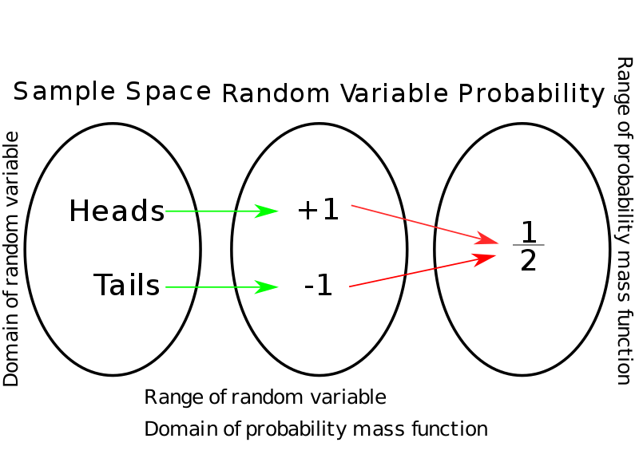
RANDOM VARIABLES
In probability and statistics, a random variable, random quantity, aleatory variable, or stochastic variable is described informally as a variable whose values depend on outcomes of a random phenomenon. The formal mathematical treatment of random variables is a topic in probability theory. In that context, a random variable is understood as a measurable function defined on a probability space that maps from the sample space to t
A random variable's possible values might represent the possible outcomes of a yet-to-be-performed experiment, or the possible outcomes of a past experiment whose already-existing value is uncertain (for example, because of imprecise measurements or quantum uncertainty). They may also conceptually represent either the results of an "objectively" random process (such as rolling a die) or the "subjective" randomness that results from incomplete knowledge of a quantity. The meaning of the probabilities assigned to the potential values of a random variable is not part of probability theory itself, but is instead related to philosophical arguments over the interpretation of probability. The mathematics works the same regardless of the particular interpretation in use.
As a function, a random variable is required to be measurable, which allows for probabilities to be assigned to sets of its potential values. It is common that the outcomes depend on some physical variables that are not predictable. For example, when tossing a fair coin, the final outcome of heads or tails depends on the uncertain physical conditions, so the outcome being observed is uncertain. The coin could get caught in a crack in the floor, but such a possibility is excluded from consideration.

Slide 15
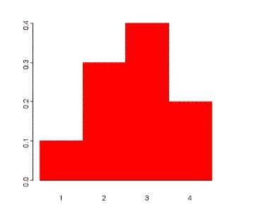
Example:
Suppose a variable X can take the values 1, 2, 3, or 4. The probabilities associated with each outcome are described by the following table:
Outcome 1 2 3 4
Probability 0.1 0.3 0.4 0.2
The probability that X is equal to 2 or 3 is the sum of the two probabilities: P(X = 2 or X = 3) = P(X = 2) + P(X = 3) = 0.3 + 0.4 = 0.7. Similarly, the probability that X is greater than 1 is equal to 1 - P(X = 1) = 1 - 0.1 = 0.9, by the complement rule.
This distribution may also be described by the probability histogram shown to the right:

Slide 16
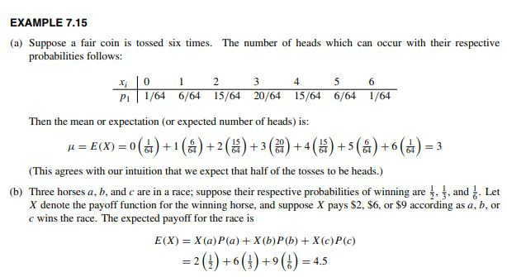
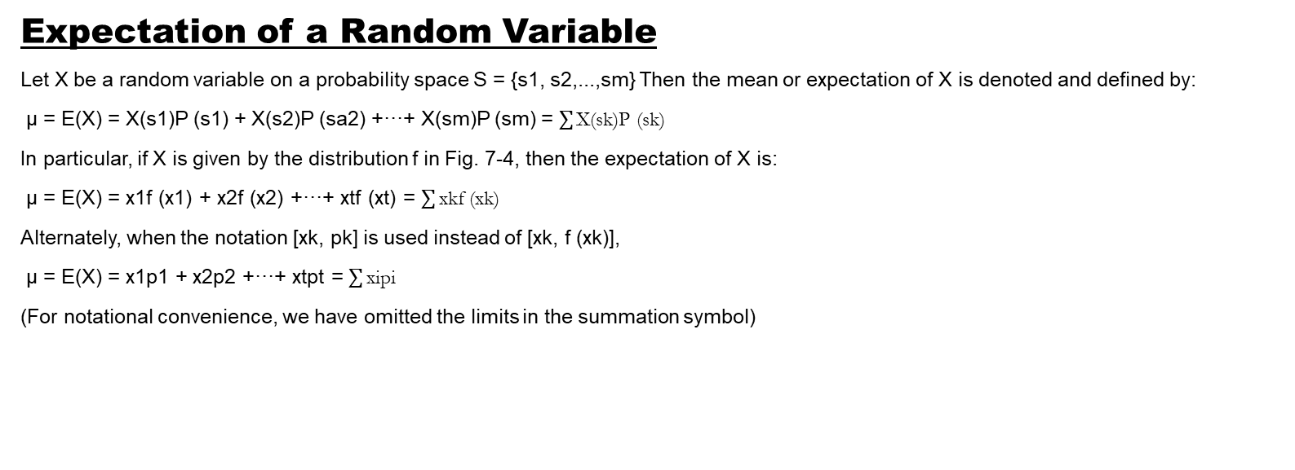
Expectation of a Random Variable
Let X be a random variable on a probability space S = {s1, s2,...,sm} Then the mean or expectation of X is denoted and defined by:
µ = E(X) = X(s1)P (s1) + X(s2)P (sa2) +···+ X(sm)P (sm) = $\sum{\text{X}\text{(}\text{sk}\text{)}\text{P}\text{ (}\text{sk}\text{)}}$
In particular, if X is given by the distribution f in Fig. 7-4, then the expectation of X is:
µ = E(X) = x1f (x1) + x2f (x2) +···+ xtf (xt) = $\sum{\text{xkf}\text{ (}\text{xk}\text{)}}$
Alternately, when the notation [xk, pk] is used instead of [xk, f (xk)],
µ = E(X) = x1p1 + x2p2 +···+ xtpt = $\sum{\text{xipi}}$
(For notational convenience, we have omitted the limits in the summation symbol)

Slide 17

CHEBYSHEV’S INEQUALITY, LAW OF LARGE NUMBERS
The standard deviation σ of a random variable X measures the weighted spread of the values of X about the mean µ. Thus, for smaller σ, we would expect that X will be closer to µ. A more precise statement of this expectation is given by the following inequality, named after the Russian mathematician P. L. Chebyshev (1821–1894).
Let X be a random variable with mean µ and standard deviation σ. Then for any positive number k, the probability that a value of X lies in the interval[µ−kσ, µ+kσ] is at least 1 − 1/k2. That is,
Example: Suppose X is a random variable with mean µ = 75 and standard deviation σ = 5. What conclusion about X can be drawn from Chebyshev’s inequality for k = 2 and k = 3? Setting k = 2, we obtain: µ − kσ = 75 − 2(5) = 65 and µ + kσ = 75 + 2(5) = 85

Slide 18

Thus we can conclude that the probability that a value of X lies between 65 and 85 is at least 1 − (1/2)2 = 3/4; that is:
P (65 ≤ X ≤ 85) ≥ ¾
Similarly, by letting k = 3, we can conclude that the probability that a value of X lies between 60 and 90 is at least 1 − (1/3)2 = 8/9.
Sample Mean and Law of Large Numbers
Consider a finite number of random variable X, Y , ..., Z on a sample space S. They are said to be independent if, for any values xi, yj ,...,zk,
P (X = xi, Y = yj ,...,Z = zk) ≡ P (X = xi)P (Y = yj ) . . . P (Z = zk)
In particular, X and Y are independent If
P (X = xi, Y = yj ) ≡ P (X = xi)P (Y = yj )
Now let X be a random variable with mean µ. We can consider the numerical outcome of each of n independent trials to be a random variable with the same distribution as X. The random variable corresponding to the ith outcome will be denoted by Xi(i = 1, 2, . . . , n). (We note that the Xi are independent with the same distribution as X.) The average value of all n outcomes is also a random variable which is denoted by Xn and called the sample mean. That is:
The law of large numbers says that as n increases the value of the sample mean Xn approaches the mean value µ. Namely

Slide 19

Theorem (Law of Large Numbers):
For any positive number α, no matter how small, the probability that the sample mean Xn has a value in the interval [µ − α, µ + α] approaches 1 as n approaches infinity. That is:
P ([µ − α ≤ X ≤ µ + α]) → 1 as n → ∞.
EXAMPLE:
Suppose a die is tossed 5 times with outcomes:
x1 = 3, x2 = 4, x3 = 6, x4 = 1, x5 = 4
Then the corresponding value x of the sample mean X5 follows:
For a fair die, the mean µ = 3.5. The law of large numbers tells us that, as n gets larger, there is a greater likelihood that Xn will get closer to 3.5.

Slide 20
The End
Thank You.

