Slide 1
WELCOME
to
Project Presentation
Software Development Lab I
Course Code: CSE2142

Slide 2

Dept. of Computer Science & Engineering
Student Information Management System
Presented By:
MD. Habibur Rahman
ID No.: 1737820121
2nd Year, 1st semester
Session: 2016-2017
Dept. of CSE
TMSS Engineering College, Bogura
Project Supervisor
Subrata Kumar Paul
Lecturer
Dept. of CSE
TMSS Engineering College,Bogura

Slide 3
Contents
(1) Introduction
(2) What is the project? Why need it?
(3)Difference between existing system.
(4)Language and tools
(5)Requirement Analysis
(6) System design
(7)Time- Scheduling
(8) Database Design (ER Diagram)
(9)System input and Display output (Pictures)
(10) System Testing
(11) Applications/Impact on the society
(12) Major References
(13)Ending

Slide 4
(1)Introduction
Hello Everyone Welcome to my first Project Presentation. In this Presentation I would like to discuss about Student Information Management System. Hope, you will watch this Presentation First to Last with patience and help me to perform a great experience on it.

Slide 5
(2)What is the Project? Why need it?
My Project is “Student Information Management System”. It is work to record and update Student Information in an Educational Institution.
In Every Educational Institution, authority should have keep every Student information without a software. This software can help to overcome this problem and helps to save their time to perform other tasks.

Slide 6
3)Difference between existing system.
This project is available in market . But I worked on this for developing my personal skill about software development.

Slide 7
(4)Language and tools
Language: This Project is written on C++ Language.
Tools: This Project is works on Windows Platform.

Slide 8
(5)Requirement Analysis
Requirement for Development
Area of Project: Windows

Slide 9
(6)System Design
Insert Student Record
Entire Student Records
Search Student Record
Delete Student Record
Update Student Record
Exit

Slide 10
(7)Time- Scheduling
Survey | 3 Days
Analysis | 5 Days
Coding | 24 Days
Review of Coding | 17 Days
Documentation | 5 Days
Total | 8 Weeks

Slide 11
(8) Database Design (ER Diagram)
STUDENT INFORMATION MANAGEMENT
Exit
Insert Student Record
Entire Student Records
Update Student Record
Search Student Record
Delete Student Record

Slide 12
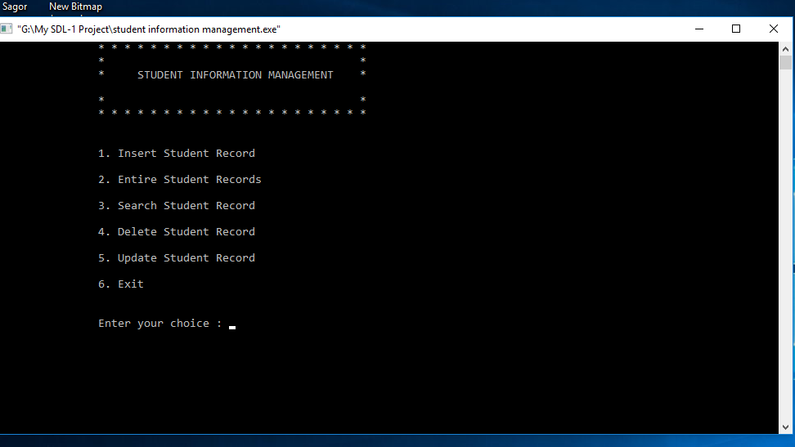
(9)System input and Display output (Pictures)
Main Menu
Fig: 9.1

Slide 13
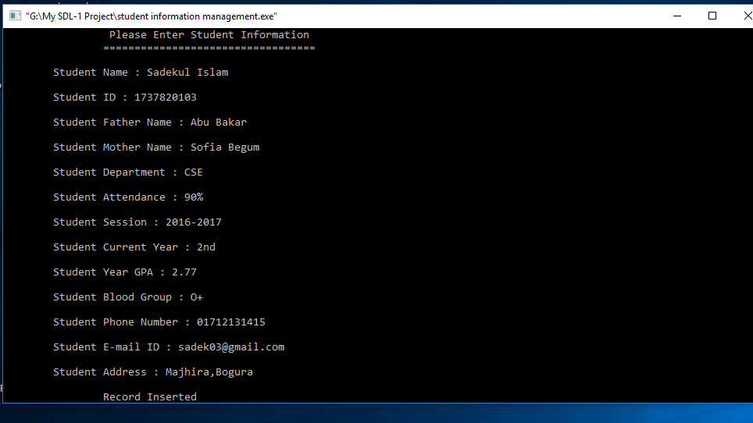
Insert Student Record
Fig: 9.2

Slide 14
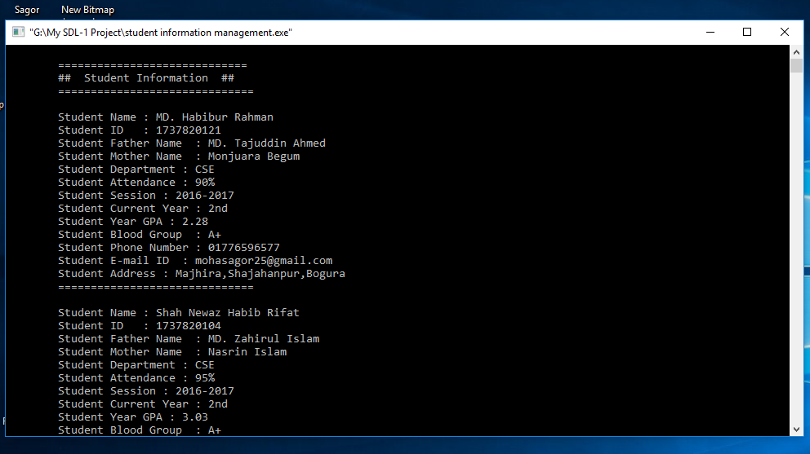
Entire Student Records
Fig: 9.3

Slide 15
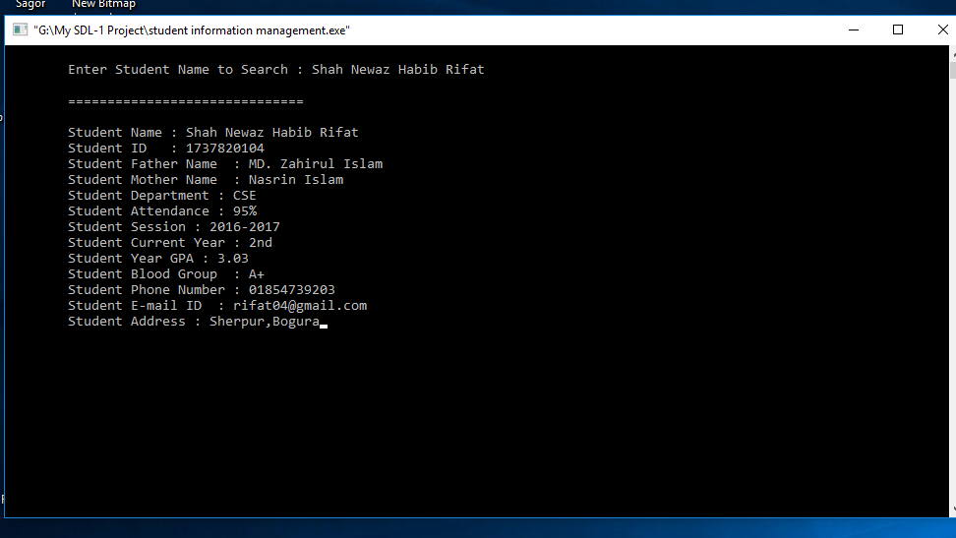
Search Student Record
Fig: 9.4

Slide 16
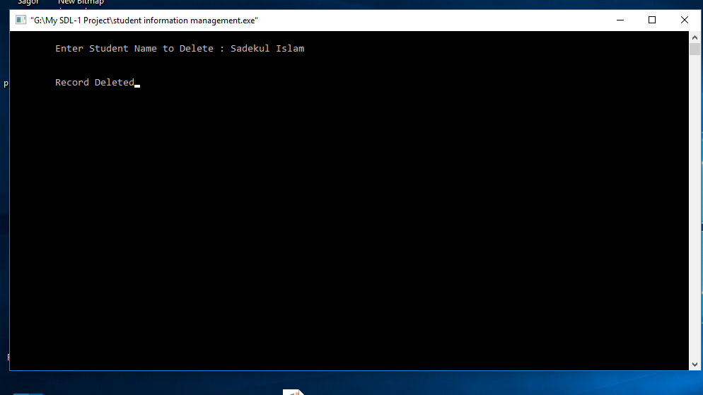
Delete Student Record
Fig: 9.5

Slide 17
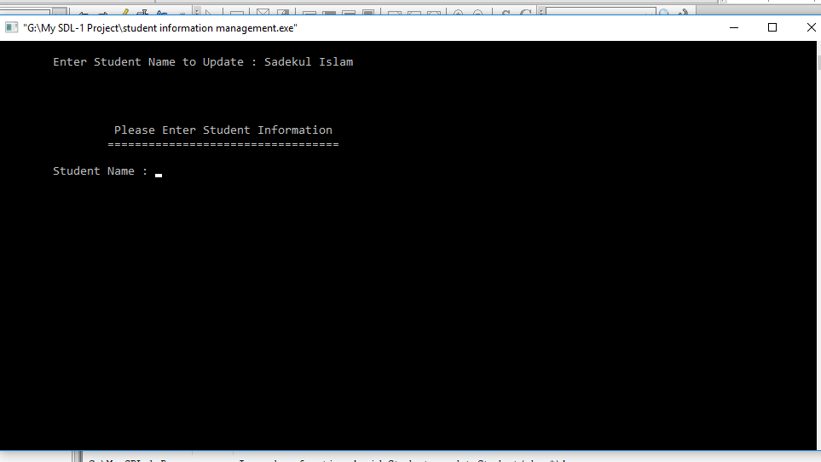
Update Student Record
Fig: 9.6

Slide 18
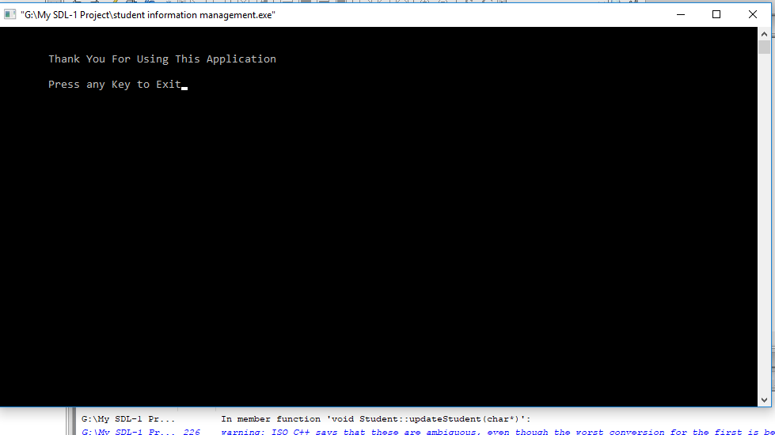
Exit
Fig: 9.7

Slide 19
(11) Applications/Impact on the society
It is uses friendly
It can reduce paper work and all system are computerize
It can handle all necessary information
All Educational Institutions should use this Software for faster work.

Slide 20
(12) Major References
Reference: Link 1, Link 2
Link 1:
http://www.cppbeginner.com/cpp-projects/student-management-system-project-in-cpp
Link 2:
https://www.projectsland.com/sis-c/

Slide 21
(13)Ending
Thanks Everyone for Watching
Do you have Any Question???

