Slide 1

More about control & algorithms
W200 Programming for Data Science

Slide 2
Welcome to Week 04
Teaching goals for this week
Content for the first 8 weeks of the course
Observations about assignments and git
Pseudocoding, modularity; Working efficiently with breaks.
Discussion about loops, iterators, continue & break.
Comprehensions.
Long breakout room for activities

Slide 3
1. Welcome to Week 04
This week’s teaching goals include good practices for you & your code:
(a) encouraging you to take a break when coding [Palomores, 80/20; “sanity checks”].
(b) breaking down the logic of your coding - text & drawing - pseudocoding. Leads to • better functions, better process decomposition and • data flows, better object design, and more • efficient code.
(c) thinking about loops & iterators - when to use one over another; getting comfortable with comprehensions.

Slide 4
2. First 8 Weeks - Programming
Unit 1 | Introduction, the Command Line, Source Control
Unit 2 | Starting Out with Python
Unit 3 | Sequence Types and Dictionaries
Unit 4 | More About Control and Algorithms
Unit 5 | Functions
Unit 6 | Modules and Packages
Unit 7 | Classes
Unit 8 | Object-Oriented Programming
Some of the main points include
(1) iterators vs. loop;
(2) the importance of pseudocoding, and
(3) planning ahead for algorithm efficiency.

Slide 5
3. Helpful Git Term | “git stash”
If you’ve modified files in a repository but want to keep them without “committing” them, try “git stash” to stash the changes before using “git pull” or “git add”.
Stash states away untracked changes.
See https://gist.github.com/carnivore/997001
https://git-scm.com/downloads
Notes:
https://abdulapopoola.com/2014/06/05/i-git-stashing-explained/

Slide 6


3. Observations about HW
Grading questions: Please email all instructors so we can discuss.
Before submitting code, test; check any math/formulae.
Formatting: Use string formatting to print without gaps and with a logical number of digits. You don’t (usually) need to separate the formatting by a comma:
print("The total including tip would be ${:,.2f}".format(total))
print("The total including tip would be","${:,.2f}".format(total))

Slide 7
3. Observations about HW
The user experience matters - in coding and in data analysis
Consider number-based inputs vs. text based. Sometimes it makes sense to number the options and ask the user for an integer.
.lower(), rstrip(), strip() can be useful on input to ensure a standard string format. Try to control user (and file) input: “error-correction on input.”
You can use a while loop for data validation.
You can “update” a variable each pass through a loop to build strings, lists, etc. over time. Even though strings aren’t mutable. You’re creating a new string with the same variable name each pass through the loop.

Slide 8
4. Pseudocoding & Algorithms
What is Pseudocoding?
“Pseudocode is an informal high-level description of the operating principle of a computer program or other algorithm. It uses the structural conventions of a normal programming language, but is intended for human reading rather than machine reading.” (Wikipedia)
Planning leads to smart coding!
Modularization.
Saves time, and in the real world, saves money.
Practice, practice, practice this functional decomposition exercise.
https://en.wikipedia.org/wiki/Software_design

Slide 9
Look Forward - Arrays | NumPy
We will come back to the topic of arrays when we discuss NumPy.
Other programming languages use “arrays” and “matrices” frequently. In Python, a lot can be done with lists instead.
When working with large vectors or matrices of numeric calculations, NumPy arrays are much, much faster.
NumPy also has some useful data generation functions, such as those in the “random” library, that can be leveraged in code. There is also the regular “random” library. https://docs.python.org/3.6/library/random.html

Slide 10
4. Pseudocoding: Example
This program calculates the Lowest Common multiple
for excessively long input values
function lcmNaive(Argument one, Argument two){
Calculate the lowest common variable of Argument
1 and Argument 2 by dividing their product by their
Greatest common divisor product
return lowest common multiple
end
}
function greatestCommonDivisor(Argument one, Argument two){
if Argument two is equal to zero
then return Argument one
return the greatest common divisor
end
}
{
In the main function
print prompt "Input two numbers"
Take the first number from the user
Take the second number from the user
Send the first number and second number
to the lcmNaive function and print
the result to the user
}
// This program calculates the Lowest Common multiple
// for excessively long input values
import java.util.*;
public class LowestCommonMultiple {
private static long
lcmNaive(long numberOne, long numberTwo)
{
long lowestCommonMultiple;
lowestCommonMultiple
= (numberOne * numberTwo)
/ greatestCommonDivisor(numberOne, numberTwo);
return lowestCommonMultiple;
}
private static long
greatestCommonDivisor(long numberOne, long numberTwo)
{
if (numberTwo == 0)
return numberOne;
return greatestCommonDivisor(numberTwo, numberOne % numberTwo);
}
public static void main(String args[])
{
Scanner scanner = new Scanner(System.in);
System.out.println("Enter the inputs");
long numberOne = scanner.nextInt();
long numberTwo = scanner.nextInt();
System.out.println(lcmNaive(numberOne, numberTwo));
}
}
Pseudocode (top)
Java code (ight)

Slide 11

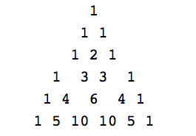
4. Pseudocoding: Pascal’s Triangle
Pause - Draw it out
These statements should be distilled to simplicity
There are 1s flanking each row
Adding each possible pair of previous row makes next row without the flanking 1s

Slide 12
4. Pseudocoding & Algorithms
We will use two arrays, one for the "last row" one for "current row"
Insight: Each pass through the loop, we can set "current row" to "last row". Then we can build a new "current row".
First initialize the two arrays to [1] and [1,1] for rows 1 and 2
We then loop through an algorithm as follows: 1. Replace "last_row" with the contents of "current_row" so we can create a new "current_row". 2. Clear out "current_row" to have nothing in it. 3. The 0 digit in current_row is 1 4. Start a "While" loop that iterates until len(current_row) == len(last_row) 5. Use a counter (n) that starts at 1 and increments by 1 each time through the loop 6. Use "append" to set current_row[n] = last_row[n] + last_row[n-1] 7. After exiting the loop, add the final "1" ! Now wait, what is the problem? This only builds one row. Go into breakouts and, starting with this pseudocode, update the pseudocode to find the "N"th line, as required in the problem.

Slide 13
4. Pseudocoding & Algorithms
What is the underlying purpose of teaching search algorithms?
Answer: To show that creative code solutions can drastically improve runtimes.
As you take courses on data at scale, it’s not enough for your code to work. It has to work, efficiently. Planning and pseudocoding help
Unit 6 will explore this further.

Slide 14

4. Pseudocoding & Algorithms
Discuss: What is the difference between the three methods?
Brute force
Bisection search
Heron’s method
Notes:
How do these relate to solution space?

Slide 15
5. Iterating through data
Here are some discussion topics, followed by examples. We’ll conclude with a breakout room activity where you apply them all.
What’s the difference between a for loop and a while loop?
Is one more general than the other?
Why might you want to exit a loop early?
What’s the benefit of “break”, of “continue” and of “else” after a loop?
What’s a boolean flag? When to use one?

Slide 16
5. Looping | For vs. While
Question: What is the difference between a “for” loop and a “while” loop?
Answer: A “while” loop iterates until a condition is met. The programmer may not know in advance how many iterations are needed.
A “for” loop iterates over a predefined group of objects, acting once on each one.
Generally, use a “for” loop when you have a known set of items to iterate over. Use a “while” loop when you are not sure how many iterations are needed in advance.
All “for” loops can be re-written as “while” loops. In fact, in the first weeks of this course we had you practice implementing several items as “while” loops that are easier to implement as “for” loops.

Slide 17


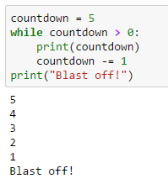
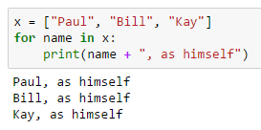
5. Looping | Examples

Slide 18
5. Exiting Loops | Three Tools
Question: Why might we want to exit a loop early?
Why “break” a loop?
Why use “continue”?
Why use “else” after a loop?

Slide 19
5. Exiting Loops | Explanations
Question: Why might we want to exit a loop early?
Break exits the entire loop early, preventing our code for running needlessly.
Continue skips the rest of the iteration, and starts the next part of the loop. There is no need to continue processing a row.
Else can be used after a loop completes, and triggers if the loop never “breaks”.

Slide 20

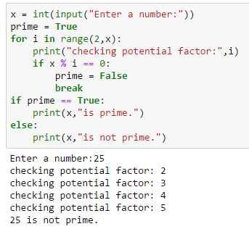
5. Exiting Loops | Break
When would we use “break”?
In the prime checker code, we do not need to check any values after we find the first non-prime value.
* What is a boolean flag?

Slide 21
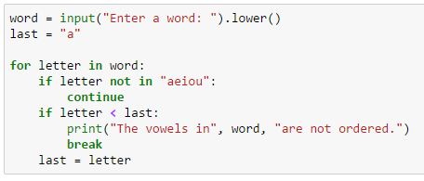
5. Exiting Loops | Continue
Question: When would we use “continue”?
Use of “continue” early in a loop can save you processing time on many iterations, or when only some values need to be processed (e.g., vowels).
See whether the vowels in the input are ordered

Slide 22

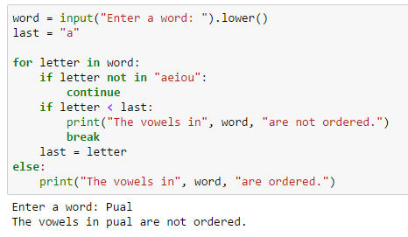
5. Exiting Loops | Break/Else
Question: When would we use “else”?
“Else” can be used to save coding effort by processing the data in a certain way if your entire loop runs.

Slide 23
6. Comprehensions | Purpose
Question: What is a “list comprehension”?
Answer: A comprehension is a single-line “for loop” that enables you to quickly build a list. You can also build sets or dictionaries.
Question: Why would we want to use one?
Answer: They are fast, efficient, and fun ways to build sequences out of other sequences!
Notice that we build more complicated conditions - so note the logic and the syntax as we progress.

Slide 24
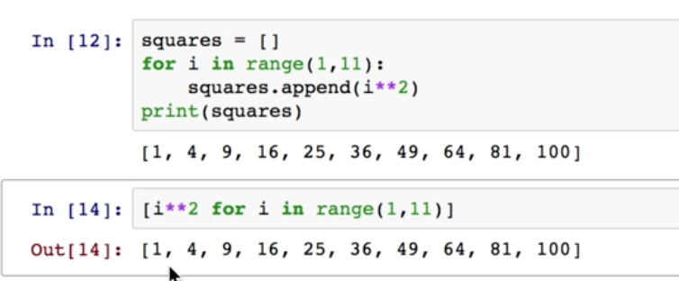
6. List Comprehensions |
a compact for loop
List comprehension implicitly appends items resulting from the “Expression”
Structure :[Expression(item) for Item in Iterable]
For loop:
List comp:

Slide 25

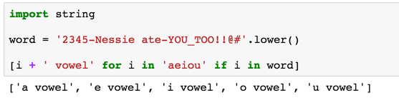
List Comprehensions | loops with conditionals
List comprehension is run on items also in the second iterable
Structure :[Expression(item) for Item in Iterable if Item in container]

Slide 26

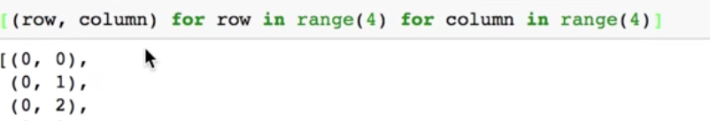
List Comprehensions | loops + loops
List comprehension produces tuples resulting from NESTED loops
Structure :[(Expr1(item1), Expr2(item2)) for Item1 in Iter1 for Item2 in Iter2]
[(0,0),(0,1),(0,2),(0,3),(0,0),(1,0),(1,1),(1,2),(1,3)...(3,3)]
Try this on pythontutor.org http://pythontutor.com/visualize.html#togetherjs=6mOAavcRgK

Slide 27

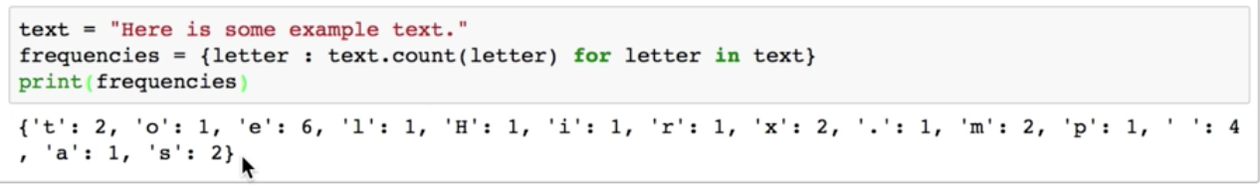
Other Comprehensions | Key:value pairs
Curly {} braces and key value pairs define this one
Structure :{Item : Expression(item) for Item in Iterable}

Slide 28
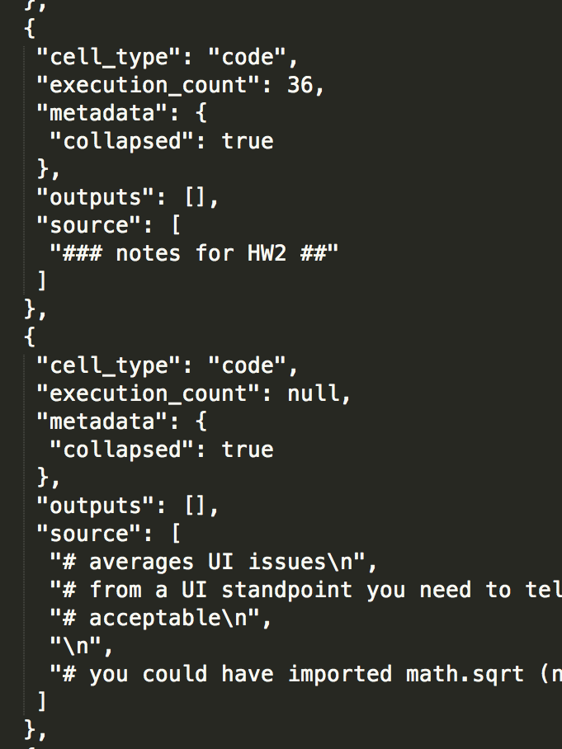
7. Activities
Activity 1 - Finish the pseudocode then implement it.
Work on the other activities, especially the .json parts.
Fun Fact: Your entire Jupyter Notebook is actually saved as JSON. You will see this if you ever need to resolve a Jupyter “merge conflict”.

Slide 29

Recap:
for and while loops
breaking and continuing in nested if-statements
comprehensions
(soon we’ll look at lambda functions that’ll build on this idea)
functional decomposition/data flow - pseudocoding & modularity
(check the optional project management document in resources)
Start thinking about your projects
and practice pseudocoding.

