Slide 1
Working with Text & Binary Data
A rapid review of encoding, files, regex, parsing, and NumPy
Week 9
Updated Oct 21, 2019

Slide 2
Today’s Agenda
Schedule
Guidance for Project 1
Check the extra notebooks for extra examples!
___________________________________________________
Number Representations
Text Representations: Text Files, Binary Files, and Encodings (ASCII, UTF-8, UTF-16, Unicode)
Python Strings
Text Encoding (Codecs)
Regular Expressions (RegEx)
Text Output
Files
Introduction to Numpy

Slide 3
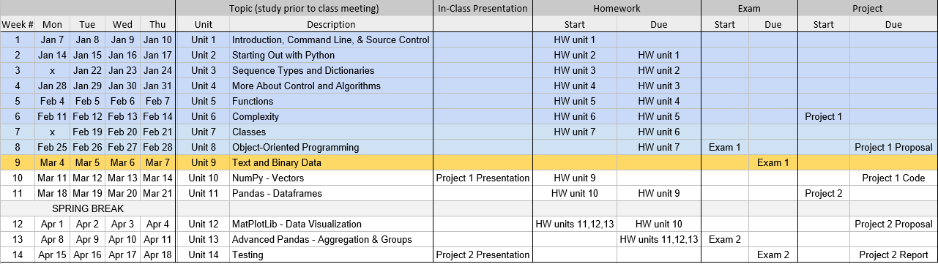
Schedule: Where We Are
https://docs.google.com/spreadsheets/d/1GN3rVDfJqpJWmxPgKPupHQWAX2fYCTHv-7jJOud73FI/edit#gid=0
Spring 2019

Slide 4

Schedule: Where We’re Going
The 2nd half of the course …
Unit 9 | Working With Text and Binary Data
Unit 10 | NumPy
Unit 11 | Data Analysis With Pandas
Unit 12 | More Analysis With Pandas; Data Visualization
Unit 13 | Testing
Team Project
Exam 2

Slide 5
Guidance for Project 1
Explain your project at a high level
Share your screen, run your code, a couple of slides if you want, … show off what you’ve done!
What were the major challenges of your implementation?
Please practice a brief (about 5 min, tops) presentation that communicates your project to others. Very important skill.
If necessary to answer questions, open the code and share to discuss …
What classes did you use to solve your problem?

Slide 6
Up and Down Levels of Abstraction
We’ve traversed the levels of abstraction … up and down …
Fundamental types: ints, floats … [aka primitives]
Container objects: lists, strings
Classes
Now … drill down to characters and bytes

Slide 7
2) Number Representations
Binary (base 2; 0 or 1)
Octal (base 8; 0,1,2,3,4,5,6,7)
Decimal (base 10; 0,1,2,3,4,5,6,7,8,9)
Hexadecimal (base 16; 0, 1, 2, 3, 4, 5, 6, 7, 8, 9, A, B, C, D, E, F)
This leads to various expressions
“byte” [8-bits]
“nibble” [4-bits]
“multibyte” [8, 16, 32, 64, 128]
Setting file permissions: read, write, execute
read/write 1 + 2 = 2⁰ + 2¹ = 3
read./execute 1 + 4 = 2⁰ + 2² = 5
read/write/execute 1 + 2 + 4 = 2⁰ + 2¹ + 2² = 7
So what is 755?

Slide 8
2.1) Number Representations - Binary / Decimal
Binary (base 2) to Decimal (base 10) examples
0000 = 0 [zero in all places, 0, 0, 0, 0]
0001 = 1 [ 1 x 2⁰] 1 in the one’s place
0010 = 2 [ 1 x 2¹] 1 in the two’s place
0100 = 4 [ 1 x 2²] 1 in the four’s place
1000 = 8 [ 1 x 2³] 1 in the eight’s place
1100 = 12 [ 1 x 2³ + 1 x 2²] 1 in the eight’s place and 1 in the four’s place
int("226")
int("11100010", 2) # binary (base 2)
int("342", 8) # 3 binary digits per 1 octal (base 8) digit
int("E2", 16) # 4 binary digits per 1 hexadecimal (base 16) digit

Slide 9
2.2) Number Representations - Octal
The choice of base 16 comes directly from the use of phrases binary strings; first 3 (Octal) and then 4 digit (nibble, aka: hexadecimal)
3 digit binary phrase (Octal)
000 = 0, 001 = 1, 010 = 2, 011 = 3, 100 = 4, 101 = 5, 011 = 6, 111 = 7
These 8 numbers represent one Octal digit that can take values 0-7
Similarly the 4 digit binary phrase (“nibble”) has 16 possible values and represents one hexadecimal digit (0-F)

Slide 10

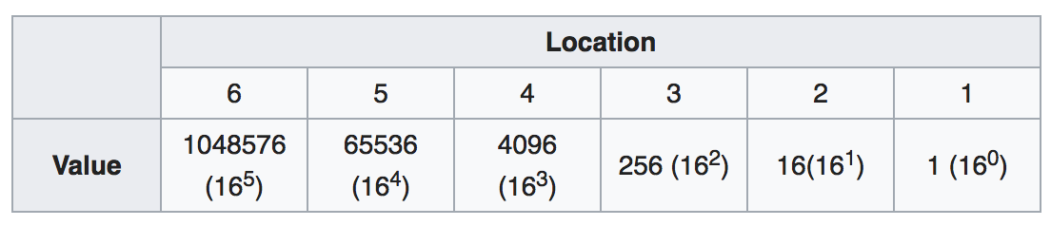
2.3) Number Representations - Hex
Hexadecimal (base 16) to Decimal (base 10)
000 is 0 zero in all places
005 is 5 (5 x 16⁰) one in the 1’s place
050 is 16 (5 x 16¹) one in the 16’s place
500 is 1280 (5 x 16²) one in the 256’s place
In hexadecimal every digit takes one of 16 values coded as 0-F
0 1 2 3 4 5 6 7 8 9 A B C D E F
http://www.digitrax.com/tsd/KB940/decimal-and-hexadecimal-numbers/

Slide 11
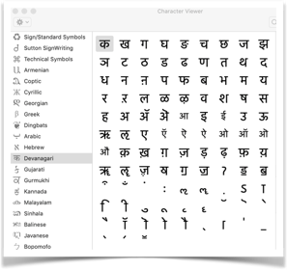
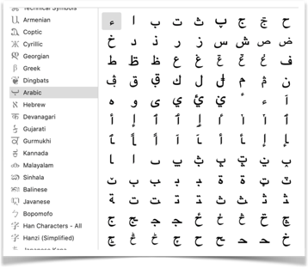
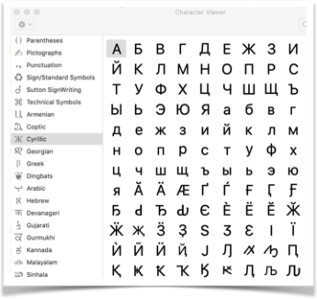
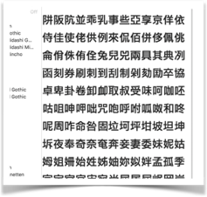
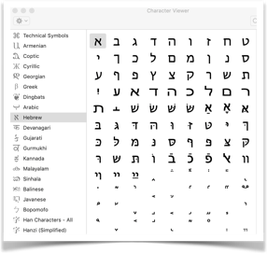

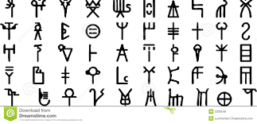
3 Text Representations
Translate icons and typed text to code & back
http://unicode.org and check out the codesheets.

Slide 12
3.1) Text Representations
Ultimately all data are stored as binary (0, 1).
“Internal reflection” of the data is how the data are stored in computer memory and secondary storage (usually as UTF-8; Windows 10 uses UTF-16 and has difficulties with UTF-8)
“External reflection” of the data is what’s shown on the screen (often UTF-8, but could be win-1285, MacRoman, koi-8, etc.) … Keep in mind: It’s all just data! We can call “X” the same thing in a variety of “dialects”
Most end-users think about what they type … but most professional/industrial standards require UTF-8 (https://www.w3schools.com/charsets/ref_html_utf8.asp). There are hundreds of encoding schemes…
When data don’t appear on screen correctly it is often an encoding mismatch between the data stream and the output device’s encoding settings. In word processing programs and in CJK and other language groups, byte-shifting is critical to storage and retrieval. https://en.wikipedia.org/wiki/Character_encoding

Slide 13
3.2) Text Representations | ASCII
ASCII uses 7 binary bits
2⁷ = 128 characters
ASCII with 8 binary bits
2⁸ = 256 characters - aka “Extended ASCII character set”
https://www.sciencebuddies.org/science-fair-projects/references/table-of-8-bit-ascii-character-codes

Slide 14
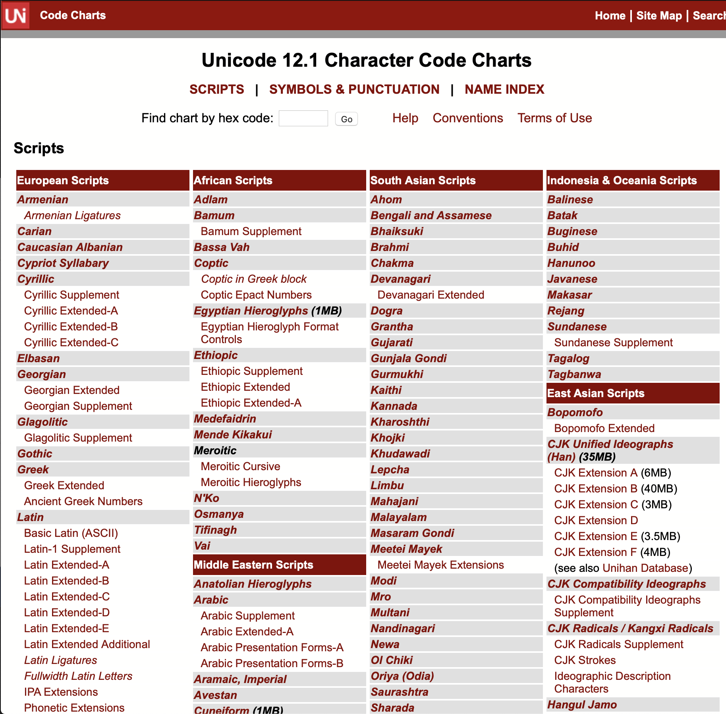
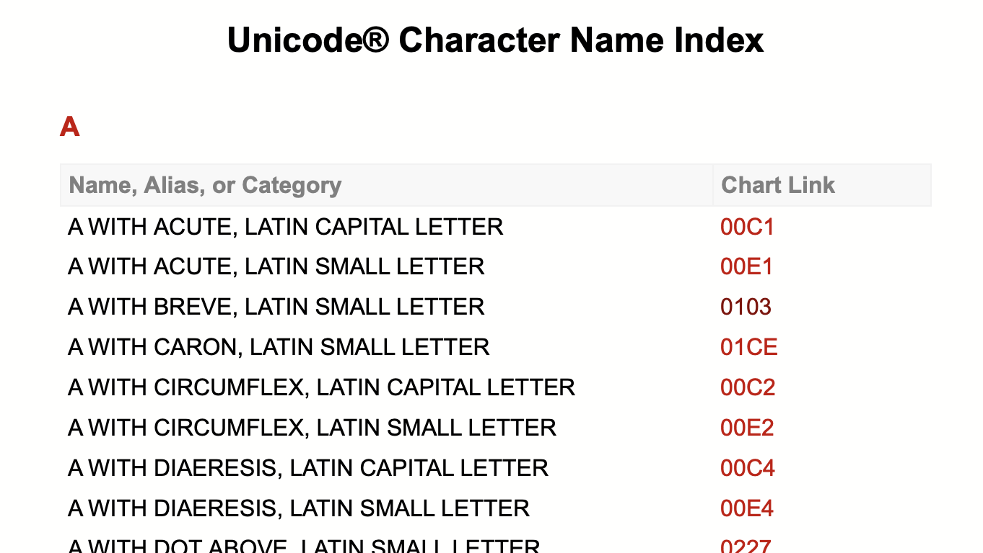
3.3) Text Representations | Unicode
Unicode encodes 120,000 characters
Modern and ancient languages, math
Python 3 has native support for Unicode
http://unicode.org/charts/charindex.html
http://www.unicode.org/charts/

Slide 15
3.4) Text Representations | Unicode
Every Unicode value has a standard name
Use unicodedata.name() to get name from a value
E.g., Value can be literal “B” or Unicode value “\u0042”
E.g., Returns “LATIN CAPITAL LETTER B”
Benefit? Every character can be identified uniquely!
You can often paste exotic characters

Slide 16
3.5) Text Representations | Python Strings
All Python 3 strings are encoded as Unicode
"\u0047\u0072\u0072\u0021" == 'Grr!’ is True
"\u0047\u0072\u0072\u0021" == 'GRR!’ is False
Note: Some characters, particularly historical ones and ligatures, may be software or O/S dependent. Accessing these characters requires knowing and being able to read the “GID”: graph identification number.

Slide 17
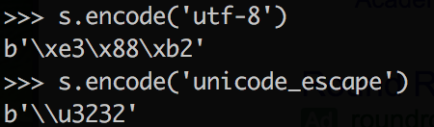
3.6) Text Encoding | UTF-8
UTF-8
Compatible with Unicode
To encode a text string in Unicode, use encode(‘utf-8’)
To decode Unicode, use decode(‘utf-8’)
b prefix denotes bitwise encoding
\x prefix denotes “hexadecimal”
Note: Windows 10 may create files using UTF-16
For example, when you create a file using echo “test” >> test.txt
If you run into encoding issues, this may be the cause.

Slide 18
3.7) Text Encoding | Unicode-8
unicodedata package
encode (), decode()
type (), len()
BTW, in almost all situations data sent over the Net have to be checked for illegal characters, control characters, insertion attacks, etc.
E.g., Data sent over the net might have ‘ in it: O’Reilly … but we must make sure the ‘ won’t conflict with an apostrophe in the code …
E.g., reading and writing data should be encoded/decoded so they can be stored/retrieved without accidental reading issues.

Slide 19
4) RegEx | Functions to Find Patterns
re.compile() # compile a search string
re.search() # gets the first match
re.match() # extract match - if at beginning
re.split() # split on matches
re.sub() # substitute on matches
re.findall() # get all matches as list
.group() # used after matching to pull out groups
matchObject = re.search(pattern, input_str, flags=0)
https://regexone.com/references/python

Slide 20
RegEx | Special Characters
. # any character 1 place
* # any number of char
? # any character optional
[0-9] # any digit
[a-z] # any letter lowercase letter
r’ ’ # the raw string literal

Slide 21

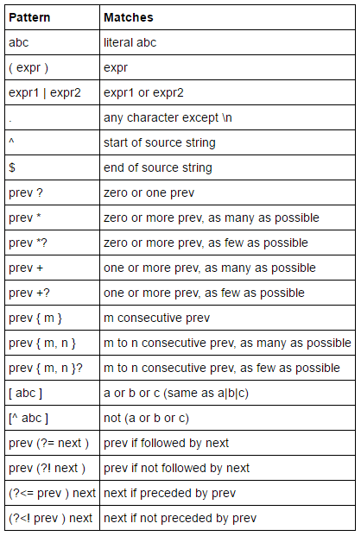
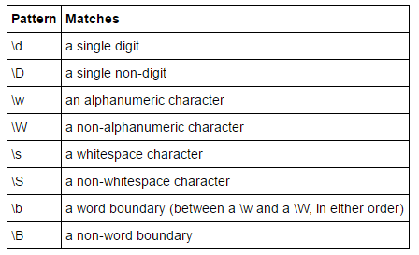
RegEx | Specifiers
not expected to know all this instantly!

Slide 22

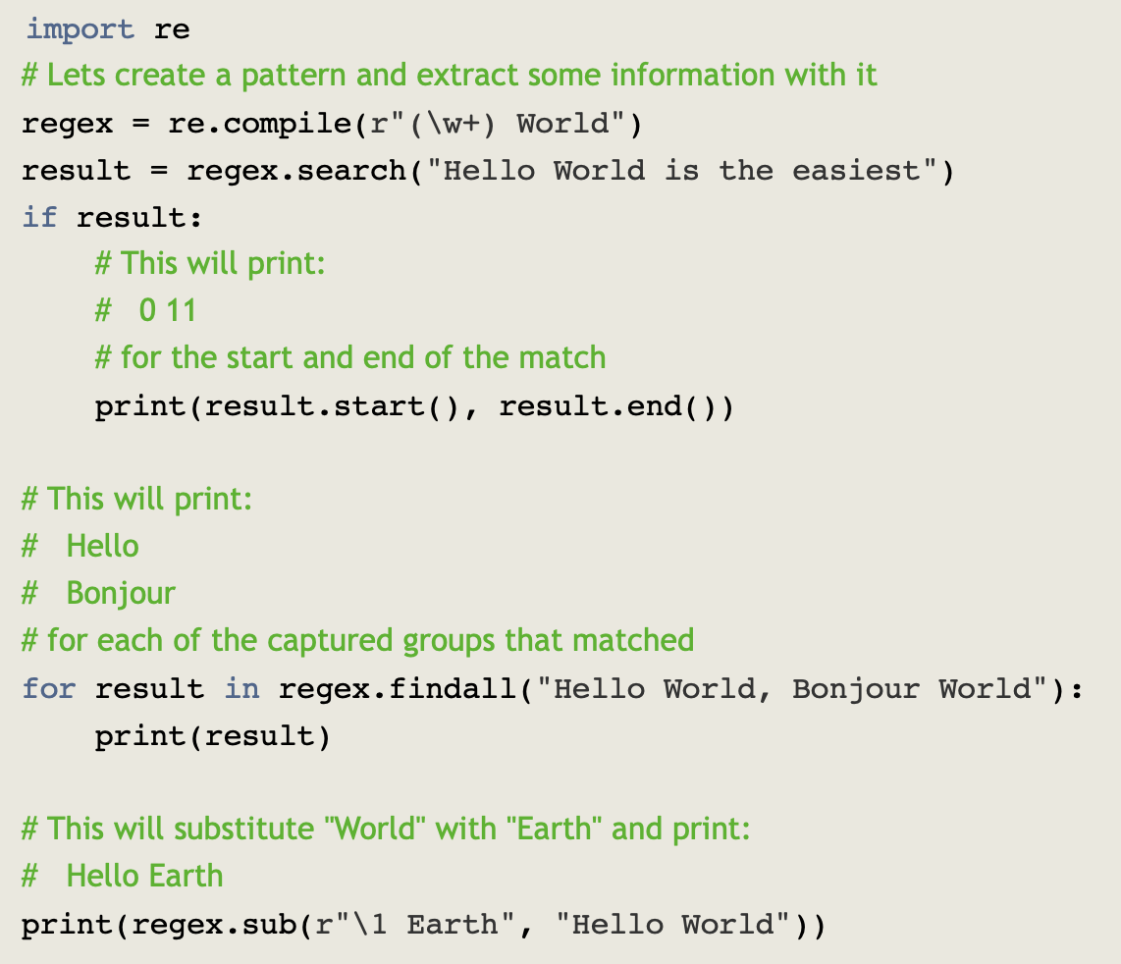
RegEx | Example
https://www.machinelearningplus.com/python/python-regex-tutorial-examples/

Slide 23

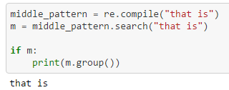

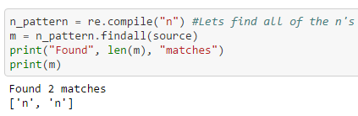
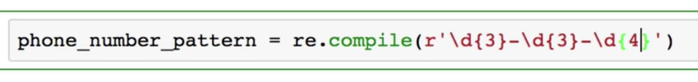
or

Slide 24

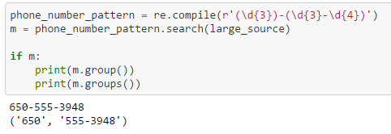

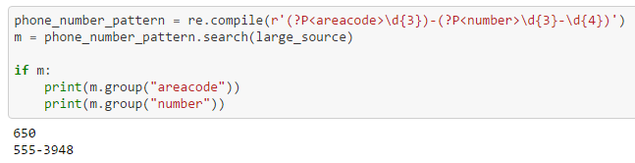
RegEx | Matching Groups

Slide 25




5) Text Output
Consider: s='㈲word'
Simple concatenation: print(‘this is my text: ’ + s)
Old Style: print (‘this is my text: %10s ’ % (s))

Slide 26


5.1) Text Output | New Style
print("This is my text: {sentence:<20s}”.format(sentence=s))
print ("This is my text: {sentence}".format(sentence=s))
print ("This is my text: {}".format(s))

Slide 27
6) Files
open(file, mode) open modes (‘wt’, ‘rd’, ‘at’, ‘rb’, ’wb’)
with() # you don’t need to close this one
write()
read()
readlines() # reads all lines as a list
readline() #reads one line in at a time
close()
See the extra notebook about files, too.

Slide 28

7) Breakout Activity
Files
String parsing
Spring 2019

Slide 29
8) NumPy
NumPy: work with n-dimensional arrays of numeric data of many types.
Pandas is built on top of NumPy and provides a more user friendly experience. There, we work with a “dataset” and include non-numeric variables.
Understanding NumPy is critical to understanding more advanced packages.
A basic understanding of NumPy will deepen your understanding of Pandas.
NumPy offers vectorized operations
https://timothyhelton.github.io/pandas_best_practices.html
https://docs.scipy.org/doc/numpy/user/quickstart.html
http://www.numpy.org
https://numpy.org

Slide 30
8.1) Introduction to NumPy | Python Functions
np.array()
np.arange(), np.linspace()
np.min(), np.max(), np.std(), np.var()
np.argmax(), np.argmin()
np.shape(), np.reshape()
np.zeros()
np.random.seed(), np.random.random_integers()
np.vstack(), np.hstack()
Dealing with n-dimensions: “axis = “ (0 or 1)

