Slide 1
Working with text & binary data
Week 09
Programming for Data Science
Everything bits & bytes; preparing, too, for data cleaning and analysis
March 05, 2020

Slide 2
Agenda
Number representations
Text Representations: ASCII, Unicode, Python Strings
Text Encoding (codex)
Regular Expressions (regex)
Text Output
Files
Intro to NumPy

Slide 3
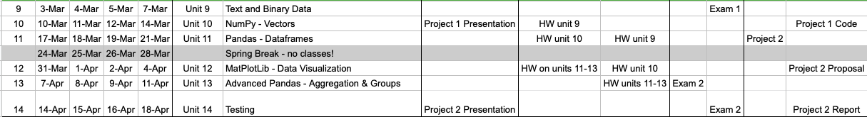

Schedule
10: NumPy
11: Data Analysis
12: More Analysis
13: Testing
Team Project Presentation & Exam 2
Calendar

Slide 4
For Project 1:
Present your project at a high level: share your screen, a couple of slides, if you’d like
Practice your presentation: what classes did you use to solve your coding problem? Major challenges?
Solutions?
Don’t just read thru the code.
Practice(!) and present in no more than 5 minutes: communicate your project to others …. Classmates are encouraged to ask questions.

Slide 5
Drilling down to bits & bytes
Base 2: Binary (0s and 1s)
Base 8: Octal (0,1,2,3,4,5,6,7)
Base 10: Decimal (0,1,2,3,4,5,6,7,8,9)
Base 16: Hexadecimal (0,1,2,3,4,5,6,7,8,9,A,B,C,D,E,F)
8-bits = byte
4-bits = nibble
> 8 = multibyte

Slide 6
Number representations
0000 = 0 [zero in all places: 0 0 0 0]
0001 = 1 [1 x 2⁰; 1 in the “one’s” place]
0010 = 2 [1 x 2¹; 1 in the “two’s” place]
0100 = 4 [1 x 2²; 1 in the “four’s” place]
1000 = 8 [1 x 2³; 1 in the eight’s place]
1100 = 12 [1 x 2³ + 1 x 2²; 1 in the eight’s and four’s places]

Slide 7
Number representations: octal
Setting file permissions in octal: read, write, execute
read/write 1 + 2 = 2⁰ + 2¹ = 3
read./execute 1 + 4 = 2⁰ + 2² = 5
read/write/execute 1 + 2 + 4 = 2⁰ + 2¹ + 2² = 7
So what is 755?
000 = 0
001 = 1
010 = 2
011 = 3
100 = 4
101 = 5
011 = 6
111 = 7
Why?
because a Turing machine can put only one symbol at a time in the tape-head position; hence need one symbol.

Slide 8

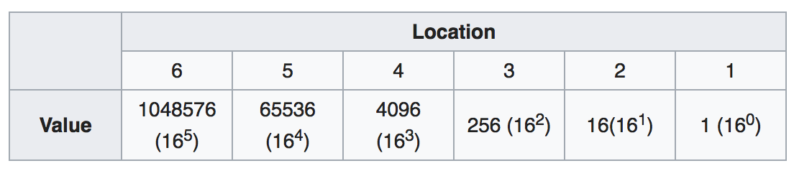
Number reps: hexadecimal
000 = 0
005 = 5 (5 x 16⁰)
050 = 16 (5 x 16¹)
500 = 1280 (5 x 16²)
The alphabet is 0 1 2 3 4 5 6 7 8 9 A B C D E F

Slide 9
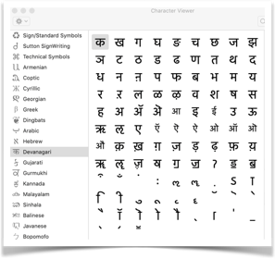
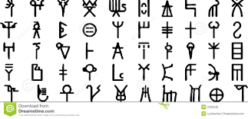
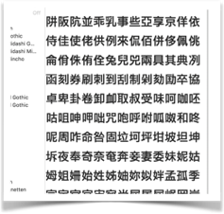
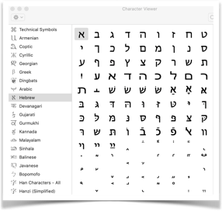
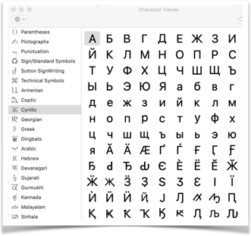

Text Representations: Unicode
Every grapheme has a unique identifying number and unique identifying name. Can be represented in hex; some historical characters require the GID (Glyph IDentifier).
Grapheme forms are linguistically- and culturally-sensitive

Slide 10
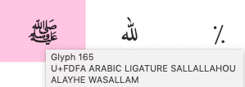
n
辵
辶
Each grapheme has its own code - so the byte string varies based on the linguistic context!
This is a challenge in compression and text processing ‘cause tonal languages (Thai, Vietnamese, etc.), Arabic/Hebrew, and CJK languages often use bytes instead of https://en.wikipedia.org/wiki/ASCII tokens (words).
हिंदी
ihdī
/u093F/u0939/u0902/u0926/u0940
i h ^{n} d ī
walk; and form in combination with other characters.
different code points for the same concept/character
/u0939/u0907/u0928/u0926/u0940
h i n d i
Notice the differences between code points and position of grapheme.
明娃
hao
مرحبا
م مم مامم
Why does this matter to you? What if the file stream were “ascii-us” or “JIS” or “IIS” or “Big5” or … and so on. There’s a combo of non-printable characters (control chars) and bytes that make processing a challenge. Used in automatic language and file-format detection.
marhabaan
M mm mm
Cultural realia expressed in code.
ﷺ

Slide 11
Text Representations
https://en.wikipedia.org/wiki/ASCII
ASCII (7-bit, 27 = 128 chars; also 8-bit ASCII “extended char set”
Unicode (120,000+ characters; Python has native Unicode support). Import unicodedata.name() to return name from a value: e.g., Literal value “B” or Unicode value “/u0042” returns “LATIN CAPITAL LETTER B” (and can go the other way, too)
Text can return boolean when compared:
"\u0047\u0072\u0072\u0021" == 'Grr!’ is True
“\u0047\u0072\u0072\u0021" == 'GRR!’ is False
http://unicode.org/charts/charindex.html
https://www.sciencebuddies.org/science-fair-projects/references/table-of-8-bit-ascii-character-codes

Slide 12
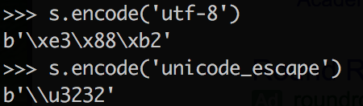
Text Encodings
UTF-8: the multibyte implementation of Unicode, a descriptive standard. Use encode/decode
b prefix denotes bitwise encoding
\x prefix denotes hex.
We’re not always sure what the data will be like when integrating heterogeneous data sources … Win10 might create files in UTF-10!
Check out the documentation: https://docs.python.org/3/howto/unicode.html
https://docs.python.org/2.4/lib/standard-encodings.html

Slide 13
RegEx: regular expressions
There’s a debate about time improvement and binding var name to data. No clear preference in practice.
re.compile()
re.search()
re.match()
re.split()
re.sub()
re.findall()
.group()
compile a search string
get the first match
extract match (at beginning)
split based on matches
get all matches as a list
used after matching to pull out groups
matchObject = re.search(pattern, input_str, flags=0)
https://regexone.com/references/python

Slide 14
RegEx: Special characters
.
*
?
[0-9]
[a-z]
r’ ‘
any character 1 place
any number of characters
any optional character
any digit
any lower-case letter
raw string literal
https://pythonforbiologists.com/regular-expressions

Slide 15
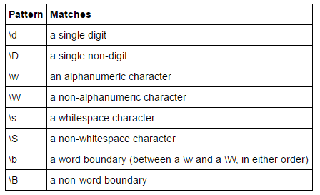

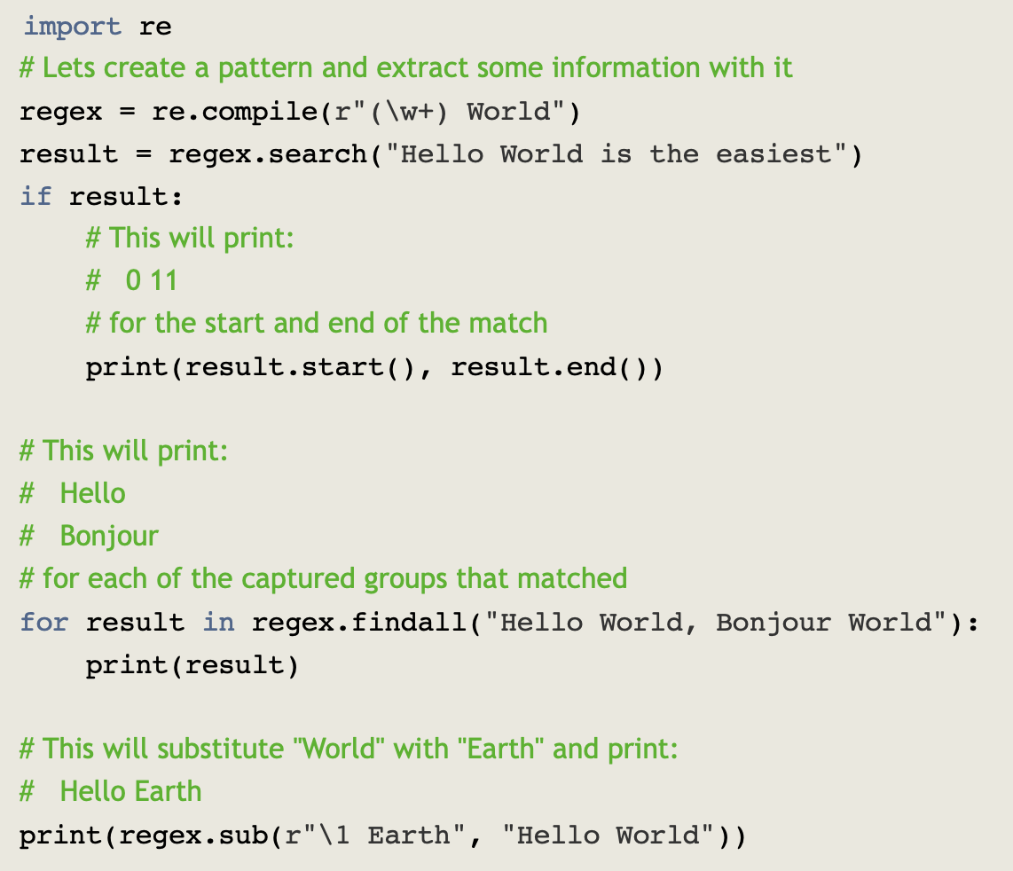

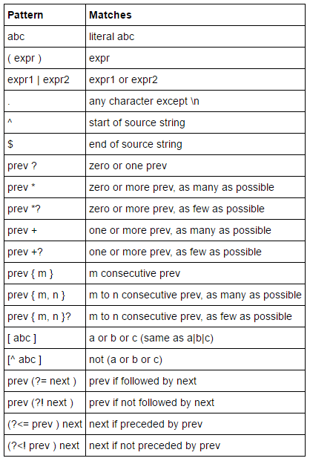
RegEx: Specifiers & Example
https://www.machinelearningplus.com/python/python-regex-tutorial-examples/

Slide 16

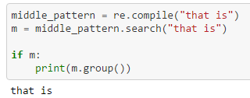

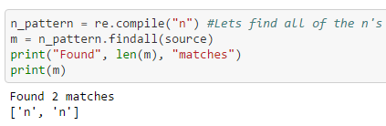
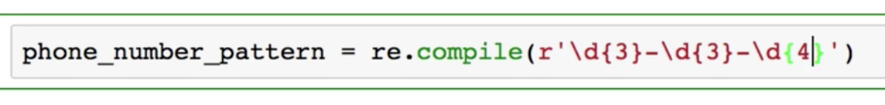
RegEx: Examples
Usually find options locate first or last occurrence but we may want every occurrence. Some find options return the index of the desired substring; this requires more coding to profit. Patterns are possible, too, and this is useful for known/expected structuring of the source data.

Slide 17

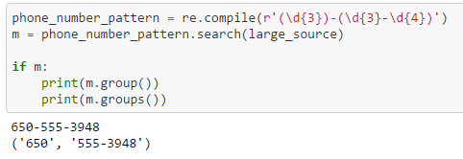

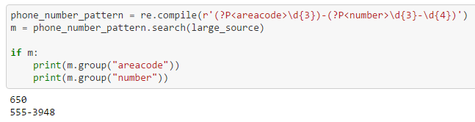
RegEx: Groups

Slide 18
Example: biology
? optional, e.g., GAT?C matches GATC or GAC
GGG(AAA)?TTT means the group of 3 s is optional. matches GGGAAATTT or GGGTTT
means char/group must be present and can be repeated
following a group/char means group/char is optional but can be repeated 0+ times
| is the “pipe” or “either|or”
dna = “ATCGCGAATTCAC”
if re.search(r”GAATTC”, dna):
print(“restriction site found.”)
if re.search(r”GGACC”, dna)
or re.search(r”GGTCC”, dna):
print(restriction site found)
if re.search(r”GG(A|T)CC”, dna):
print(“Yup, another restriction site.”)
if re.search(r”GG[ATGC]GC”, dna):
print(“Restrictions…”)
https://pythonforbiologists.com/regular-expressions

Slide 19
Example: biology
Position commands:
{start,stop}. GA{2,4}T matches G then 2 to 4 As, then T.
^ matches the start of a string; $ matches the end of a string.
^AAA matches AAATTT but not GGGAAATTT
GGG$ matches AAAGGG but not AAAGGGCCC
^AUG[AUGC]{30,1000}A{5,10}$
This complex pattern will identify full-length eukaryotic messenger RNA sequences.
Reading the pattern from left to right, it will match:
an AUG start codon at the beginning of the sequence
followed by between 30 and 1000 bases, which can be A, U, G or C
followed by a poly-A tail of between 5 and 10 bases at the end of the sequence

Slide 20
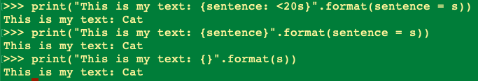
Text output using .format()
Let’s say s = ‘Cat’
print(“Some text: {sentence: <20s}”.format(sentence = s))
print(“Some text: {sentence}”.format(sentence = s))
print(“Some text: {}”.format(s))

Slide 21
Files!
All languages have (seemingly generic) file objects for reading/writing; and have variations depending on file type and architecture (e.g., FileObjects and various stream options).
open(file, mode) (‘wt’,’rd’,’at’,’rb’, ‘wb’);
be sure to close()!
with() command; don’t need to close
write() read() readlines() readline()
try:
with open("words.txt", "r", encoding = ‘utf-8', newline = None) as fd:
lines = fd.readlines()
lines = [w.replace("\n","") for w in lines]
sorted_lines = lines.sort()
https://docs.python.org/3/tutorial/inputoutput.html
https://docs.python.org/3/c-api/file.html

Slide 22
Breakout Rooms
To practice reading files (.json), string parsing, and a stream

Slide 23

NumPy: quick intro
work with n-dimensional arrays of numeric data
Works with Pandas to provide a more user-friendly experience. Use a “dataset” and include non-numeric variables.
Using NumPy deepens knowledge of using python and other libraries.
https://timothyhelton.github.io/pandas_best_practices.html
https://docs.scipy.org/doc/numpy/user/quickstart.html
http://www.numpy.org

Slide 24
NumPy basic functions
import numpy as np
np.array()
np.arange(), np.linspace()
Measures of Central Tendency: np.min(), np.max(), np.std(), np.var()
np.argmax(), np.argmin()
np.shape(), np.reshape()
np.zeros() (more helpful than you’d think)
np.random.seed(), np.random.random_integers()
np.vstack, np.hstack()
dealing with n-dimensions; axis = 0. or axis = 1

Slide 25
Summary
Numeric and Text Representations
Encoding: ASCII, Unicode, Python Strings
Text encoding/decoding
Regular Expressions and examples
Formatting text with .format()
File I/O basics
Breakout room processing tweets
A look at NumPy basic functions

