Slide 1
EHS Safety Tool
User Guide
Complete Guide to Digital Safety Management
v1.0.0 | February 2026
1 / 22

Slide 2
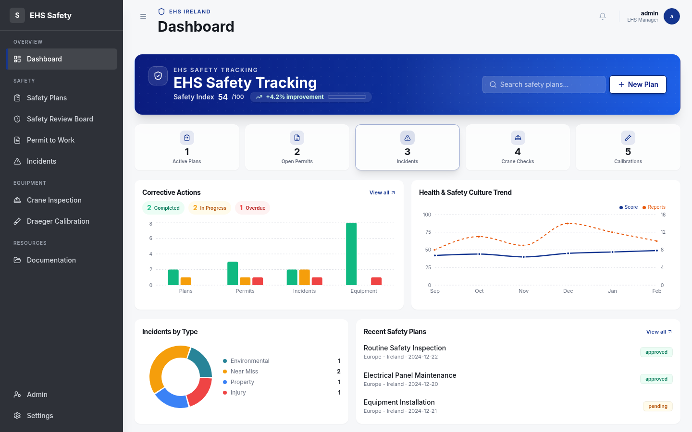
Dashboard
2 / 22

Slide 3
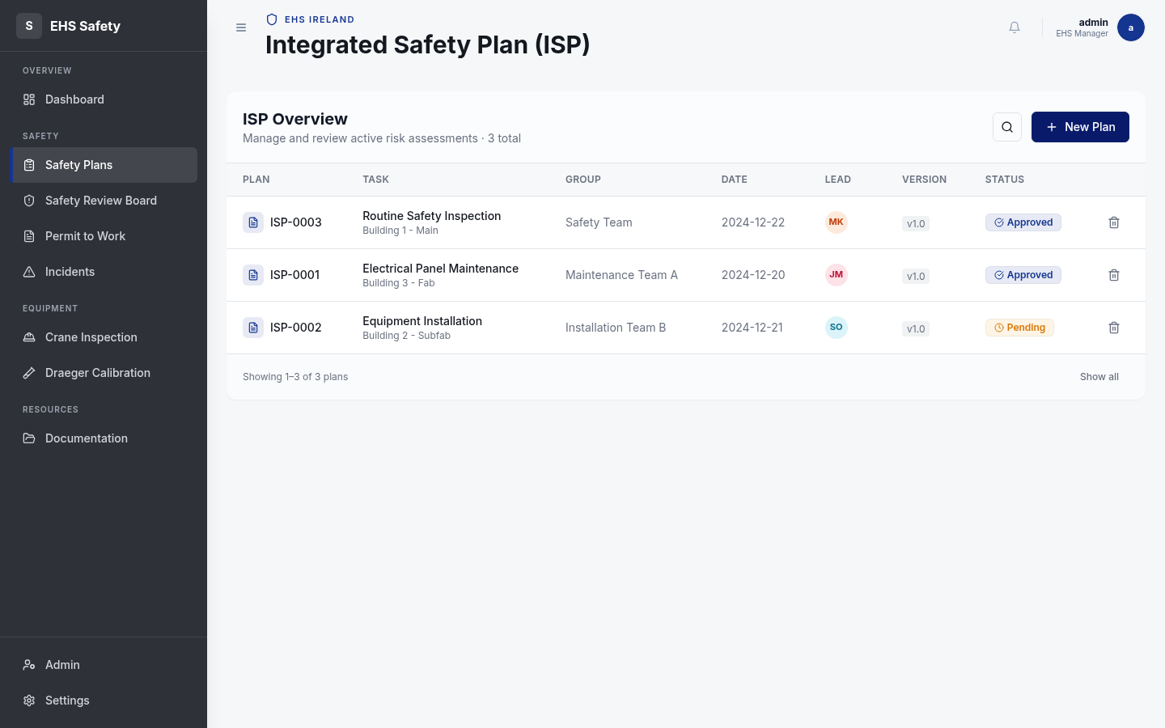
Safety Plans
3 / 22

Slide 4
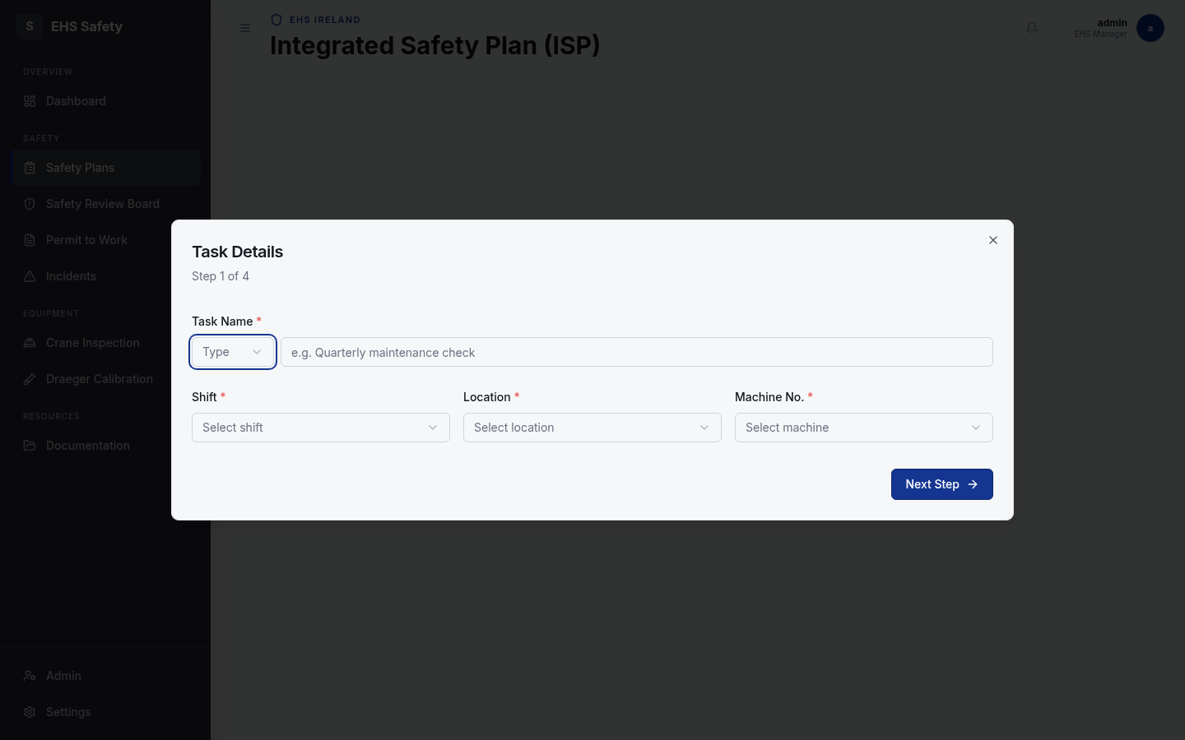
ISP Form
4 / 22

Slide 5
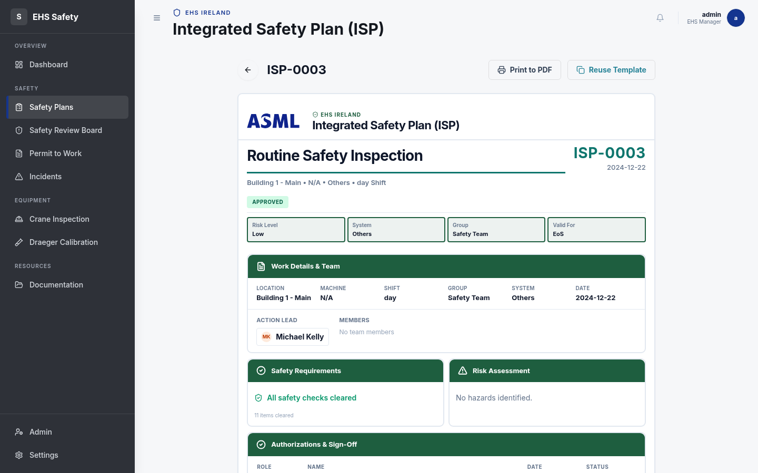
ISP Document
5 / 22

Slide 6
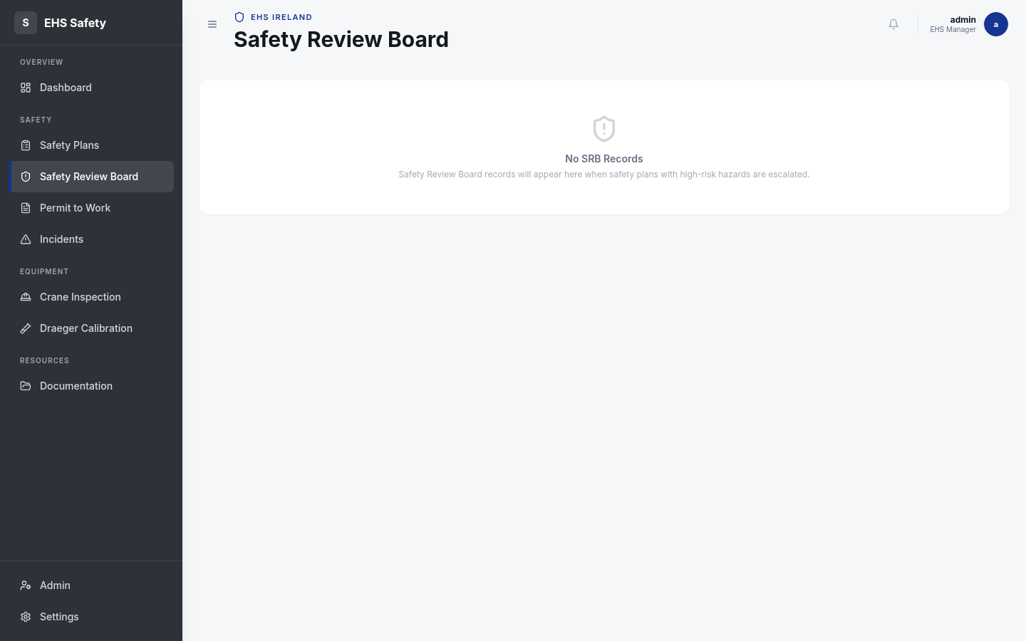
Safety Review Board
6 / 22

Slide 7
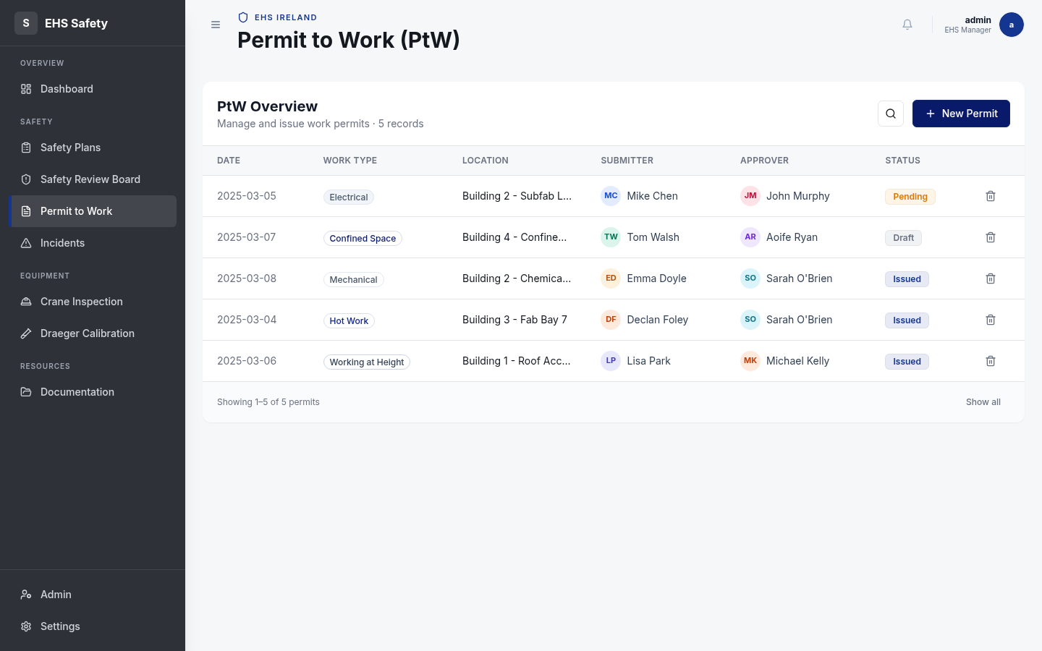
Permit to Work
7 / 22

Slide 8
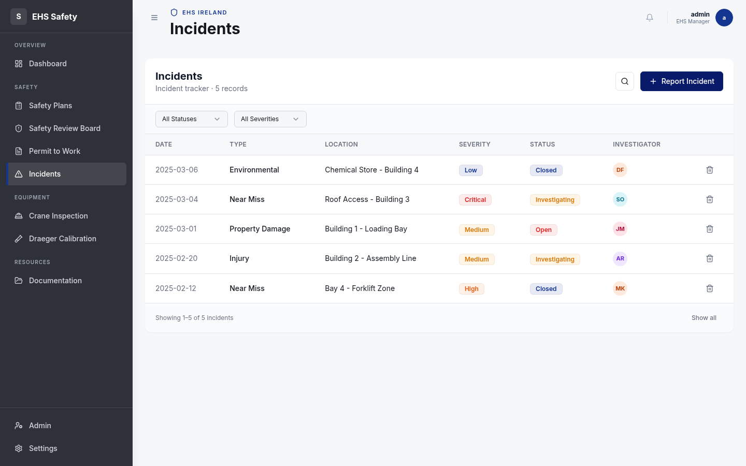
Incidents
8 / 22

Slide 9
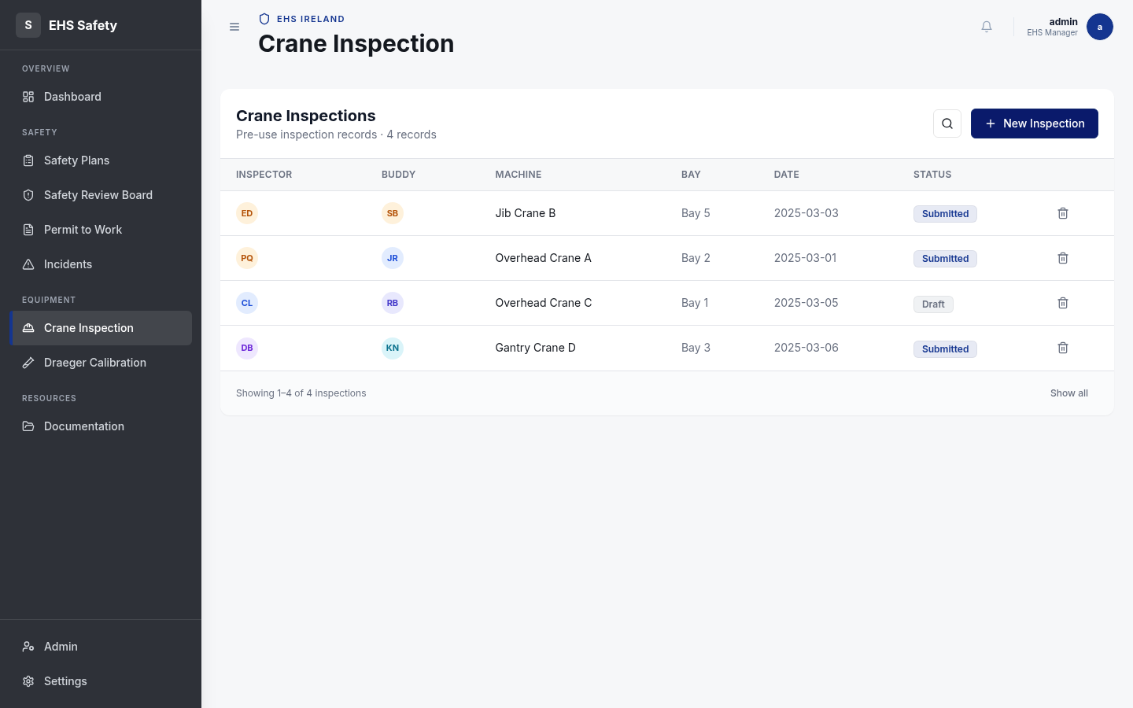
Crane Inspection
9 / 22

Slide 10
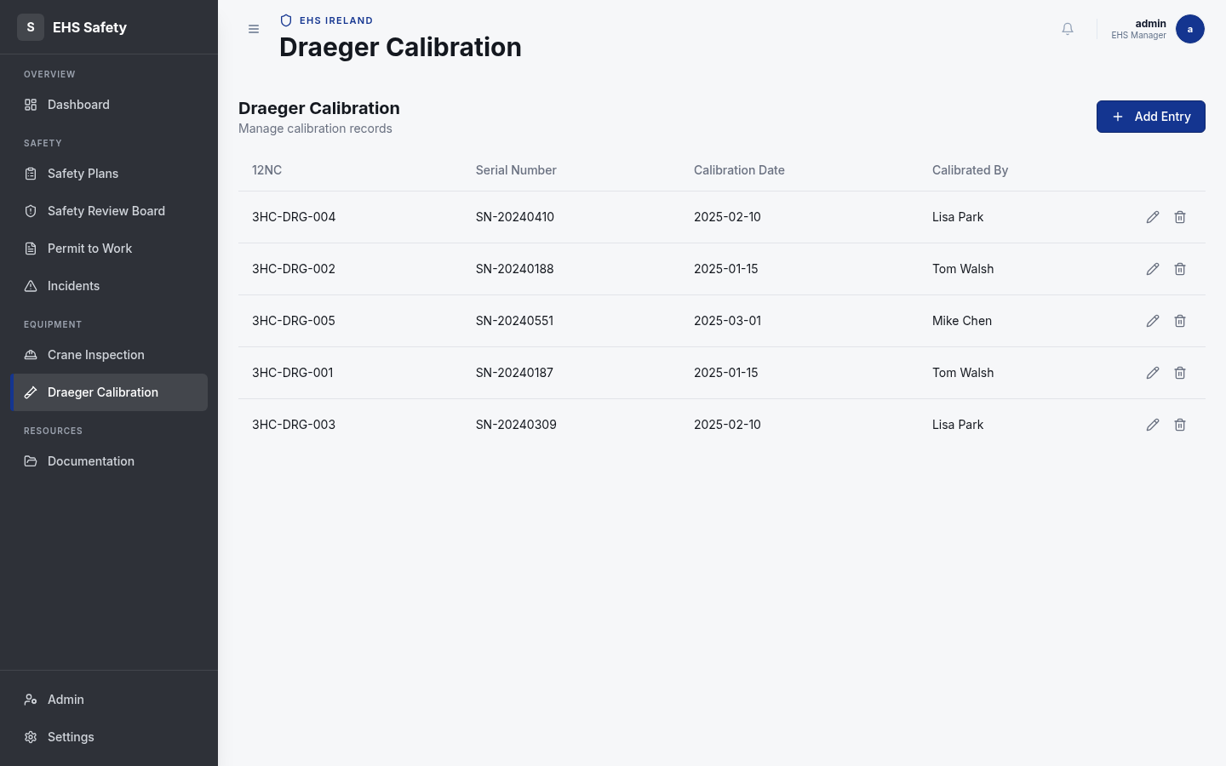
Draeger Calibration
10 / 22

Slide 11
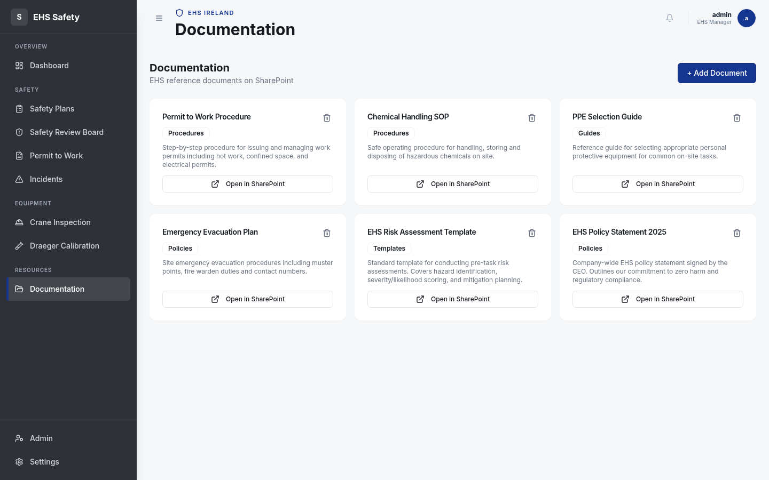
Documentation
11 / 22

Slide 12
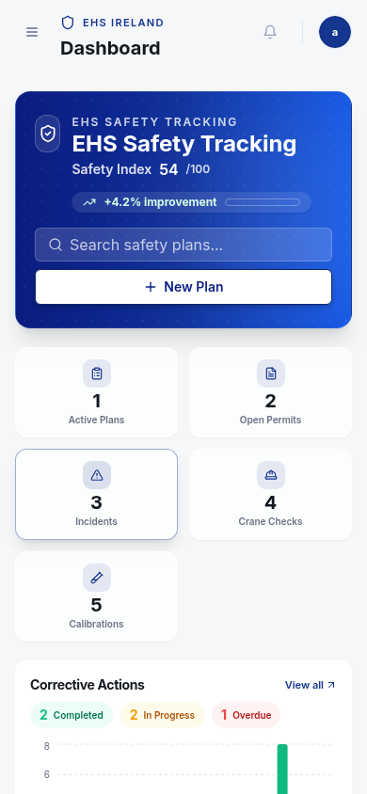
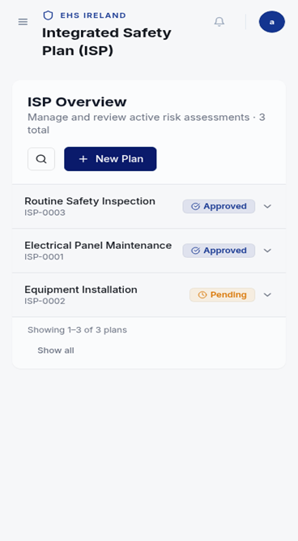
Mobile Access
12 / 22

Slide 13
Getting Help
14 / 22

Slide 14
Security & Compliance
15 / 22

Slide 15
Future Features
17 / 22

Slide 16
Quick Start
18 / 22

Slide 17
Training Resources
19 / 22

Slide 18
Support Channels
20 / 22

