Slide 1
EHS Safety Tool
User Guide
Complete Guide to Digital Safety Management
v1.0.0 | February 2026
1 / 22

Slide 2
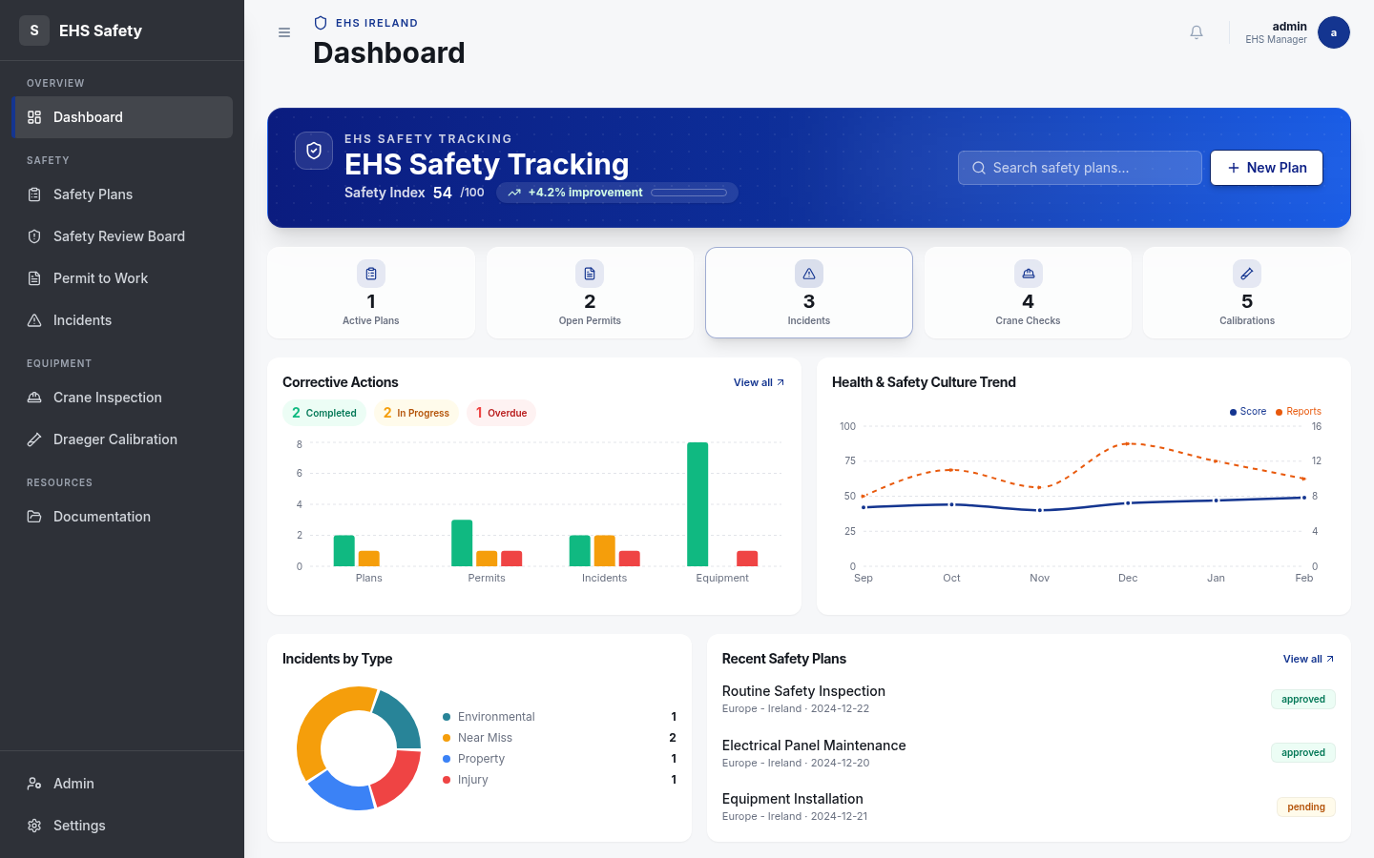
What is the EHS Tool?
1 / 22

Slide 3
Getting Started
2 / 22

Slide 4
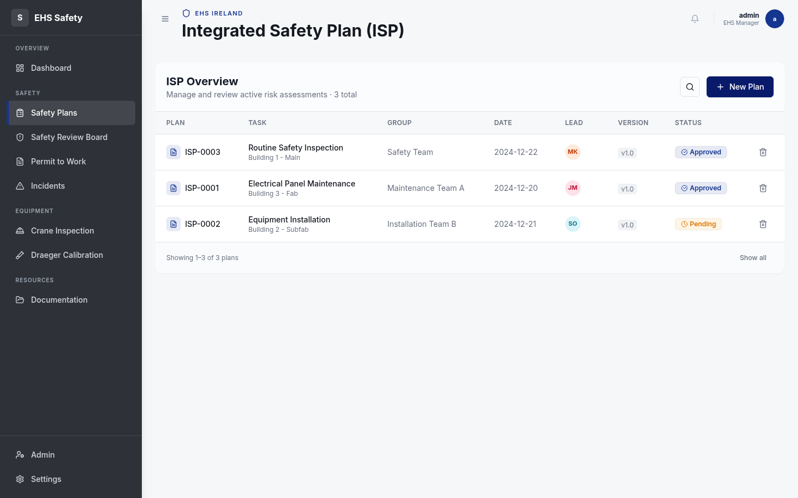
Safety Plans Overview
3 / 22

Slide 5
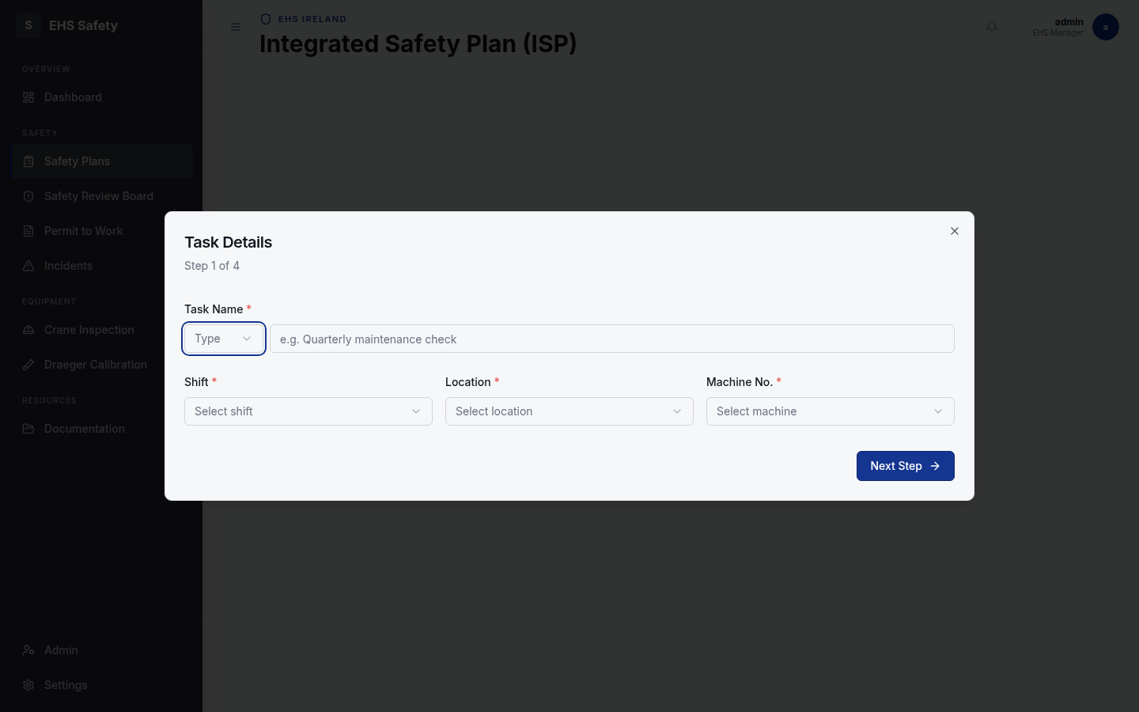
Creating Safety Plans
4 / 22

Slide 6
Step 1: Task Details
5 / 22

Slide 7
Step 2: Assessment
6 / 22

Slide 8
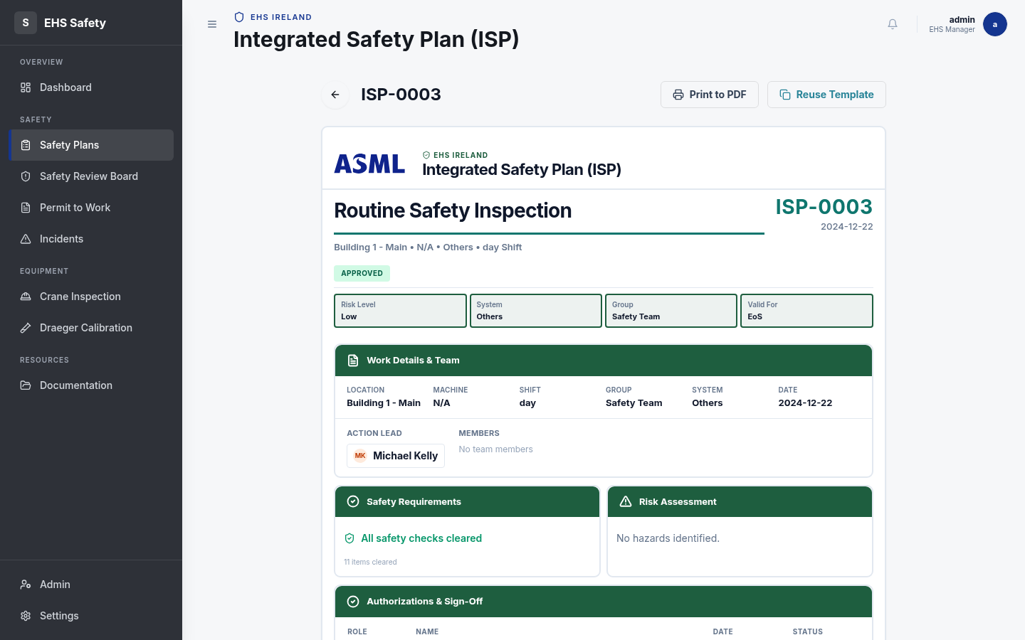
Step 3: Hazards
7 / 22

Slide 9
Step 4: Sign Off
8 / 22

Slide 10
ISP Document Format
9 / 22

Slide 11
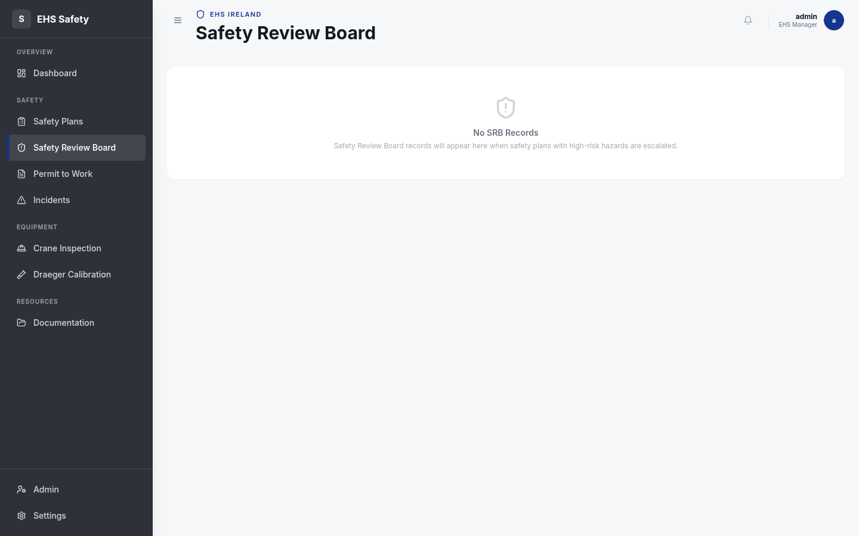
Safety Review Board
10 / 22

Slide 12
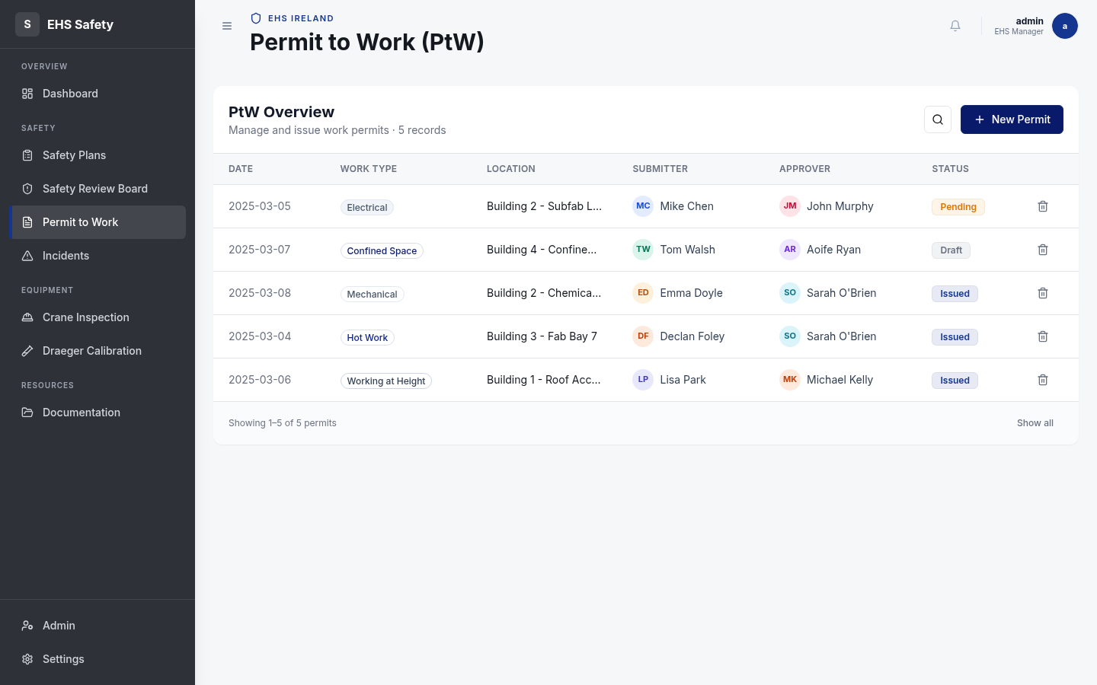
Permit to Work
11 / 22

Slide 13
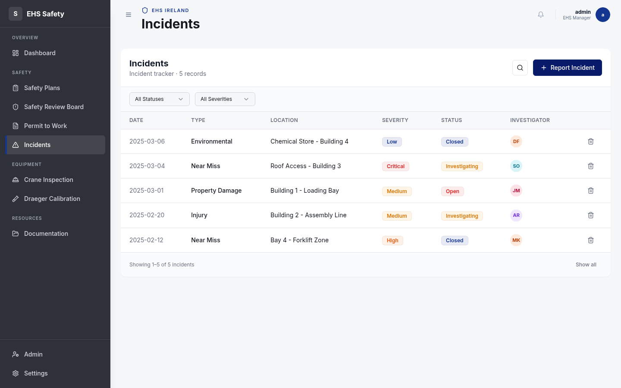
Incidents Management
12 / 22

Slide 14
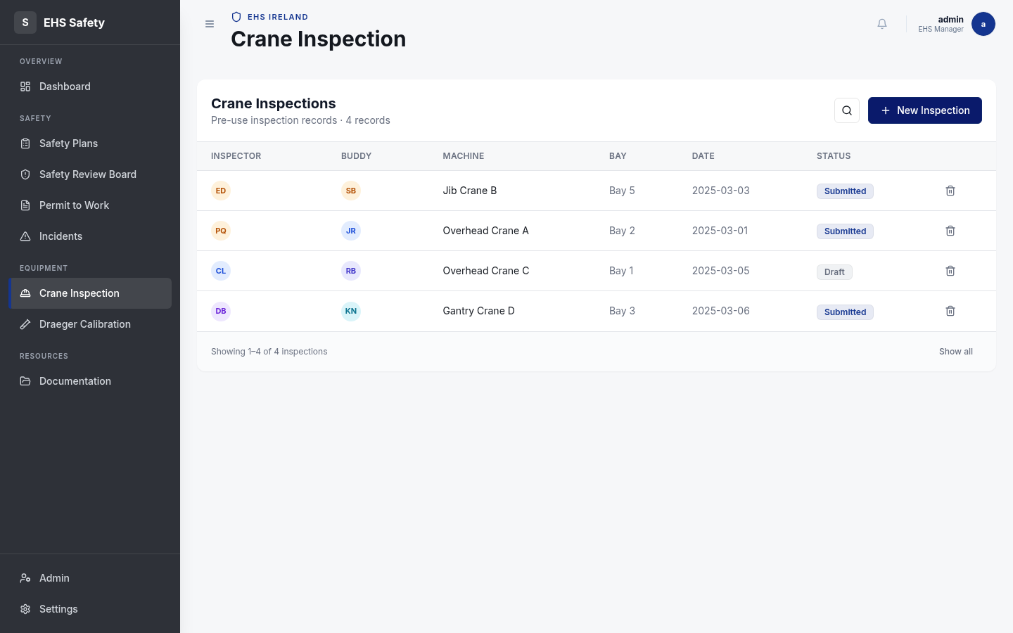
Crane Inspection
13 / 22

Slide 15
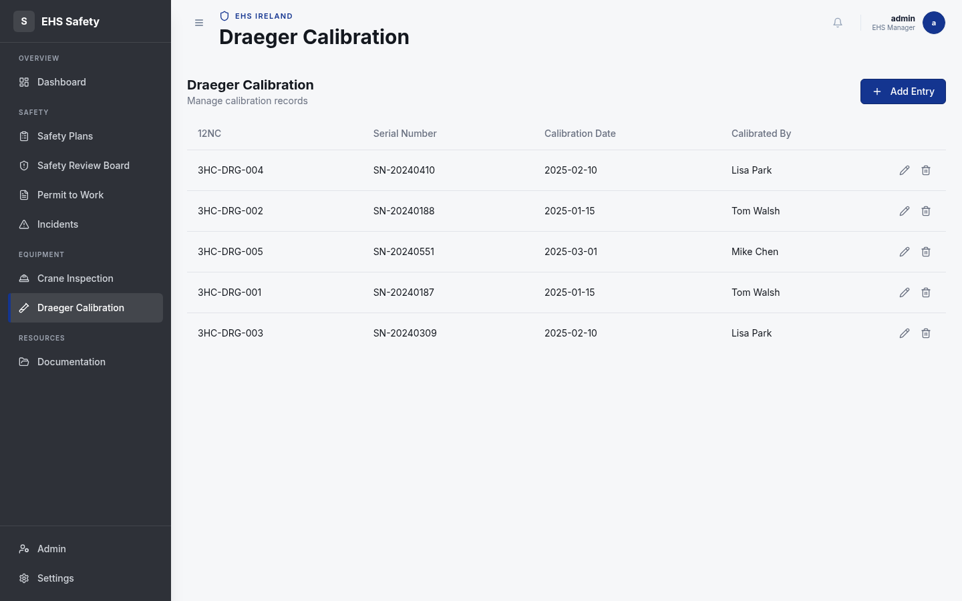
Draeger Calibration
14 / 22

Slide 16
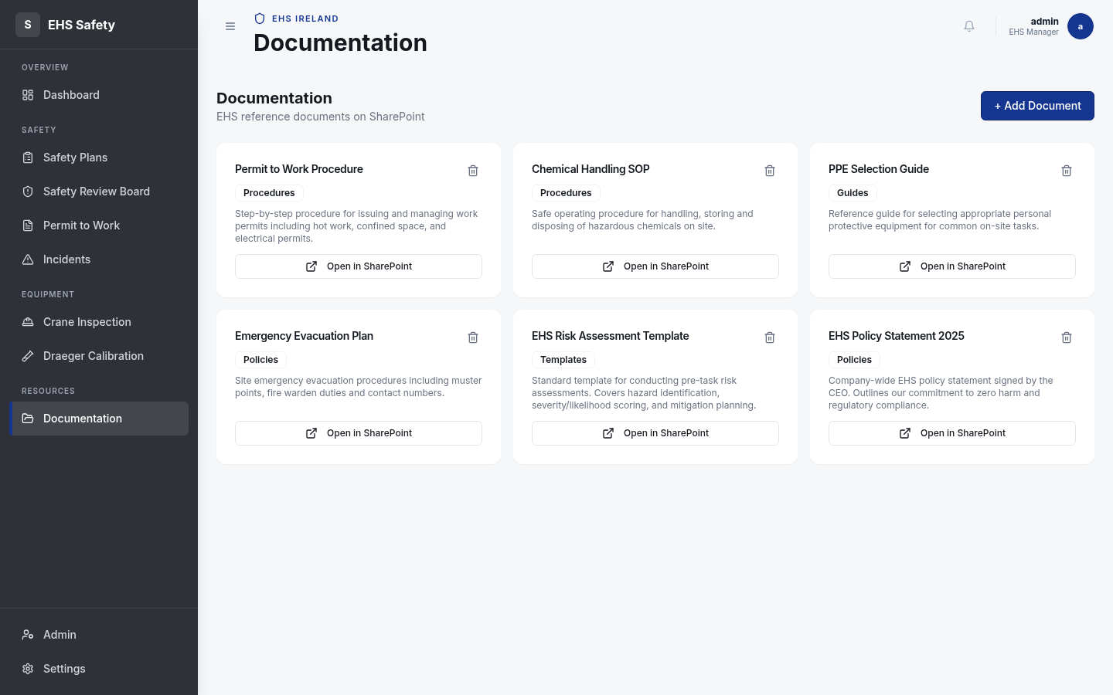
Documentation Library
15 / 22

Slide 17
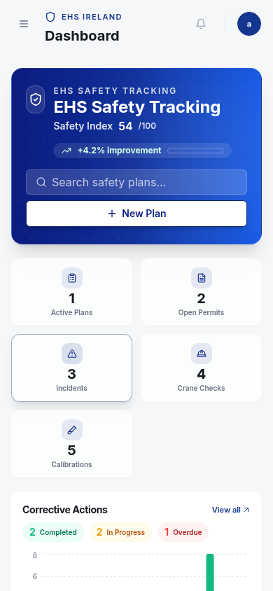
Mobile Features
16 / 22

Slide 18
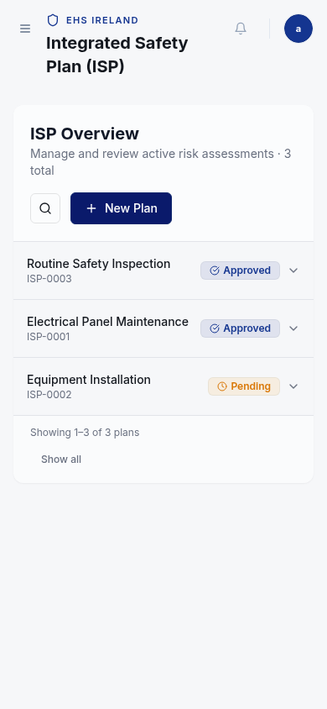
Status Reference
17 / 22

Slide 19
Future Integration
18 / 22

Slide 20
Support Resources
19 / 22

Slide 21
Quick Reference
20 / 22

Slide 22
You're Ready!
Safety is everyone's responsibility
ehs-tool@asml.com
21 / 22

