Slide 1
Windows/Mac Antivirus
By Jackie Borin Advisor: Dr. Wei Dai

Slide 2
Agenda
The Importance of Antivirus
WannaCry Ransomware
Common Malware Types
Basics of Antivirus
What Antivirus is and Does
Windows 11 Defender Antivirus
Antivirus in Windows 11
MacOS Antivirus
Antivirus in Mac 11
Conclusion

Slide 3
The Importance of antivirus

Slide 4
WannaCry Ransomware Attack
WannaCry – Ransomware targeting Windows devices in 2017
Encrypted user’s data and demanded ransom to return the files
Microsoft Defender Antivirus detects and removes WannaCry by 2018
2016 – Devices secure
2017 – WannaCry Ransomware unleashed
2018 – Windows Antivirus protects against WannaCry
Source: https://usa.kaspersky.com/resource-center/threats/ransomware-wannacry
Source: https://www.microsoft.com/en-us/wdsi/threats/malware-encyclopedia-description?Name=Ransom:Win32/Wannacry.D&ThreatID=-2147238884

Slide 5
Types of Malware
Virus – Spreads itself to other programs and systems
Worm – Spreads itself to other devices
Trojan – Pretends to be legitimate, but is malicious
Ransomware – Encrypts files or locks user out of device until ransom is paid
Adware – Unwanted, spammy ads
Bots – Causes your computer to perform malicious tasks without you knowing
Antivirus software can protect against these attacks
Source: https://arcticwolf.com/resources/blog/8-types-of-malware

Slide 6
Basics of Antivirus

Slide 7

What Antivirus is and does
“Antivirus software helps protect your computer against malware and cybercriminals. Antivirus software looks at data — web pages, files, software, applications — traveling over the network to your devices. It searches for known threats and monitors the behavior of all programs, flagging suspicious behavior. It seeks to block or remove malware as quickly as possible”
Source: https://us.norton.com/internetsecurity-malware-what-is-antivirus.html
Image source: https://www.lifewire.com/how-to-tell-if-your-antivirus-is-working-153380

Slide 8

Windows 11 Defender Antivirus
Image source: https://www.freepnglogos.com/pics/logo-windows

Slide 9
Updating windows 11
Find the Antivirus settings
Antivirus settings
Scan types

Slide 10

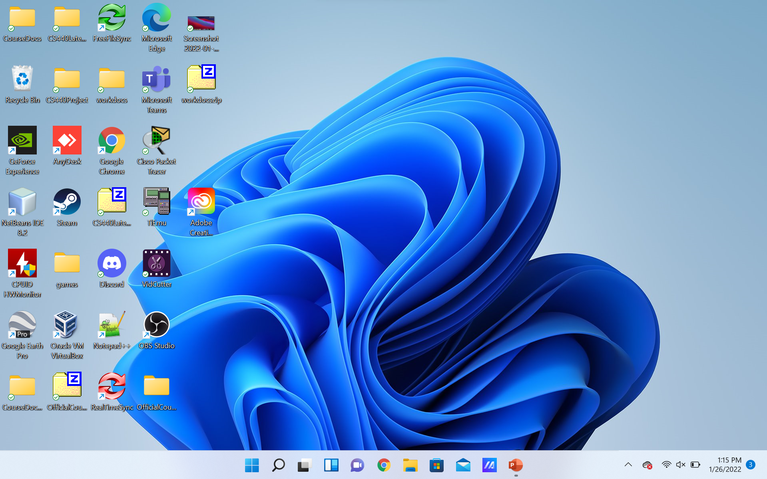
Find the Antivirus settings
Step 1 – Click on the search icon towards the bottom left of the screen:
Alternatively, you can press the Windows key on your keyboard instead of clicking the Search icon

Slide 11
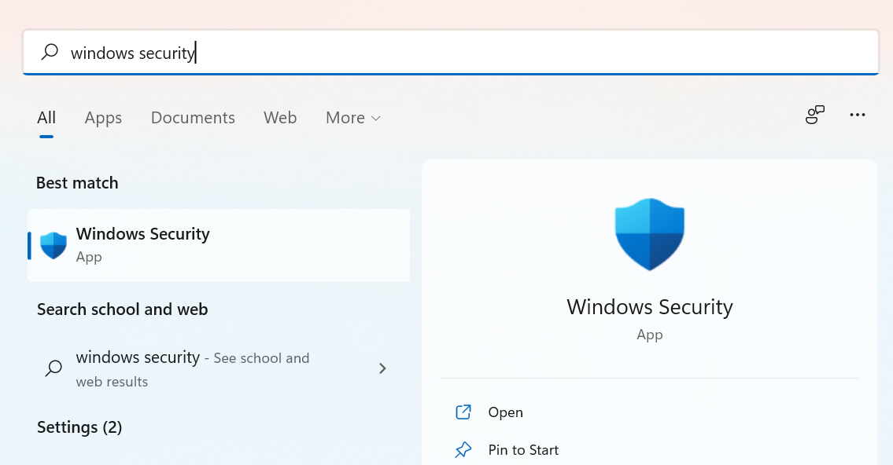

Find the Antivirus settings
Step 2 – Search “Windows security”:
Step 3 – Click to open the “Windows Security” app:

Slide 12
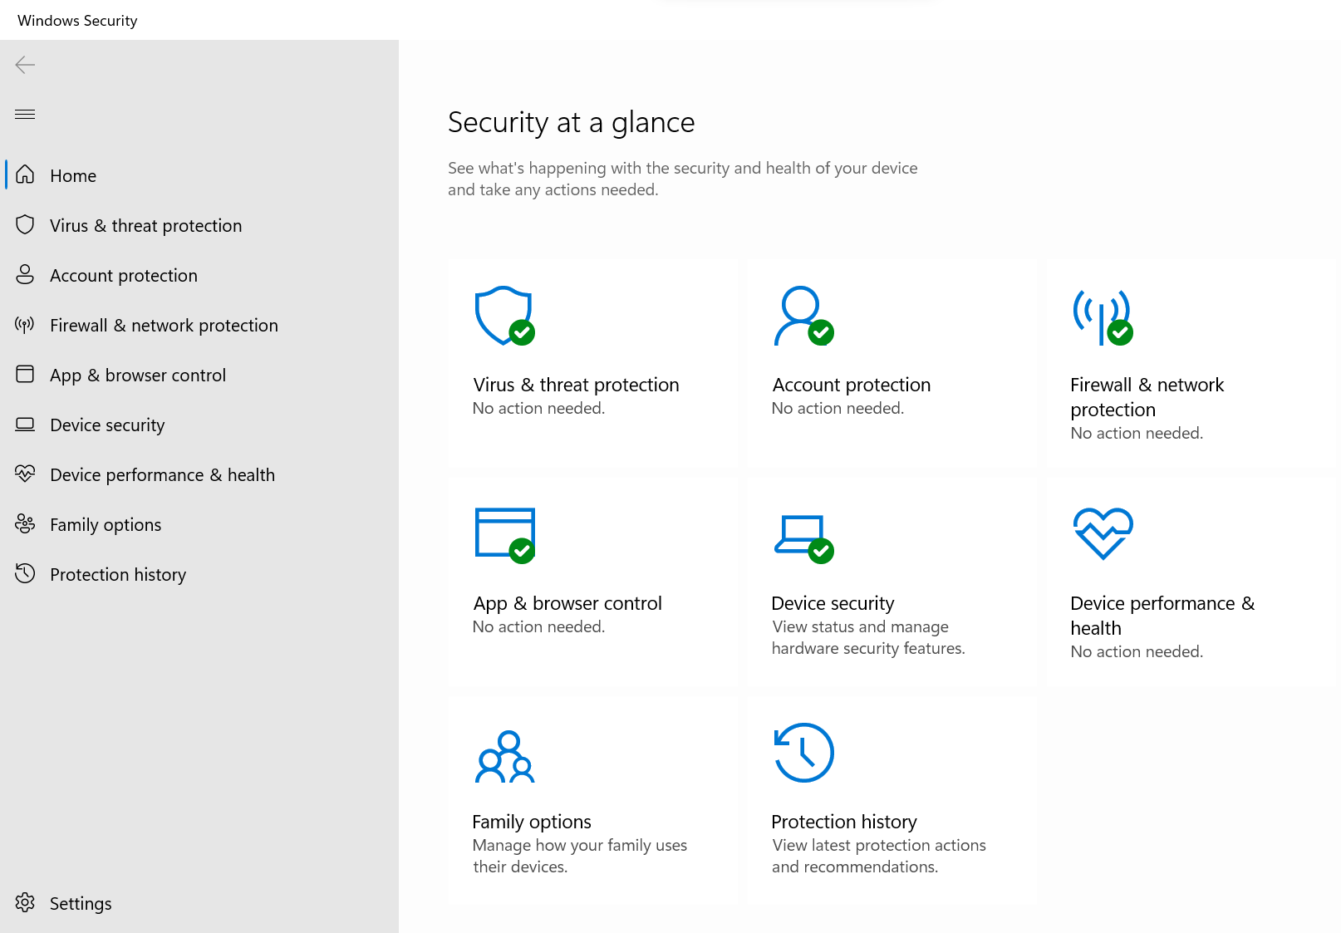
Find the Antivirus settings
This is the Windows Security app. It is the central hub for security features in Windows.

Slide 13
Find the Antivirus settings
Step 4 – Click on “Virus & threat protection” to be taken to antivirus settings

Slide 14
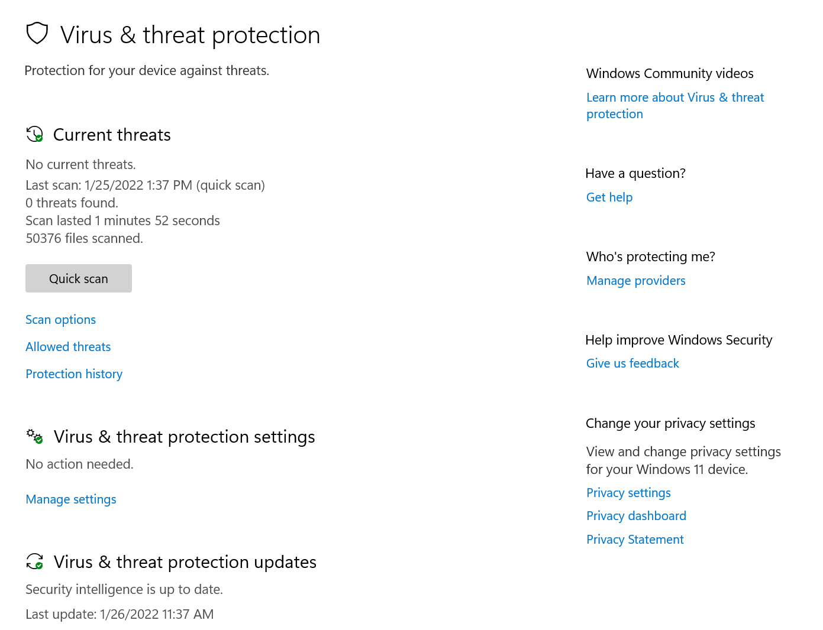
Antivirus Settings
“Current Threats” – See when the last scan was done and if any threats were found
“Virus & threat protection settings” – Modify antivirus settings
“Virus & Threat Protection Updates” – Verifies that your computer has the latest security update

Slide 15
Scan Types
Click on “Scan options”

Slide 16
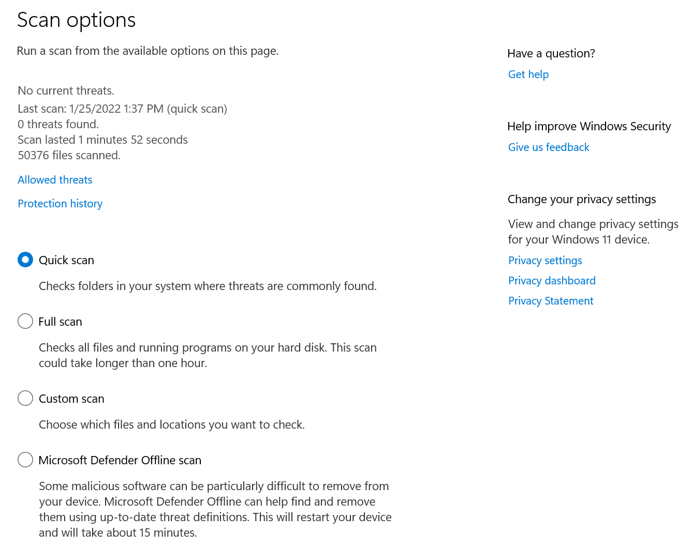
Scan Types - Continued
Quick Scan – Better than nothing, should be done regularly if unable to do Full scan
Full Scan – Recommended type, should be done regularly
Custom Scan – Ideal to scan a recent download you’re unsure about (before you open the download)
Microsoft Defender Offline Scan – Not usually necessary unless something is suspected

Slide 17

Mac 11 Antivirus
Image source: https://www.freepnglogos.com/pics/png-apple-logo
How mac 11 Protects Against Malware

Slide 18
How Mac Protects Against Malware
Mac does not offer options to run manual scans like Windows. Instead, all processes are done automatically in the background.
Mac OS has the following features to protect against malware:
App Review
Notarization
Gatekeeper
XProtect
Malware Removal Tool

Slide 19
How Mac Protects Against Malware
App Review:
Only apps that are reviewed and verified to be malware-free are allowed in the App Store
Gatekeeper:
When something is installed, Gatekeeper verifies that the program has been made by a trustworthy developer, has not been altered, and is notarized by Apple as being safe
Notarization:
Apple scans a program for malware, and is granted a Notarization ticket if no malware is found
XProtect:
Apple’s antivirus technology that automatically detects and blocks malware
Malware Removal Tool:
Apple’s tool for removing malware
Source: https://support.apple.com/en-tj/guide/security/sec469d47bd8/web
Source: https://www.apple.com/macos/security/
Source: https://support.apple.com/en-tj/guide/security/sec5599b66df/1/web/1

Slide 20
Conclusion
Summary of this chapter

Slide 21
Conclusion
Antivirus prevents malware from being installed, detects malware, and removes installed malware
Common types of malware: Virus, worm, trojan, ransomware, bot, adware
Windows contains an interactive Antivirus scanning tool
Mac contains automated Antivirus that runs in the background

