Slide 1
Introduction
Why this course is necessary
By Bill Green

Slide 2
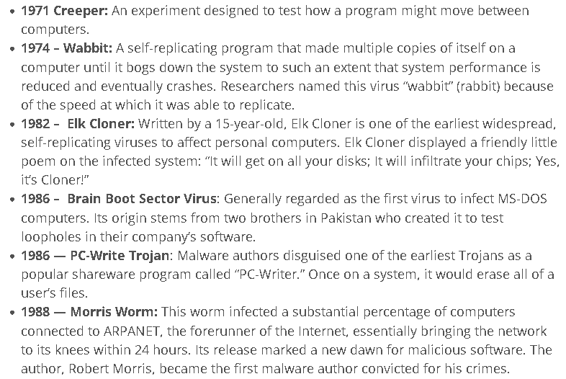
Computer viruses are not new
https://www.lastline.com/blog/history-of-malware-its-evolution-and-impact/

Slide 3
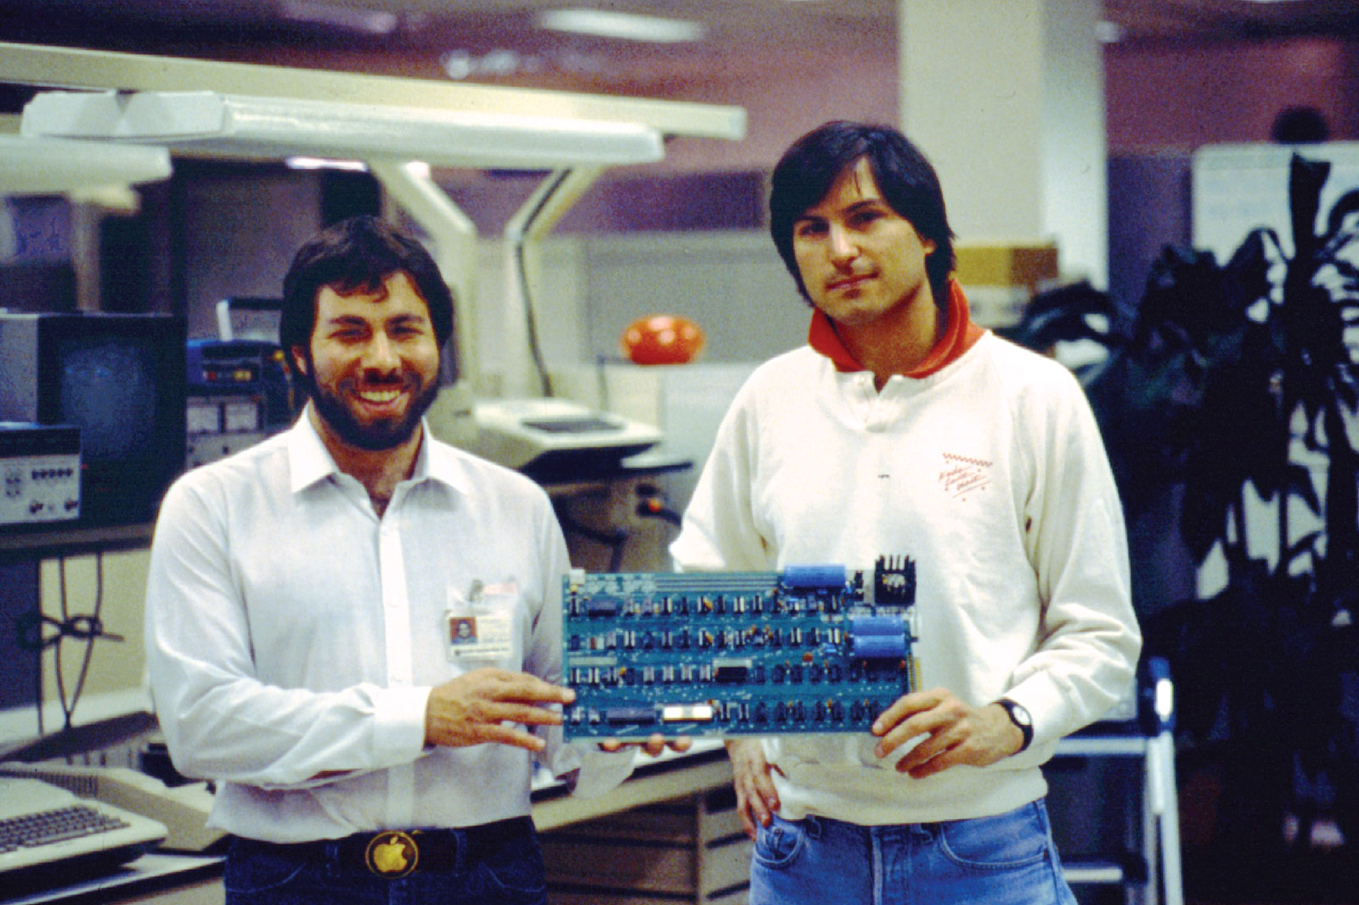
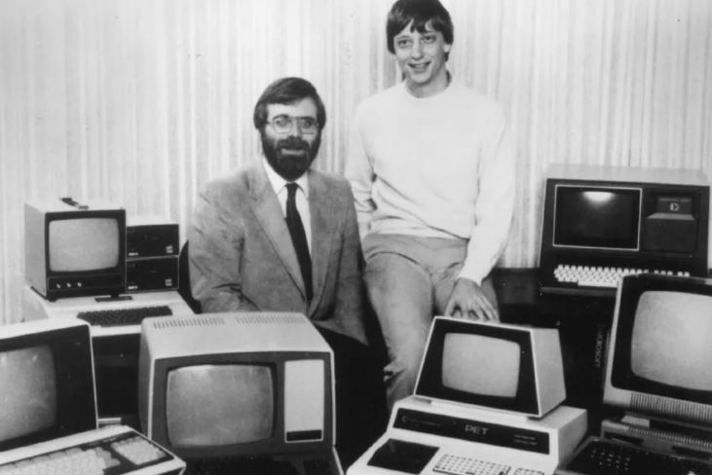
Computers become part of our everyday lives

Slide 4
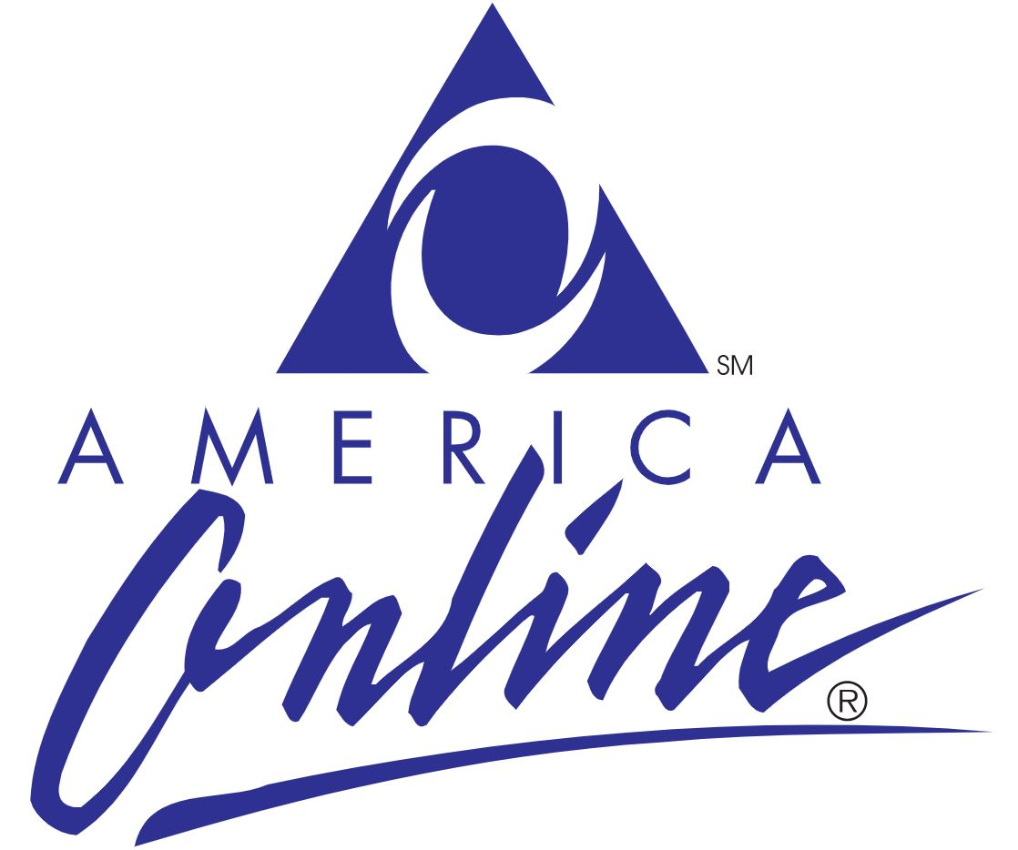

Computers connect home users to the world

Slide 5
Virus: A malicious computer program that, when activated, changes the way a computer acts and operates by attaching itself to a legitimate application or document.
Worm: A malicious application with the ability to spread to other computers using the network protocols of the infected host. For instance, WannaCry ransomware worm rapidly spread through enterprise networks by using the SMB protocol in Windows.
Trojan: Taking its name from the Greek story of the Trojan Horse, a Trojan is malicious software posing often as a legitimate and even wanted application. Trojans can read keystrokes, steal passwords, encrypt data or even create a backdoor for other malicious applications.
Adware: The least nefarious, but always irritating malware is adware. Adware is a malicious software that causes irritating pop-ups and ads on both PCs and mobile devices.

Slide 6
Computers require care and feeding
Updating and Patching
Proper Anti-Virus Use
Data protection – backup and recovery

